Slide 1
Science gateways for life sciences: The EGI perspective
Gergely Sipos
Technical Outreach Manager
EGI.eu, Amsterdam
gergely.sipos@egi.eu

Slide 2
Overview
The European Grid Infrastructure ecosystem
Services & support
for science gateways communities
for Life Sciences Grid Community VRC
Refactoring EGI for Horizon 2020
Requirements & opportunities

Slide 3
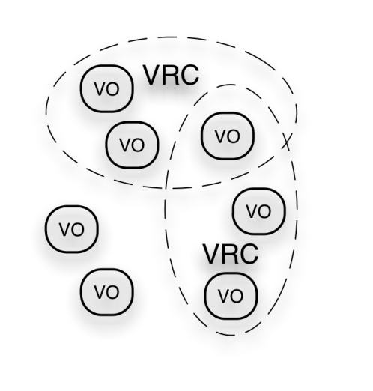
EGI Ecosystem
User Community
Project: GISELA
LSGC VRC
ESFRI projects
Biomed VO
TRANSfoRm
Policies + Funding
Project: DRIHM
...
VLEMED VO
ESFRI cluster projects
Project: SCI-BUS
...
PneumodgirdVO
Project: DECIDE
Medigrid VO
LSgrid VO
Requirements + Feedback
Services + Support
EGI-InSPIRE project
2010-2014
Service & Resource Providers
Requirements + Feedback
Public Funding Bodies
Policies + Funding
Requirements
Technology Providers
European Commission
EGI.eu foundation
National Grid Infrastructures (NGIs)
Open Source Providers
National Research Councils
Strategic Feedback
Middleware + Support
Commercial Providers

Slide 4
The infrastructure today - layered view
Virtual Research Communities
(Users)
Science gateway technologies
Science gateways
Key
Ecosystem
Partners
NGIs + EGI.eu
Software
Central Services
Domain Services
Community Services
Services
Planning & Coorination
Platforms
gLite
dCache
Globus
Federated cloud testbed
UNICORE
ARC
Infrastructure
Support
Distributed resources

Slide 5
EGI science gateways
“...a community-specific set of tools, applications, and data collections that are integrated together via a web portal or a desktop application, providing access to resources and services from the European Grid Infrastructure.” → http://go.egi.eu/sciencegateways
Science gateways are domain/community specific, but science gateway enabling technologies are typically not
Common aspects:
Reusable software components & technologies
Development, operation, monitoring, training, user support practices
Reducing barriers to access (e.g. federated identity; robot certificates)
Requirements about underlying services (functional and non-functional needs for computing, storage, helpdesk, availability monitor, etc.)

Slide 6
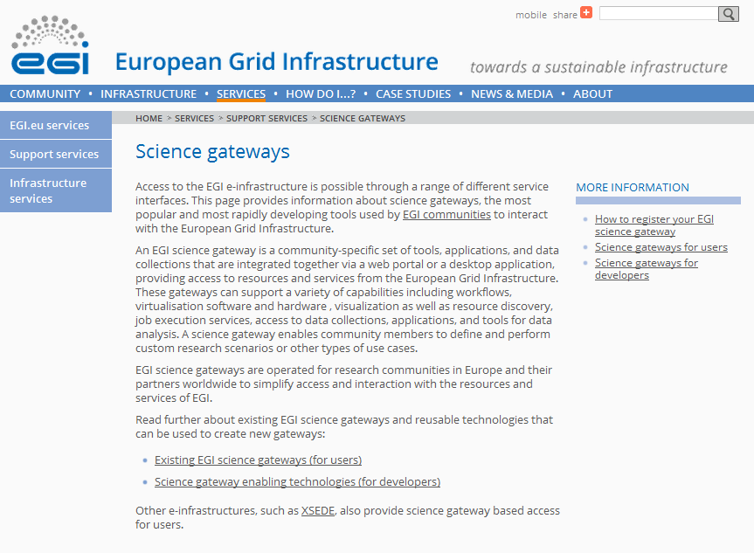
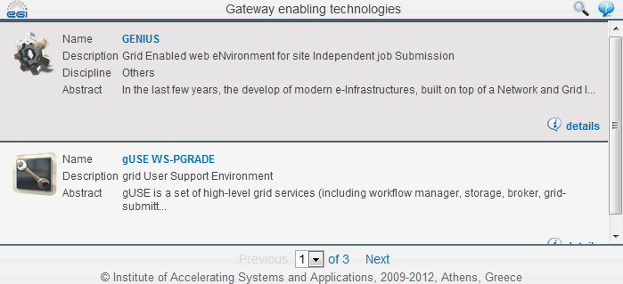
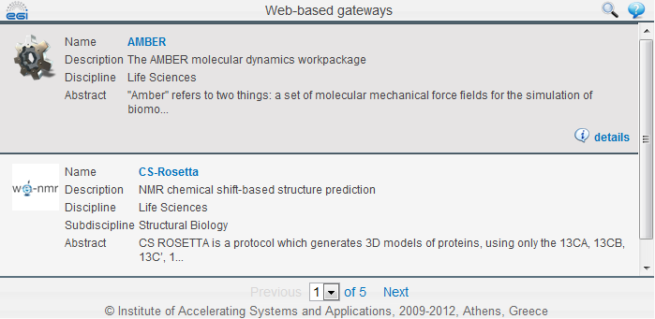
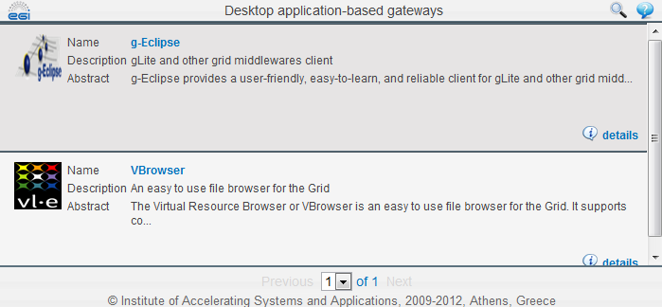
EGI science gateways and technologies catalogues
Catalogue of existing solutions: http://go.egi.eu/sciencegateways
Science gateways (for scientific users)
Web gateways - 24
Desktop app. gateways - 5
Enabling technologies (for developers) - 7
Embed these catalogues into your website! http://appdb.egi.eu/gadgets/editor
Gadget - an HTML-IFRAME
Listing items from AppDB by tag
web.gateway
application.gateway
technology.gateway

Slide 7
EGI portal gateway primer: Collect best practices
New project within the ‘EGI Virtual Team framework’
https://wiki.egi.eu/wiki/VT_Science_Gateway_Primer
Foreseen outputs
Up to date and complete information about EGI science gateways and science gateway enabling technologies
Recommendations on how to improve the (promotion) of these to the community
A comprehensive document, an 'EGI gateway primer', that collects information about technologies, policies, solutions that exist from the EGI community for gateway developers
Integrates effort from various NGIs, VRCs, projects
Join now! Invitation is open until 31st of May (Email nuno.ferreira@egi.eu and szeberenyi@sztaki.hu)

Slide 8
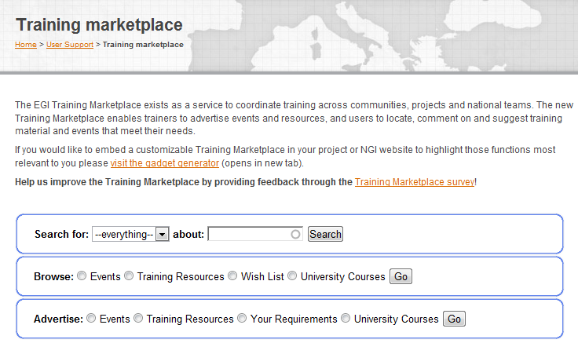
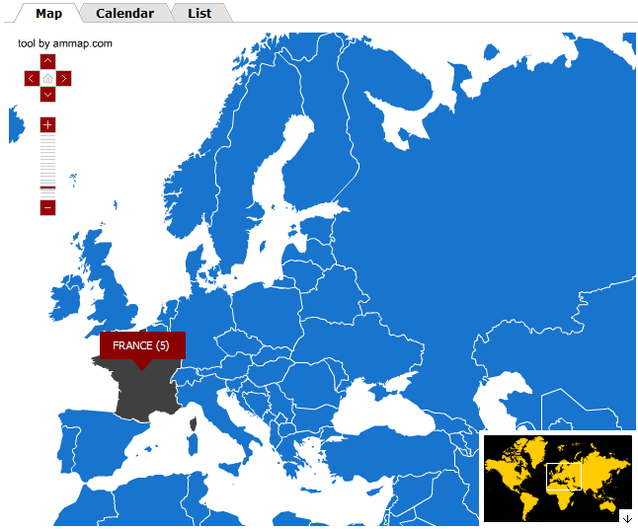
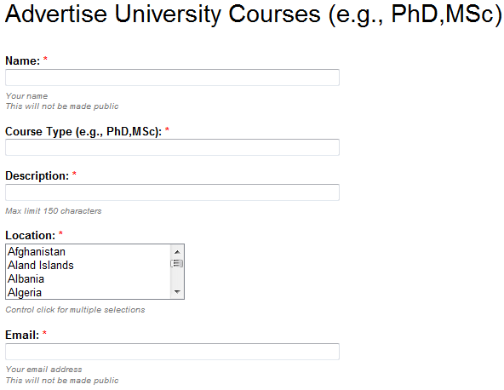
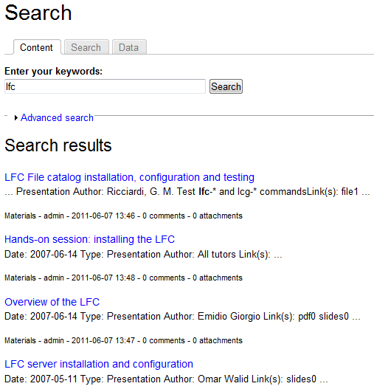
EGI Training Marketplace http://training.egi.eu
Benefits:
Register & share
training events, expertise, services, materials, resources, online courses, university courses
Browse and search items
Community features such as commenting, rating
Access through web page and web gadget

Slide 9
Reducing barriers to access
Federated identity management
Various initiatives by NGIs, projects, communities, e.g.:
Italy, Hungary, Switzerland, Finland, ...
EduGain, REFEDS, AAA Study, ...
Series of community workshops: http://indico.cern.ch/conferenceDisplay.py?confId=191892
EGI Virtual Team project:
https://wiki.egi.eu/wiki/VT_Federated_Identity_Providers_Assessment
Robot certificates
Already available from 10 Certification Authorities: https://wiki.egi.eu/wiki/Robot_certificates
Statistics about robot usage:
~50 robot certs; ~250 robot users (21.000 registered EGI users)

Slide 10
Common underlying services – Common requirements
User Community Support Team of EGI.eu
User Community Board
Structured scientific communities
VOs
EGI Requirements Tracker
Input channels for community requirements
VRCs
Technology Coordination Board
Technology providers
projects
NGIs
events
Operations Management Board
Resource centres
EGI Helpdesk
NGIs & projects
Submit requirements
Monitor requirements:
http://go.egi.eu/requirements

Slide 11
Some of the open LSGC requirements lsgc.org/en/LSGC:home;jsessionid=1A568B3D65F7338F8540C3CF3D397405#Technicals
#3209 Accounting Portal: get all users data from the VO manager view
#2968 JDL does not offer GLUE attribute for available disk space on worker node
#2966 Enhanced WMS throughput
#2965 Enhanced information feedback by middleware error messages
#2769 Homogenous APIs for a middleware
#2766 Storage monitoring
#2690 Service not in Production/ Nagios BOX
#2689 SE error messages
#2518 LFC automatic failover mechanism for users and applications
#2024 data lifetime management (VO: vlemed)
#2022 enforcement of access control between file catalogue and physical files (VO: vlemed)
...(30 in total – 23/05/2012)

Slide 12
European Grid Infrastructure for Horizon 2020: http://go.egi.eu/EGI2020
Virtual Research Communities
Services of e.g.
iBRAIN,
e-BioGrid,
eMAT,
Virtual Screening
LifeWatch
CLARIN
...
Virtual Research Environment
Collaboration services (Monitoing, Accounting, Training Marketplace, …)
Community specific services
Community specific services
VM
VM
DB
SW
VM
VM
Middleware services
Research facilities (e.g. detectors, sensor networks)
VM
DB
SW
EGI Federated Cloud
EGI resources (clusters, storages,...)
Dedicated or shared resources/platforms (e.g. Clusters; desktop grids, EC2, PRACE, XSEDE, GPGPU)

Slide 13
Virtual Research Environments
Definitions:
Wikipedia (2011): A virtual research environment or virtual laboratory is an online system helping researchers collaborate
UK JISC (2004): VREs help researchers in all disciplines manage the increasingly complex range of tasks involved in carrying out research.
NeCTAR (Australian Research Cloud) (2011): Virtual Laboratories connect researchers to existing and new research facilities, data repositories and computational tools to streamline research workflows and enable new opportunities for research innovation
EGI’s role:
Support the simulation, data sharing and data analysis activities of innovative, collaborative VREs.
Science gateways are the ‘integration, presentation & access layer’ in VREs

Slide 14
Conclusions
A sustainable EGI requires sustainable National Grid Infrastructures (NGIs)
NGIs need stable user base to attract funding
Scientific communites need attractive services from the NGIs
Life Sciences Grid Community VRC and its VOs within EGI
VRE & gateways development support
Middleware requirements
Training marketplace, Applications Database
Main middleware projects end in May 2013
‘Federated cloud’ initiative in EGI
How should we build on and share the existing services?

Slide 15
Questions?
gergely.sipos@egi.eu

Slide 16
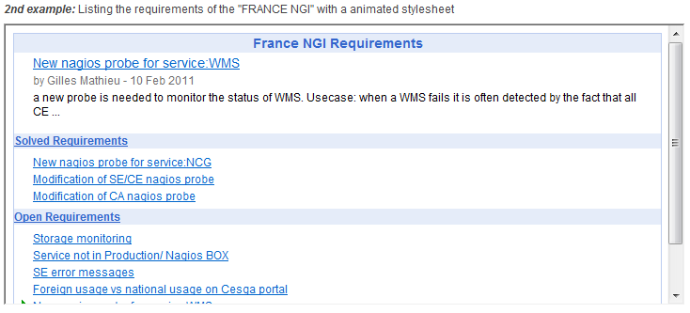
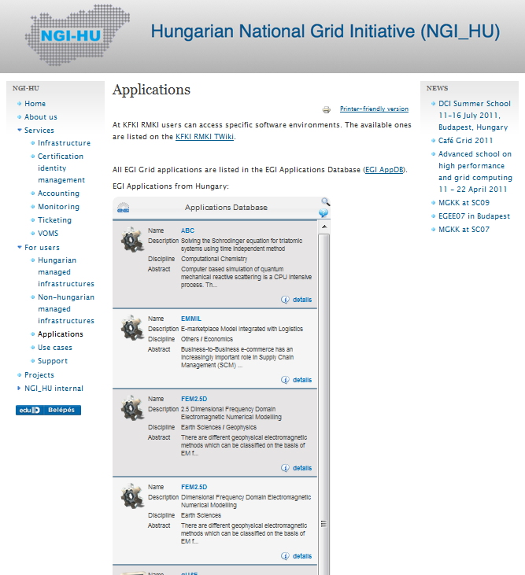
Web gadgets
An alternative way of reusing services
Benefits
Customisability
Reusability
Compatibility
Existing gadgets:
Application Database
Training Marketplace
Requirement Tracker
Use and develop gadgets & share them through EGI:
www.egi.eu/user-support/gadgets

Slide 17
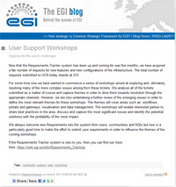
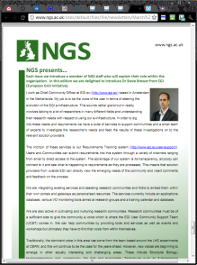
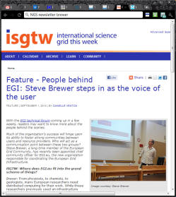
Outreach to new communities
Dissemination teams of EGI.eu and (some) NGIs
EGI Blog (www.egi.eu/blog)
EGI-InSPIRE Newsletters
Web news
Twitter & Facebook
Support teams with contacts within the NGIs
Respontible for outreach to new communities
Work on specific outreach projects: https://wiki.egi.eu/wiki/Virtual_Team_Projects, e.g.
Establish an EGI VRC for
Sound and Music Grid Computing; for GAIA-Space Grid Computing; for Fire & smoke simulation; etc.
ESFRI contact list
Organise a high impact presence for EGI at EGU General Assembly
Assessing the adoption of Federated Identity Providers within EGI

