Slide 1
Reproducible Open Science with GitHub, EGI Notebooks, Binder and Zenodo
Gergely Sipos, Giuseppe La Rocca – EGI Foundation
Dissemination level: Public
http://go.egi.eu/eapec2019

Slide 2
Outline for session 2
Open Science
EOSC
EOSC-hub
Reproducilibility with Notebooks and Binder, Zenodo, OpenAIRE
Adding big data
Next steps

Slide 3
Open Science
Open science is the movement to make scientific research and its dissemination accessible to all levels of an inquiring society, amateur or professional.
Publications, data, physical samples, and software
A continuation of, rather than a revolution in research practices
An important approach to increase the reproducibility of research
Benefits: increased science output; lower costs; reproducibility;
Jupyter Notebooks, Virtualisation/containerisation, Open Access data repositories provide new foundation for open science

Slide 4
Motivation: Increased science output
Publications from science archive data
Source: Michael Wise / EUDAT Conference / January 23, 2018

Slide 5
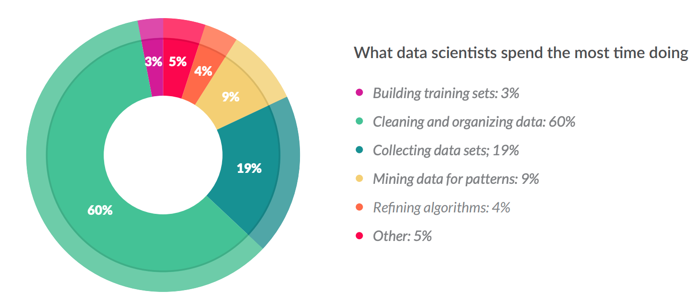
Motivation: Financial
Less than 20% !
From 80% spent on data wrangling to 80% spent on analytics/research
Source: CloudFlower data science report 2016 https://visit.figure-eight.com/rs/416-ZBE-142/images/CrowdFlower_DataScienceReport_2016.pdf
Slight increase in the 2018 report

Slide 6
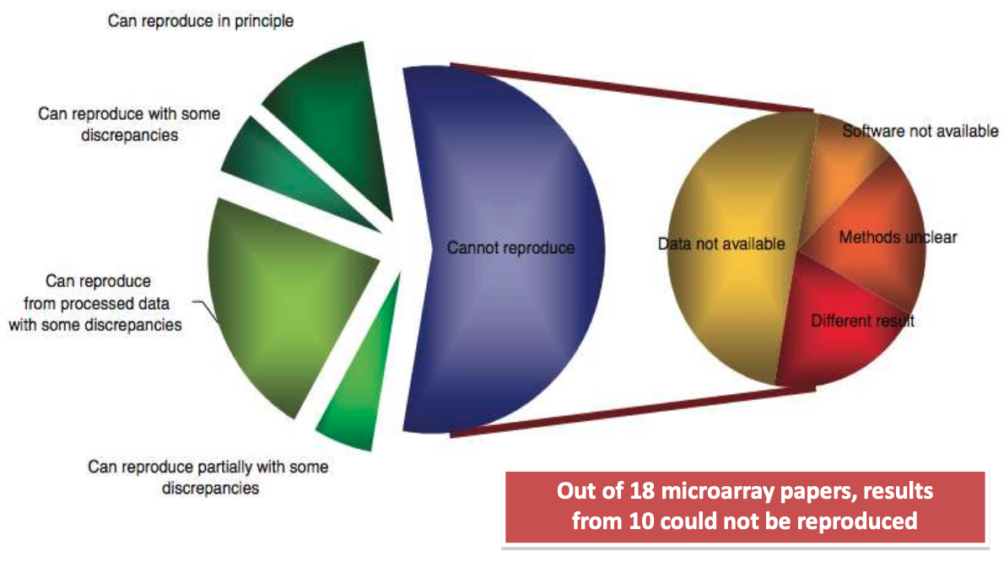
Motivation: Reproducibility
Source: Ioannidis et al., 2009. Repeatability of published microarray gene expression analyses. Nature Genetics 41: 14
See also: Science publishing: The trouble with retractions http://www.nature.com/news/2011/111005/full/478026a.html Bjorn Brembs: Open Access and the looming crisis in science https://theconversation.com/open-access-and-the-looming-crisis-in-science-14950

Slide 7
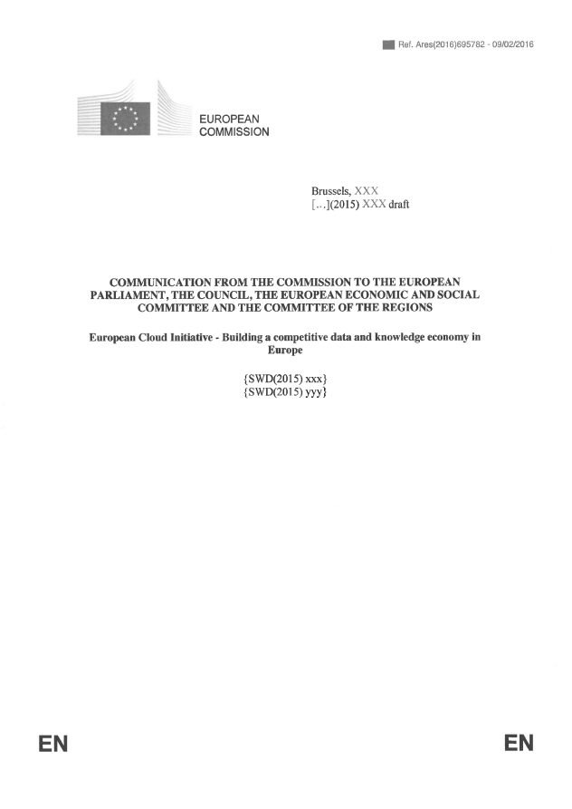
European Open Science Cloud - Problem statement
How to maximise the incentives for sharing data and to increase the capacity to exploit them?
How to ensure that data can be used as widely as possible, across scientific disciplines and between the public and the private sector?
How better to interconnect the existing and the new data infrastructures across Europe?
How best to coordinate the support available to European data infrastructures as they move towards exascale computing?
European Cloud Initiative by the European Commission (April 2016)
“…a trusted, open environment for the scientific community for
storing, sharing and re- using scientific data and results…”
^{“…by 2020…”}

Slide 8
What happened since April 2016: EC initiatives
1st EOSC High Level Expert Group (final report)
2nd EOSC High Level Expert Group (final report)
EOSC summits (2017, 2018)
EOSC implementation Roadmap (April 2018) (link)
6 action lines (Archi., Data, Services, Access & Interf., Rules, Governance)
EOSC Portal launch (Nov 2018)
EOSC Executive Board (Nov 2018. Members)
EOSC Governance board (Jan 2019)
EOSC Symposium (26-28. Nov, 2019, Budapest)

Slide 9
What happened since April 2016: Projects
EOSC Implementation
Roadmap action lines
On-going H2020 projects contributing to the implementation
Architecture
Data
+ from Q3 2019:
Regional projects:
EOSC-Nordic
NI4OS-Europe
EOSC-Pillar
EOSC-synergy
Services
Access and Interface
Governance
Rules of Participation

Slide 10
About the European Open Science Cloud
The federated infrastructure and supporting initiative providing
all researchers, innovators, companies and citizens
with seamless access to an open-by-default, efficient and cross-disciplinary environment
for storing, accessing, reusing data, tools, publications and other scientific outputs for research, innovation and educational purposes
Credits: EOSCpilot (https://eoscpilot.eu/)

Slide 11
Vision
Researchers from all disciplines
have easy, integrated and open access to the advanced digital services, scientific instruments, data, knowledge and expertise they need
to collaborate to achieve excellence
in science, research and innovation
100 partners
36 months
33 million Euro

Slide 12
Mission
The EOSC-hub project mobilises providers of European relevance offering services, software and data for advanced data-driven research and innovation.
These resources are offered via the Hub – the integration and management system of the European Open Science Cloud, acting as a European-level entry point for all stakeholders.
33m EUR
100+ partners
2018-2020
Coord. by EGI Foundation

Slide 13
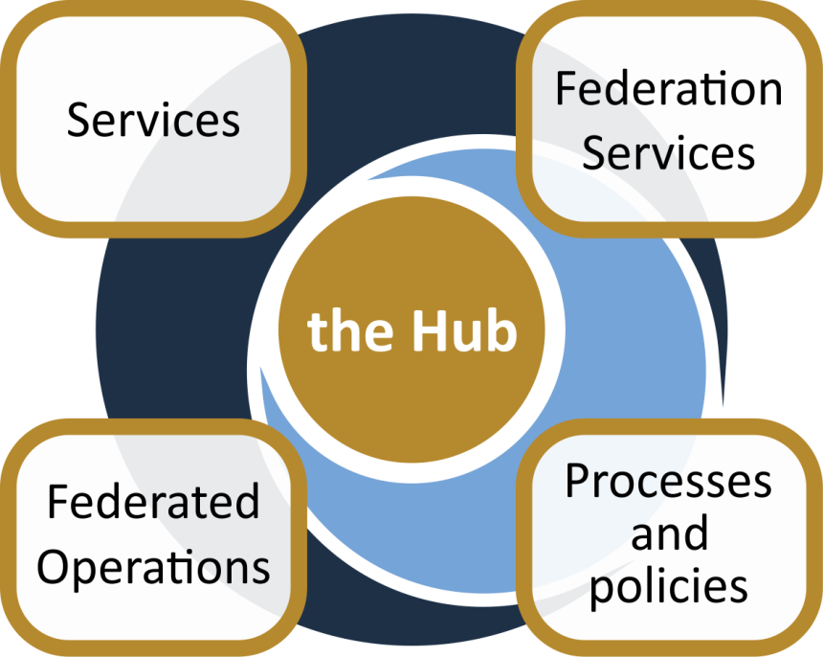
The EOSC-hub project established ‘The Hub’
From the consortium AND from external contributors
Usage according to Rules of Participation
Data
Applications & tools
Baseline services (storage, compute, connectivity)…
Training, consultants
Marketplace
AAI
Accounting
Monitoring
…
Lightweight certification of providers
SLA negotiation
Customer Relationship Management
…
Security regulations,
Compliance to standards,
Terms of use,
FAIR implementation guidelines
…
Based on FitSM

Slide 14
Area 1: Services
e-Infra
Humanities
Engineering
Medical and Health Sciences
Natural sciences
Generic services
EGI Federation
PHYSICAL SCIENCES
Astronomy (LOFAR)
Fusion (ITER)
High Energy Physics (CMS and VIRGO)
Space Science (EISCAT-3D)
Language and literature (CLARIN)
Environmental engineering (sea vessels, LNEC)
Biological Sciences (ELIXIR)
+ a growing number of external contributions
EUDAT CDI
EARTH SCIENCE
EO Pillar
GEO
Climate Research (ENES)
Seismology (ORFEUS, EPOS)
Arts (DARIAH)
Civil Engineering (Disaster Mitigation)
Structural biology (WeNMR)
INDIGO-DataCloud
BIOLOGICAL SCIENCES
Marine and freshwater biology (IFREMER)
Biodiversity conservation (LifeWatch)
Ecology (ICOS)

Slide 15
Generic services from e-Infrastructures:
Support to the Research Data Lifecycle
Access, Deposition & Sharing
Application DB (software & VM)
B2DROP (data)
B2Note (data)
B2SHARE (data)
DataHub
4
1
Data Management, Curation & Preservation
Discover & Reuse
B2HANDLE
B2SAFE
European Certified Trusted Repository
B2FIND (data)
Marketplace (Services)
3
Processing & Analysis
2
Applications on Demand
Federated HTC & Cloud Compute IaaS & PaaS
Processing of sensitive data
Jupyter Notebook
Thematic data analytics
Scientific Workflow Management, Orchestration (DIRAC, PaaS Orchestrator)

Slide 16
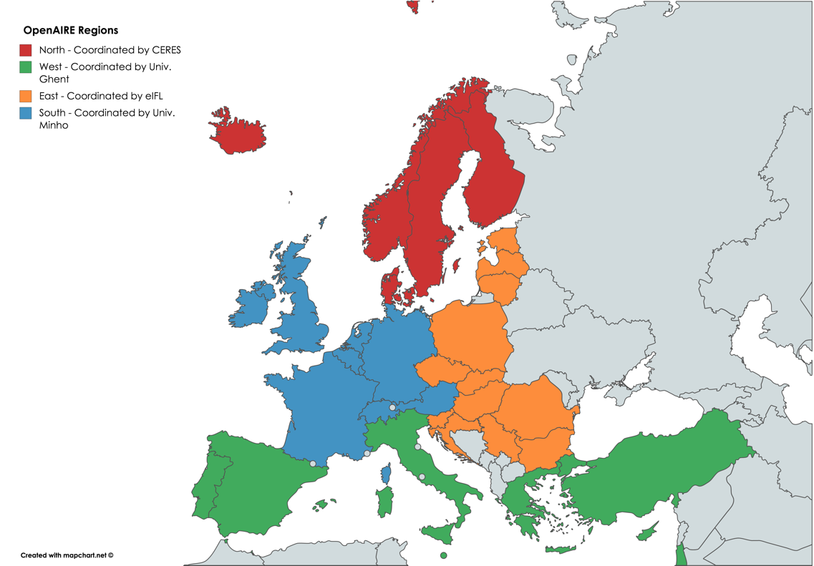
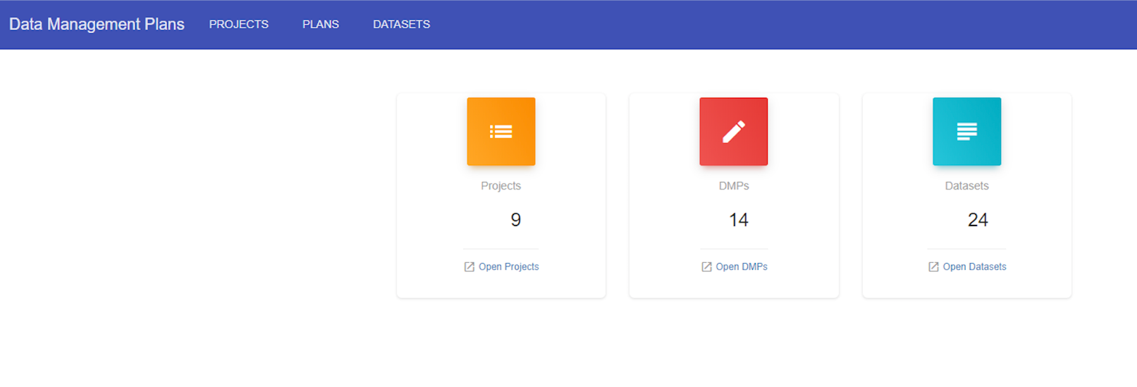
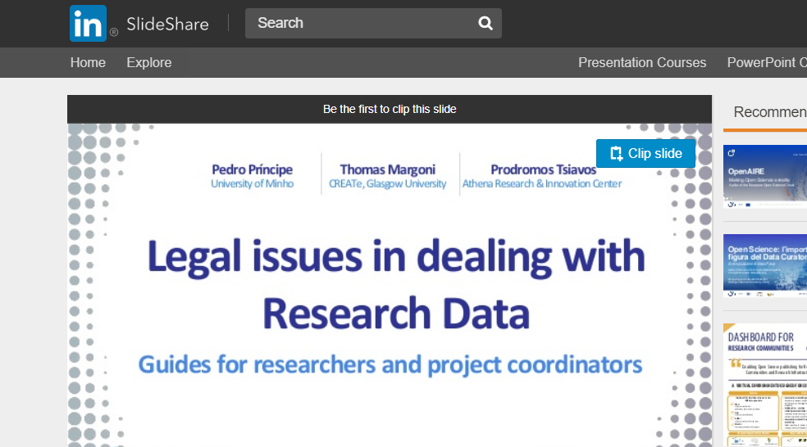
Services for Research Data Management from OpenAIRE-Advance
National Open Access Desks
Technology
Prepare DMP
Support
Deposit research objects (data and more)
Guides & factsheets
Anonymise data
Webinars & training

Slide 17
Area 2: Federation services
EOSC Portal website and Marketplace
Authentication-Authorization Infrastructure
Accounting Monitoring
Helpdesk
Service integration support and training
Engagement with new service providers
Making services robust
Making problems resolvable
Making services accessible
Making services usable
Making services discoverable
and orderable

Slide 18
Area 3: Federated operation
Example – Service Portfolio Management requirements:
PR1.1 A service portfolio shall be maintained. All services shall be specified as part of the service portfolio.
PR1.2 Design and transition of new or changed services shall be planned.
PR1.3 Plans for the design and transition of new or changed services shall consider timescales, responsibilities, new or changed technology, communication and service acceptance criteria.
PR1.4 The organisational structure supporting the delivery of services shall be identified, including a potential federation structure as well as contact points for all parties involved.
IT service management
Focuses on the provision of high quality IT services
Defines, documents and maintains service management processes
EOSC-hub Service Management: Based on FitSM standard
85 requirements that should be fulfilled by an organisation (or federation)
16 general requirements; 69 process-specific requirements
14 processes
Service portfolio management
Service level management
Incident management
Change management
Capacity management
Information security management
…
Implementation in EOSC
EOSC-hub Federation services (will) implement all processes: First internal audit took place
Other services are encouraged and supported in implementation/alignment (FitSM training; consultancy; ‘implementation workshop’ provided by EOSC-hub)

Slide 19
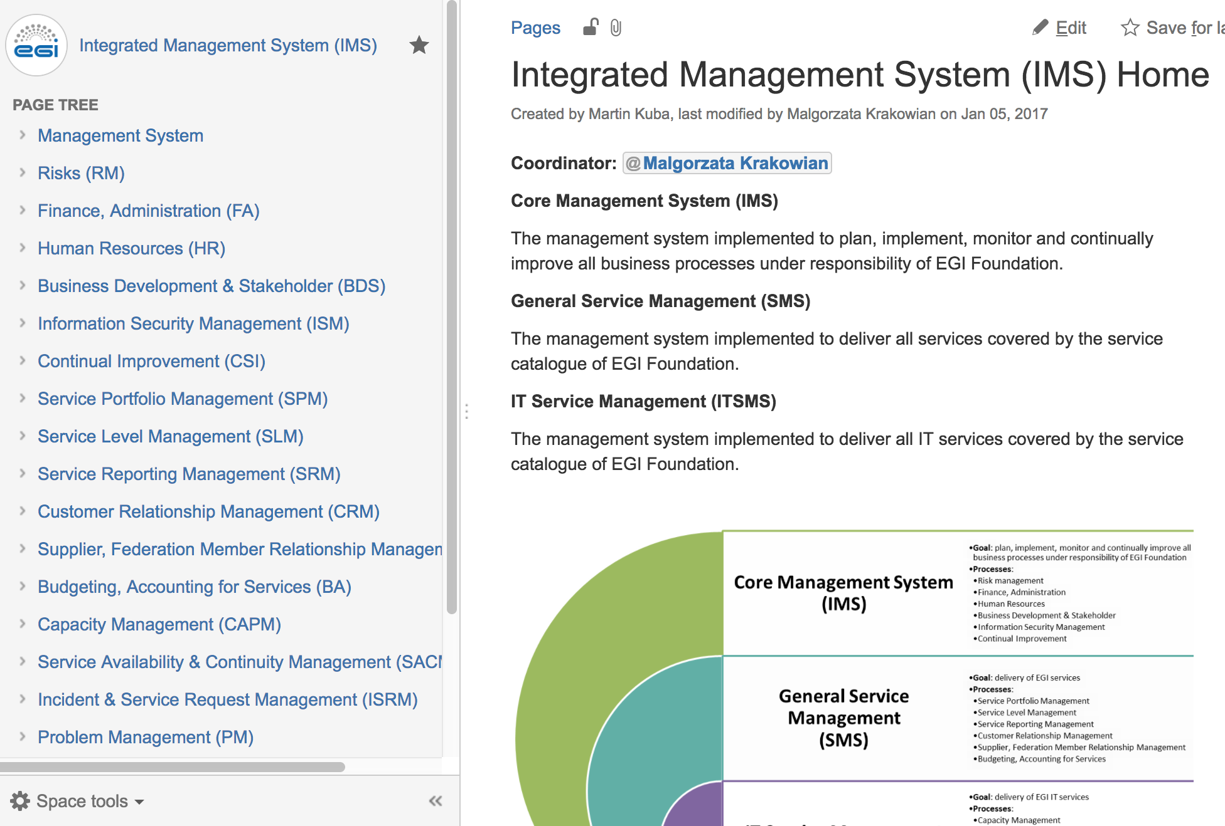
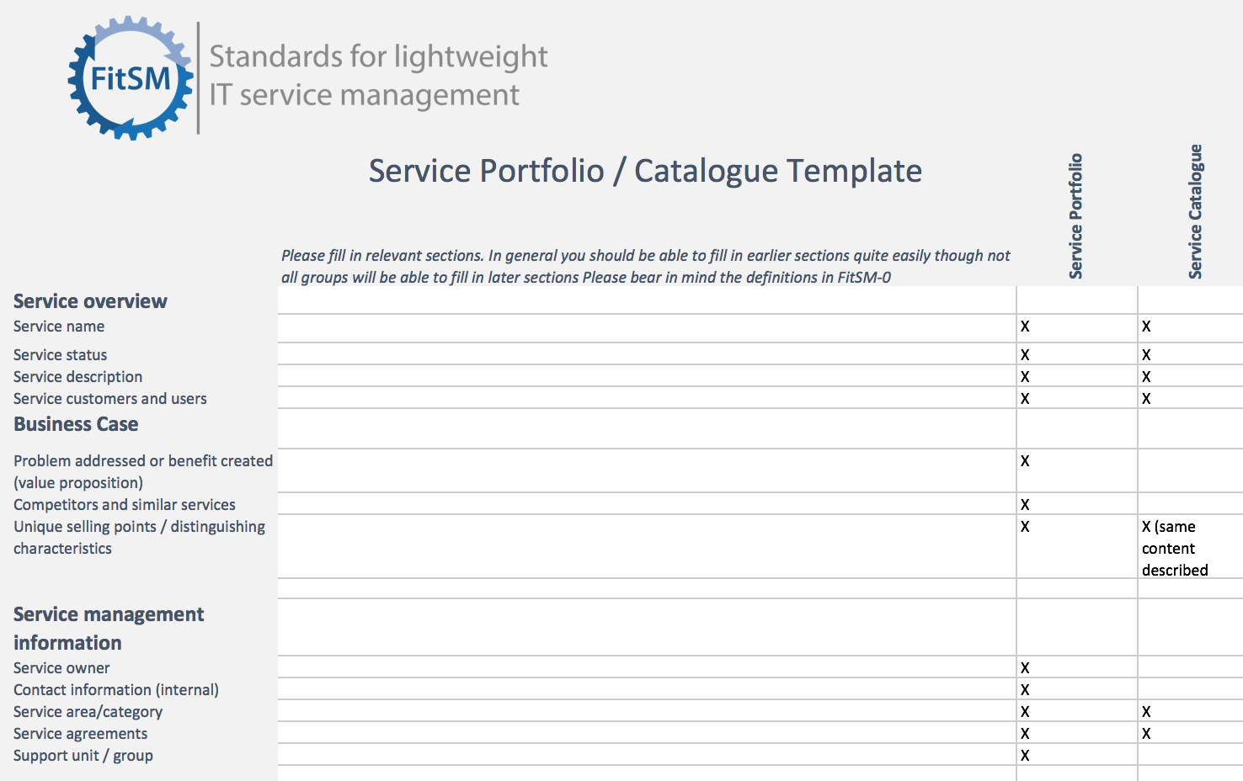
Implementing FitSM – What does it mean in practice?
Process documentation
e.g. Confluence
Ticket tool
e.g. JIRA, RT
Templates
e.g. Word docs, Excel, Google Apps, Forms
Committed and trained teams
Following the documentations

Slide 20
Area 4: Processes and policies
Harmonising service-related policies and supporting providers in the implementation
Acceptable use policy
Operations security policy
Conditions of use
Licenses
‘FAIR’ services and data (Findable, Accessible, Interoperable, Reusable)

Slide 21
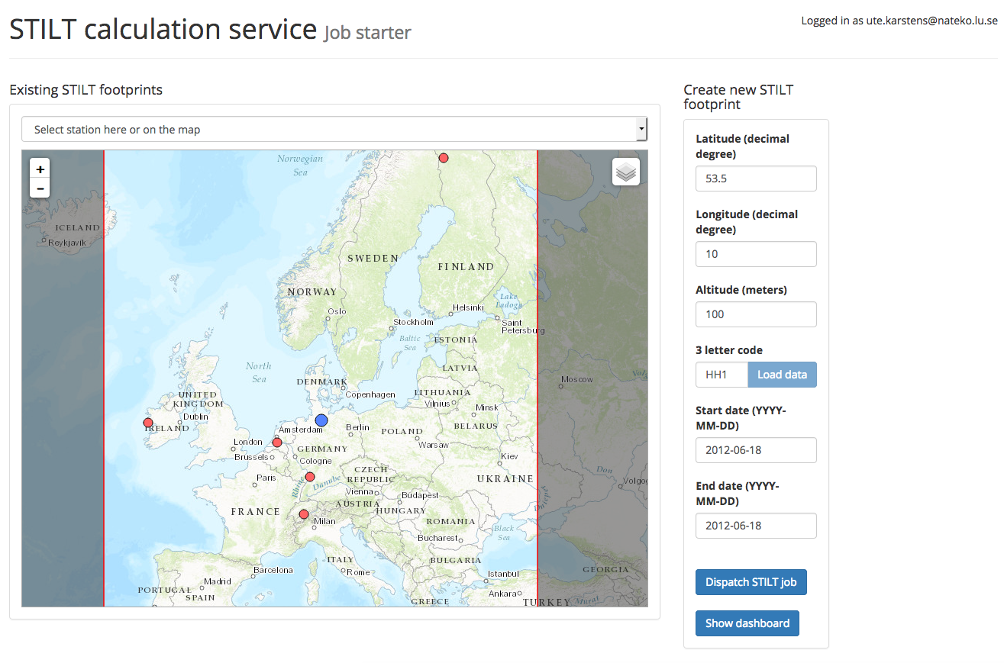
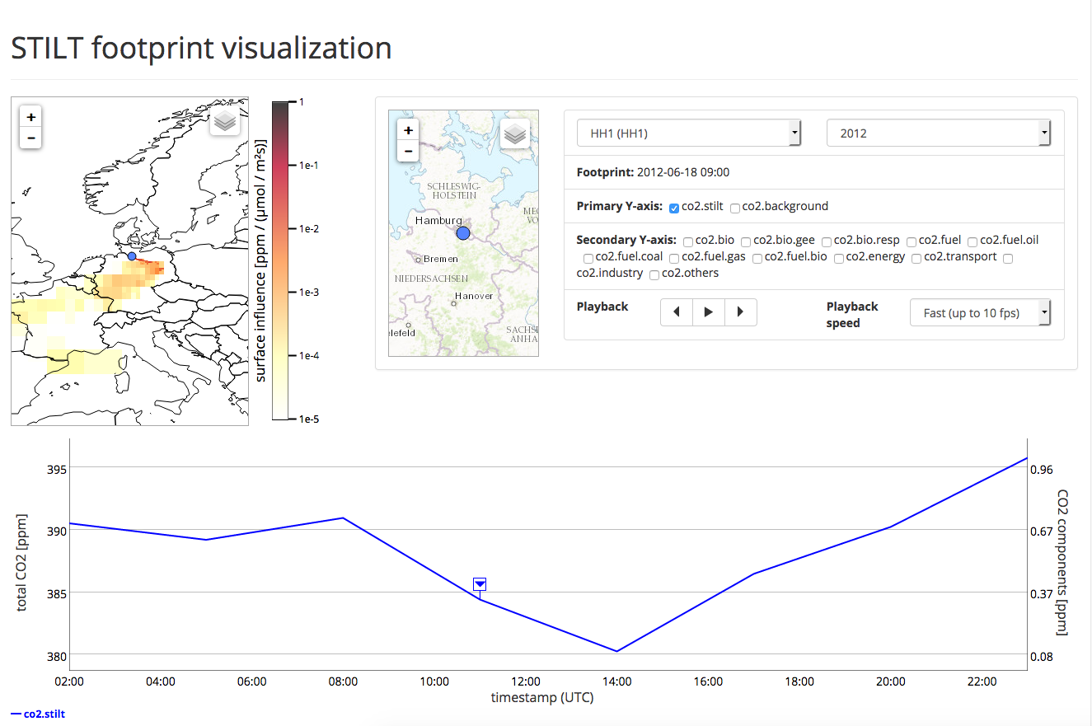
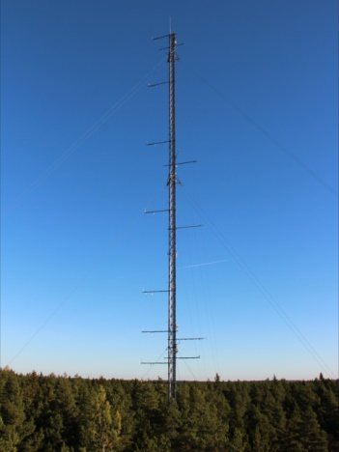
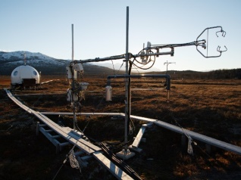
Example: Integrated Carbon Observation System
A pan-European research infrastructure for quantifying and understanding the greenhouse gas balance of the European continent
Users: Scientists; Engineers; Policy makers
Compute requests
Results
Cloud (CSC, CESNET, Juelich)
ICOS Carbon Portal
External HTC and HPC services
Data products
STILT
Lagrangian transport model
(Uni of Lund)
ICOS repository (data & metadata)
B2Safe (CSC)
iRODS (PDC)
Ecosystem thematic centre
Athmospheric thematic centre
Oceanic thematic centre
Sensor data (near real-time)
Measurement stations

Slide 22
Reproducible open science with Notebooks

Slide 23
Reproducibility: beyond sharing code and data
Peng, Science, 2011

Slide 24
Reproducible Open Science
The computational tools to solve a problem
Python, R, Julia, and wide ecosystem of libraries and tools for science
An interface to facilitate coding/creating
Jupyter
A way to communicate your work
Notebooks
Leverage on the EGI Cloud to scale-up the resources
A way to share your work
GitHub, Zenodo or other similar repositories
A way to pack it all for replication
Docker (used by Binder)
A way to persistently identify it
DOIs (Digital Object Identifiers)
binder

Slide 25
Our implementation of Open Science
EGI Notebooks
EGI Binder
1. Perform data analysis and visualisation
GitHub
6. Reproduce analysis
Your repository
5. Resolve DOI to Notebook
2. Publish notebook and Generate DOI
3. Cite DOI
in publication
Fellow researchers
Journal paper
4. Discover DOI

Slide 26
Git & GitHub
Git is a distributed version-control system for tracking changes in source code during software development
Written to manage development of Linux
GitHub is a social network for software development
Git repository hosting service + extra features
GitHub provides a web-based interface on top of git.
Collaboration features: access control, wikis, issues, projects, …
Connected with Zenodo:
Got a DOI from a GitHub repo

Slide 27
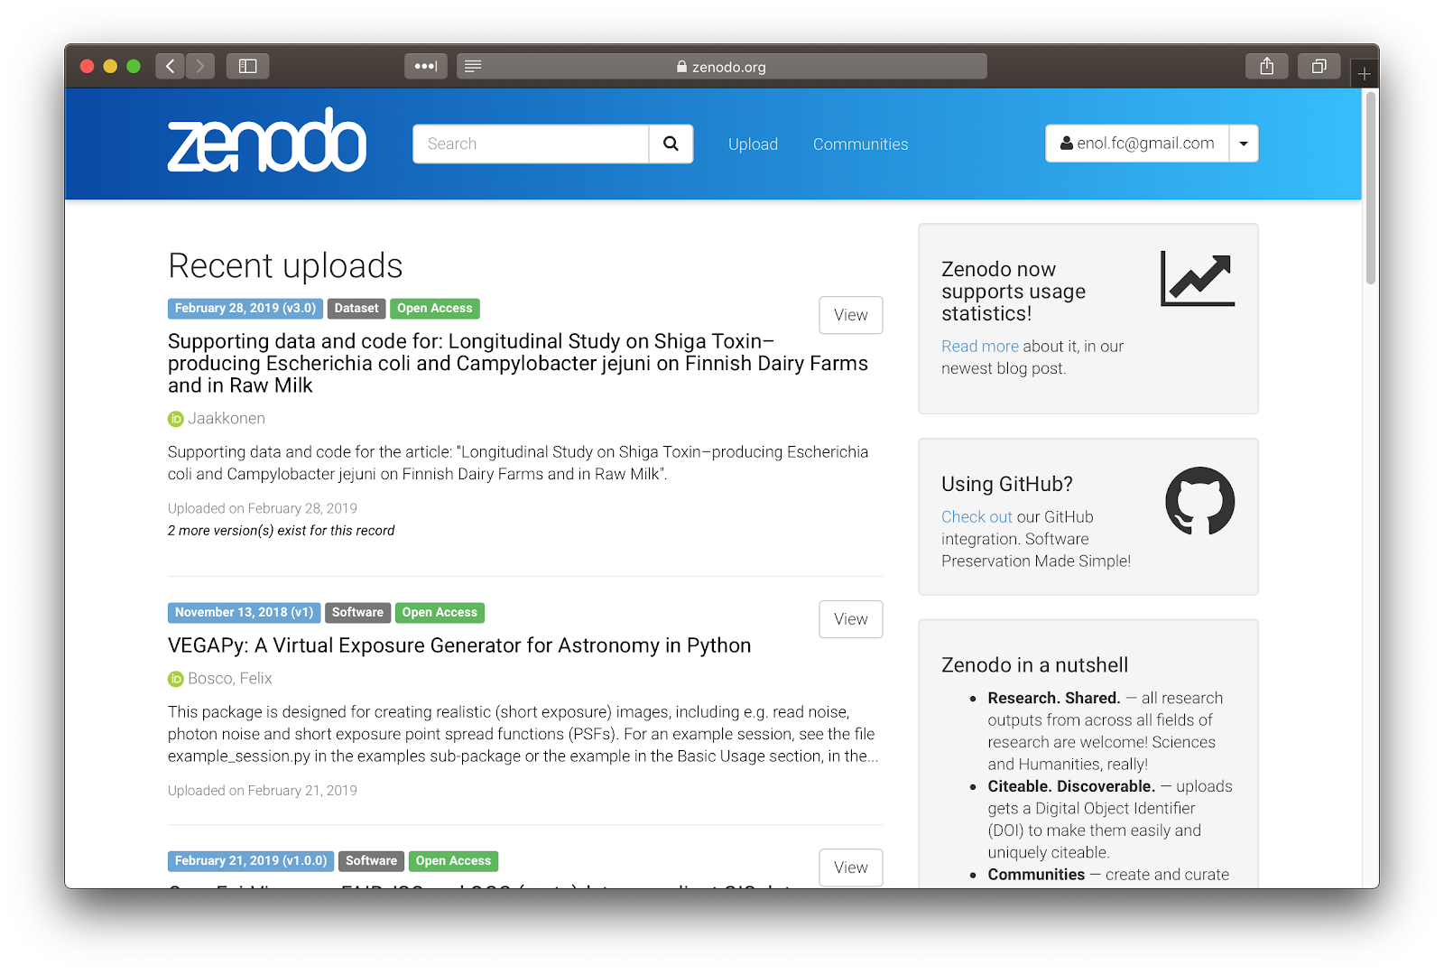
Zenodo
‘Open Science’ repository from OpenAIRE
Hosted at CERN data centre
http://zenodo.org
For
Publications, white papers, datasets, software, etc.
For
Long-tail science
Projects
Communities
Research groups
…
Dropbox, GitHub integration: - Web or API access
Access stats and reports for communities

Slide 28
Binder
An open-source web application to turn repositories in interactive notebooks
It uses Modern technology in cloud orchestration (Kubernetes), interactive computing (Jupyter), scientific computing (the open-science ecosystem)
Credit: Juliette Taka https://twitter.com/JulietteTaka

Slide 29
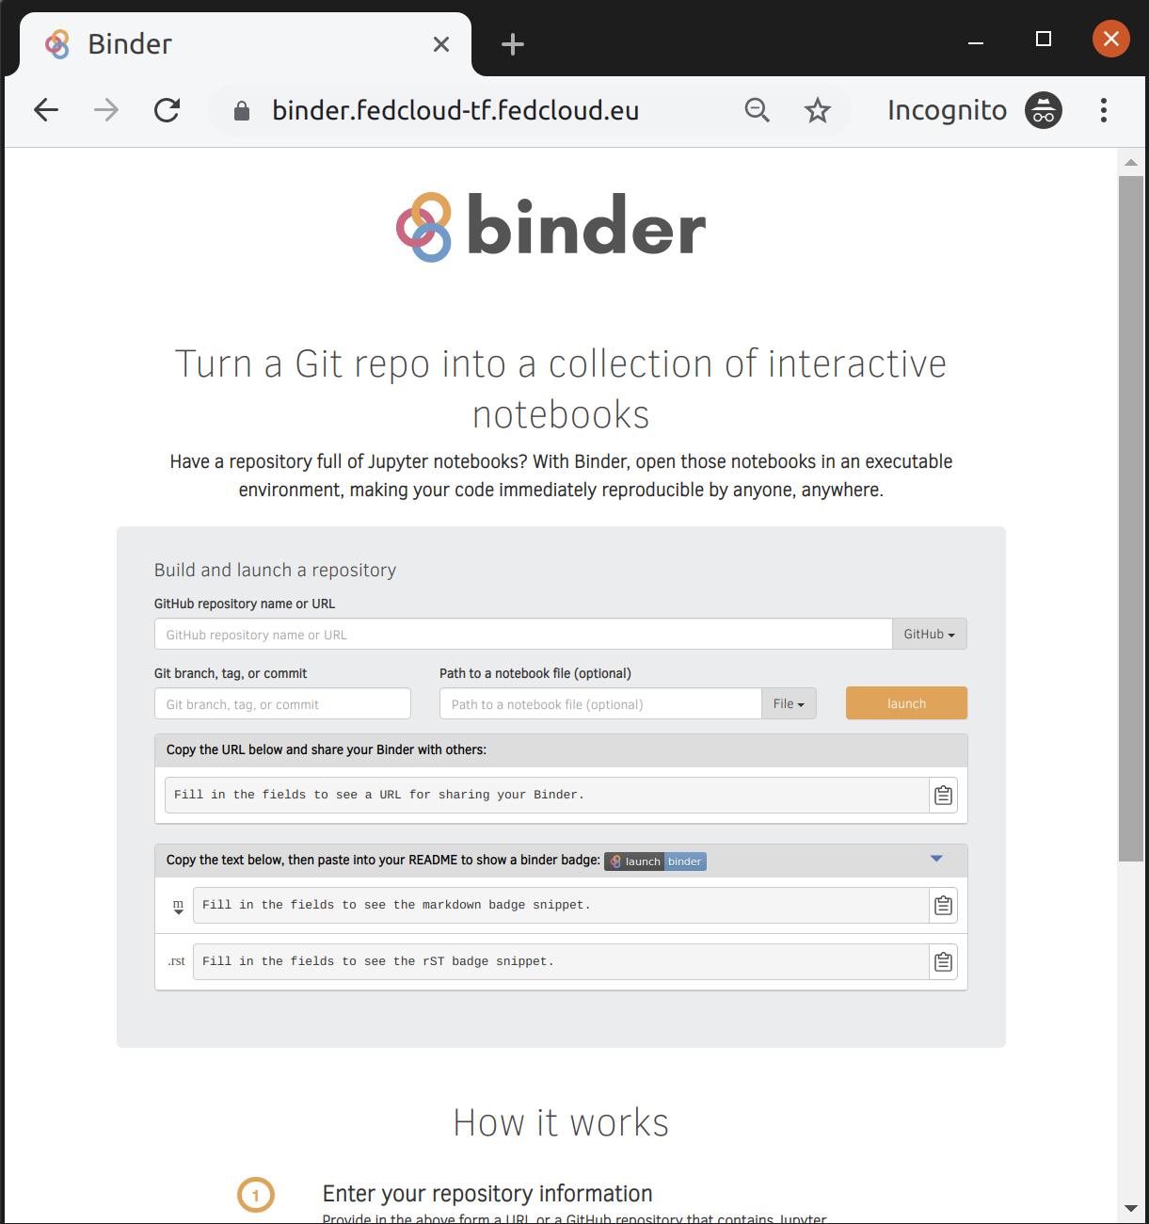
What does Binder do?
Pulls code from repository
repo2docker: Creates reproducible containers from repositories
jupyterhub: Generates user sessions that serve these containers
Kubernetes: manages the computing infrastructure
EGI Binder:
Provides an interface to create, share, and share the sessions

Slide 30
EGI Binder service
The service is available in Alpha mode for restricted users
Notebooks to reply in the service are limited to 1 CPU, 1GB RAM and 10GB of persistent storage per user
Production version is planned to be opened in late 2019

Slide 31
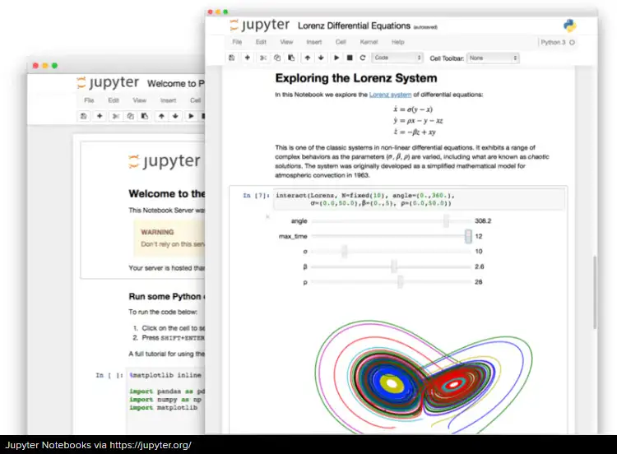
Overview of the hands-on
1. Edit the notebook 1'. Download the ipynb file
EGI Notebooks services
EGI Binder Notebooks
Re-execute
2. Create repository
2'. Upload ipynb file
2''. Add requirements.txt
GitHub
7. Provide GitHub project reference
Your repository
3. Specify the GitHub repo
6. Obtain GitHub project reference
Fellow researchers
4. Generate a DOI (this is done by Zenodo)
5. Discover Notebook (use DOI)

Slide 32
Some Binder examples
MyBinder gallery:
https://mybinder.readthedocs.io/en/latest/examples.html
LIGO sample notebook:
https://mybinder.org/v2/gh/minrk/ligo-binder/master?filepath=index.ipynb
R studio:
http://mybinder.org/v2/gh/binder-examples/r/master?urlpath=rstudio
CMS Open Data:
https://mybinder.org/v2/gh/cms-opendata-education/cms-online-notebooks-for-binder/master

Slide 33
Hands-on
Create your first shareable Binder notebook

Slide 34
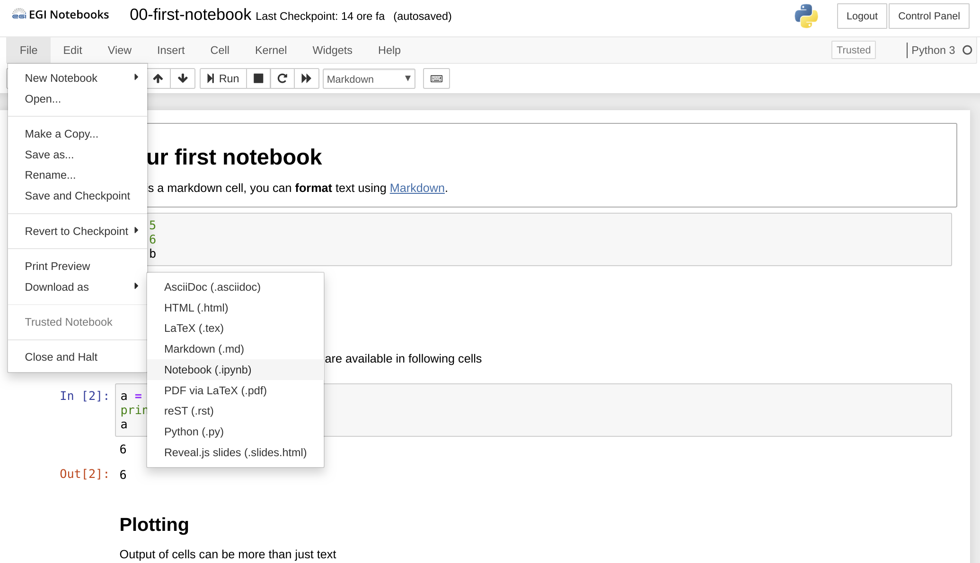
Create your first shareable Binder notebook
Go to https://training.notebooks.egi.eu
Go to the training-binder folder
Download the notebook 00-first-notebook to your laptop

Slide 35
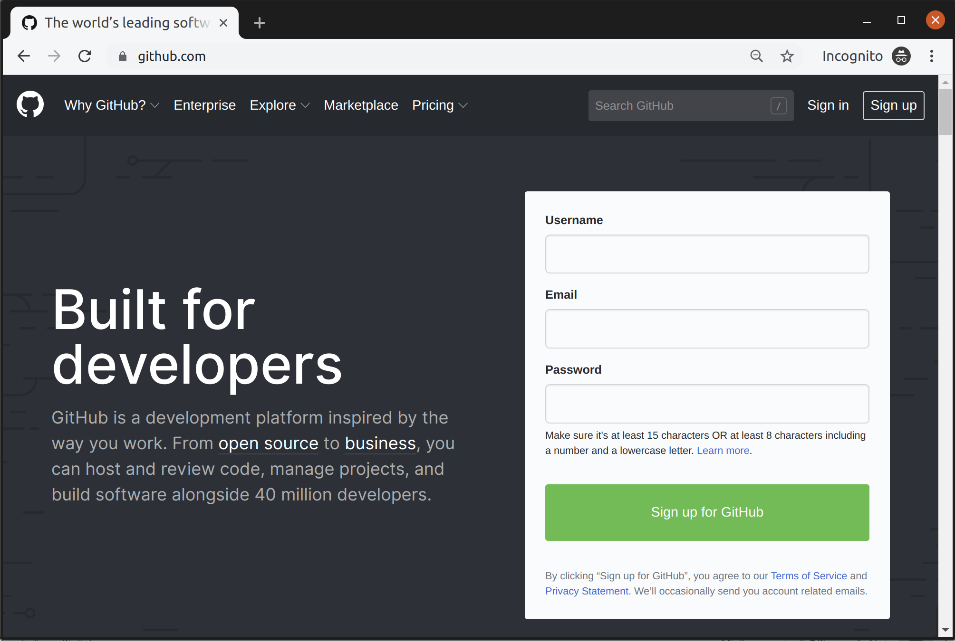
Sign up for a GitHub account (if you don't have it!)
Sign-up if you don’t have an account already.
Only requires a valid email

Slide 36
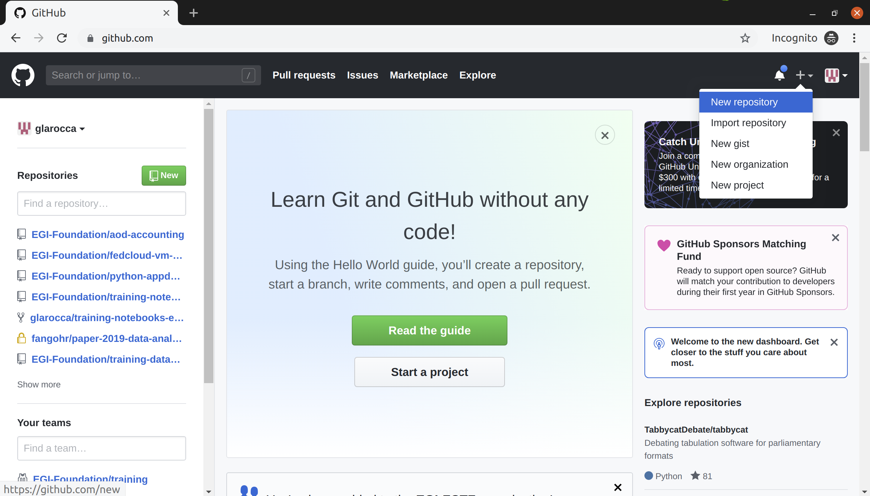
Create a new repository on GitHub

Slide 37
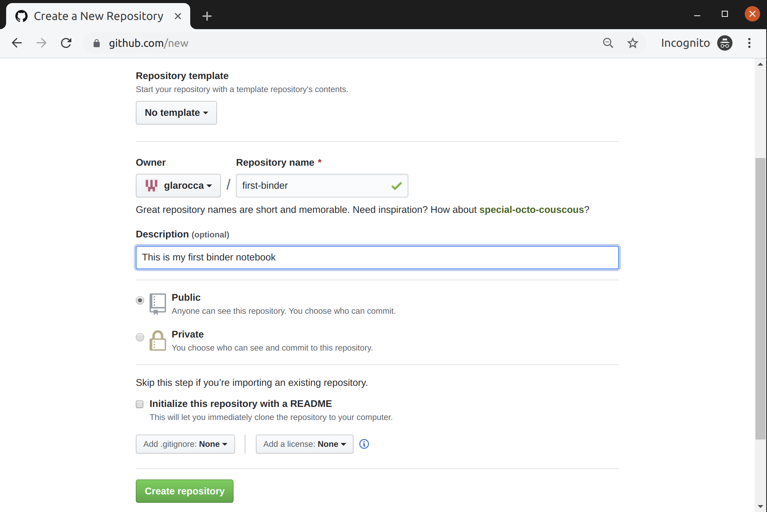
Create a new repository on GitHub (cont.)

Slide 38
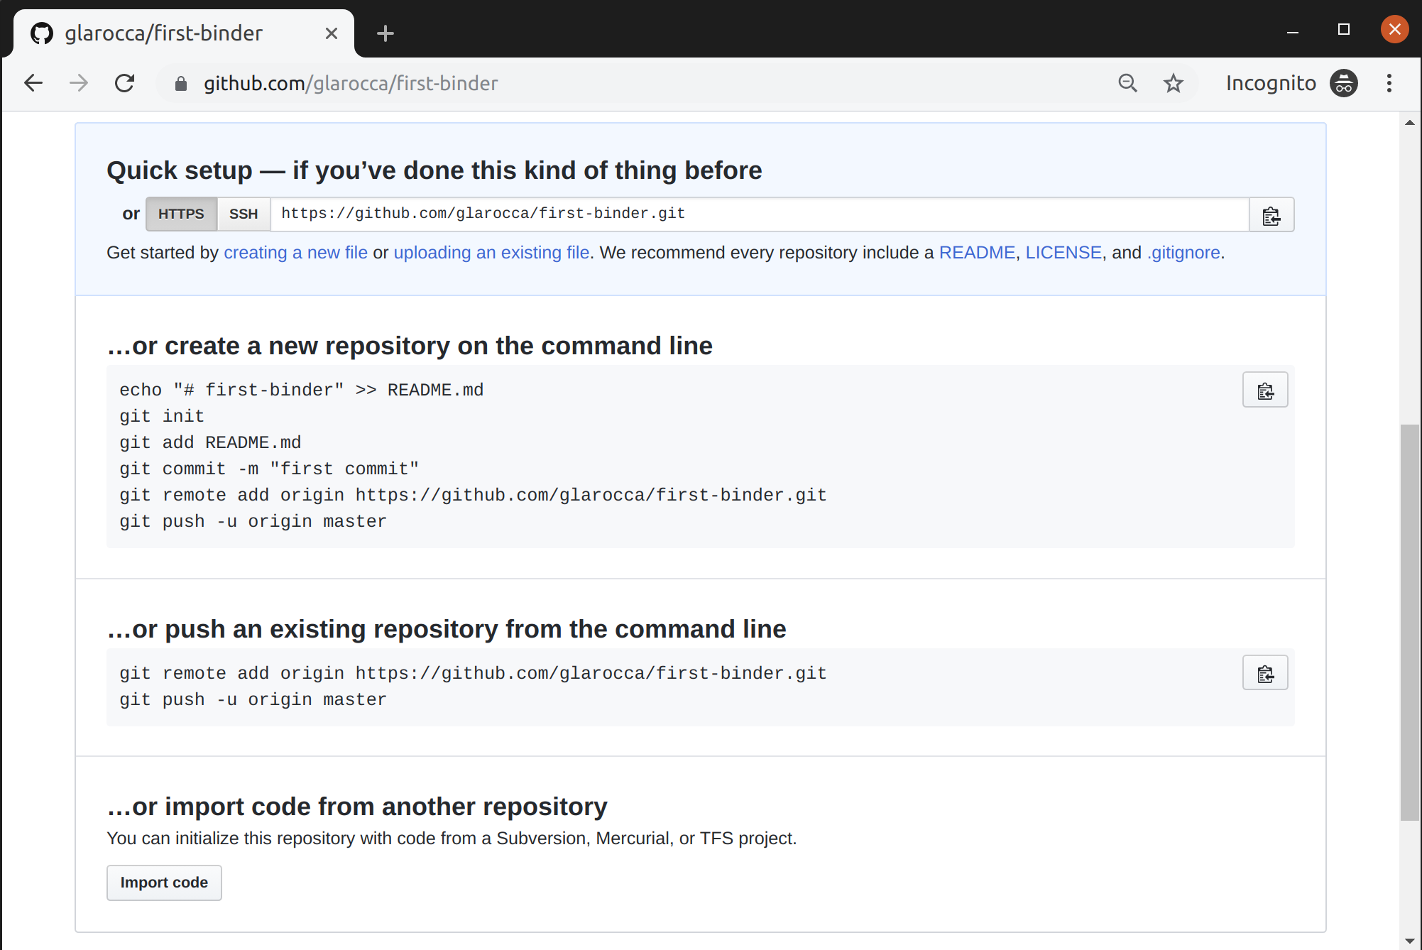
Upload your notebook (00-first-notebook)

Slide 39
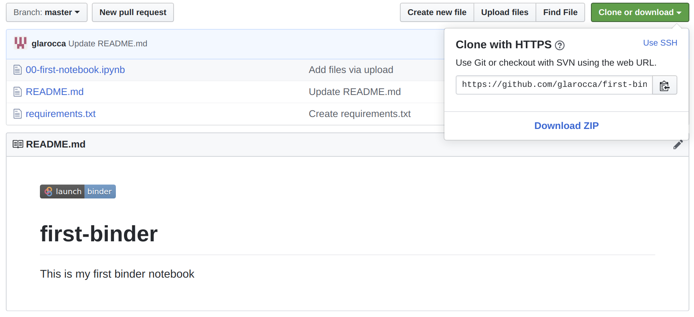
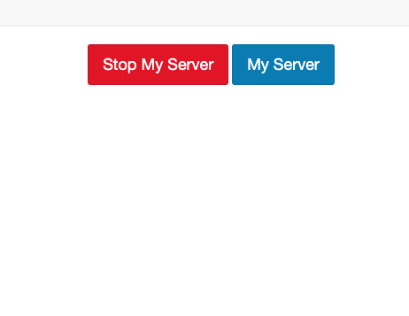
Add missing requirements in the GitHub repo
Go to https://cs3.fedcloud-tf.fedcloud.eu/hub/home and stop your server before retry!

Slide 40
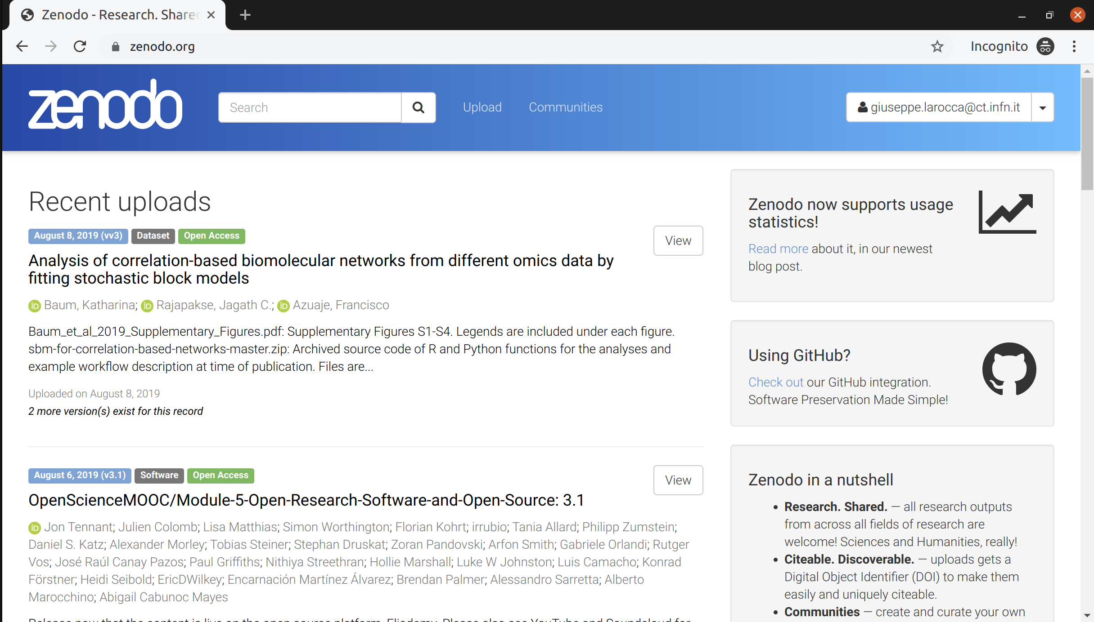
Share your GitHub repo on Zenodo
Login to Zenodo - https://zenodo.org with your GitHub account

Slide 41
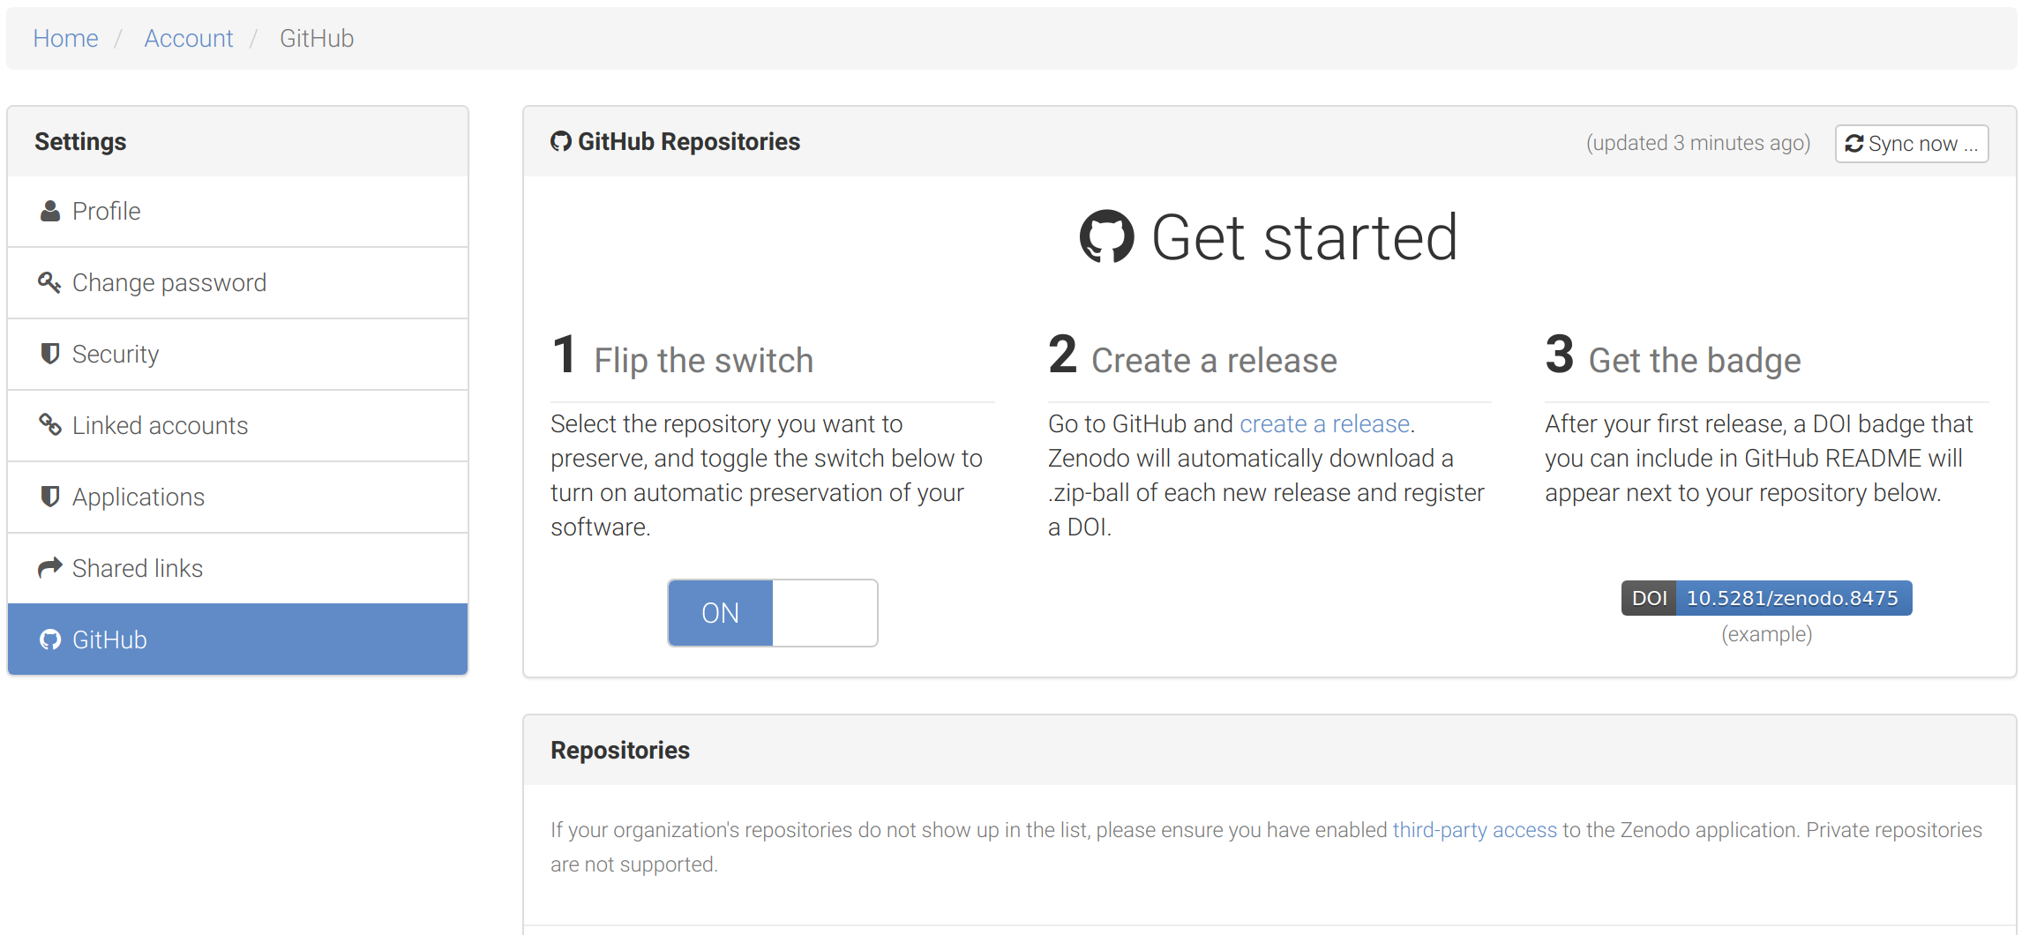
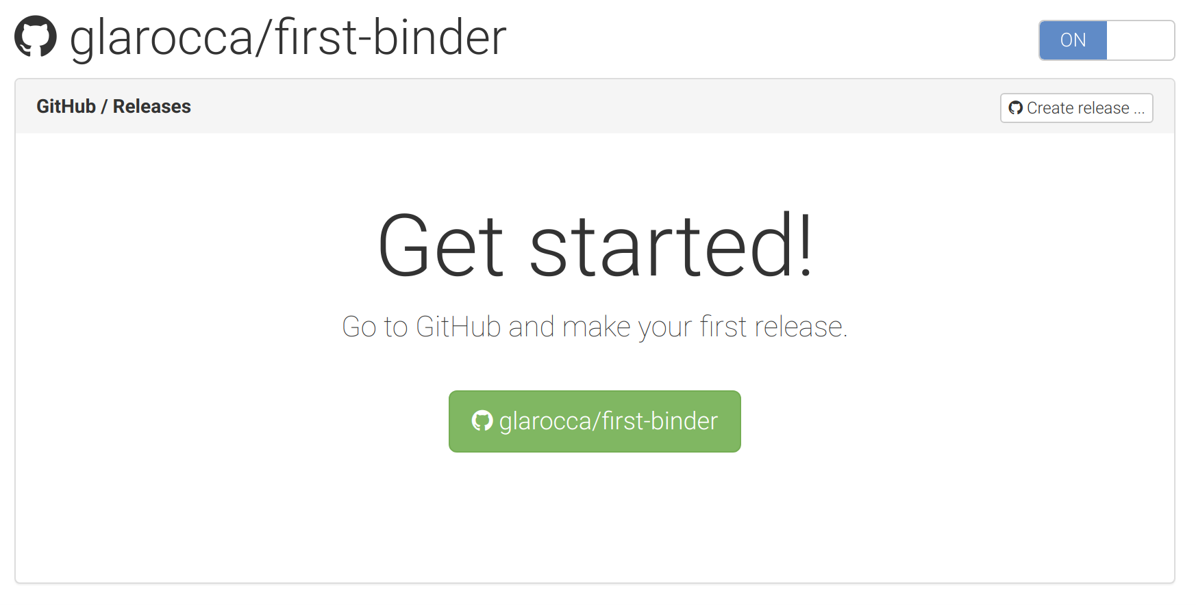
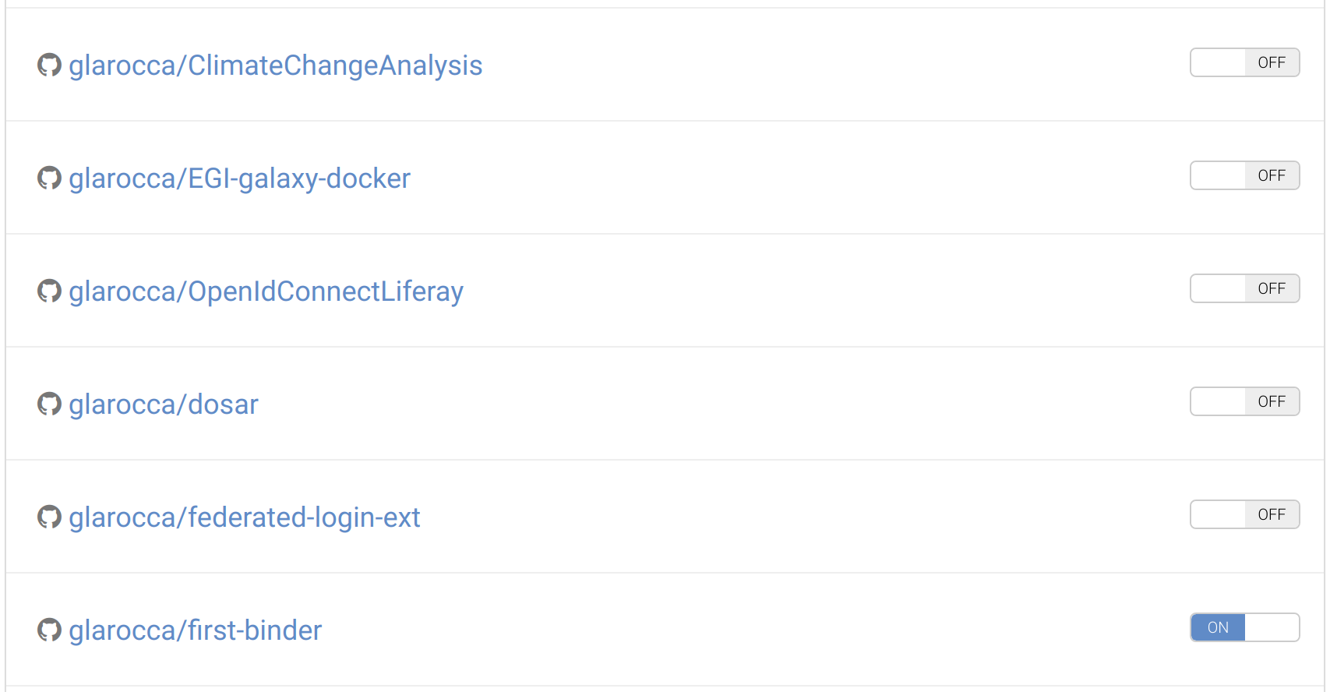
Enable your GitHub repository at Zenodo
Select the repo to enable from the Repositories list
Enable the repo (click ON)
Click on the GitHub repo link
Create a release

Slide 42
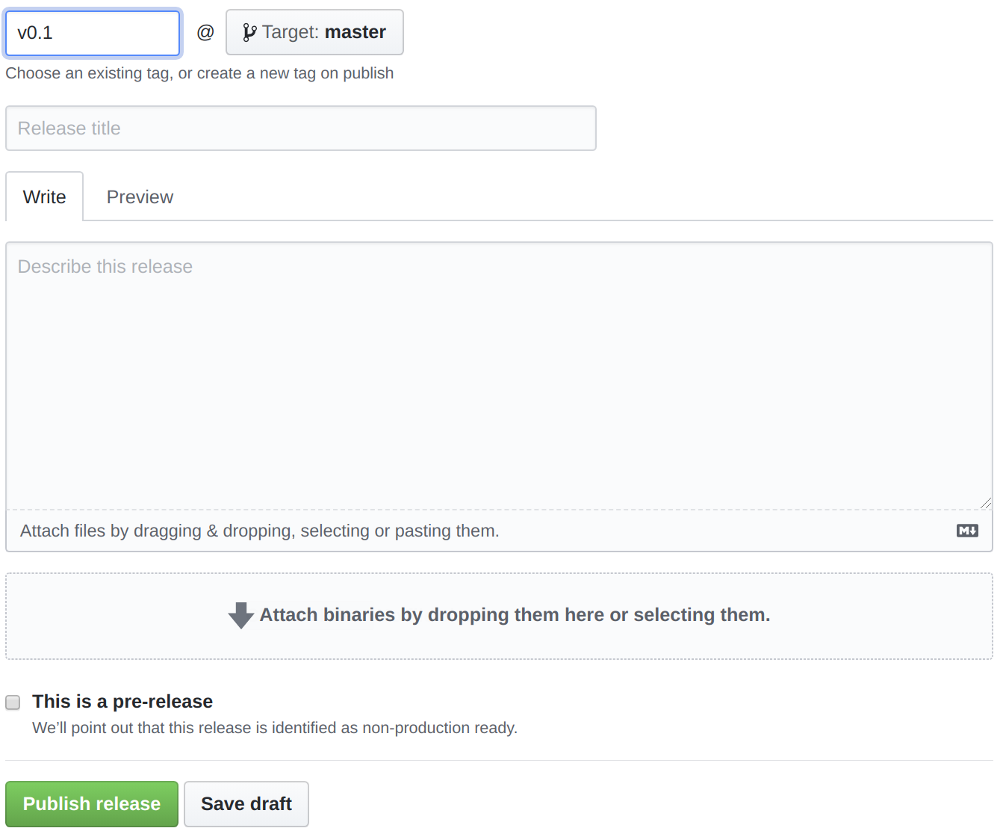
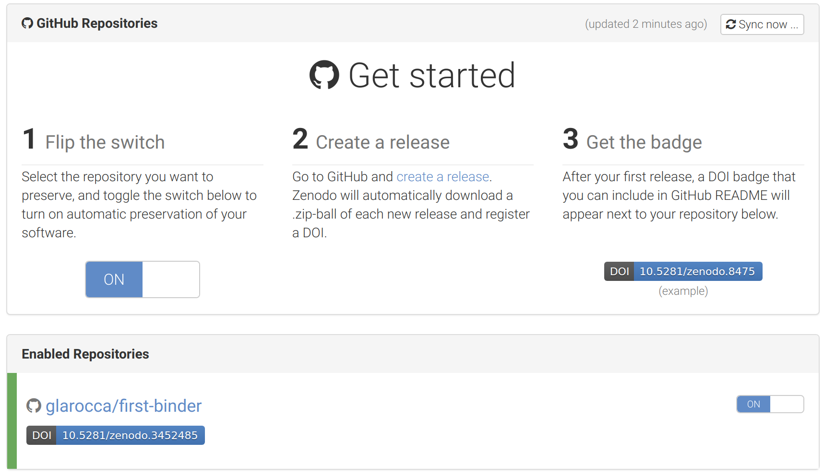
Create a release for your GitHub repo

Slide 43
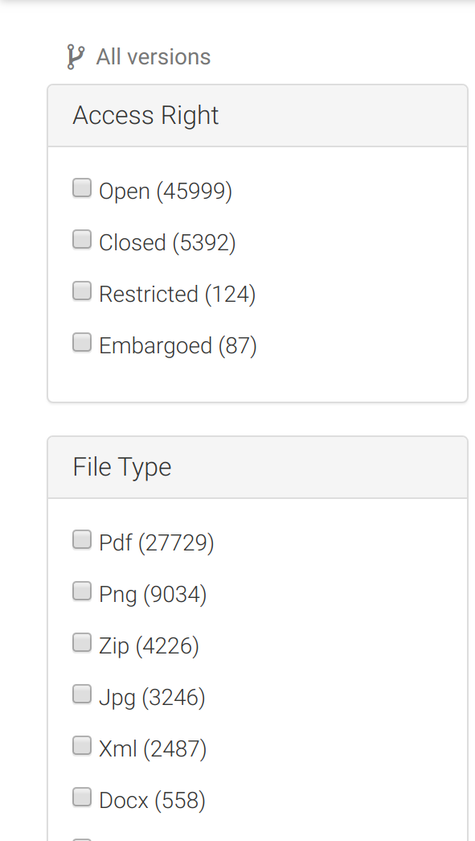
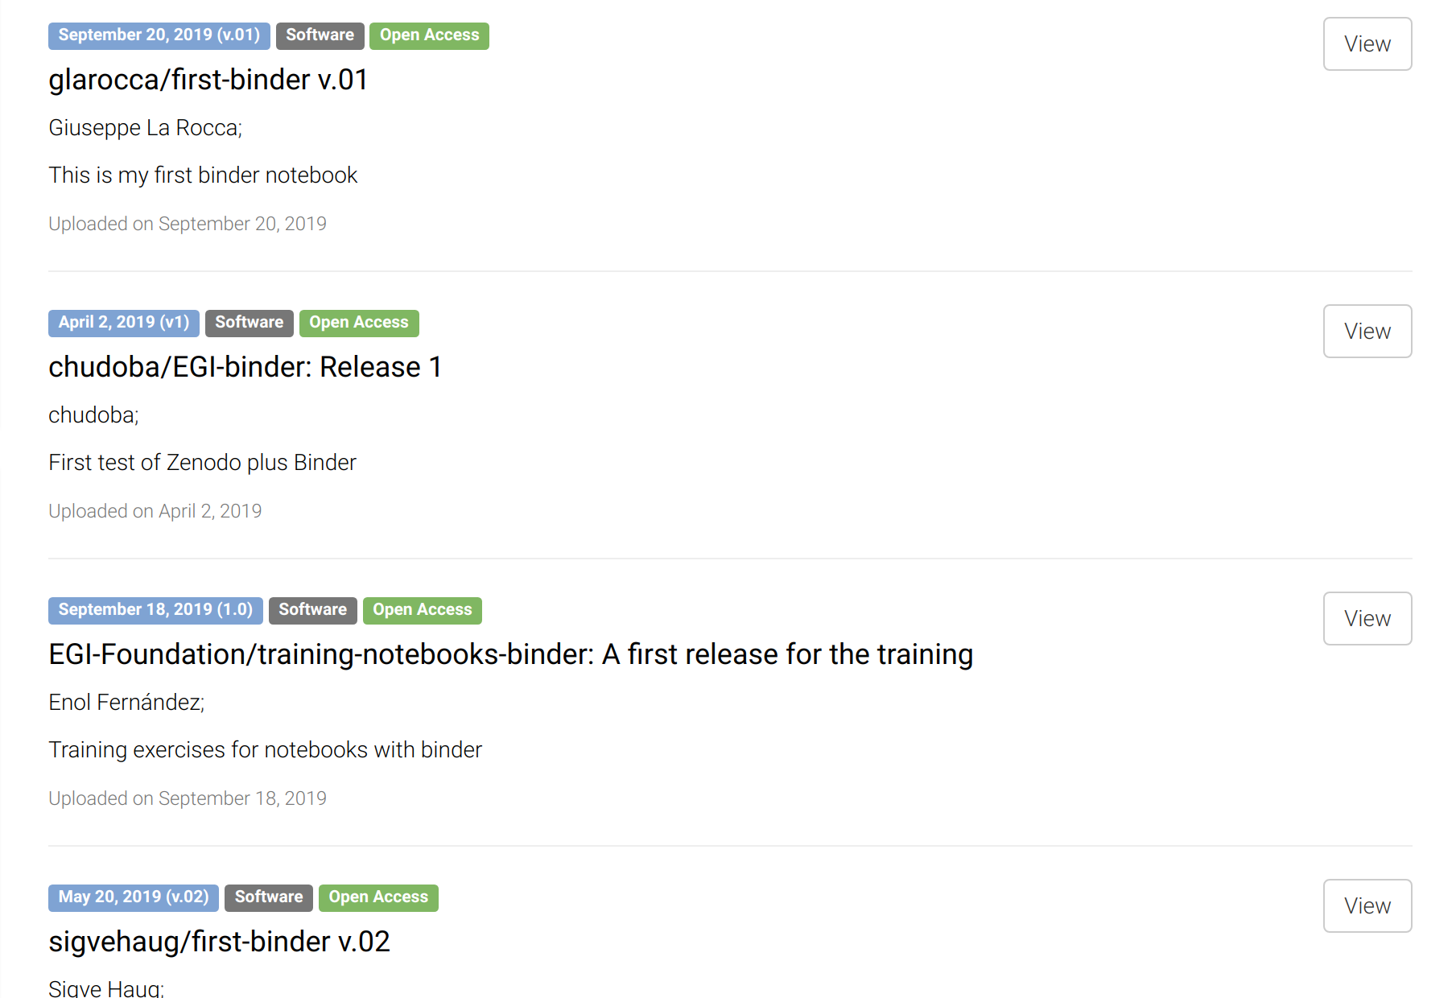
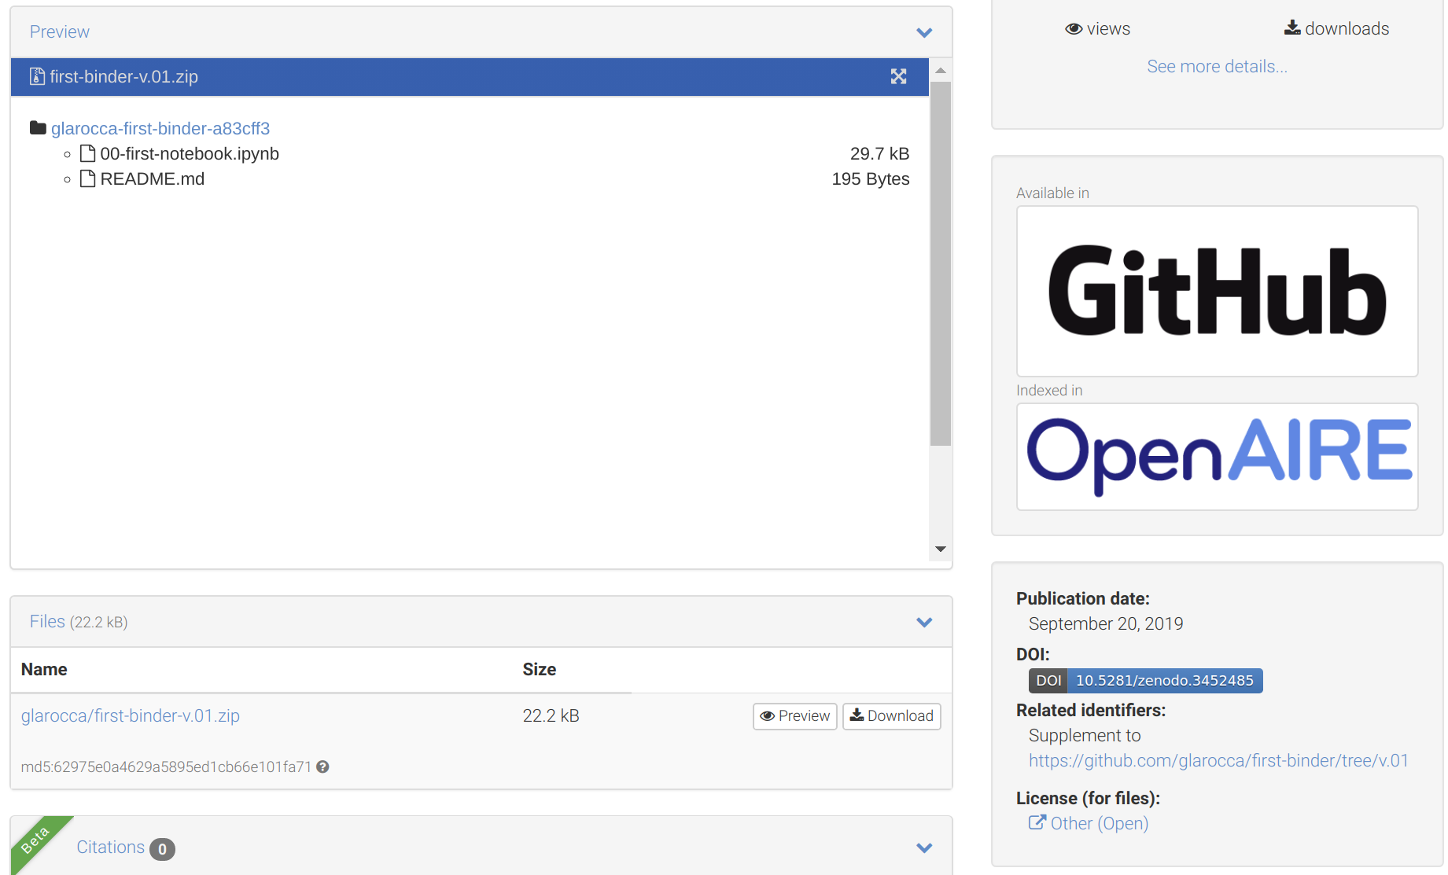
Search your GitHub repo in Zenodo
v
COPY

Slide 44
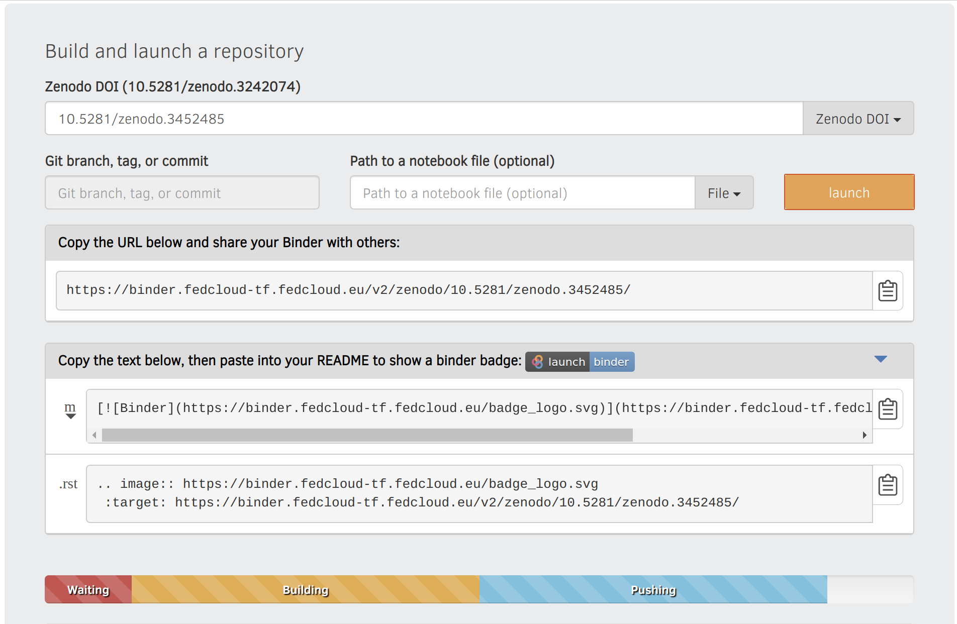
Reproduce your analysis with Binder
WARNING:
Registration of the DOI can take up to 10 minutes
Binder has to wait until registration is finished.
To check whether the DOI is resolved, please use the website: https://dx.doi.org/
Create a LaunchBinder button in your repo
Go to https://cs3.fedcloud-tf.fedcloud.eu/hub/home and stop your server before retry!

Slide 45
Hands-on summary
1. Edit the notebook 1'. Download the ipynb file
EGI Notebooks services
EGI Binder Notebooks
Re-execute
2. Create repository
2'. Upload ipynb file
2''. Add requirements.txt
GitHub
7. Provide GitHub project reference
Your repository
3. Specify the GitHub repo
6. Obtain GitHub project reference
Fellow researchers
4. Generate a DOI (this is done by Zenodo)
5. Discover Notebook (use DOI)

Slide 46
Working with big data
EGI Notebooks integrated with DataHub

Slide 47
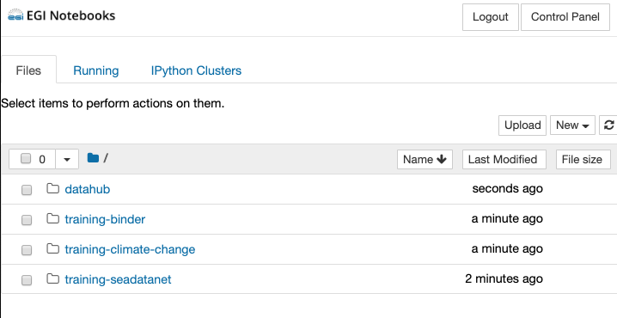
Data management
Big data accessed via EGI DataHub
EGI Notebooks
EGI Binder
1. Perform data analysis and visualisation with big Data
GitHub
6. Reproduce analysis with big data
Your repository
2. Publish notebook and Generate DOI
5. Resolve DOI to Notebook and Data
3. Cite DOI
in publication
Fellow researchers
Journal paper
4. Discover DOI

Slide 48
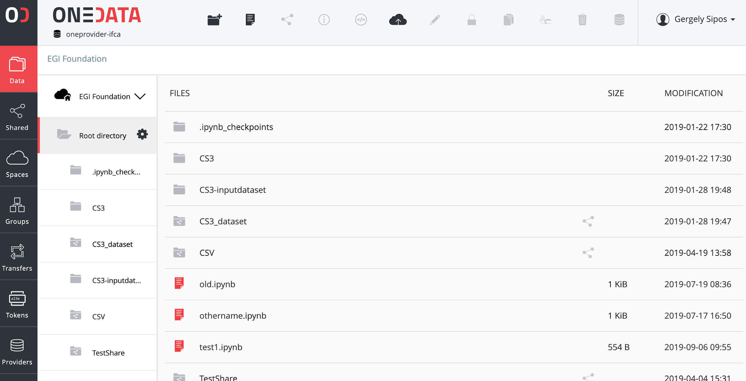
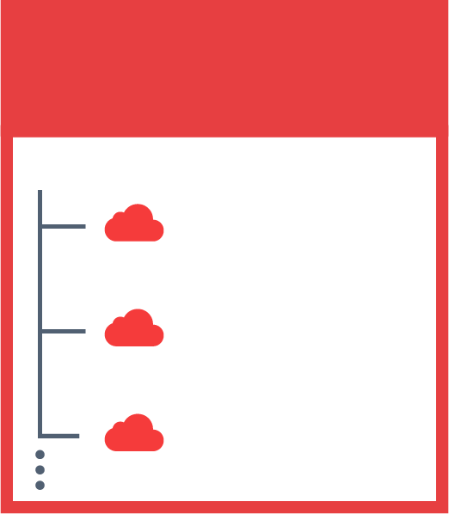
The problem we want to address
Cloud provider:
Physical storage for files
JOHN’S SPACES
SENTINEL 2
DEEP LEARNING
SARA’S SPACES
PUBLICATIONS
REPLICATION
Space: Local organisation of files (directory structure)
SENTINEL 2
SKY MAPS
MY DATA

Slide 49
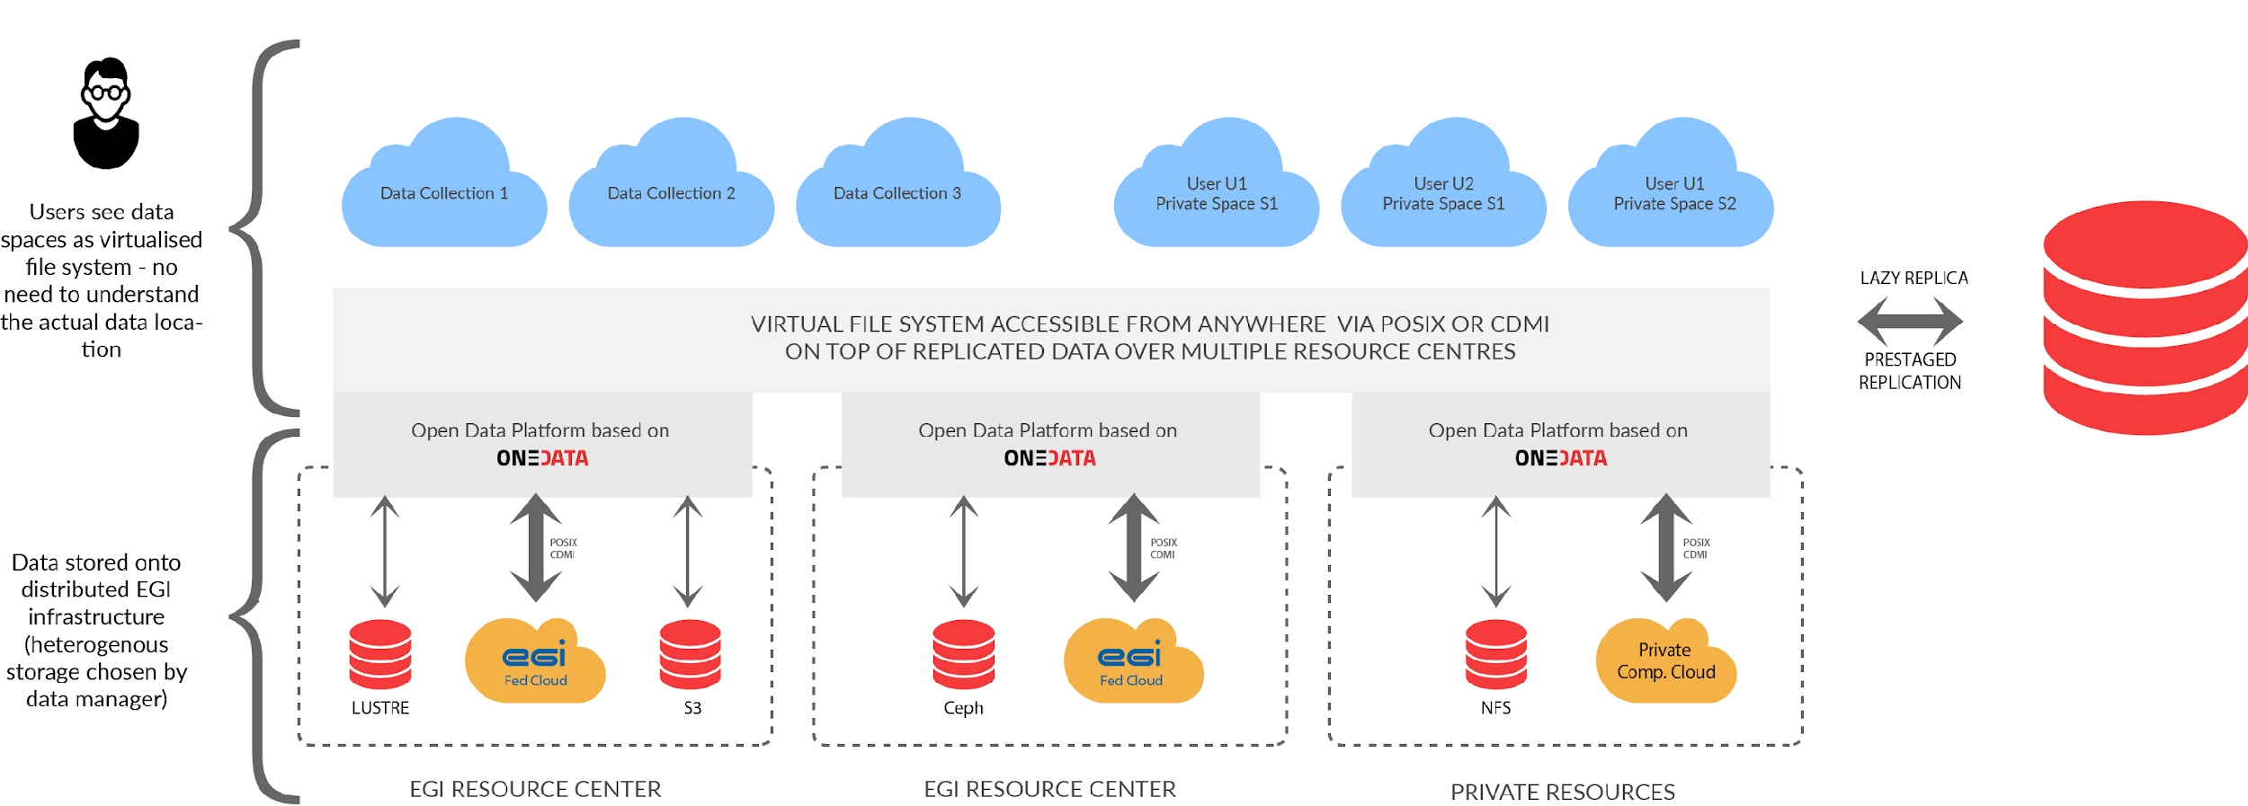
Accessing federated data in Notebooks
Federated files appear as a directory structure for the user
EGI Notebooks
EGI Binder

Slide 50
Getting access Deploying locally

Slide 51
Using the services after this training
EGI Notebooks - We talked about 2 access modes:
Catch-all instance: https://notebooks.egi.eu
Community deployment
Data access services
E.g. DataHub, B2DROP - Check in EOSC-hub Marketplace. Some with, some without user approval
Zenodo – There are three access modes
Sandbox: We used this today (sandbox.zenodo.org)
Normal user user: Zenodo.org - Upload your ‘research objects’
Community: Request community dashboard via https://www.zenodo.org/signup/
GitHub: Login and use (outside EOSC)

Slide 52
Setting up an EGI Notebooks in EaP
Join EGI Cloud with a new site
https://wiki.egi.eu/wiki/Federated_Cloud_resource_providers_support
https://egi-federated-cloud-integration.readthedocs.io/en/latest/
Join EGI DataHub with a new oneprovider (for access to big data) running on your cloud:
https://onedata.org/docs/doc/administering_onedata/deployment_tutorial.html
Support the DataHub spaces you are interested in your new oneprovider
Deploy EGI Notebooks
https://egi-notebooks.readthedocs.io/en/latest/technical.html
https://zero-to-jupyterhub.readthedocs.io/en/latest/index.html
See additional material at https://indico.egi.eu/indico/event/4431/session/4/?slotId=0#20190506

Slide 53
Getting EGI resources for a community Notebook
We also welcome and support providers to join!
Trigger the process with an ‘EGI Cloud’ or ‘EGI Notebooks’ order in the EOSC Portal
Type, number, size, cost, availability, etc.
Applic. provider
Requirements
Conditions
Storage provider
Cloud provider
Negotiator
Grid provider
Project/Community representative
Service Level Agreement
Operation Level Agreement
Training
Support
Satisfaction review (every 3/6/12 months)
Performance reports

Slide 54
FEEDBACK FORMS

