Slide 1
A collaboration and Compute Platform from EGI for Open Science in Asia
EGI Advanced Computing for EOSC
Giuseppe La Rocca giuseppe.larocca@egi.eu EGI Foundation
APAN53 Cloud Working Group Meeting https://www.aarnet.edu.au/apan53

Slide 2
Outline
The European Open Science Cloud (EOSC) initiative: overview
How EGI is contributing to the delivery of the EOSC-Exchange
The EGI-ACE project
A new collaboration platform for Asia-Pacific
Opportunities
How to use it
Next steps
Q&A

Slide 3
Why the EOSC ? What is the EOSC ?

Slide 4
Why the European Open Science Cloud (EOSC) ?
Enable Open Science and the digital transformation of science
Empower 1.7 million of European researchers to reap benefits of data-driven science
Build an open research data commons in Europe widely inclusive of all disciplines and Members States, sustainable in the long-term
Give Europe a global lead in research data management; helping developing an internet of FAIR digital objects
Reduce fragmentation by federating existing Research Infrastructures
Enable interdisciplinary research to address societal challenges
Enable the Digital Single Market and stimulate the emergence of a competitive EU cloud sector

Slide 5
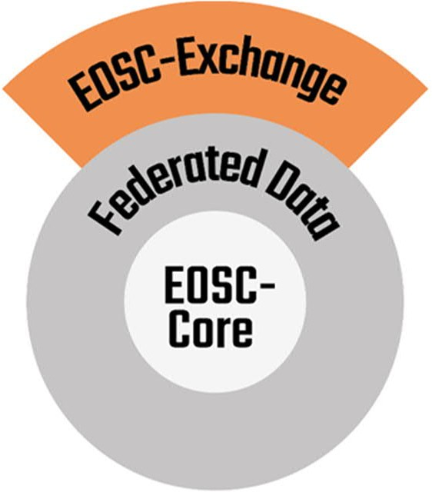
What is the EOSC ?
A trusted and open virtual environment for the scientific community with the seamless access to services addressing the whole research life cycle
Virtual space where science producers and science consumers come together
Inclusive to people of all background and cultures
Offer a wide range of content and services

Slide 6
EGI: Advanced Computing for Research

Slide 7
Vision
All researchers have seamless access to services, resources and expertise to collaborate and conduct world-class research and innovation
Mission of the EGI Federation
Deliver open solutions for advanced computing and data analytics in research and innovation
Mission of the EGI Foundation
Enable the EGI Federation to serve international research and innovation together

Slide 8
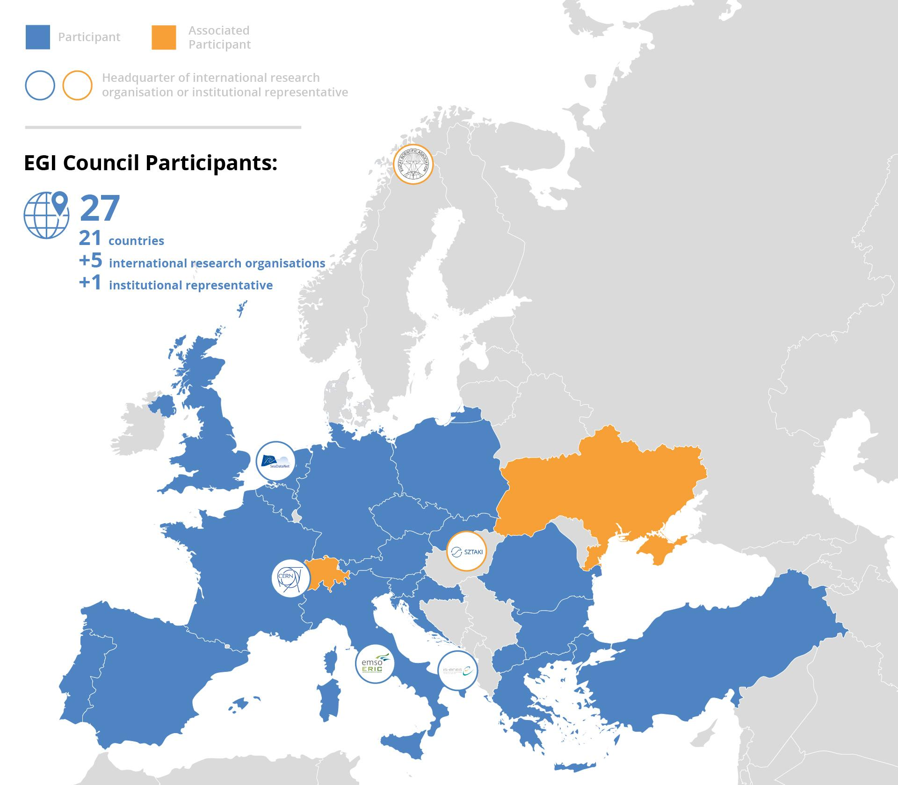
EGI Governance
EGI Foundation (EGI.eu) in Amsterdam

Slide 9
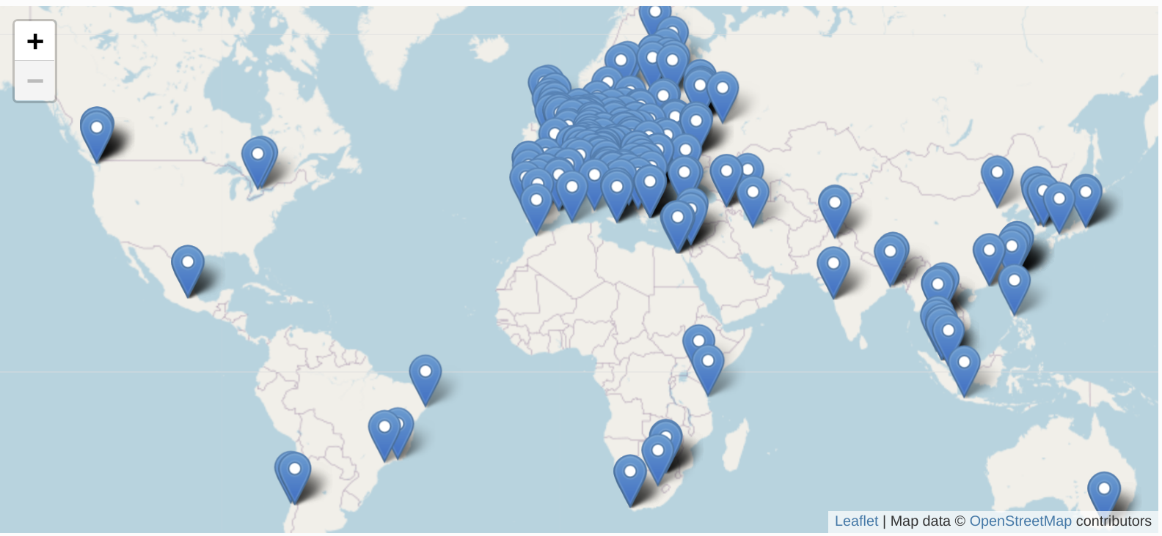
Maps and Statistics
HTC: 5.2 Billion CPU h/year
HTC
+24%/year
Cloud: 43 Million CPU h/year
Cloud
+60%/year

Slide 10
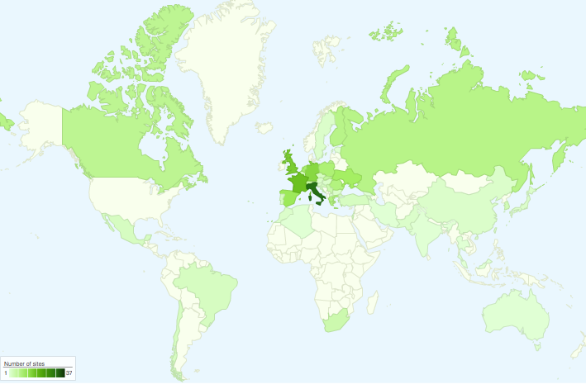
Infrastructure Partnerships - Memorandum of Understandings

Slide 11
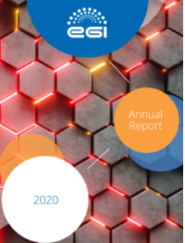
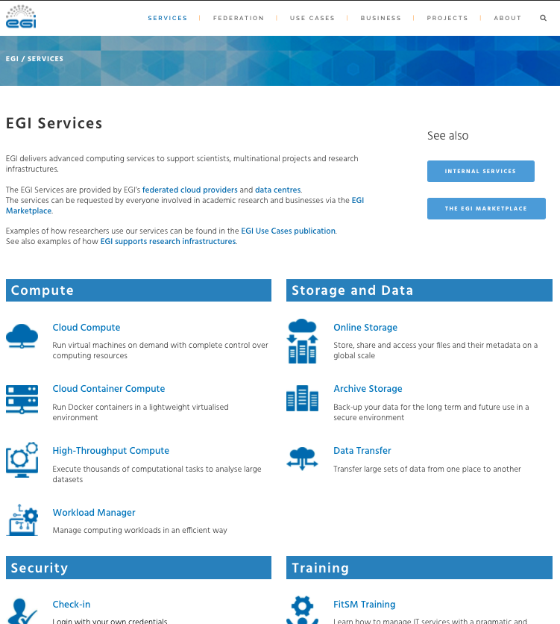
Learn more about EGI
Access/order EGI services:
https://www.egi.eu/services/
support@egi.eu
https://www.egi.eu/about/publications/

Slide 12
How EGI is contributing to EOSC-Exchange

Slide 13
EGI-ACE mission
Implement the Compute Platform of the European Open Science Cloud and contribute to the EOSC Data Commons by delivering integrated computing, platforms, data spaces and tools as an integrated solution that is aligned with major European cloud federation projects and HPC initiatives.
Start: January 2021
Duration: 30 months
Consortium: 33 participating partners, 23 third-parties
Budget: 12 Million EUR (8 Million EC)

Slide 14
Integrated tiered service architecture
Data Spaces
and Analytics
Data and thematic data analytics and processing tools
EOSC portal
(EOSC Exchange services)
External adopters
Green Deal Data Space
Health Data Space
Fundamental Science Data Space
Humanities Data Space
Platforms
generic added-value platform level services
EOSC
users
Interactive Computing
Automated Cluster deployment
Distributed AI training
Workload Management
Service Management, Tools, Processes, Policies
Federated
Access
Federation-wide management of data and computing
Federated Compute
Federated Identity
Federated Data
Federated
Resources
Compute and storage facilities
Research Clouds
Public Clouds
HTC
HPC
Federated resource brokering and allocation
Usage accounting across sites and communities
Service availability/reliability monitoring
User/admin response mgm via Helpdesk
Continuous improvement (feedback from users and sites)

Slide 15
EGI-ACE concept and methodology: Tier service architecture
Data Spaces
and Analytics
Data and thematic data analytics and processing tools
EOSC portal
(EOSC Exchange services)
Early adopters
Green Deal Data Space
Health Data Space
Fundamental Science Data Space
Humanities Data Space
Platforms
generic added-value platform level services
EOSC
users
Interactive Computing
Automated Cluster deployment
Distributed AI training
Workload Management
Service Management, Tools, Processes, Policies
Federated
Access
Federation-wide management of data and computing
Federated Compute
Federated Identity
Federated Data
Federated
Resources
Compute and storage facilities
Research Clouds
Public Clouds
HTC
HPC

Slide 16
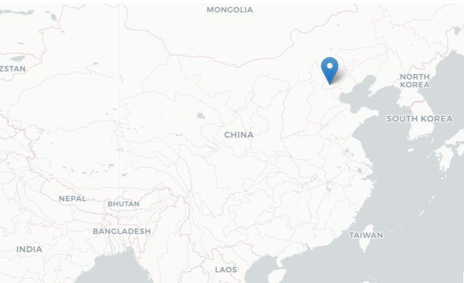
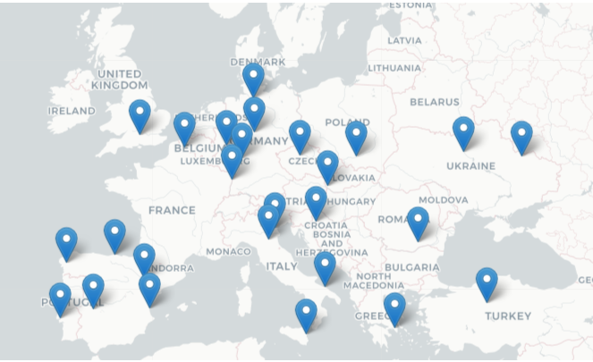
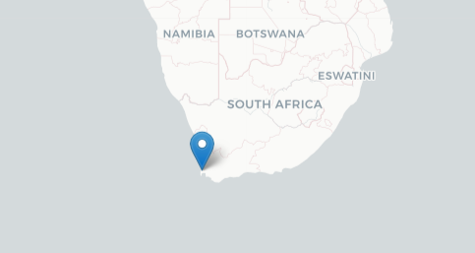
Towards a Global Open Science Cloud
New in 2021:
27 cloud providers
New in 2022

Slide 17
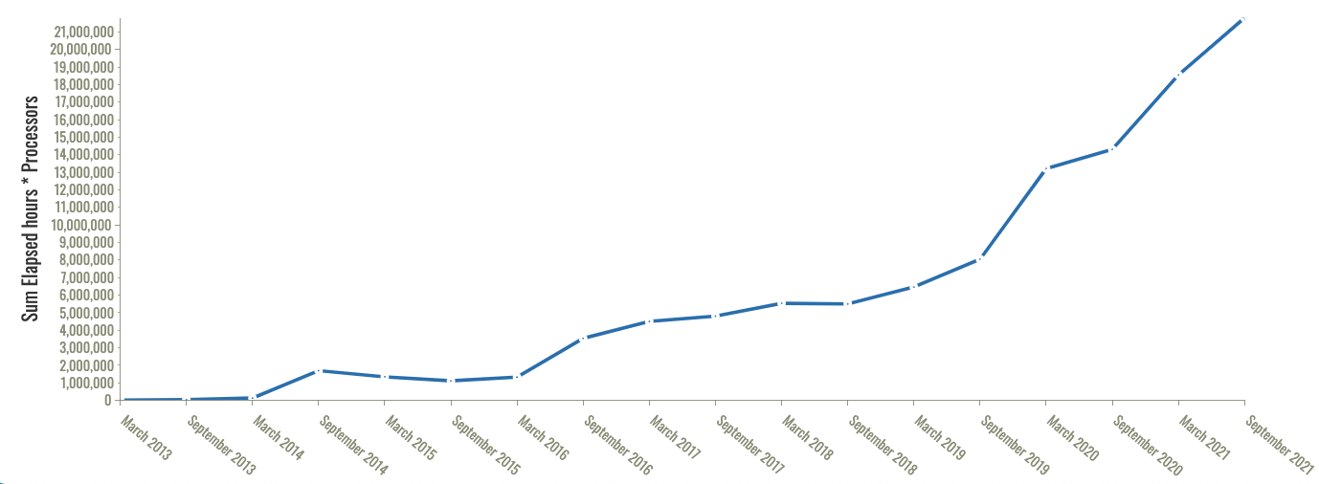
EGI Cloud capacity consumption trends
Start of EGI-ACE
Start of EOSC-hub
+60% 2021-2022
43 Million CPU hours

Slide 18
Who pays for this?
EGI providers
Serving with the use of...
EC funds (VA in EGI-ACE, Infra projects)
Local funds (institutional/national investments)
EGI-ACE integrates providers and allocates capacity based on
Institutional/national commitment for disciplines (national funding)
International commitment (VA funding)
→ Minimising the dependency on VA funding

Slide 19
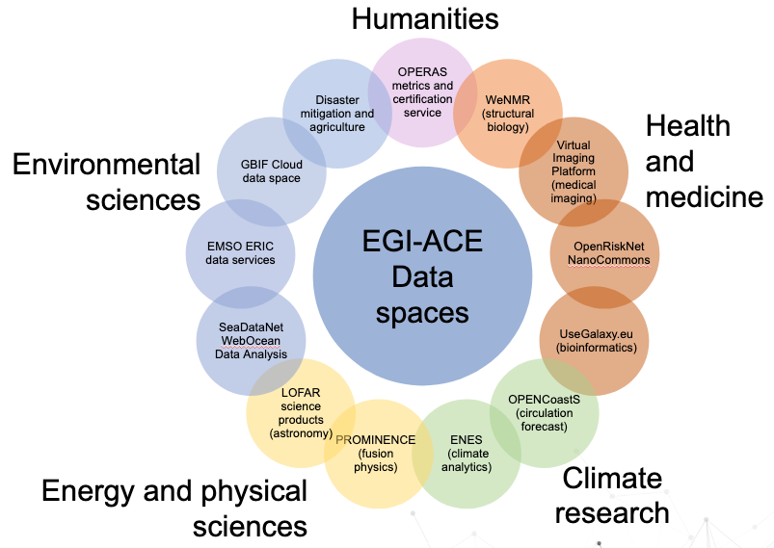
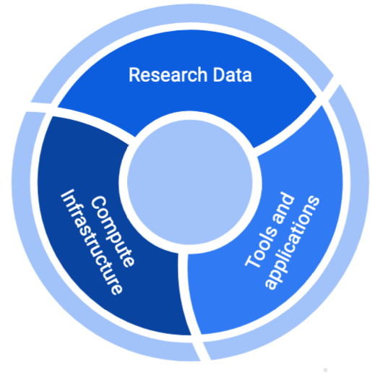
Thematic Services from EGI-ACE: Scientific Data Spaces
Already in EOSC Portal
Supported by federated resources, access and platform services with SLAs

Slide 20
The Disaster Mitigation and Agriculture DS
Vision: Sustainability of the Humanity and the Earth
Goal: Enhance capability for hazard risk analysis
Approaches: Deeper understanding of natural hazards
Quantify risks and reduce risk determinants by evolved knowledge of physical processes behind the disaster events
Improving efficiency of numerical simulations according to the knowledge of root cause and drivers of target hazards
Case study approach: develop best practices; find out gaps to get insights; discover challenges and further requirements
Open science mode
Partners: ASGC/TW (Coord.), BD, ID, IN, JP, MM, MY, NZ, PH, TH, and VN
18 case studies of 6 types of hazards in 8 country partners have been conducted

Slide 21
Open Science collaboration platform for Disaster Mitigation and Agriculture researchers
A cloud resource pool from EGI-ACE (aka Virtual Organisation = VO). VO Name: vo.environmental.egi.eu
Initial capacity:
CESNET, Czech Republic
16 vCPU cores,
48 GB of RAM,
1 TB of block storage
Initial services:
EGI Cloud Compute; Online Storage, Workload Manager, RUCIO

Slide 22
Opportunities by the new collaboration platform
Application delivery:
Setup application portals in the cloud
Scientific analysis (computational VMs, containers)
Sharing scientific data (access to distributed datasets in the cloud)
Via the EGI DataHub service
Share your own capacity (join the VO with a new cloud)
How to use it?
1.) Sign-up for account: https://aai.egi.eu/signup
Instructions to active your EGI account: https://docs.egi.eu/users/aai/check-in/signup/
2.) Subscribe to the vo.environmental.egi.eu VO filling the web form: https://aai.egi.eu/registry/co_petitions/start/coef:369
3.) Access via Horizon OpenStack: https://dashboard.cloud.muni.cz/

Slide 23
What’s next
Connecting Scientific Gateways
E.g. the iCOMCOT Portal from Academia Sinica to offload international traffic to the EGI-ACE VO
Sharing scientific data
Adding further services from EGI-ACE
E.g. Notebooks and Binder for reproducible analysis

Slide 24
Do you have an open science computational use case that does not fit to the EGI Environmental Sciences Virtual Organisation? → Submit it to the EGI-ACE Call!

Slide 25
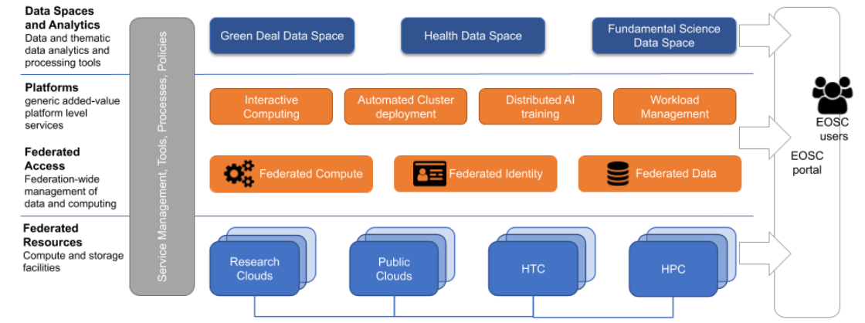
How EGI-ACE supports use case call applicants
Use case shepherds (lead experts)
Training Programme
Users docs
Provider specific support
Service and resource allocation
https://docs.egi.eu

Slide 26
Thank you!

