Slide 1
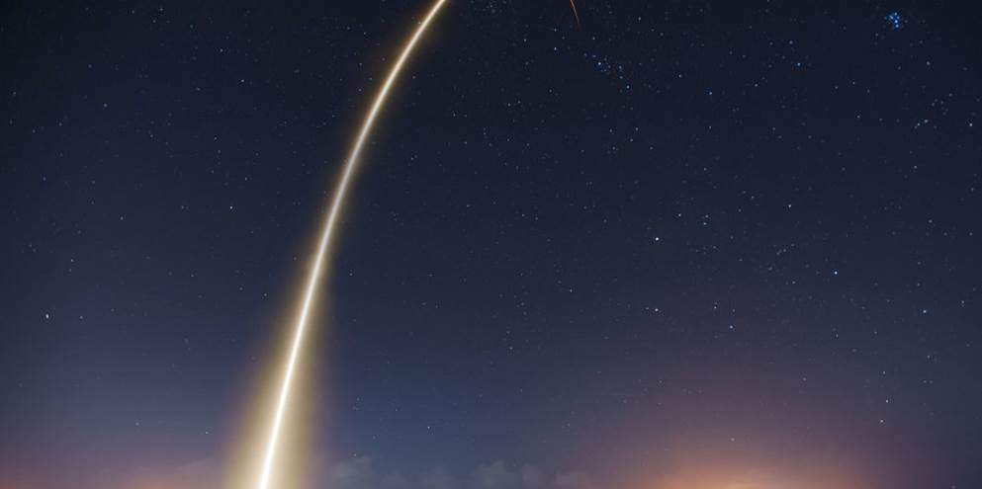
EGI: advanced computing for research
in Europe
Technische Universität Wien
19-04-2017
www.egi.eu

Slide 2
EGI: Advanced Computing for Research
Notes:
A globally distributed ICT infrastructure that federates the digital capabilities, resources and expertise of national and international research communities in Europe and worldwide.
EGI has delivered unprecedented data analysis capabilities to more than 48,000 researchers from many disciplines and is now committed to bring innovation to the private sector.

Slide 3
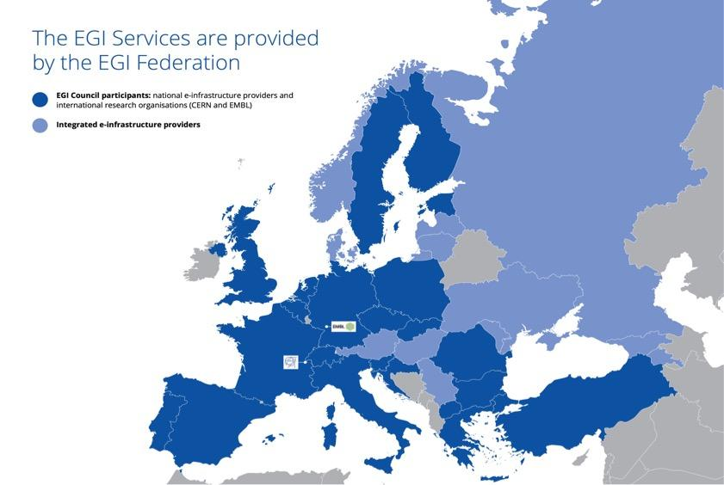
635,000 Cores
500 PB of storage
>48,000 Users
~200
Virtual Organizations
15 ESFRI Research Infrastructures
Active Users/Early Adopters

Slide 4
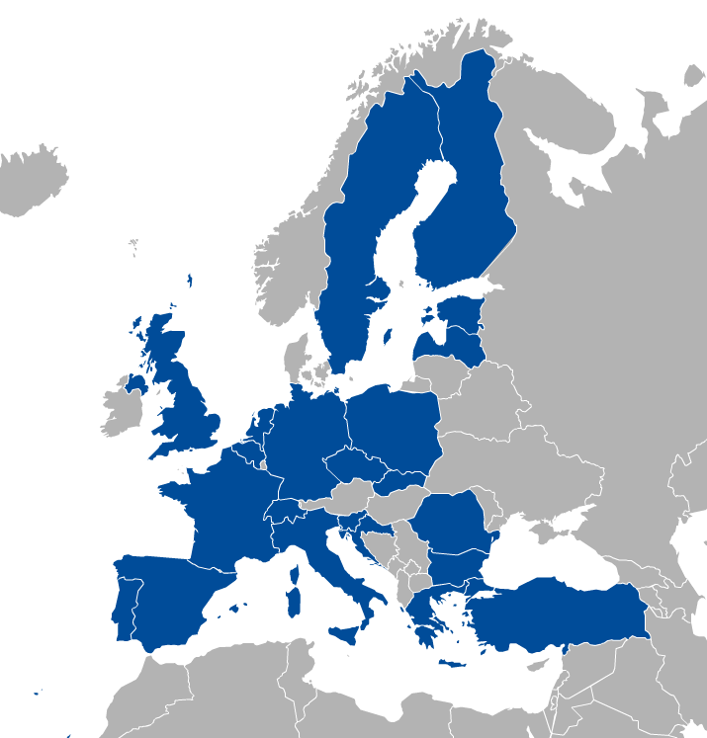
EGI Membership
https://www.egi.eu/about/egi-council/
Major national e-Infrastructures “NGIs”: 22
EIROs: CERN
EGI Foundation
(ERICs)

Slide 5
EGI Funding
(1) Innovation and outreach
➔ EC H2020
➔ Current flagship project: EGI-Engage
(2) Federation services
➔ yearly fees and in-kind contributions
(3) Distributed Compute/Storage/Data of
➔ National funding agencies

Slide 6
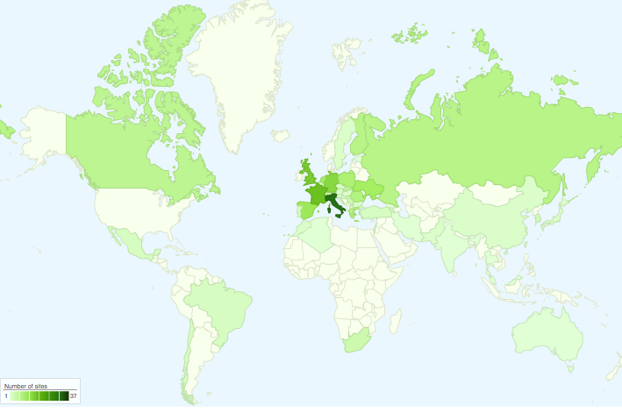
International Partnerships
Canada
China Inst. Of HEP
Chinese Academy
of Sciences
USA
India Centre for
Development of
Advanced Comp.
Africa and Arabia
Council for Scientific and
Industrial Research, South Africa
Asia Pacific Region
Academia Sinica
at Taiwan
Latin America
Universida de Federal do
Rio de Janeiro
Ukraine
Ukrainian National
Grid

Slide 7
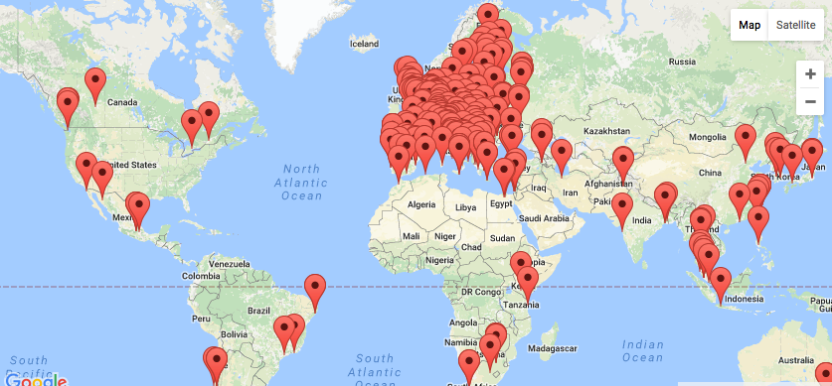
EGI Federation, 2016 QR3 The largest distributed compute e-Infra worldwide
23 Cloud providers, 280 HTC centres
+250 000 instantiated VMs/year
1.7 Million jobs/day
2.6 Billion CPU hours/year +26%
>48 000 users, +25%

Slide 8
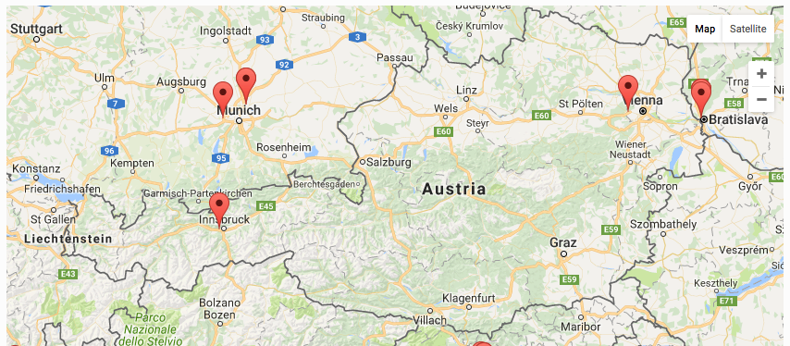
Austrian contribution to EGI
Two data HEP centres (currently operated and supported by the Italian NGI) → ATLAS and CMS experiments
No participation to the EGI Council

Slide 9
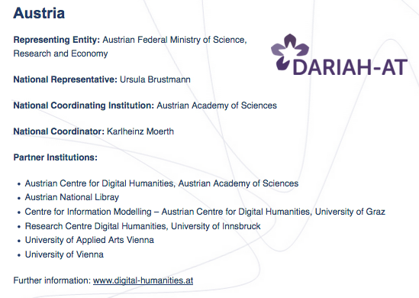
Collaborations with other Austrian initiatives
DARIAH – Digital research infrastructure for Art and Humanities
EGI-Engage Competence Centre, support to develop and run a scientific gateway offering semantic search capabilities and other applications (https://dariah-gateway.lpds.sztaki.hu/)

Slide 10
Collaborations with other Austrian initiatives/Cont
BBMRI – Biobanking and BioMolecular resources Research Infrastructure
BBMRI-ERIC established in 2013, Graz, AUSTRIA
EGI-Engage competence centre
Definition of Biobanking use cases suitable for execution in a hybrid cloud environment like EGI federated cloud
Reuse of federation services to implement a private cloud federation

Slide 11
Collaborations with other Austrian initiatives/Cont
Collaboration with EODC and other ESA partners for the realization of a Data Hub hybrid Earth Observation active distributed data infrastructure offering data, computing and high level data products with reusing EGI data and cloud federation technologies and services
Complementing the DG-GROW DIAS initiative
Leveraging the EC initiative to establish a European Open Science Cloud
EOSC-hub project proposal submitted to the EC in March 2017

Slide 12
Collaborations with ESFRI Research Infrastructures
Distributed Competence Centre
BBMRI
ELIXIR
EPOS
MoBrain/ INSTRUCT
EISCAT-3D
DARIAH
LifeWatch
Environment (disaster mitigation)
EMSO (unfunded, MoU)
Introduction to EGI, 19-04-2017

Slide 13
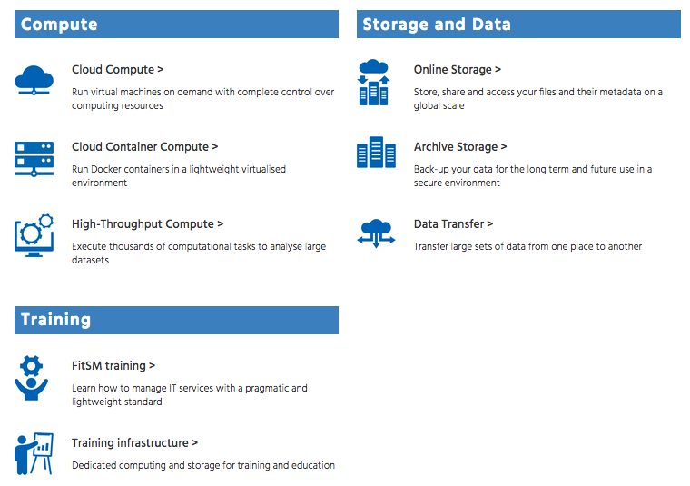
Services Catalogue for researchers/innovators
https://www.egi.eu/services/

Slide 14
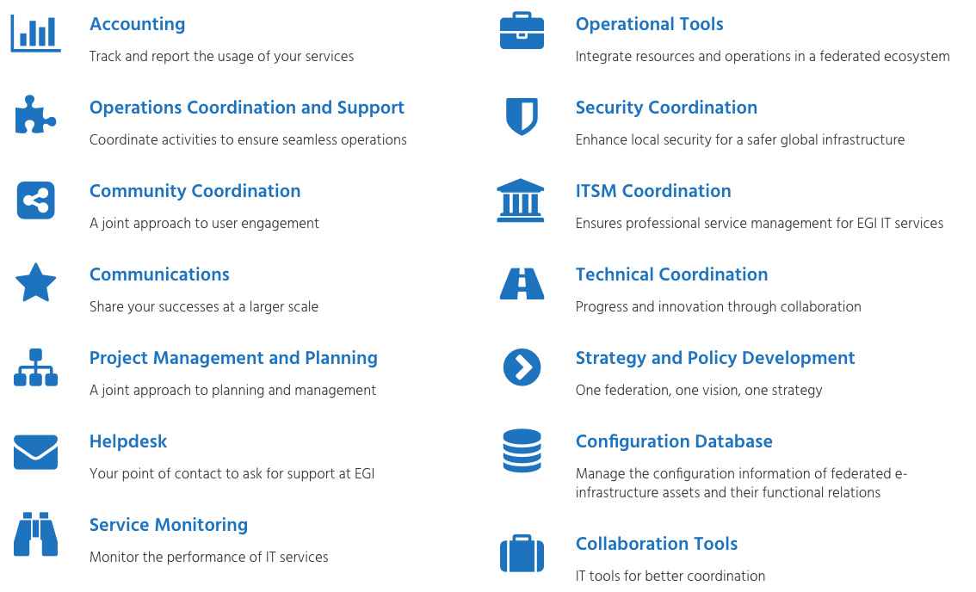
Internal Services Catalogue for members of the Federation
Internal services
http://go.egi.eu/ServiceCatalogue

Slide 15
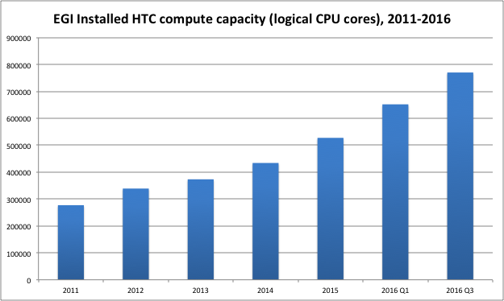
Installed compute capacity trends 2011-2016

Slide 16
EGI Federated Cloud participants
As of | Number of resource centres
2016 | 23 (+3 integrations in progress)
Cloud management system | Number of resource centres
OpenStack | 15
Open Nebula | 6
Synnefo | 1
Notes:
Total of 6k cores

Slide 17
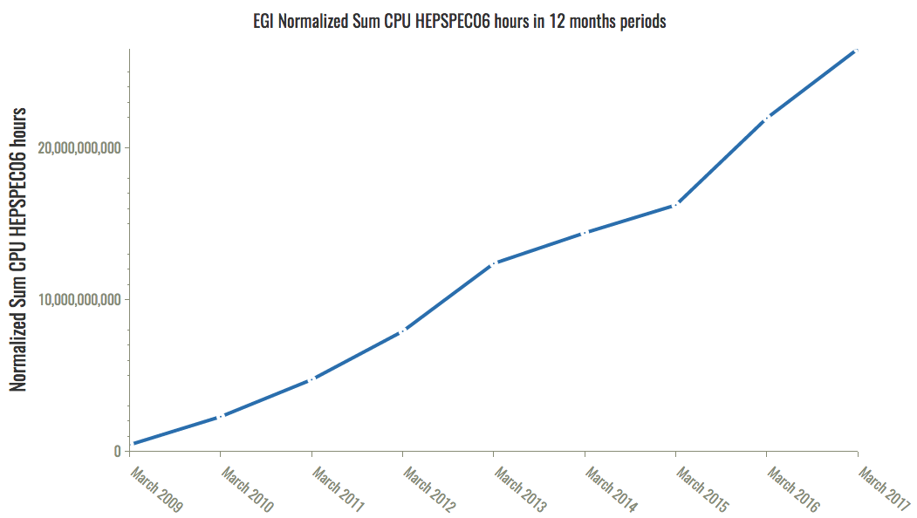
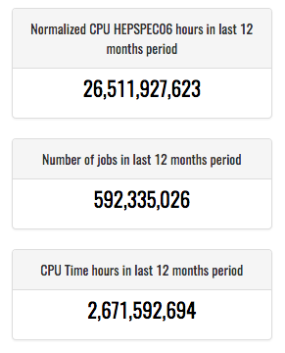
HTC usage trends 2009-2017

Slide 18
E-Infrastructure support to Research e-Infrastructures
and Large Research Collaborations
A mandatory requirement
for sustainability

Slide 19
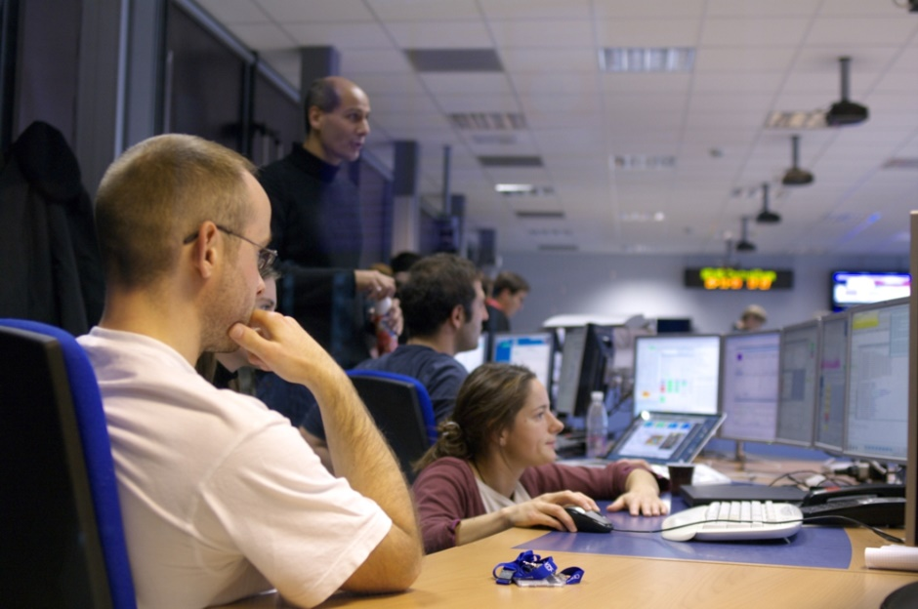
WLCG: Online Storage and Data Transfer at unprecedented scales
In 2016, the Worldwide LHC Computing Grid (WLCG) transferred on average 80 Petabytes of data per month.
This corresponds to more than 1 billion files per month transferred to thousands of particle physicists working across the world.
ATLAS control room at CERN
WLCG provides computing and storage to the High Energy Physics experiments operating at CERN’s Large Hadron Collider

Slide 20
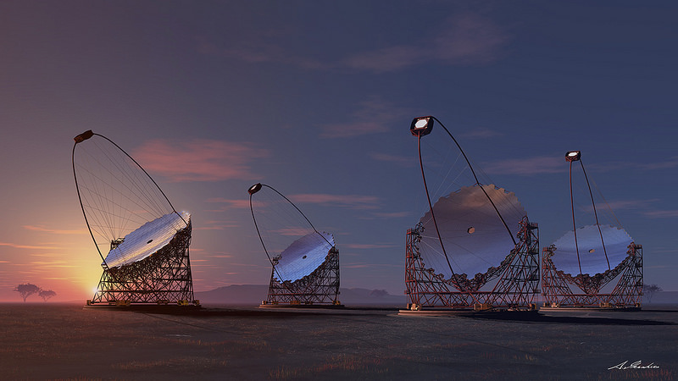
Cherenkov Telescope Array:
the world’s leading gamma-ray observatory
1350 scientists from 32 countries
CTA EGI usage (2013-2016):
360 million HS06 CPU hours
11 PB of data transferred
2 PB currently in storage
11 million compute jobs
Credit: Akihiro Ikeshita Mero-TSK
CTA uses EGI’s High-Throughput Compute and Online Storage services to manage its computational challenges during the array preparatory phase.
http://go.egi.eu/cta

Slide 21
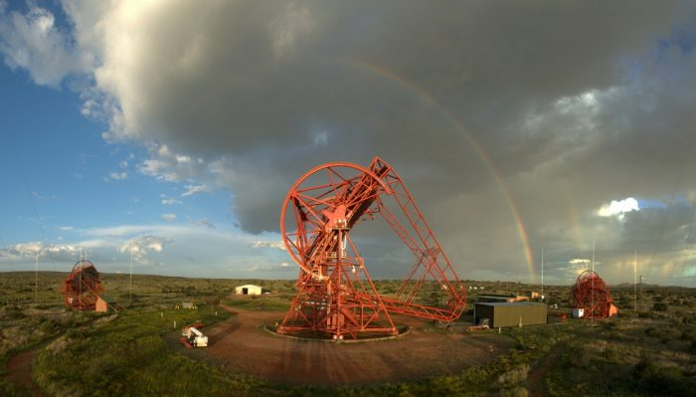
H.E.S.S. Experiment:
a window to the high energy universe
240 scientists from 14 countries
H.E.S.S. EGI usage (per year):
38 million HS06 CPU hours
2,000 compute jobs running at any given time
Credit: Julien Bolmont / Collaboration HESS / CNRS Photothèque
H.E.S.S. uses EGI’s High-Throughput Compute service to run massive Monte Carlo simulations from the data collected in their observatory in Namibia.
http://go.egi.eu/hess

Slide 22
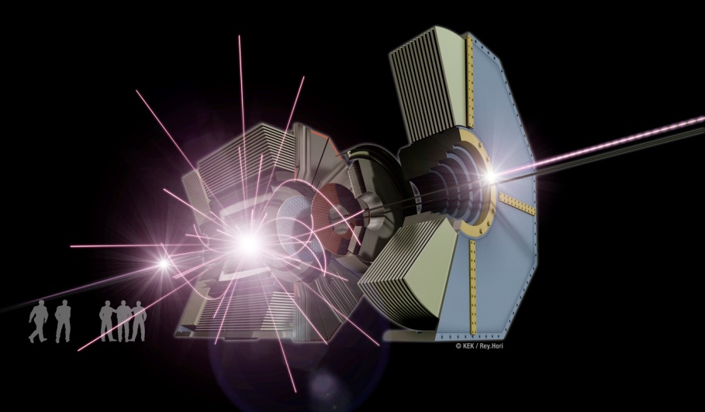
Belle II: Finding the balance between
matter and antimatter
700 scientists from 23 countries and regions
Belle II EGI usage (2009-2016):
~1.61 billion HS06 CPU hours
~16.4 million submitted jobs
Credit: Julien Bolmont / Collaboration HESS / CNRS Photothèque
The Belle II experiment (based at the SuperKEKB accelerator in Japan) was set up to search for a new mechanism for the CP violation beyond the Kobayashi-Maskawa theory.
http://go.egi.eu/belle

Slide 23
Applications, tools and platforms for science
Break silos and provide services
for the whole research lifecycle

Slide 24
HADDOCK portal – Structural Biology
For modelling the structure of proteins and other molecules
Scientists input their data and specifications; HADDOCK returns best fit simulations.
So far, HADDOCK processed over 130,000 submissions from more than 7,500 scientists.
HADDOCK relies on EGI’s High-Throughput Compute service
https://www.egi.eu/use-cases/scientific-applications-tools/haddock/

Slide 25
VIP portal – Medical Imaging
For medical simulation and image data analysis
VIP allows life scientists to use complex computational tools with no added IT overhead.
VIP relies on EGI’s High-Throughput Compute service and the DIRAC instance provided by France Grilles
http://go.egi.eu/vip

Slide 26
Chipster - Bioinformatics
For genomic analysis
A user-friendly analysis software for high-throughput data with over 350 analysis tools and a large collection of reference genomes
Users can save and share automatic analysis workflows, and visualize data interactively
http://chipster.csc.fi/
Research story:
http://go.egi.eu/BIBD

Slide 27
EGI and e-Infrastructures towards EOSC

Slide 28
e-Infrastructure collaborations and challenges
Opportunities
Joint efforts in outreach and technical support
Digital Infrastructure for Research annual conference, DI4R 2016
Integration of access policies, AAI and connect compute/data preservation services into a single pan-European catalogue
EGI/EUDAT Joint bid for EINFRA-12 (A) H2020 call, 30 MEuro
ICT cross-border procurement and purchase agreement framework
How to procure services on e-Infrastructures and other suppliers?
Governance of e-Infrastructures
Challenges
Establishment of national e-Infrastructures involving all key players
Sustained national funding for the ICT needs of data-driven research

Slide 29
e-Infrastructure and EOSC
EOSC-hub project proposal for evaluation in H2020 EINFRA-12 (A), 30 Meuro
EOSC-hub mobilises providers from the EGI Federation, EUDAT CDI, INDIGO-DataCloud and major research e-infrastructures offering services, software and data for advanced data-driven research and innovation. These resources are offered via the Hub – the integration and management system of the European Open Science Cloud, acting as a single entry point for all stakeholders

Slide 30
e-Infrastructure and EOSC/cont
20 major European initiatives, besides EGI and EUDAT:
BBMRI, CLARIN, CMS, DARIAH, ECRIN, EISCAT, ELIXIR, EPOS, ICOS/eLTER, LifeWatch, LOFAR
Research collaborations: disaster mitigation/APAN WG, ENES, EO pillar/ESA, GEOSS/GEO Secretariat, ITER, LNEC, Marine, WeNMR.

Slide 31
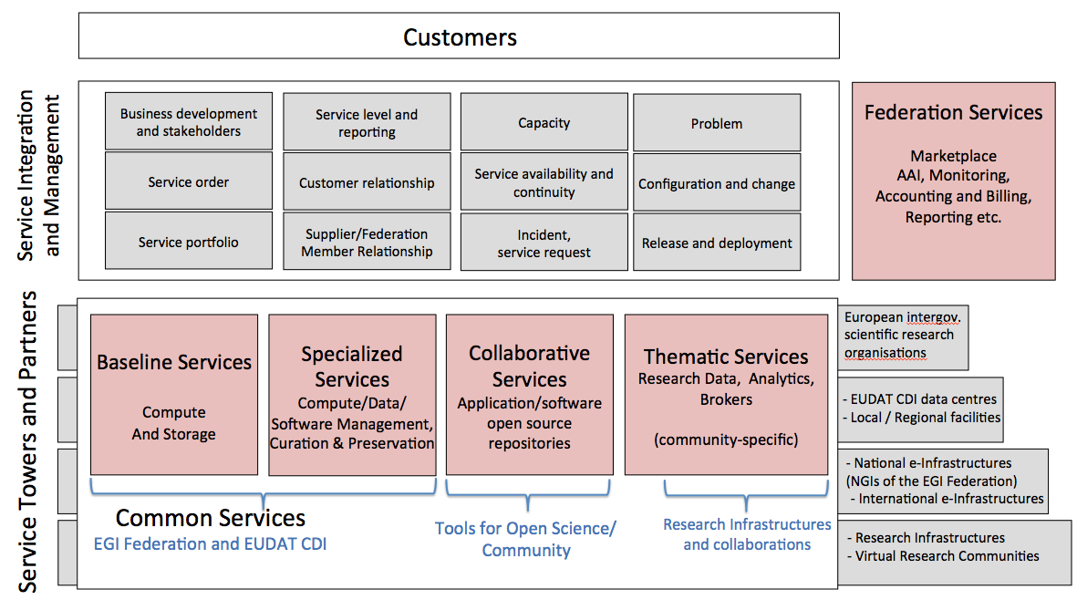
e-Infrastructure and EOSC/cont

Slide 32
Discover more
Visit https://www.egi.eu/
Services https://www.egi.eu/services/
Publications https://www.egi.eu/about/publications/
Contact us:
For public institutions: contact@egi.eu
For private organisations: business@egi.eu

