Slide 1
The Road Towards A Production Quality Federated Cloud Infrastructure In Europe
Dr David Wallom
Chair EGI Federated Cloud Task Force
Associate Director, Oxford eResearch Centre, University of Oxford
david.wallom@oerc.ox.ac.uk

Slide 2
Outline
EGI, new challenges and cloud computing.
Learning from other projects and activities.
Federation model objectives, deliverables, mandate and membership.
Standards and core infrastructure services.
Federation test bed.
Use cases.
Conclusions.

Slide 3
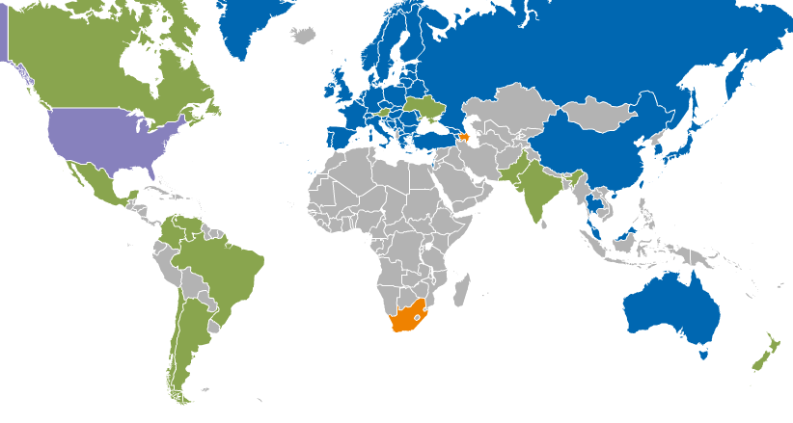
Operational Infrastructure
Registered Users: 21714 VOs: 233
LCPUs: 470,000 Disk: 143PB Tape: 138PB
Jobs: 1.62 million/day
Resource Centres | EGI-InSPIRE & EGI Council members | 319
 | Including integrated RPs | 351
Countries | EGI-InSPIRE & EGI Council members | 42
 | Including integrated RPs | 54
Integrated EGI-InSPIRE Partners and EGI Council Members
External Resource Providers (integrated)
Internal/External Resource Providers (being integrated)
Peer Resource Providers
Thanks to Steven Newhouse

Slide 4
EGI New Challenges and Cloud Computing
New communities and application design models
Need for long running services (not only jobs).
Workflows that integrate local and remote systems.
Integrating community-specific resources (sensors, antennas, repositories, ...).
Since ~2010 the trend has been for resource providers to move Grid middleware in virtualised environments.
portals
custom services
portals
dev env
dev env
grid middleware
grid middleware
hypervisor
OS
OS
OS
OS
OS
OS
OS
OS
hardware
hardware

Slide 5
EGI New Challenges and Cloud Computing
Personalised environments for individual research communities in the European Research Area.
Community Services
Community
Services
Globus
EGI.eu Coordination
Core software and support
Community
Platform
dCache
gLite
ARC
Globus
UNICORE
NGI
VM Mgmt
Data
Image Sharing
VM Mgmt
Data
Image Sharing
VM Mgmt
Data
Image Sharing
NGI
NGI
Commercial
IaaS
Monitoring
Accounting
Notification
Monitoring
Accounting
Notification
Monitoring
Accounting
Notification
Monitoring
Accounting
Notification
EGI-wide message bus

Slide 6
Flexible Services for the Support of Research (FleSSR) – 2008 -> 2011
6 Partners
Academic and industrial;
3 cloud infrastructures.
Goals
Building federated cloud infrastructure, extending the use of UK NGS central services with cloud brokering and accounting.
Use cases
Multi Platform Software Development;
On demand Research data storage.

Slide 7
FleSSR Infrastructure assumptions & Architecture
Local/Global: services depends either on local or global access. Cloud brokering is not mandatory for AWS-like service access;
Multiple identities: every user may have multiple identities, both local and global;
Only personal identities: group identities are not implemented. The management of every single identity is left to the legally responsible user;
Multiple AA technologies: AA may differ depending on local and global policies/technologies;
Multiple accounting: every single identity is accounted for its usage. Every individual may get multiple invoices.
Zeel/i Broker
Oxford
Reading
STFC/NGS Accounting Database
Eduserv

Slide 8
FleSSR Use Cases
Zeel/i Broker
Instance configuration manager
Build manager
CVS / SVN repository
FleSSR cloud
On demand Research data Storage
- Management of multiple storage volumes
Build instance 1
Build instance 2
Build instance 3
Build instance 4
Build instance 5
Zeel/i Broker
Volume Manager
Multi Platform Software Development
- Management of multiple VM instances
FleSSR cloud
EBS Volume
VM EBS Interface

Slide 9
EGI Federation Model
Standards and validation: emerging standards for the interfaces and images – OCCI, CDMI, OVF.
Resource integration: Cloud Computing to be integrated into the existing production infrastructure.
Heterogeneous implementation: no mandate on the cloud technology.
Provider agnosticism: the only condition to federate resources is to expose the chosen interfaces and services.
User Communities
User Communities
User Communities
Federated interfaces
Federated services
Cloud Management
Cloud Management
Cloud Management
Cloud Management
Cloud Management
Hardware
Hardware
Hardware
Hardware
Hardware

Slide 10
EGI Task Force Federated Clouds
User Communities
Stakeholders
Resource Centres offer Cloud services
Technology Providers tender solutions
User communities Consume cloud services
6 scenarios = 6 key federated cloud capabilities
Manage VM instances
Data access/transfer interface
Cloud service information federation
Resource consumption management
Cloud service availability
Notification & Automation
consume
offer
Resource Centre
tender
Cloud Management Technology Provider
appoint
10 scenarios = 10 key federated cloud capabilities
Federated AAI
VM Image Management
Brokering
Contextualisation

Slide 11
Objectives and Deliverables
Engagement: identify and work with resources providers, technology providers, and user communities.
Integration: integration of cloud resources within EGI’s production infrastructure – e.g. monitoring, accounting and information publishing.
Recommendations: identify issues that need to be addressed by other areas of EGI – e.g. policies, operations, support and dissemination.
Blueprint document: advice/full documentation to resource providers/users on how to engage with the federated virtualised environment. A living document on the EGI Wiki.
Test bed: implement interfaces and services for a federated cloud on the basis of the Task Force blueprint and the available standards and technologies.

Slide 12
Task Force Mandate and Organisation
Mandate: 18 months, September 2011 – March 2013.
Activities: divided into 3 blocks of 6 months each.
Workgroups:
working units within the Task Force.
Investigate a specified set of capabilities for a federation of clouds.
Have leaders and collaborators.
Workbenches: sections of the TF Wiki site collecting and documenting the activities of each workgroup.
Meetings: weekly conference call. F2F every 3 months.
https://wiki.egi.eu/wiki/Fedcloud-tf

Slide 13
Task Force – Apr 2013
Cyfronet
FZJ
OeRC
EGI.eu
CESNET
GWDG
TUD
CNRS
IN2P3
Technologies
OpenNebula.
StratusLab.
OpenStack.
Synnefo.
WNoDeS.
KTH
Members
70 individuals (+17%).
40 institutions (+34%).
13 countries (=).
Masaryk
FCTSG
INFN
CETA
CESGA
IGI
SARA
RADICAL
Stakeholders
22 Resource Providers (+46%).
10 Technology Providers (+42%).
7 User Communities (+40%).
4 Liaisons (+33%).
IFCA
STFC
SZTAKI
BSC
GRNET
Imperial
DANTE
LMU
IPHC
IISAS
SixSq
100%IT
IFAE
SRCE
Notes:
Problem to face: people do not want to do any work. Gamification = making everything into games, competitive spirit. Try to think about a way to publish metrics of merit and work done.

Slide 14
OCCI
Open Cloud Computing Interface
an API and RESTful standard protocol for IaaS, PaaS and SaaS cloud management.
>20 OCCI implementations in a variety of products, including OpenNebula, RESERVOIR, SLA@SOI, INFN, Aurenav, CloudCentral, Emotive, BigGrid, the Claudia Project, SSF, Morfeo, libvirt, jClouds, CompatibleOne, and R2AD™. Production implementation for OpenStack Essex Release

Slide 15
CDMI
Cloud Data Management Interface
CDMI is a open standard for cloud storage
Defines client-to-cloud and cloud-to-cloud interactions
Defines object semantics for content stored in the cloud
15

Slide 16
GLUE 2
Originally an information model for Grid entities
A conceptual model, designed to be independent of data models adopted for its implementation.
Rendered to concrete data models such XML Schema, LDAP Schema
Definition of EGI GLUE 2 profile
Detailed semantics, extension to the schema definitions
Classification attributes by use case and importance
Information validation criteria
GOCDB GLUE 2 XML rendering of the EGI service registry and participation to OGF standardization activities

Slide 17
Usage Record rd 2.0
Representation of data on the consumption of resources using an XML schema
Usage Record 2.0/OGF
EMI CAR (Compute Accounting Record)/CPU and cloud
EMI StAR (Storage Accounting Record)
EMI Secure STOMP Messenger v1.2 (June 2012) and 2.0 (March 2013)

Slide 18
Open Virtualisation Format
Distributed Management Task Force (DMTF) standard
Open, secure, portable, efficient and extensible format for the packaging and distribution of (collections of) virtual machines
Its goal is to facilitate the automated, secure management not only of virtual machines, but the appliance as a functional unit
It is platform independent, hypervisor independent , and processor architecture independent
VMs in OVF can be packaged in a virtual appliances suited all wrapped up in a single file. The creator of the appliance can encrypt, compress and digitally sign OVF content
It is packaging standard and not a runtime standard
Uses existing packaging tools to combine one or more virtual machines together with a standards-based XML wrapper

Slide 19
EGI’s Core Infrastructure
The services that federate and integrate the functional services deployed in the production infrastructure
EGI Core Infrastructure Platform
Information
Discovery
(BDII)
Federated AAI
Monitoring
Accounting
Metrics
Visualisation
(gstat)
Service
Catalogue
(GOCDB)
Messaging
Operations Portal
Thanks to Steven Newhouse

Slide 20
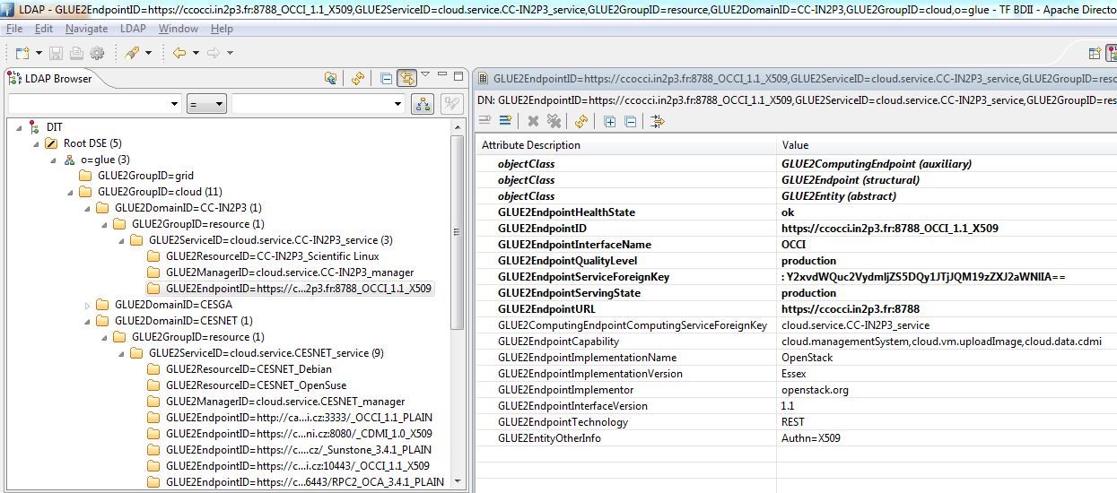
Services
Information system. Each cloud infrastructure exposes a LDAP server publishing information by means of a customised GLUE2 schema. Each LDAP server is polled by a top-BDII server.
ldap://test03.egi.cesga.es:2170

Slide 21
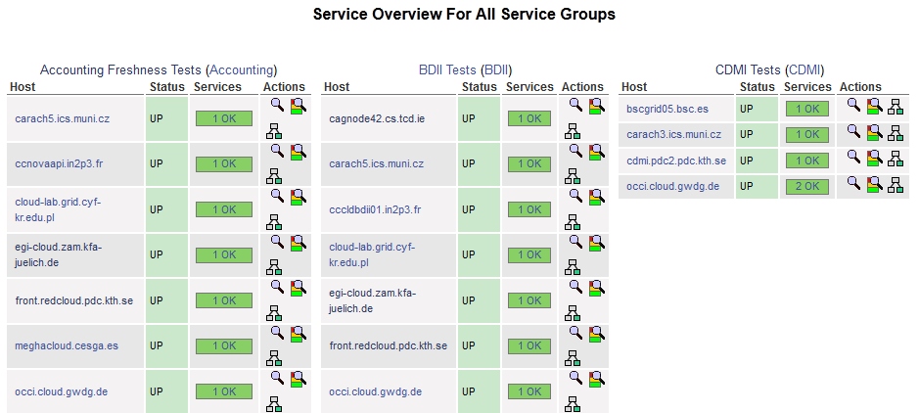
Services
Monitoring. A standard Nagios installation is used to monitor the availability of the management interfaces exposed by each cloud infrastructure. Probes to test the state of the federated services are under development.
https://test30.egi.cesga.es/nagios/

Slide 22
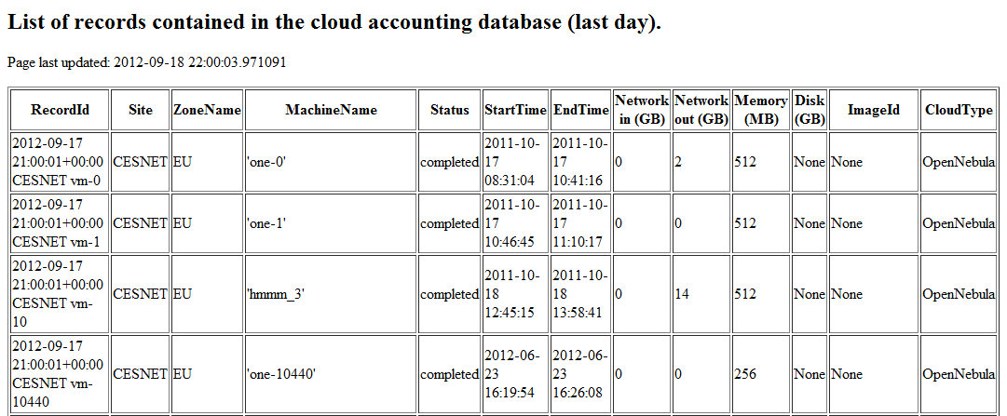
Services
Accounting. Each cloud infrastructure generates usage records based on an extended version of the EGI UR format recommendation. Records are uploaded to a central server by means of a client customised for each type of infrastructure.
http://goc-accounting.grid-support.ac.uk/cloudtest/vms.html

Slide 23
EGI’s Cloud Infrastructure
EGI Collaboration Platform
EGI Cloud Infrastructure Platform
VM
Mgmt
Storage
Mgmt
Information
Image Repository
Cloud Management Stacks
(OpenStack, OpenNebula, …)
Image Metadata Marketplace
EGI Core Infrastructure Platform
Federated AAI
Central Service
Registry
Monitoring
Accounting
Thanks to Steven Newhouse

Slide 24
Task Force Deliverables
FedCloud test bed
https://wiki.egi.eu/wiki/Fedcloud-tf:Testbed
Blueprint document
https://wiki.egi.eu/wiki/Fedcloud-tf:Blueprint
Notes:
Scenario 7 Federated AAI Scenario 8 VM Marketplace

Slide 25
Federation Test bed: Set Up – March 2012
VM Mngmt
OCCI 1.1
Information
GLUE 2.0+
LDAP/BDII
AAI
Login/Passwd
Resource Providers
OpenNebula
curl
Data
CDMI 1.0
Monitoring
Nagios
Accounting
OGF UR+
Message Bus

Slide 26
Federation Test bed: Consolidation – September 2012
VM Mngmt
OCCI 1.1
VM sharing
Marketplace
Information
GLUE 2.0+
LDAP/BDII
AAI
X509
Resource Providers
OpenNebula, OpenStack
curl
Data
CDMI 1.0
Monitoring
Nagios
Accounting
OGF UR+
Message Bus

Slide 27
Federation Test bed: Integration – April 2013
VM Mngmt
OCCI 1.1
VM sharing
Marketplace
Information
GLUE 2.0+
LDAP/BDII
AAI
X509
Resource Providers
OpenNebula, OpenStack, WNoDeS
curl
Data
CDMI 1.0
Monitoring
Nagios
Accounting
OGF UR+
Message Bus

Slide 28
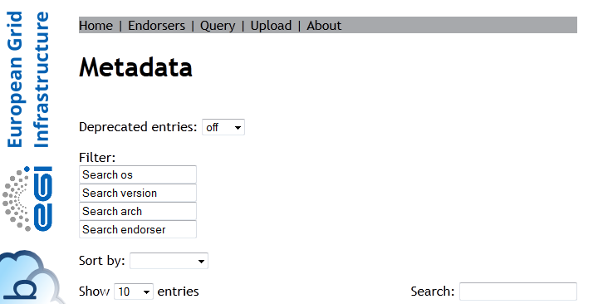
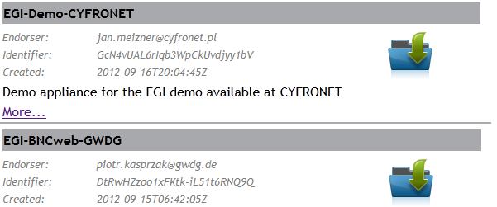
Cloud Services
Marketplace. A repository were Resource Providers and EGI can publish metadata about images from which virtual machines can be instantiated. When needed, a single image can be signed and then endorsed by multiple providers.
http://marketplace.egi.eu/metadata/
Notes:
VM Marketplace with restricted access for licensed software concerns

Slide 29
Federation Test bed – April 2013
FedCloud Core Services
EGI Production Infrastructure
AAI
VOMS Proxy
Image Metadata
Marketplace
Service Availability
SAM
User Interfaces
Appliance
Repository
Configuration DB
GOCDB
OCCI Clients
rOCCI; WNoDeS-CLI
CDMI Clients
Libcdmi-java
Information System
Top-DBII
Accounting
APEL
Resource Providers
VOMS proxy
OpenNebula
OpenStack
StratusLab
WNoDeS
SSM
Monitoring
Nagios
External Services
OCCI server
Vmcatcher
Vmcaster
Certification Authorities
VO
VOMS server
CDMI server
Marketplace client
LDAP
Notes:
SSM = Secure Stomp Messenger. SSM was designed as a way of using python and STOMP to securely and reliably send messages from APEL clients to the APEL server. It is designed to use the EGI broker network, but should be compatible with any stomp broker.

Slide 30
Cloud Federation Test bed – Future
EGI Production Infrastructure
AAI
Service Availability
SAM
VOMS Proxy
FedCloud Services
Configuration DB
GOCDB
User Interfaces
Image Metadata
Marketplace
OCCI Clients
rOCCI; WNoDeS-CLI
CDMI Clients
Libcdmi-java
Accounting
APEL
Appliance
Repository
Resource Providers
Information System
Top-DBII
VOMS proxy
OpenNebula
OpenStack
StratusLab
WNoDeS
SSM
External Services
OCCI server
Vmcatcher
Vmcaster
Certification Authorities
Monitoring
Nagios
CDMI server
Marketplace client
LDAP
VO
VOMS server
Notes:
SSM = Secure Stomp Messenger. SSM was designed as a way of using python and STOMP to securely and reliably send messages from APEL clients to the APEL server. It is designed to use the EGI broker network, but should be compatible with any stomp broker.

Slide 31
Integration of new technologies – April 2013
VOMS server – PERUN
System for managing VOs, users, resources and services. Currently, 32 VOs, 1900+ users, 1800+ machines, 20+ services. http://perun.metacentrum.cz
OCCI client/server implementations
rOCCI: Developed in Ruby by CESNET and GWDG, offers a server implementation of OCCI 1.1 for OpenNebula and StratusLab and a client compatible also with the OpenStack OCCI server.
WNoDeS-CLI: developed in Python at INFN/CNAF, it leveraging the EGI core services and offers interoperability across WNoDeS, OpenNebula and OpenStack. Designed as a back-end for a web-based portal.
Image management backend – Vmcaster/catcher
System to distribute, download, endorse, update OS images across multiple resource providers. Used as backend image management system.
Notes:
rOCCI: Florian Feldhaus, Piotr Kasprzak, Boris Parak
WNoDeS-CLI: Elisabetta Ronchieri
PERUN:
System for managing virtual organizations, users, resources and services
Currently manages: 32 VOs, >1900 users, >1800 machines, >20 services
More info on web page http://perun.metacentrum.cz or e-mail perun@cesnet.cz

Slide 32
FedCloud Test Bed Use Models
NB: Users = researchers
IaaS for power users
Comparable experience to ec2-api-tools, euca2ools.
Command line interface for easy scripting and integration with workflow.
Multiple language bindings to create a developer-oriented ecosystem.
IaaS as a backend
Promote uniform OCCI server implementations.
Facilitate the development of connectors and shims.
Platforms.
IaaS for end users
Portals. Upcoming IGI portal + SlipStream EGI mini project.
Community services.

Slide 33
Demo Use Cases – September 2013
BNCweb (CLARIN)
Interface to the British National Corpus (100ml words).
Used in a wide variety of computational linguistic applications.
Searching the text and exploiting the detailed textual metadata.
Open source project, freely available for educational and research purposes.
Use cases
Teaching a masters course in 'Exploring English Usage' in October-November 2012, and 'Corpus Linguistics' in February-March 2013.
Federated search in the CLARIN European e-Infrastructure.
Build additional web services on top of BNCWeb, e.g. adding improved visualizations of the search results.

Slide 34
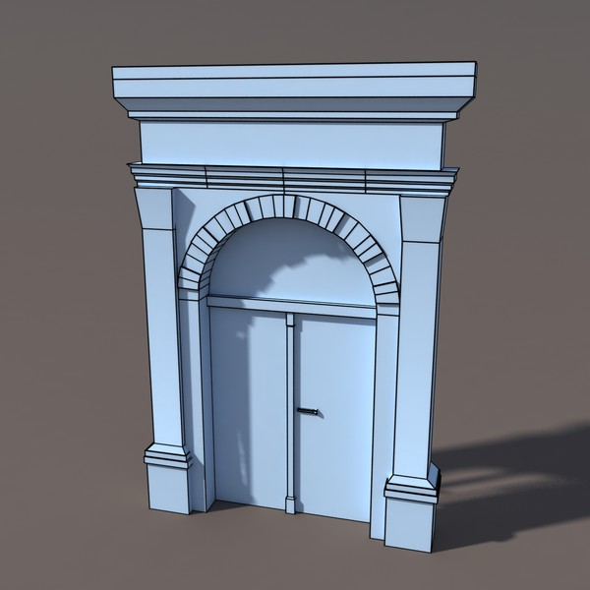
EU Federated IaaS Cloud for CLARIN and BNCWeb
1st line infrastructure
2nd line Community support
Resource Discovery Service
Federated Cloud
SSO
Community Tools as Virtual Machines in Marketplace
Linguistic Datasets and corpa

Slide 35
Use Cases – April 2013
WeNMAR – Structural Biology
Validating biomolecular NMR structures. VM images pre-packaged with VirtualCing and ToPoS.
Training. VM images pre-packaged with Gromacs.
BioVel/OpenBio – Ecology
remote hosting of OpenModeller service.
OpenModeller + Venus-C COMPS + FedCloud test bed.
WS-PGRADE/gUSE – Software Engineering
User support environment for grid and clouds + GUI.
Flexible deployment of virtualised DCI to run predefined, repeatable tests.

Slide 36
Power User
Resource Provider
GWDG
OCCI 1.1
Certification Authority
CDMI 1.0
Resource Provider
CESNET
OCCI 1.1
CDMI 1.0
VOMS
PERUN
Resource Provider
IISAS
OCCI 1.1
User(s)
VOMS
SSH key
[OS image]
OCCI client
Appliance Repository
Resource Provider
KTH
OCCI 1.1
Information
LDAP
Resource Provider
CESGA
OCCI 1.1
Monitoring
Nagios
Resource Provider
BSC
CDMI 1.0
VM metadata
Marketplace
Resource Provider
FZJ
OCCI 1.1
Accounting
APEL
Resource Provider
LAL
OCCI 1.1
OCCI 1.1
Resource Provider
INFN/CNAF

Slide 37
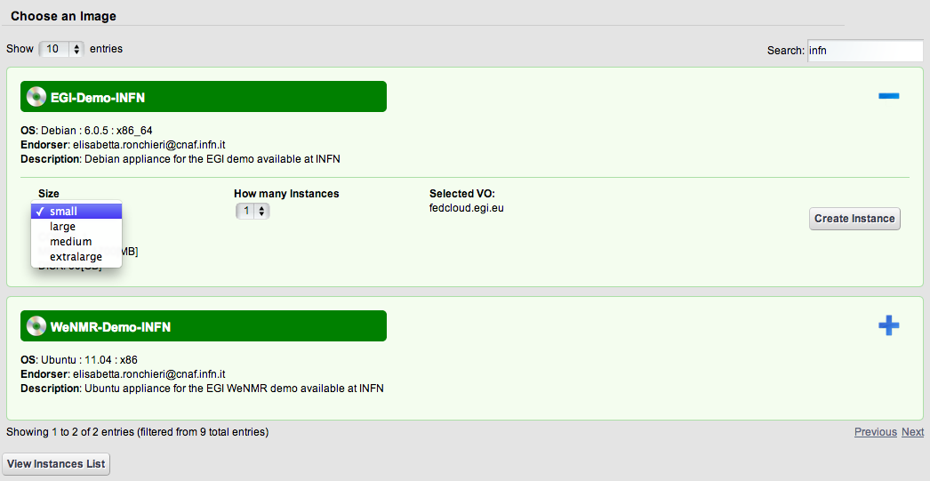
Services for the End User

Slide 38
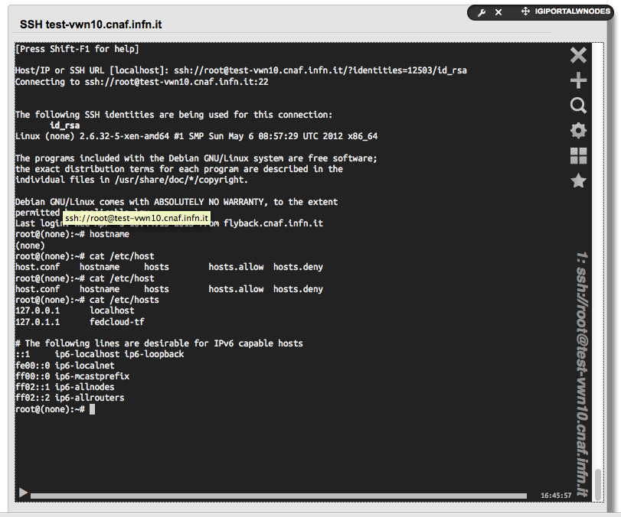
Services for the End User

Slide 39
Federation View – Image Management
Resource Provider
GWDG (ON/OS)
MP client
Vmcstr/ctchr
Resource Provider
CESNET (ON)
MP client
Vmcstr/ctchr
Appliance Repository
Resource Provider
CYFRONET (ON)
MP client
Vmcstr/ctchr
Resource Provider
KTH (ON)
MP client
Vmcstr/ctchr
VM metadata
Marketplace
Resource Provider
CESGA (ON)
MP client
Vmcstr/ctchr
Resource Provider
BSC
ON = OpenNebula.
OS = OpenStack.
WN = WNoDeS.
MP = Marketplace.
Resource Provider
FZJ (OS)
MP client
Vmcstr/ctchr
Resource Provider
LAL (SL)
MP client
Vmcstr/ctchr
Resource Provider
INFN/CNAF (WN)
MP client
Vmcstr/ctchr

Slide 40
Federation View – Monitoring
SSM
Resource Provider
GWDG (ON/OS)
OCCI
BDII
CDMI
SSM
Resource Provider
CESNET (ON)
OCCI
BDII
CDMI
SSM
Resource Provider
CYFRONET (ON)
OCCI
Configuration DB GOGDB
BDII
SSM
Resource Provider
KTH (ON)
OCCI
BDII
Monitoring
Nagios
SSM
Resource Provider
CESGA (ON)
OCCI
BDII
Resource Provider
BSC
CDMI
SSM
Resource Provider
FZJ (OS)
OCCI
BDII
SSM
Resource Provider
LAL (SL)
OCCI
ON = OpenNebula.
OS = OpenStack.
WN = WNoDeS.
BDII
SSM
Resource Provider
INFN/CNAF (WN)
OCCI
BDII
Notes:
Cloud Data Management Interface (CDMI)
Open Cloud Computing Interface

Slide 41
Federation View – Accounting
Resource Provider
GWDG (ON/OS)
SSM
Resource Provider
CESNET (ON)
SSM
Resource Provider
CYFRONET (ON)
SSM
Configuration DB GOGDB
Resource Provider
KTH (ON)
SSM
Accounting
APEL
Resource Provider
CESGA (ON)
SSM
Resource Provider
Venus-C
SSM
ON = OpenNebula.
OS = OpenStack.
WN = WNoDeS.
SSM = Secure Stomp Messenger.
Resource Provider
FZJ (OS)
SSM
Resource Provider
LAL (SL)
SSM
Resource Provider
INFN/CNAF (WN)
SSM

Slide 42
Federation View – Information Publishing
Resource Provider
GWDG (ON/OS)
LDAP
Resource Provider
CESNET (ON)
LDAP
Resource Provider
CYFRONET (ON)
LDAP
Configuration DB GOGDB
Resource Provider
KTH (ON)
LDAP
Information System
TOP-BDII
Resource Provider
CESGA (ON)
LDAP
Resource Provider
Venus-C
LDAP
ON = OpenNebula.
OS = OpenStack.
WN = WNoDeS.
Resource Provider
FZJ (OS)
LDAP
Resource Provider
LAL (SL)
LDAP
Resource Provider
INFN/CNAF (WN)
LDAP

Slide 43
Conclusions
End of the first mandate
From a Task Force to an official Task within EGI-InSPIRE.
Towards production-grade cloud resources within the EGI infrastructure:
EGI mini-projects and further development of deployed technologies;
transition into EGI operations.
Biggest challenges:
contextualisation;
consistent OCCI client/server implementations –> cloud profile
data.
Focusing on use cases and early adopters:
dedicated user support;
policies for tailored image management and support;
SLA.
Next Phase – September 2013 – Pre-production

Slide 44
EGI’s Grand Vision
Establish by 2020 a distributed open compute and data infrastructure comprising a 10M Core Federated Cloud and 10 Exabyte of Federated Cloud Storage across Europe that is able to support the data analysis activities of all researchers within the European Research Area
EGI Council Discussion – June 2013

Slide 45
With thanks to…
Matteo Turilli
Zeeshan Ali Shah
Viet Tran
Sandor Acs
Björn Hagemeier
Emir Imamagic
Alison Packer
Piotr Kasprzak
Owen Synge
Mattieu Puel
Ivan Diaz Alvarez
Michel Drescher
Mohammed Airaj
Jan Meizner
Peter Solagna
Boris Parak
Daniele Lezzi
Alvaro Simon
John Gordon
Kostas Koumantaros
Elisabetta Ronchieri
Andy Edmonds
Florian Feldhaus
Ilja Livenson
Roberto Rosende Dopazo
Michel Jouvin

Slide 46
Thank you
Task Force resources
Mailing List: fedcloud-tf@mailman.egi.eu
Wiki site: http://go.egi.eu/tf-fedclouds
GitHub: https://github.com/EGI-FCTF
Indico site: https://www.egi.eu/indico/categoryDisplay.py?categId=56
Contact the chair: david.wallom@oerc.ox.ac.uk

