Slide 1
EGI Change Management (CHM) An Introduction
Matthew Viljoen
26 Oct 2016

Slide 2
Contents
Background
Why is CHM and why bother?
The policy, scope and process
Request for Change
Implementation
Final thoughts

Slide 3
Background
EGI Foundation:
Aim is to obtain ISO 9001/20001 certification
Using RT to track (rather than approve) changes for some time
Myself:
6yrs working at RAL (WLCG Tier1) serving HEP community
Involved in introduction/refining of CHM at RAL Tier1*
Experienced pitfalls and problems with adoption of CHM
Proposing EGI CHM based on RAL Tier 1 process
* key people: Andrew Sansum, Gareth Smith, STFC

Slide 4
What is CHM and why bother?
A lightweight process based on peer review of changes which helps to ensure:
changes are well thought through, planned and
risks are understood (and mitigated against)
Some benefits:
Improve quality of service for end users
Continuous improvement for EGI
Helps coordination of dependent service delivery
Spreads know-how, prevents “islands of knowledge”
Collective responsibility of major decisions

Slide 5
The policy, scope and process
All ‘high risk’ changes are under scope (or lower risk changes that would benefit by the process) affecting production services listed in the EGI Service Catalogue
Changes are assessed and approved by the Change Advisory Board (CAB) prior to implementation.
A Request for Change (RfC) is filled in for each change (standard series of questions)
Recurrent changes may be classified as standard changes or pre-approved changes, not needing explicit approval by CAB on subsequent occassions
Emergency changes may be applied without prior assessment and approval (but they need to be recorded and reviewed)

Slide 6
Calculation of Risk
Risk = Likelihood x Impact
LIKELIHOOD
IMPACT
Rating | Description
1 | Unlikely
2 | Possible
3 | Likely
4 | Almost Certain
Rating | Description
1 | Minor
2 | Moderate
3 | Major
4 | Catastrophic
see: https://wiki.egi.eu/wiki/EGI-Engage:Risk_Plan for more details
Risks:
=<4 can be approved by the Service Owner
>4 needs to be assessed by the CAB
Any change of Impact = Catastrophic need to be assessed by the SSB

Slide 7
Normal change workflow
Step # | Responsible | Action
1 | Change Owner | Fills in RfC and creates ticket in RT
2 | Service Owner | Assesses level of risk. If risk =<4, approves the change which may then proceed
3 | CAB | If risk >4, assesses change and approves it.
4 | Change Owner | If appropriate, signs off the change by informing stakeholders
5 | Change Implementer | Implements the change
6 | CAB | Reviews and closes the change
https://confluence.egi.eu/display/IMS/CHM1+Manage+changes+including+emergency+changes

Slide 8
Standard (recurrent) change workflow
A standard change is first approved as a normal change. It may then be approved by the CAB to become a standard change, in which case it is added to the wiki in the list of standard changes for a particular service.
Step # | Responsible | Action
1 | Change Owner | Creates ticket in RT (no RfC necessary)
2 | Service Owner | Approves the change which may then proceed
3 | Change Owner | If appropriate, signs off the change by informing stakeholders
4 | Change Implementer | Implements the change
5 | Service Owner | Reviews and closes the change
https://confluence.egi.eu/display/IMS/CHM2+Maintain+the+list%2C+descriptions+and+step-by-step+workflows+for+well-known+and+recurring+changes

Slide 9
Emergency change workflow
An emergency change addresses a critical situation. These don’t require RfC or CAB approval but do need to be recorded and assessed.
Step # | Responsible | Action
1 | Change Implementer | Implements the change
2 | Service Owner | Creates a ticket in RT to record the emergency change and capture information about it
3 | CAB | Reviews and closes the change
https://confluence.egi.eu/display/IMS/CHM1+Manage+changes+including+emergency+changes

Slide 10
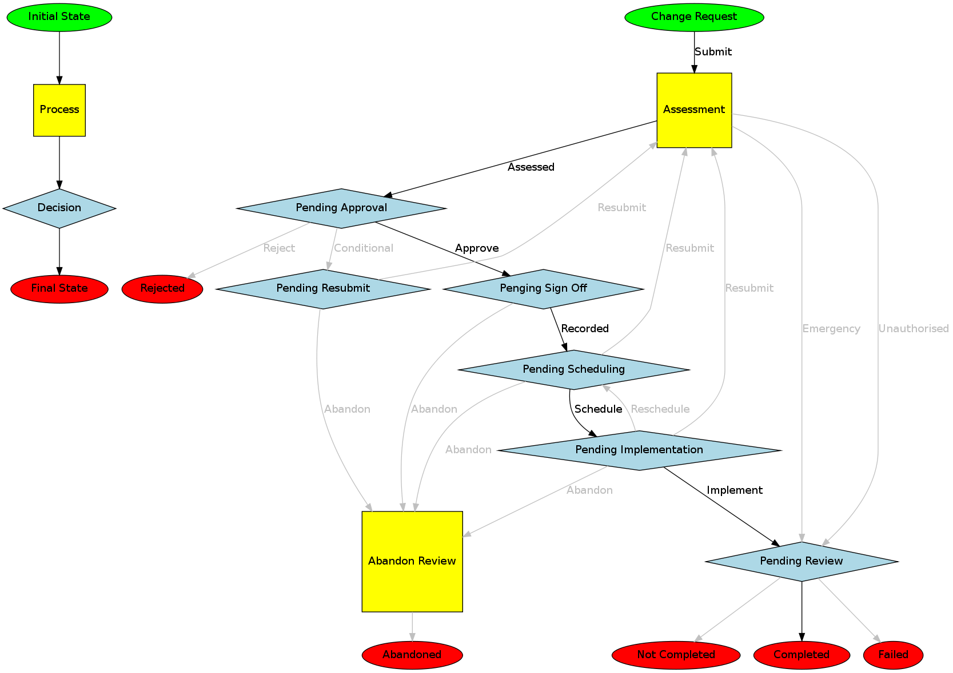
Normal change workflow diagram

Slide 11
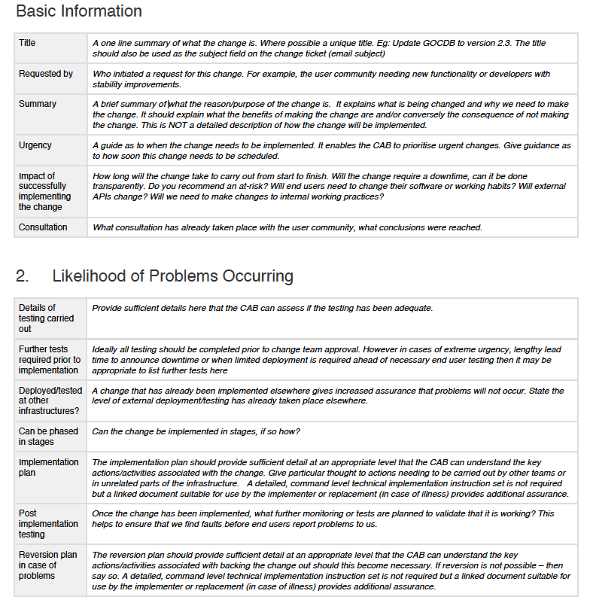
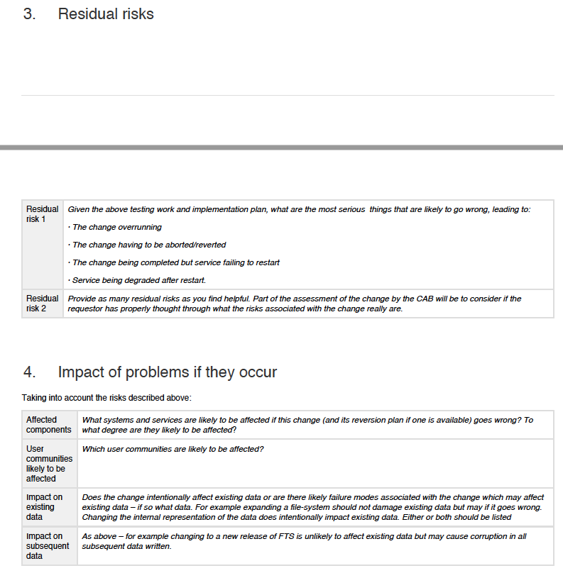
The Request for Change (RfC)

Slide 12
Implementation
Need to list services that will be under CHM
New queue for CHM in RT with custom fields (risk, status)
Convene regular CAB. Proposed membership:
Matthew Viljoen (Chair)
Peter Solagna
Tiziana Ferrari
Gergely Sipos
Diego Scardaci
Vincenzo Spinoso
CAB can meet up monthly, or on-demand to assess changes. Change owner present to introduce change
Identify first change (normal and standard) to be trialed through CHM
Populate the standard changes on the wiki

Slide 13
Final thoughts
Measuring the success of CHM:
During reviews, changes may be scored (e.g. successful, problematic, rolled back). These stats may be later analysed.
Potential problems:
Not engaging people in the process
Misunderstanding the process (“It’s unnecessary bureaucracy, a waste of my time”)
Important changes not going through CHM
Beware the ‘low risk’ changes!

