Slide 1
EGI-InSPIRE
Steven Newhouse
EGI.eu Director
EGI-InSPIRE Project Director

Slide 2
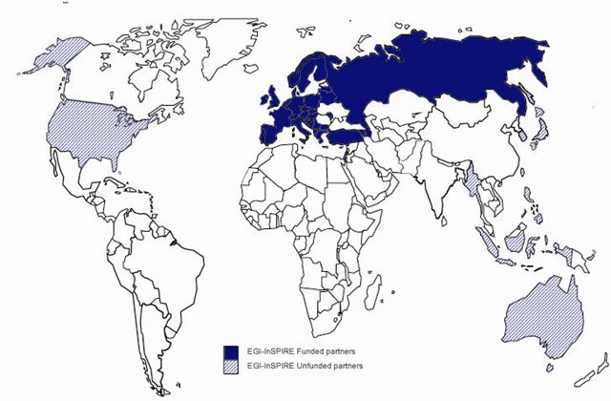
The EGI-InSPIRE Project
Integrated Sustainable Pan-European Infrastructure for Researchers in Europe
A 4 year project with €25M EC contribution
Project cost €72M
Total Effort ~€330M
Effort: 9241
Funded
Un-Funded
Project Partners (51)
EGI.eu, 40 NGIs, 2 EIROs
Asia Pacific (8 partners)

Slide 3
Key Challenges
EGI must provide an open, multi-disciplinary production infrastructure
Attract users from all communities
Provide the technology they need for their work
EGI must provide a cost effective solution
Solutions for data intensive science community
Add value beyond those offered by commerce
EGI is a federation of strong NGIs
Secure, interoperable network of resource providers

Slide 4
What will EGI initially focus on?
Continue to provide a secure reliable generic infrastructure
Integrate resources based on gLite, UNICORE, ARC, Globus, ...
Leverage new technologies to provide more flexibility to users
Support the user communities using the infrastructure
Assist and support the current EGEE communities
Engage with and support new structured communities
e.g. ESFRI projects
Improve the efficiency of the infrastructure
The number of jobs, users & data continue to increase
Utilisation and effectiveness of the resources needs to match
Use new technologies to make middleware selection and operation a domain specific decision

Slide 5
EGI means Innovation
Deploy Technology Innovations into Production
Distributed Computing continues to evolve
Grids → Desktops → Virtualisation → Clouds →?
Enable Software Innovation
Provide reliable persistent technology platform
Community tools built on the deployed technology
Support Research Innovation
Infrastructure for data intensive science
Support for Virtual Research Communities (e.g. ESFRI)

Slide 6
Technology Roadmap
Authentication Capability
Security
Authorisation Capability
Computing
Capability
Data
Capability
----
Information
System
Capability
Functional
Monitoring Capability
Management
… Capability
Management Capability

Slide 7
The Process
Work with the resources providers to:
Requirements for management interfaces
Requirements for the security interfaces
Work with the user community to:
Requirements for the functional interfaces
Requirements for the security interfaces
Work with the technology providers to:
Exploit the available standards and software
To converge on what is achievable

Slide 8
Sustainability
Not just about money… but need to fund:
European coordination of the infrastructure
Cost effective resource provision
Commercial resource provision
Commercial software provision
After a decade of experimentation…
Where is it we bring value to our customers?

