Slide 1
DI4R 2016
Survey summary

Slide 2
Numbers
407 registered participants
89 replies

Slide 3
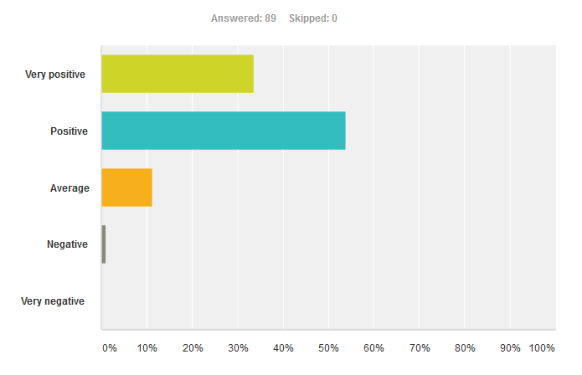
1 - What was your general impression of the DI4R conference?

Slide 4
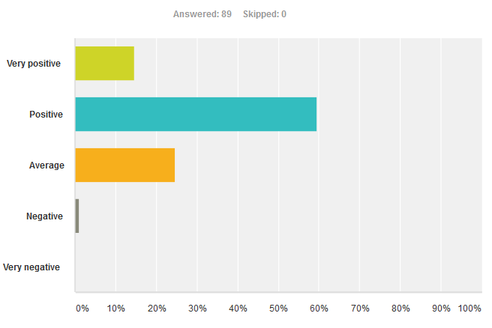
2 - What was your impression of the DI4R sessions and talks?

Slide 5
2 - Selected comments
28 comments
Common comment: not enough users, researchers, etc.
“(…) getting end-users to visit this event is nigh impossible, therefore shift the focus to intermediaries: representatives of the NGIs & NRENs and those of RIs.”
“It would be good to have more time for discussions - e.g. break-out groups, more panel discussions and less long presentations (…)”
“I expected more technical content, especially related with actual uses of concrete science experiments.”
“too plenary/1-way communication; too little space/time for comments and questions, timing really needs to be kept far stricter”
“I'd put more effort still in picturing (…) the opportunities for synergies based on understanding similarities and differences (…) of various infrastructures/organizations/communities, rather than just presenting ourselves in a classical way.

Slide 6
3 - Catering and conference venues. Any feedback?
74 comments (people do always have something to say about this…)
Mostly positive, lots of compliments
Two venues were inconvenient, but no major complaints
Some rooms too small for the number of people attending
Very little said about WiFi – good sign!
More tables in the catering area would have been good
“Complaint” about serving wine in a brewery (conference dinner)

Slide 7
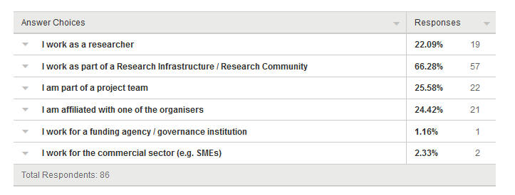
4 - Which description(s) fits you best? (multiple choices possible)
122 boxes ticked in 86 replies
Interesting that 22% of people identify as researchers

Slide 8
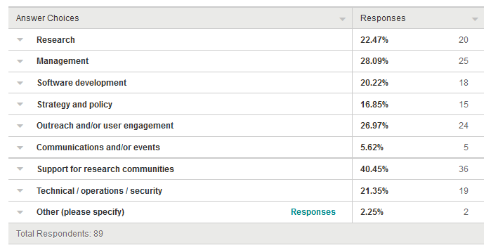
5 - What is your primary function? (multiple choices possible)
164 boxes ticked in 89 replies: multi-hat syndrome!

Slide 9
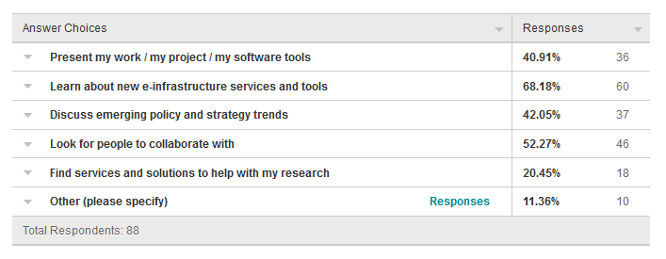
6 - What was your goal in attending? (multiple choices possible)
207 boxes ticked in 88 replies
Exploring and networking

Slide 10
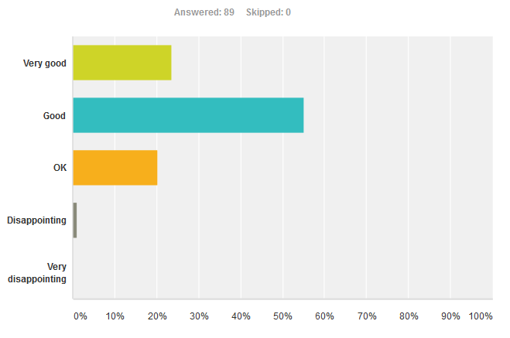
7 - And what was the outcome of your experience?

Slide 11
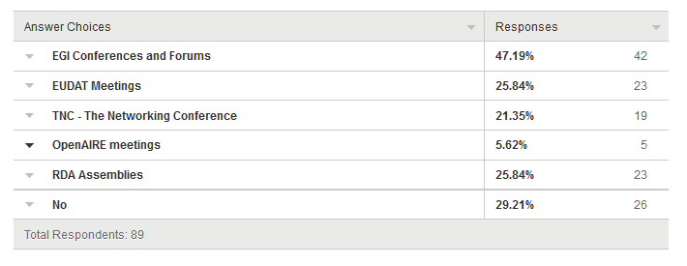
8 - Have you attended any of these meetings before?
138 boxes ticked in 89 replies
Ca. 1/3 newbies

Slide 12
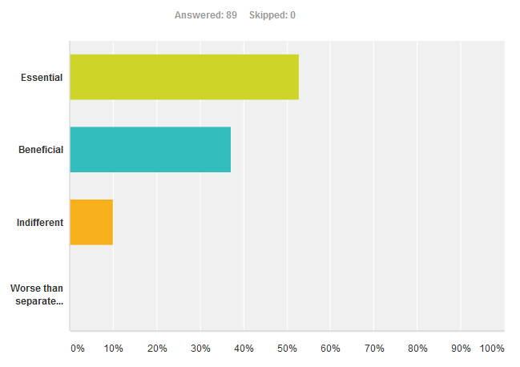
9 - Did you find a benefit to having all e-infrastructures represented in one joint conference?

Slide 13
10 - Would you like to leave us any other thoughts, comments, feedback?
39 responses
Very negative comments about the online programme and the website
“Focus more on the join up between infrastructures and invite sessions that are more discursive or panel based rather than just talking at people.”
“I was somewhat disappointed that it seems the main e-infrastructures seem to competing rather than collaborating. I would hope in the future to see success stories of integration between them.”
“I was aware of this event only by chance (through my EGI local representative). I think universities might be a good way to reach people.”
“A useful addition in my mind though would be to include discipline-specific training session.
“organize it more like a un-conference; networking, workshops, hacking, discussing, writing together etc. getting shit done basically ;) now too many 'promotional talks‘”

