Slide 1
E-Science workflows: The EGI perspective
Gergely Sipos
gergely.sipos@egi.eu

Slide 2
Overview
The European Grid Infrastructure ecosystem
The infrastructure
Services & support for workflow communities
Outreach to new communities
Refactoring for Horizon 2020

Slide 3
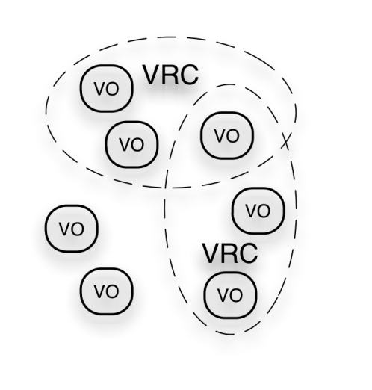
EGI Ecosystem
User Community
SHIWA
Anduril
TRANSfoRm
...
Policies + Funding
Wf4Ever
Galaxy
BioVel
...
Requirements + Feedback
Services + Support
EGI-InSPIRE
Service & Resource Providers
Requirements + Feedback
Public Funding Bodies
Policies + Funding
Requirements + Feedback
European Commission
EGI.eu
Technology Providers
Open Source Providers
National Research Councils
Resource Infrastructure Providers
Strategic Feedback
Technology + Support
Commercial Providers
Policies + Funding

Slide 4
Infrastructure - layered view
Workflow technologies
Virtual Research Communities
(Users)
Workflow technologies
Key
Ecosystem
Partners
NGIs + EIRO EGI.eu
Software
Central Services
Domain Services
Community Services
Services
Planning & Coordination
Platforms
gLite
UNICORE
dCache
ARC
Globus
Infrastructure
Support
NGI
NGI
EIRO
NGI
NGI

Slide 5
EGI and workflow technologies
Workflow services are domain / community specific
Outside of middleware
Support for the integration and operation of workflow services within the ecosystem
Services by communities & projects
Services by the NGIs
Number of aspects:
Gathering and tracking requirements
Support the technical integration of workflow systems
Promoting existing & emerging solutions
Identify and support the reuse of best practices

Slide 6
The EGI requirement gathering and tracking process
The EGI Community
Submit your requirements
Browse requirements
Offer solution to requirements:
http://www.egi.eu/user-support/getting_help/
Channels for Operation requirements
Support Team of EGI.eu
1)
2)
Technology providers
VOs
Channels for User & community requirements
EGI Requirements Tracker
Techn. Coord. Board
VRCs
User Comm- unity Board
3)
4)
5)
projects
NGIs
events
EMI
IGE
SAGA,
...
Helpdesks
(EGI, NGIs, projects,...)

Slide 7
User Community Board
Develops the strategy and defines the priorities for the human and technical user community support services provided by EGI
Monthly meetings (https://www.egi.eu/indico/categoryDisplay.py?categId=21)
Representatives of EGI VRCs and Heavy User Communities http://www.egi.eu/user-support/vrc_gateways:
Structural Biology and NMR
High Energy Physics
Digital Research Infrastructure for the Arts and Humanities
Research Infrastructure for Language Resources
Life Sciences
Earth Science
Computational Chemistry and Material Science
Fusion
The study of e-Science
Astronomy and Astrophysics
Hydrometeorology

Slide 8
Middleware support: APIs
Workflow developers need
Robust, documented, homogenuous APIs to interact with middleware services (Requirement: https://rt.egi.eu/guest/Ticket/Display.html?id=2769)
Informative error messages
(Requirements: https://rt.egi.eu/guest/Ticket/Display.html?id=1778)
Middleware API table:
https://wiki.egi.eu/wiki/Service_APIs
Table will be finalised by EMI project as part of EMI-2 release (April 2012) (gLite, ARC, Unicore, dCache)
Submit specific technical requests through the tracker!
Integrate the tracker into your community website!

Slide 9
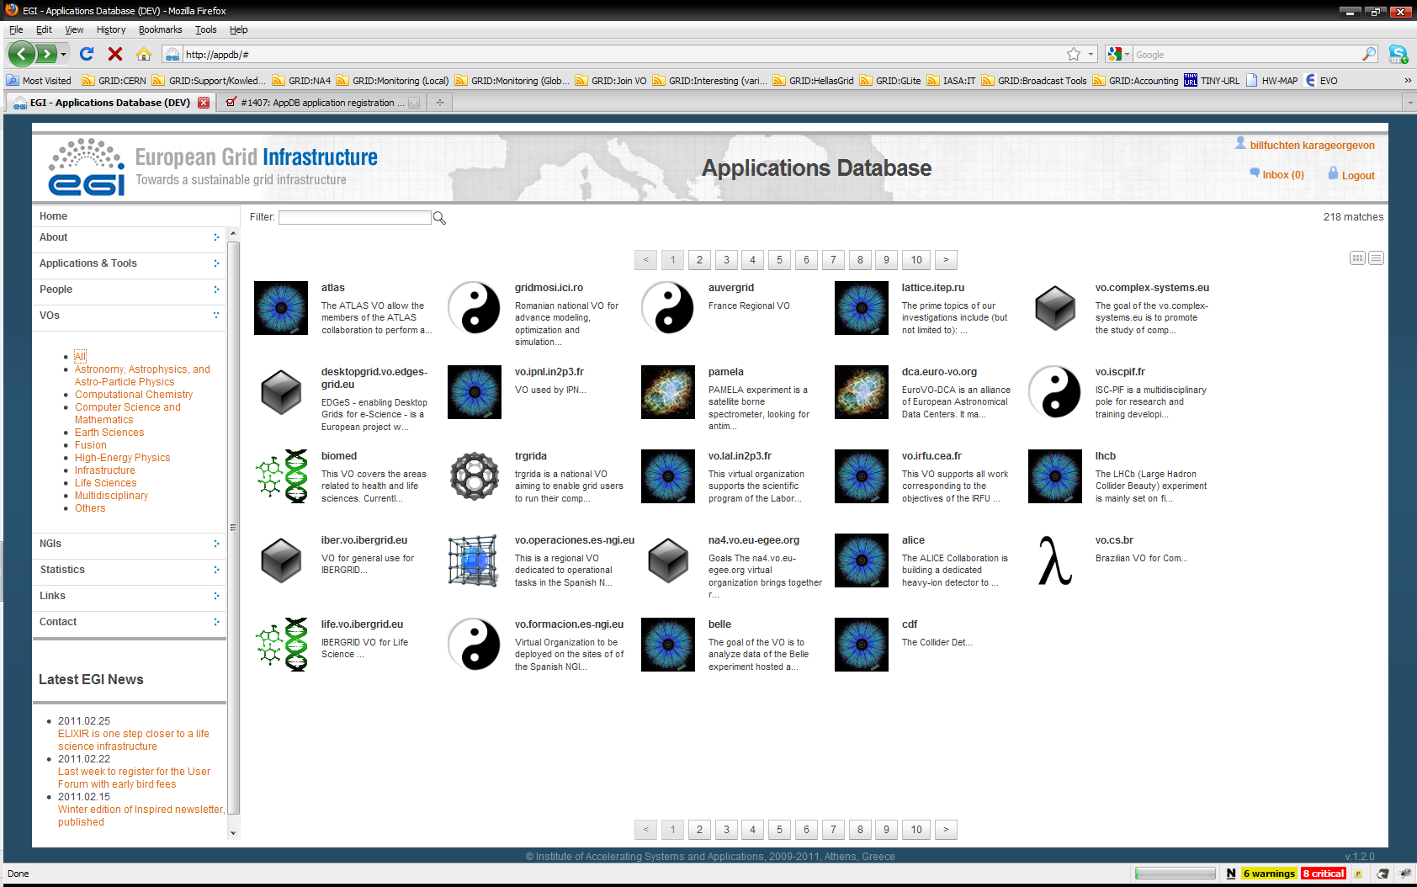
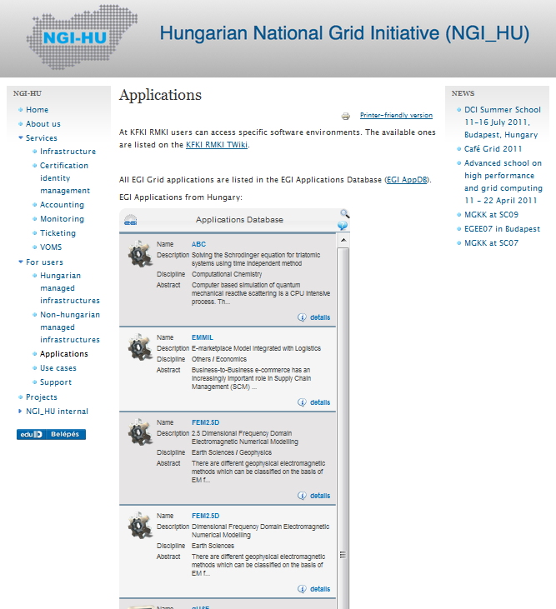
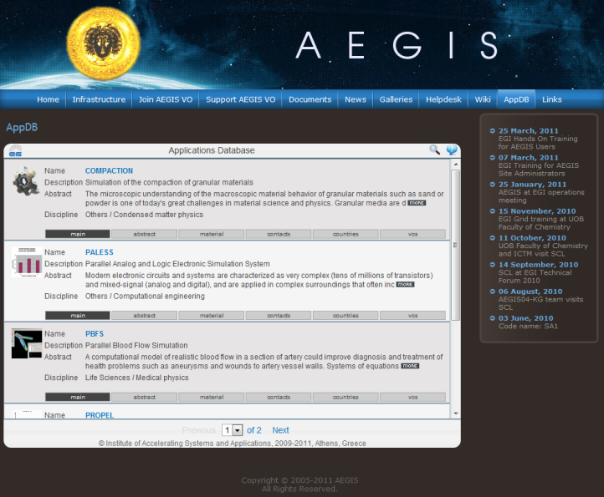
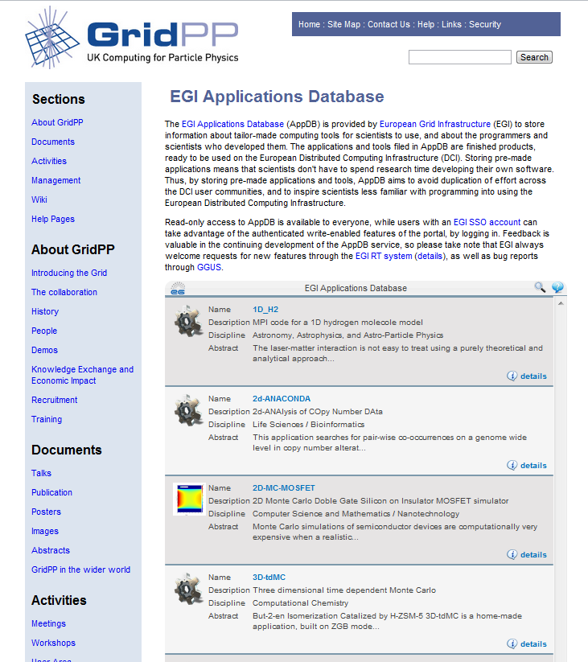
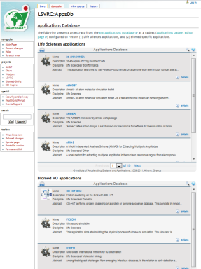
Promoting solutions: EGI Applications Database
Benefits:
Gives recognition to reusable Scientific applications and application developer tools
Gives recognition to application developers
Access through web page AND web gadget
Community features such as commenting and ranking
http://appdb.egi.eu

Slide 10
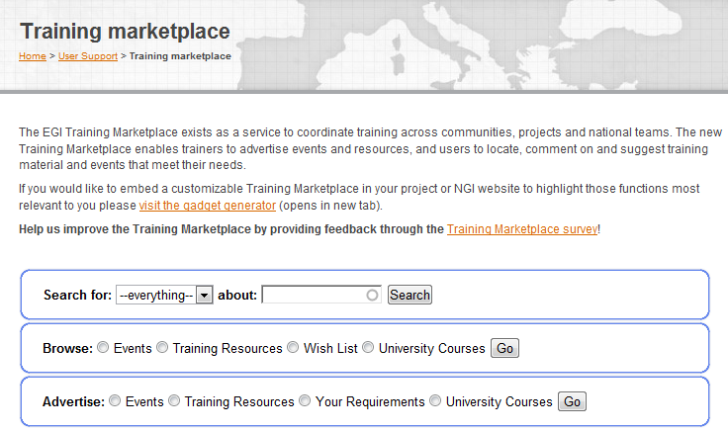
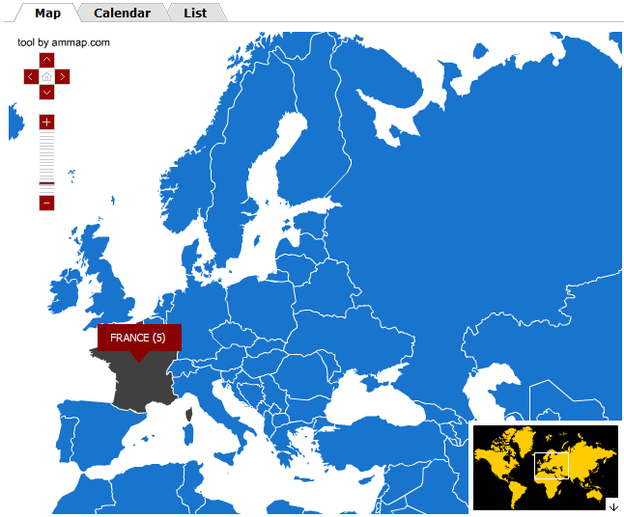
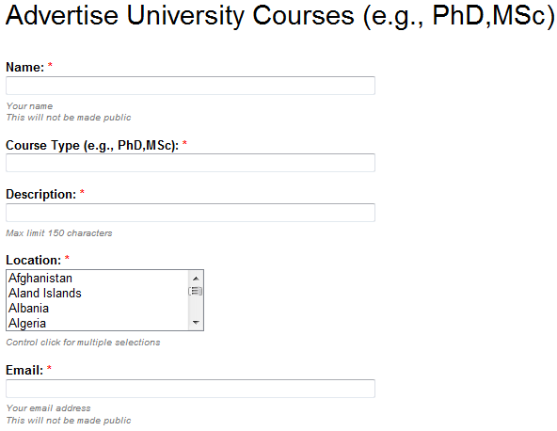
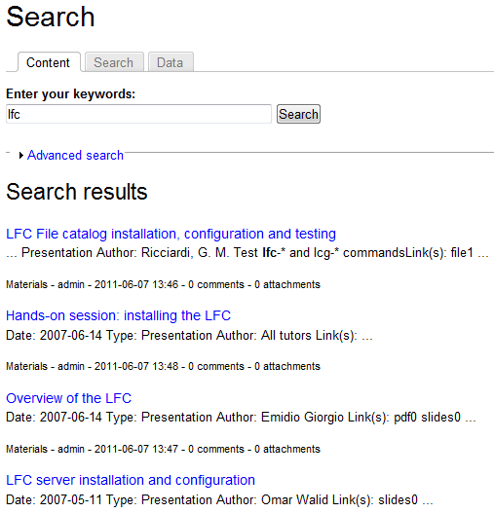
Promoting solutions: Training Marketplace
Benefits:
Register
training events, expertise, services, materials, resources, online courses, university courses
Browse and search
Request training services
Access through web page and web gadget
http://training.egi.eu

Slide 11
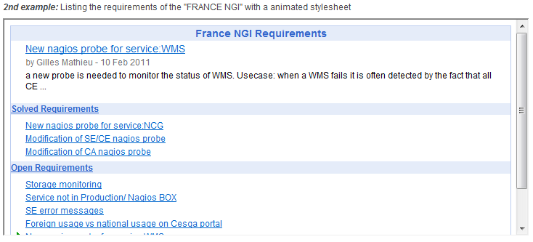
Web gadgets
An alternative way of reusing services
Benefits
Customisability
Reusability
Compatibility
Existing gadgets:
Application Database
Training Marketplace
Requirement Tracker
Use and develop gadgets & share them through EGI:
www.egi.eu/user-support/gadgets

Slide 12
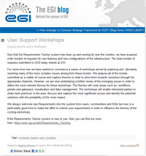
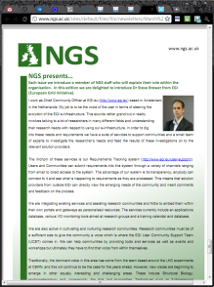
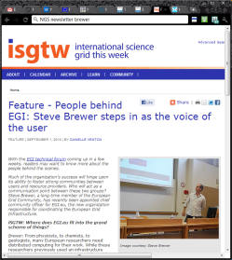
Outreach to new communities
Dissemination teams of EGI.eu and (some) NGIs
EGI Blog (www.egi.eu/blog)
EGI-InSPIRE Newsletters
Web news
Twitter & Facebook
Support teams with contacts within the NGIs
Respontible for outreach to new communities
Work on specific outreach projects: https://wiki.egi.eu/wiki/Virtual_Team_Projects, e.g.
Establish an EGI VRC for
Sound and Music Grid Computing; for GAIA-Space Grid Computing; for Fire & smoke simulation; etc.
ESFRI contact list
Organise a high impact presence for EGI at EGU General Assembly
Assessing the adoption of Federated Identity Providers within EGI

Slide 13
Key Challenges
Sustainability
18K users at the moment but 1.8M publicly funded researchers in Europe
Do we need to appeal to the 100% or just 1%?
How do we engage with and support the long-tail of researchers?
Technology
The 99% want other services (e.g. not jobs!)
How do we enable these services to be deployed?
What are the core (infrastructure) services to do this and still share resources and data?
Customers or Users?
There are integration costs…. but who pays?
PRACE & XSEDE: application process provides strong ties
EGI & OSG: virtual organisations a barrier to strong ties
Do we need to rethink the autonomous VO model?

Slide 14
EGI Refactoring for 2020
Supporting services encapsulated into Virtual Machines
Federated IaaS layer & collaboration services enables the integration of resources & services
Separated roles for:
Platform integrators
Platform operators
Platform users
Key to mass customisation
Collaboration Services:
Accounting
Monitoring
VOMS
Federated ID
Persistent Data ID
…
Community Platform 2
Community Platform 1
(e.g. ASTRA space science)
Community
Distribution (e.g. WLCG)
Community Platform 4
Community Platform 3
(e.g. Speech Processing)
IaaS Interface Layer EGI Federated Cloud TF: https://wiki.egi.eu/wiki/Fedcloud-tf:FederatedCloudsTaskForce
Federated Resources:
Public and commercial mix
Different countries (35+) and admin domains (350+)

Slide 15
Questions?
gergely.sipos@egi.eu

