Slide 1
Hosting CLARIN services in the EGI cloud
Gergely Sipos EGI Foundation
Boris Parak
CESNET
Willem Elbers CLARING ERIC
support@egi.eu
http://go.egi.eu/cloud

Slide 2
EGI: Advanced Computing for Research
Notes:
A globally distributed ICT infrastructure that federates the digital capabilities, resources and expertise of national and international research communities in Europe and worldwide.
EGI has delivered unprecedented data analysis capabilities to more than 48,000 researchers from many disciplines and is now committed to bring innovation to the private sector.

Slide 3
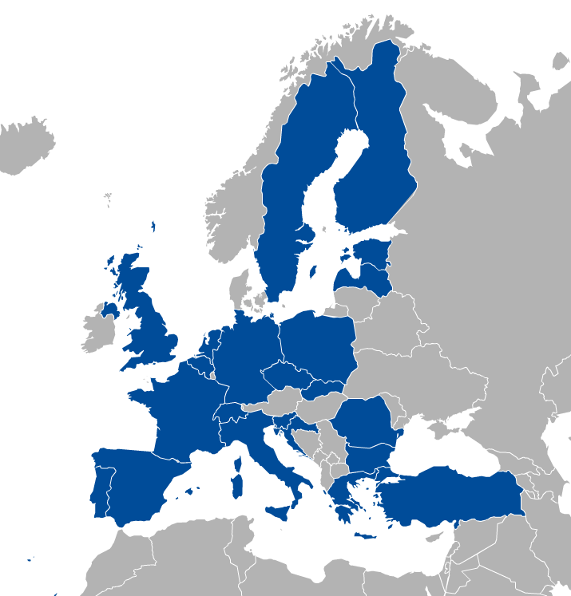
EGI Membership
Major national e-Infrastructures: 22 NGIs
EIRO: CERN (European Intergovernmental Research Organisation)
Membership fees sustain the federation and community
EGI Foundation
Collaboration & federation

Slide 4
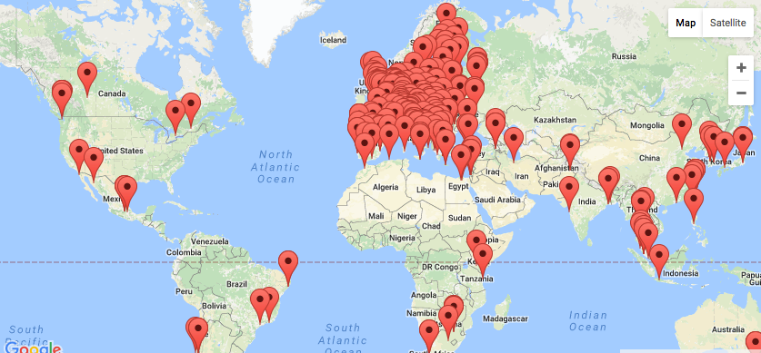
EGI Federation Largest distributed compute e-Infrastructure of the world
EGI Foundation (Amsterdam)
300+ HTC providers
23 Cloud providers
650k CPU cores
285 PB online storage
1.7 Million jobs/day
2.6 Billion CPU hours/year
240 Virtual Organisations
>48 000 users

Slide 5
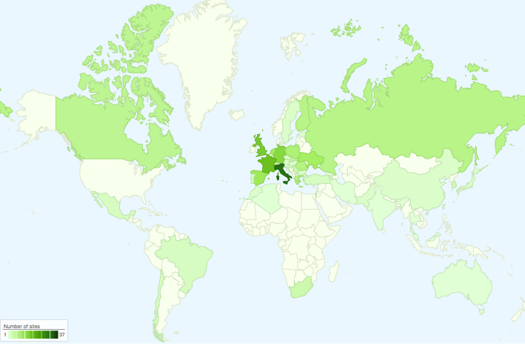
International Partnerships
Canada
China Inst. Of HEP
Chinese Academy
of Sciences
USA
India Centre for
Development of
Advanced Comp.
Africa and Arabia
Council for Scientific and
Industrial Research, South Africa
Asia Pacific Region
Academia Sinica
at Taiwan
Latin America
Universida de Federal do
Rio de Janeiro
Ukraine
Ukrainian National
Grid

Slide 6
EGI serves researchers and innovators
Size of individual groups
WLCG
ELI
CTA
ELIXIR
EPOS
BBMRI
INSTRUCT
CLARIN
EISCAT_3D
DARIAH
LOFAR
LifeWatch
ICOS
EMSO
CORBEL
ENVRIplus
…
VRE projects
OpenDreamKit
WeNMR
DRIHM
VERCE
MuG
AgINFRA
CMMST
LSGC
SuperSites Exploitation
Environmental sci.
neuGRID
…
PeachNote
CEBA Galaxy eLab
Semiconductor design
Main-belt comets
Quantum pysics studies
Virtual imaging (LS)
Bovine tuberculosis spread
Convergent evol. in genomes
Geography evolution
Seafloor seismic waves
3D liver maps with MRI
Metabolic rate modelling
Genome alignment
Tapeworms infection on fish
…
Agroknow
CloudEO
CloudSME
Ecohydros
gnubila
Sinergise
SixSq
TEISS
Terradue
Ubercloud
…
ESFRIs, FET flagships
Multinational communities, (e.g. H2020 projects)
Industry, SMEs
‘Long tail of science’

Slide 7
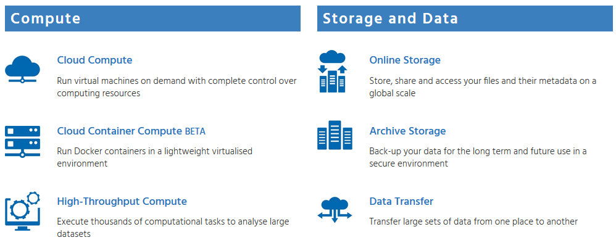
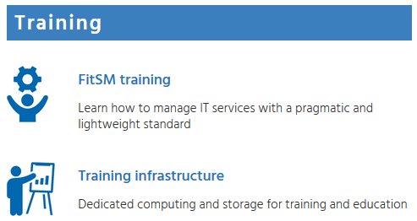
The EGI Service Catalogue
www.egi.eu/services

Slide 8
Introduction to EGI cloud

Slide 9
EGI Cloud
Grid of clouds
Uniformed user interfaces
Harmonised operational behaviour
Based on open standards and open technologies
Primarily an IaaS cloud, but with community-hosted PaaS and SaaS on top
Infrastructure → Access AND Technology stack → Deploy

Slide 10
The current infrastructure
Today:
23 providers from 14 NGIs
15 OpenStack
7 OpenNebula
1 Synnefo

Slide 11
Typical usage models
Compute and data intensive workloads
Batch and interactive (e.g. Jupyter notebooks) with scalable and customized environments
Service Hosting
Long-running services (e.g. web server, database, application server)
Datasets repository
Store and manage large datasets (in a storage volume)
Disposable and testing environments
Host training environments, test applications

Slide 12
Computing models
HTC Grid service (e.g. clusters; HTC) | Commercial cloud service (e.g. Azure) | EGI cloud service (federated IaaS cloud)
For batch computing For embarrassingly parallel applications Using multiple sites at a time | For interactive and batch computing For service hosting Flexible OS and application use Typically one site is used Pay-as-you-go No user support (or central paid service) | For interactive and batch computing For service hosting Flexible OS and application use Use single or multiple sites at a time Virtual Organisation based access Free at the point of use (for research) With local user support

Slide 13
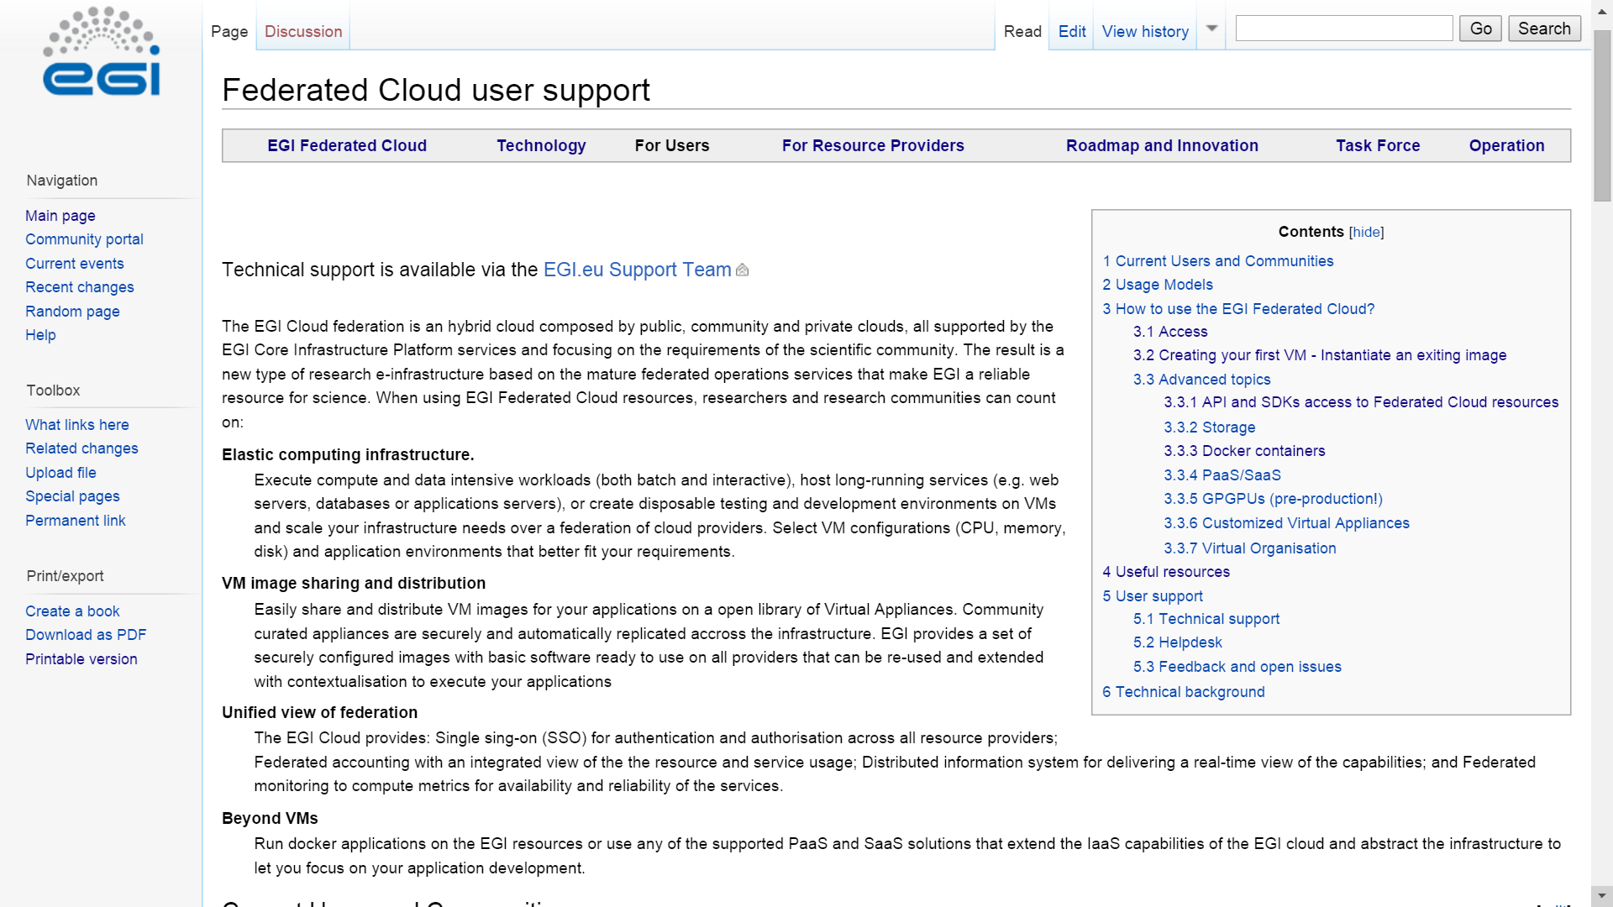
Main resource about EGI Cloud
EGI Federated Cloud User Guides:
https://wiki.egi.eu/wiki/Federated_Cloud_user_support

Slide 14
CLARIN services in the EGI Cloud

Slide 15
Brokering resources for a community
Trigger the process with a service request on the EGI website
Type, number, size, cost, availability, etc.
Applic. provider
Service requirements
Conditions
Storage provider
Cloud provider
Negotiator
Grid provider
Project/Community representing the VO
Service Level Agreement
Operation Level Agreement
Training
Support
Satisfaction review (every 3/6/12 months)
Performance reports

Slide 16
CLARIN cloud provider:
National grid & cloud infrastructure including storage
Multiple production IaaS clouds operated by CESNET
MetaCloud (OpenNebula-based)
2,900 CPU, ≈ 30 TB RAM1
EGI Federated Cloud (also OpenNebula-based)
≈300 CPU + 1,600GB RAM
Full-fledged & certified FedCloud site
Numerous testbed deployments (also OpenNebula-based)
ownCloud personal cloud-based storage

Slide 17
CLARIN services in the CESNET cloud
CLARIN component registry (http://clarin.eu/cmdi), the backbone of the Component-based MetaData Infrastructure.
The CLARIN docker registry (http://docker.clarin.eu), which plays an important role in the CLARIN deployment workflow.
The CLARIN maven repository (http://nexus.clarin.eu), intensively used during CLARIN software development projects.
A grafana instance (http://metrics.clarin.eu), to visualize server status and metrics.
Document archive for the CLARIN ERIC central office.

Slide 18
Future outlook – The European perspective European Open Science Cloud
“The European Open Science Cloud (EOSC) is a vision for a federated, globally accessible, multidisciplinary environment where researchers, innovators, companies and citizens can publish, find, use and reuse each other's data, tools, publications and other outputs for research, innovation and educational purposes.”
Credits: Open Science Policy Platform EOSC wg
EOSCpilot H2020 project: 2017.Jan 1 – 2018 Dec 31.
EOSC-hub H2020 project: 2018.Jan 1 – 2020 Dec 31.

Slide 19
Next Community Event Digital Infrastructures for Research (DI4R)
https://www.digitalinfrastructures.eu
Co-located with EOSCpilot 1st Stakeholder Engagement Event (28-29 Nov)
CALL FOR CONTRIBUTION IS NOW OPEN!

Slide 20
Summary
EGI Foundation: Cloud service broker
CESNET: Cloud service provider
CLARIN ERIC: Cloud customer
CLARIN community: Cloud user

