Slide 1
Results of the EGI-KISTI joint research project
Gergely Sipos
Head of Services, Solutions, Support
EGI Foundation
15 October 2024
KISTI, Daejeon

Slide 2
Outline
EGI
EOSC - European Open Science Cloud
EGI-KISTI project

Slide 3
The EGI Federation is an international e-infrastructure federation
We provide advanced computing and data analytics services for research and innovation
2010
From the Large Hadron Collider compute grid…
2024
….to a multidisciplinary, global, open science infrastructure

Slide 4
Vision
All researchers have seamless access to services, resources and expertise to collaborate and conduct world-class research and innovation
Why a federation?
Support science at international scale
Build an hyperscale facility for research
Invest nationally, access globally
Bring computing to the data
Mission of the EGI Federation
Deliver open solutions for advanced computing and data analytics in research and innovation
Mission of the EGI Foundation
Enable the EGI Federation to serve international research and innovation together

Slide 5
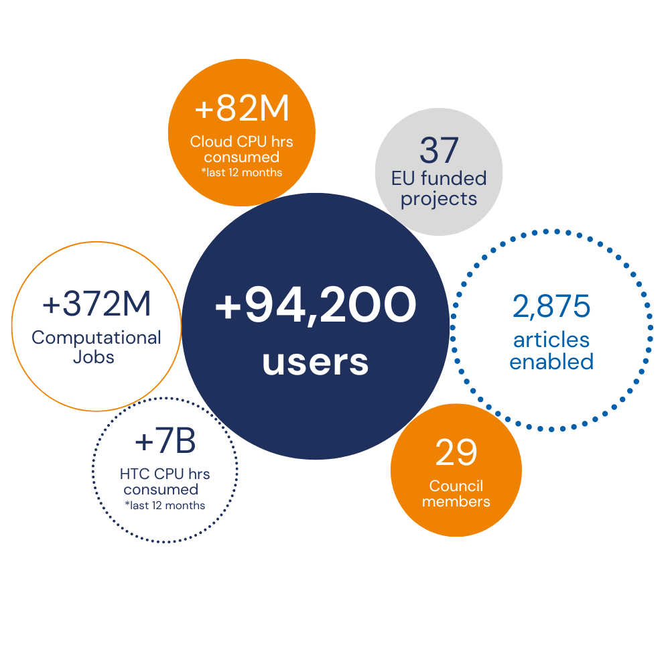
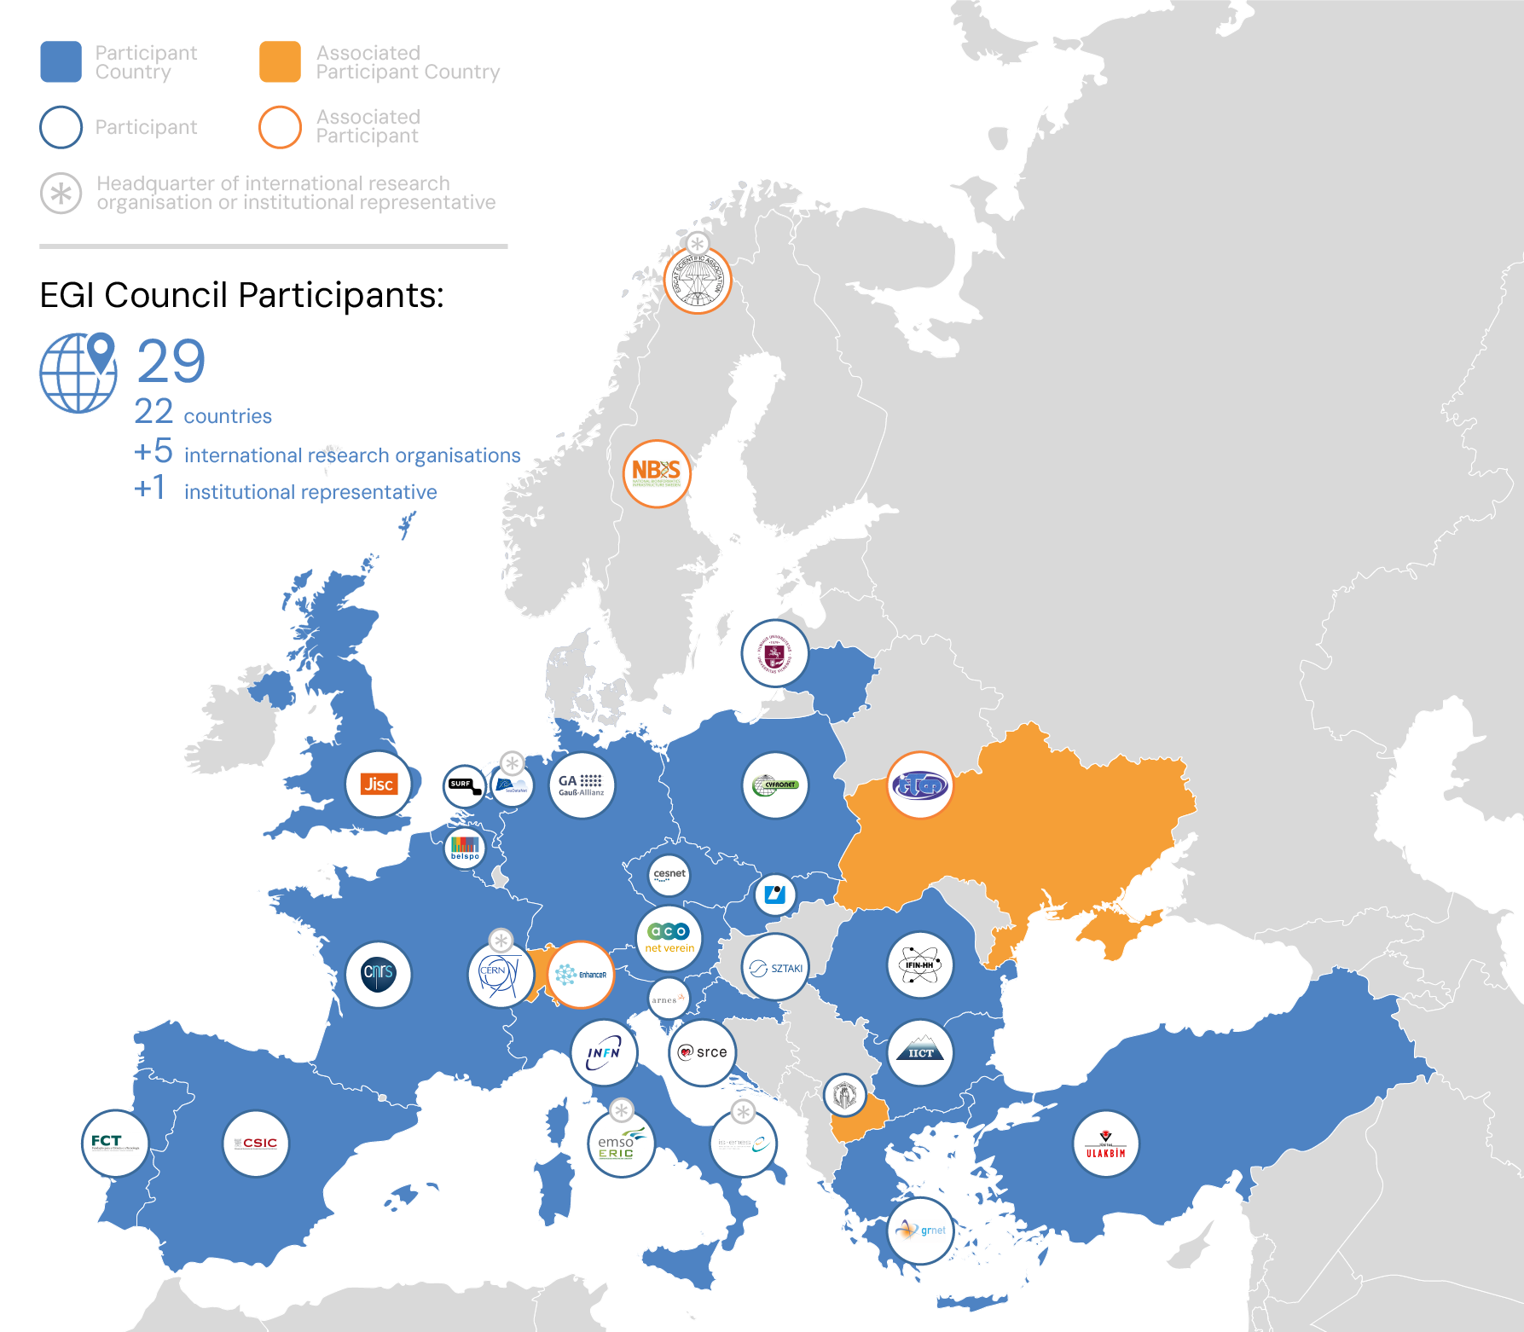
EGI in a Nutshell
Coordinated by the EGI Foundation, a membership organisation
www.egi.eu
EGI Federation
A European flagship digital infrastructure for data-intensive scientific computing
Year 2023 in EGI numbers
Why a federation?
Support science at international scale
Build an hyperscale facility for research
Invest nationally, access globally
Bring computing to the data

Slide 6
EGI services
Services for Research
Services for Federation
Services for Business
Our large-scale computing and data analytics services are helping scientists to accelerate their research.
Our internal services provide tools for coordination of the EGI Federation, improving how we work together.
We help companies to exploit and provide services and resources for compute- and data-intensive research and innovation.
https://www.egi.eu/services/research
Notes:
3 target user groups supported by EGI

Slide 7
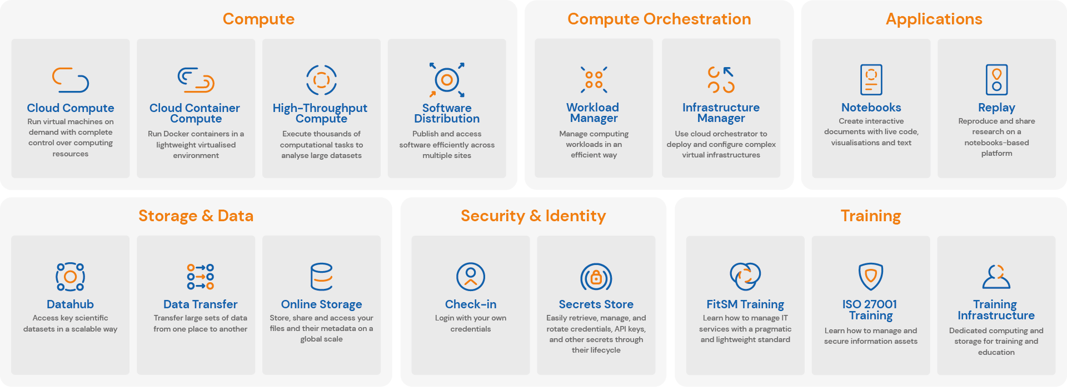
The EGI Services for Research Portfolio
https://www.egi.eu/services/research/
User documentation: https://docs.egi.eu

Slide 8
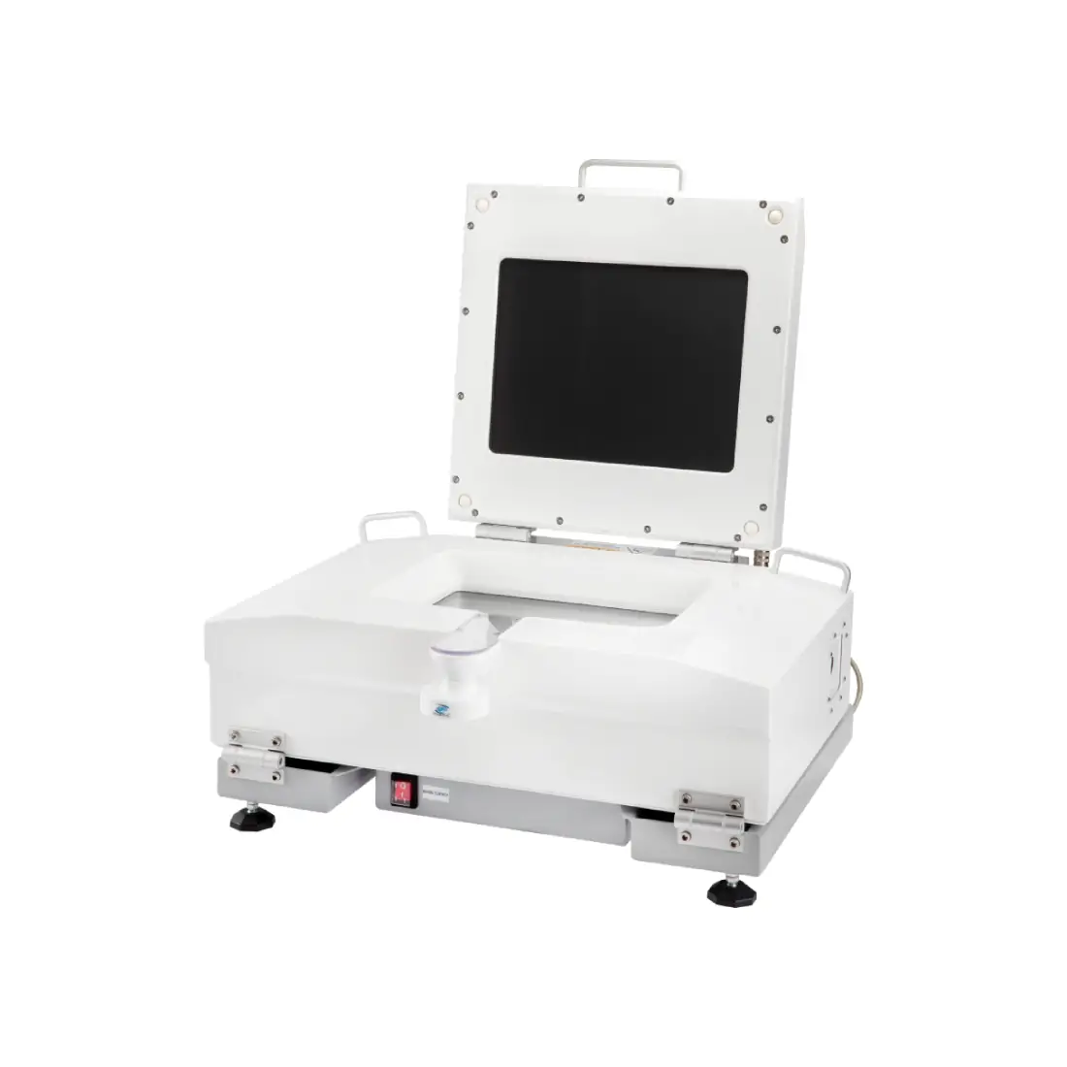
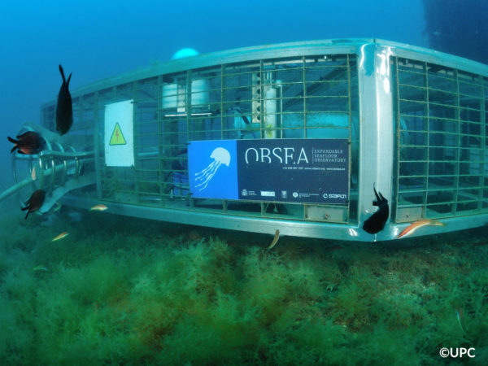
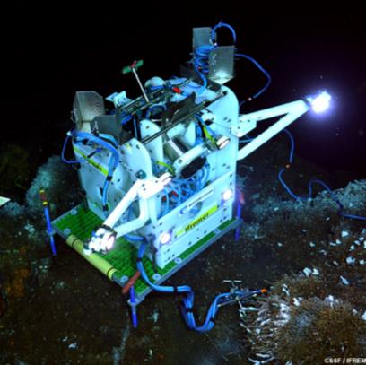
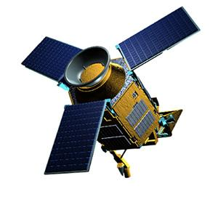
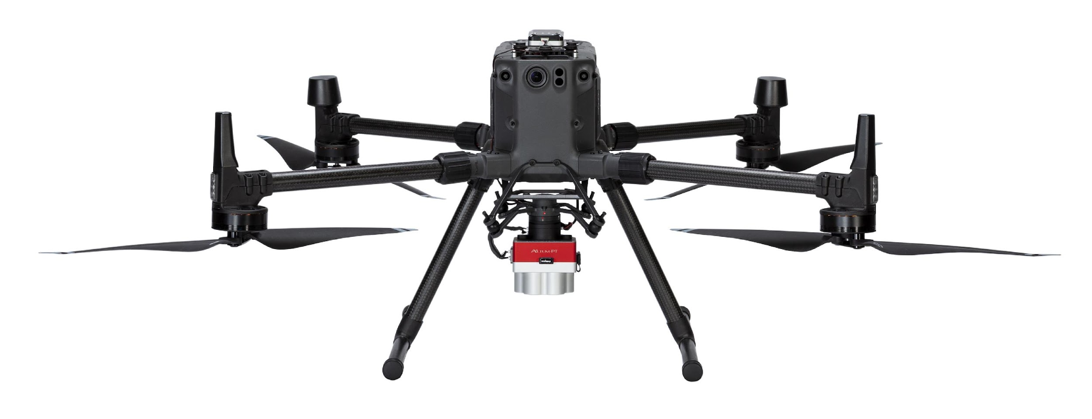
Project example: iMagine (2022-2025)
Challenge: Image data tsunami in aquatic sciences
In Europe, we spent circa 1.4 Billion Euro a year in marine data acquisition (in-situ and remote sensing data)
AI/ML
From DATA to KNOWLEDGE
Underwater cameras
Microscopes
CCTV cameras
Seafloor observatories
Satellites
Drones
VALORISATION
Fish monitoring and classification
Marine litter detection
Oil spill prediction, …
. . .
ACQUISITION
MANAGEMENT
Notes:
Marine environmental management and implementing ocean restoration initiatives require more knowledge and understanding. The implementation requires an increase of our overall knowledge, demanding more science and improved access to observation data and analytical processing. This builds upon national environmental observation and monitoring networks and programs, complemented with EU initiatives such as the Copernicus programme (CMEMS) and EMODnet, and European Research Infrastructures (RIs). Great additional potential in collecting and processing image data using high-performance image analysis tools, including Artificial Intelligence (AI) techniques, and in more sharing of image repositories.

Slide 9
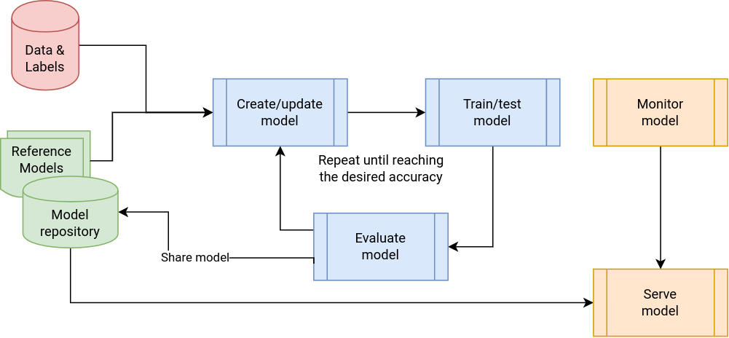
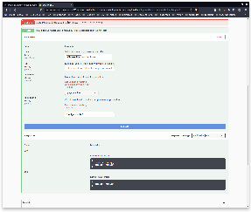
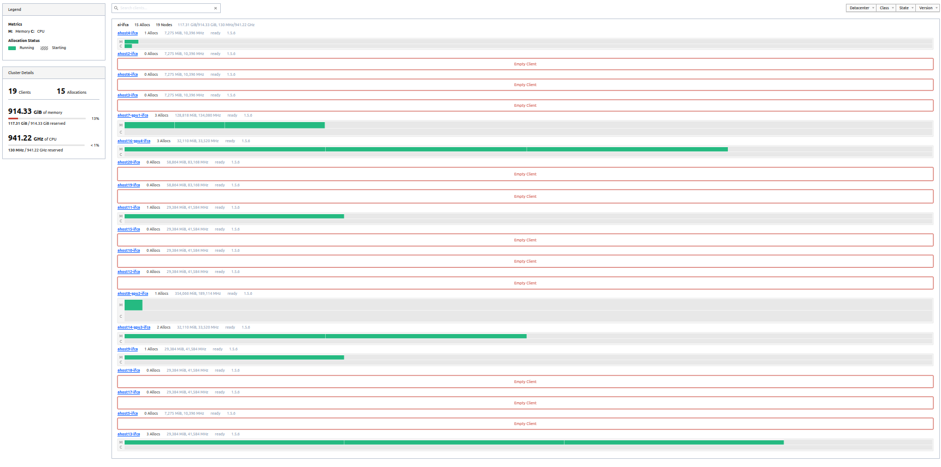
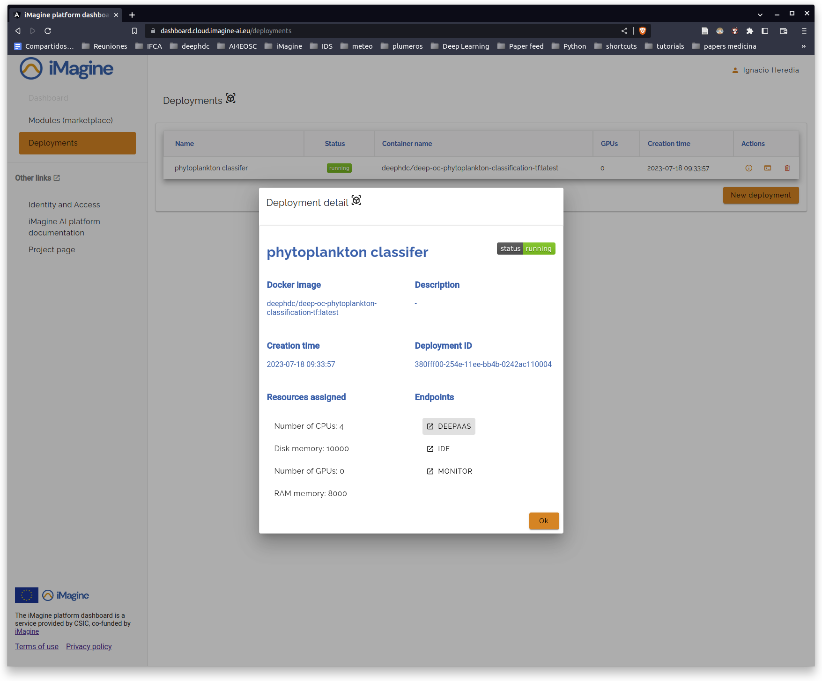
The iMagine Approach
AI/ML Model development, training and delivery
Thematic Services
Competence Centre
CPU intensive
GPU intensive
8 internal use cases &
3 external use cases
Benefitting 10+ Research Infrastructures and linking to
Thematic Services
iMagine AI Platform
Generic, scalable platform for developing and sharing AI/ML applications.
Platform Service
EGI Federated Cloud + Infrastructure Manager + Check-in
Infrastructure
1500 TB-months
132,000 GPU-hours
6,000,000 CPU-hours
OpenStack clouds with GPUs, CPUs, Storage in Spain, Portugal, Turkey & Ireland.

Slide 10
EGI services
Services for Research
Services for Federation
Services for Business
Our large-scale computing and data analytics services are helping scientists to accelerate their research.
Our internal services provide tools for coordination of the EGI Federation, improving how we work together.
We help companies to exploit and provide services and resources for compute- and data-intensive research and innovation.
https://www.egi.eu/services/federation
Notes:
There are plethora of services offered by the EGI Foundation to the members represented in the EGI Council. We can broadly classify the services in three categories -
Let us look at them in a bit more detail. For that I am going to give examples of some services

Slide 11
Tools and Services for the Federation
Offered by the EGI Foundation to the members of the EGI Council
COORDINATION SERVICES
TECHNICAL TOOLS
Operations Coordination and Support
Accounting
Community Coordination
Collaboration Tools
ITSM Coordination
Configuration Database
Technical Coordination
Operational Tools
Project Management and Planning
Helpdesk
Security Coordination
Service Monitoring
Strategy and Policy Development
Validated Software and Repository
Communications
Industry Engagement

Slide 12
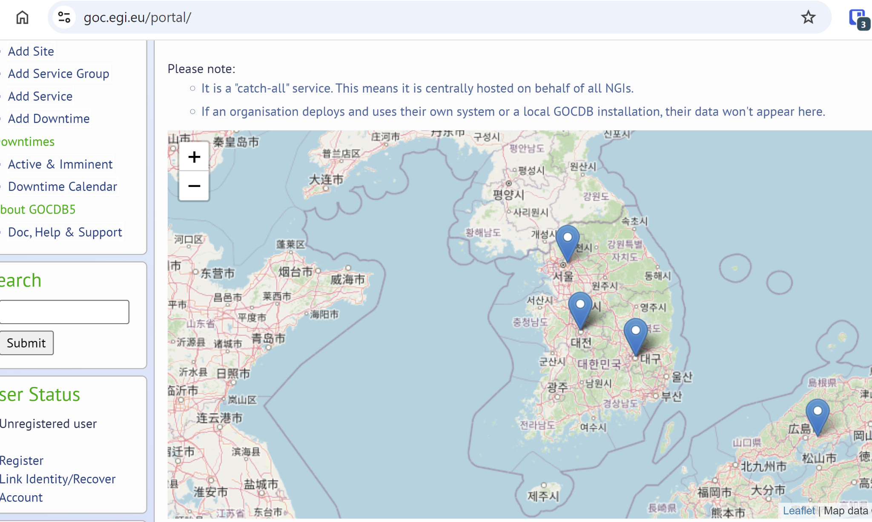
WLCG use of the EGI Federation services - Sites in Korea
(source: https://goc.egi.eu/)
KR-UOS-SSCC (Unversity of Seoul)
Seoul Super Computing Center at University of Seoul
View site
KR-KISTI-GSDC-01 (Korea Institute of Science and Technology Information)
GSDC ALICE Tier1
View site
AND
KR-KISTI-GSDC-02 (Tier2 Center, Korea Institute of Science and Technology Information, Daejeon, Korea.)
EGI site for WLCG Tier2 center
View site
LCG_KNU (The Center for High Energy Physics, Kyungpook National University, South Korea)
View site

Slide 13
A new project for opening EGI to big data open science:
RI-SCALE - Unlocking RI potential with Scalable AI and Data
March 2025 - Feb 2027

Slide 14
Challenges to be addressed by RI-SCALE
1/
Increasing size and complexity of research data holdings
2/
Limited data analytics capacity, integrating technical knowledge, compute environments, data staging, data analysis and AI techniques
3/
Lack of business models for the data economy when applied to research

Slide 15
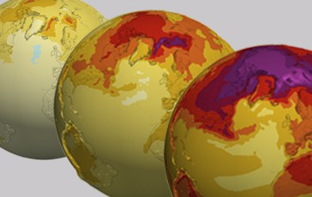
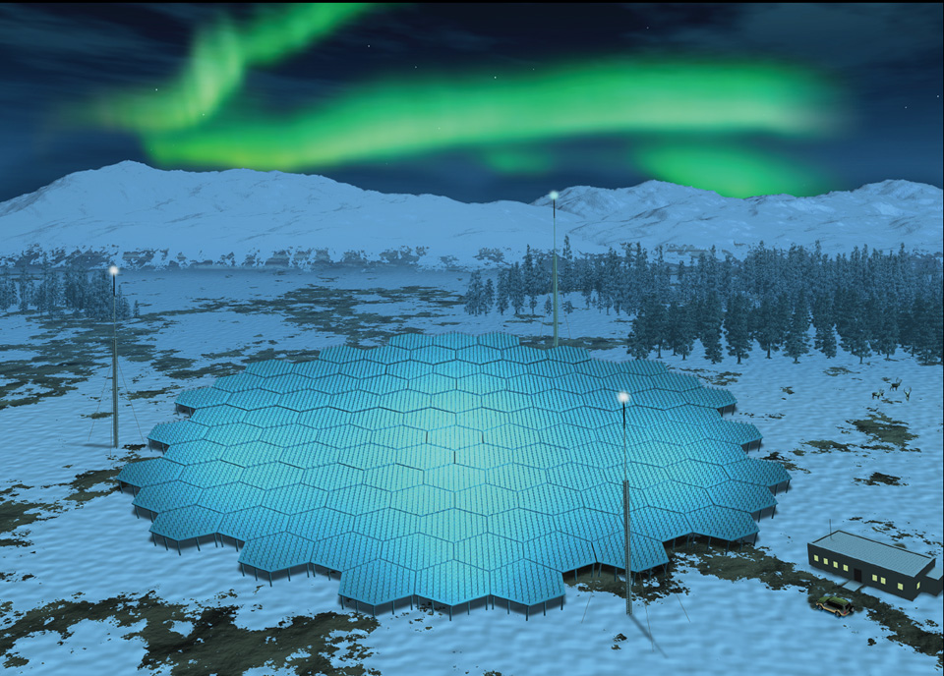
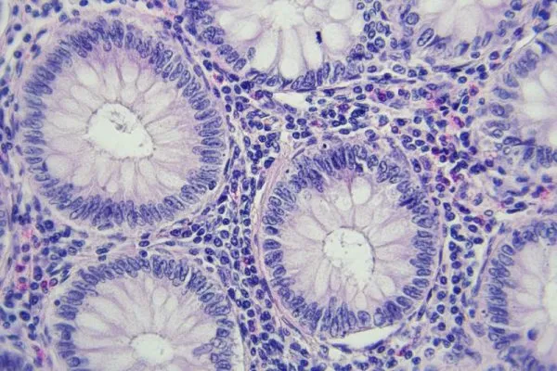
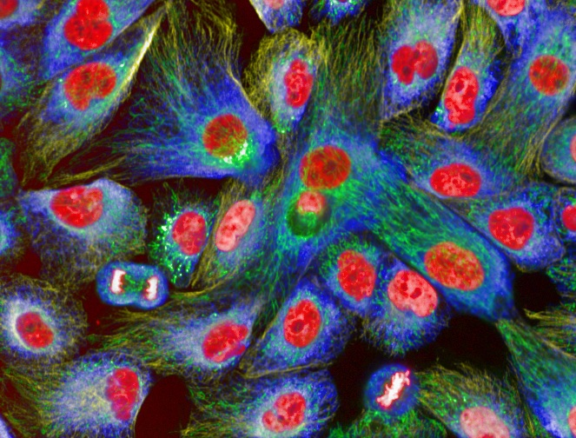
RI-SCALE use cases (credits: RI-SCALE consortium)
Climate modelling High-resolution downscaling of climate scenarios and risk trend analysis in agriculture Smart detection of anomalies in climate data usage
Near-Earth geospace studies Intelligent Scheduling of Radar Observations and Experiments Space Debris and Anomaly Detection
Cancer treatment Colorectal cancer prediction with explainable AI Synthetic data for computational pathology
Imaging in life sciences Foundational models for heterogeneous biological image data Generative AI-Powered assistant for data discovery and analysis
CMIP6 data repository at DKRZ,
20PB in total
40 years of EISCAT and new EISCAT3D data, few PBs/yearar
Cancer & digital pathology data at 3 BBMRI sites,
3 PB in total
BioImage Archive and EMPIAR DBs at EMBL-EBI, 4.5 PB in total
Notes:
ENES1 - Challenge: The agricultural and insurance sectors can benefit heavily from high-resolution map data (a few hundred metres). However, the current CMIP6/EURO-CORDEX simulations or climate datasets provided by DestinE are at a much lower resolution. This use case pursues wider data exploitation by downscaling these datasets to a higher resolution. The downscaling will be performed by exploiting AI and statistical models with particular reference to systems based on Convolutional Neural Networks (CNN). These algorithms process two-dimensional inputs to return high-resolution maps and identify which system returns more reliable maps. Validation will happen in the agriculture and insurance sectors, where future business models can be explored.
ENES2 - Challenge: The ESGF Data Statistics service continuously collects information about data usage from the Earth System Grid Federation data nodes. A data-driven approach to data downloads can provide valuable insights to RI managers about infrastructure usage and potential issues connected with data transfer failures. Given the high number of downloads, such information could be exploited to identify and predict possible issues at the infrastructural level.
The use case will validate the DEP system through an AI application that exploits such data download information for early detection of changes in the download patterns and anomalies related to download failures.
EISCAT1 - Challenge: The EISCAT radars run observational campaigns defined by researchers and other end-users according to their needs and objectives. For every observational need, a radar experiment definition includes a number of requirements, like the geophysical conditions the users wish for during the experiment. However, the conditions in space might not be what the user requires for the experiment. The decision of ‘which experiment to run when’ is based on numerous external real-time data sets from satellites and ground instruments. This use case will train an AI model to support this complex decision-making to optimise the use of the radars. Validation of the model will be performed with different space conditions.
EISCAT2 - Challenge: Finding anomalies (e.g. rare events or disturbances) in the EISCAT data can be the basis for various data valorisation pathways. This use case will implement the concept to advance ‘sustainable space use’. With the advent of “New Space” (i.e. miniaturisation leading to ever smaller satellites, as well as rapidly increasing numbers of satellites), overcrowding of orbits increases the risk of collisions, thereby creating more space debris, which eventually can lead to cascading, i.e. causing a “chain reaction” (Kessler Syndrome). We will use the existing EISCAT data to identify events relating to the presence of space objects, establish occurrence statistics and find connections between these events, then identify anthropogenic objects that can threaten sustainable space use, while producing sets of tracks (range, range rate and RCS measurements) to be used for orbital determination.
BBMRI1 - Challenge: This use case aims to identify a novel biomarker for stratifying colorectal cancer (CRC) risk through analysis of lymph node tissue abnormalities. Such a digital biomarker will facilitate the early detection and treatment of colorectal cancer, offering a more personalised approach to cancer care. Such a histological marker is not known by pathologists today and may only be identified with AI technologies in very large data sets. The use case will use a weakly supervised training approach guided by disease-free survival data. The dataset needed was scaled by the initial machine learning experiments and power calculations scaled the dataset needed to approx. 3.000 cases / 45.000 whole slide images of lymph nodes.
BBMRI2 - Challenge: There are many challenges in sharing Whole Slide Images (WSIs), such as privacy restrictions and missing consent to share the original data. Synthetic WSIs allow the creation of synthesised copies of datasets that can be shared by overcoming these challenges. Moreover, synthetic image generation can be leveraged to learn high-level representations of WSIs describing their content in a semantically meaningful way. In particular, we focus on training a model on CRC data, potentially generating images at resolutions up to 100,000 by 100,000 pixels. Generating images at such high resolutions is particularly challenging since it requires vast amounts of computational resources and training data.
Euro-Bioimaging1 - Challenge: Understanding, categorising and providing access to large cohorts of mixed life sciences imaging data requires computational understanding of those images. The most promising route towards this is through foundation models that capture domain understanding of heterogeneous image data and produce embeddings which support multiple downstream use cases, such as categorisation, similarity search and derived measurements. This use case will run a large-scale foundation model training exercise.
Euro-Bioimaging2 - Challenge: With the growing complexity and amount of data and tools at RIs, both users and operators struggle in finding and applying the right combinations of these to certain scientific cases. Generative chat engines could simplify this process through an AI-powered assistant and transform how users navigate and analyse the vast datasets available. The AI-powered assistant will also facilitate advanced data analysis tasks like cell counting and segmentation. This dual functionality aims to make both the exploration of the archive and the execution of complex analyses accessible to all users, including those without required technical expertise.

Slide 16
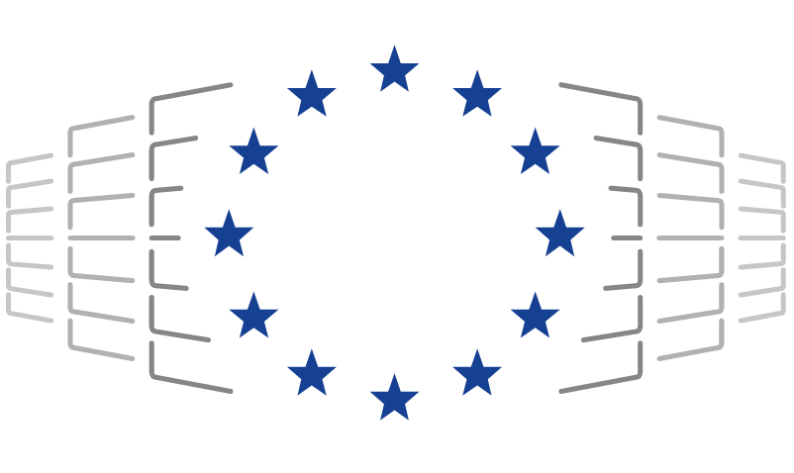
RI-SCALE: technology innovation for scalable data exploitation
Value for data managers Data enrichment, error detection, etc.
Value for scientist Data mining, analysis, AI-powered helpdesk, etc.
Goal: scalable data exploitation
Policies for data replication scaling out data to the EGI Federation
AI frameworks for data valorisation
Credit based data usage accounting
Interoperability validation with data spaces
Destination Earth, Copernicus Data Space, EUCAIM cancer image federation
RI data holdings
E-infrastructures
Data Exploitation Platform
CPUs
Long term storage
AI frameworks and models
GPUs
GROQs
Data lifecycle management
Short/mid term data replicas
Trust and identity

Slide 17
EOSC
European Open Science Cloud

Slide 18
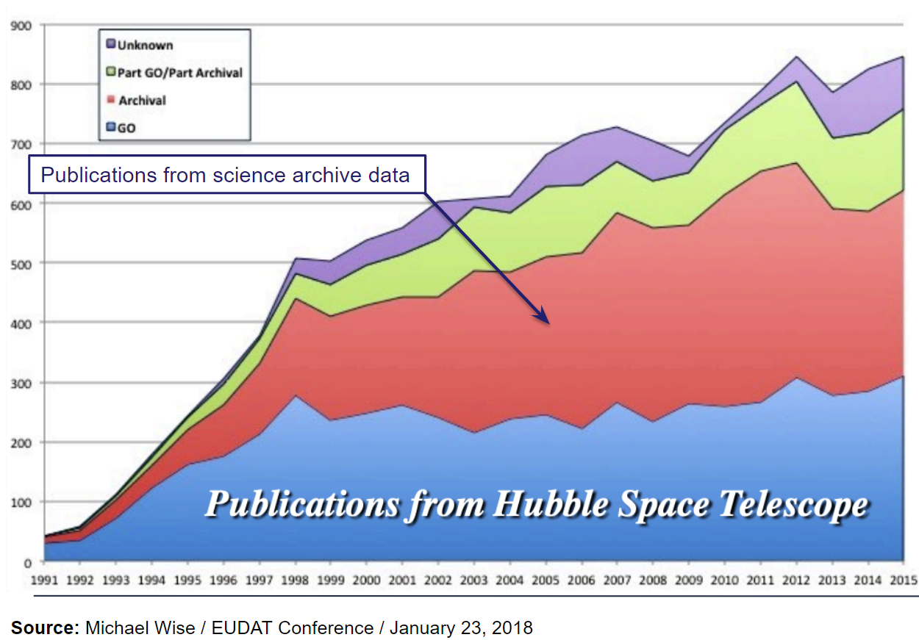
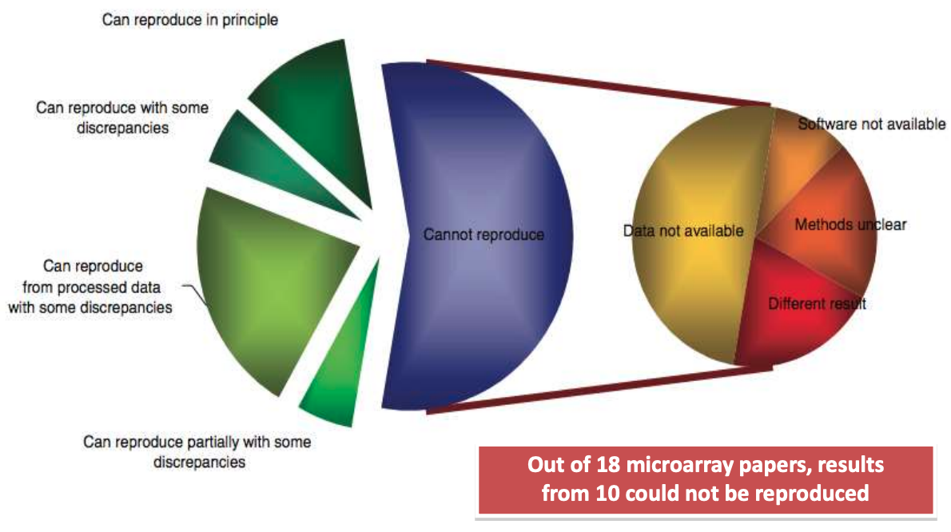
Motivation: increase scientific output, value, transparency, trust
Source: Ioannidis et al., 2009. Repeatability of published microarray gene expression analyses. Nature Genetics 41: 14
See also: Science publishing: The trouble with retractions http://www.nature.com/news/2011/111005/full/478026a.html Bjorn Brembs: Open Access and the looming crisis in science https://theconversation.com/open-access-and-the-looming-crisis-in-science-14950

Slide 19
Since 2018
European Open Science Cloud
Vision: A multi-disciplinary environment where researchers can publish, find and re-use data, tools and services, enabling them to better conduct their work.
Builds on existing infrastructures and services supported by the European Commission, Member States and research communities.
Brings these together in a federated ‘system of systems’
EGI services enable federation and advanced computing in EOSC
Complemented by: policies, requirements (e.g. DMP), education, data stewards, incentives
Together making “Open science as the new norm”

Slide 20
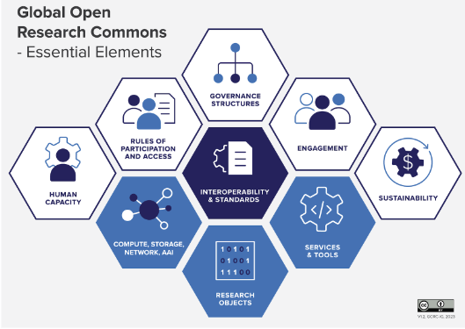
EGI’s look at EOSC: The European Open Research Commons
EOSC Beyond project from Mar 2024
EGI position paper: https://zenodo.org/records/11128540
Collaboration is the hallmark of modern science
The Open Science Commons embodies this vision
The Global Open Research Commons International Model Report, Version 1; Payne,K., Corrie,B., Crawley,F., Harrower,N., Macneil,R., Maxwell,L., Sansone,S.-A., Treloar,A., Woodford, C., Åkerström, W.N.
EOSC Data Commons new project from April 2025

Slide 21
EOSC Data Commons - A new EOSC Project from April 2025, coordinated by EGI
Services for inter- and cross-disciplinary data discovery, access, sharing and reuse in the EOSC Federation
EGI Federation and Repository Owners and Data Providers
5 Multidisciplinary Repositories
7 Thematic Repositories
HAL
DaSCH

Slide 22
A joint project of multiple EOSC stakeholders
(Started in 2024, coordinated by EGI)
Node-based technical architecture
EOSC Federation Technical Architecture taking into account the introduction of the concept of Node
03
New EOSC Core Services
Next generation of Core Services for the next release of the EOSC EU Node and as reference implementation for other nodes
01
02
Sandbox and integration suite
Testing, validation and integration of EOSC nodes with data spaces

Slide 23
EGI-KISTI project
Research on interconnection methodology between EOSC-EGI and KRDC(KISTI) in terms of technology and policy

Slide 24
Project scope
In response to this global trend, the Korea Institute of Science and Technology Information (KISTI), under the Ministry of Science and ICT in Korea, is currently undertaking the construction of the Korean Research Data Commons (KRDC) to facilitate the integration of various domestic or institutional research data commons systems. Specifically, starting from 2022, KISTI has been designing and developing the KRDC Framework to implement KRDC and concurrently building strategies for collaboration with advanced global systems such as the European Open Science Cloud (EOSC), with the aim of establishing a global interconnection framework in the future.
To facilitate the aforementioned objectives, EGI, which plays a pivotal role in the EOSC initiative, and KISTI conducted an international collaborative research to establish a methodology for connectivity between EOSC and KRDC, thereby ensuring seamless interoperability and collaboration.

Slide 25
Project tasks
Task 1:
Investigation of methodology for EOSC construction and interconnection
Task 2:
Strategy development for applying EOSC technologies to KRDC
Task 3: Analysis of construction/operational costs and roadmap for an EOSC-like system
in Korea
Task 4:
Development of integration strategies and testing scenario
Task 5:
Evaluative comments on KRDC functions

Slide 26
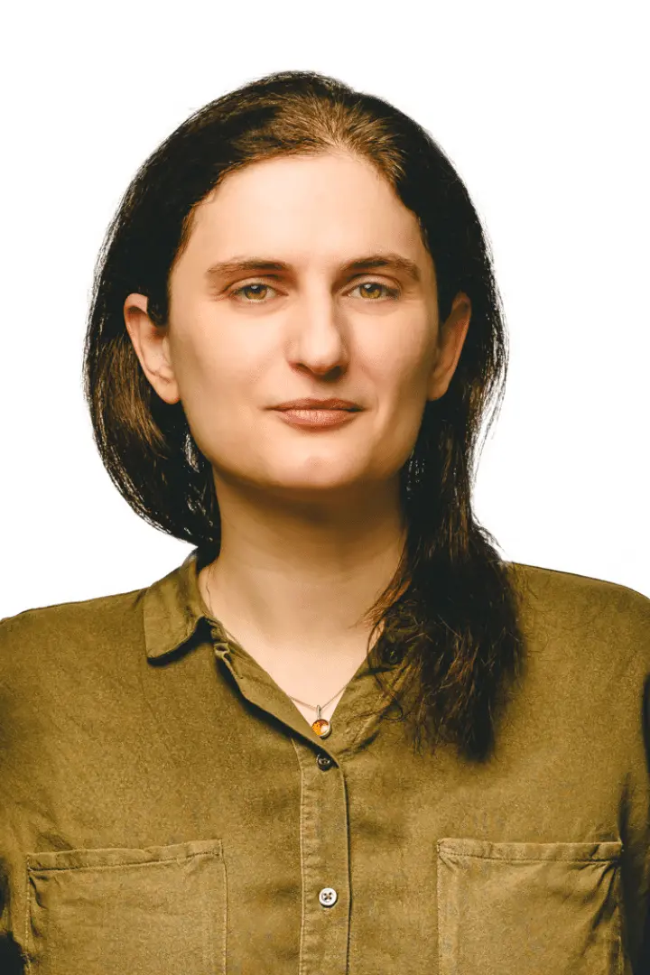
The EGI project team
Gergely Sipos - Coordination
Valeria Ardizzone - Authentication & Authorisation expert
Enol Fernandez - Compute and platform services expert
Andrea Manzi - Data services expert
Diego Scardaci - EOSC expert
Małgorzata Krakowian - Project management expert

Slide 27
Achievements
Status and technology analysis of EOSC from the KRDC perspective
Compatibility study between the services and protocols of EGI and KRDC
EGI - KRDC interoperability scenarios; Advantage-risk analysis; Demonstrator
Financial and operational considerations for an EOSC-like system in Korea
User-centric assessment of the KRDC system
Possibilities for future KISTI - EGI collaboration

Slide 28
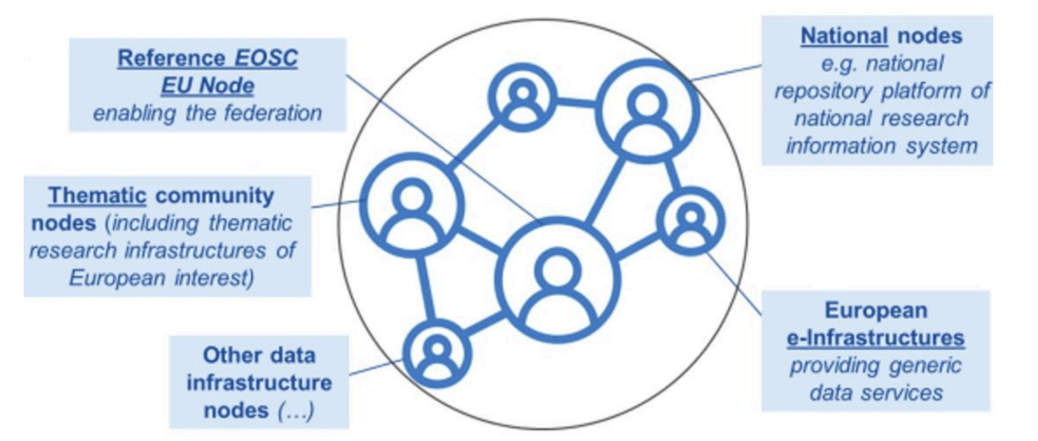
Achievement 1:
Status and technology analysis of EOSC from the KRDC perspective
Rules and requirements for all other EOSC Nodes are under development
EGI as federator (Service Management System, …)
LAUNCH AT THE EOSC SYMPOSIUM (21-23 October)
EGI as contributor to user-facing services
(Jupyter Notebooks)
To provide inter-node connections
EOSC as a federation of ‘Nodes’
EGI’s ambition is to contribute as a node
Scalable compute-storage
Generic platforms
Thematic data and services
Ability to take over federation functions

Slide 29
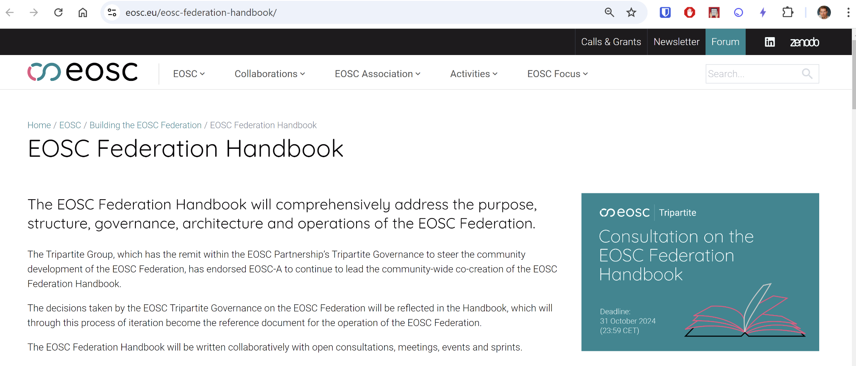
NEW!
Consultation on the Federation Handbook section is now open

Slide 30
Slide from: Webinar for EOSC Candidate Nodes, Monday 7 October 2024

Slide 31
Achievement 2:
Compatibility study between the services and protocols of EGI and KRDC
To exchange scientific data between KRDC and EGI
To ensure authenticated access among KRDC and EGI
User documentation: https://docs.egi.eu
https://www.egi.eu/services/research/

Slide 32
Achievement 3:
EGI - KRDC interoperability scenarios; Advantage-risk analysis; Demonstrator
Discover
Download
Analyse
(Entry to scientific datasets)
EGI
KRDC
2. Download
3. Analyse

Slide 33
Achievement 4:
Based on the recommendations of the EOSC Financial Sustainability Task Force (Apr’2024)
Financial and operational considerations for an EOSC-like system in Korea
Caution!
EOSC operates in a very complex financial environment with funding sources from European and national funding agencies, academic institutions and commercial entities from 30+ countries
EOSC is in transition regarding its technological, governance and financial structures
Joint funding from the Korean science funding agency, and the institutes supplying components to KOSC (~Korean Open Science Cloud) is essential to ensure nation-wide engagement and strategic relevance.
Long-term, stable political and financial commitment is essential.
KOSC should be part of the rich ecosystem of existing Korean research infrastructure facilities, and should build on, complement and enhance, but not duplicate, it.
KOSC need to provide straightforward access to the Korean research community’s services and platforms for data utilisation and analytics, to support realisation of the full potential of research data.
Federating data and services through KOSC involve additional costs for providers, which should be paid for primarily by the institutes contributing those data and services.
Coordination of KOSC strategy and funding between participating institutes and with the Korean science funding agency is required and should be assured as part of the KOSC governance.
The sustainability of research services must be addressed for efficient use of investment.
Inclusiveness: Whatever legal and governance model is adopted, the division of costs within its funding model should not act as a barrier for institutes to participate.

Slide 34
Achievement 5:
User-centric assessment of the KRDC system
“The KRDC system demonstrated to be a complex, but well thought-through system that supports the entire lifecycle of digital science, from data discovery, to data staging, data processing and result sharing.”
“We hope that our feedback helps KISTI further advance the KRDC system and will be considered in its future development roadmap.”
Quote from the 40 page long evaluation report

Slide 35
Achievement 6.
Possibilities for future KISTI - EGI collaboration
Sharing of additional assets, particularly computational resources, workflows, processing applications between KRDC and EGI. (e.g. in JupyterLab).
Demonstration of diverse access management policies required in international research collaborations to achieve complex sharing of resources and digital assets and among their members. (e.g. “moving data to compute” vs. “moving compute to data” considering the size and sensitivity of data)
Support for AI applications and AI-powered services within an integrated EGI – KRDC ecosystem.
Re-evaluate KRDC – EOSC interconnection options after the transitioning of EOSC to Node architecture is over. (spring 2025 the earliest)
Related recommendations:
Identify scientific communities that require coordinated resource sharing between Europe and Korea, and involve them in future piloting and validation activities.
Consider EGI membership (institutional/national) and gain all EGI benefits, incl. EC project development

Slide 36
Thank you!

