Slide 1
EGI for Open Science
Gergely Sipos
Head of Services, Solutions, Support
EGI Foundation

Slide 2
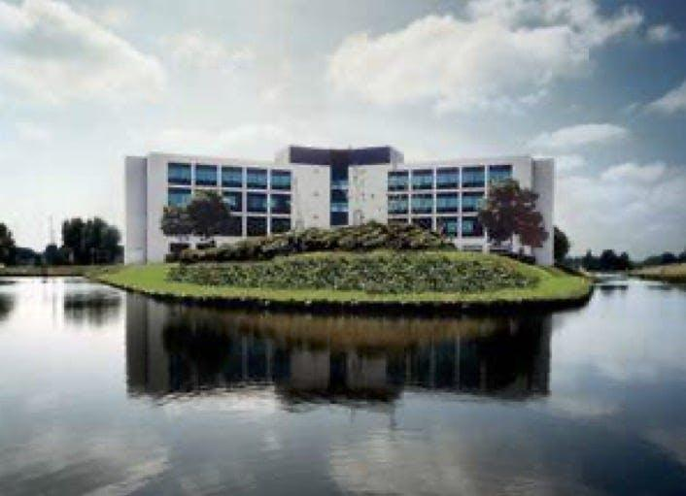
EGI Foundation
Gergely Sipos
Non-for-profit organisation
Established in Amsterdam in 2010
Coordinates the EGI Federation
45 employees, 19 different nationalities
Works at EGI Foundation since 2010
Head of the technical department
Coordinator of Open Science projects
PhD in Compute Science
Lives in Budapest

Slide 3
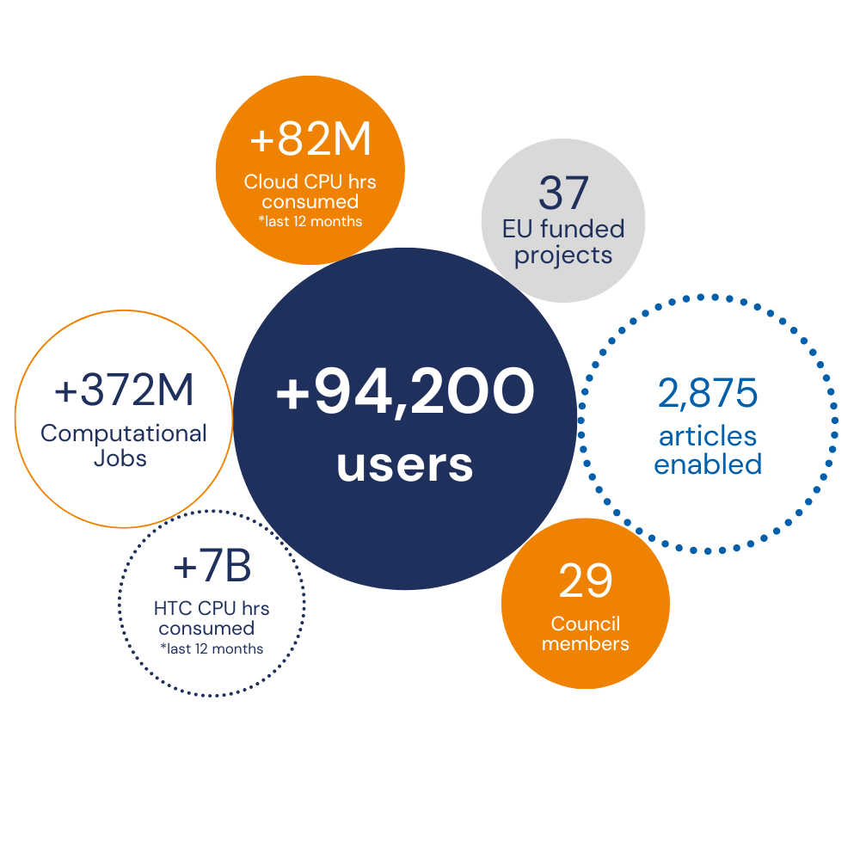
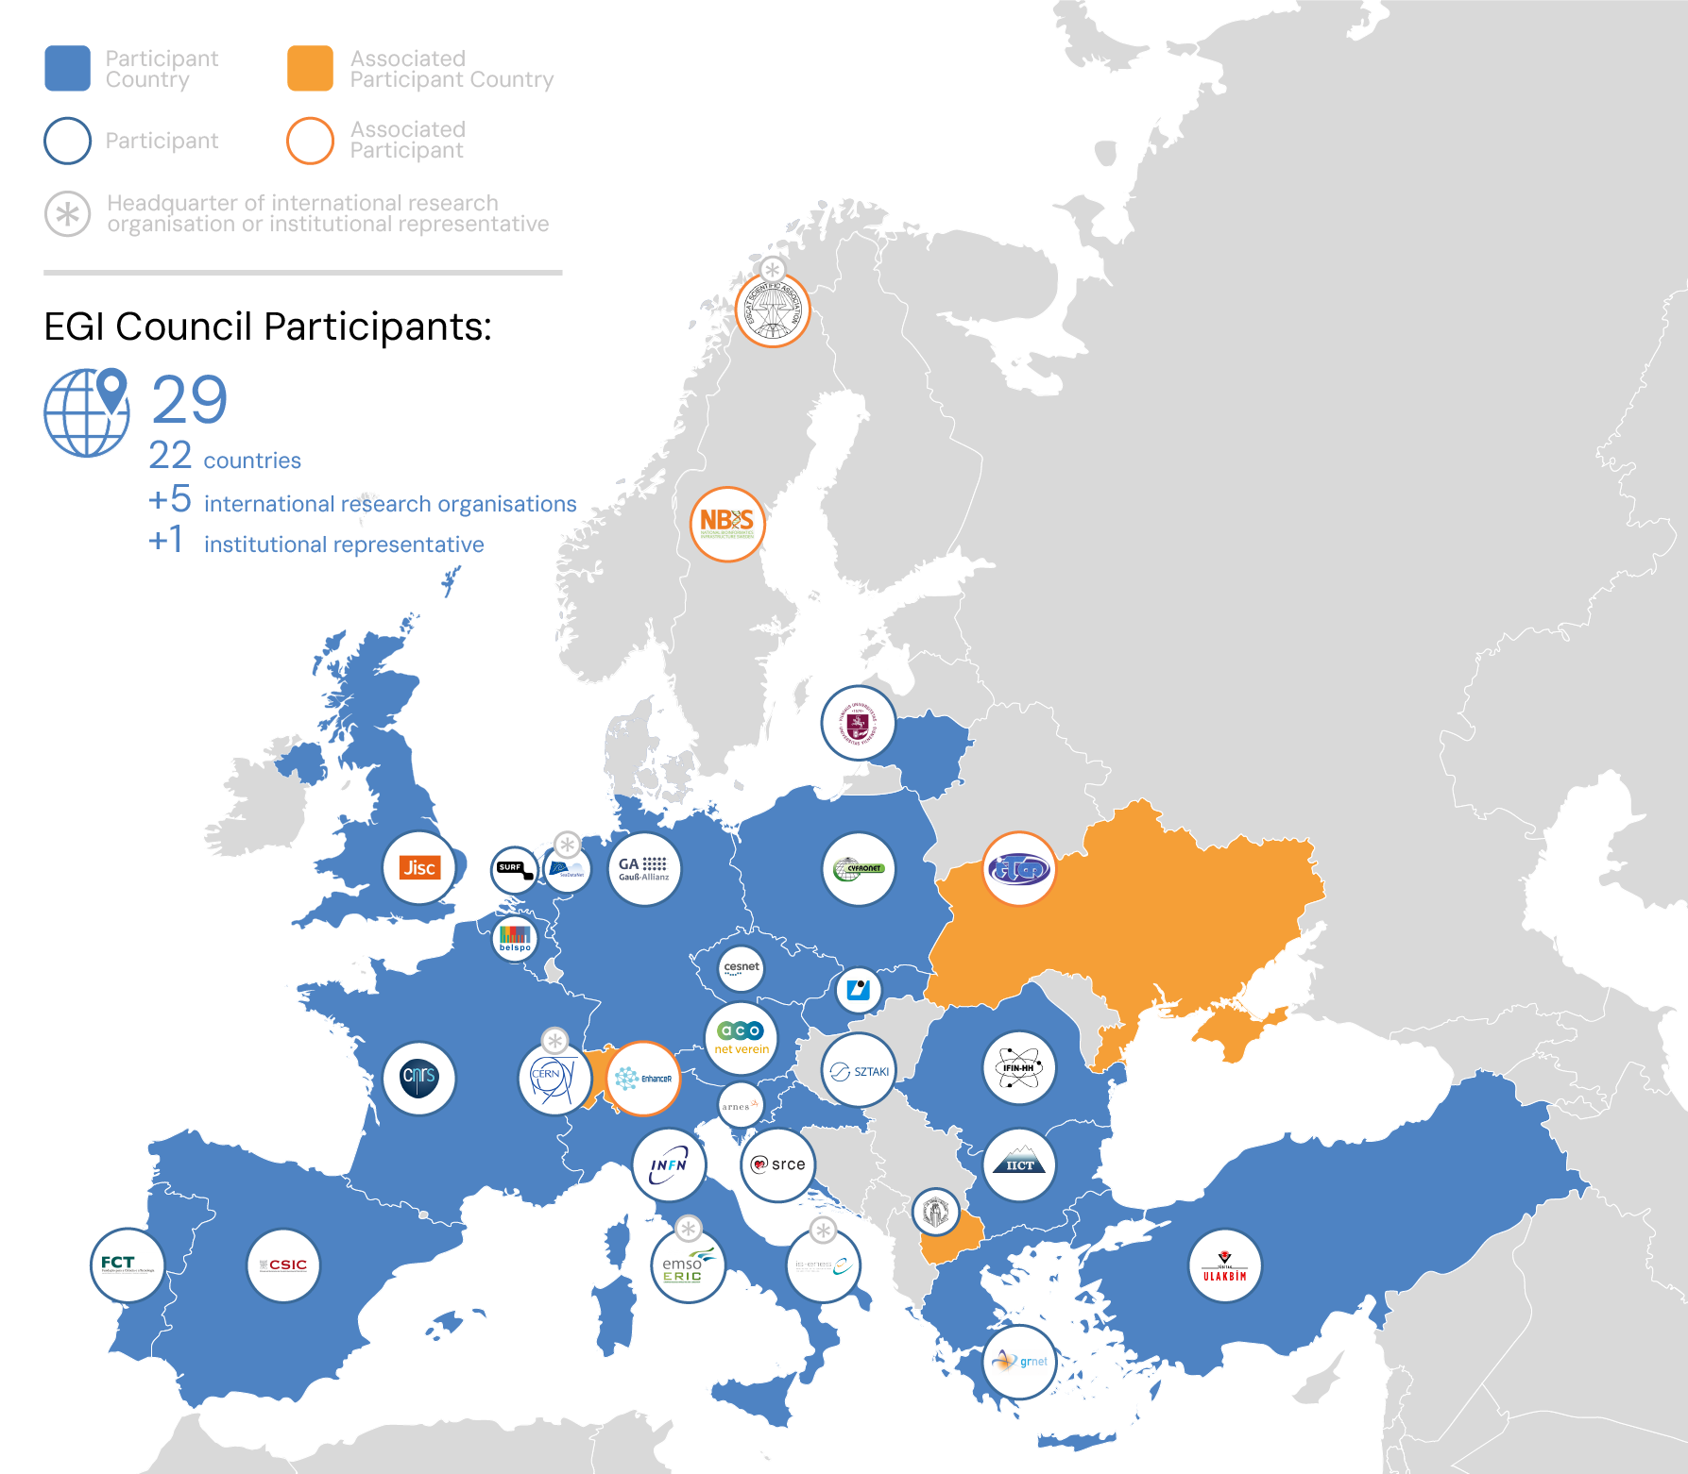
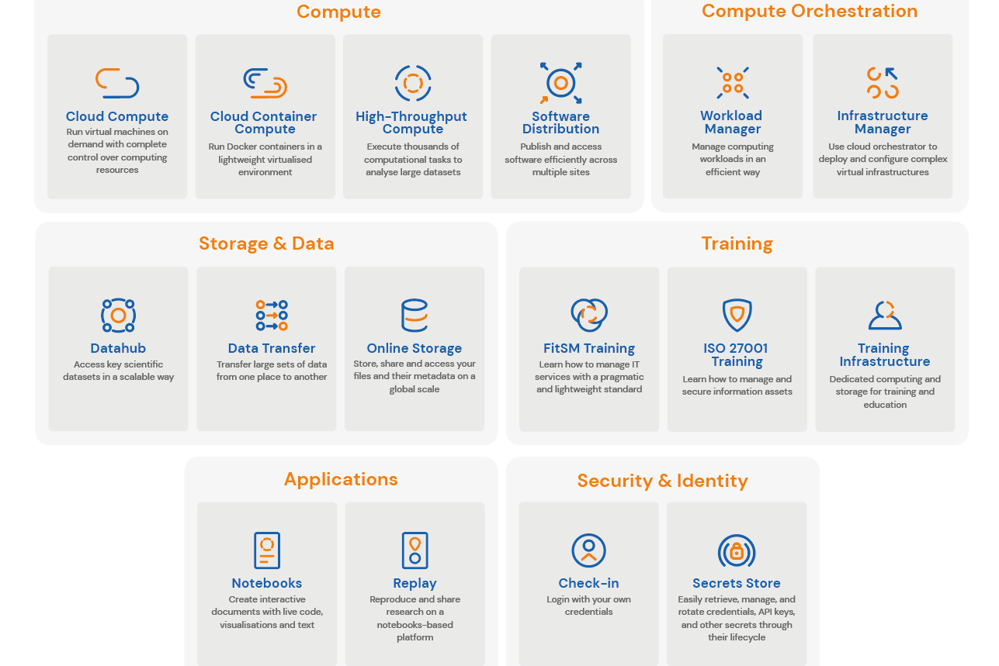
EGI in a Nutshell
www.egi.eu
EGI Federation
A European flagship digital infrastructure for data-intensive scientific computing
EGI in numbers¹
EGI Services
EGI delivers advanced computing services to support scientists, international projects, research infrastructures and businesses.
EGI services for research
Why a federation?
Support science at international scale
Build an hyperscale facility for research
Invest nationally, access globally
Bring computing to the data

Slide 4
EGI for Open Science
Federated compute & storage platform
For big data open science
Core elements for the ‘European Open Science Cloud’ (EOSC)
Service monitor, User portal, Usage accounting, Identity federation, Helpdesk, …
Technical support for service providers and users
Data and application integration, Community platforms e.g. ENVRI-hub Next, iMagine
Digital Innovation Hub
For public-private partnerships
Projects and Task Forces to evolve all these systems and activities
E.g. EOSC-Beyond, EOSC Task Forces

Slide 5
To be continued…

