Slide 1
Introduction to Jupyter and EGI Notebooks - Big Data 2019 Conference
Giuseppe La Rocca – giuseppe.larocca@egi.eu
Dissemination level: Public
http://go.egi.eu/bigdata2019

Slide 2
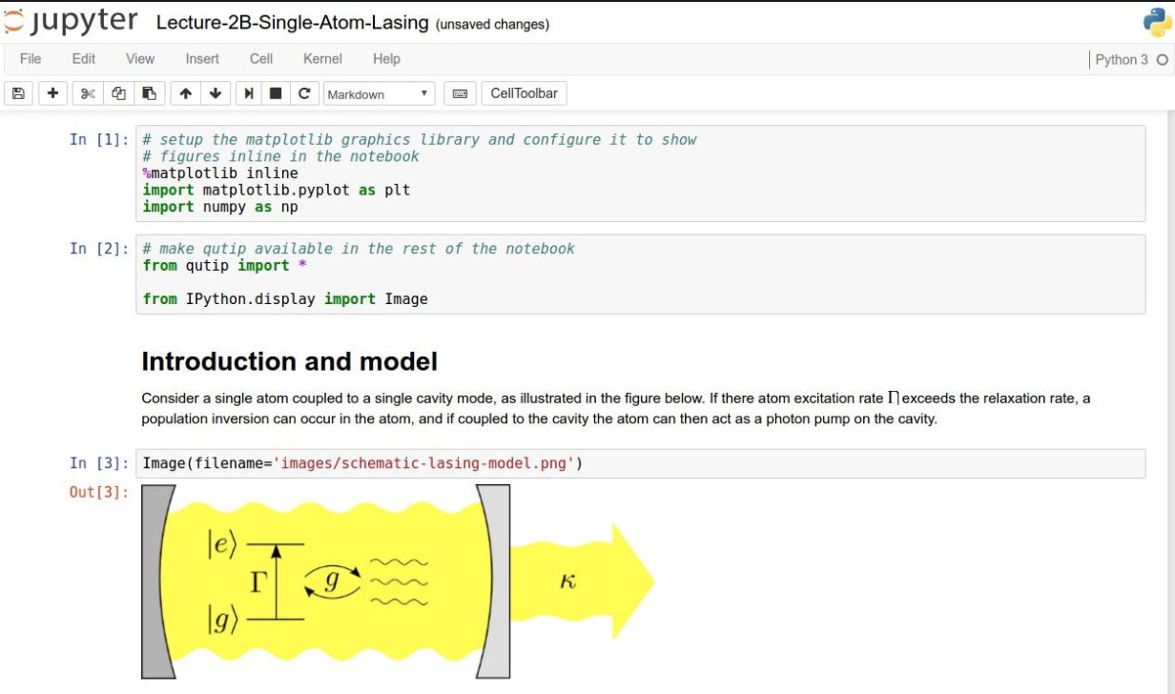
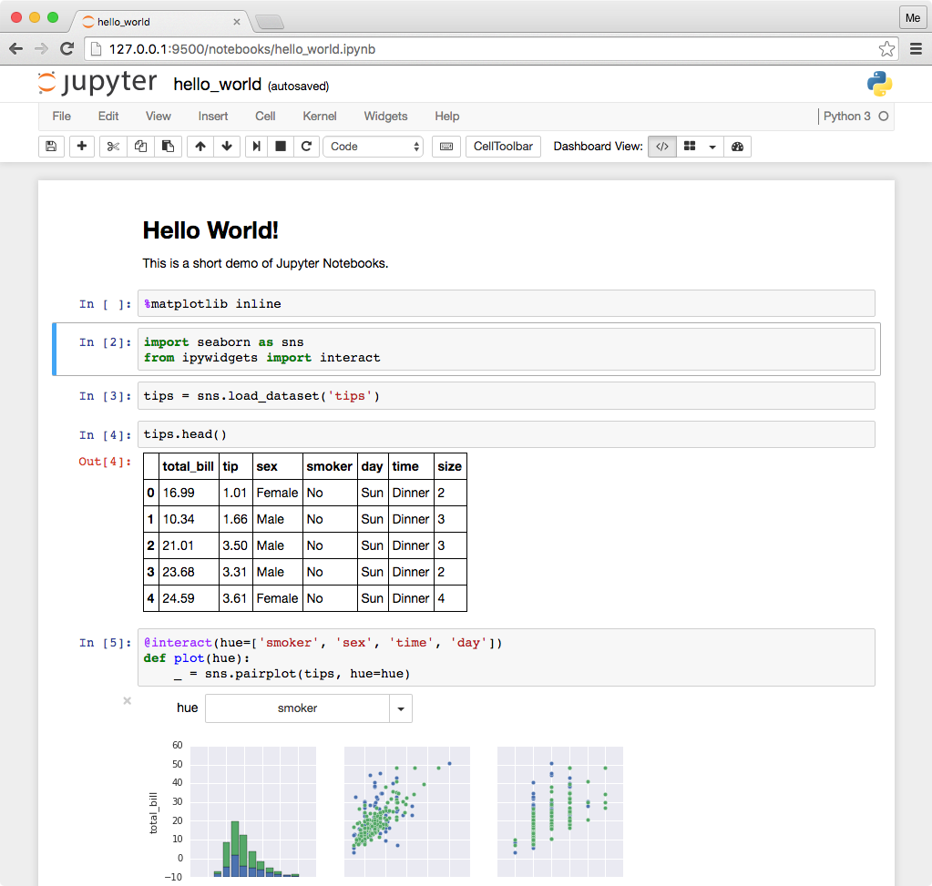
Training objectives
Learn the basics of EGI notebooks
Jupyter
Hands on practice with the EGI notebooks service
Basic data import, processing and visualisation
GitHub, Zenodo, Binder
Sharing & re-executing notebooks
Other possibilities
Working with big data
How to become a user

Slide 3
Agenda
Session 1 (13:30-15:10):
Introduction to EGI and the EGI Notebooks service (talk)
Hands-on
Exercise 1 – Getting started
Exercise 2 – Get some data and plot it
Other Notebooks features (demo)
A real notebook example
Session 2 (15:30-17:00):
Binder, GitHub, Zenodo – Sharing, Identifying, Re-executing notebooks
Talks + hands-on exercises
Accessing big data from notebooks – EGI DataHub (demo)
Become a user - Notebooks in EOSC (talk)
Feedback forms (10’)

Slide 4
Overview of EGI
Notes:
How many of you know about EGI and its Cloud services?

Slide 5
EGI: Federation of national e-infrastructures
Established in 2010
EGI Foundation: Coordinator (based in Amsterdam, Science Park)
NGIs: National e-infrastructures (22 country + CERN)
Membership fees sustain the federation; Projects to advance our services (e.g. EOSC-hub)
EGI = Compute, Storage, Data, Training, Consultancy services
Institutional representatives

Slide 6
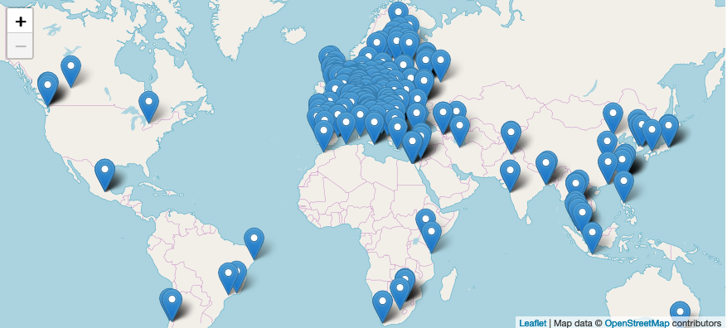
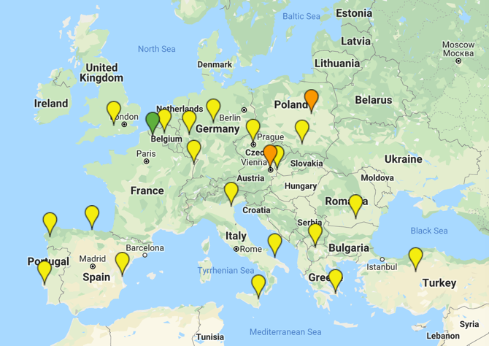
EGI Federation & Cloud federation (Jun 2019)
4.4 Billion CPU core wall time (2018)
> 1 Million computing cores in 2019
> 740 PB disk & tape
Resource centres
2,915 service end-points
Cloud providers (22)

Slide 7
A global system of e-Infrastructures

Slide 8
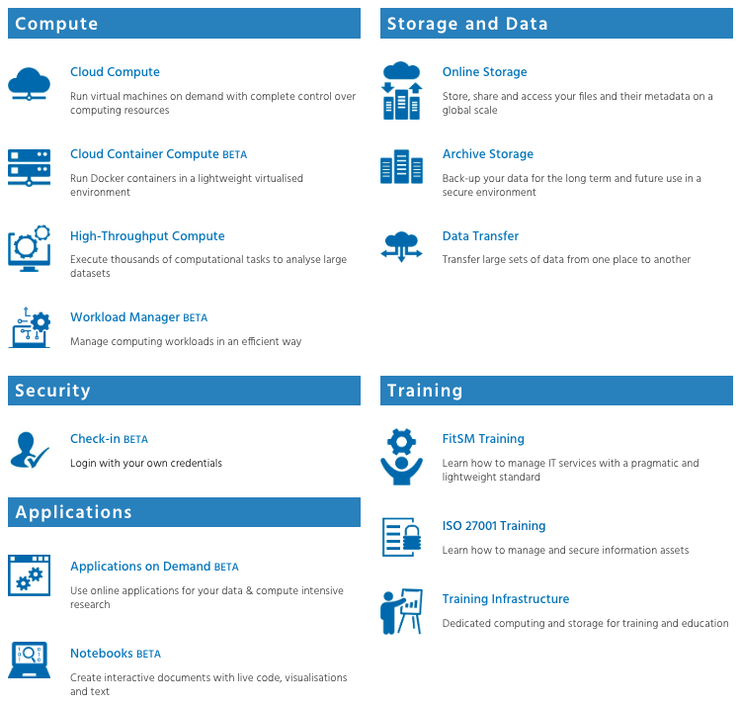
The EGI Service Catalogue: www.egi.eu/services
Used by Notebooks

Slide 9
EGI Cloud
Multi-cloud Infrastructure as a Service
Single Sign-On via Check-in
Harmonised access to participating cloud sites
Technology agnostic, supports OpenStack, OpenNebula and Synnefo
Supports community platforms (PaaS) and applications (SaaS)
24/7 operation in the cloud (access control, monitoring, security alerts, etc.)
EGI Notebooks is one of these
Cloud
Compute
Cloud Container
Compute
Online
Storage
High level applications
Training
Infrastructure

Slide 10
EGI Notebooks
‘Jupyter as a Service’ in the EGI Cloud
Notes:
How many know about Jupyter
Used jupyter before?
Programming experience?

Slide 11
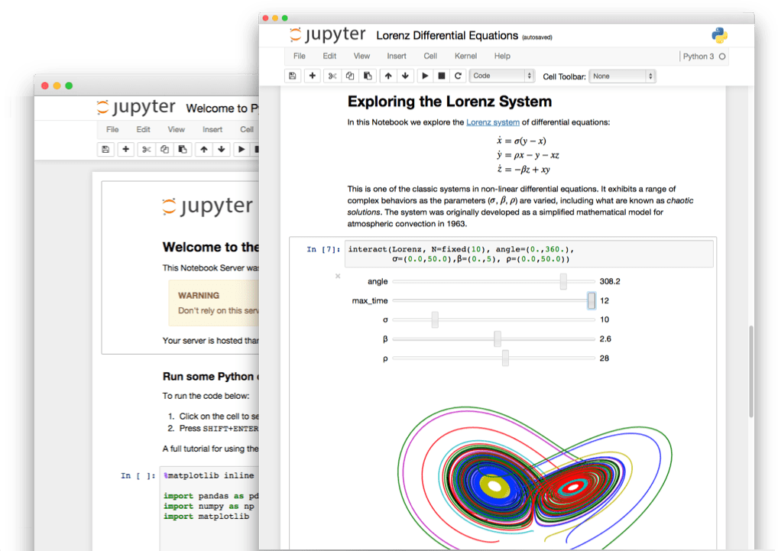
The Jupyter Notebook in a nutshell
Non-profit, open-source, interactive platform for Data Science born out of the iPython project in 2014
Released under the BSD license
Notebooks can be shared with others using email, Dropbox, GitHub
Interactive widgets

Slide 12
Some key features
Language of choice
The Notebook has support for over 40 programming languages, including Python, R, Julia and Scala
Interactive output
Your code can produce interactive output: HTML, images, videos, LaTeX, and custom MIME types
Big data integration
Leverage big data tools, such as Apache Spark for Python, R and Scala.
Share notebooks
Notebooks can be shared with others using email, Dropbox, GitHub and the Jupyter Notebook Viewer

Slide 13
JupyterHub
Jupyter is single user by design
JupyterHub is a multi-user version of notebook designed for companies, classrooms and research labs
Manages Authentication
Spawns single-users notebooks servers on-demand
Gives each user a complete Jupyter server

Slide 14
EGI Notebooks
JupyterHub hosted in the EGI Cloud
Offers Jupyter notebooks ‘as Service’
One-click solution: login and start using
Extra EGI Features:
Login with the EGI AAI Check-In service
Persistent storage for notebooks
Use EGI computing and storage resources from your notebooks

Slide 15
EGI Notebooks service modes
Catch-all instance (https://notebooks.egi.eu)
Available via the Marketplace
Limited resources: 1 CPU, 1GB RAM and 10GB of persistent storage
Sponsored access (free for the users)
Kills notebooks after 1 hour of inactivity (Directories and files are permanent)
Community deployments
Tailored to specific community with custom computing/storage, e.g.:
access to GPUs, fat nodes
access to Spark, other BigData/ML environments
auto-mount filesystems on notebooks (e.g. specific DataHub space)
…
Deployment for training https://training.notebooks.egi.eu
1 CPU / 1GB RAM and 10GB storage / user
To be used today

Slide 16
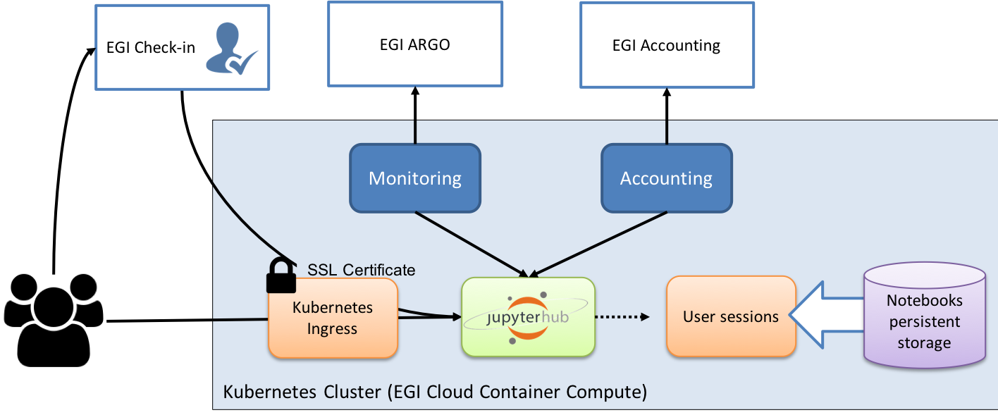
Technology Stack
https://training.notebooks.egi.eu

Slide 17
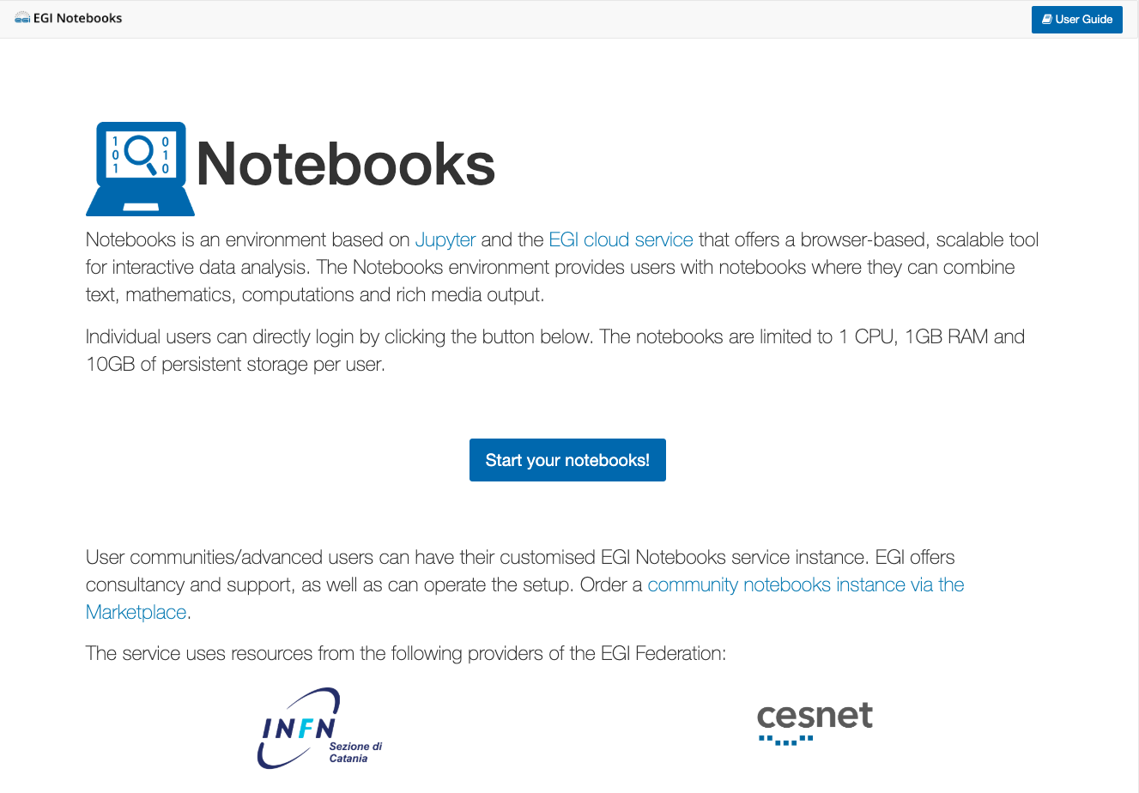
Single Sign-On (SSO)
Completely integrated with EGI Check-in
Login with eduGAIN, social (Google, Facebook, LinkedIn) OR EGI SSO
Fine grained authorisation
VO membership
Role, group, …
Login at https://training.notebooks.egi.eu
Choose Your institutional account or preferred social account (or setup an EGI SSO account: https://egi.eu/sso)
You will receive an email to validate your request

Slide 18
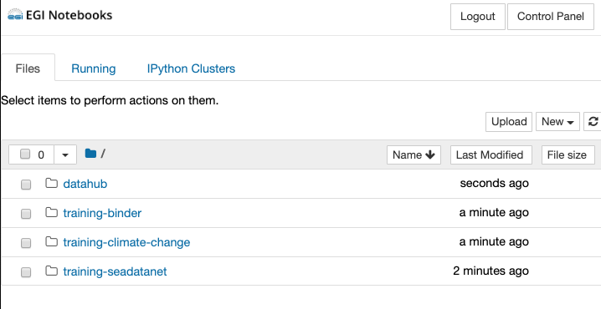
Directories
DataHub spaces (see later)
To be used in the Binder exercise
Files for our 1st exercise
SeaDataNet: DataHub demo

Slide 19
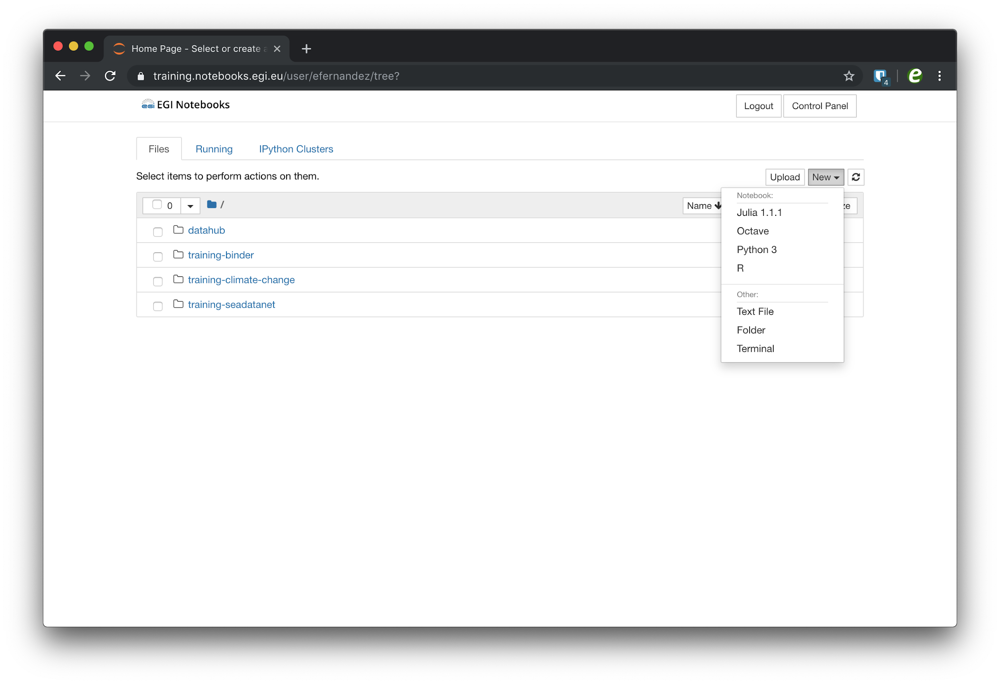
Jupyter Notebooks interface
Launch your notebook with the python Kernel
File browser
Run a terminal on the notebooks server

Slide 20
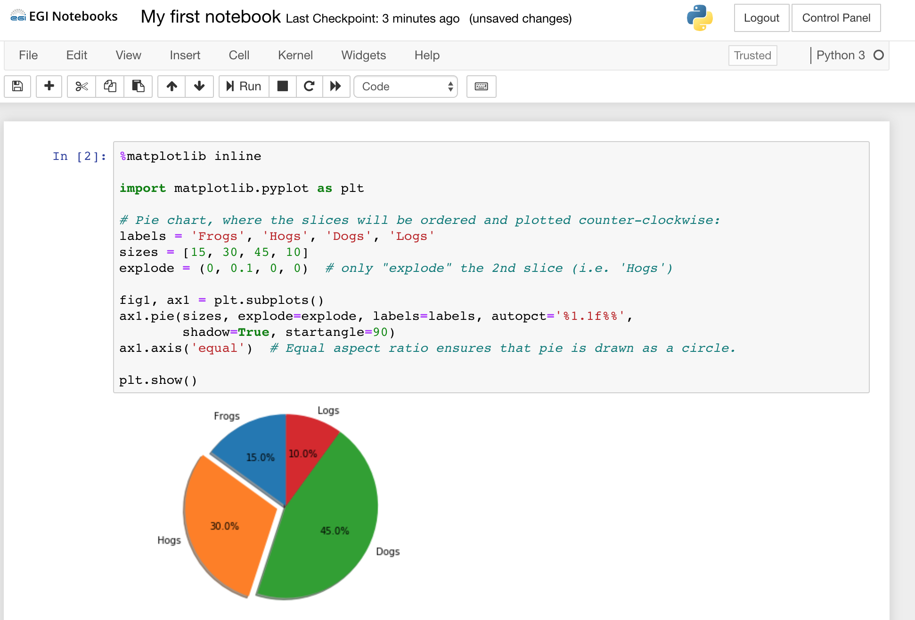
A running notebook
Menu bar: The menu bar presents different options that may be used to manipulate the way the notebook functions.
Toolbar: The tool bar gives a quick way of performing the most-used operations within the notebook, by clicking on an icon.
Cell: the notebook cell
Menu bar
Tool bar
Cell
Cell output
Notes:
When you start your notebook you create a new .ipynb file

Slide 21
Structure of a notebook
The notebook consists of a sequence of cells.
A cell is a multiline text input field
The execution behaviour of a cell is determined by the cell’s type.
There are three types of cells: Code, Markdown, and Raw cells.
Code cells allow you to edit and write new code, with full syntax highlighting and tab completion.
The programming language you use depends on the kernel
Markdown cells allow to alternate descriptive text with code
Raw cells provide a place in which you can write output directly. Raw cells are not evaluated by the notebook

Slide 22
Shortcuts
The essential shortcuts to remember are the following: Shift-Enter: run cell.
Execute the current cell, show any output, and jump to the next cell below. If Shift-Enter is invoked on the last cell, it makes a new cell below. This is equivalent to clicking the Cell, Run menu item, or the Play button in the toolbar.
Esc: Command mode.
In command mode, you can navigate around the notebook using keyboard shortcuts.
Enter: Edit mode.
In edit mode, you can edit text in cells

Slide 23
Hands-on
http://go.egi.eu/notebooks-training
Check examples on: Training instance > Hands-on

