Slide 1
INDIGO: Building a DataCloud Framework to Support Open Science
Yin Chen, yin.chen@egi.eu, EGI.eu
Fernando Aguilar, aguilarf@ifca.unican.es , IFCA-CSIC
Jesus Marco, marco@ifca.unican.es , IFCA-CSIC
Sandro Fiore, sandro.fiore@unisalento.it, CMCC
Massimiliano Rossi, massimiliano.rossi@ingv.it, INGV
INDIGO Collaboration Team, infor@indigo-datacloud.eu

Slide 2
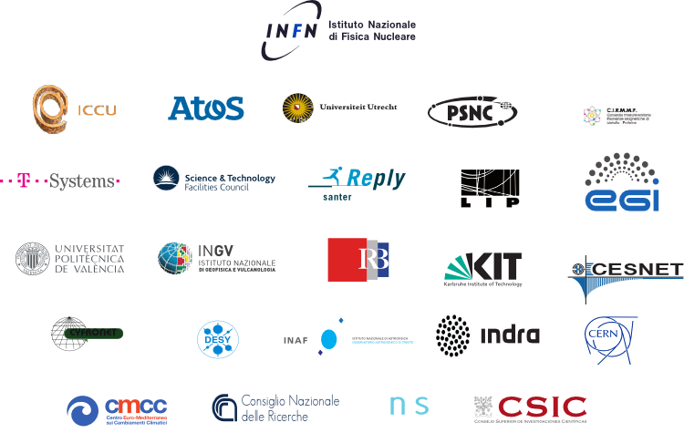
INDIGO-DataCloud
Towards a sustainable European PaaS-based cloud solution for e-Science
INDIGO - DataCloud develops an open source data and computing platform targeted at scientific communities, deployable on multiple hardware and provisioned over hybrid, private or public, e-infrastructures.
H2020 project, Apr 2015 – Oct 2017, 11M EURO
26 European partners in 11 European countries
website: www.indigo­‐datacloud.eu
> Biological & Medical science
> Social science & Humanities
> Environmental and Earth science
> Physics & Astrophysics
The platform aims to address a wide range of challenging requirements posed by leading-edge research activities conducted by 11 scientific communities from different research areas

Slide 3
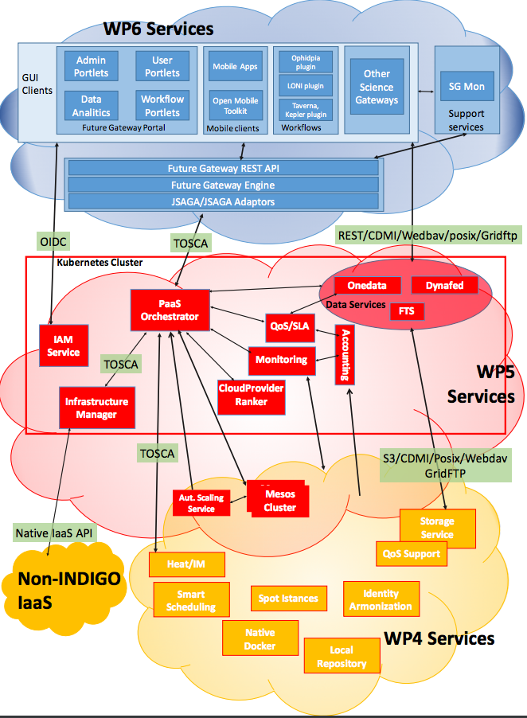
INDIGO
Architecture
Enhanced features in:
IaaS
PaaS
SaaS
User-driven design approach
Based on community requirements
Reduce the gaps between ICT & Researchers

Slide 4
INDIGO- Communities
Life Sciences: ELIXIR, INSTRUCT/WeNMR, EuroBioImaging
Physical Sciences & Astronomy: CTA, LBT, WLCG
Social Sciences & Humanities: DARIAH, DCH-RP
Environmental Science: LifeWatch, EMSO, ENES

Slide 5
Methodology for Requirement Collection
highly criticized
and refined
in several iterations
A template was designed to gather information from communities
Based on Case Studies
A Case Study is an implementation of a research method involving an up-close, in-depth, and detailed examination of a subject of study (the Case), as well as its related contextual conditions.
Focus on Case Studies that are representative both of the research challenge and complexity but also of the possibilities offered by INDIGO-Data Cloud solutions on it.
A Case Study is (ideally) based on a set of User Stories, i.e. how the researcher describes the steps to solve each part of the problem addressed.
User Stories are the starting point of Use Cases, where they are transformed into a description using software engineering terms (like the actors, scenario, preconditions, etc).
Use Cases are useful to capture the Requirements that will be handled by the INDIGO software developed in JRA work packages, and tracked by the Backlog system from the OpenProject tool.
The template serves as a structured framework with guiding questions concerned by INDIGO development work packages.
User Story A
User Story A’
User Story B
User Story C
User Story B’
Case Study 1
Case Study 2
Requirements
#LW1
#LW2
Use Cases
Open Project
BACKLOG

Slide 6
Methodology for Requirement
Analysis
Step1: Analysis of the Questionnaires to identify requirements
Produced large EXCEL table, several entries per Case Study
Community, Req#, Req. Descr., Rank (Mandatory/Convenient/Optional), Current, Gaps, Solution…)
Step2: identification of common requirements
Produced single EXCEL table

Slide 7
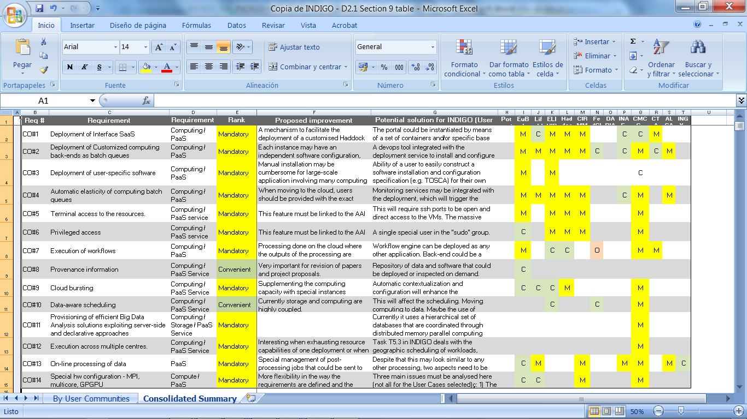
INDIGO Community
Requirements List

Slide 8
Reduce the Gaps between ICT and Communities Researchers
Identify communities Champions
Share activities inside INDIGO (in particular with ICT people)
Advanced research activities (postdoc+ level)
Different Technical/Scientific background/interest
Understand how INDIGO services will match communities requirements
Confirmation of the Case Studies analysis
Selection of INDIGO components/services
Using Tool for communication, i.e. OpenProject
Record Case Studies, User Stories, Requirements
Track INDIGO development
Give feedback to ICT
Testbeds to “try”
Realistic resources
Where demos can be built
Build an exploitation path for their communities
Help to prepare material to “support” their solution in front of colleagues
Explore all components (e-infrastructure/resources included!)
Dissemination material

Slide 9
Case Studies
Case Study P0_1: Monitoring and Modelling Algae Bloom in a Water Reservoir
Case Study P0_2: TRUFA (Transcriptomes User-Friendly Analysis)
Case Study P1: Medical Imaging Biobanks
Case Study P2: Molecular Dynamics Simulations
Case Study P3_1: Astronomical Data Archives
Case Study P3_2: Archive System for the Cherenkov Telescope Array (CTA)
Case Study P4_1: HADDOCK Portal
Case Study P4_2: DisVis
Case Study P4_3: PowerFit
Case Study P5: Climate models inter comparison data analysis
Case Study P6: eCulture Science Gateway
Case Study P7: EGI FedCloud Community Requirements
Case Study P8: ELIXIR-ITA: Galaxy as a Cloud Service
Case Study P9: MOIST—Multidisciplinary Oceanic Information System
Case Study P10: Data repository platform for DARIAH

Slide 10
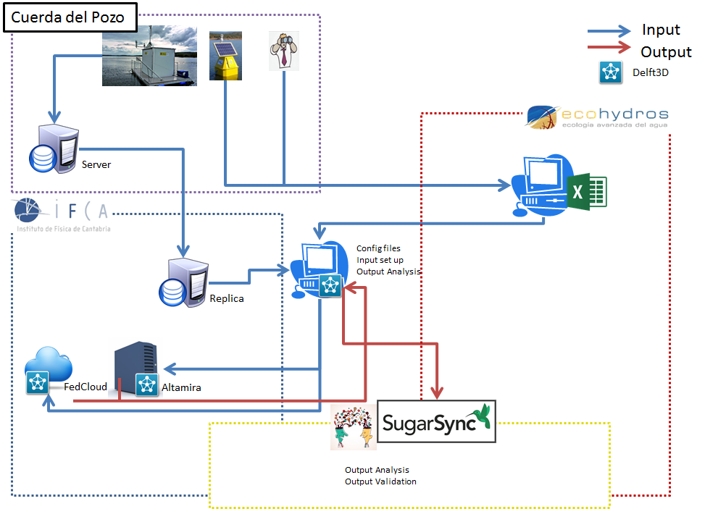
Community use cases of using
INDIGO Solutions - Modeling

Slide 11
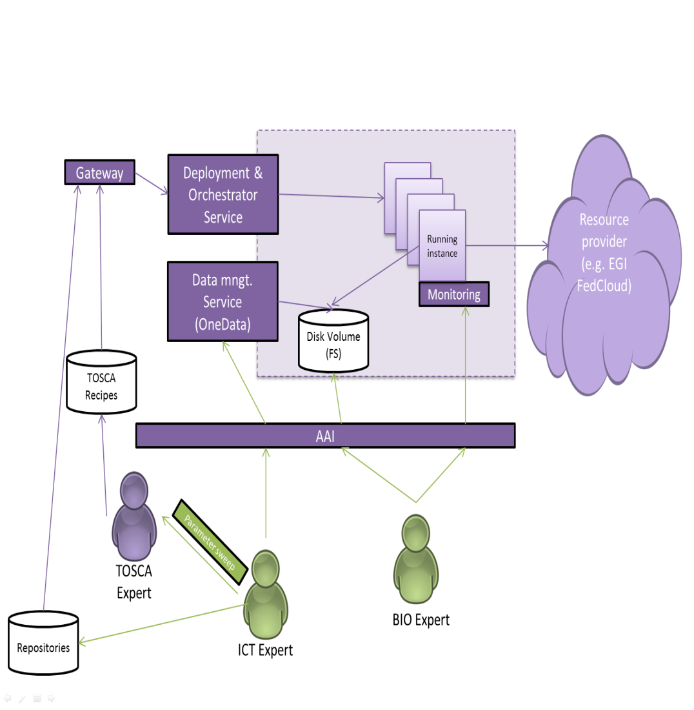
Community use cases of using
INDIGO Solutions - Modeling
ICT Expert configures a VM/Container with all software needed.
ICT expert needs to upload all the input files for being modelled.
N models can be run using the same input: Parameter sweep.
TOSCA expert configure the template to deploy de 1-N instances for running models.
The Orchestrator deploys the N Running Instances, which are monitored.
RIs access directly to input files and write output files.
BIO expert (final user) can check the running status and access directly to the output.

Slide 12
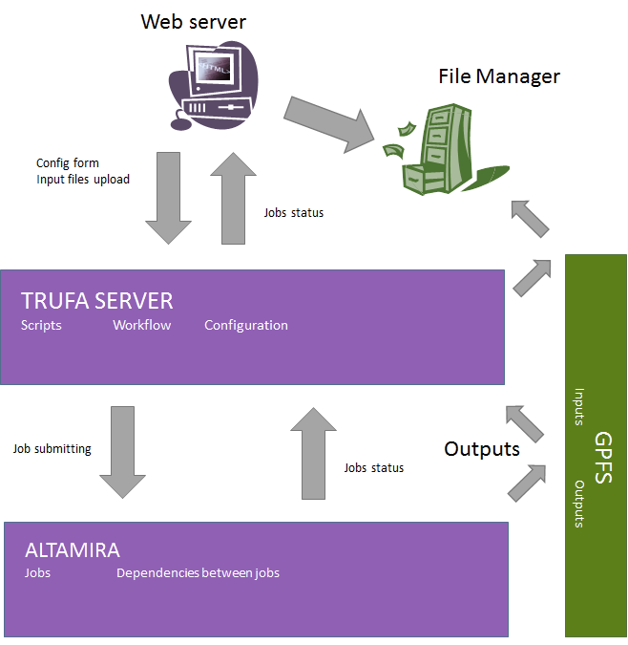
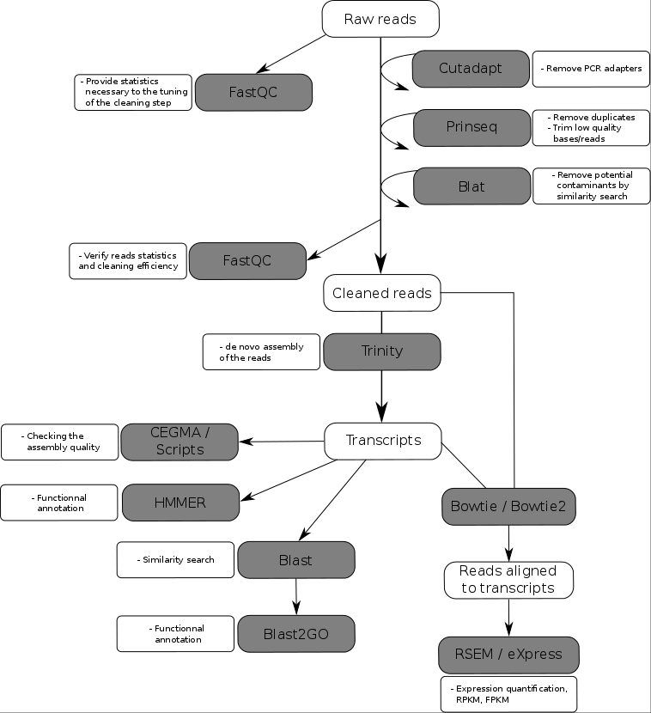
Community use cases of using
INDIGO Solutions - Workflows

Slide 13
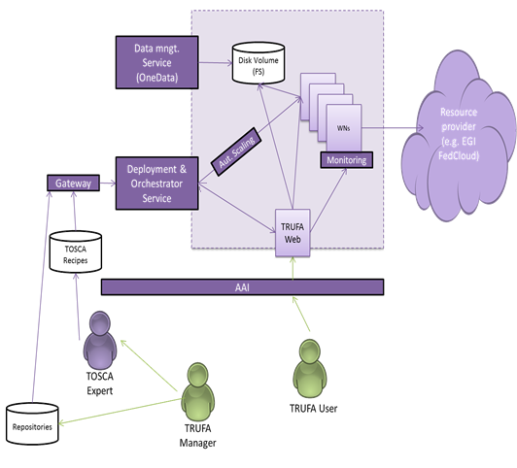
Community use cases of using
INDIGO Solutions - Workflows
TRUFA manager sets up a container/VM for TRUFA web and WNs (including all the pipeline software).
TOSCA expert configure the templates to deploy the environment.
TRUFA web is a service that need to be always running (Kubernetes?)
TRUFA Web should be able to communicate with Orchestrator that manage the WNs and Scale them when needed.
TRUFA Web can check the status of the jobs.
Both TRUFA web and WNs can access to a Disk volume managed by OneData. Input/Output
User access directly to TRUFA Web that is the endpoint to manage the actions: upload input, download outputs, configure a pipeline, check the status.

Slide 14
More info:
INDIGO-DataCloud
Better Sotware for better Science
Save the date - The path towards INDIGO DataCloud Release
Internal demo software release – April 2016
First INDIGO Software release – July 2016
Second INDIGO Software release – March 2017
Subscribe to INDIGO Newsletter:
www.indigo­‐datacloud.eu
Follow on:
www. twitter.com/indigodatacloud
https://www.linkedin.com/groups/INDIGODataCloud-8416266/about

