Slide 1
EGI HTC (Cluster) and Cloud Federation Implementation
Gergely Sipos Customer and Technical Outreach Manager
Gergely.sipos@egi.eu

Slide 2
Outline
Who we are
What we provide for ‘advanced computing’
How we do this (Operations)
Tools
People
Processes
Impact of our work
HPC federation in Europe: PRACE

Slide 3
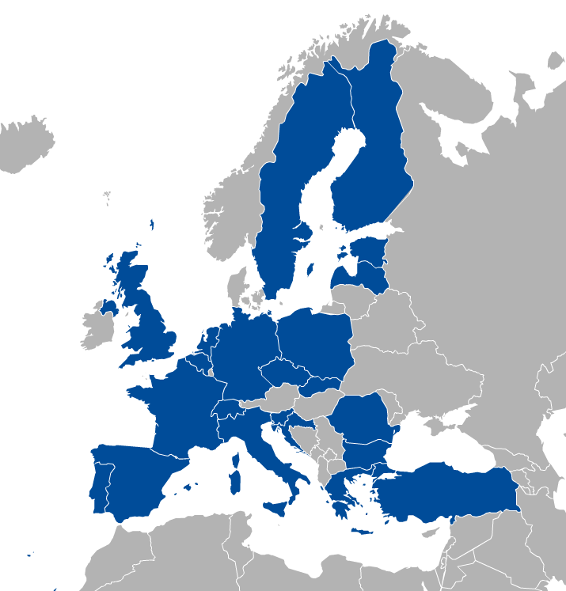
EGI: Federation of national e-infrastructures
Established in 2010
EGI Foundation: Coordinator (based in Amsterdam, Science Park)
NGIs: National e-infrastructures (22 country + CERN)
Shared mission to provide ADVANCED COMPUTING FOR RESEARCH
Membership fees sustain the federation; Projects to advance our services (e.g. EOSC-hub)
Institutional representatives

Slide 4
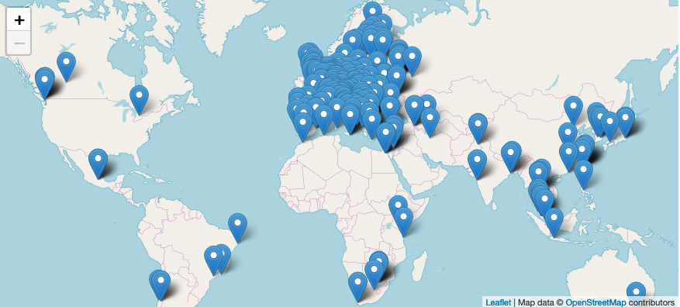
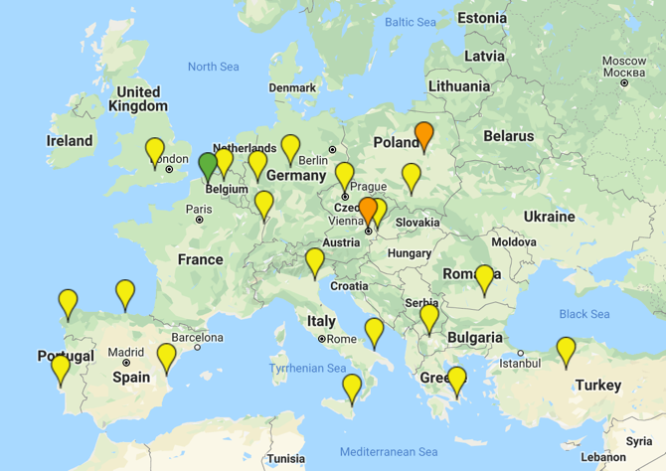
EGI Federation & Cloud federation (Jun 2019)
4.4 Billion CPU core wall time (2018)
> 1 Million computing cores in 2019
> 740 PB disk & tape
2,915 service end-points
Resource centres (200+)
Cloud providers (25)

Slide 5
A global system of e-Infrastructures Secured with Memorandum of Understandings

Slide 6
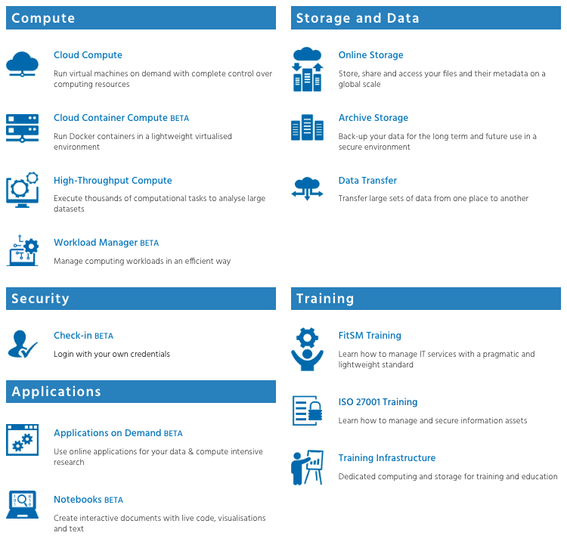
The EGI Service Portfolio: www.egi.eu/services
Most technical services have ready-to-use instances for the ‘long tail of science’

Slide 7
Resource allocation to communities
Trigger the process with a service access order through the EGI Website
Type, number, size, cost, availability, etc.
Applic. provider
Requirements
Conditions
Storage provider
Cloud provider
Negotiator
Grid provider
Project/Community representative
Service Level Agreement
Operation Level Agreement
Training
Support
Satisfaction review (every 3/6/12 months)
Performance reports

Slide 8
The pillars of operation in EGI
User communities
EGI Service Portfolio
Technical tools & services
Distributed operations teams
Processes

Slide 9
Pillar 1: Technical tools & services
GOCDB is a database of service endpoints. Used e.g. by Monitoring
ARGO determines health of services using ‘test probes’
Opens incident tickets in the Helpdesk
Keep track of federated assets
Making services robust
Enables federated authentication across EGI and community services
APEL supports CPU, GPU, Cloud and storage accounting and trend analysis
Configuration DB
Monitoring
Keeping track of resource usage
Making services accessible
Accounting
Check-in
Making services discoverable
and orderable
Making problems resolvable
Website and Marketplace
Run by designated partners for the whole federation.
Helpdesk
Distributed helpdesk connects users, providers and monitor system
A ‘webshop’ to find services & instances, to request access
Notes:
Marketplace: Expose your services to a broader audience
Applications DB: Validated software and repository for the EGI infrastructure
DataHub: Access, analyse and publish distributed data in the cloud.
Check-in: Login with your own credentials
Helpdesk: Your point of contact to ask for support at EGI
Configuration DB: Manage the configuration information of federated e-infrastructure assets and their functional relations
Accounting: Track and report the usage of your services
Monitoring: Monitor the performance of IT services

Slide 10
EGI Internal Service Portfolio
For the members of the federation

Slide 11
Pillar 2: Distributed operations team
Site level: Service operators
Operation of site-specific services and operations tools
NGI level (Country level)
Oversight of national landscape
Validation of new services
Participation at regular ‘Operations Management Board’ teleconferences
EGI Foundation level: Federation coordinator team
Oversight of the whole federation
IT Service Management processes
Organisation of operations meetings
Specialised teams:
Computer Security Incident Response Team (CSIRT)
Security monitoring (checking for vulnerabilities)
Training (tools, good practices)

Slide 12
Pillar 3: Processes
Example – Capacity Management requirements:
PR5.1 Service capacity and performance requirements shall be identified taking into consideration SLAs.
PR5.2 Capacity plans shall be created and maintained.
PR5.3 Capacity planning shall consider human, technical and financial resources.
PR5.4 Performance of services and service components shall be monitored based on monitoring the degree of capacity utilisation and identifying operational warnings and exceptions.
Service portfolio management
Service level management
Incident management
Change management
Capacity management
Information security management
…
IT service management
Focuses on the provision of high quality IT services
Defines, documents and maintains service management processes
EGI Service Management: Based on FitSM standard
85 requirements that should be fulfilled by an organisation (or federation)
16 general requirements; 69 process-specific requirements
14 processes
EGI implementation
FitSM-compliant ITSM covering the EGI Service Portfolio: Guides for all EGI team
Providing training on FitSM for both members and external parties
Organising FitSM implementation workshops; Audits

Slide 13
Operations impact
Cloud and HTC federations
1223 service endpoints monitored; +20% annual increase in CPUh use
25 cloud providers; 48 integrated services (PaaS, SaaS); 600k VMs created in 2018
Support for 12 ESFRI Research Infrastructures
47 vulnerabilities reported and handled in 2018
41 new community resource allocations were setup in 2018
Reuse and expansion the EGI operations pillars in the ‘European Open Science Cloud’ (EOSC)
EOSC-hub - “The service integration and management system of EOSC"https://eosc-hub.eu/

Slide 14
The European HPC partnership: PRACE (The Partnership for Advanced Computing in Europe)
What PRACE do
Open access to world-class HPC systems to EU scientists and researchers
Variety of architectures to support the different scientific communities
High standards in computational science and engineering
Peer Review at European level to foster scientific excellence
Robust and persistent funding scheme for HPC supported by national governments and European Commission (EC)
Support the development of intellectual property rights (IPR) in Europe by working with industry and public services
Collaborate with European HPC industrial users and suppliers
Tier-0 resources
(hosting members)
France
Germany
Italy
Spain
Switzerland

Slide 15
Upcoming events:
EOSC Symposium: 26-28 Nov 2019, Budapest, HU
EOSC-hub week: 18-20 May 2020, Karlsruhe, DE
EGI conference: 23-25 Jun 2020, Lyon, FR

Slide 16
EGI Cloud IaaS: access layers
GUI Access
AppDB VMOps
AAI: Check-in
Federated
Access
IaaS Federated Access Tools
GUI Users
Developers/
Advanced users
Direct API
Access
IaaS API
IaaS API
Cloud Management Framework
Cloud Management Framework
EGI Federation features:
Accounting, Monitoring, Conf. DB, Info Discovery, AppDB
Notes:
User communities build either on top of orchestration tools that allow to deal with multiple providers in a homogeneous way or directly interact with the native APIs of the provides. Both cases they can use single sign-on thanks to Check-in.
A common GUI provided by AppDB VMOps brings a user-friendly dashboard to manage the resources at the distributed providers
The EGI federation services are integrated with the providers using their native APIs to deliver the extra features of EGI Cloud mentioned in previous slide
GUI access:
AppDB VMOps https://dashboard.appdb.egi.eu/vmops
API/CLI access:
Discovery: AppDB IS API (REST and GraphQL) https://wiki.egi.eu/wiki/Federated_Cloud_Discovery#AppDB
IaaS Federated Access Tools: https://wiki.egi.eu/wiki/Federated_Cloud_IaaS_Orchestration
Direct IaaS access, several APIs depending on the provider: https://wiki.egi.eu/wiki/Federated_Cloud_APIs_and_SDKs

Slide 17
The EGI Cloud federation in action
Support
Activities
Natural
Sciences
Engineering & Technology
Other
Medical & Health Sciences

Slide 18
Funding Model
Local infrastructure capacity building and operations
National funding
Research and Innovation
Human networks
H2020
ESIF
Research funds
Federation services and processes
EGI council fees
EGI participants’ in kind contributions
National funding
H2020
Paid services & consultancies
EGI Participants
EGI Foundation
EGI Community
Notes:
The local infrastructure capacity building and operations is paid through national fundings and structural funding

