Slide 1
The European Grid Infrastructure Collaboration
European Grid Infrastructure
Gergely Sipos
EGI.eu
gergely.sipos@egi.eu

Slide 2
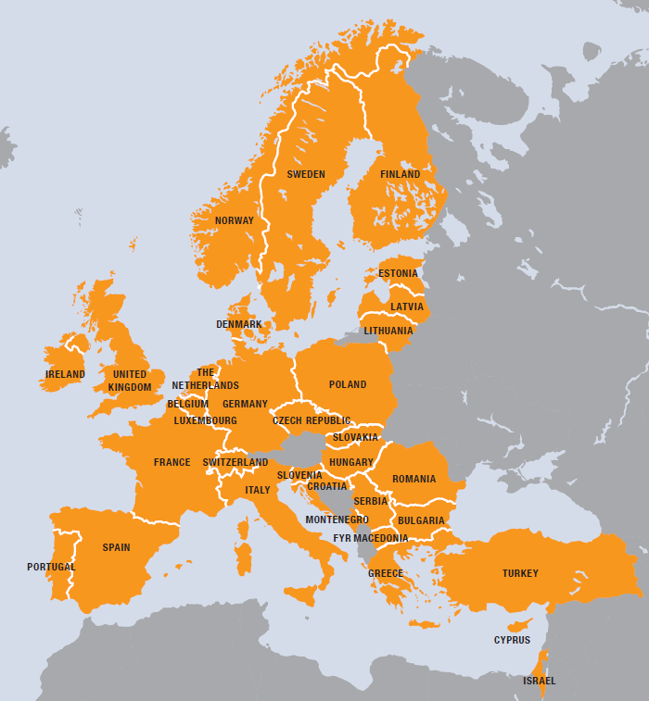
European Grid Infrastructure
European
Over 35 countries
Grid
Secure sharing of IT resources
Infrastructure
Computers (clusters)
Data
Applications
…. and beyond!!
EGI.eu
For European researchers and their international collaborators
Notes:
E-Infrastructures are geographically distributed computing resources and data storage facilities linked by high-performance networks. They allow scientists to share information securely, analyse data efficiently and collaborate with colleagues worldwide. They are an essential part of modern scientific research and a driver for economic growth.
The European Grid Infrastructure (EGI) was established in 2010 building on over a decade of investment by national governments and the European Commission. EGI is a European-wide federation of national computing and data storage resources. Its aim is to support cutting-edge research, innovation and knowledge transfer in Europe. EGI federates resources from various resource centres, mainly from research insitututes and universities. These centres provide computer clusters, storage servers, applications and human support services for secure access and sharing. EGI provides these services to European researchers and their international collaborators.
EGI is coordinated by EGI.eu, a not-for-profit foundation based in Amsterdam and owned by EGI’s participants, the National Grid Infrastructures (NGIs).

Slide 3
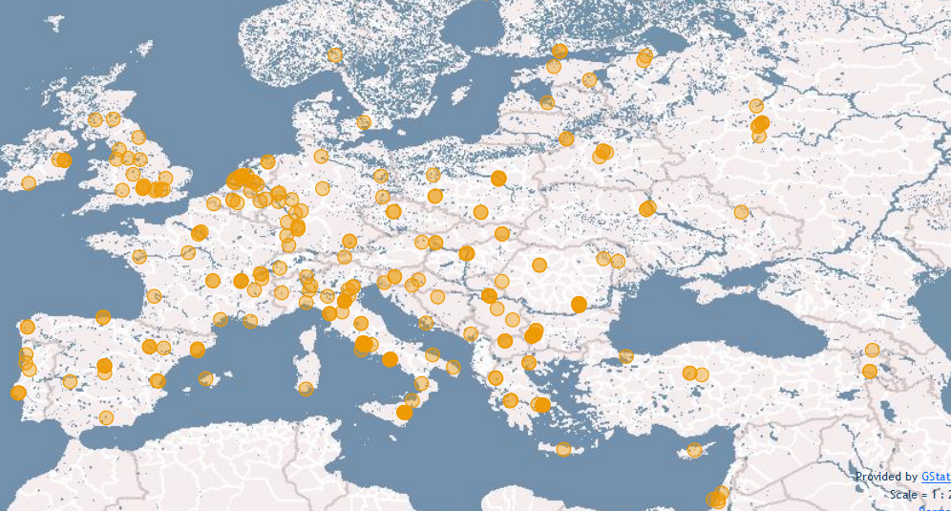
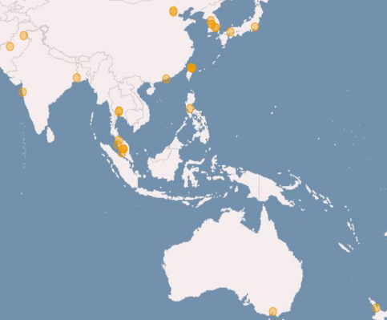
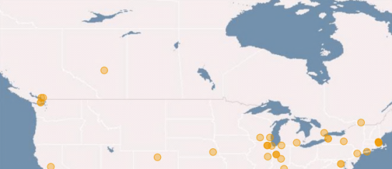
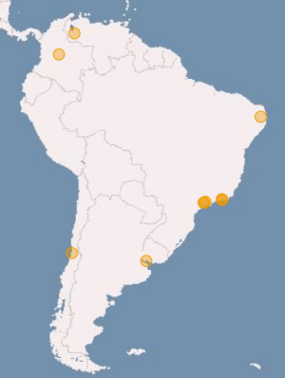
Key resource providers in EGI: National Grid Infrastructures
Metric | Value (August 2013)
Nb. of resource centres | 340
Nb. of CPU cores | 373,800
Disk (PB) | 235 PB
Tape (PB) | 170 PB
Nb. of computing jobs | 1.6 million/day
Notes:
EGI federates resources from Europe and collaborates with peer-infrastructrues from the US, South America and Asia Pacific. These infrastructures together operate a computer network that federates resources from 340 centres, supporting in excess of 1.6 million computing jobs per day. As of today, the storage resources that are part of this network provide 235 PB disk and 170 PB tape based capacity.
Statistics were taken from the EGI Metrics Portal:
http://metrics.egi.eu/

Slide 4
A multi-disciplinary e-infrastructure http://www.egi.eu/community/
Virtual Research Community (VRC)
Virtual Research Community (VRC)
Current VRCs:
wLCG - High Energy Physics
WeNMR – Structural biology
LSGC – Life sciences
(CMMST – Comp. Chemistry)
(HMRC – Hydro-Meteorology)
(CLARIN – Humanities)
Research communities
Cloud
Grid
Most active VO groups:
High Energy Physics
Astronomy & Astrophysics
Life Sciences
Earth Sciences
Computational Chemistry
Fusion
…
VO
VO
VO
VO
Virtual Organisations
User
User
User
Members
User
User
User
Sites
Sites
Sites
Sites
Sites
~22.000 users, ~230 Registered VOs:
http://operations-portal.egi.eu/vo
Notes:
EGI serves more than 22,000 researchers with the distributed storage and computing resources they need for their work. From large, international collaborations, such as the high-energy particle pysics experiments at CERN, to small independent labs and individual scientists EGI provides resources, software, tools and services through a network of resource centres across the globe.
The added value of EGI covers all disciplines from the humanities to high energy and nuclear physics. The large, structured communities sign Memorandum of Understanding with EGI to secure the resources and services they need for their work from the infrastructure. Smaller communities and research labs can establish Virtual Organisations to get access to certain resources and applications from EGI. Individual researchers can join virtual organisations and can access resources and applications that are allocated for these from EGI.
EGI signed or in the process of signing MoUs with several communities, and operates services for around 230 Virtual Organisations.
4

Slide 5
EGI’s strategic focus areas
Virtual Research Environments
Community & Coordination
Integration & support of scientific environments
Operational Infrastructure
Governance
Communication (inreach, outreach)
Operate a European wide grid infrastructure
Build a federated cloud infrastructure
Notes:
• Operational Infrastructure:
- Support the currently deployed commonly used grid services and their evolution in demand to the use from current and new research communities. Help pan-European research infrastructures scale out the uniform operation of their functional services across Europe.
- Integrate the institutional private clouds emerging in the public sector with public clouds coming from the commercial sector to provide a uniform capability to new research
communities to deploy and operate the virtual research environments they need across Europe.
• Virtual Research Environments: A key requirement to the wider scale adoption of e-Infrastructures is the ability for individual researcher and research collaborations to personalise the virtual research environments (spanning the low-level platform services to the user interface used by the researcher) needed by a particular research community to undertake their research.
• Community & Coordination: The network of national interfaces linked to a European coordination body that provides governance to the community and the continued development of that community and the ecosystem it supports through communication, outreach, support and marketing events.
For further information refer to:
EGI Strategic Plan – Seeking New Horizons: EGI’s Role in 2020. Availabile online at https://documents.egi.eu/document/1098.

Slide 6
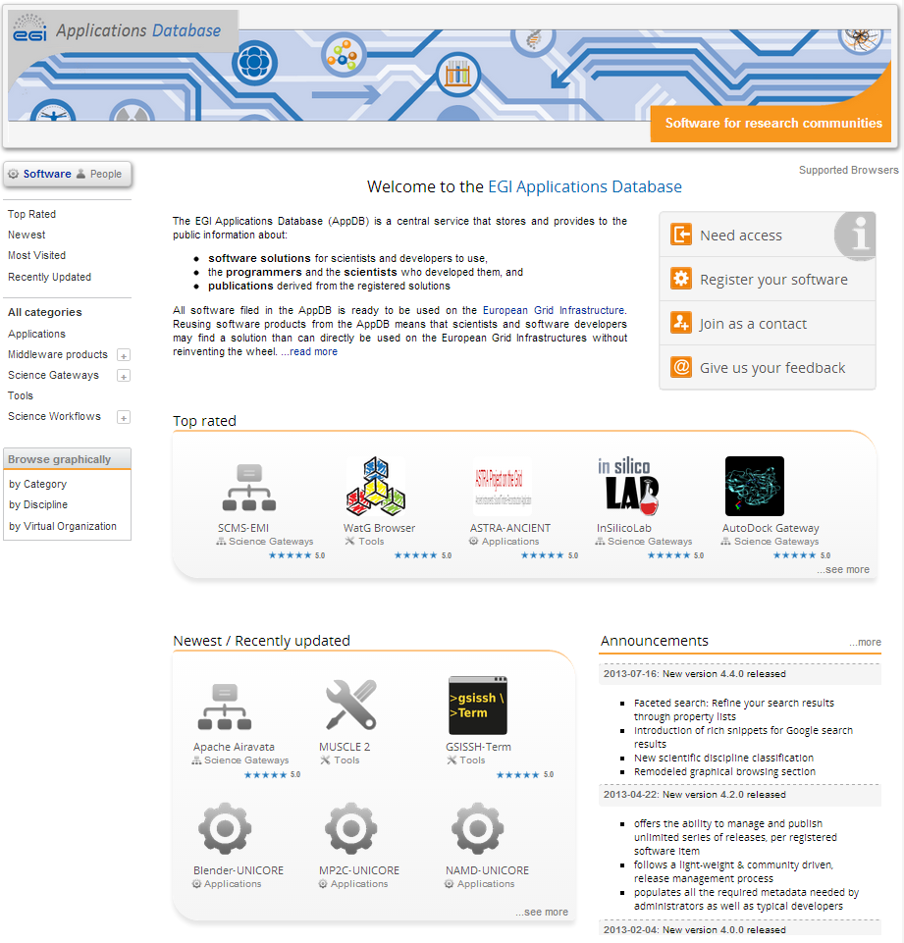
Virtual Research Environments
Applications Database http://appdb.egi.eu
Search by scientific discipline
Search by type
Search by country
Use
Scientific applications
Science gateway portals
Workflow systems
Developer tools
Middleware software
Interact
Follow updates (RSS, Atom)
Provide feedback (Rate & Comment)
Contact the developers
Notes:
The EGI Applications Database (AppDB) is a repository that stores and provides software and information about software to EGI members, and to the general public about:
tailor-made scientific applications that are integrated with the EGI production infrastructure, or with some EGI partner infrastructure (for example with a desktop grid).
Environments (science gateway portals) that integrate and make scientific software easily accessible for researchers
software tools, components and frameworks that application developers can use to integrate new scientific models and applications with the EGI production infrastructure, or with some EGI partner infrastructure.
publications about the aforementioned scientific application and software items. programmers and scientists who develop, drive the development and/or provide user support about the above software
AppDB facilitates the reuse of scientific software and software developer tools. By choosing a proven, off-the-shelf solution from AppDB scientists and scientific programmers can save time when using scientific applications at a large scale, or when porting software to EGI. AppDB helps the community find synergies across multiple groups, and help us avoid duplicated software developments.

Slide 7
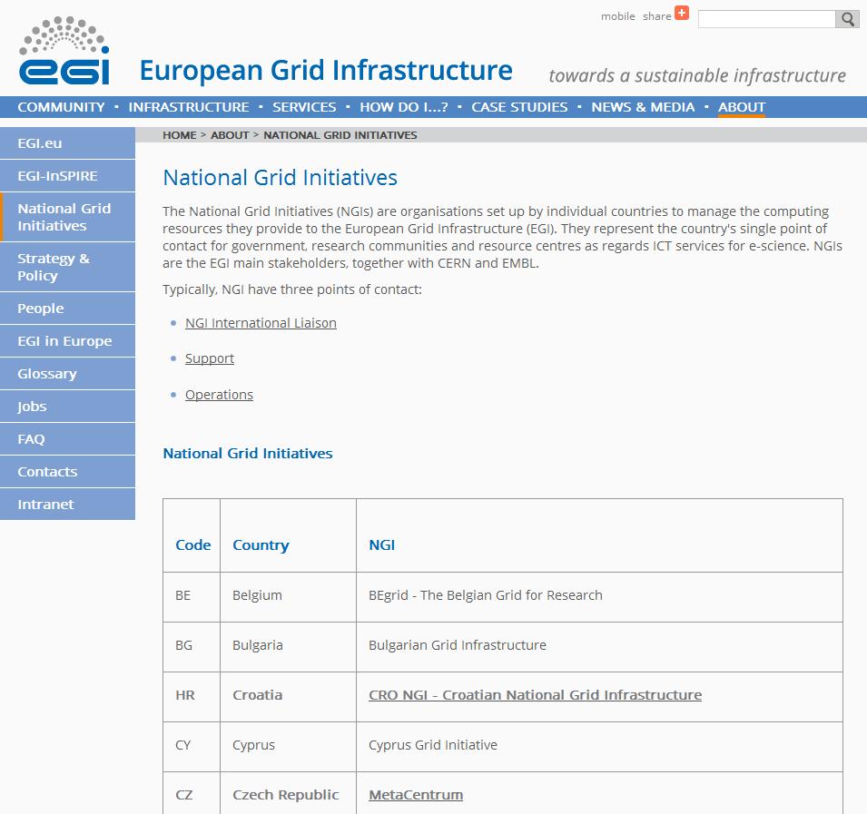
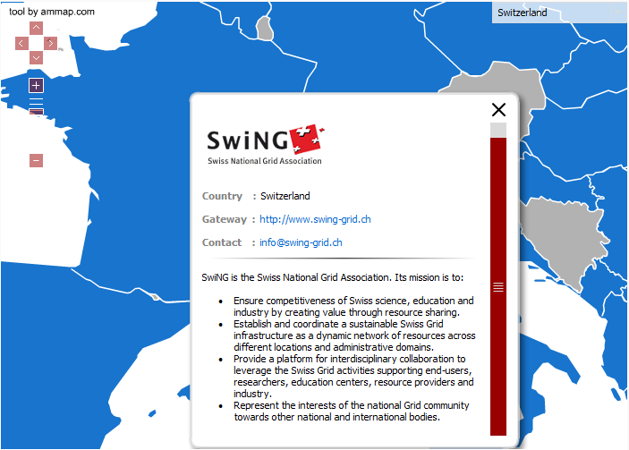
Community and user support: NGI support teams, EGI.eu
NGI: the country's single point of contact for government, research communities and resource centres as regards ICT services for e-science.
Manage the computing resources and support services they provide to the European Grid Infrastructure.
Has named contact for:
International liaison (for EGI.eu)
Support (User)
Operation (Infrastructure)
Notes:
The human support network of EGI also follows a federated structure: The providers of core support services – for users and for resource operators – are the NGIs. Each NGI provides a single point of contact for those who want to use the existing services (user support), or want to federate new resources into the infrastructure (Operation support). The NGIs also provide a liaison contact to EGI, and these liaisons help EGI.eu define and coordinate European level e-infrastructure policy, strategy and outreach activities.

Slide 8
Summary
EGI is a multi-disciplinary e-infrastructure
Federated, with resources and support provided by the National Grid Infrastructures
Established grid services, emerging cloud platform
Software tools and applications through the EGI Applications Database

