Slide 1
A European Federated Cloud: Cloud-based e-infrastructure by EGI
Gergely Sipos gergely.sipos@egi.eu
Technical Outreach Manager
EGI.eu, Amsterdam
EGI-InSPIRE RI-261323

Slide 2
Outline
The European Grid Infrastructure collaboration
Infrastructure, users, usage
Virtualisation and cloud for EGI
Benefits and new possibilities
Roadmap of the EGI Federated Cloud
Some of the use cases

Slide 3
The EGI Collaboration
E-infrastructure services
Scientific applications
Collaborative tools
Consultancy & support
Community events
Middleware & operation technologies
EGI Collaboration
Research
Community
Research
Community
National Grid Infrastr.
Research
Community
Research
Community
Research
Community
National Grid Infrastr.
National Grid Infrastr.
National Grid Infrastr.
EGI.eu
institute

Slide 4
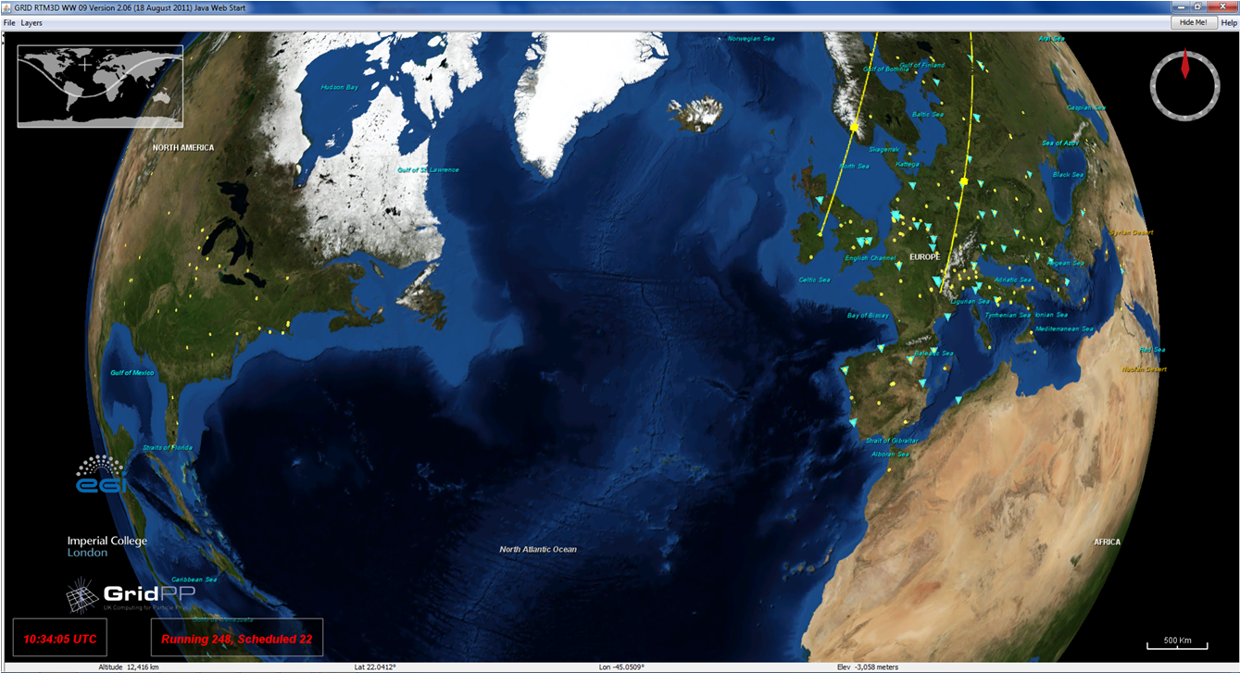
EGI now Real Time Monitor: http://rtm.hep.ph.ic.ac.uk
350 sites in 45 countries
270.000 cluster CPU cores
20.000 desktop PC cores
150+134 PB disk+tape
1.5 million job/day
21.000 users
220 research collaborations
Notes:
Sites are in:
Europe
North America
South America
Asia-Pacific
Australia
Africa

Slide 5
Scientific computing applications
Example:
Environment modelling
Life sciences simulations
Cluster grids (EGI)
High Performance Computing
Message passing
Example:
Monte Carlo simulation
Image/video processing
Cluster grids (EGI)
Desktop Grids (EGI)
Cloud (e.g. Hadoop)
Embarrassingly parallel

Slide 6
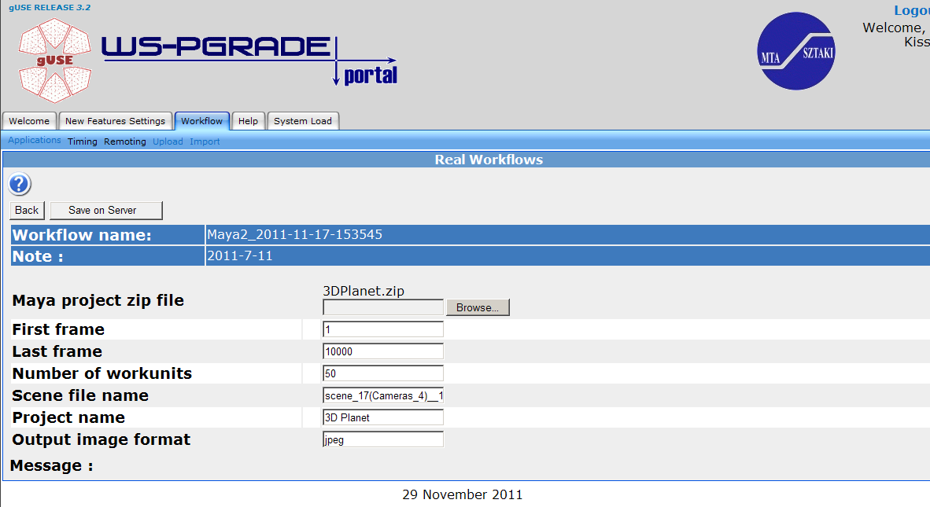
Example: Rendering with Maya (Westminster University, London)
Desktop PCs
Broker
Clusters
Contact: Tamas Kiss T.Kiss@westminster.ac.uk

Slide 7
New challenges
Sustainable operation
Integrating community-specific resources (sensors, antennas, repositories,...)
Workflows that integrate local and remote systems
Need for long running services (not jobs!)

Slide 8
Virtualisation & cloud in EGI
Scientific portals (SaaS environments)
Scientific portal
Scientific portal
Scientific portal
Developer environments
Custom services
Developer environments
Grid middleware
Grid middleware
Hypervisor
OS
OS
OS
OS
OS
OS
OS
OS
Hardware
Hardware

Slide 9
EGI cloud roadmap http://go.egi.eu/cloud
Since ~2010: Grid middleware in virtualised environments
Sept 2011 – March 2013: Federated Cloud Task Force
Identify open source technologies (OpenStack, OpenNebula,...) and open standard (OCCI, CDMI, GLUE2,...)
Deploy a testbed
Write blueprint for resource centres
Identify issues from non-technical areas (policy, dissemination)
August 2012 – March 2013: Pilot use cases
Support early adopters
Collect and feedback requirements
Establish user-facing services

Slide 10
Some of the pilot use cases
Structural biology – We-NMR project: Gromacs training environments
Ecology – BioVel project: Remote hosting of OpenModeller service
Linguistics – CLARIN project: Scalable ‘British National Corpus’ service (BNCWeb)
Software development – SCI-BUS project: Simulated environments for portal testing
Space science – ASTRA-GAIA project: Data integration with scalable workflows

Slide 11
Conclusions
Sustainable e-infrastructure based on national providers
Established services for job and data processing
Virtualisation & cloud
Reducer of operational cost
Platform to support new use cases
Accelerator of e-infrastructure adoption
Routine use of cloud inside individual institutions
Integrations towards a Federated cloud
Based on open source technologies

Slide 12
Questions
EGI Technical Forum 2012
Prague, Czech Republic 17–21 September
http://tf12.egi.eu

