Slide 1
Updates on DCH-RP services, resources, and the e-CSG
Roberto Barbera
Univ. of Catania & INFN

Slide 2
Outline
Status of the DCH-RP infrastructure
The TERENA AAA Study and some driving considerations
Federated identity services available
The e-Culture Science Gateway
Upload/download of contents and current middleware limitations
Summary and conclusions

Slide 3
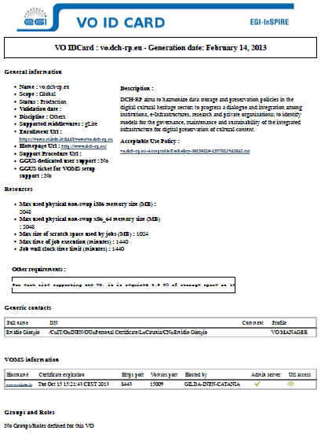
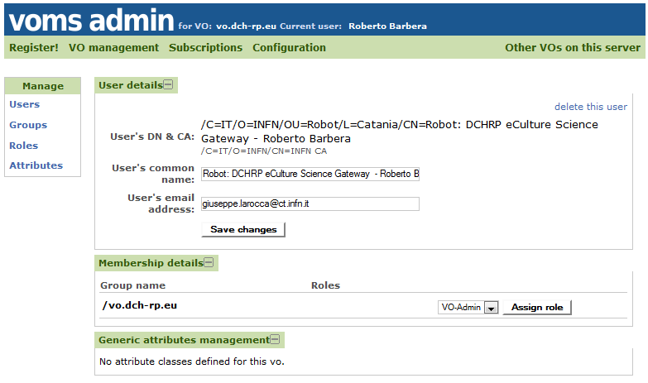
The DCH-RP VO services
v

Slide 4
The DCH-RP available resources

Slide 5
The TERENA AAA Study (commissioned by the EC)
The goal has been broken down into two objectives:
1. A collection of users’ access requirements coming from differentccommunities;
2. A gap analysis of the existing AAIs used in the realm of research and education,
the use-cases they support and the associated challenges.
https://confluence.terena.org/display/aaastudy/AAA+Study+Home+Page

Slide 6
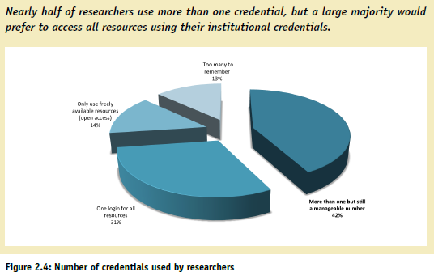
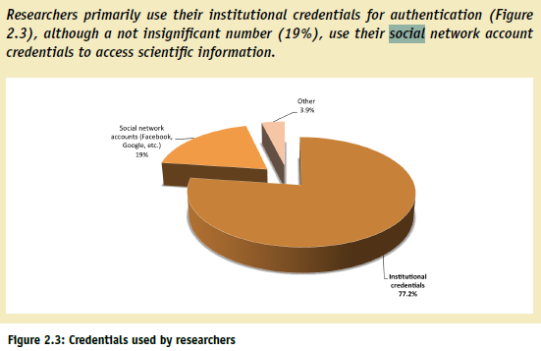
The TERENA AAA Study (commissioned by the EC)

Slide 7
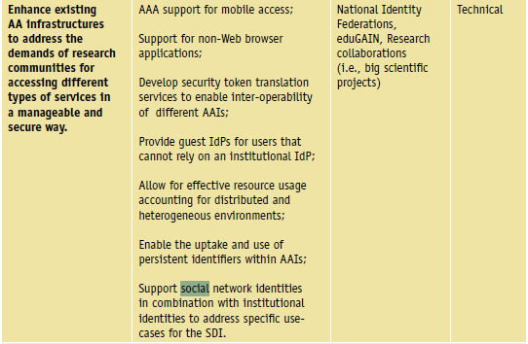
The TERENA AAA Study (commissioned by the EC)
Recommendations

Slide 8
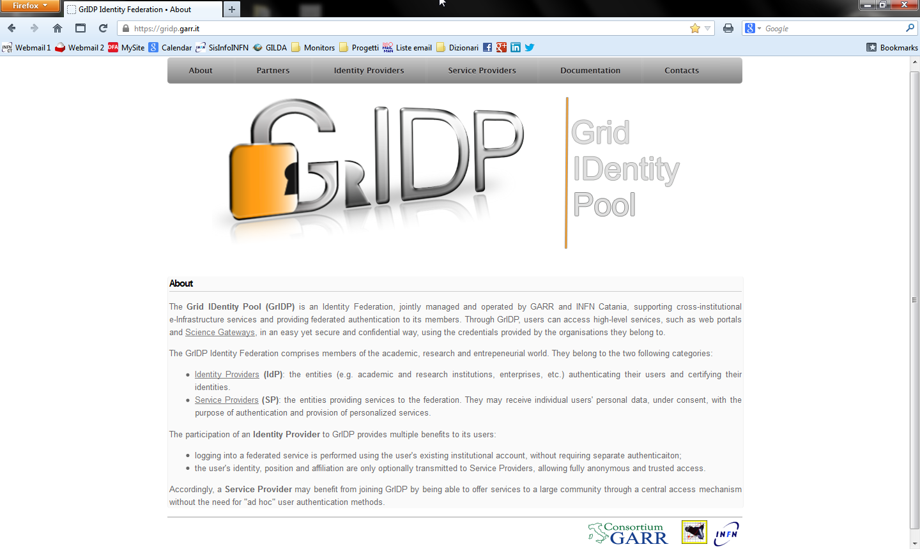
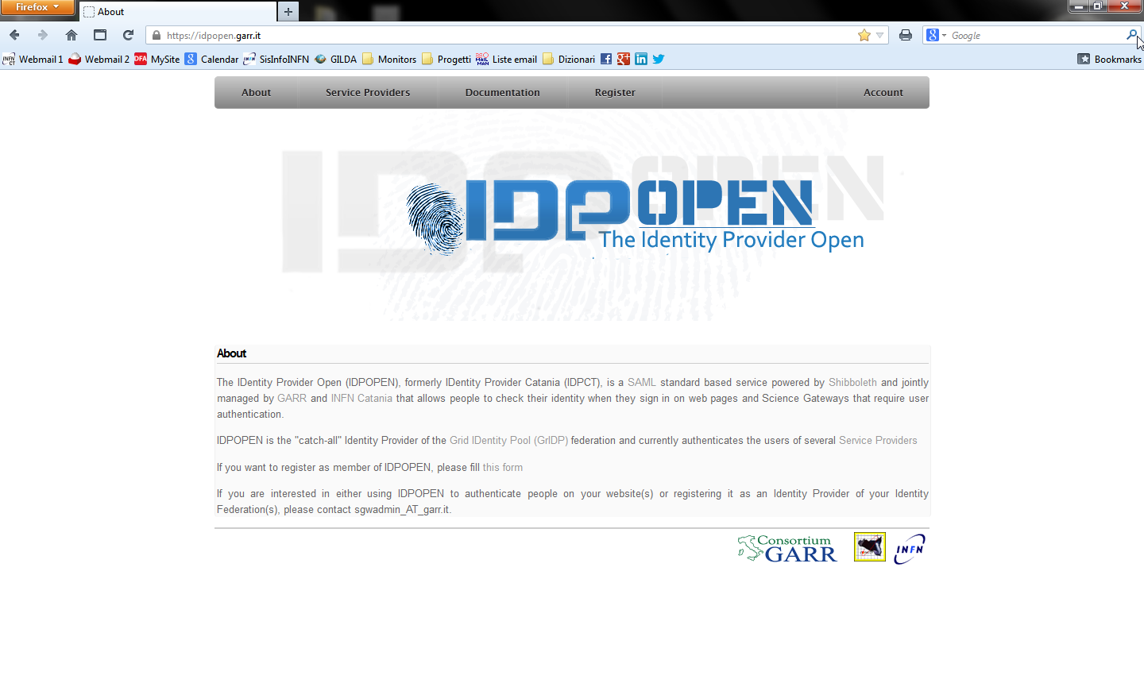
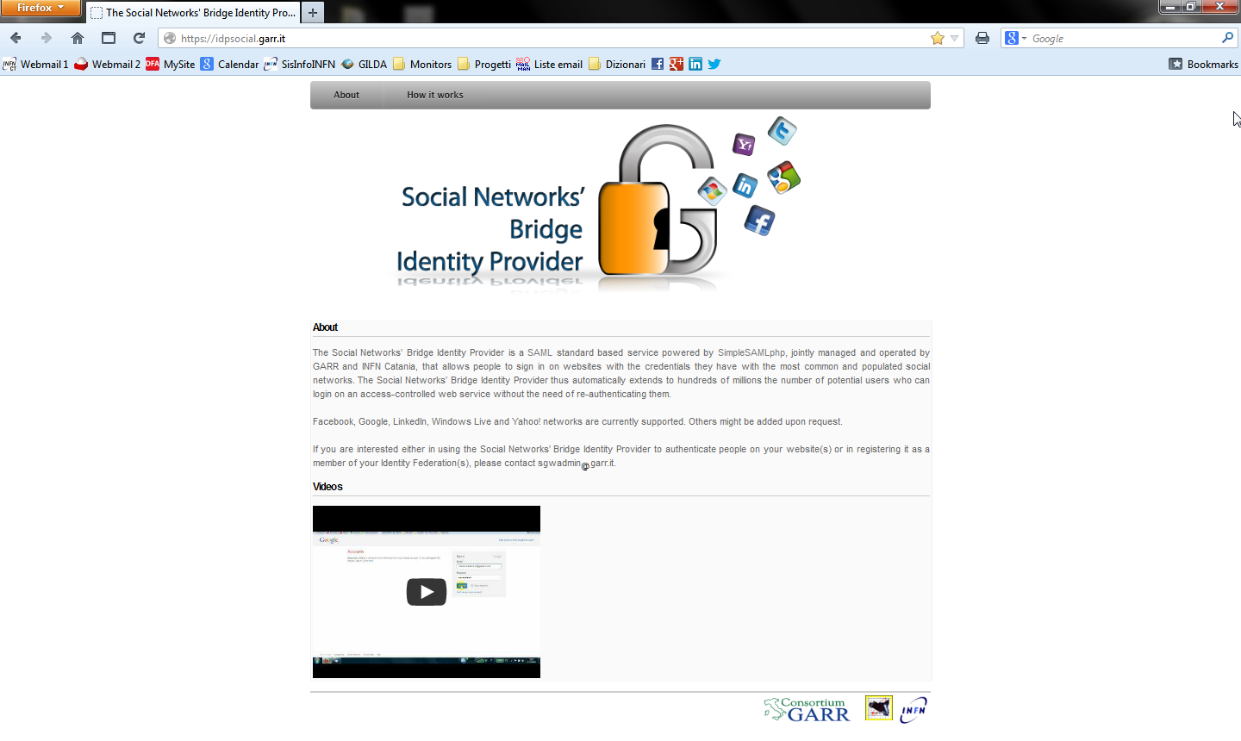
The GrIDP «catch-all» federation
v
EGI SSO is also an IdP of GrIDP

Slide 9
The DCH-RP e-CSG (http://ecsg.dch-rp-eu)

Slide 10
The DCH-RP e-CSG (http://ecsg.dch-rp-eu)

Slide 11
The DCH-RP e-CSG (http://ecsg.dch-rp-eu)

Slide 12
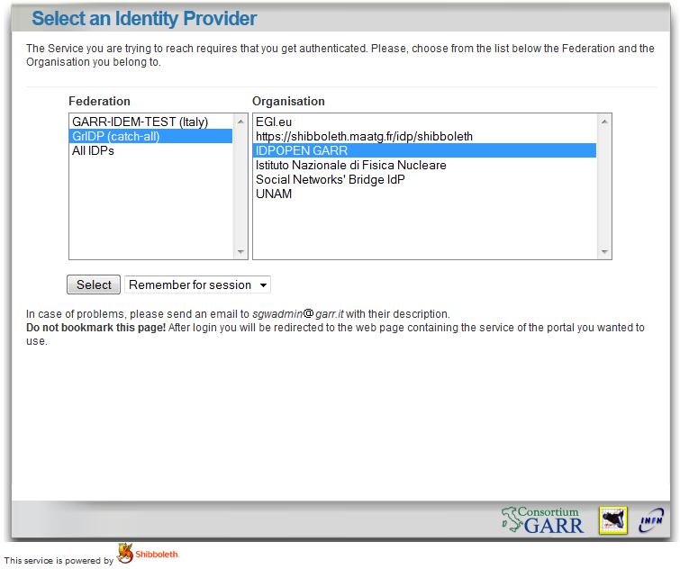
The GrIDP Discovery Service and the IDPOPEN GARR login
v

Slide 13
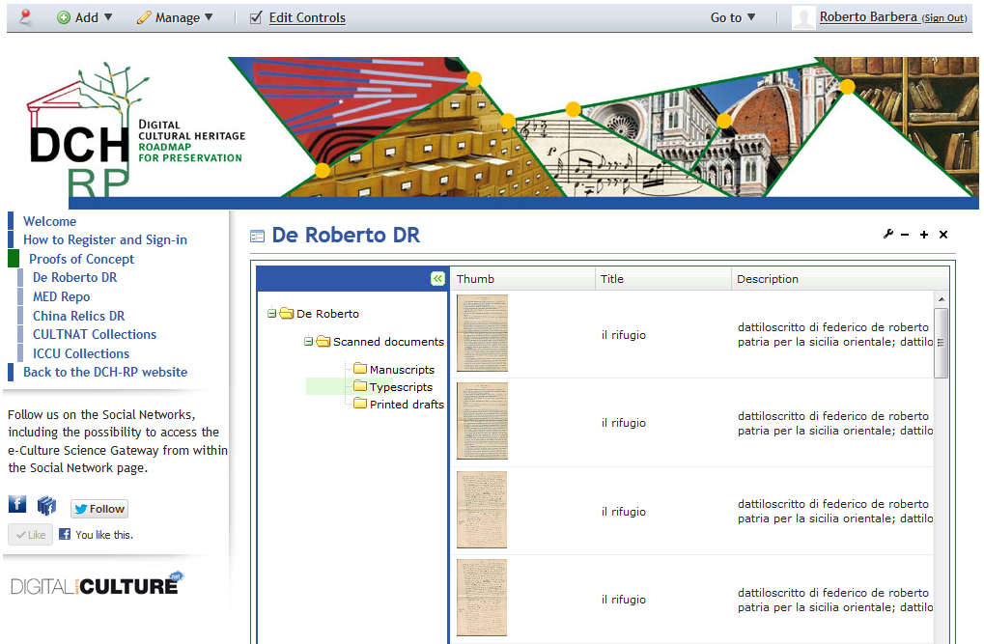
The DCH-RP e-CSG (http://ecsg.dch-rp-eu)

Slide 14
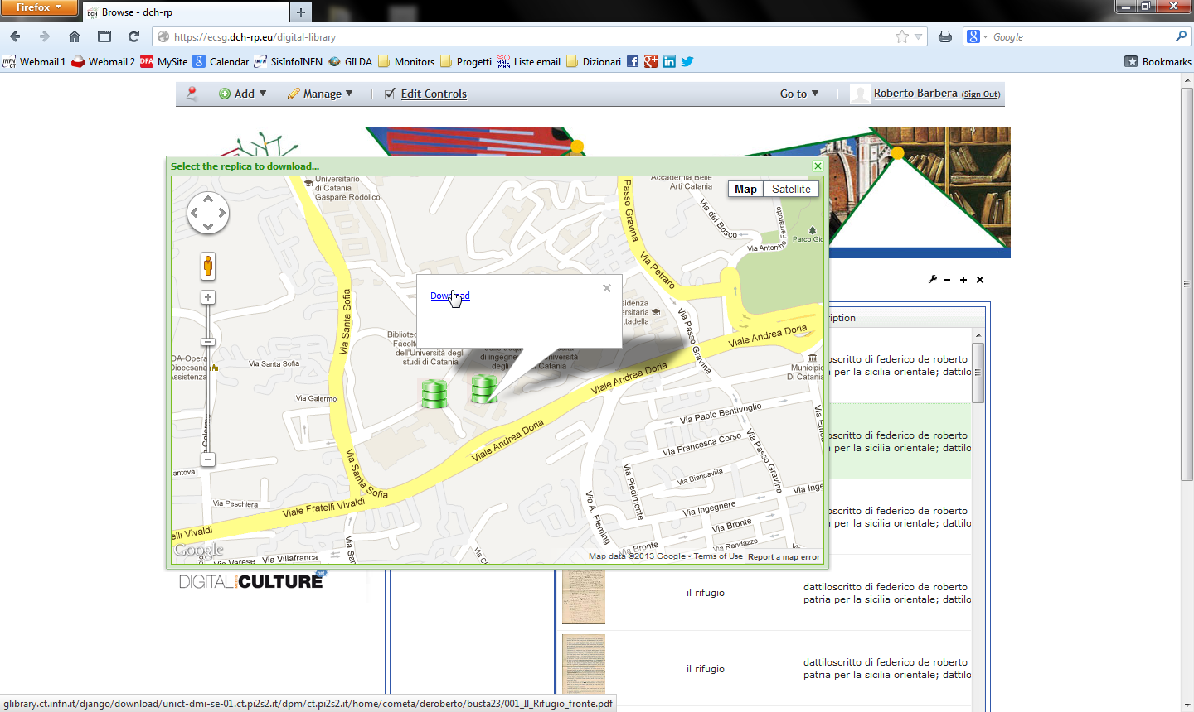
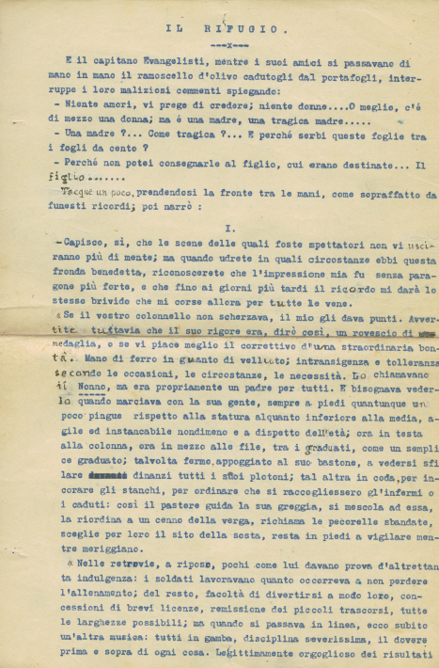
The DCH-RP e-CSG (http://ecsg.dch-rp-eu)

Slide 15
The DCH-RP e-CSG Community page on FB
v
SSO possible through the Social Networks’ Bridge IdP

Slide 16
Upload of DCH contents (e-CSG «in the middle»)
Immediately feasible
but non scalable
e-CSG
2. Upload on the Grid
User
1. Upload on the eCSG
S
R
M
Local storage
Grid storage

Slide 17
Upload of DCH contents (e-CSG «as a broker»)
Very scalable
but currently
impossible due
to middleware
limitations
e-CSG
2. Prepare to upload
1. Request to upload
H
T
T
P
/
S
User
3. Upload on the Grid
Local storage
Grid storage

Slide 18
Current status of HTTP/S interface in EMI-2 SE’s
DPM SE
GET function supported
PUT function supported (through WebDav)
POST function unsupported (needed by browsers)
We have made a «new feature» request; estimated implementation time: 2 months
In Catania we have developed a patch that works with EMI-2
StoRM SE
GET/PUT/POST functions unsupported in EMI-2
They will be supported in EMI-3, to be released at the end of February
dCache SE
No information yet
We have to investigate with the developers

Slide 19
Summary and conclusions
DCH-RP VO services have been created
Several TB’s of disk space are already available to host the data of the Proofs of Concept
The e-CSG has been released and integrated with federated identity services
Current middleware limitations prevent to use StoRM and dCache Storage Elements
A patch has been created for DPM so we can start implementing the service in the e-CSG

Slide 20
Thank you!
Roberto Barbera
Univ. of Catania & INFN
roberto.barbera@ct.infn.it

