Slide 1
Bridging grid, cloud, supercomputing and storage resources at a global scale
European Grid Infrastructure
Gergely Sipos
EGI.eu
User Community Support Team
gergely.sipos@egi.eu
9th Eu-Co-CC
Sopron, Hungary, 2013. September

Slide 2
Outline
The European Grid Infrastructure (EGI)
...and the grid computing landscape
Established EGI solutions for comp. chemistry
Grid infrastructure
Frameworks for applications and data management
Tools for service operators
Recent initiatives
EGI-EUDAT-PRACE pilots
XSEDE collaboration
EGI Federated Cloud
Towards a CMMST Virtual Research Community

Slide 3
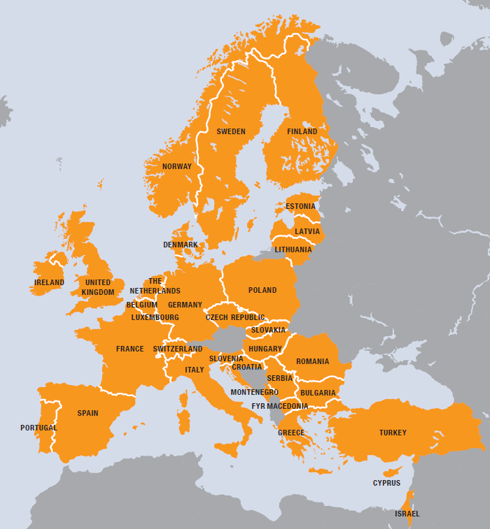
European Grid Infrastructure
European
Over 35 countries
Grid
Secure sharing of IT resources
Infrastructure
Computers (clusters)
Data
Applications
…. and beyond!!
EDG→EGEE→EGI
EGI.eu
For European researchers and their international collaborators
Notes:
E-Infrastructures are geographically distributed computing resources and data storage facilities linked by high-performance networks. They allow scientists to share information securely, analyse data efficiently and collaborate with colleagues worldwide. They are an essential part of modern scientific research and a driver for economic growth.
The European Grid Infrastructure (EGI) was established in 2010 building on over a decade of investment by national governments and the European Commission. EGI is a European-wide federation of national computing and data storage resources. Its aim is to support cutting-edge research, innovation and knowledge transfer in Europe. EGI federates resources from various resource centres, mainly from research insitututes and universities. These centres provide computer clusters, storage servers, applications and human support services for secure access and sharing. EGI provides these services to European researchers and their international collaborators.
EGI is coordinated by EGI.eu, a not-for-profit foundation based in Amsterdam and owned by EGI’s participants, the National Grid Infrastructures (NGIs).

Slide 4
Grid computing landscape
PRACE (in Europe)
XSEDE (in US)
Massively parallel (e.g. MPI HPC)
Supercomp. grid
Massively parallel (e.g. MPI)
Cluster grid
Embarassingly parallel (HTC) Workflows
EGI
Desktop grid
Embarassingly parallel (HTC)
Workflows

Slide 5
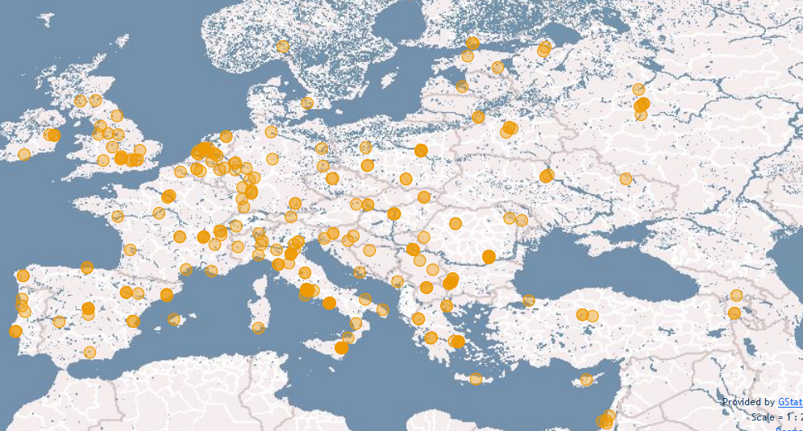
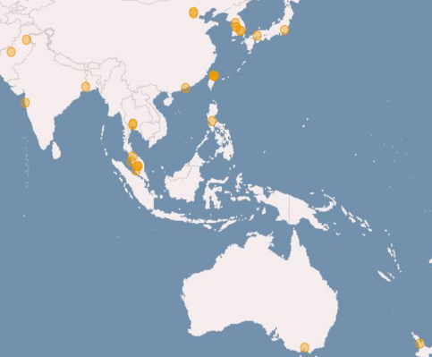
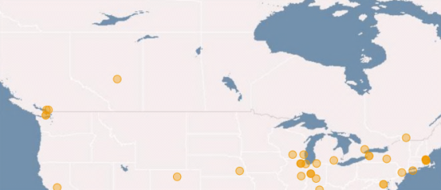
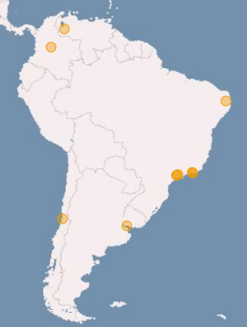
Resource & service providers in EGI: National Grid Infrastructures
Metric | Value (August 2013)
Nb. of resource centres | 340
Nb. of cluster CPU cores | 373,800
Disk (PB) | 235 PB
Tape (PB) | 170 PB
Nb. of computing jobs | 1.6 million/day
+ User support, training, ...
Notes:
EGI federates resources from Europe and collaborates with peer-infrastructrues from the US, South America and Asia Pacific. These infrastructures together operate a computer network that federates resources from 340 centres, supporting in excess of 1.6 million computing jobs per day. As of today, the storage resources that are part of this network provide 235 PB disk and 170 PB tape based capacity.
Statistics were taken from the EGI Metrics Portal:
http://metrics.egi.eu/

Slide 6
Resource allocation via Virtual Organisations
Virtual Research Community (VRC)
Virtual Research Community (VRC)
Current VRCs:
wLCG - High Energy Physics
WeNMR – Structural biology
LSGC – Life sciences
(HMRC – Hydro-Meteorology)
(CLARIN – Humanities)
(CMMST – Comp. chemistry)
Research communities
Virtual Organisations
Most active VO groups:
High Energy Physics
Astronomy & Astrophysics
Life Sciences
Earth Sciences
Computational Chemistry
Fusion
…
VO
VO
VO
VO
User
User
User
Members
User
User
User
Sites
Sites
Sites
Sites
Sites
~22.000 users, ~230 Registered VOs:
http://operations-portal.egi.eu/vo
Notes:
EGI serves more than 22,000 researchers with the distributed storage and computing resources they need for their work. From large, international collaborations, such as the high-energy particle pysics experiments at CERN, to small independent labs and individual scientists EGI provides resources, software, tools and services through a network of resource centres across the globe.
The added value of EGI covers all disciplines from the humanities to high energy and nuclear physics. The large, structured communities sign Memorandum of Understanding with EGI to secure the resources and services they need for their work from the infrastructure. Smaller communities and research labs can establish Virtual Organisations to get access to certain resources and applications from EGI. Individual researchers can join virtual organisations and can access resources and applications that are allocated for these from EGI.
EGI signed or in the process of signing MoUs with several communities, and operates services for around 230 Virtual Organisations.
6

Slide 7
EGI Virtual Organisations for computational chemistry
VO name | Scope | Job queues | CPU cores | Mem. per node | Total storage
Compchem | International | 44 | ~20.000 (4 - 6000 / queue) | 1.5-16GB | 1.9 PB
Gaussian | International | 3 | ~15.000 (5.000 - 1.0000 / queue) | 2-8GB | 40 TB
chem.vo.ibergrid.eu | Spain | 19 | ~5.000 (8-1600 / queue) | 1-32GB | 77 TB
Trigrida/b | Turkish | 3 | ~500 (240-320 / queue) | 4-16GB | 1 PB
+ many multi-disciplinary VOs
VO data and information to join: http://operations-portal.egi.eu/vo
Resource data from EGI Information system
Request a new VO at http://operations-portal.egi.eu/vo/registrationWelcome

Slide 8
Comp. Chem. cumulative computing time (Million walltime hours, 2006 – 2013)
Approx. 5 million hour / 6 month → 1200 CPU 24/7

Slide 9
EGI’s strategic focus areas
Virtual Research Environments
Community & Coordination
Integration & support of scientific environments
Operational Infrastructure
Governance
Communication (inreach, outreach)
Operate a European wide grid infrastructure
Build a federated cloud infrastructure
Notes:
• Operational Infrastructure:
- Support the currently deployed commonly used grid services and their evolution in demand to the use from current and new research communities. Help pan-European research infrastructures scale out the uniform operation of their functional services across Europe.
- Integrate the institutional private clouds emerging in the public sector with public clouds coming from the commercial sector to provide a uniform capability to new research
communities to deploy and operate the virtual research environments they need across Europe.
• Virtual Research Environments: A key requirement to the wider scale adoption of e-Infrastructures is the ability for individual researcher and research collaborations to personalise the virtual research environments (spanning the low-level platform services to the user interface used by the researcher) needed by a particular research community to undertake their research.
• Community & Coordination: The network of national interfaces linked to a European coordination body that provides governance to the community and the continued development of that community and the ecosystem it supports through communication, outreach, support and marketing events.
For further information refer to:
EGI Strategic Plan – Seeking New Horizons: EGI’s Role in 2020. Availabile online at https://documents.egi.eu/document/1098.

Slide 10
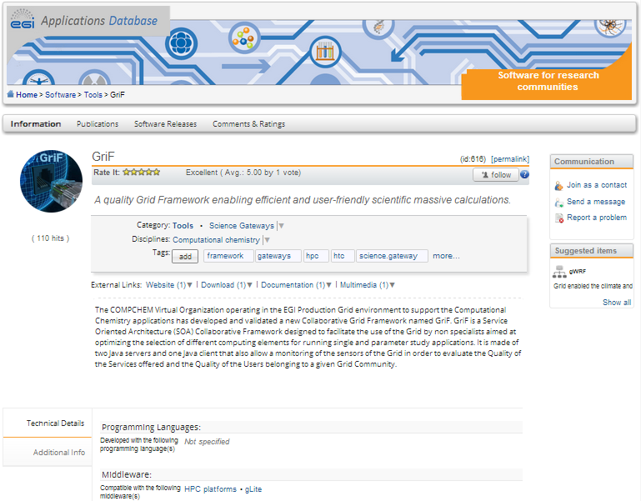
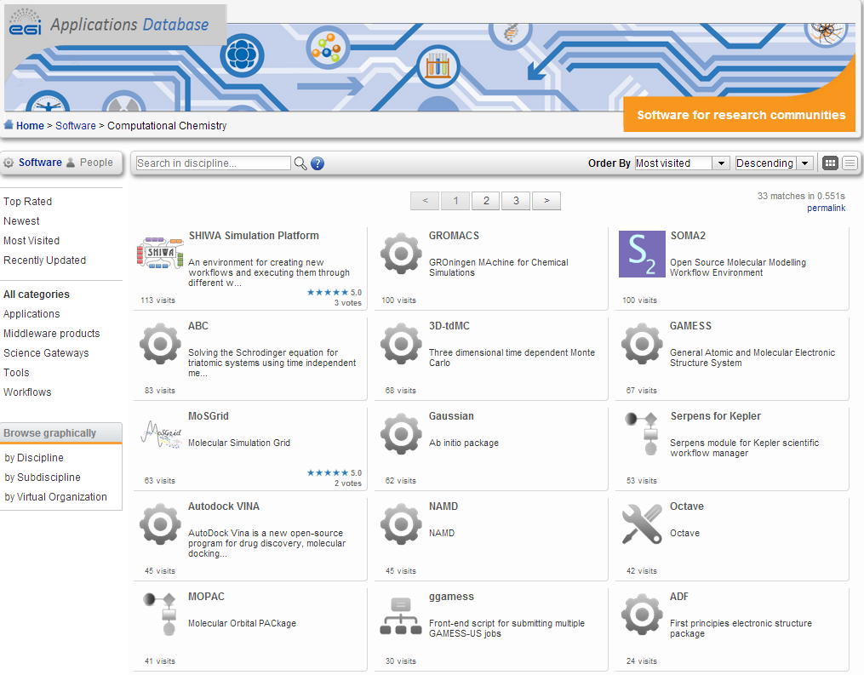
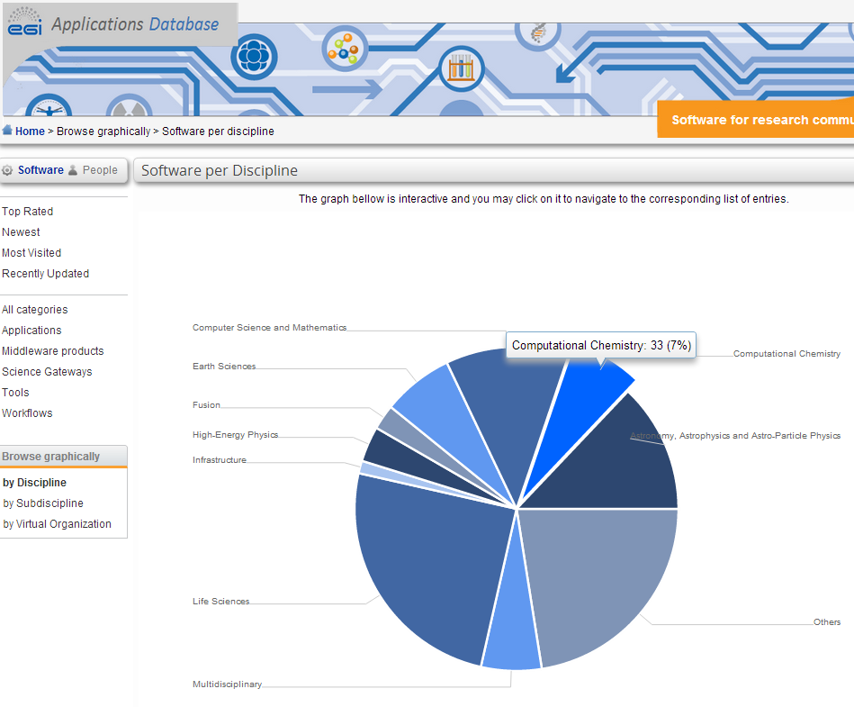
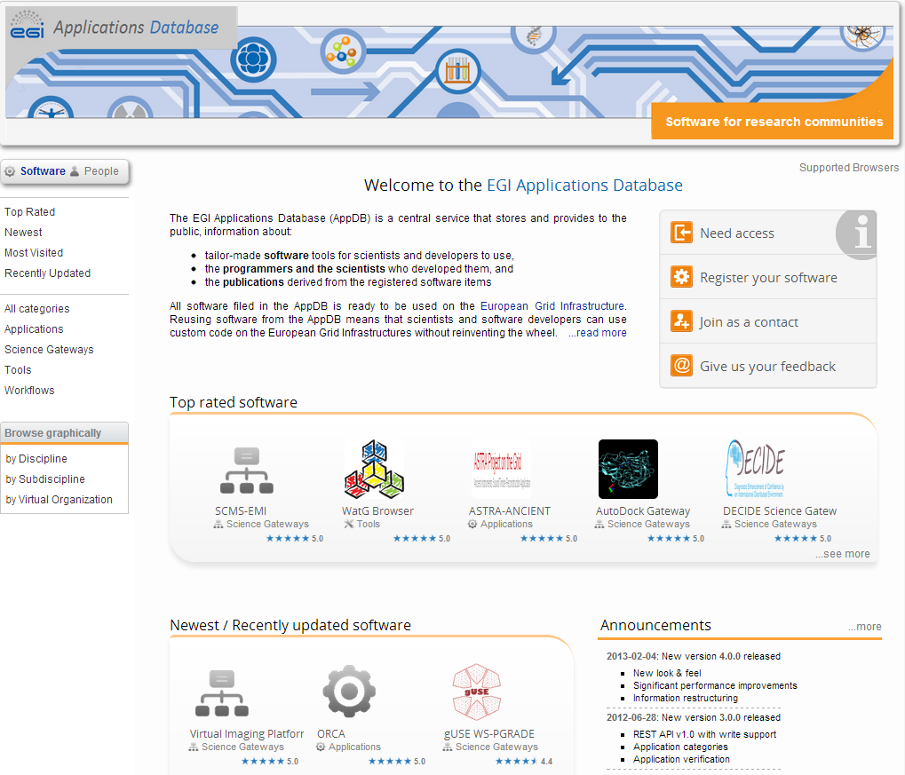
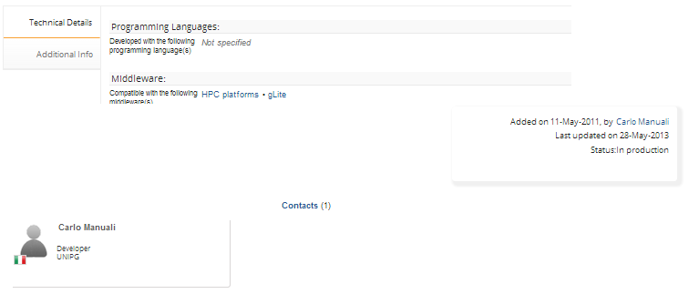
Applications and tools for Virtual Research Environments
Registered in EGI Applications Database: http://appdb.egi.eu
Browse by scientific discipline, country, date, ratings, etc.
Access varies per application:
Via portal (username/pwd)
First register in VO (X509 cert)
Download to client side
...
Interact
Follow updates (RSS, Atom)
Rate & Comment
Contact provider/supporter
By discipline

Slide 11
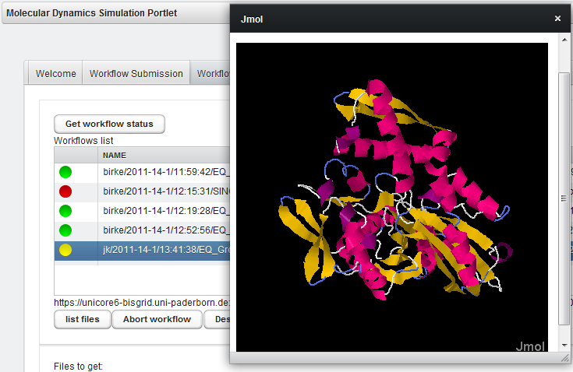
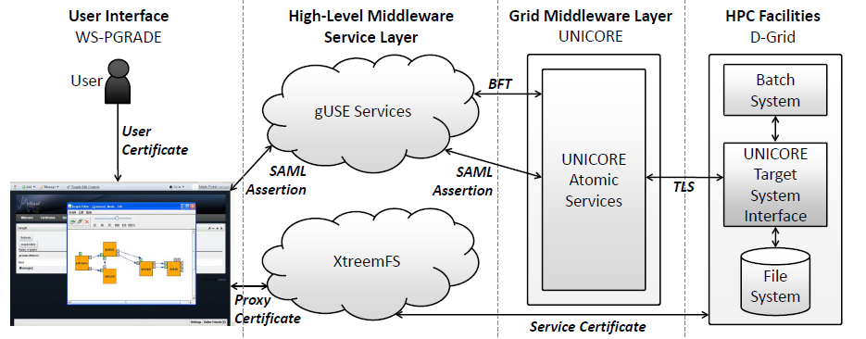
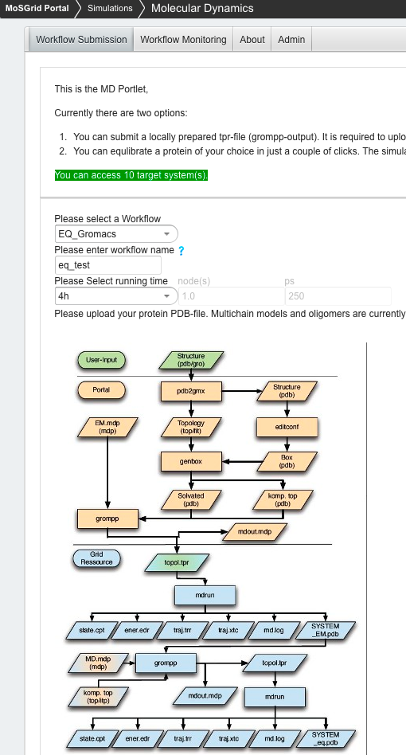
A Virtual Research Environment: MosGrid portal https://mosgrid.de/portal
Authentication
Job submission engine
Data transfer engine
access with UNICORE
Quantum Chemical Calculations
based on approximated solutions of the Schrödinger equation
Average scalability
Gaussian, NWChem, Turbomole, …
Molecular Dynamics
based on forcefields describing molecular interactions
Good scalability
Gromacs, NWChem, Amber, …
Docking
Based on simplified forcefields
Excellent scalability
CADDSuite, FlexX, …

Slide 12
Tools for resource & service operation
To operate computers and software realibly...
Research institutes
Scientific services
Service
Community portals
EGI offers:
Service catalogue
Service Availability Monitor (+test probes)
Helpdesk
Accounting system
Operations portal
Service
Service
Service
Registry
Accounting
Monitoring
Heldesk
Operation portals
Local NGIs
Infrastructure services

Slide 13
Recent initiatives 1:
EGI-EUDAT-PRACE pilots

Slide 14
Interoperability for data transfers
Communities
Mapper
VPH
VERCE
Client tools
EUDAT Data Staging Service
FTS3
GlobusOnline.eu
UberFTP
Globus-url-copy
EUDAT File Manager
Protocols
SRM
http/webdav
GridFTP/FTP
XROOT (rfio)
dCache (dcap)
Middlewares
QosCosGrid
Globus
DPM
dCache
iRODS/Griffin
XROOT
E-infrastructures
EGI
PRACE
EUDAT
Caption
Entity that can be used in interoperability scenarios

Slide 15
Direct file transfers
Communities
Mapper
VPH
VERCE
http://www.globusonline.eu
http://go.egi.eu/globusonlinecookbook
Client tools
EUDAT Data Staging Service (PID)
GlobusOnline.eu
GlobusOnline .eu Transfer Service
control
E-infrastructures
EGI
EUDAT
PRACE
iRODS/Griffin
Globus
SRM
DPM,
dCache,
Storm
GridFTP
transfer
GridFTP
GridFTP
transfer

Slide 16
Recent initiatives 2:
EGI-XSEDE collaboration
The CMMST use case

Slide 17
Target setup
Compchem VO
From GriF website
Input for GriF for brokering decisions
gLite sites (CEs and SEs)
GriF desktop client
EGI middleware
gLite sites (CEs and SEs)
gLite sites HTC
GriF server (in Italy)
GriF desktop client
Pre-defined and endorsed executables
Resource information system
Robot cert.
...
Robot cert.
GriF desktop client
Provides
gLite sites (CEs and SEs)
Endorsed by the compchem community
XSEDE middleware
gLite sites (CEs and SEs)
INFN Certification Authority (IGTF CA)
XSEDE sites HPC
Caption
Working setup
04/09/2013
Planned setup

Slide 18
Recent initiatives 3:
EGI Federated Cloud

Slide 19
EGI’s Cloud Strategy
Personalised environments based on open standards
SaaS
Project/community specific services (VM images)
Project/community specific services (VM images)
Project/community specific services (VM images)
E.g. OpenStack OpenNebula
PaaS
VM Mgmt
Data
Information
VM Mgmt
Data
Information
VM Mgmt
Data
Information
Institutional cloud
NGI cloud
Commercial cloud
IaaS
Monitoring
Accounting
Notification
Monitoring
Accounting
Notification
Monitoring
Accounting
Notification
EGI operation tools

Slide 20
EGI cloud roadmap http://go.egi.eu/cloud
Sept 2011 – March 2013: Federated Cloud Task Force
Identify open source technologies (OpenStack, OpenNebula,...) and open standards (OCCI, CDMI, BDII,...)
Deploy a testbed
August 2012 – March 2013: Pilot use cases
Support early adopter communities
Establish user-facing services
March 2013 – September 2013: pre-production
Stabilise services
Write blueprint for resource centres
Engage with more use cases
Apply for access! http://go.egi.eu/cloud

Slide 21
Towards a CMMST Virtual Research Community
CMMST - Chemistry, Molecular & Materials Science and Technology
An EGI ‘Virtual Team project’ (February-October 2013)
Lead by Antonio Lagana (Uni. Of Perugia)
30 members from 11 countries
Goals:
To define a sustainable relationship with the NGIs
To define the ‘rules’ of an open community (credit system, levels,...)
To collect and define applications and tools for an open community
To gather resources and support from CMMST, EGI and XSEDE
Output: A plan that stakeholders can act upon
Join the initiative, provide feedback on the plan: https://wiki.egi.eu/wiki/Towards_a_CMMST_VRC

Slide 22
Summary & next steps
EGI is based on a federated model
NGIs and specialised projects provide resources and services
Established grid solutions including virtual organisations and software tools for Computational Chemistry
EGI Applications Database: http://appdb.egi.eu
EGI VOs: http://operations-portal.egi.eu/
EGI is not just computing and storage
User and software developer support from the NGIs: http://www.egi.eu/services/support_contacts/index.html
Tools and operation support: http://www.egi.eu/solutions/fed-ops/
New initiatives:
Try the federated cloud testbed: http://go.egi.eu/cloud
Support the CMMST VRC: https://wiki.egi.eu/wiki/Towards_a_CMMST_VRC

