Slide 1
Federated Data Testbed
Lukasz Dutka
Cyfronet AGH
VT-FedData

Slide 2
Motivation
Provide distributed environment for testing and experimenting with distributed data access and management tools available in EGI.

Slide 3
Testbed
CESGA – Spain
CERN – Switzerland
CRNS – France
CSIC-IFCA – Spain
CYFRONET – Poland
DESY – Germany
GWDG – Germany
GRNET – Greece
INFN-Bari – Italy
Others soon

Slide 4
Federated Solutions
CDMI Gateway (GRNET) – implementation of CDMI protocol interface for data stored on local POSIX filesystem.
dCache (DESY) - a system for storing and retrieving huge amounts of data, distributed among a large number of heterogeneous server nodes, under a single virtual filesystem tree with a variety of standard access methods. dCache provides methods for exchanging data with backend (tertiary) Storage Systems as well as space management, pool attraction, dataset replication, hot spot determination and recovery from disk or node failures. Data in dCache can be accessed via NFSv4.1 (pNFS) as well as through WebDav.
DynaFed (CERN) - aggregate storage and metadata farms exposing standard protocols that support redirections and WAN data access, making they behave as a unique system, building the illusion of a unique namespace from a set of distinct endpoints, being able to accommodate also explicit, catalogue-based indexing.

Slide 5
Federated Solutions cont’d
FTS (CERN) - The File Transfer Service (FTS) is the lowest-level data movement service defined in the gLite architecture. It is responsible for moving sets of files from one site to another, allowing participating sites to control the network resource usage. It is designed for point to point movement of physical files. The FTS has dedicated interfaces for managing the network resource and to display statistics of on-going transfers. Optionally, the FTS supports Logical File Names (LFNs), i.e. is able to provide catalogue lookup and registration.
iRODS (CRNS) - data management software, it virtualizes data storage resources, so users can take control of their data, regardless of where and on what device the data is stored. As data volumes grow and data services become more complex, iRODS is increasingly important in data management. Plug-in support for microservices, storage resources, drivers, and databases; and extensive documentation, training and support services.

Slide 6
Federated Solutions cont’d
Onedata (CYFRONET) - a data storage solution for easy and unified access to your distributed data. Onedata hides system complexity providing a global filesystem-like view of data accessible from everywhere - your laptop, server, cluster, cloud or grid. Onedata allows for easy team cooperation by controlled accessing of common data. It is designed and implemented in a secure, efficient manner with performance issues being of prime concern. It supports data migration between sites by using our parallel data transfer method allowing for partial file transfers and for transfer prioritization.

Slide 7
Underlying Technologies
CEPH (S3, Block Storage)
Swift (S3)
Lustre (POSIX)
GPFS (POSIX)
NFSv.4 (POSIX)

Slide 8
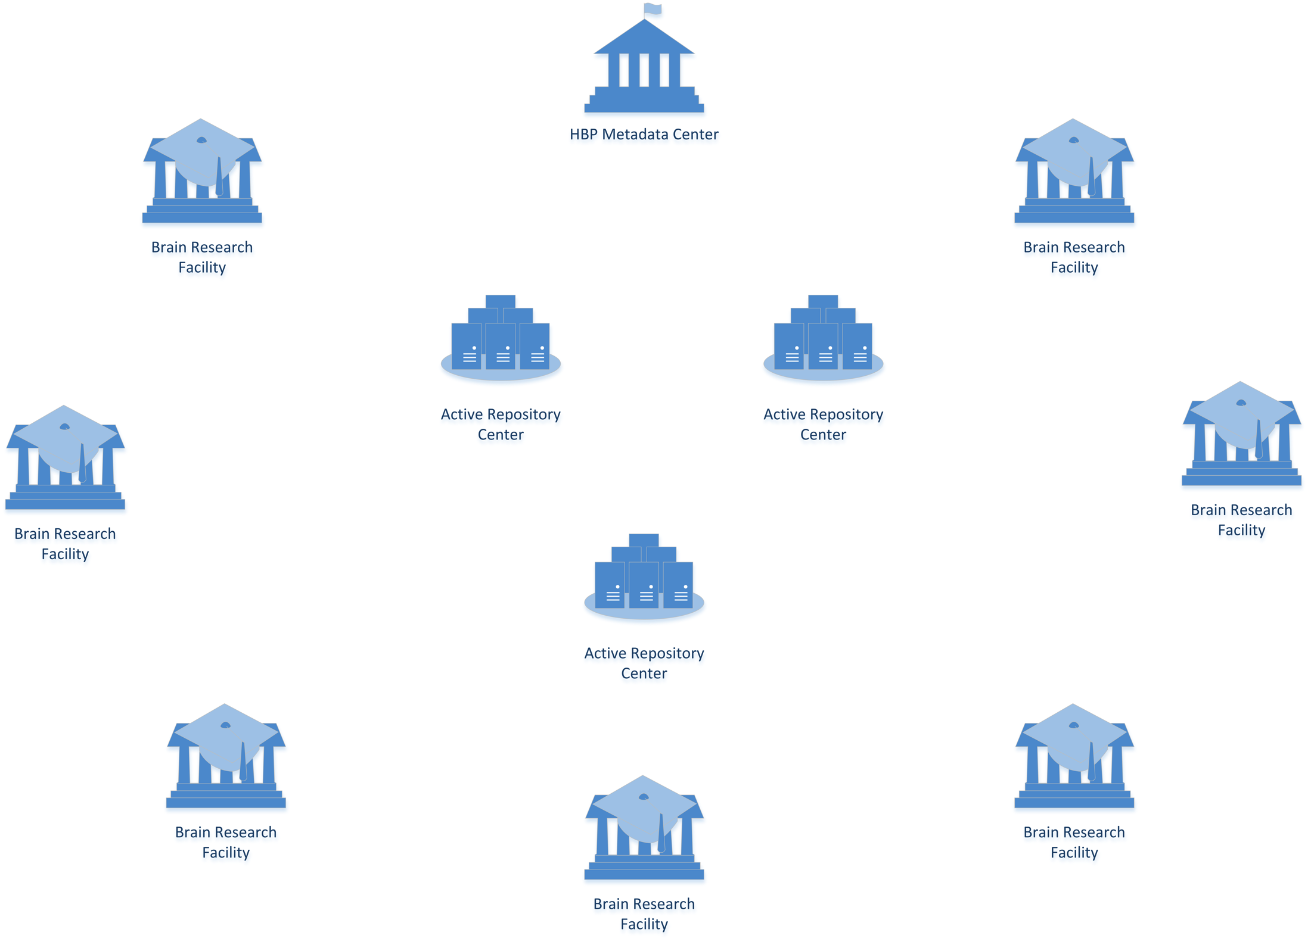
Understanding Deployment

Slide 9
Identified Use cases
UC1 Brain Scan Creation
UC2 Remote interactive multiresolution visualization of large volumetric datasets
UC3: Feature extraction and analysis of large volumetric datasets
UC4: Publication and citation of data
UC5: Management of Access Control Rights

Slide 10
Requirements
PERFORMANCE. Being able to work at throughput 1GB/s per node (for image service nodes, throughput between the node and the storage)
STORAGE CAPABILITIES
files at size up to 10TB
POSIX access to data
CO-LOCATION. CPUclose to data

Slide 11
Metrics of Success
simplicity of bringing up another active repository
simplicity of the process transferring data to the active repository site (UC1)
flexibility of accessing the same data by multiple scientists including intra groups access (UC3)
decentralization of resource management. There are many collaborating groups but they remain independent. The system should be flexible to allow independently gain resources by those groups and still provide some integration level.
simplicity of the access control (UC5)

Slide 12
Metrics of Success
scalability of processing through load distribution/brokering, it should be easy (maybe automatic), instantiation of new processing units based on the traffic to active repositories. (UC2)
how difficult distribution/upgrading of the application software onto the environment will be. Docker approach is under HBP investigation now.
support for persistent identification (DOI and persistence life cycle approaches) (UC4)
process of migration data between active repositories if needed, that might be limited

Slide 13
Testbed for HBP plan for 4-6 months
Finalize Use Case and Requirements document
Selection of technologies potentially matching requirements
List of test cases
Basic tests and feedback
Final tests and feedback

