Slide 1
Mechanisms of Interfederation
Alessandra Scicchitano
AARC NA2 WP Leader, GEANT PDO
Taipei - Taiwan
13th March 2016
Notes:
AARC addresses challenges of interoperability and functional gaps

Slide 2
Outline
Federated Identity Management
Interfederation
EduGAIN
Example of use of eduGAIN
Conclusions

Slide 3
Federated Identity Management
Federated identity management (FIM) enables identity information to be developed and shared among several entities and across trust domains. Tools and standards permit identity attributes to be transferred from one trusted identifying and authenticating entity to another for authentication, authorization and other purposes.
The difference between Single Sign On (SSO) and federated identity is subtle:
SSO unifies access management for disparate systems within an organization.
Federated identity does the same, but across different organizations.
Notes:
Identity management refers to the policies, processes, and technologies that establish user identities and enforce rules about access to digital resources.
Federated identity management permits to extend this approach across multiple organizations so that users belonging to one institutions to access the resources of another one.

Slide 4
FIM Components
There 3 main parties in Federated Identity Management:
User: Each user is associated with a person. A user is characterized by an identity. A collection of attributes that represent properties about that specific person.
Identity Provider (IdP): asserts authentication and identity information about the user.
Service Provider (SP): receives and checks the information to grant authorization to the user to access the service.
Notes:
The IdP is the only party handling the user’s credential

Slide 5
FIM: How it works
Almost all federations
currently use the
SAML2 protocol
https://www.openconext.org
Notes:
user wants to login to a web based service
the SP redirects the user’s browser to an IdP together with a request to authenticate.
The user then logs in at the IdP (typically the users’ “home institution”) and the IdP validates the authentication.
the IdP then redirects the user back to the SP, together with an "assertion" that confirms that often contains additional information (called "attributes") about the user, such as his/her name, e-mail address and relationship with the institute (employee, student, …). The SP can then grant access based on that conformation and the additional attributes it received with it.
For security reasons the communication between browser, SP and IdP is almost always done over HTTPS, rather than plain HTTP. In addition, the assertion that the SP receives from the IdP after login by the user is signed by the IdP using a private key to ensure the validity and integrity of the assertion. The public key counterpart of that private key is known by the SP based on an out-of-band exchange and is typically one of the things that needs to be configured when setting up an association between an SP and an IdP. The authentication request from the SP to the IdP can be signed as well, in which case the IdP also needs to know the public key of that SP of course.

Slide 6
Federation Identity Management
SPs and IdPs have to trust each other for this approach to work. Typically this trust is made explicit by signing policies and contracts that describe the requirements and responsibilities of the IdPs and SPs. An Identity Federation is a collection of IdPs and SPs that have agreed to work together and trust each other.
An organization may belong to more than one federation at a time
IdPs and SPs "know" nothing about the federations. They deal with metadata.

Slide 7
Federation Metadata
An XML document that describes every federation entity
Contains
Unique identifier for each entity known as the entityID
Endpoints where each entity can be contacted
Certificates used for signing and encrypting data
May contain
Organization and person contact information
Information about which attributes an SP wants/needs
Metadata is usually distributed by a public HTTP URL
The metadata should be digitally signed
Metadata must be kept up to date so that
New entities can work with existing ones
Old, or revoked, entities are blocked
Credit to Lukas Hammerle - SWITCH for this slide

Slide 8
Federation Architectures
A federation can be built according to the mesh and/or the hub-and-spoke principle:
Mesh federation: each entity is responsible for its connections to other entities.
Hub-and-spoke federation: all entities connect to the hub and the hub manages connections between entities on a central location.

Slide 9
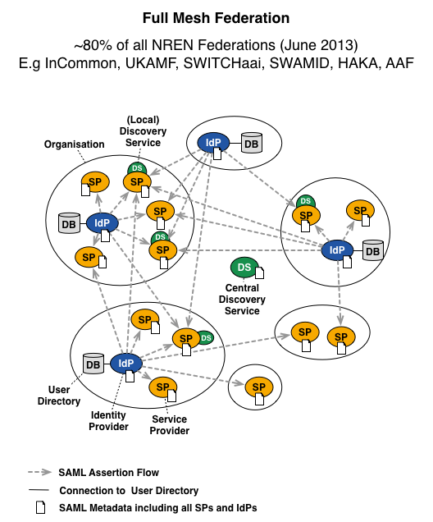
Mesh vs H&S
https://wiki.surfnet.nl
Notes:
Most federations employ the mesh principle.
IdPs and SPs must create and maintain connections to each other themselves.
IdPs and SPs must typically do more work themselves (configuring attribute release, maintaining a discovery service etc etc). Ask the user where he/she wants to login so it can direct the user to the desired IdP. This is what the discovery service does.
In a hub-and-spoke federation, a central "hub" exists between all connected Identity Providers and Service Providers. Due to this design with a central hub, extra features can be rolled out easily and centrally, such as strong authentication and user consent. The central proxy can provide the WAYF function for all the SPs.
It is also implicit in the Hub-and-Spoke model, because the hub has a static 1:1 mapping for each service that might provide an attacker inside the IdP with enough information about the nature of services if analyzing data from many users, or impersonating a single user

Slide 10
Interfederation
Identity Federations are mostly of national scope but:
research projects are international
content publishers’ customers are international
audience of research wikis and blogs is international
Interconnecting national federations → Interfederation
Interfederation service facilitates international research collaboration
Content publishers can offer their services without concluding contracts with each single federation

Slide 11
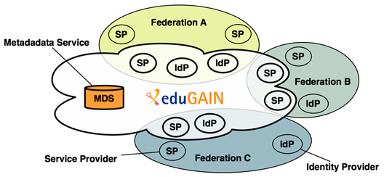
eduGAIN
eduGAIN is a form of interfederation. Participating federations share information (metadata) about entities from their own federation with eduGAIN. Next, eduGAIN bundles these metadata and publishes it on a central location.
Notes:
eduGAIN aggregates metadata from participating federations (metadata service). This aggregate is consumed by all participating federations, such that Identity Providers and Service Providers can find each other.
Technically, this aggregate works as follows: 'export metadata aggregate’, eduGAIN aggregate,
Each participating federation produces a so called 'export metadata aggregate'; a file that contains the metadata of local Identity Providers and Service Providers that participate in eduGAIN. Note that this is often a subset of all Identity Providers and Service Providers from that federation.
eduGAIN combines all export metadata aggregates and generates an "eduGAIN aggregate"; a file that combines all metadata from all participating federations.
This eduGAIN aggregate is signed by eduGAIN and published on the internet, thereby making it available to all participating federations.
Each participating federation must consume this eduGAIN aggregate and supply it to their local Identity Providers and Service Providers.

Slide 12
Some benefits
Enables trustworthy exchange of information between federations without many bilateral agreements
Reduces the costs of developing and operating services
Improves the security and end-user experience of services
Enables service providers to greatly expand their user base
Enables identity providers to increase the number of services available to their users

Slide 13
Some issues
Federated incident handling: Concerns of major science service providers that if they go the federated route, they need to be notified by IdP’s of compromised accounts relevant to the service provider.
Attribute release is proving very problematic.
Metadata is increasing in size and complexity.
Notes:
- Selective release of values from a multi-valued attributes is not yet solved
- Metadata Growth in new participants, interfederation, end-entity tags, etc. – Size is affecting distribution and usage • Moving to dynamic metadata – Similar to the shift from /etc/hosts to DNS – Metadata protocols in development and standardization

Slide 14
Example: TCS
Trusted Certificate Service (TCS):
Since July 2015 with a new Supplier: Digicert
And two portals: CertCentral and the SAML portal
The SAML consumes the eduGAIN metadata

Slide 15
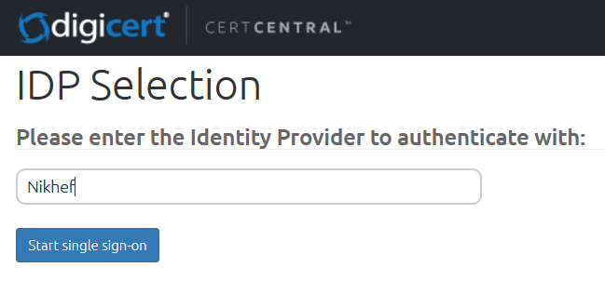
SSO SAML portal hosted by DigiCert
Scope: client certificates
DigiCert itself is a SAML2Int Service Provider <md:EntityDescriptor entityID="https://www.digicert.com/sso">
visible to Federations and IdPs via the eduGAIN metadata
DigiCert knows about all IdPs in eduGAIN (via eduID.at – Austrian Federation)
Thanks David! ☺
Notes:
An identity provider publishes data about itself in an <md:EntityDescriptor>
The entityID attribute is the unique identifier of the identity provider

Slide 16
Conclusions
FIM makes life easier getting ready of too many usernames and passwords;
It protects user information;
Interfederation enables local federations to talk to each other;
EduGAIN is a form of interfederation that is well known and established since years;
There are clear examples of how interfederation enables international collaboration;
FIM is cool!!

Slide 17
Alessandra.Scicchitano@geant.org

