Slide 2
Exploiting scientific data in the international context - The elements of success
Gergely Sipos
Head of Services, Solutions, Support
EGI Foundation (Amsterdam)
gergely.sipos@egi.eu
www.egi.eu
This work by the EGI Foundation is licensed under a
Creative Commons Attribution 4.0 International License
(http://creativecommons.org/licenses/by/4.0/)

Slide 3
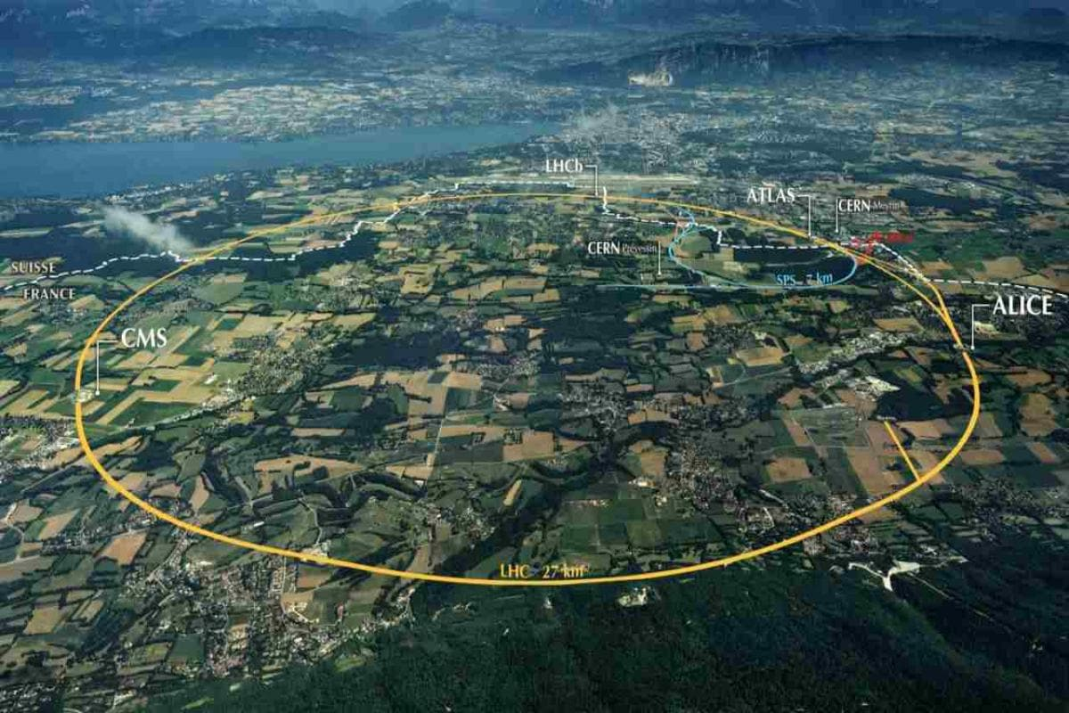
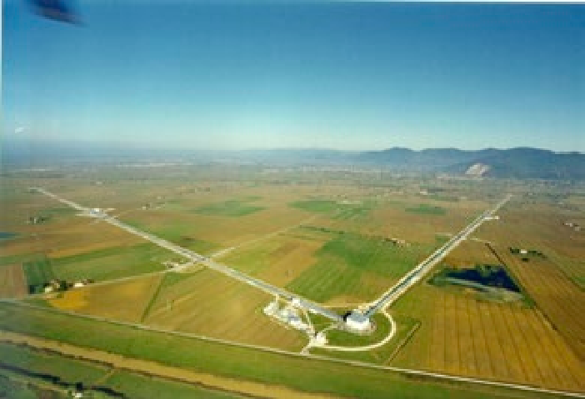
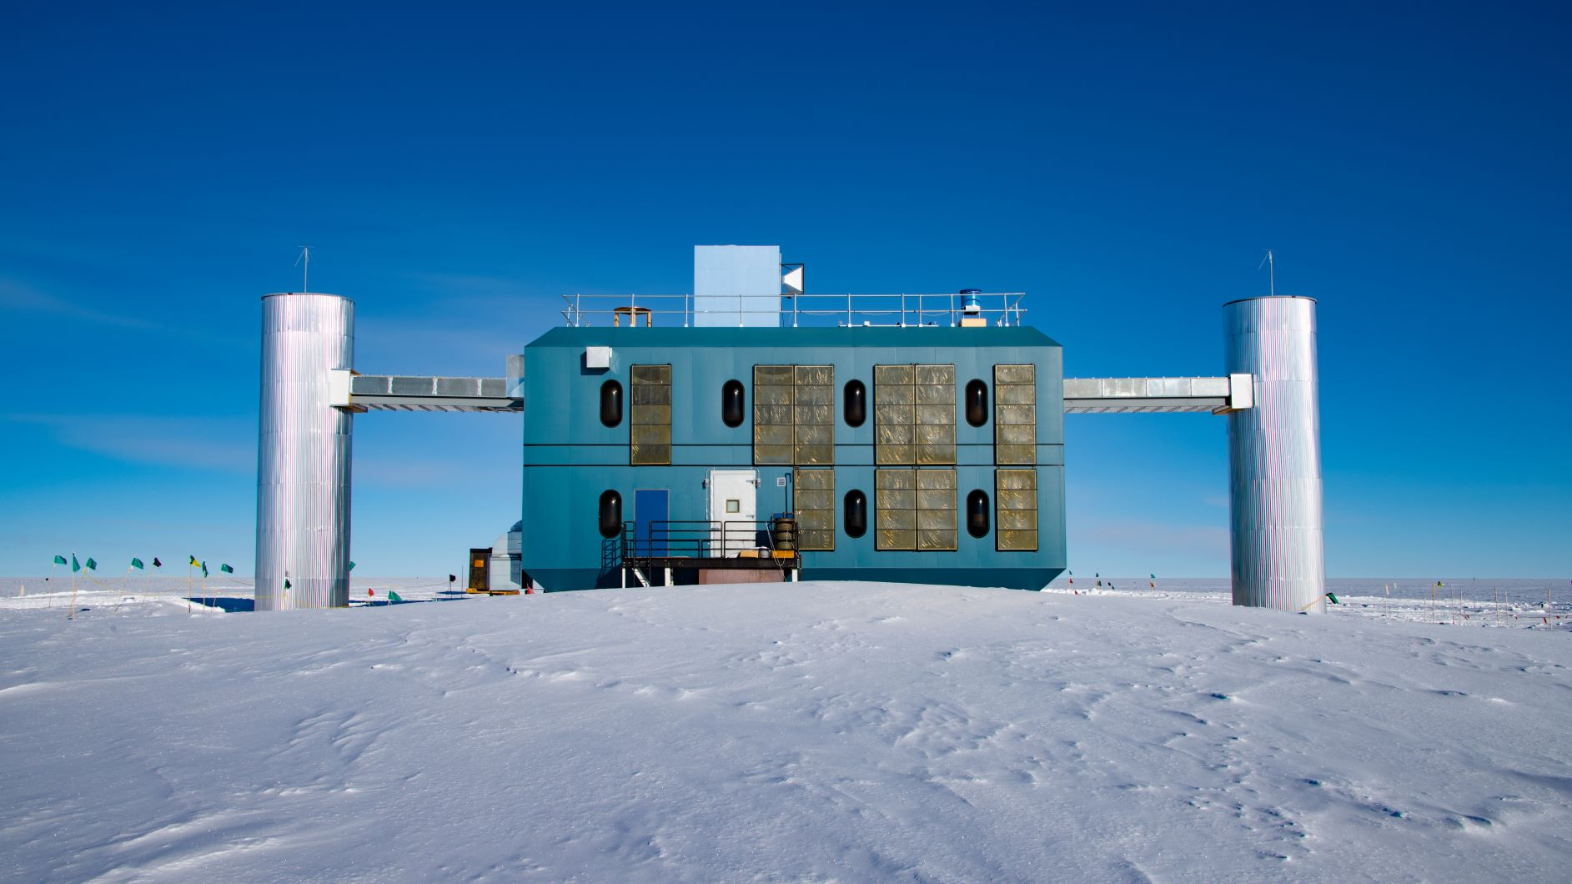
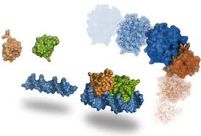
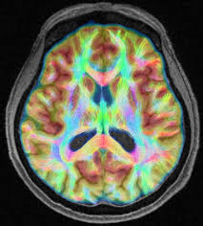
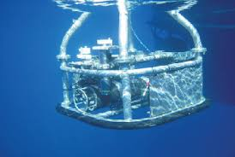
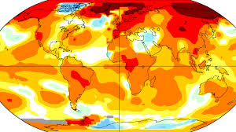
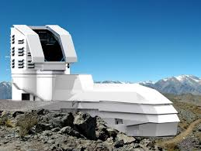
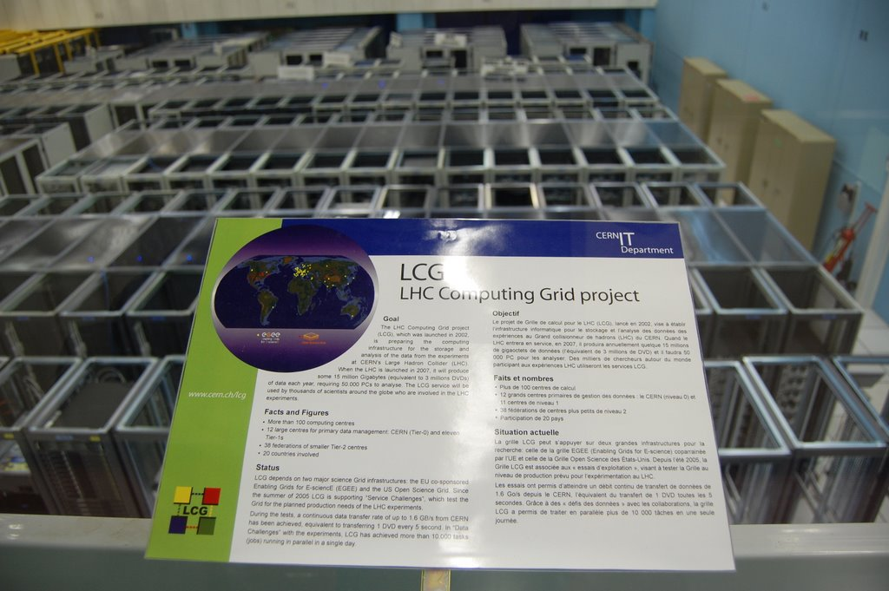
~2000
2020+
LOFAR
IceCube
WeNMR
Bioimaging
SeaDataNet
ENES
LSST
…
?

Slide 4
OCEAN
CLIMATE
ASTRONOMY
www.seadatanet.org
https://portal.enes.org
www.astron.nl/telescopes/lofar
>110 data centres from 34 countries for discovery and access to marine data.
3-5 PB data from CMIP5 experiment alongside 30+ software tools targeting different user communities.
31 stations in Europe with 30 million data products in 50+PB storage.
OPPORTUNITY
Hard to import large amounts of data into Ocean Data Viewer to explore and analyse these.
Data download is a big barrier for climate scientists: download takes significant amount of time; networks are unstable.
Transforming raw data to science-ready data is a challenge, limiting the impact of LOFAR output.
CHALLENGE

Slide 5
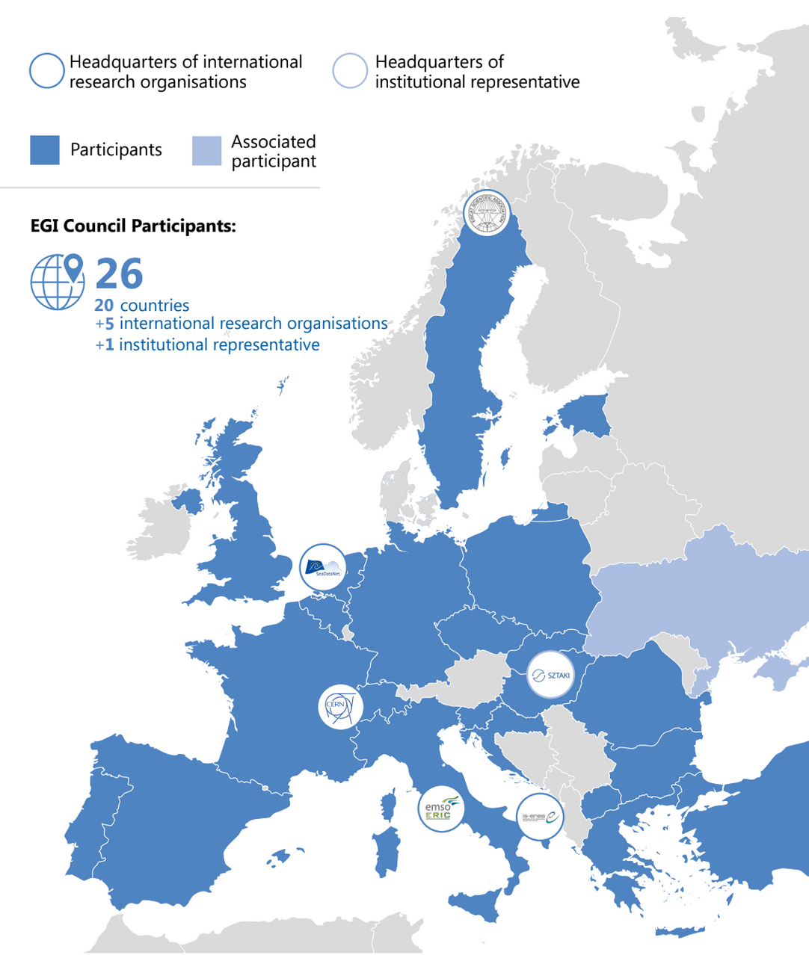

Slide 6
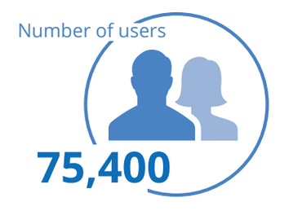
International user communities
including thousands of
researchers from China

Slide 8
A future outlook
Cross-Research Infrastructure (RI) and cross-border access is difficult due to different funding models, access and provisioning policies
Data and service provisioning to international user communities possible only when supported by sound business models or existing collaboration agreements. Today only a few structured int. research groups have achieved this.
Needs of large investments for the creation, processing, preservation, access and reuse of research data ➔ will the funding match the anticipated needs of future data-intensive science?
Opportunities for economies of scale and aggregation of demand can arise with joint provisioning of infrastructure common components
Major separation between data preservation and data exploitation infrastructures in many disciplines
RIs and e-Infrastructures should collaborate to support the entire research workflow of an experiment

Slide 9
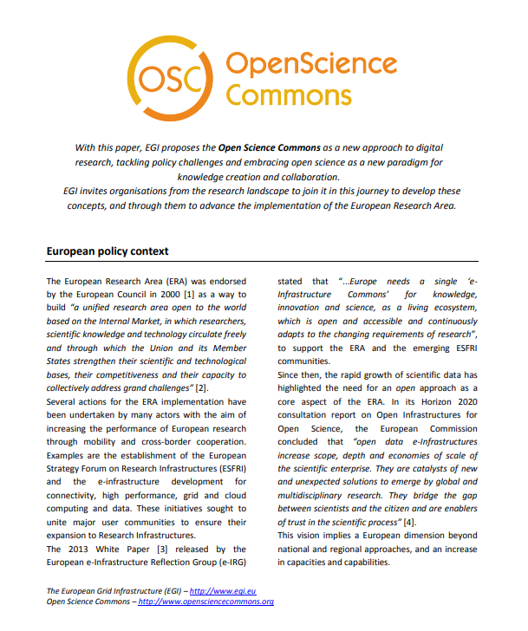
Tomorrow’s scenario?
Open Science Commons (2014)
The Data Science Commons
A federation of research data, computing, applications and other open science resources, responding to the problem of scalable access to research data through a new data provisioning service approach that is complementary to the traditional data download model.
https://zenodo.org/record/4884748
Notes:
A globally distributed ICT infrastructure that federates the digital capabilities, resources and expertise of national and international research communities in Europe and worldwide.
EGI has delivered unprecedented data analysis capabilities to more than 46,000 researchers from many disciplines and is now committed to bring innovation to the private sector.

Slide 10
The Data Commons should...
Allow to discover, access and analyze major research datasets and information for third-party exploitation
Provide access to the data & data products close to processing facilities while avoiding duplication of local data storage & compute infrastructures across research performing organizations in Europe
Notes:
A globally distributed ICT infrastructure that federates the digital capabilities, resources and expertise of national and international research communities in Europe and worldwide.
EGI has delivered unprecedented data analysis capabilities to more than 46,000 researchers from many disciplines and is now committed to bring innovation to the private sector.

Slide 11
The Data Commons should…
Offer a hybrid distributed compute platform (HTC, HPC, cloud) and integrated rich portfolio of scientific application tools supporting self-service provisioning
Offer tools for scalable data movement across data preservation infrastructures and distributed interconnected network of “data hubs”
Provide integrated capabilities for publishing and sharing scientific outputs from experiments to support open science
Support federated authentication and authorization for use of existing personal credentials and easy to use access channels
Notes:
A globally distributed ICT infrastructure that federates the digital capabilities, resources and expertise of national and international research communities in Europe and worldwide.
EGI has delivered unprecedented data analysis capabilities to more than 46,000 researchers from many disciplines and is now committed to bring innovation to the private sector.

Slide 12
The Data Commons require...
Coordinated development, operations, procurement, management and provisioning across RIs and e-Infrastructures sharing expertise and technologies of common interest
The federation of existing/future publicly funded digital infrastructures leveraging national investments to achieve economies of scale across Europe
Changes in the policies of the participating infrastructures to support both national and international user groups - Infrastructures open by default
International cooperation among digital infrastructures in the world, to scale beyond Europe
Notes:
A globally distributed ICT infrastructure that federates the digital capabilities, resources and expertise of national and international research communities in Europe and worldwide.
EGI has delivered unprecedented data analysis capabilities to more than 46,000 researchers from many disciplines and is now committed to bring innovation to the private sector.

Slide 13
https://eosc.eu/

Slide 14
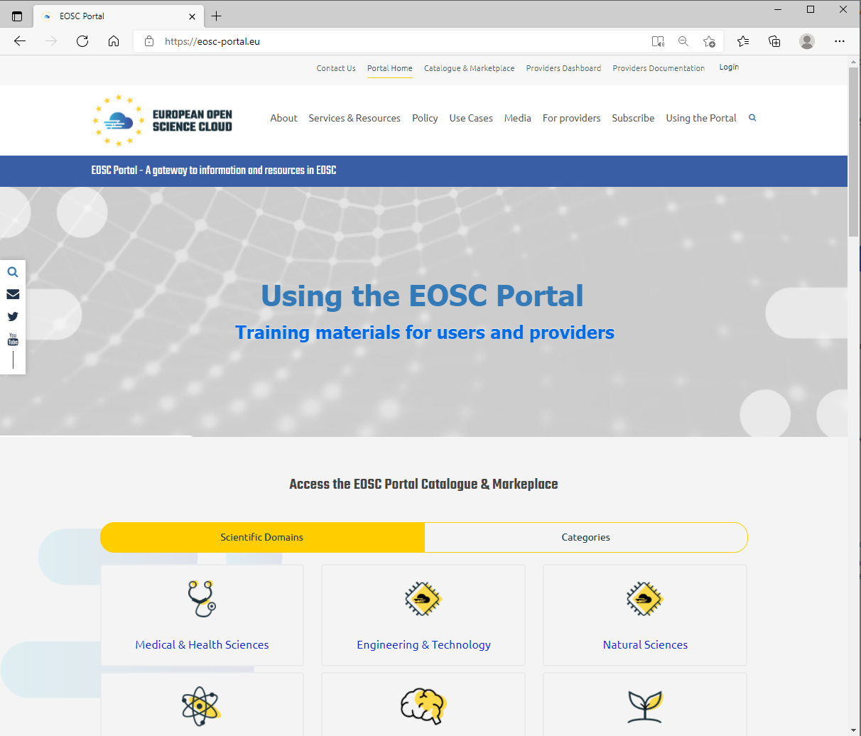
Provider onboarding
Catalogue of services
Service access management
Helpdesk + FAQ

Slide 15
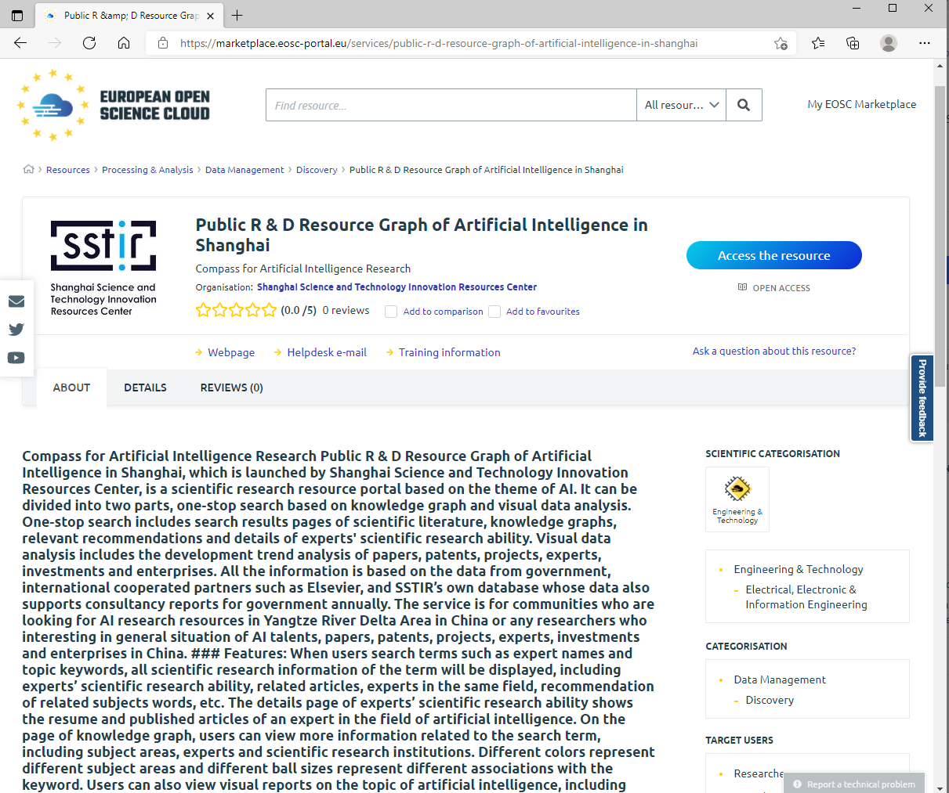

Slide 16
https://eosc.eu/
?

Slide 17
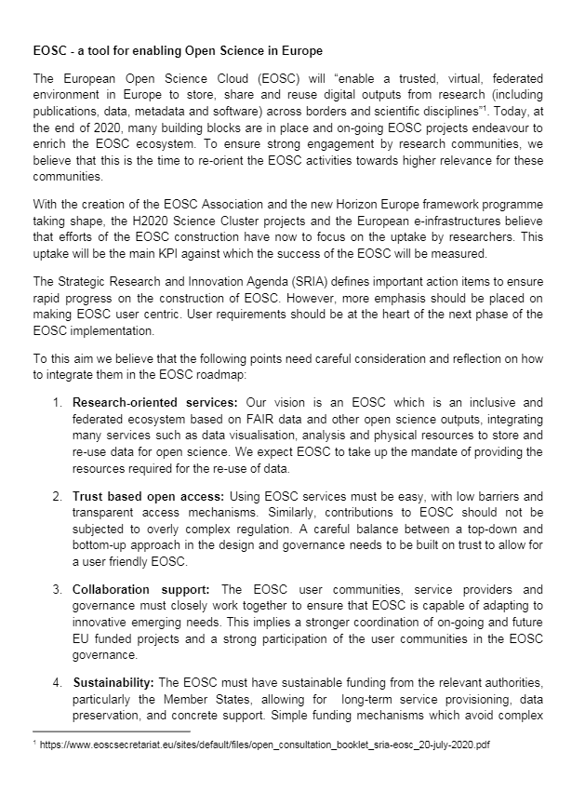
Joint position paper (Sep 2020)
The research e-Infrastructures claim the need…
to sustain the costs of re-use of data by integrating data, visualization, analysis and physical resources to store and re-use data for open science
Recommend…
EOSC should play a role in sustaining the cost of open data re-use
Advocate that…
the Member States need to play a key role in the long-term service provisioning funding to avoid complex commercial transactions.
https://zenodo.org/record/4044010

Slide 18
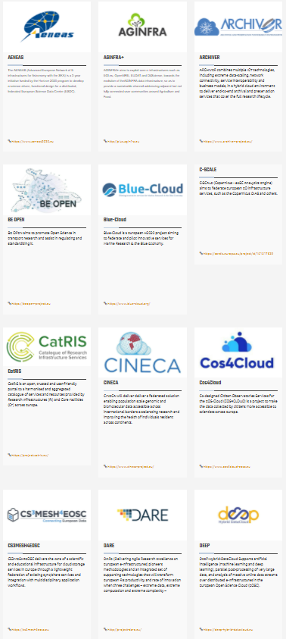
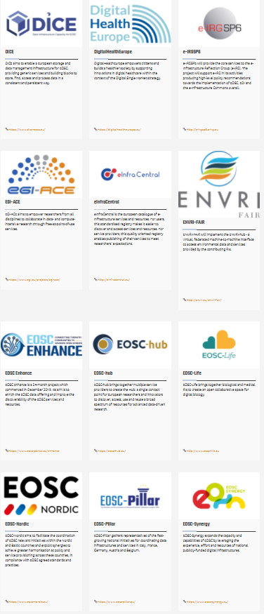
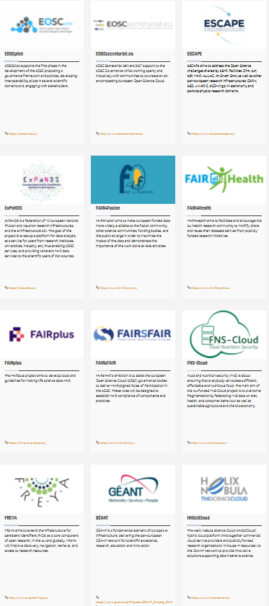
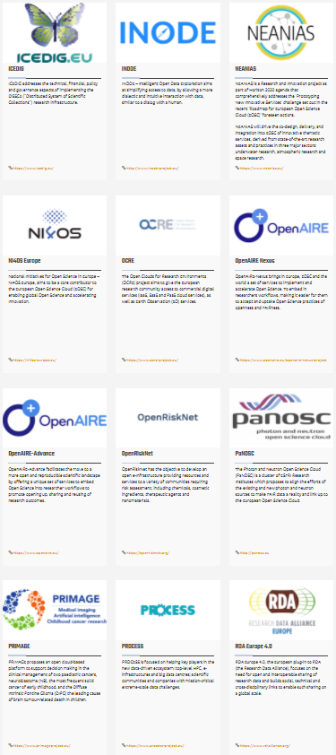
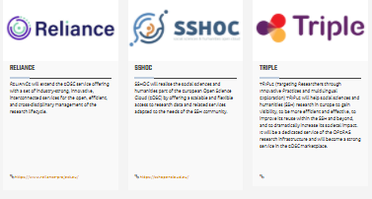
EOSC project landscape
EGI Advanced Computing for EOSC

Slide 19
Mission: Implement the Compute Platform of the European Open Science Cloud and contribute to the EOSC Data Commons by delivering integrated computing, platforms, data spaces and tools as an integrated solution that is aligned with major European cloud federation projects and HPC initiatives.
Start: January 2021
Duration: 30 months
Consortium: 33 participating partners, 23 third-parties
Budget: 12 Million EUR

Slide 20
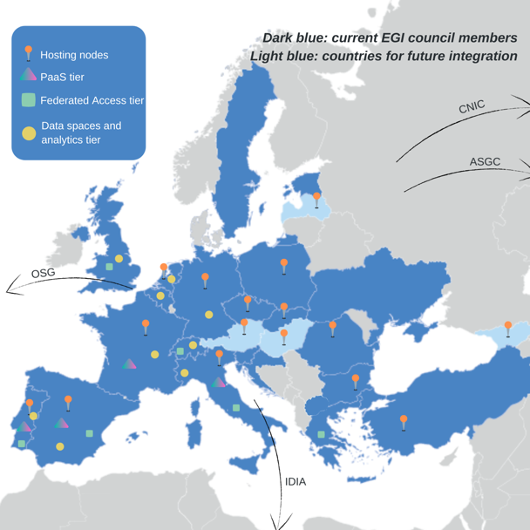
57% of the budget allocated service provisioning
16 partners to deliver cloud, HTC and HPC resources
12 user access and platform solution providers
21 providers from 13 communities to deliver data spaces
12 federation service providers
EGI Foundation as coordinator

Slide 21
Service portfolio
Data Spaces
and Analytics
Data and thematic data analytics and processing tools
EOSC portal
Early adopters
Green Deal Data Space
Health Data Space
Fundamental Science Data Space
Humanities Data Space
Platforms
generic added-value platform level services
Interactive Computing
Automated Cluster deployment
Distributed AI training
Workload Management
Service Management, Tools, Processes, Policies
Federated
Access
Federation-wide management of data and computing
Federated Compute
Federated Identity
Federated Data
Federated
Resources
Compute and storage facilities
Research Clouds
Public Clouds
HTC
HPC

Slide 22
Infrastructure services: Cloud, HTC, HPC
For users and communities within the project AND for new EOSC users
Cloud-HTC compute and short-mid term storage:
80 Million CPU hours / 250,000 GPU hours / 20 PB storage
Mix of funding mechanisms:
Virtual Access:
Local grants enabling policy-based access (EGI Cloud Federation + new partners):
Pay-for-use:
Pilot HPC sites:
Moldova
Latvia
Georgia
Hungary
Austria
USA
China
South Africa

Slide 23
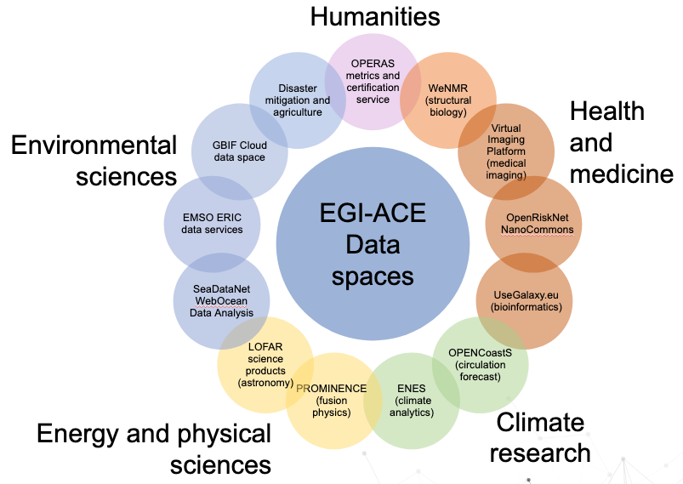
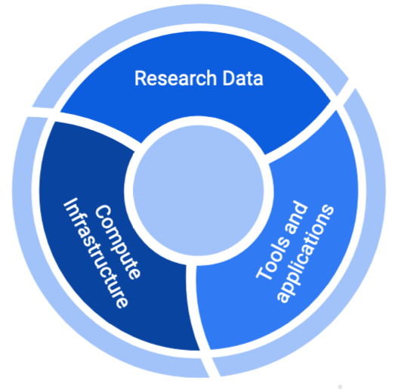
Data spaces
Research data:
ESGF data archive
Tools and applications:
JupyterLab
Enes libraries
EC3
Synda & DataHub
Compute infrastructure:
Cloud and HPC sites

Slide 24
Compute Platform: Resource allocation
Single users
Small groups
Experimental users
International projects
Multi-national communities
EOSC USERS
Business-to-User
Business-to-Business
EOSC Portal
EGI-ACE Open calls Evaluation every 2 months
Ready-to-use resources/services
Self-service configuration
Short term engagement
High capacity demand
Custom configurations
Long term engagement
https://www.egi.eu/projects/egi-ace/call-for-use-cases
Opportunity for joint EU-CN use cases!

Slide 25
EGI-ACE Objective 4: Contribute to the realization of a global Open Science Cloud
Credits: Jianhui LI Computer Network Information Center, CAS

Slide 26
~2000
2020+
LOFAR
IceCube
WeNMR
Bioimaging
SeaDataNet
ENES
LSST
…
?
EOSC and EGI-ACE by implementing the Data Science Commons

Slide 27
Thank you!
gergely.sipos@egi.eu
www.egi.eu

