Slide 1
EGI Sustainability & Business Models
Sergio Andreozzi
EGI.eu Policy Development Manager

Slide 2
Outline
EGI Ecosystem
Addressing Sustainability
What We Did So Far
What’s Next

Slide 3
What is EGI?
European
Focus on meeting the needs of European Researchers
Their key need is to collaborate internationally and to perform large-scale data analysis
Grid
Federation of shared resources, not a single technology
Supports a collaborative social network
Infrastructure
Established physical and organisational structures
Services and facilities for an economy to function

Slide 4
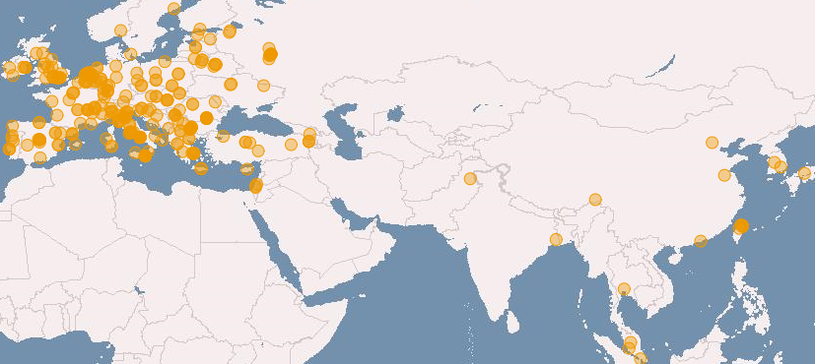
European Grid Infrastructure (April 2011 and yearly increase)
Logical CPUs (cores)
239,840 EGI (+24.9%)
338,895 All
102 PB disk and 89 PB tape
Resource Centres
338 EGI
345 All (+6.8 %)
96 supporting MPI (+6.8%)
Countries (+11.5%)
51 EGI
57 All (+18.75)
38 NGIs providing resources
22 National Operations Centres
16 NGIs in 5 Federated Operations Centres
1 EIRO providing resources
18 countries in 4 non-European Operations Centres

Slide 5
EGI Collaboration
NGI
EIRO
NGI
NGI
EIRO
NGI
NGI
Virtual Research Community
Virtual Research Community
Virtual Research Community
EGI.eu
NGI: National Grid Initiative
EIRO: European Intergovernmental Research Organisation

Slide 6
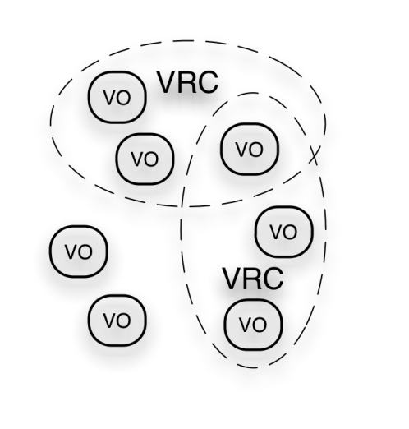
EGI Ecosystem
User Community
Policies + Funding
EGEE-III
Requirements + Feedback
Services + Support
EGI-InSPIRE
NA3 & SA3
Service & Resource Providers
Requirements + Feedback
NA2
Public Funding Bodies
Policies + Funding
Requirements + Feedback
European Commission
EGI.eu
Technology Providers
NA1
SA2
Open Source Providers
National Research Councils
Resource Infrastructure Providers
Strategic Feedback
SA1 & JRA1
Technology + Support
Commercial Providers
Policies + Funding

Slide 7
Cost Structure (2010-2013)
EGI.eu
European Commission
EGI-InSPIRE
(25000K)
597K
EGI-InSPIRE Central Budget
(597K)
EGI Global Tasks
(performed once for all)
4653K
EGI.eu Activity
(8010K)
Running EGI
(4 yrs)
2643K
19750K
6000K
NGI Activity
Partner Tasks
(International & EGI Global Tasks)
(65848K)
NGIs & EIROs
(49455K)
43455K

Slide 8
How to Sustain EGI after 2013?
What do we need to sustain?
Services:
Human: governance, events, requirements, …
Infrastructure: accounting, monitoring, helpdesk, …
Technical: applications DB, training marketplace, …
Organisations:
EGI.eu
NGIs/EIROs
Technology Providers
User Communities

Slide 9
What We Did So Far
EGI Sustainability Plan
EGI-InSPIRE Deliverable with Yearly update
First release: D2.7http://go.egi.eu/egi-inspire-d2.7
EGI Ecosystem
Service Decomposition
Revenue streams and Pricing Mechanisms
Initial exercise on Matching Services to Revenue Streams

Slide 10
What We Did So Far
Integration of Cloud and Virtualisation in EGI
https://documents.egi.eu/document/258
EGI: infrastructure, usage
Cloud: Technology and Operating Models
Cloud activities in Grid context
Evolving EGI
Drivers, cost analysis (EGI, e-IRGSP2, Amazon)
Vision for integration of virtualisation in EGI
Towards a Technology Roadmap
Live document

Slide 11
What We Did So Far
Explored new organisational structure for EGI.eu
ERIC: European Research Infrastructure Consortium
Legal Framework from EU
MS212:
https://documents.egi.eu/document/244
Survey to NGIs/EIROs
https://documents.egi.eu/document/674
Questions to ERIC Team

Slide 12
What We Did So Far
Organised EGI Technical Forum Workshop
Session 1
Tuesday 20 September 2011 (14:00-15:30)
Business Models and Sustainability Plans (20')
Open questions and discussion (10')
NGI Rep 1: Sustainability Plans (TBD, 20')
NGI Rep 2: Sustainability Plans (TBD, 20’')
Roundtable discussion + panel clarifying open issues and concerns (20’)
Session 2
Tuesday 20 September 2011 (16:00-17:30)
Intro to mapping exercise (Steven Newhouse, 15')
Whiteboard mapping of business models to services (60’)
Summary and closing discussion (15’)
Preparatory Survey to NGIs
http://www.zoomerang.com/Survey/WEB22CR4R283VG
Business Models, Sustainability, Impact Assessment
Notes:
Total EGI cost over 4-years = €335M --- €25M from EC --- Rest is supported by national funding agencies

Slide 13
What’s Next
Define a comprehensive strategic plan for EGI and EGI.eu
Generate a number of possible business models
Using http://www.businessmodelgeneration.com/
For EGI, EGI.eu, NGIs/EIROs
Exploring the possibility for EGI.eu to provide limited commercial services
"An ERIC shall pursue its principal task on a non-economic basis. However, it may carry out limited economic activities, provided that they are closely related to its principal task and that they do not jeopardise the achievement thereof. "Limited" is interpreted as up to 25% of the total annual activities.”
Link Business Models to a Strategic Plan
Link sustainability plan of EGI/EGI.eu to the sustainability plan of (Heavy) User Communities

Slide 14
What’s Next
Run Successful Workshops at EGI Technical Forum
Sustainability and Business Models
e-Fiscal Workshop
Wednesday 21 September 2011 (11:00-12:30)
Introduction to e-FISCAL project (Fotis Karagiannis, 15’)
State-of-the-art review on costs/business models for e-Infrastructures (15')
e-Fiscal Draft Questionnaire (15’)
Open discussion on the draft questionnaire (45’)
Notes:
Total EGI cost over 4-years = €335M --- €25M from EC --- Rest is supported by national funding agencies

Slide 15
Summary
EGI/EGI.eu/NGIs are in place to provide researchers with a pan-European e-Infrastructure for large-scale data analysis
We are investigating how to sustain income after 2013 in order to continue providing our value
Innovating EGI with virtualisation support
Reaching out new communities
Exploring new business models
Aligning with EU long-term strategies
Europe 2020, Digital Agenda, Innovation Union, Horizon 2020
Exploring new organisational forms for EGI.eu

Slide 16
Thank you!
sergio.andreozzi@egi.eu
policy@egi.eu
References
e-Fiscal Workshop - http://go.egi.eu/ftpte
EGI TF Business Model and Sustainability Session - http://go.egi.eu/policy-session-egiuf2011
EGI Sustainability Plan (D2.7) - https://documents.egi.eu/document/313
Integration of Clouds and Virtualisation into EGI (D2.6) - https://documents.egi.eu/document/258
Suitability of ERIC Legal Framework for EGI.eu (MS212) - https://documents.egi.eu/document/244
EGI Standards Roadmap - https://documents.egi.eu/document/206
EGI Website Policy Page - http://www.egi.eu/policy/
EGI User Virtualisation Workshop http://go.egi.eu/uvw1

Slide 17
EXTRA SLIDES

Slide 18
Business Model Canvas

Slide 19
Key Activities
Human (coordination)
Coordination, mgmt. boards, admin, policy, dissemination, technology roadmaps, operations and user support, TPM, requirements gathering, security, documentation and stats
Infrastructure (running and monitoring)
Software rollout, monitoring, accounting, security tools, helpdesk, configuration repository, operations portal, core services
Technical (user, operations and tech support)
VO services, software acceptance criteria, validation and repository, AppDB, training services
Full taxonomy: https://documents.egi.eu/document/313
Notes:
‘Human Services’ for coordination and community building;
‘Infrastructure Services’ for properly running and monitoring the infrastructure;
‘Technical Services’ for supporting the collaboration and interaction of the user, operations and technology communities.

Slide 20
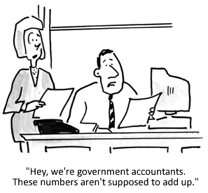
Revenue Streams
Fixed Fee
Subscription: monthly or yearly fees (e.g. membership)
Freemium: first level free; subsequent payment based
Professional Services: dedicated or special services upon request
Usage-based
Freemium: use free until a specified amount; then payment based
Pay as you go: pay only for what used
Free to Use: services not worth charging or accounting for
In-kind Effort Sources: collaborative efforts
Public Funding
Project: submit project proposals for specific activities
Structural Funds: for research & innovation (EC funds to stimulate national funding)
Recurrent: become a budget line item
Notes:
There are others: brokerage, advertising, lending/renting/leasing, licensing

