Slide 1
FitSM Overview
This work has been funded by the European Commission. It is licensed under a Creative Commons Attribution-ShareAlike 4.0 International License.

Slide 2
What is IT Service Management?

Slide 3
What is ITSM?
ITSM
Background
IT Service Management (ITSM) is …
… a structured way to set up, launch, operate and manage IT services
… a conceptual structure for organizational processes and procedures
… a checklist to make sure you are doing things repeatably, predictably, efficiently
ITSM is not …
… changing everything you do to use a management-speak handbook
… buying a tool
… marketing

Slide 4
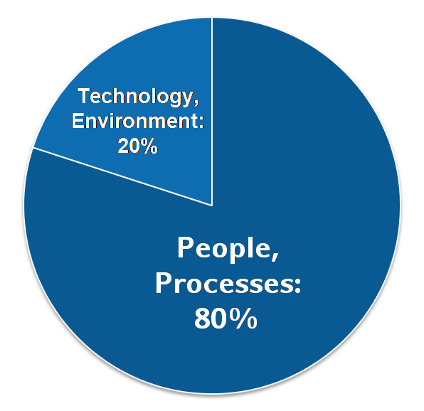
Why ITSM?
About 80% of all service outages originate from “people and process issues”
Duration of outages and degradations significantly dependent on non-technical factors
IT Service Management …
… aims at providing high quality IT services meeting customers’ and users’ expectations …
… by defining and installing management processes covering all aspects of managing the service lifecycle:
Planning
Roll-out and delivery
Operational support
Changing and improving
ITSM
Background
Reasons for service outages
[Gartner, 2001]

Slide 5
ITSM: Success factors
ITSM
Background
People
Processes
Technology
Skills
Awareness
Defined activities
Responsibilities
Support people in their roles
Effectiveness and repeatability
Increase process effectiveness and efficiency
Typical tools for service management:
Workflow support tool
(Trouble) ticket tool
Wiki
Excel sheets
Word templates
…
Typical service management processes:
Incident management
Change management
Service portfolio management
Service level management
Capacity management
Information security management
…

Slide 6
ITSM: 5 key facts
ITSM means: Alignment of IT service operations to the customers' needs.
ITSM means: A process approach in delivering and supporting IT services.
ITSM supports a consistent terminology, avoiding bad communication and lack of understanding.
ITSM requires the provider to understand the requirements of its customers.
There are various frameworks and standards providing guidance around ITSM.
ITSM
Background

Slide 7
ITSM: Federation challenges
Traditional service management practices …
assume single central control over all service management processes by the service provider
hardly address collaborative approaches to service delivery
As a result: Applying service management in federated environments may be more difficult, and not all concepts / ideas will work
The FitSM approach meets these needs:
Lightweight set of requirements
No requirements based on unrealistic assumptions
Concrete implementation guidance

Slide 8
Common problem statements regarding traditional ITSM in academia/research
“ITSM is way too complicated“
“It costs too much, we don‘t have the resources“
“Our environments and organisations are different“
ITIL
“Too much effort
for the benefits
it brings”
COBIT
ISO20K
“Too far away, not for
our community”

Slide 9
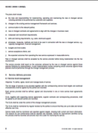
Third way for ITSM
‘Full’ commercial ITSM
FitSM Solution
Less unfamiliar
More achievable
More suitable
Path to ‘full’ ITSM
Freely available
No/little formal ITSM
ISO/IEC 20000

Slide 10
What is FitSM?

Slide 11
What is FitSM?
“FitSM is a pragmatic, lightweight and achievable standard for IT service management. It is modular and provides requirements as well as practical ITSM implementation guidance.”
FitSM can be described as…
Lightweight
Easy to understand
Freely available
Highly compatible
www.fitsm.eu

Slide 12
FitSM parts, structure and processes

Slide 13
FitSM parts
FitSM-0
Overview & vocabulary
Terminology
FitSM-1
Requirements
Requirements
FitSM-2
Objectives and activities
FitSM-3
Role model
Support & Guidance
FitSM-4
Selected templates and samples
FitSM-5
Selected implementation guides
FitSM-6
Maturity and capability assess-ment scheme

Slide 14
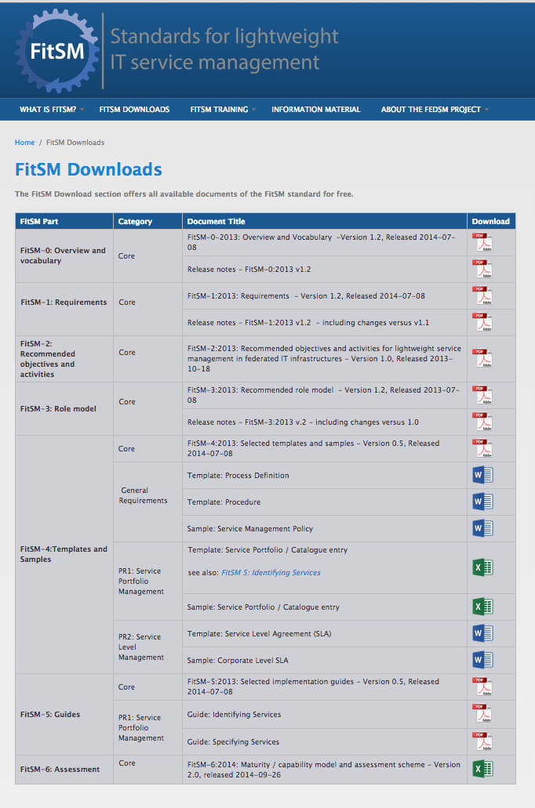
Available on www.fitsm.eu
FitSM-0 (.pdf)
FitSM-1 (.pdf)
FitSM-2 (.pdf)
FitSM-3 (.pdf)
FitSM-4, -5
4 Templates (.doc, .xls)
3 Samples (.doc, .xls)
2 Guides (.pdf)
FitSM-6 (.xls)
Much more to come!!
Notes:
More templates, samples and guides are being prepared.
Clients driving priorities as well!

Slide 15
FitSM: ITSM process framework
Service portfolio management (SPM)
Service level management (SLM)
Service reporting management (SRM)
Service availability & continuity management (SACM)
Capacity management (CAPM)
Information security management (ISM)
Customer relationship management (CRM)
Supplier relationship management (SUPPM)
Incident & service request management (ISRM)
Problem management (PM)
Configuration management (CONFM)
Change management (CHM)
Release & deployment management (RDM)
Continual service improvement management (CSI)
Core management processes for any IT service

Slide 16
Easy and effective

Slide 17
FitSM in practice
What do I need
to achieve?
How to do it, what to write
Parts 0,1
Terms, requirements
Parts 4, 5
Template
Guide
Part 6
Assessment
tool
Parts 2, 3
Activities, Roles
Who, exactly what to do?
Where to start, assess current status

Slide 18
Accessible

Slide 19
FitSM Licensing
FitSM-0
Overview and Vocabulary
FitSM-1
Requirements
FitSM-2
Objectives and activities
FitSM-3
Role model
FitSM-4
Selected templates and samples
FitSM-5
Selected implementation guides
FitSM-6
Maturity and capability assessment scheme

Slide 20
Compatible to existing standards

Slide 21
Related standards and frameworks
ISO/IEC 27000
ISO 9000
ISO/IEC 20000
FitSM
ITIL®
Legend
Quality Management
standard
COBIT
IT Management Framework
Software engineering maturity model
CMMI
adaption of concepts

Slide 22
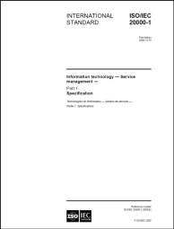
ITIL, ISO/IEC 20000, COBIT
IT Infrastructure Library® Number of books with "good practice" in IT Service Management Slogan: "the key to managing IT services" Descriptions of key principles, concepts and processes in ITSM | Most popular and wide-spread framework Not a "real" standard, but often related to as "de-facto standard" 5 books released by the British Cabinet Office
ISO/IEC 20000 International standard for managing and delivering IT services Defines the minimum requirements on ITSM | Developed by a joint committee (JTC) of ISO and IEC Based on ITIL®, BS 15000 Auditable, certifiable
Control Objectives for Information and Related Technologies IT Governance framework Specifies control objectives, metrics, maturity models | Developed by ISACA can be combined with ITIL® and ISO/IEC 20000
ISO/IEC 20000

Slide 23
ISO 9000, ISO/IEC 27000, CMMI
ISO 9000 International standard for quality management Quality management principles Minimum requirements for a quality management system | Applicable to all organizations and branches Auditable, certifiable Several documents
ISO/IEC 27000 International standard for information security management Minimum requirements for an information security management system (ISMS) More than 100 security controls | Applicable to all organizations and branches Auditable, certifiable Based on BS 7799 Auditable, certifiable Several documents
Capability Maturity Model Integration Maturity and capability model Organizational maturity assessment | Developed by SEI (Software Engineering Institute), Carnegie Mellon University
ISO 9000
ISO/IEC 27000

Slide 24
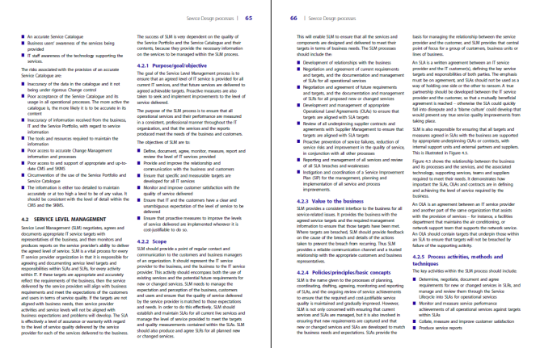
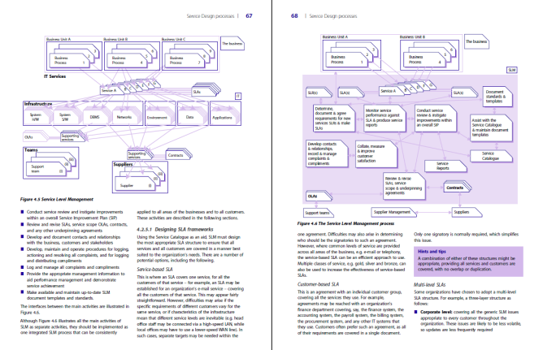
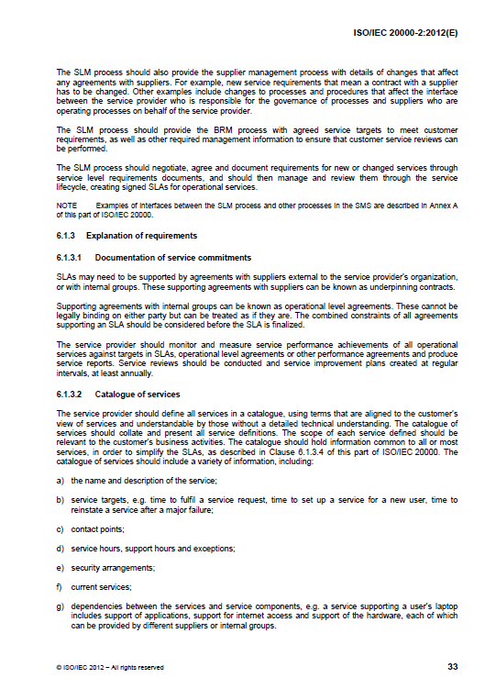
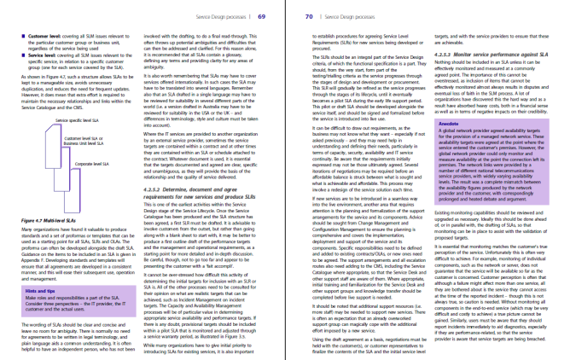
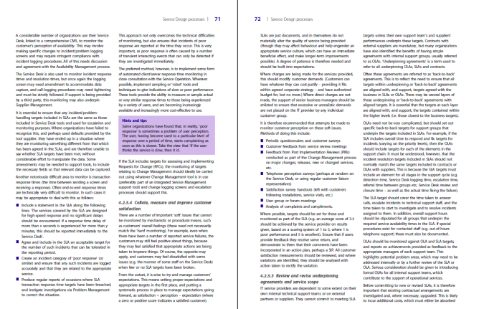
FitSM, ISO/IEC 20000 and ITIL
ISO/IEC 20000
136 pages (3 core documents)
26 pages of requirements (part 1)
FitSM
38 pages (4 core documents)
9 pages of requirements (part 1)
ITIL (good practices)
About 2,000 pages (5 core books)
No requirements

Slide 25
FitSM and ISO/IEC 20000 processes
Service Portfolio Management
(Design and transition of new or changed services)
Service Level Management
FitSM
Service Reporting
ISO/IEC 20000
Service Availability and Continuity Management
Capacity Management
Information Security Management
Budget & Accounting
Customer Relationship Mgmt
Business Relationship Mgmt
Supplier Relationship Management
Incident and Service Request Mgmt
Problem Management
Configuration Management
Change Management
Release and Deployment Management
Continual Service Improvement
(Maintain and improve the SMS)

Slide 26
Comparison (our view)
 | ITIL 2011 | ISO/IEC 20000 | MOF | FitSM
Free available | ✖ | ✖ | (✔) | ✔
Easy | ✖ | ☐ | ✖ | ✔
Complete | ✔ | ✖ | ✔ | ☐
Templates and examples | ☐ | ✖ | ✔ | (✔)
Qualification programme | ✔ | ✔ | (✖) | ✔
FitSM does not replace one of the existing standards but complements them meaningfully, especially if getting started in an ITSM project

Slide 27
Easy and efficient qualification scheme

Slide 28
FitSM qualification program
Expert Level
Expert training in IT service management
2 days
Advanced Level
2 days
2 days
Advanced training in
service planning and delivery
Advanced training in
service operation and control
Foundation Level
Foundation training in IT service management
1 day
Notes:
Full training titles:
Expert training in IT service management according to FitSM
Advanced training in service planning and delivery according to FitSM
Advanced training in service operation and control according to FitSM
Foundation training in IT service management according to FitSM

Slide 29
Certification by TÜV SÜD Examination Institute
TÜV SÜD Examination Institute
Experienced and well-established (E.g. one of the nine new examination institute for ITIL certifications)
Offering certifications for personnel worldwide (most business in Europe and India)
Owner of ISO/IEC 20000 training and qualification scheme
Notes:
TÜV has procedures for maintaining

Slide 30
Some Trainings and Workshops

Slide 31
FitSM is a product of the FedSM Project

Slide 32
FitSM a product of the FedSM Project
FedSM: 3-year, FP7 project, funded by the European Commission
(1 Sept 2012 to 31 August 2015)
Increase maturity and effectiveness of (IT) Service Management in Federated e-Infrastructures by applying suitable good practices.
Consultants
Clients
EMERGENCE TECH LTD.
Notes:
FedSM – full project title “Service Management in Federated e-Infrastructures” – is funded under the coordination and support action funding scheme
something something FP7 EC … ….
Project duration: 36 months, from 1st September 2012 to 31st August 2015

Slide 33
Wider applicability
It quickly became apparent that what was being created was extremely attractive for organisations well beyond e-Infrastructures
No lighter weight version of ITSM on the market
Applicable to any organisation providing IT services
All managers looking for better ways to plan and organize
All IT operations staff to improve efficiency and effectiveness
For growing organizations/companies
Research and academia now needing to manage IT services
ITIL trainers seeing future market
Attended FitSM train the trainer style course

Slide 34
Future is bright!
IT Education Management Organisation (ITEMO)
Taking stewardship of the FitSM standard and qualification scheme after project end
Certification scheme will be maintained by TÜV SÜD after end of project (non-exclusively)
Non-profit association; ca. 25 members
Mission: Maintain professional qualification schemes for IT Management
e.g. SCRUM certification for personnel
FitSM authors are ITEMO members
Training and consultancy can be offered commercially

Slide 35
General information

Slide 36
Q&A and contact
All currently available documents of FitSM
www.fitsm.eu
If you have questions
If you have suggestions or criticism
If you implement parts of FitSM and find it useful
info@fitsm.eu

Slide 37
Icons Disclaimer
The icons used in this collection of slides can be found at: www.iconsdb.com and are freely available.

