Slide 1
Shaping the EOSC – The EOSC-hub contribution
Status Update
Dissemination level: Public/Confidential If confidential, please define:
Disclosing Party: (those disclosing confidential information)
Recipient Party: (to whom this information is disclosed, default: project consortium)

Slide 2
EOSC-hub
Project introduction

Slide 3
EOSC-hub mobilises providers from 20 major
digital infrastructures, EGI*, EUDAT CDI** and
INDIGO-DataCloud jointly offering services,
software and data for advanced data-driven
research and innovation.
* EGI is not an acronym (any more)
** CDI – Collaborative Data Infrastructure

Slide 4
Project figures
European Commission Horizon2020 programme
100 Partners, 76 beneficiaries (75 funded)
3874 PMs, 108 FTEs, more than 200 technical and scientific staff involved
€33,331,18, funded by:
European Commission: €30,000,000
EGI Foundation and its participants: €2,155,540
EGI participants: €1,221,094
36 months: Jan 2018 – Dec 2020

Slide 5
EOSC-hub Mission
The project will create EOSC Hub:
a federated integration and management system for EOSC
From the consortium AND from external contributors
Usage according to Principles of engagement
Services
Processes and policies
Federated operations
Federation services
Data
Applications & tools
Baseline services (storage, compute, connectivity)…
Training, consultants
Marketplace
AAI
Accounting
Monitoring
…
Lightweight certification of providers
SLA negotiation
Customer Relationship Management
…
Security regulations,
Compliance to standards,
Terms of use,
FAIR implementation guidelines
…
Based on FitSM
10/6/2018
5

Slide 6
What does the Hub provide?
Contact point for researchers and innovators to discover, access, use and reuse a broad spectrum of resources for advanced data-driven research
Catalogue of resources and services
Humanities, Engineering, Medical and Health Sciences, Natural Sciences
Corpus of policies, processes and federation services (community-defined)
Principles of engagement and EOSC “core” services
Quality assurance reviews
Manage end-to-end service level management performance
Competence Centres and a Joint Digital Innovation Hub
Specialized Technical support, training

Slide 7
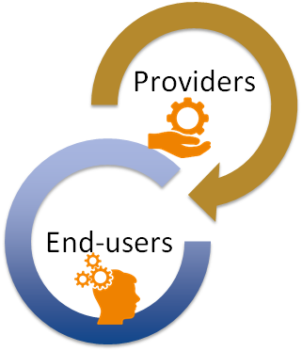
Value proposition
Publish and promote services and resources
Defined Hub policies (general & community-specific)
FAIR best practices, access and usage policies, interoperability, standards
General service management processes with the providers
Tools for federated service management
Accounting, monitoring, federated AAI, registries
Incident and support management, customer relationship and order management, SLA management, IT security management, …
Using institutional credentials for access
Discover and compare services
Order services and resources, get access and support
Order extended capacities
Order service upgrades

Slide 8
Shaping the EOSC
The EOSC-hub contribution

Slide 9
Shaping the EOSC The EOSC-hub contribution
EOSC implementation roadmap and project strategy
The EOSC service management system
The EOSC Portal
Engagement with and boarding of service providers to the EOSC
Boarding of services providers
Engagement with service providers
EOSC-hub Technical architecture as a contribution to the EOSC
Technical coordination
Technical architecture
Communication, dissemination and training

Slide 10
Shaping the EOSC
The EOSC-hub contribution to the EOSC implementation roadmap

Slide 11
Contribution to the EOSC implementation roadmap The EOSC-hub roles
Architecture as EOSC Service Integrator
Framework to manage services sourced from a number of service providers
Data as Facilitator of FAIR Data Discovery
Discovery and access channel to FAIR-accredited datasets
Services as Service portfolio manager
Definition of a participatory and lightweight service portfolio management process in collaboration with the participating service providers.
Access & Interface as Aggregator of demand and supply
Engagement with the demand and supply side of the EOSC
Co-development
Operation of a marketplace as one entry point to EOSC
Rules of Participation as Maintainer of a corpus of Rules of Participation
Collaboration with partners and external projects/initiatives to establish and maintain a corpus of policies that is inclusive and provides value for both service providers and service users

Slide 12
EOSC-hub strategy goals
Establish an inclusive EOSC-hub - the EOSC federated core
Strengthen digital capabilities, expertise and adoption of the FAIR principles
Co-create and integrate open and user-driven services and solutions
Facilitate the exploitation of research data and decrease service fragmentation
Prototype a EOSC business model and procurement
Build a sustainable and participatory mode of operations for stakeholder dialogue

Slide 13
Shaping the EOSC
The EOSC Service Management System
Processes and procedures to onboard, operate and offer EOSC services

Slide 14
EOSC Service Management System
Framework to manage services sourced from a number of service providers
Processes and procedures to onboard, operate and offer EOSC services
Progress in all 12 process definitions and implementations
Supplier Portfolio Management | Configuration Management | Capacity Management
Service Level Management | Change Management | Information Security Management
Customer Relationship Management | Release and Deployment Management | Incident and Service Request Management
Supplier Relationship Management | Service Availability and Continuity Mgmt | Problem Management
Setting up of Service Management Board (SMB)
Management/governance body for all Service Providers of EOSC-hub
Major operational news: security, upgrades, operational problems etc.
Validation of operational aspects
Changes to policies affecting Operations
Forum to discuss operational issues

Slide 15
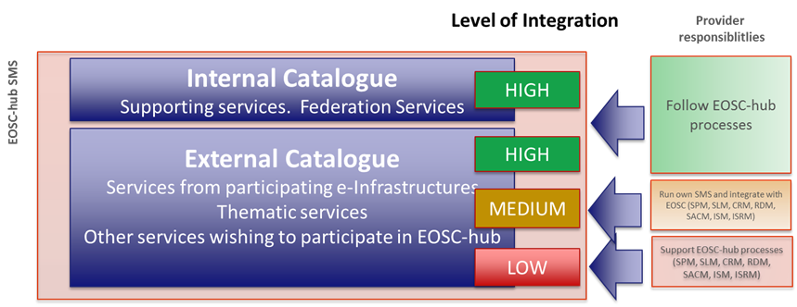
Contribution to the definition of the Rules of Participation
Collaboration with partners and external projects/initiatives to establish and maintain a corpus of policies that is attractive and provides value for both service providers and service users.
Task Force set-up and working on defining the RoP
Collaboration with the 2nd HLEG EOSC and other EOSC projects (EOSC-pilot, eInfraCentral, OpenAIRE Advance, etc.)
Ongoing: definition of appropriate procedures to assess the conformance of the services to the RoP and to the FAIR principles
Defined operational requirements to join the service catalogue
Ongoing:
Legal and policy requirements
Technical requirements

Slide 16
Shaping the EOSC
The EOSC Portal
EOSC-hub contribution

Slide 17
The EOSC Portal
The EOSC Portal is a European-level entry point to all services and resources needed by European researchers to perform science in a collaborative, open and cost efficient way: publish → discover → access
EOSC objectives | What EOSC Portal does
Increase the ability to exploit research data: data can be used as widely as possible, across scientific disciplines and between the public and the private sector | > Publish, discover, access services and resources for all scientific disciplines > Open to national, regional, pan-European providers, and supports different exploitation models (e.g. free at point of use, commercial) > Provide interoperable generic and thematic services for data exploitation
Increase interoperability, interconnect the existing and the new research digital infrastructures across Europe, remove fragmentation | > Provide thematic services integrated with European compute/data platforms for data exploitation > Single sign on, integrated access and order
Support open science | > Research artefacts sharing and discovery: services to share and discover research artefacts (publications, datasets, software, workflows etc.), research artefacts data sources (publication repositories, publishers, data archives, software archives, etc.), and others

Slide 18
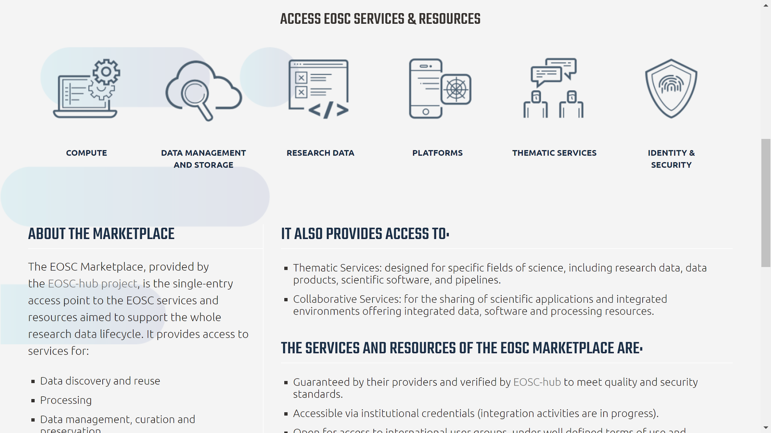
Contribution to the EOSC Portal launch
Design of the EOSC Portal
Value proposition
Provisioning of the EOSC Marketplace
Access services of the EOSC catalogue
Selection and implementation of use cases for the launch event
Preparation of the launch event
Vienna, 23 Nov 2018

Slide 19
The EOSC Marketplace as key component of the EOSC portal
Discover and access channel to production level services (TRL8 & 9) and FAIR-accredited datasets
Added values for service providers and end-users
Service providers | End-users
Publish, share and advertise services & resources, promote the adoption outside the traditional user groups | Discover a set of scientific outputs, applications, research data exploitation/discovery platforms, data management, compute services
Reach out to a wider international user base of researchers and innovators | Get complete, harmonized information on access policies, maturity level, standard compliance
Get a free online platform to manage service requests, interact with users, provide support, agree the most suitable service levels. | Smoother authentication/authorization process with own credentials for authentication
Allow users to authenticate with their own credentials to access your services and resources and get support to enable this. | Choose and access multiple resources and services according to the user’s needs by placing orders
Contribute to the definition and maintenance of EOSC service provisioning policies and the portfolio roadmap. | Provide feedback about services and information about needs → service roadmap
Receive a label that identifies validated services & resources

Slide 20
Shaping the EOSC
Engaging with and boarding of service providers

Slide 21
Boarding of service providers Creating a catalogue of services as part of EOSC
First version of the EOSC service portfolio defined
External service portfolio:
Research Enabling services: Customer-facing services that are offered via the EOSC Hub
Internal service portfolio:
Access Enabling serving: Supporting services needed to operate the EOSC Hub
Draft of the service portfolio management process defined
Templates, Procedures, Tools to on board, validate and update services
49 services already boarded
Engagement activities to onboard more services
Result | Impact and KPI
EOSC service portfolio A set of integrated services accessible via the Hub | 49 service entries of the EOSC-hub service portfolio Marketplace as catalog of the live services Rules of participation for services providers in EOSC

Slide 22
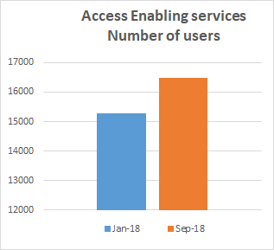
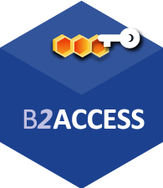
Boarding of service providers Access Enabling Services
1200 new users
All the services needed to operate the Hub:
AAI, CMDB, Helpdesk, Monitoring, Accounting, Marketplace, etc
16 services already joined the Service Portfolio
E.g.: ARGO, DPMT, EGI Check-in, EUDAT B2ACCESS, GOCDB, GGUS, INDIGO IAM, …
EGI Check-in | VA Metrics
 | Users: from 92 to 461 (+401%)
 | User logins: from 200 to 621 (+210%)
 | Connected services: from 18 to 31 (+72%)
 | User communities: from 2 to 4 (+100%)
 | Reached countries: from 15 to 49 (+227%)
EUDAT B2ACCESS | VA Metrics
 | Users: from 1065 to 1328 (+25%)
 | Connected services: from 12 to 21 (+75%)
 | Reached countries: 48
 | Web-site views: 70

Slide 23
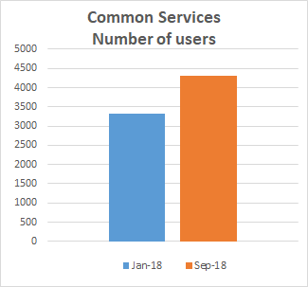
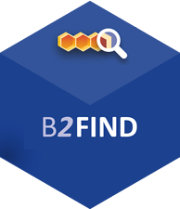
Boarding of service providers Research Enabling Services – Common Services
1000 new users
Services used as building blocks to implement other researches enabling services
Interoperable with other EOSC services
Interconnection to implement workflows
24 services already joined the Service Portfolio
E.g.: EGI Cloud Compute, EUDAT B2SAFE or INDIGO IM
EGI Application on Demand | VA Metrics
 | Users: from 5 to 26 (+420%)
 | Reached countries: from 3 to 14 (+367%)
 | Users very satisfied
EUDAT B2FIND | VA Metrics
 | Users per week: from 20 to 30 (+50%)
 | Data search per week: from 50 to 100 (+100%)
 | Integrated data providers: 19
 | Reached countries: 20

Slide 24
Boarding of service providers Research Enabling Services – Thematic Services
Domain specific services for end-users
They benefit from the single access hub and the supporting services provided by the EOSC-hub project
Helpdesk, standard access workflow, single sign-on, …
They can be discovered along with other services in a consistent fashion through the Marketplace
9 Thematic Services in the portfolio
5 Already operational
WeNMR | VA Metrics
 | New users in 9 months: from 1750 to 2273 (+401%)
 | Number of user runs submitted to portals in 9 months: from 13800 to 36179 (+162%)
 | Job submitted: 5034534
 | Consumed CPU time: 15685748 hours
 | Reached countries: 96
Dynamic On Demand Analysis Service
EO PILLAR

Slide 25
Engaging with service providers Research Enabling Services – Competence Centers
Use cases | CCs | Services
Application and data platform | EISCAT_3D ICOS-eLTER | DIRAC B2Stage, B2Share B2Safe | EOSC-hub AAI Fed.Cloud Containers Storage (online, archive)
Data and application replication ‘backbone’ | ELIXIR EPOS- Orfeus | FTS, B2Stage Kubernetes Life sc. & EPOS AAI
User workflows over distributed data and compute | Fusion R.astronomy Disaster Mit. | DODAS OneData Jupyter
Incubators for early adopter research communities
Technical support
Architecture planning:
Sharing plans and technology experiences
Tech-talks with project experts
Area-specific consultancy web-meetups
Storage; AAI; Cloud-Containers-Orchestration
Formal description of the requirements
Cross-infrastructure integration
Guided by community requirements:
Integration between Common and Domain Specific services
Integration between Common services
E.g.: Check-in and DIRAC (EISCAT_3D CC), Check-in and EBI Embassy OpenStack cloud (ELIXIR CC), EGI Jupyter and B2Drop (EPOS-ORFEUS CC)
Service providers invited to join the Service Portfolio when enough mature

Slide 26
Engaging with service providers Business sector & the Joint digital innovation hub
Business pilots success stories to further develop European economic innovation capacity
Result | Impact and KPI
EOSC Digital Innovation Hub | 6 SME collaborations Web site: https://www.eosc-hub.eu/digital-industry-hub Engaging with EC DIH Working Group and finalizing the application for the DIH catalogues
Create partnerships with SMEs/industry, innovation clusters, accelerators and investors that stimulate innovation
MOUs in progress | Mind the Byte (SME Drug discovery); Kings Distributed Systems (SME interested in providing CPU capacity and offering a token/credit system); UberCloud (broker services to facilitate engagement with SMEs for establishing new pilots); Politecnico di Milano/Engineering (DIH business models, platform adoption)
Collaborations | BDVA (iSpaces); Acellera and Evotec (SMEs Drug Discovery); Sunbay (new external request); XSEDE (industry programme experience and knowledge sharing collaboration)

Slide 27
Engaging with service providers Other Service Providers
EOSC-hub engages with the demand and supply side of the EOSC
26 communities engaged/7 approached/ 26 potential lead
Joint sessions with ESFRI clusters, EOSCpilot Scientific Demonstrators and H2020 e-infrastructure projects at EOSC-hub Week
Joint workshops under finalisation with ESFRI clusters (CORBEL, ASTERICS, ENVRI, etc.)
Form to collect expression of interests on becoming an EOSC provider
https://eosc-hub.eu/join-as-service-provider
Result | Impact and KPI
Training events and resources | Train people in research and academic organisations preventing lack of skilled and specialized infrastructure operators 16 events, 538 trained people

Slide 28
Shaping the EOSC
EOSC-hub Technical architecture as a contribution to the EOSC
Technical Coordination
Technical Architecture

Slide 29
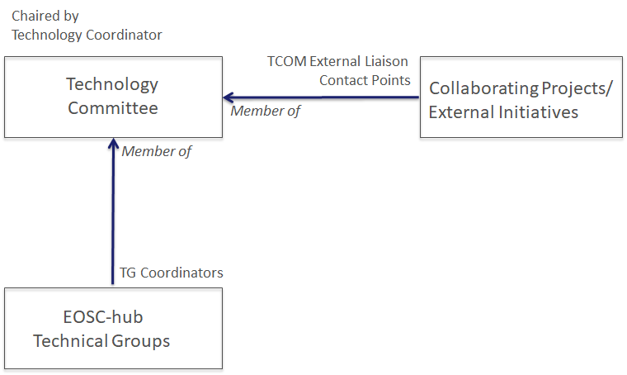
Technical coordination
Technical committee (TCOM) appointed and operational
Technical roadmap
Contribution to open source community projects and standards bodies
Compliance to standards and security of the service in the catalogue
Coordinating with external initiatives and projects
12 Technical areas identified
A technical group per area
Involving representatives of all services and
products of the area
Technical Areas
Data Platforms for Processing | Software Release and SQA
Data Publishing and Open Data | Federation Tools
Data Preservation/Curation/Prov. | PaaS Solutions
Metadata Management and Data Discovery | Workflow management and user interfaces and Data analytics
HTC/HPC Compute | Security
Cloud Compute | AAI

Slide 30
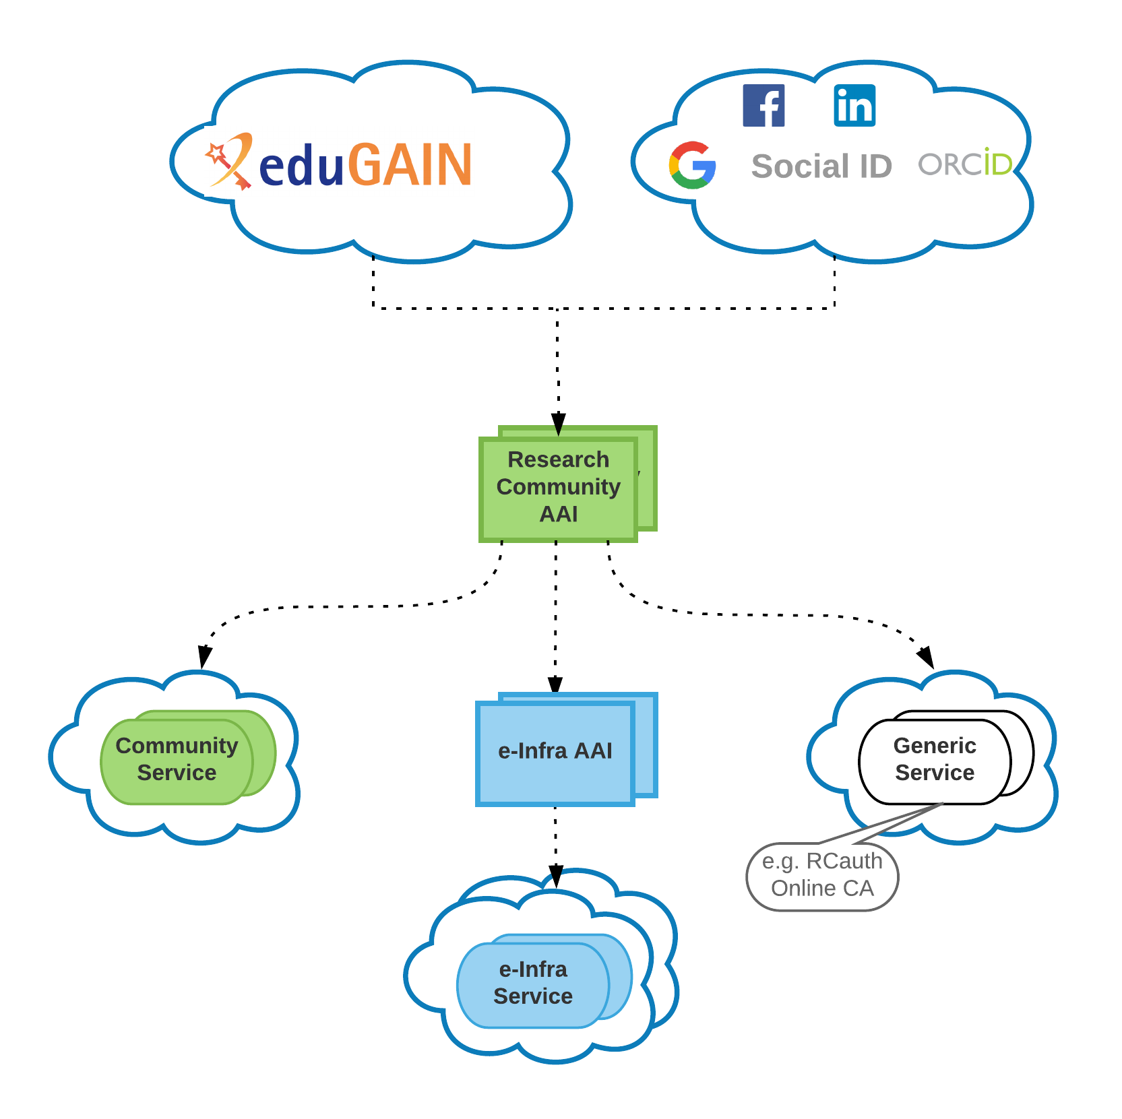
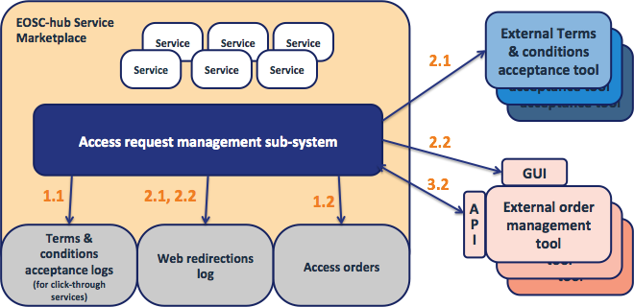
Technical Architecture
EOSC-hub AAI architecture defined
EGI Check-in / EUDAT B2ACCESS interoperability achieved
EOSC-hub Distributed Order Management System
Draft architecture available
Plan to integrate DPMT and GOCDB with the Marketplace
Accounting
EUDAT accounting data integrated in the EGI accounting repo
Design of the EOSC-hub accounting portal
Monitoring
Prototype of the unified monitoring system
Unified EOSC-hub Helpdesk available in Nov 2018
Working on integration between EGI, EUDAT and INDIGO common services
B2FIND, B2DROP, EGI Cloud Compute, INDIGO Orchestrator, etc
Setup testbeds
EOSC-hub AAI
EOSC Marketplace - Distributed order mgmt

Slide 31
Shaping the EOSC
Communication, Dissemination and Training

Slide 32
Communication and Dissemination
Joint EOSC-hub/OpenAIRE communication/stakeholder engagement activities
Joint communication plan in place
2 joint case studies (www.eosc-hub.eu/collaborations/openaire-advance)
Joint webinar & session at DI4R 2018 on national initiatives (with GEANT, PRACE, RDA)
Joint exhibition booth at ICT2018 (4-6 Dec 2018, Vienna)
EOSC-hub Events:
First EOSC-hub week, 16-20 Apr 2018, Malaga – over 170 stakeholders engaged
DI4R2018, 9-11 Oct, Lisbon – over 20 EOSC-hub sessions! (over 360 participants)
EOSC-hub website in place: www.eosc-hub.eu
Integrated with the EOSC-hub service catalogue (www.eosc-hub.eu/catalogue)
Equipped with dedicated areas for DIH and Competence Centers
EOSC-hub branding & project templates defined
EOSC-hub dissemination material created
Flier, poster, rollup banners, 2 editions of the EOSC-hub magazine, 2 issues of the project internal newsletter, 17 news articles, 7 blog posts, 4 short videos

Slide 33
Training
Training programme and online services for training
Training Catalogue (under testing)
Training programme for the first project year
Training infrastructure up & running
OLAs with resource providers in place till 12/2020 (reviewed every year)
Online tools and services for supporting training are available
Training the trainers event on Tue 23 Oct: introduce the material to trainers
Training events
Scheduling and planning of 7 training events on Data Management Plans
4 FitSM foundation level trainings
~60 formally certified in FitSM
10 of 13 WP Managers and more than half of ~60 Task Leaders trained so far
Webinars “Lightweight Service Management for Research Infrastructures: FitSM Approach”
CORBEL (6 Feb) (~50 participants) and ENVRI+ (20 Mar) (~15 participants)
Trainings on infrastructure and common services (~70 participants)
Doman-specific training to data providers and data scientists (~120 participants)

Slide 35
Backup Slides

Slide 36
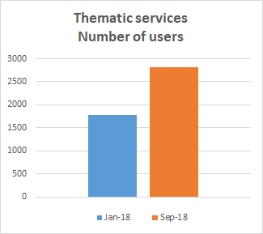
Virtual access
1000 new users
1200 new users
1000 new users

Slide 39
Backup CCs
Use cases | CCs | Services
Application and data platform | EISCAT_3D ICOS-eLTER | DIRAC B2Stage, B2Share B2Safe | EOSC-hub AAI Fed.Cloud Containers Storage (online, archive)
Data and application replication ‘backbone’ | ELIXIR EPOS- Orfeus | FTS, B2Stage Kubernetes Life sc. & EPOS AAI
User workflows over distributed data and compute | Fusion R.astronomy Disaster Mit. | DODAS OneData Jupyter
Use cases | CCs | Services
Application and data platform | EISCAT_3D ICOS-eLTER | DIRAC B2Stage, B2Share B2Safe | EOSC-hub AAI Fed.Cloud Containers Storage (online, archive)
Data and application replication ‘backbone’ | ELIXIR EPOS- Orfeus | FTS, B2Stage Kubernetes Life sc. & EPOS AAI
User workflows over distributed data and compute | Fusion R.astronomy Disaster Mit. | DODAS OneData Jupyter

Slide 40
