Slide 1
Reproducible Open Science with GitHub, EGI Notebooks, Binder and Zenodo
Gergely Sipos, Giuseppe La Rocca – EGI Foundation
Dissemination level: Public
http://go.egi.eu/eapec2019

Slide 2
Open Science
Open science is the movement to make scientific research and its dissemination accessible to all levels of an inquiring society, amateur or professional.
Publications, data, physical samples, and software
A continuation of, rather than a revolution in research practices
An important approach to increase the reproducibility of research
Benefits: increased science output; lower costs; reproducibility;
Jupyter Notebooks, Virtualisation/containerisation, Open Access data repositories provide new foundation for open science

Slide 3
Motivation: Increased science output
Publications from science archive data
Source: Michael Wise / EUDAT Conference / January 23, 2018

Slide 4
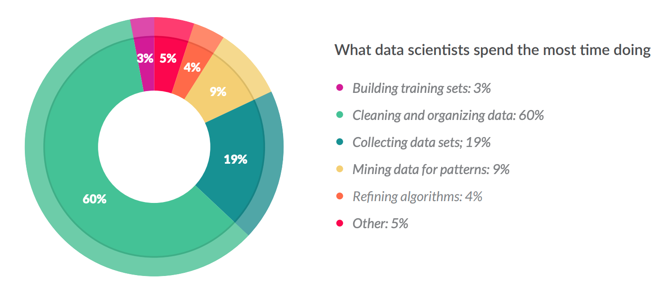
Motivation: Financial
Less than 20% !
From 80% spent on data wrangling to 80% spent on analytics/research
Source: CloudFlower data science report 2016 https://visit.figure-eight.com/rs/416-ZBE-142/images/CrowdFlower_DataScienceReport_2016.pdf
Slight increase in the 2018 report

Slide 5
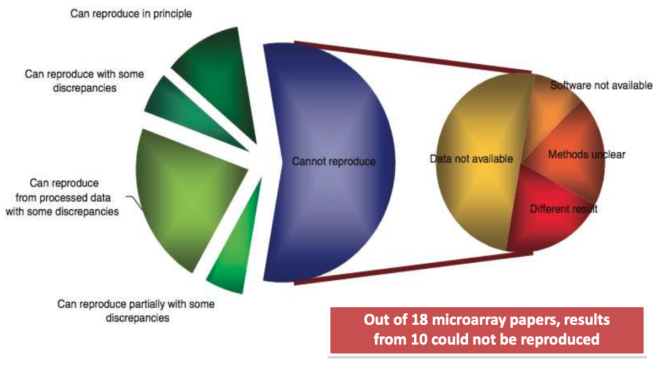
Motivation: Reproducibility
Source: Ioannidis et al., 2009. Repeatability of published microarray gene expression analyses. Nature Genetics 41: 14
See also: Science publishing: The trouble with retractions http://www.nature.com/news/2011/111005/full/478026a.html Bjorn Brembs: Open Access and the looming crisis in science https://theconversation.com/open-access-and-the-looming-crisis-in-science-14950

Slide 6
Reproducibility: beyond sharing code and data
Peng, Science, 2011

Slide 7
Reproducible Open Science
The computational tools to solve a problem
Python, R, Julia, and wide ecosystem of libraries and tools for science
An interface to facilitate coding/creating
Jupyter
A way to communicate your work
Notebooks
Leverage on the EGI Cloud to scale-up the resources
A way to share your work
GitHub, Zenodo or other similar repositories
A way to pack it all for replication
Docker (used by Binder)
A way to persistently identify it
DOIs (Digital Object Identifiers)
binder

Slide 8
Our implementation of Open Science
EGI Notebooks
EGI Binder
1. Perform data analysis and visualisation
GitHub
6. Reproduce analysis
Your repository
5. Resolve DOI to Notebook
2. Publish notebook and Generate DOI
3. Cite DOI
in publication
Fellow researchers
Journal paper
4. Discover DOI

Slide 9
Git & GitHub
Git is a distributed version-control system for tracking changes in source code during software development
Written to manage development of Linux
GitHub is a social network for software development
Git repository hosting service + extra features
GitHub provides a web-based interface on top of git.
Collaboration features: access control, wikis, issues, projects, …
Connected with Zenodo:
Got a DOI from a GitHub repo

Slide 10
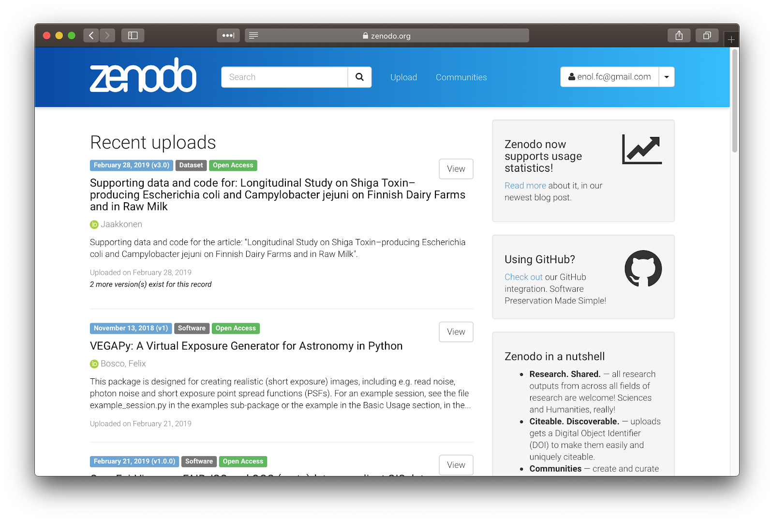
Zenodo
‘Open Science’ repository from OpenAIRE
Hosted at CERN data centre
http://zenodo.org
For
Publications, white papers, datasets, software, etc.
For
Long-tail science
Projects
Communities
Research groups
…
Dropbox, GitHub integration: - Web or API access
Access stats and reports for communities

Slide 11
Binder
An open-source web application to turn repositories in interactive notebooks
It uses Modern technology in cloud orchestration (Kubernetes), interactive computing (Jupyter), scientific computing (the open-science ecosystem)
Credit: Juliette Taka https://twitter.com/JulietteTaka

Slide 12
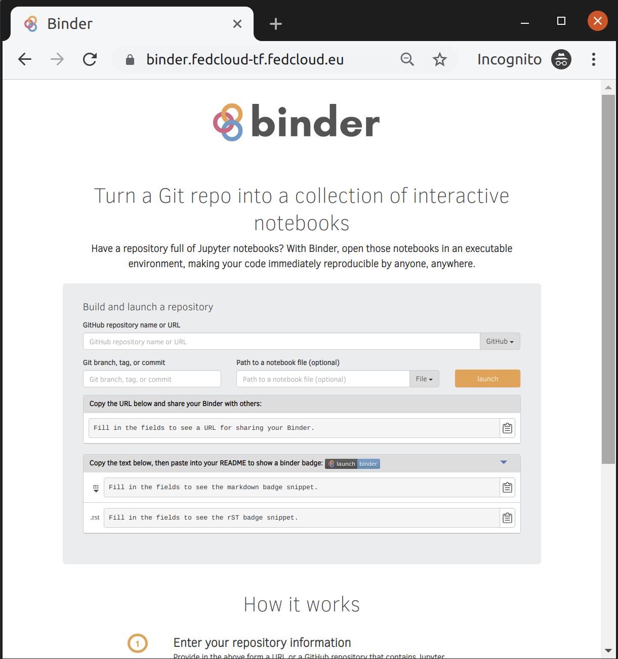
What does Binder do?
Pulls code from repository
repo2docker: Creates reproducible containers from repositories
jupyterhub: Generates user sessions that serve these containers
Kubernetes: manages the computing infrastructure
EGI Binder:
Provides an interface to create, share, and share the sessions

Slide 13
EGI Binder service
The service is available in Alpha mode for restricted users
Notebooks to reply in the service are limited to 1 CPU, 1GB RAM and 10GB of persistent storage per user
Production version is planned to be opened in late 2019

Slide 14
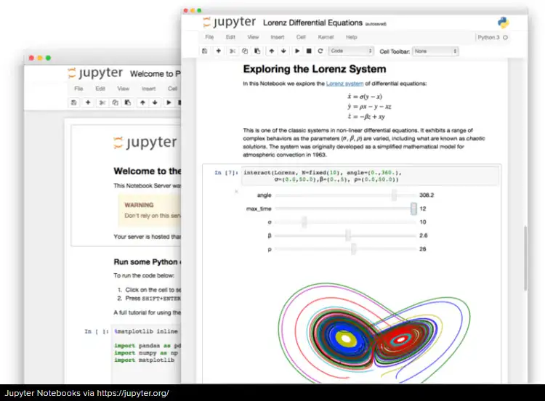
Overview of the hands-on
1. Edit the notebook 1'. Download the ipynb file
EGI Notebooks services
EGI Binder Notebooks
Re-execute
2. Create repository
2'. Upload ipynb file
2''. Add requirements.txt
GitHub
7. Provide GitHub project reference
Your repository
3. Specify the GitHub repo
6. Obtain GitHub project reference
Fellow researchers
4. Generate a DOI (this is done by Zenodo)
5. Discover Notebook (use DOI)

Slide 15
Some Binder examples
MyBinder gallery:
https://mybinder.readthedocs.io/en/latest/examples.html
LIGO sample notebook:
https://mybinder.org/v2/gh/minrk/ligo-binder/master?filepath=index.ipynb
R studio:
http://mybinder.org/v2/gh/binder-examples/r/master?urlpath=rstudio
CMS Open Data:
https://mybinder.org/v2/gh/cms-opendata-education/cms-online-notebooks-for-binder/master

Slide 16
Hands-on
Create your first shareable Binder notebook

Slide 17
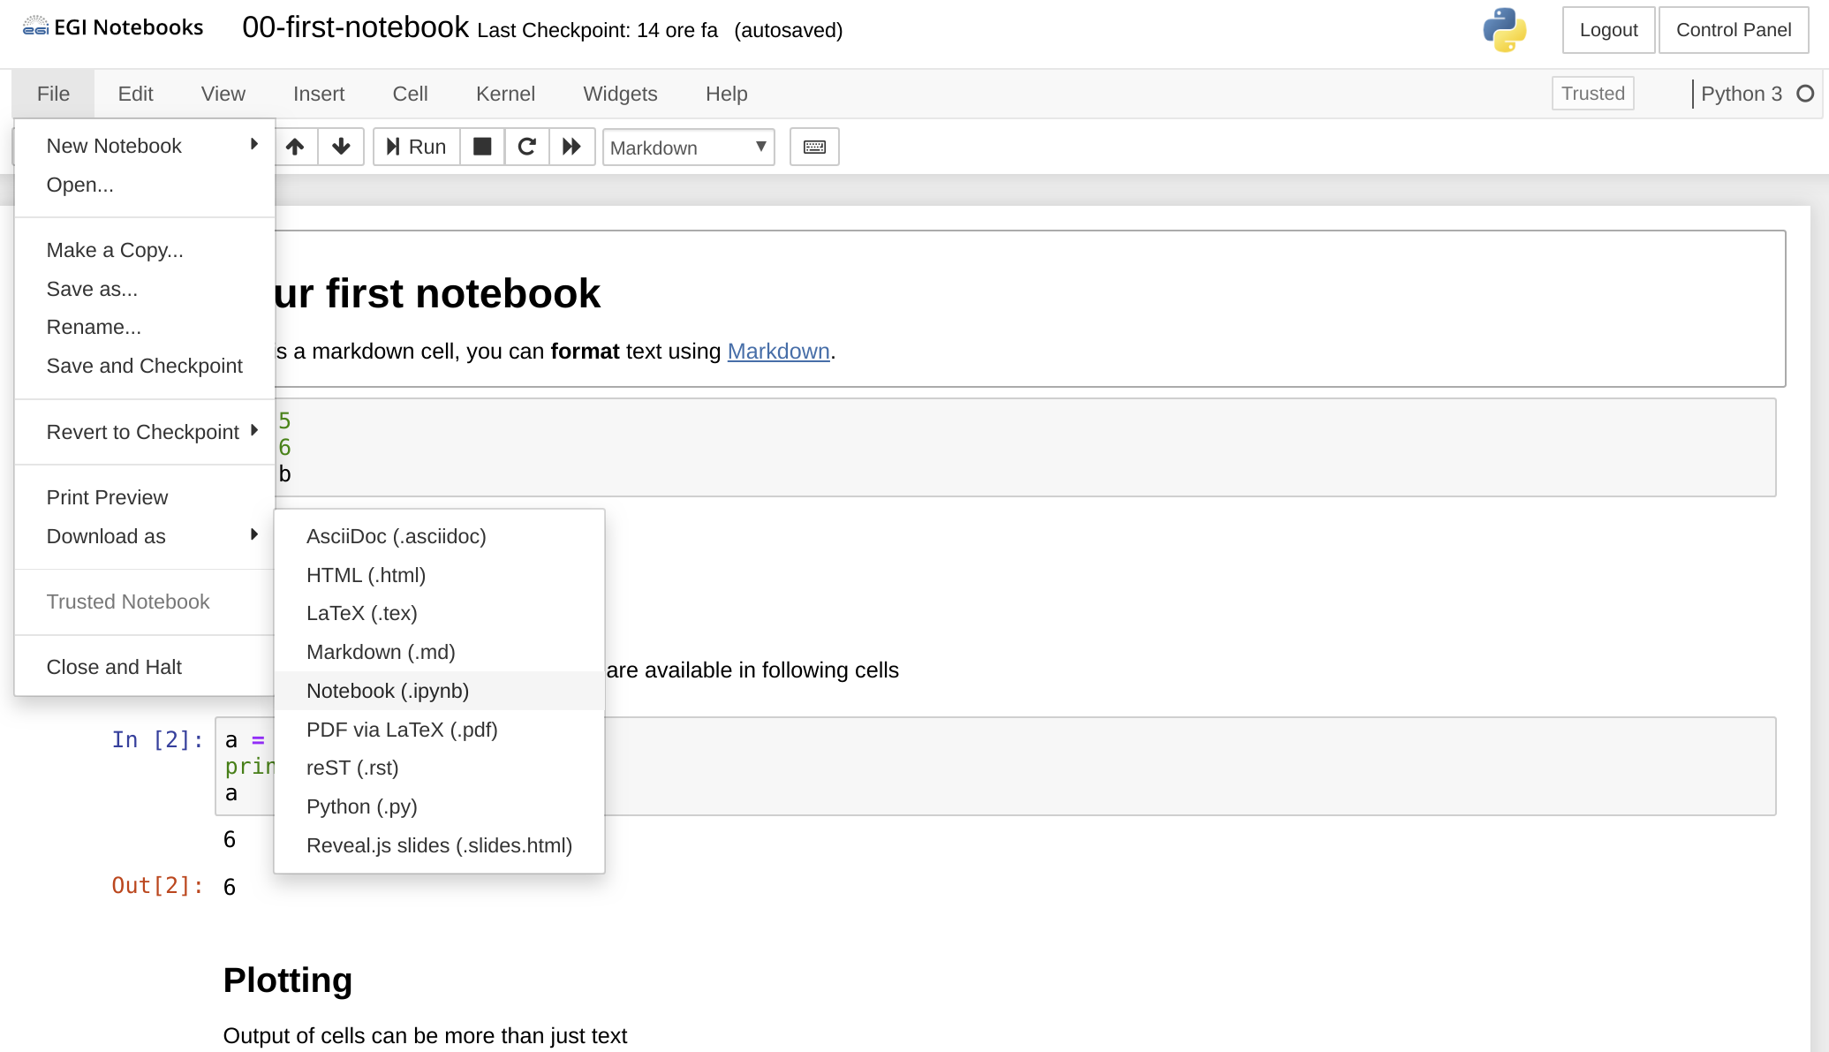
Create your first shareable Binder notebook
Go to https://training.notebooks.egi.eu
Go to the training-binder folder
Download the notebook 00-first-notebook to your laptop

Slide 18
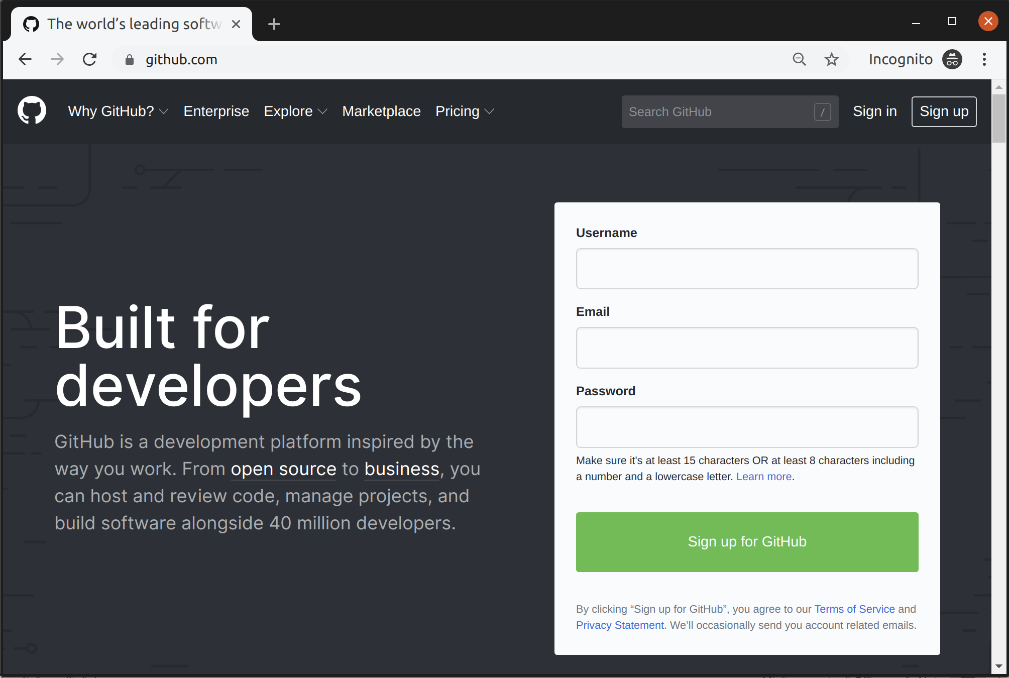
Sign up for a GitHub account (if you don't have it!)
Sign-up if you don’t have an account already.
Only requires a valid email

Slide 19
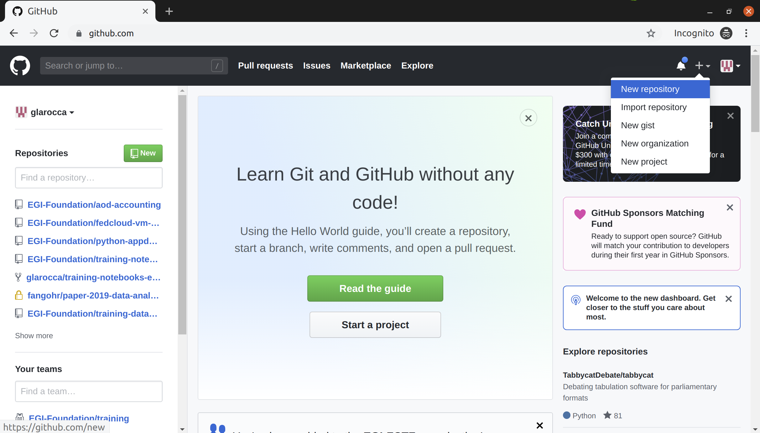
Create a new repository on GitHub

Slide 20
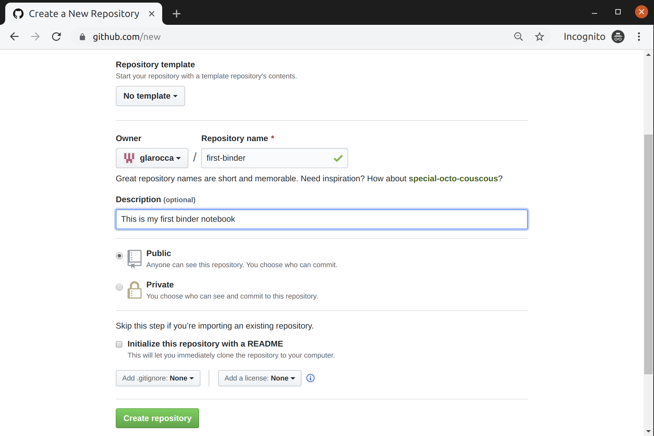
Create a new repository on GitHub (cont.)

Slide 21
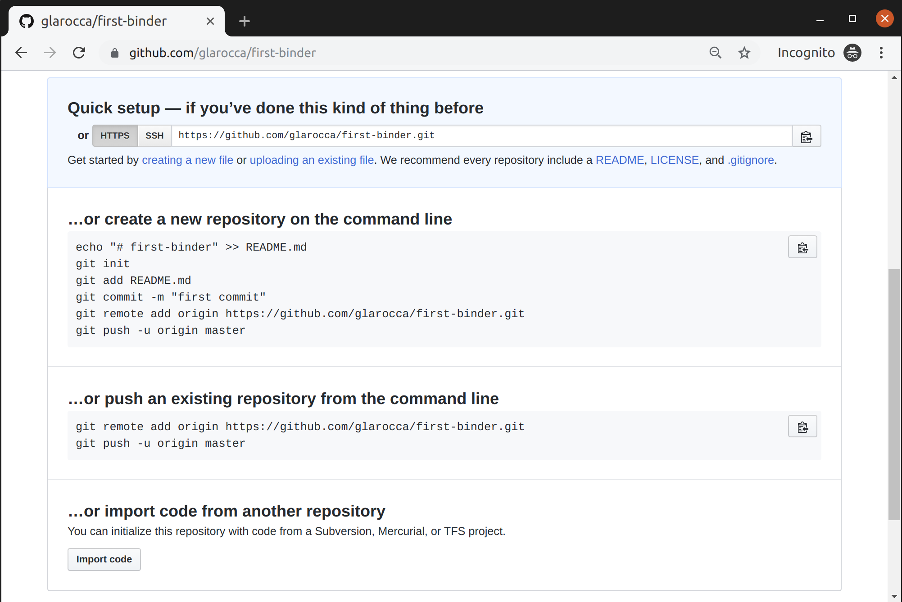
Upload your notebook (00-first-notebook)

Slide 22
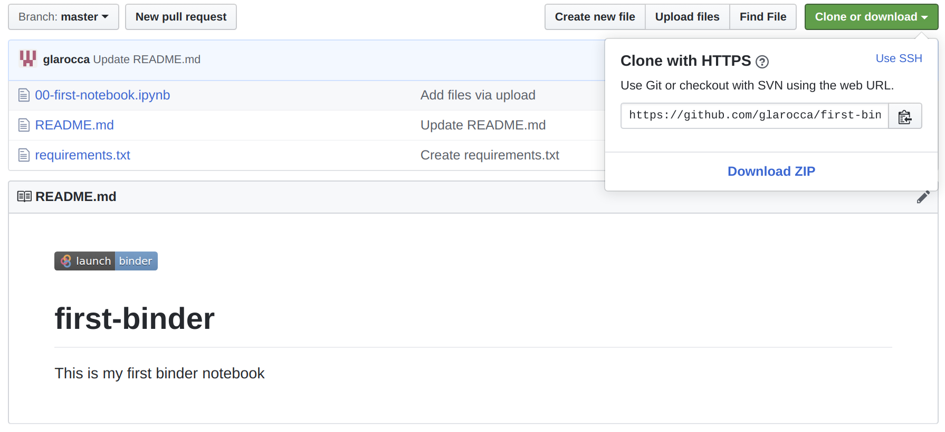
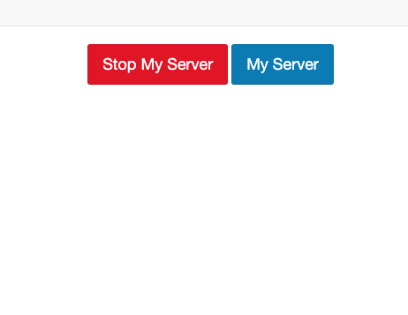
Add missing requirements in the GitHub repo
Go to https://cs3.fedcloud-tf.fedcloud.eu/hub/home and stop your server before retry!

Slide 23
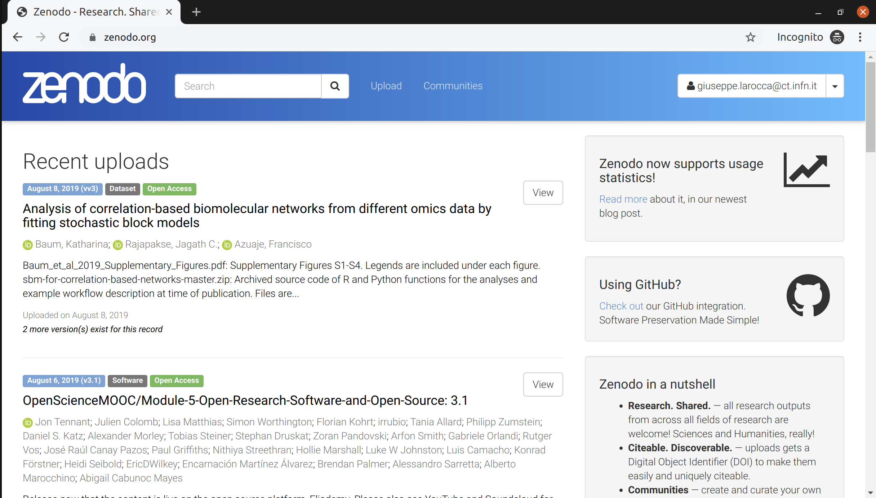
Share your GitHub repo on Zenodo
Login to Zenodo - https://zenodo.org with your GitHub account

Slide 24
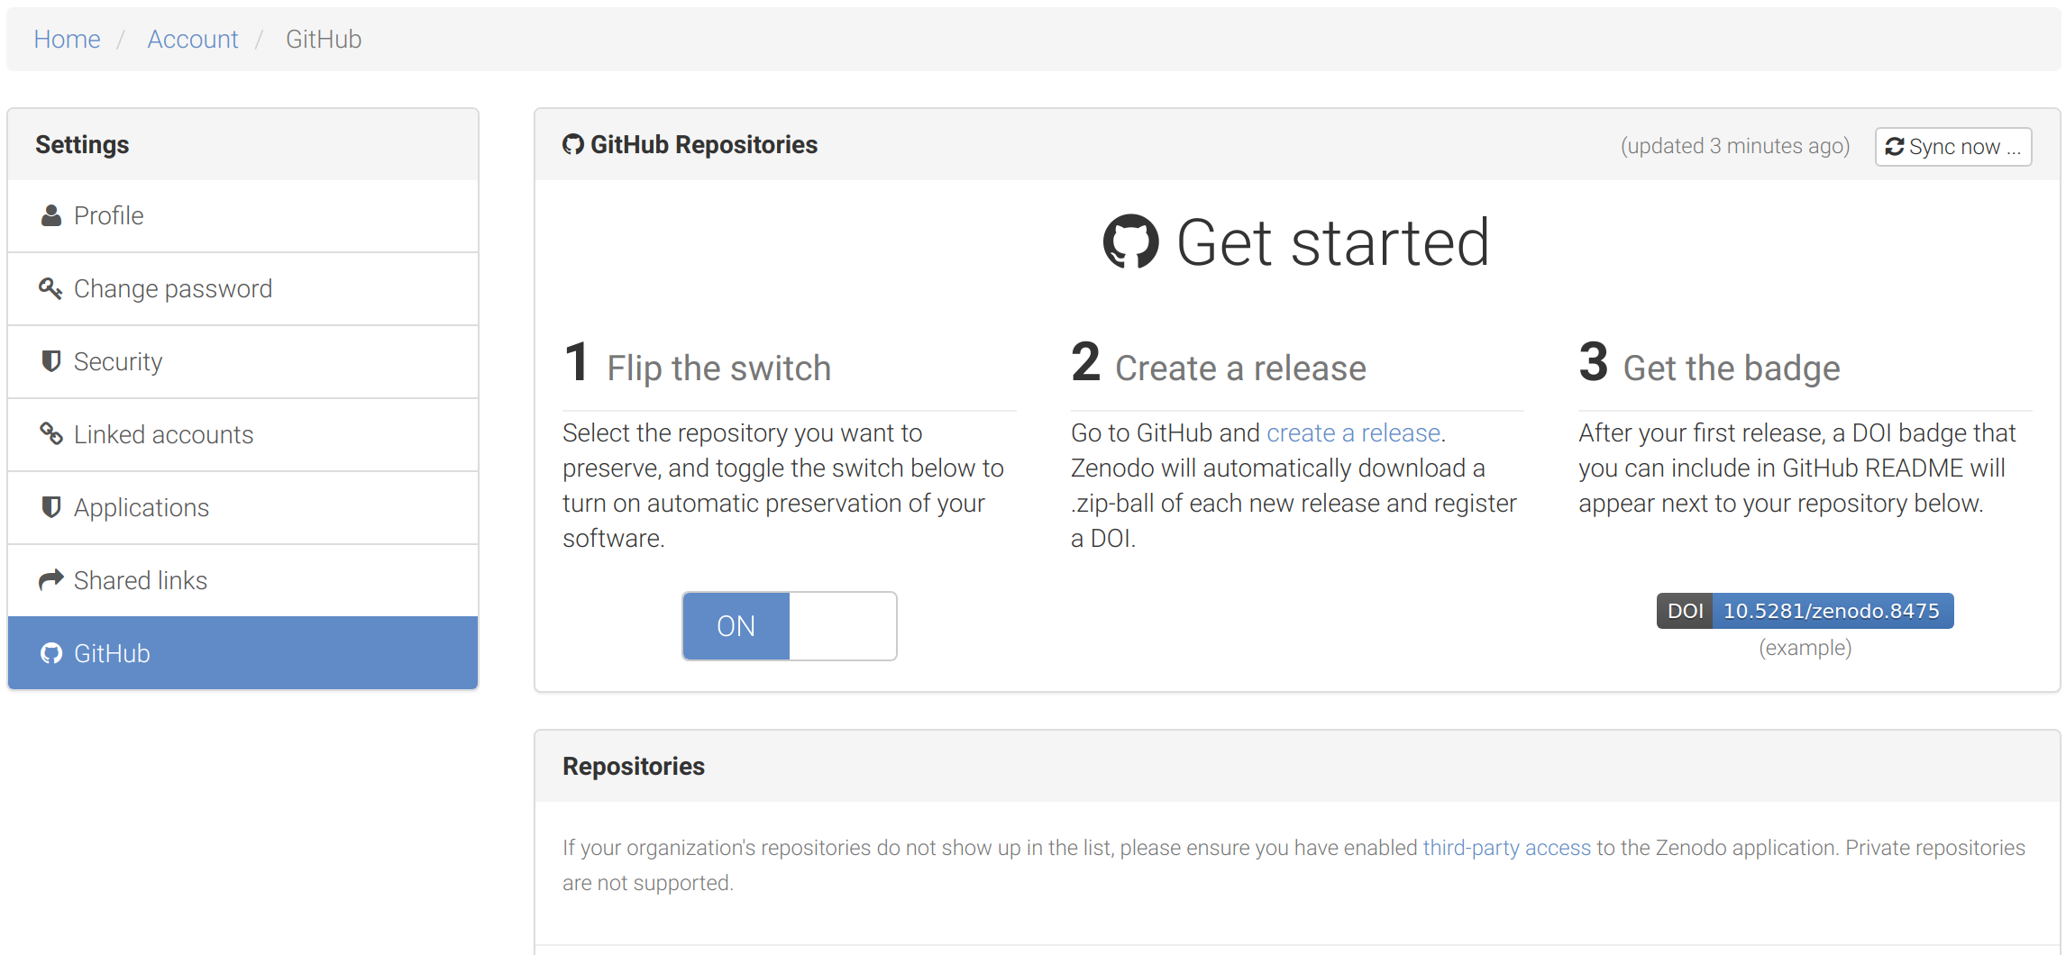
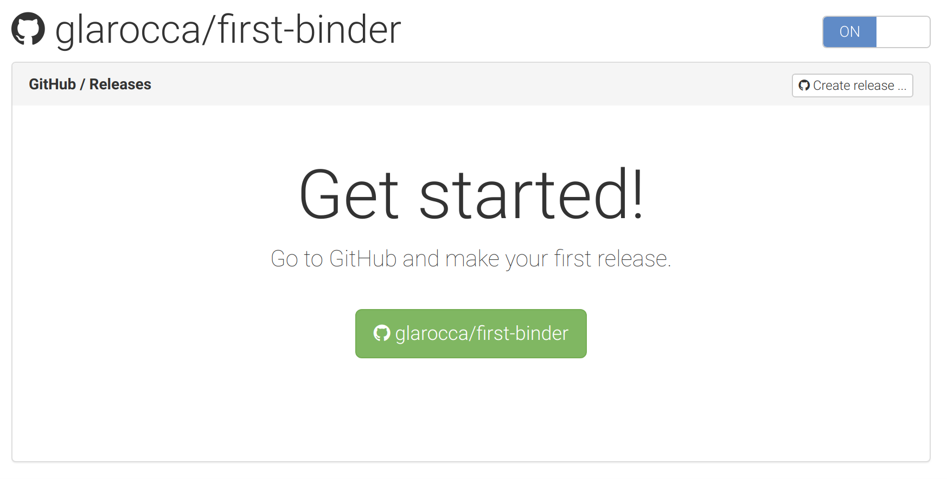
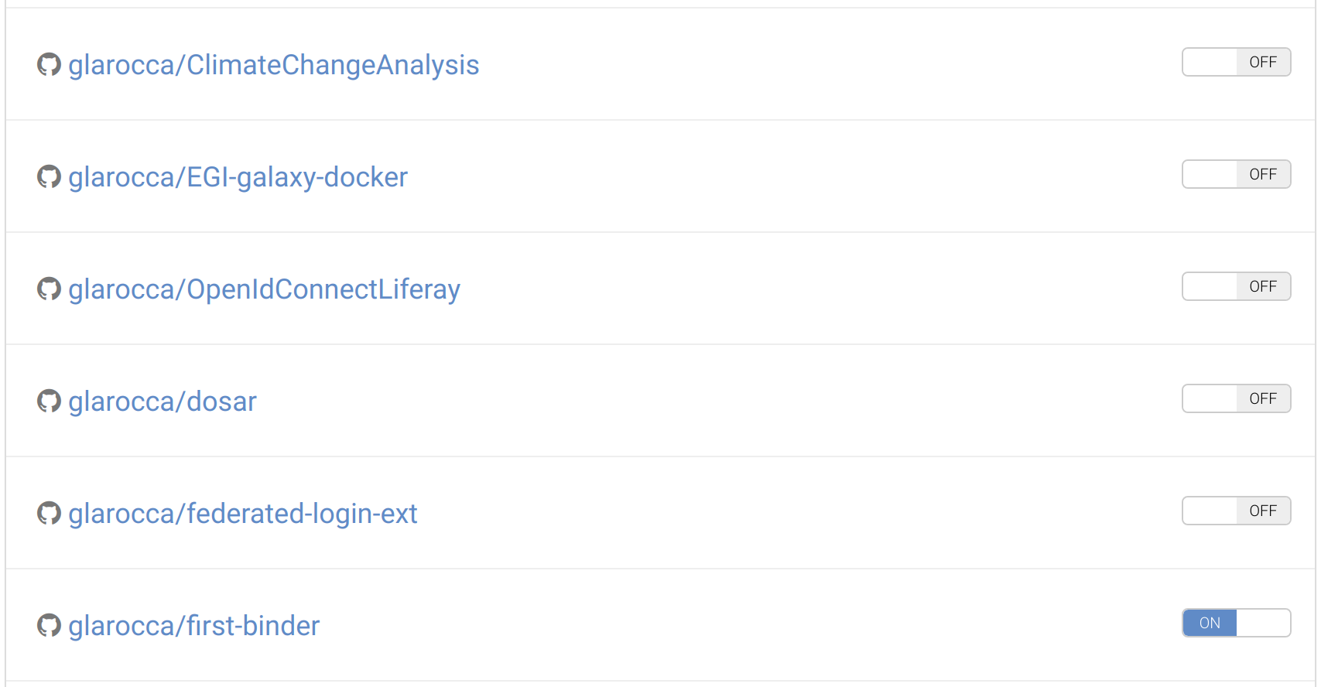
Enable your GitHub repository at Zenodo
Select the repo to enable from the Repositories list
Enable the repo (click ON)
Click on the GitHub repo link
Create a release

Slide 25
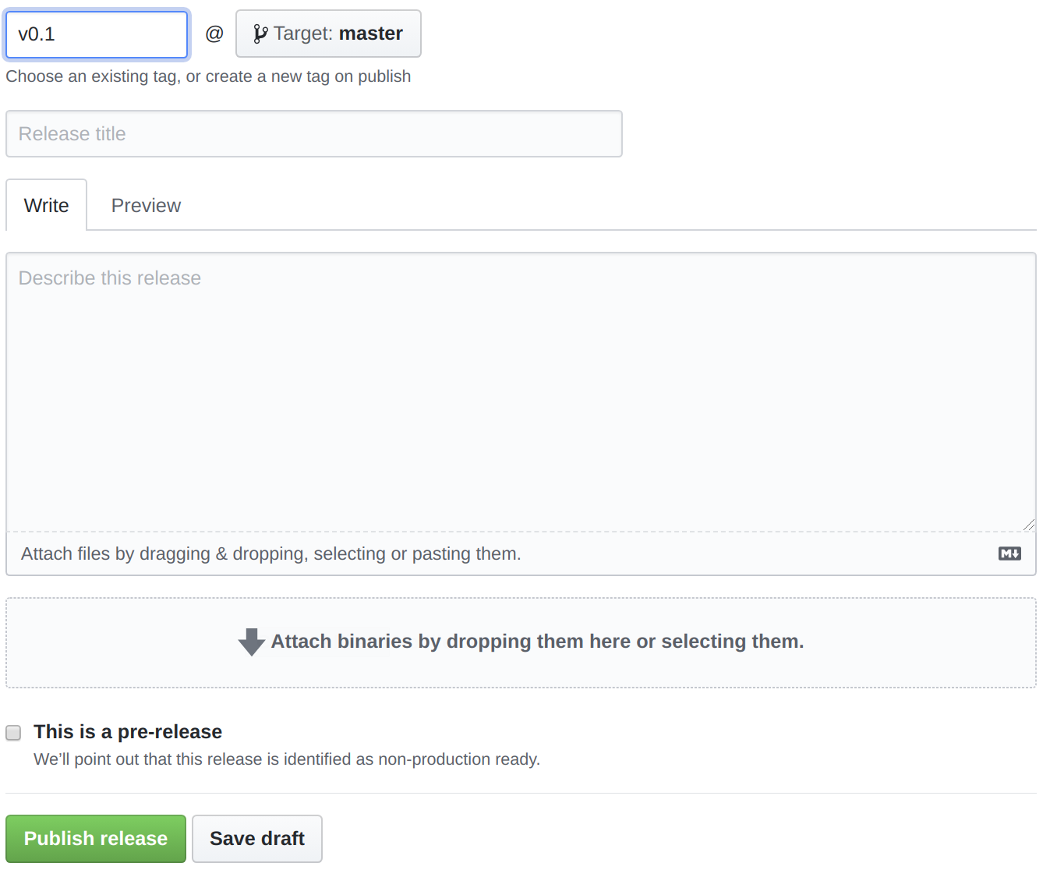
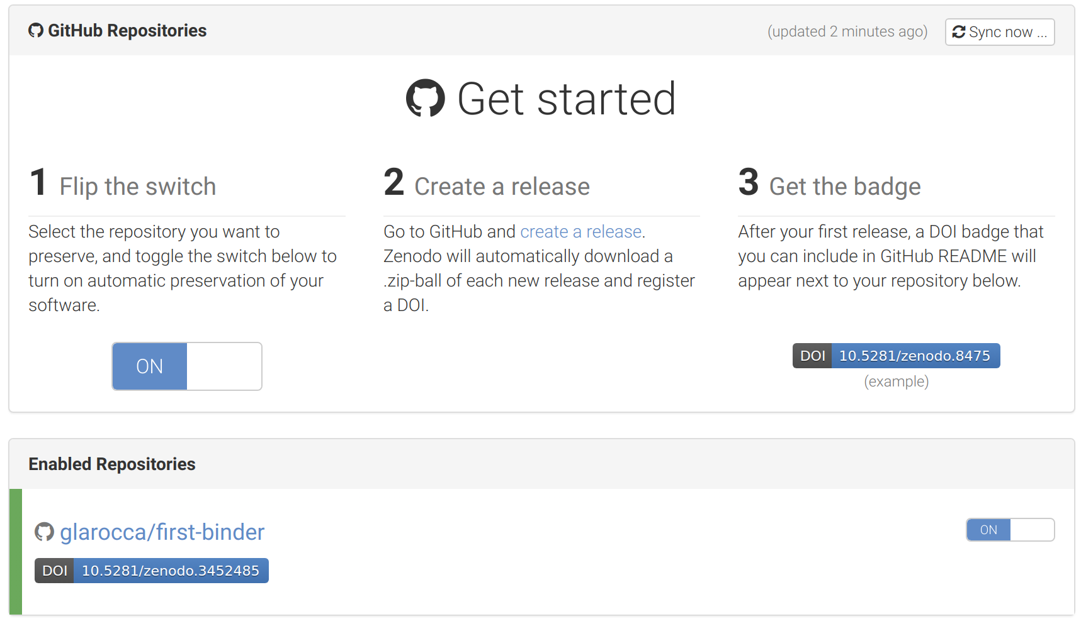
Create a release for your GitHub repo

Slide 26
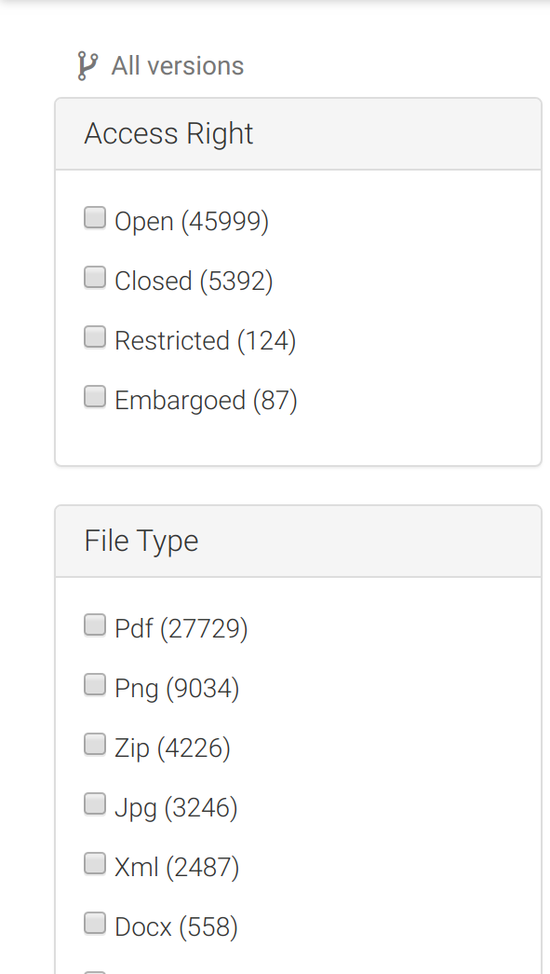
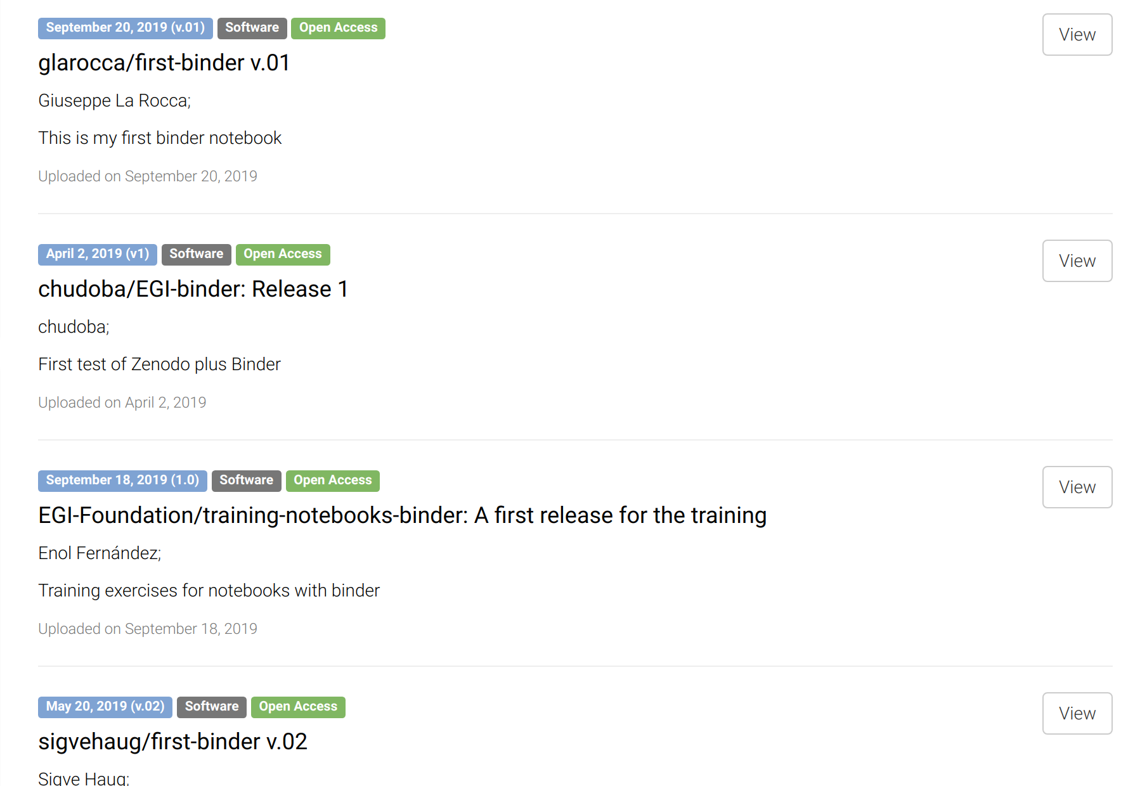
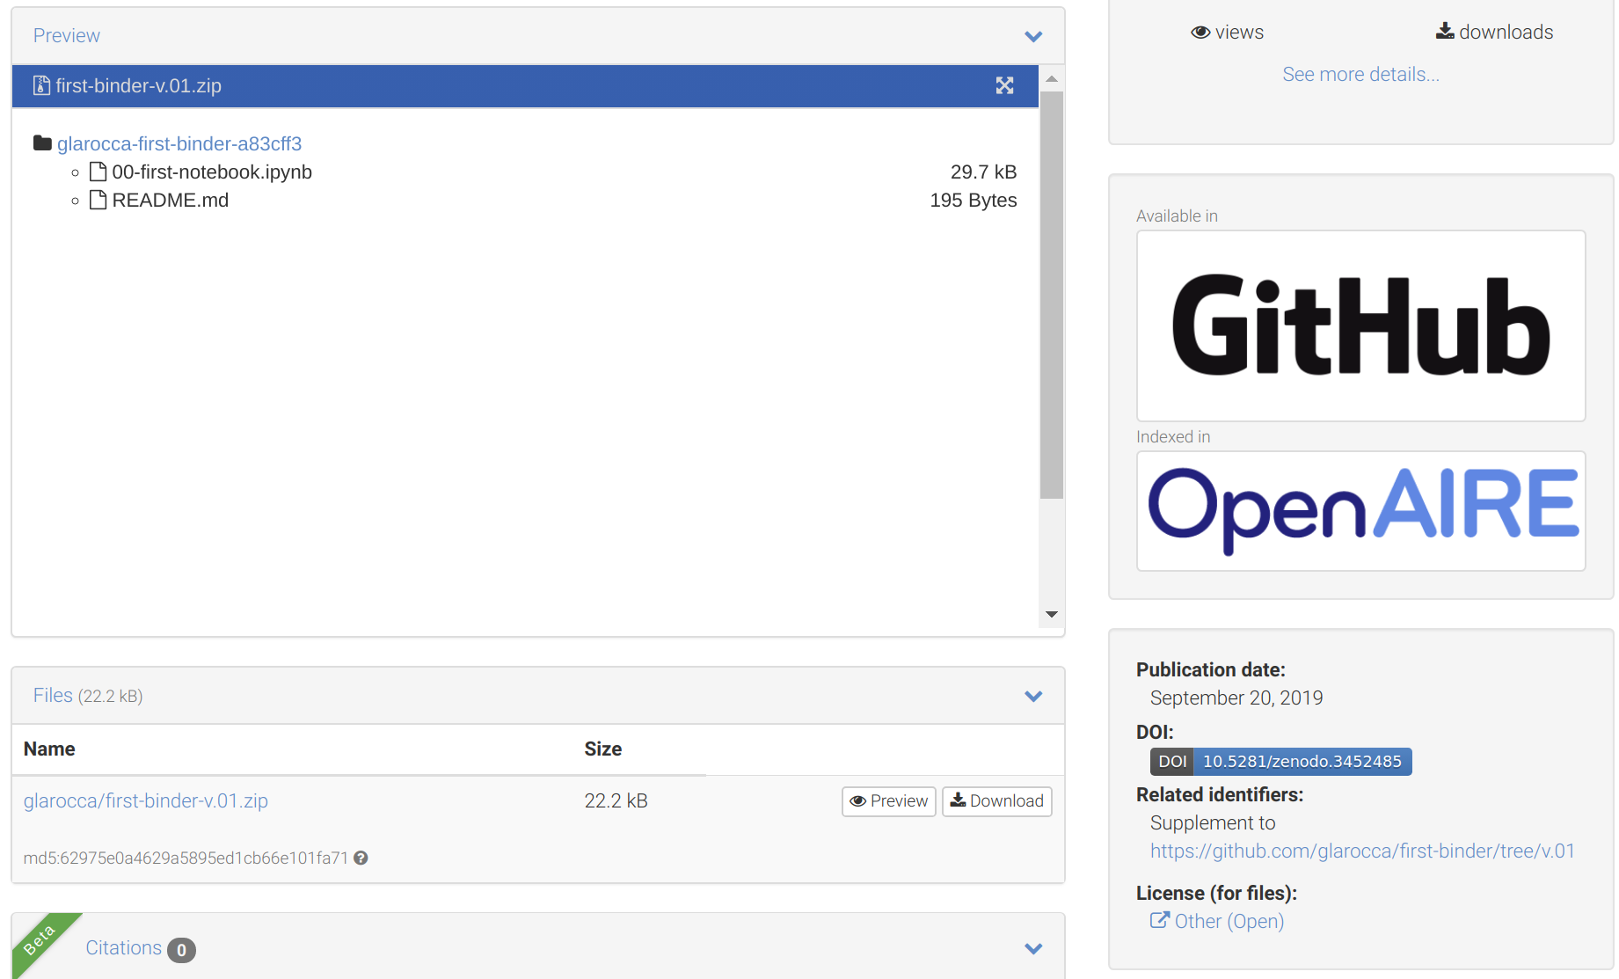
Search your GitHub repo in Zenodo
v
COPY

Slide 27
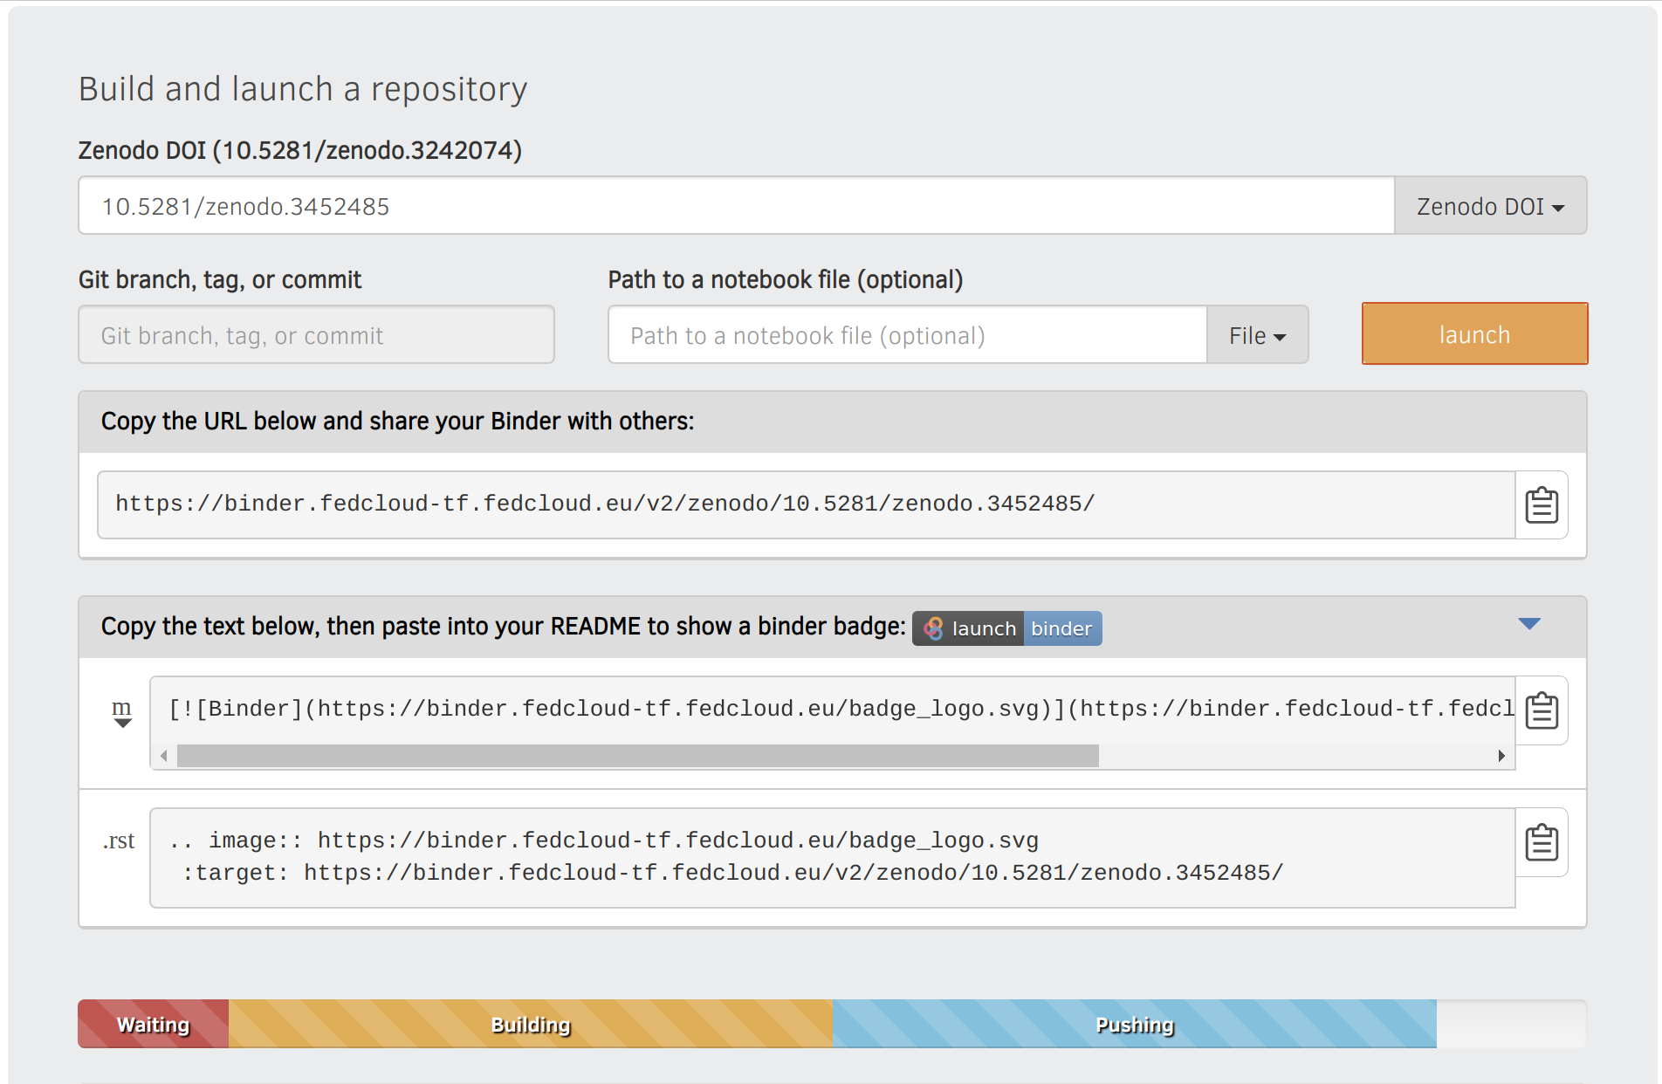
Reproduce your analysis with Binder
WARNING:
Registration of the DOI can take up to 10 minutes
Binder has to wait until registration is finished.
To check whether the DOI is resolved, please use the website: https://dx.doi.org/
Create a LaunchBinder button in your repo
Go to https://cs3.fedcloud-tf.fedcloud.eu/hub/home and stop your server before retry!

Slide 28
Hands-on summary
1. Edit the notebook 1'. Download the ipynb file
EGI Notebooks services
EGI Binder Notebooks
Re-execute
2. Create repository
2'. Upload ipynb file
2''. Add requirements.txt
GitHub
7. Provide GitHub project reference
Your repository
3. Specify the GitHub repo
6. Obtain GitHub project reference
Fellow researchers
4. Generate a DOI (this is done by Zenodo)
5. Discover Notebook (use DOI)

Slide 29
Working with big data
EGI Notebooks integrated with DataHub

Slide 30
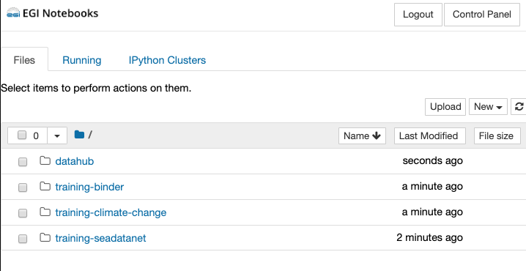
Data management
Big data accessed via EGI DataHub
EGI Notebooks
EGI Binder
1. Perform data analysis and visualisation with big Data
GitHub
6. Reproduce analysis with big data
Your repository
2. Publish notebook and Generate DOI
5. Resolve DOI to Notebook and Data
3. Cite DOI
in publication
Fellow researchers
Journal paper
4. Discover DOI

Slide 31
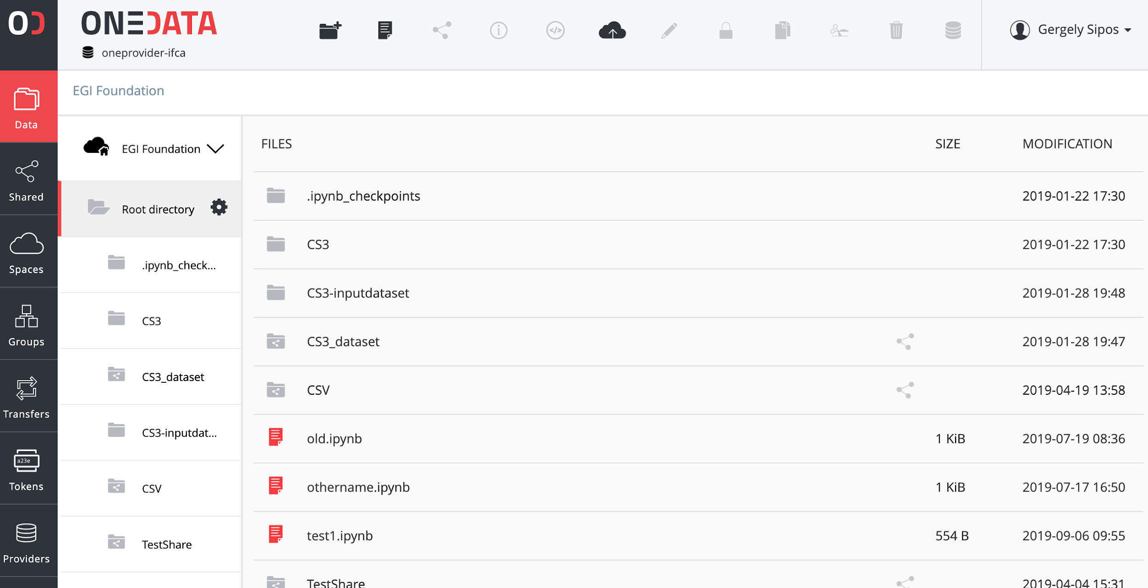
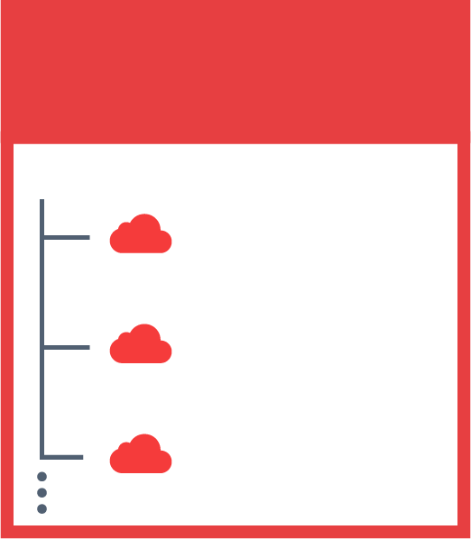
The problem we want to address
Cloud provider:
Physical storage for files
JOHN’S SPACES
SENTINEL 2
DEEP LEARNING
SARA’S SPACES
PUBLICATIONS
REPLICATION
Space: Local organisation of files (directory structure)
SENTINEL 2
SKY MAPS
MY DATA

Slide 32
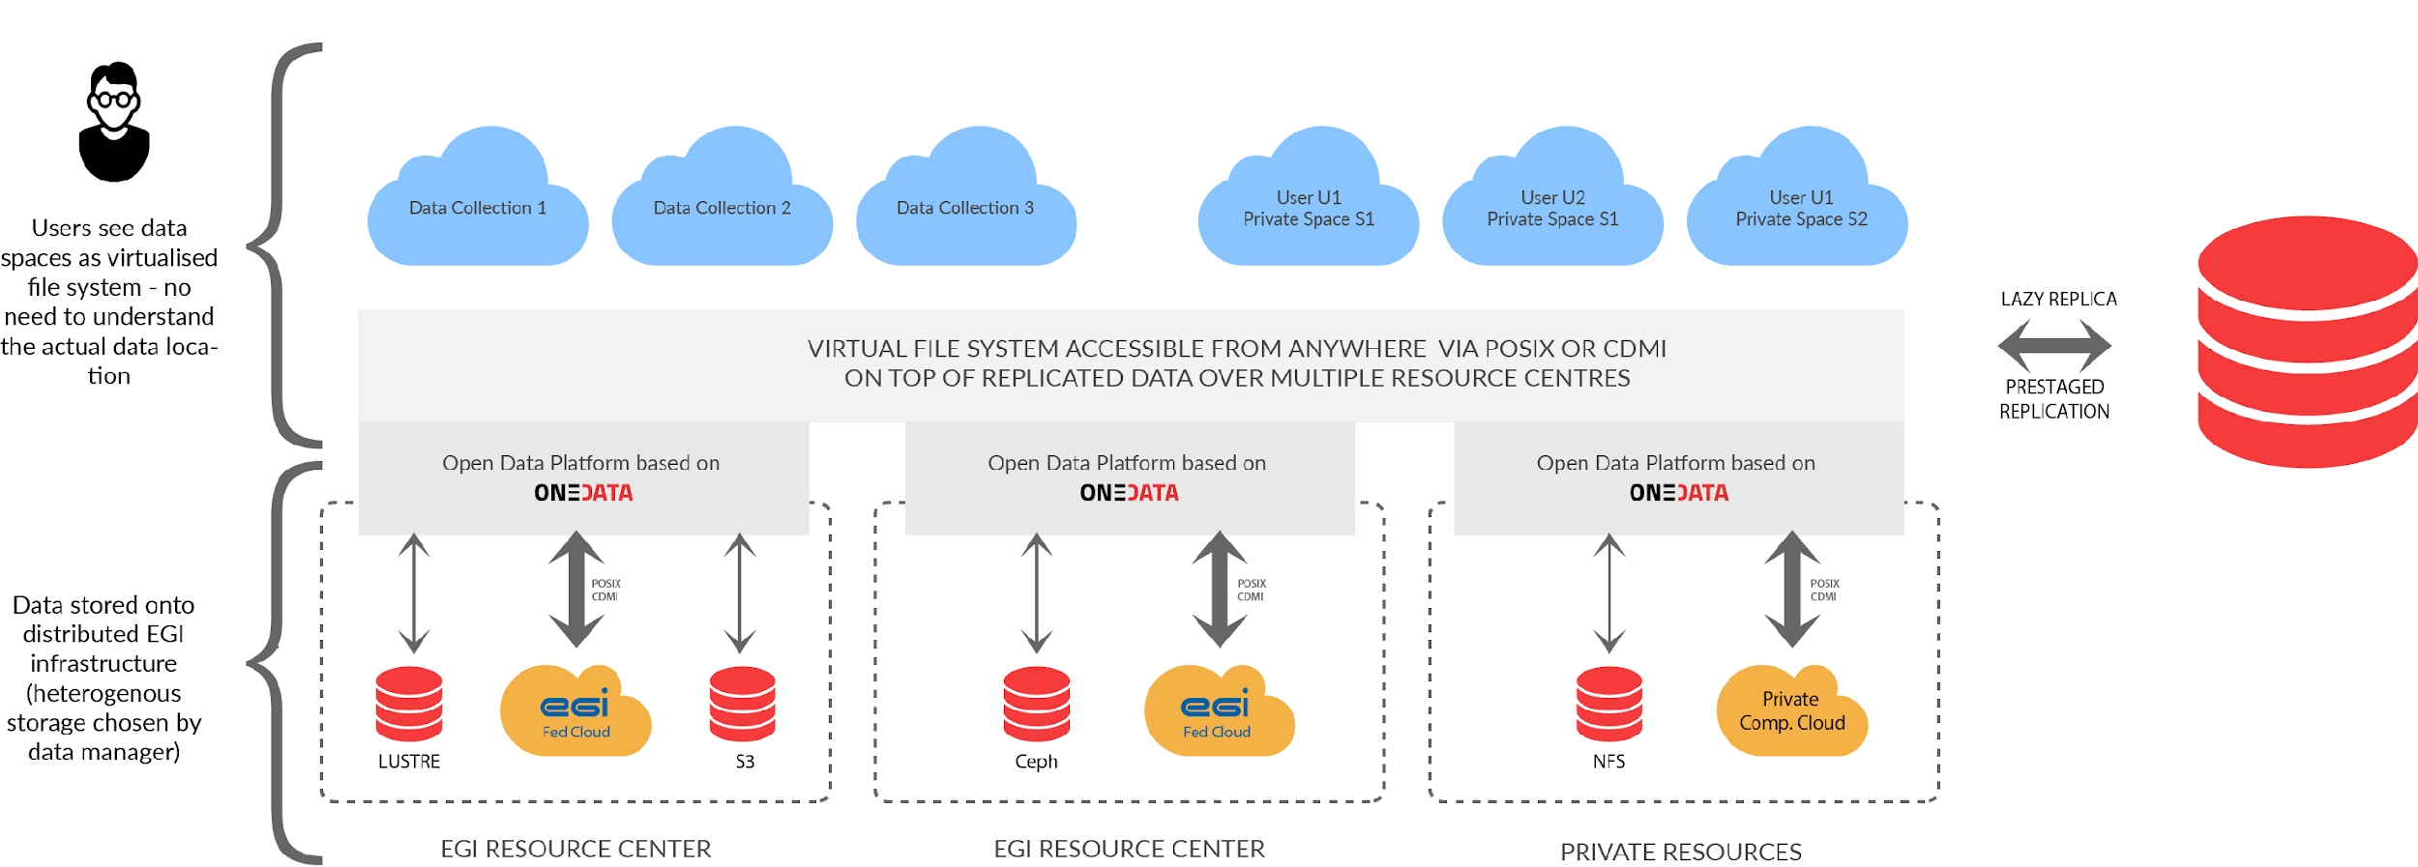
Accessing federated data in Notebooks
Federated files appear as a directory structure for the user
EGI Notebooks
EGI Binder

Slide 33
Getting access Deploying locally

Slide 34
Using the services after this training
EGI Notebooks - We talked about 2 access modes:
Catch-all instance: https://notebooks.egi.eu
Community deployment
Data access services
E.g. DataHub, B2DROP - Check in EOSC-hub Marketplace. Some with, some without user approval
Zenodo – There are three access modes
Sandbox: We used this today (sandbox.zenodo.org)
Normal user user: Zenodo.org - Upload your ‘research objects’
Community: Request community dashboard via https://www.zenodo.org/signup/
GitHub: Login and use (outside EOSC)

Slide 35
Setting up an EGI Notebooks in EaP
Join EGI Cloud with a new site
https://wiki.egi.eu/wiki/Federated_Cloud_resource_providers_support
https://egi-federated-cloud-integration.readthedocs.io/en/latest/
Join EGI DataHub with a new oneprovider (for access to big data) running on your cloud:
https://onedata.org/docs/doc/administering_onedata/deployment_tutorial.html
Support the DataHub spaces you are interested in your new oneprovider
Deploy EGI Notebooks
https://egi-notebooks.readthedocs.io/en/latest/technical.html
https://zero-to-jupyterhub.readthedocs.io/en/latest/index.html
See additional material at https://indico.egi.eu/indico/event/4431/session/4/?slotId=0#20190506

Slide 36
Getting EGI resources for a community Notebook
We also welcome and support providers to join!
Trigger the process with an ‘EGI Cloud’ or ‘EGI Notebooks’ order in the EOSC Portal
Type, number, size, cost, availability, etc.
Applic. provider
Requirements
Conditions
Storage provider
Cloud provider
Negotiator
Grid provider
Project/Community representative
Service Level Agreement
Operation Level Agreement
Training
Support
Satisfaction review (every 3/6/12 months)
Performance reports

Slide 37
FEEDBACK FORMS

