Slide 1
EGI and Worldwide e-Infrastructure for Structural Biology: Status and Plans
EGI-Inspire final review, Amsterdam, February 13th 2015
Alexandre M.J.J. Bonvin
Project coordinator
Bijvoet Center for Biomolecular Research
Faculty of Science, Utrecht University
the Netherlands
a.m.j.j.bonvin@uu.nl

Slide 2
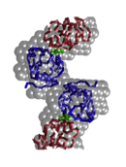
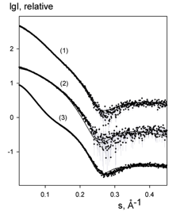
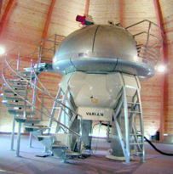
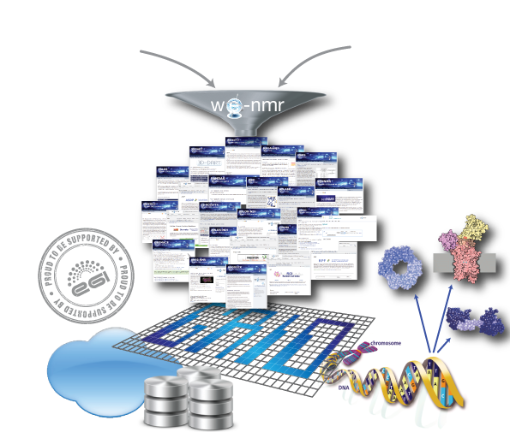
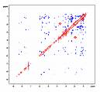
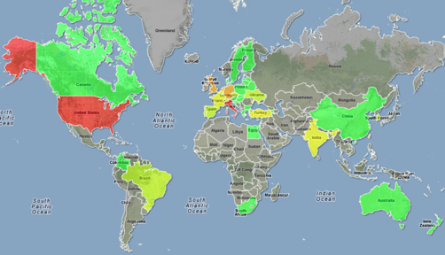
NMR SAXS
A worldwide
e-Infrastructure for NMR and structural biology
WeNMR VRC (Jan 2015)
The 1st VRC officially recognized by EGI
One of the largest (#users) VO in life sciences
> 1600 VRC members (>60% outside EU)
of which >680 VO-registered users (with certificates)
~ 100 000 CPU cores (from 41 sites)
> 2000 SI2K CPU years
> 5M jobs
User-friendly access to Grid via web portals
www.wenmr.eu
Serving ESFRI INSTRUCT

Slide 3
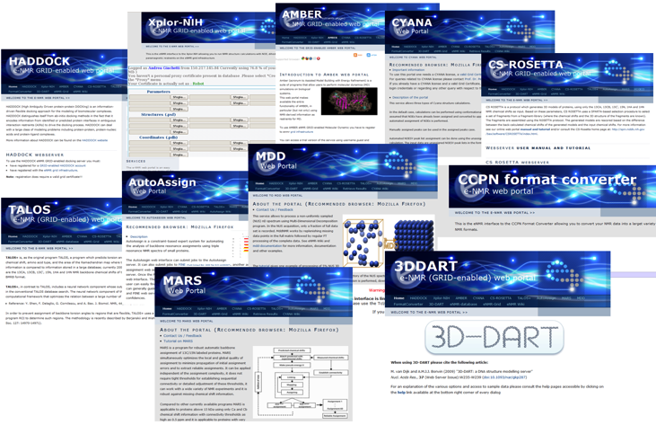
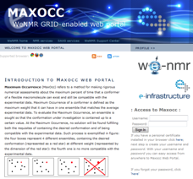
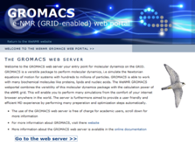
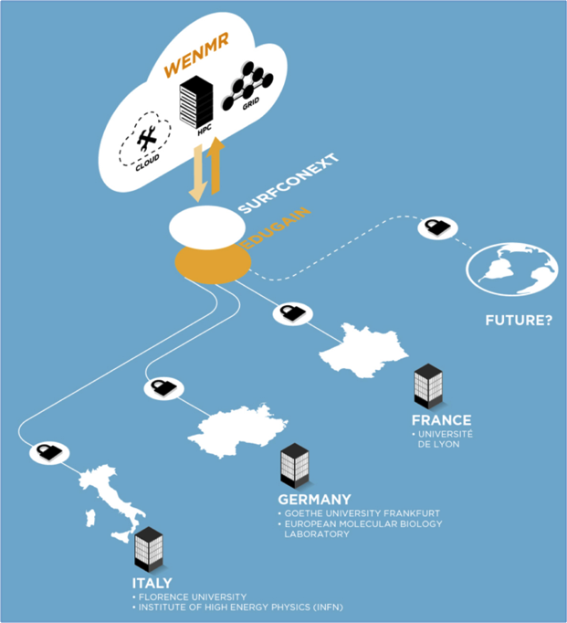
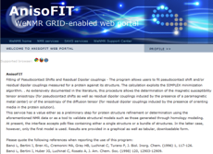
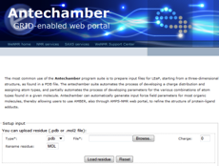
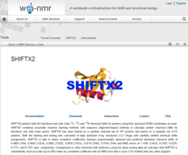
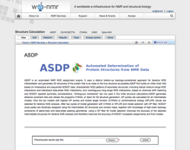
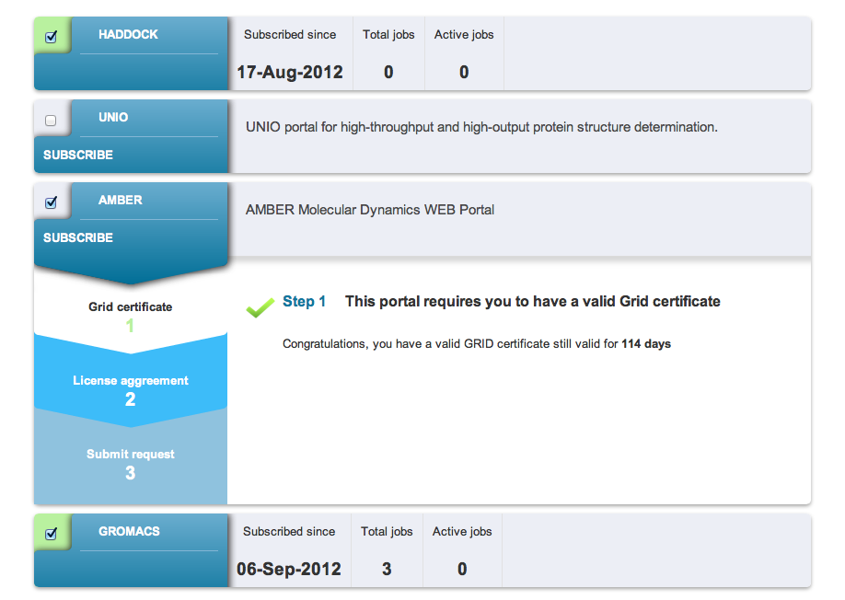
A glimpse of the WeNMR services portfolio
User-friendly solutions
Predefined applications and workflows
Added value to the data
User support (also via EGI Distributed Competence Center and GGUS portal)
Make use of robot certificates
VRC-specific
SSO solutions (direct access to portals via VRC credentials)
Notes:
3
3

Slide 4
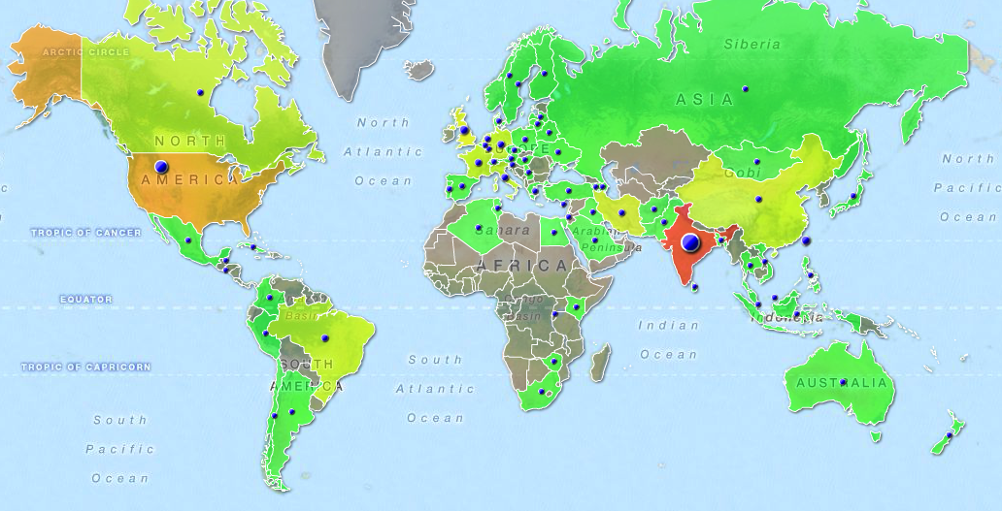
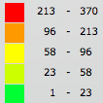
WeNMR VRC users distribution
Over 1600 VRC (www.wenmr.eu) members (64% / 36% outside Europe)!
(Jan 2015)
http://www.targetmap.com/viewer.aspx?reportId=38717

Slide 5
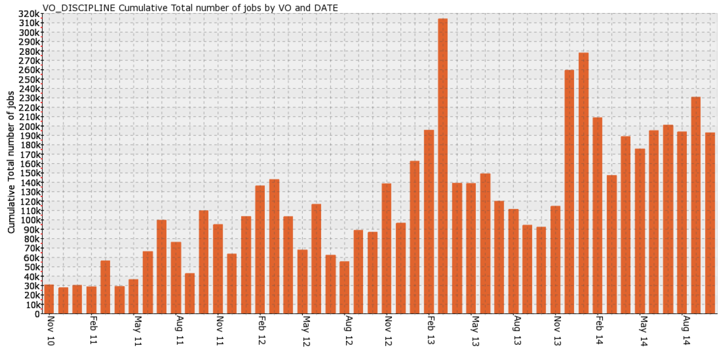
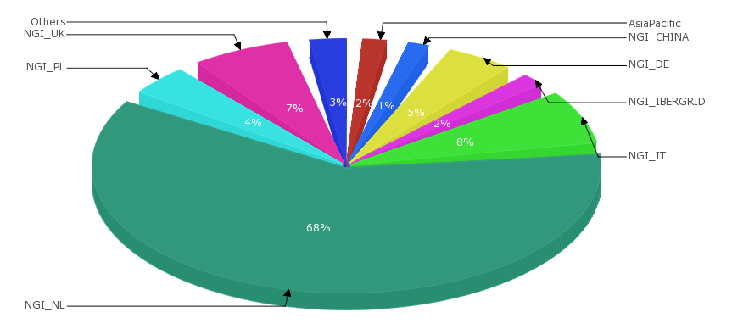
EGI Usage statistics
Excluding OSG resources
End of EU funding
Geographic distribution
(Nov 2013 – Nov 2014)
Enabled via EGI federated operation
Statistics http://accounting.egi.eu

Slide 6
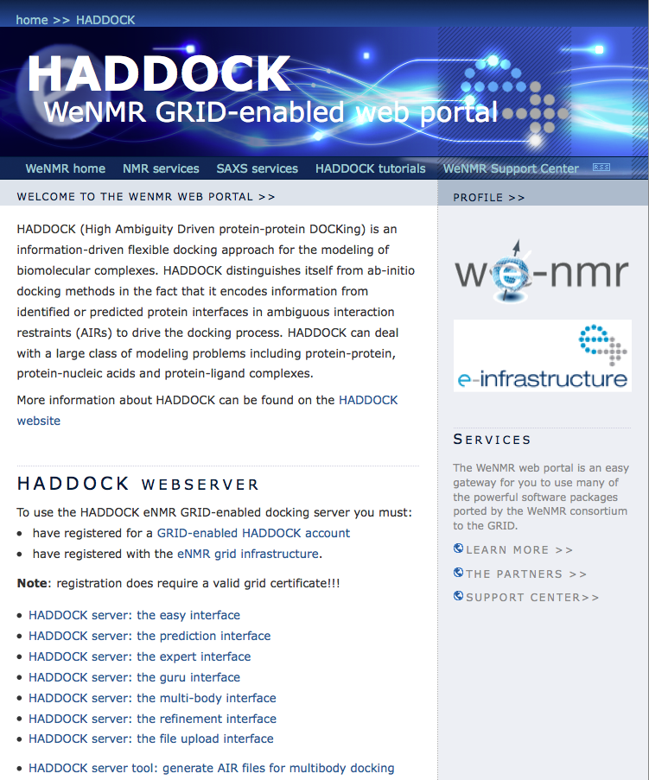
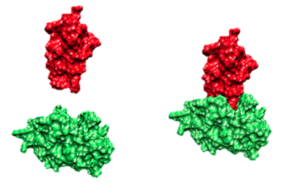
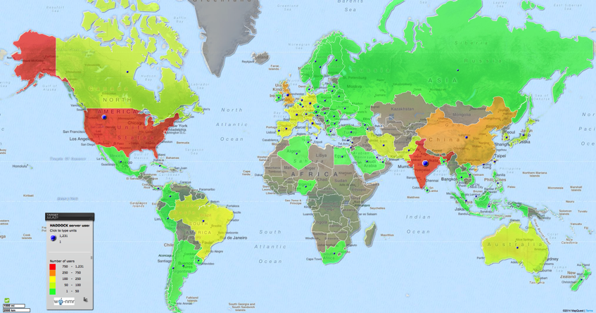
HADDOCK web portal
Was existing before the VRC, running on local resources only
> 5000 registered users (both from WeNMR VRC and HADDOCK direct registration) (heavily cited!)
> 91000 served runs since June 2008
> 20% on the GRID
Increased usage enabled through EGI resources!
De Vries et al. Nature Prot. 2010

Slide 7
HADDOCK web portal: Making best use of Grid solutions
Direct gLite-based submission
Crowd computing
-> pushing jobs to the grid
Dirac4EGI service
-> pulling jobs to the grid via pilots
HADDOCK portal statistics
(grid jobs only)
Currently >80% of the submissions are directed transparently to EGI resources

Slide 8
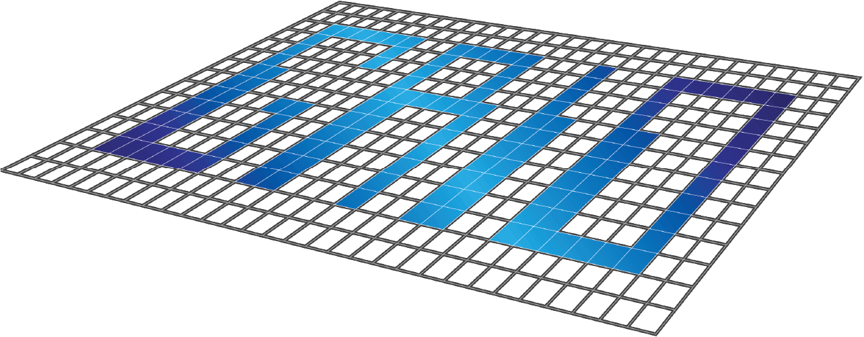
Conclusions
Lively, active and still growing community
Innovative and user-friendly e-Science solutions
Perfect use of high-throughput data analysis (i.e. Grid)
Success and sustainability made possible through EGI services (resources, accounting, support, dissemination...)
WeNMR SSOSX

Slide 9
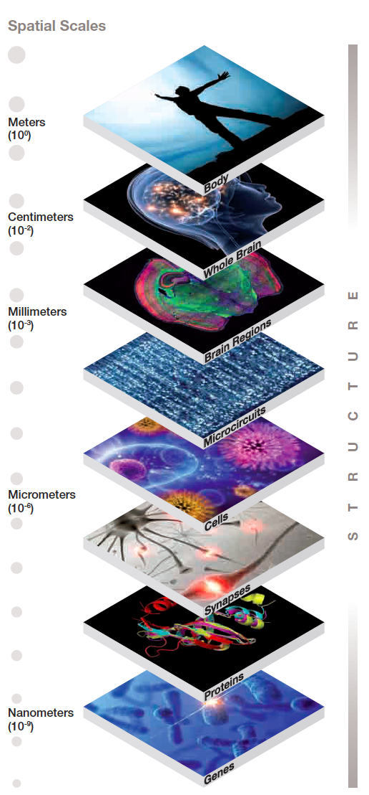
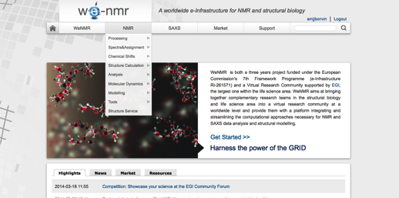
Future plans
Bring the micro (WeNMR) and macro (N4U) worlds together into one competence center under future EGI activities:
With activities toward:
Integrating the communities
Making best use of cloud resources
Bringing data to the cloud (cryo-EM)
Exploiting GPGPU resources
While maintaining the quality of our current services!

Slide 10
Questions?

