Slide 1
The European Grid Infrastructure
Steven Newhouse
Project Director, EGI.eu

Slide 2
The Data Deluge
It goes beyond High Energy Physics
And ESFRI projects
Medical Records
Genome $3B & 10 years → $5,000 & 24hrs
Scans, Xrays, etc.
Mobile medical monitors
From Humanity
TV, radio, documents, videos, etc.
Analysis and understanding

Slide 3
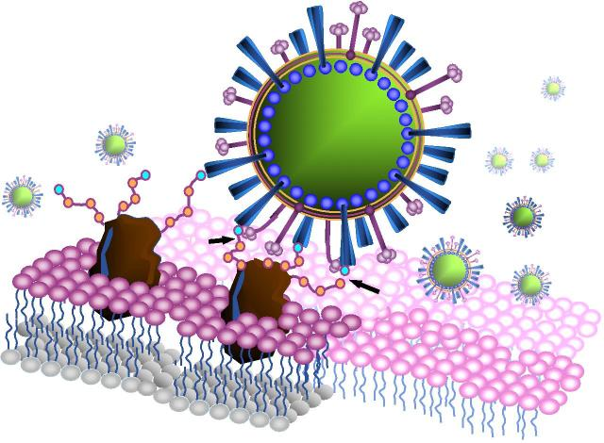
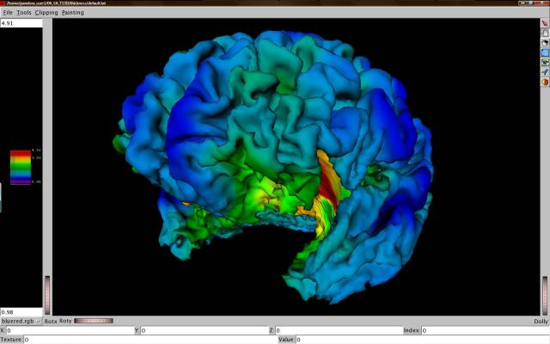
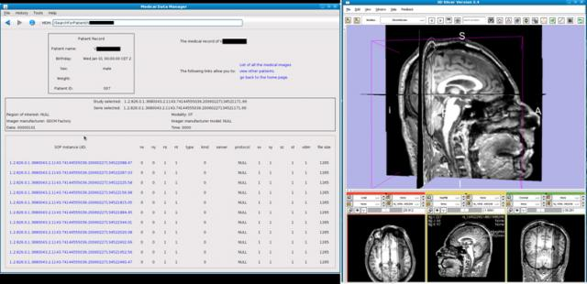
What does a grid do?

Slide 4
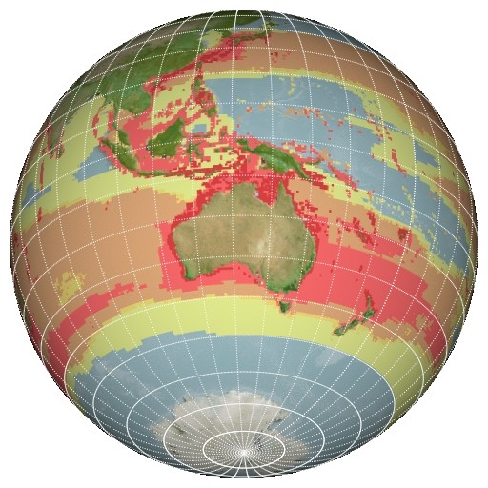
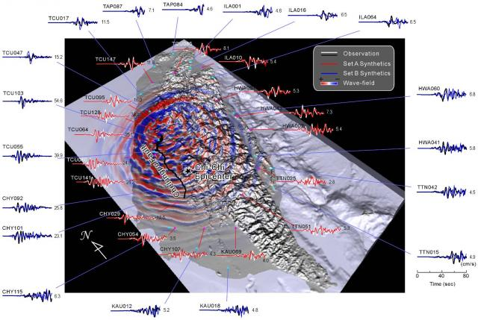
What does a grid do?

Slide 5
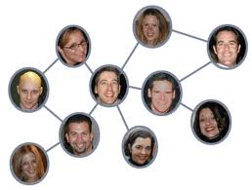
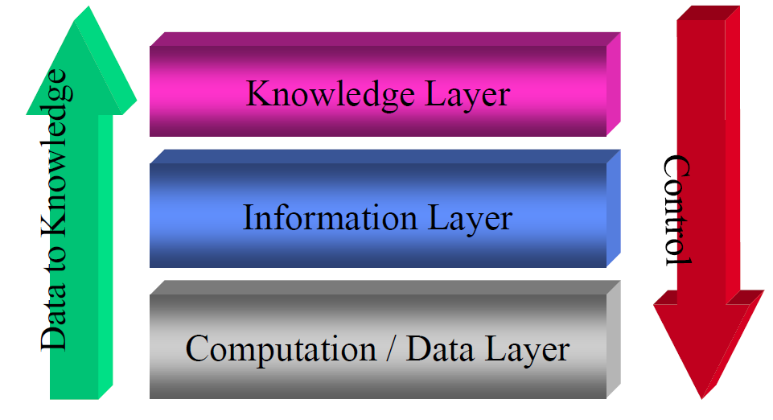
The Social Scientist
Driven by international collaborations
Data driven sharing
Analysis at scale

Slide 6
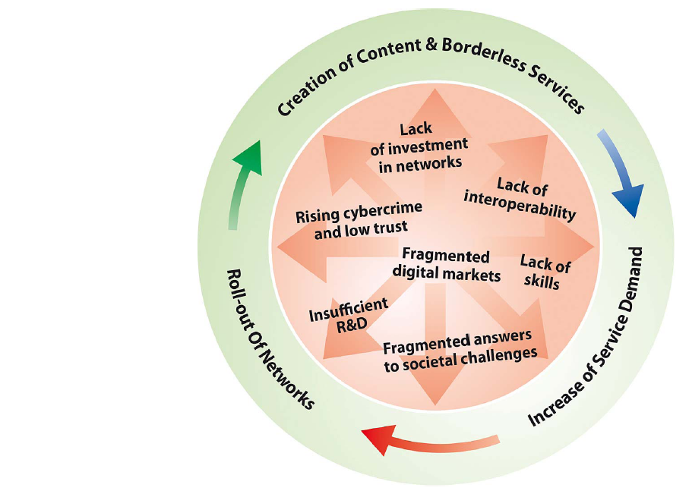
Digital Agenda for Europe
Not just for consumers
Will impact science
Key criteria in FP8?
It is relevant to us
remove barriers to the free movement
of knowledge

Slide 7
Driving e-Research
comprehensive research and innovation strategy which is the "Innovation Union" flagship to implement Europe 2020.
Europe should also build its innovative advantage in key areas through reinforced e-Infrastructures (i.e. GEANT & EGI)

Slide 8
Getting there by 2020
The correct route may not be obvious….!

Slide 9
The Last Decade

Slide 10
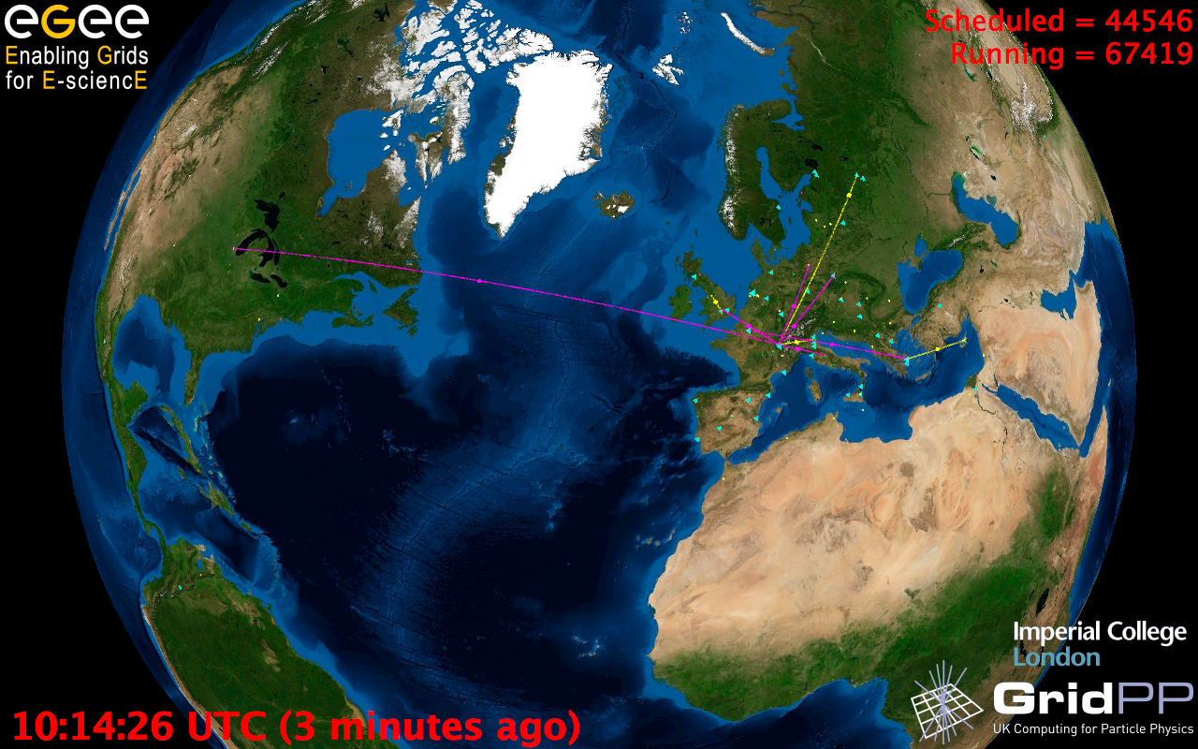
European Grid Infrastructure
Status April 2010 (yearly increase)
10000 users: +5%
243020 LCPUs (cores): +75%
40PB disk: +60%
61PB tape: +56%
15 million jobs/month: +10%
317 sites: +18%
52 countries: +8%
175 VOs: +8%
29 active VOs: +32%

Slide 11
What is EGI?
European:
Focus on meeting the needs of European Researchers
Their key need is to collaborate internationally
Grid:
Federation of shared resources, not a single technology
Supports a collaborative social network
Infrastructure:
Established physical and organisational structures
Services and facilities for an economy to function

Slide 12
Further Challenges…
Sustainability
Cost
Relevance
Technology

Slide 13
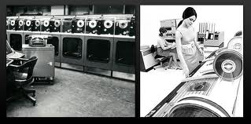
Sustainability
My project will last for 5 years, and I will need to read and analyse my data for 10 years after that….
Will you be around that long?

Slide 14
EGI
Collaboration
Research
Community
Research
Community
Research
Community
N
G
I
Research
Community
Research
Community
N
G
I
E
I
R
O
N
G
I
N
G
I
E
I
R
O
EGI.eu

Slide 15
EGI.eu Governance
EGI.eu established as non-profit foundation
Governance & ownership by its participants
Participants:
European NGIs
Associated participants:
Other groups willing to agree with EGI.eu objectives
EGI Council: All participants represented
Votes linked to fees

Slide 16
EGI.eu
Coordination for European Grid resources
Established February 8th 2010
Central policy & services needed to run a grid
Sustainable small coordinating organisation
Based in Amsterdam
Coordinating core (~20 people) in Amsterdam
Technical services from partners (~20 people)
EGI and EGI.eu supported initially by EGI-InSPIRE

Slide 17
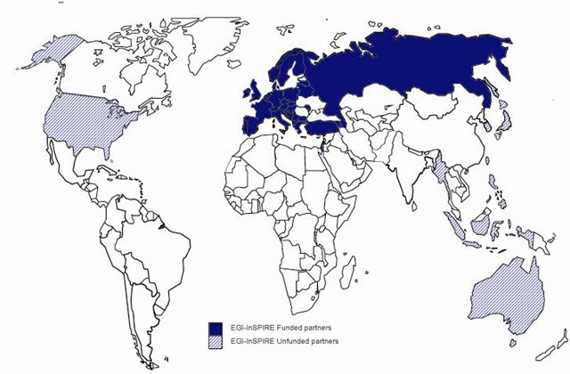
The EGI-InSPIRE Project
Integrated Sustainable Pan-European Infrastructure for Researchers in Europe
A 4 year project with €25M EC contribution
Project cost €72M
Total Effort ~€330M
Effort: 9261PMs
Funded
Un-Funded
Project Partners (50)
EGI.eu, 40 NGIs, 2 EIROs
Asia Pacific (8 partners)

Slide 18
A Virtuous Service Cycle
Users
Requirements
Technology
Assessment
Infrastructure

Slide 19
EGI Supports Innovation
Deploy Technology Innovation
Distributed Computing continues to evolve
To include: Grids, Desktops, Virtualisation, Clouds, …
Enable Software Innovation
Provide reliable persistent technology platform
Tools built on gLite/UNICORE/ARC/Globus
Support Research Innovation
Infrastructure for data driven research
Support for international research (e.g. ESFRI)

Slide 20
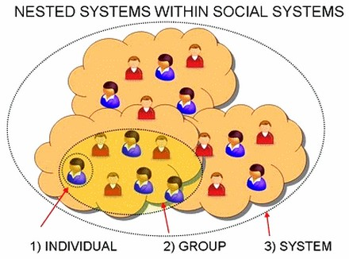
Relevance
OK so you have processes….
How are you going to help me do what’s relevant to me and my community?
Human Network
Representation in the e-Infrastructure
3) COMMUNITY

Slide 21
Scaling the Human Network
Across an NGI Research Community
Across an International Research Community
Across different disciplines & skill levels
From an Individual to a Community
Services that enable the human network
Services that support building your
Virtual Research Community

Slide 22
A Virtuous User Cycle
Aka: “the chicken and egg conundrum...
Design
Deliver
Discover
Feedback through VRCs in the User Community Board
User Services Advisory Group to drive detailed design
Where is the community?
How can I contribute?
- VRCs
Mailing lists
Workshops
Forums
Blogs
Projects
Sharing stories
Collaborating
Applications
Data collections
Requirements
Proposals
Projects
Success stories
How do I use these resources?
Integrated Services
Human
Technical
Infrastructure
Attend training courses
Utilise training material
Access data
Run applications on the grid

Slide 23
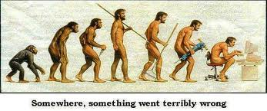
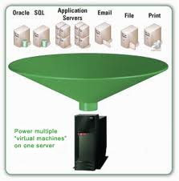
Technology
I’ve told you what I want, how are you going to support my exact needs, now and in the future, instead of my competitors?

Slide 24
European e-Infrastructure
Applications
Networking
Resources
Desktops
HTC Grids
HPC Grids
Petascale
HPC
EGI
EGEE
PRACE
Virtualised Resources

Slide 25
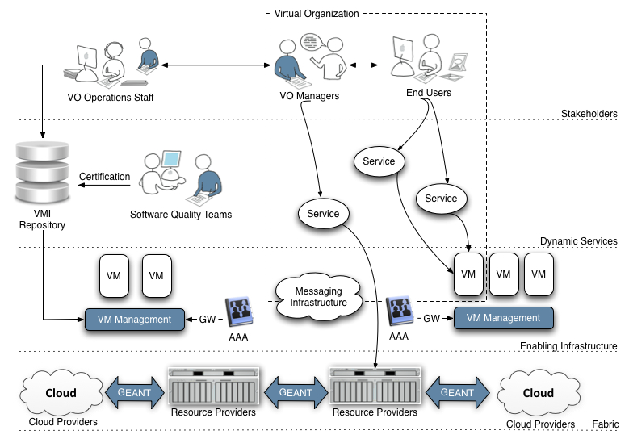
A Virtualised Future?
End-User Technology Experts
(National, European & Global Collaborations)
Experts
(Communicating between users & providers)
End-Users
(National, European & Global Collaborations)
VO Specific Operations Staff
Virtual Research Community
Infrastructure
Providers
Infrastructure Providers
(Research & Commerical – National, European & Global)

Slide 26
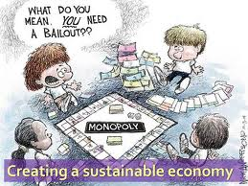
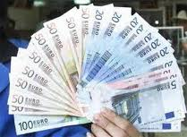
Cost
This sounds wonderful! How much is it going to cost me?

Slide 27
Running EGI.eu (4 yrs)
EGI.eu
European Commission
EGI-InSPIRE
(25000K)
597K
EGI-InSPIRE Central Budget
(597K)
4653K
EGI.eu Activity
(8010K)
EGI Global Tasks
2643K
This moves EGI.eu towards sustainability
19750K
6000K
NGI Activity
Partner Tasks
(International & Global Tasks)
(65848K)
NGIs
(49455K)
43455K

Slide 28
Summary
EGEE:
Demonstrated a production e-infrastructure
EGI:
Provide a sustainable production e-infrastructure
EGI.eu established in Amsterdam
Supported transition through EGI-InSPIRE
Moving towards sustainable coordination

Slide 29
Questions?
Call for papers opens October 2010
See www.egi.eu/EGIUF2011 for more details
Contact:
Steven Newhouse
director@egi.eu

