Slide 1
Argus service for the 2nd EGA pilot: Authorisation
Gergely Sipos
gergely.sipos@egi.eu
Argus

Slide 2
Context
CSC, EBML-EBI, EGI.eu agreed to develop two independent but corroborative pilots.
Pilot 1 (authentication) to provide an option for European Genome-phenome Archive (EGA) users to use federated identity when using EGA services, and
Pilot 2 (authorization) to create an electronic workflow that allows researchers to apply access to a particular dataset in the EGA through an appropriate Data Access Committee (DAC).
This presentation provides an introduction to the Argus authorisation service and how it could be used within the 2nd pilot.

Slide 3
Argus authorisation service
Argus
Can user B perform action C on Service A?
Service
A
Action C
Yes
No
(I don’t know OR Error → No)
User B
Attribute-based authorisation system. It uses attributes to:
identify the user attempting to perform an action,
the resource on which the action is to be performed,
the action itself, and
other optional environmental information.
Notes:
permit - indicates the subject is permitted to perform the action on the resource
deny - indicates the subject is not permitted to perform the action on the resource
not applicable - indicates no policy applied to the request and so no decision could be reached
indeterminate - indicates there was an error evaluating the policy

Slide 4
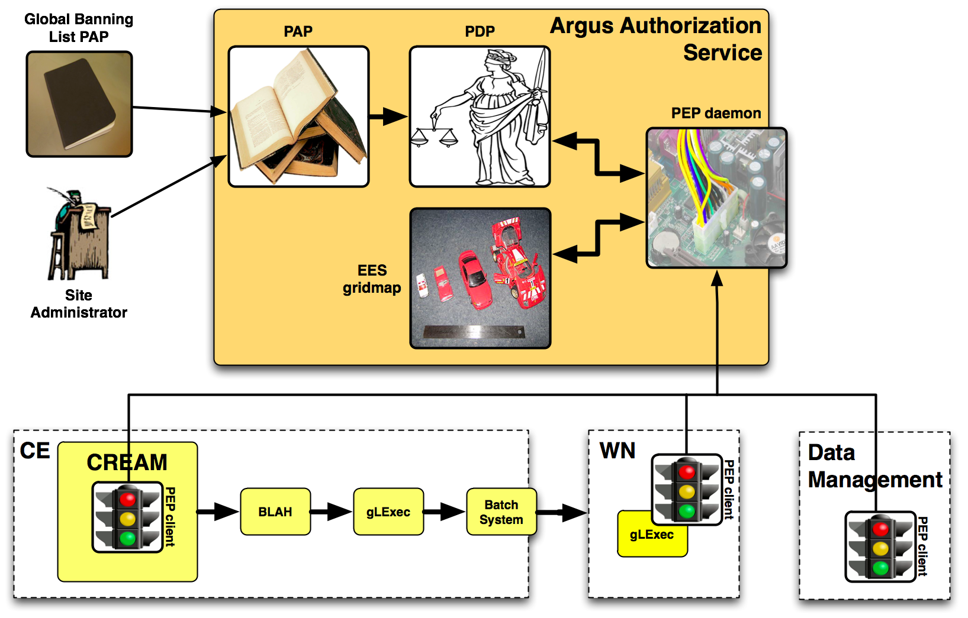
Use in the European Grid Infrastructure
Manage consistent authorization policy based decisions within sites, within a National Grid Infrastructure
Argus

Slide 5
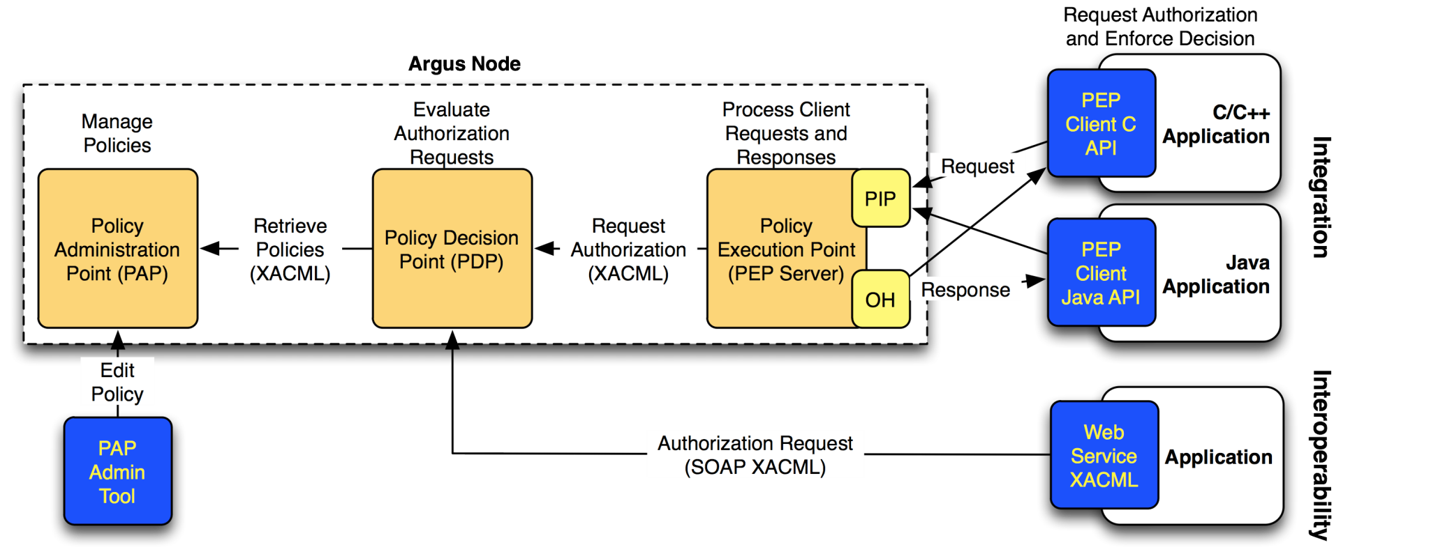
Under the hood
Consistent authorisation decisions across services within a single, OR accross multiple sites
Authorize & Ban user by certificate DN, email, institute, …
Policies in Simplified Policy Language (SPL) or XACML
Argus
SPL
SPL
XACML

Slide 6
Argus in EGA
Logged in from an identity federation
Data Access Committee
Grant access
Request access
EGA portal
Update policy (SPL)
administration
Update policy (SPL)
PAP CLI
Argus
Request dataset
Obtain autz info
PEP API
execution
Obtain authz info
EGA
Provide dataset
Notes:
PEP has Java and C APIs

Slide 7
SPL example
resource "http://cern.ch/authz/ce1" {
action "http://cern.ch/authz/actions/ce-submit" {
rule permit {
subject="CN=John Doe,OU=Standard Commercial Certificate,O=Acme, L=Zuerich,ST=Zuerich,C=CH"
}
rule deny {
subject="CN=Jane Smith,OU=Standard Commercial Certificate,O=Acme,
L=Zuerich,ST=Zuerich,C=CH"
}
}
}
User authentication using X509 certificates

Slide 8
Possible SPL for EGA pilot
resource “http://autz.ebi.ac.uk/EGAC00000000006” {
action “http://autz.ebi.ac.uk/actions/download” {
rule permit {
email=“gergely.sipos@egi.eu”
email=“tommi.nyronen@csc.fi”
email=“juha.muilu@helsinki.fi”
}
rule deny {
email=“john@badsite.com”
}
}
}
Example: User authentication using federated identity
Choose any attribute(s) you want to describe users

Slide 9
Some commands from PAP CLI
pap-admin [global-options] add-policy [options] <permit|deny> <id=value>...
pap-admin [global-options] remove-policy [options] id...
pap-admin [global-options] ban [options] <id> <value>
Taken from Argus 1.3.0 manual:
https://twiki.cern.ch/twiki/pub/EMI/ArgusEMIDocumentation/emi-argus-sys_admin_guide-1.0.0.pdf

Slide 10
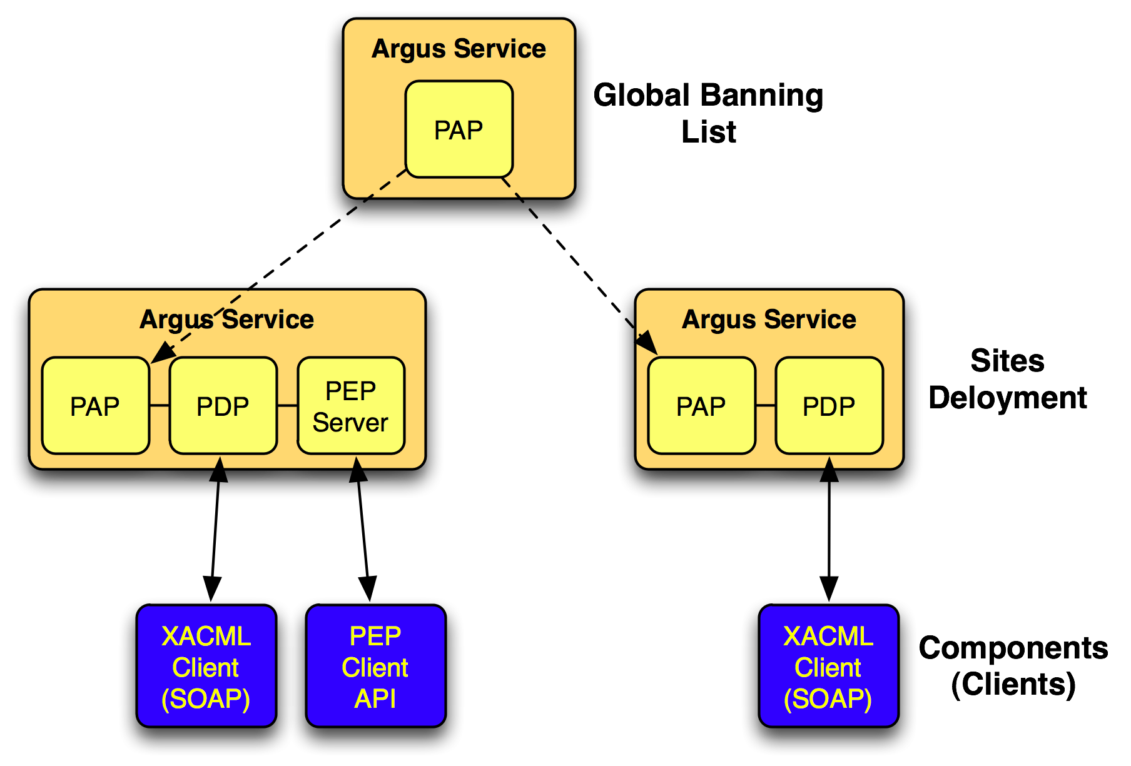
Additional possibility: Hierarchical distributon of policies
To fetch and trust policies from other domains
EBI Argus
EGA1 Argus
EGA2 Argus

Slide 11
Other aspects to consider
Policy Administration Point authenticates administrators with X509 certificates
(Some of the ) DAC members need to have personal certificates
Authentication in the PEP API is configurable:
Public OR site certificate based access to EGA service
Frequency of policy synchronization between PAP and PEP is configurable
Set to 1 min for (almost) immediate effect
Use of Argus by EGI middleware services (from EMI):
EMI-1 (April 2011): CREAM, gLexec , ARC CE
EMI-2 (7 May 2012): WMS, StoRM, LFC/DPM and UNICORE

Slide 12
Benefits of using Argus in the EGA pilot
Can serve a well defined, useful role within the EGA pilot
Established release and support structure from EMI project, EGI & the NGIs
EMI releases, support unit in EGI Helpdesk
Possibility to scale to multiple applications
Consistent authorisation accross multiple EGA services

Slide 13
Further information
Argus main page:
https://twiki.cern.ch/twiki/bin/view/EMI/Argus
Argus Introduction
https://twiki.cern.ch/twiki/bin/view/EGEE/AuthorisationFramework
Argus documentations:
https://twiki.cern.ch/twiki/bin/view/EMI/ArgusEMIDocumentation
Developers:
SWITCH: Valery Tschopp, Joel Casutt, Christoph Witzig (PDP, PEP server and client libraries, release)
CNAF: Andrea Ceccanti (PAP)
HIP: John White, Kalle Happonen (QA, Certification)
NIKHEF: Oscar Koeroo, Mischa Salle (EES)

