Slide 1
EGI Compute and Data Services for Open Access in H2020
Tiziana Ferrari
Technical Director, EGI.eu
tiziana.ferrari@egi.eu
Notes:
- Explain the problem for the solutions
What is a distributed competence center, why EGI can do it
How to get capacity:
-- federation of owned resources
-- guaranteed resource allocation from existing resource providers (publicly-funded/commercial)
-- opportunistic

Slide 2
Outline
What is EGI?
Services for Researchers
Supporting Open Access
Collaboration with EGI

Slide 3
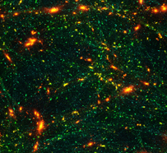
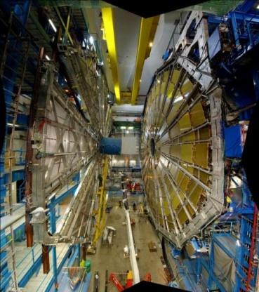
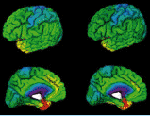
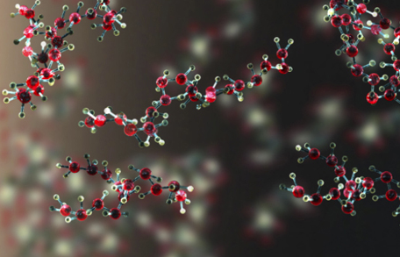
Accelerating Excellent Science
MISSION. To support researchers from all disciplines with the reliable and innovative ICT services they need to accelerate excellent science
Natural sciences
Physical sciences
Medical and health sciences
Engineering and technology
…
http://www.egi.eu/case-studies/

Slide 4
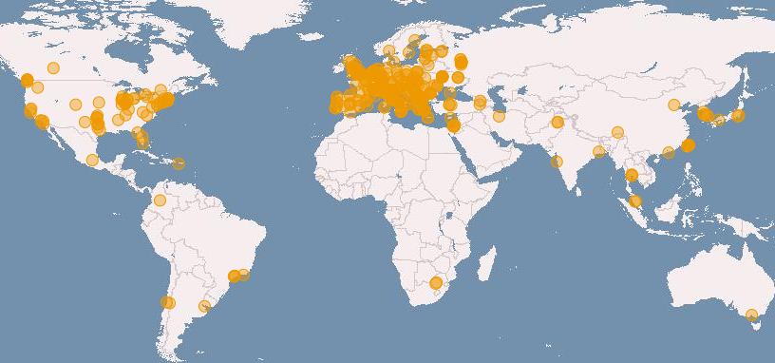
European Grid Infrastructure
Distributed and federated data and computing facilities
Grid and Cloud compute platform
340 data centres in 34 National Grid Initiatives/EIROs
435,000 logical CPU cores
10 years of support to science
> 200 research projects
190 PB disk, 180 PB tape
1.6 M job/day
> 99.6% reliability

Slide 5
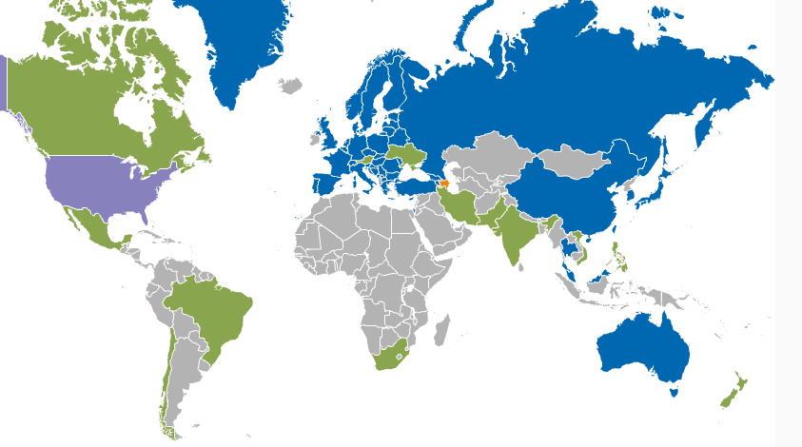
European Grid Infrastructure
EGI infrastructure
EGI partners
EGI peer infrastructures
5

Slide 6
Principles
Uniform access to heterogeneous data and compute services
Grid and Cloud platforms
Federation of services from
Publicly funded infrastructures
Institutional infrastructures
Commercial providers (partnership with Helix Nebula)
→ free at point of delivery/pay per use

Slide 7
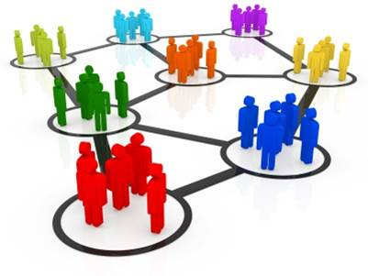
Services for long tail and big science
Individual Researchers
High-Throughput Data Analysis
Community Driven Innovations and Support
Federated Cloud
Research
Teams
Large Research Communities

Slide 8
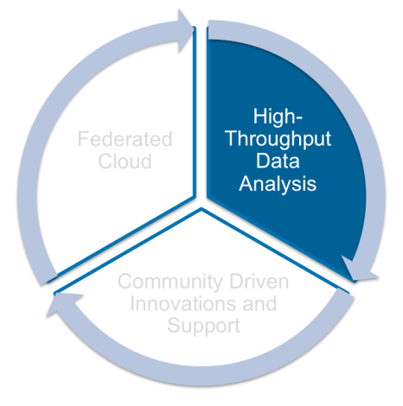
High-Throughput Data Analysis
Do you need to manage and analyse large datasets, or to execute thousands of computational tasks?
European federation of publicly-funded clusters
for High-Throughput Computing (HTC)
Grid Compute: run large-scale computational jobs
Grid Storage: store/access/retrieve files
Data Management: e.g. metadata catalogue, file transfer service
Based on open standards and open source software
Added Value
Integrate heterogeneous infrastructure/technologies
Uniform access to distributed computing capabilities to run large-scale computational jobs processing big data and preventing single vendor lock-in‏
Possibility to federate your own resources
Facilitate collaboration across communities and borders by sharing compute and data

Slide 9
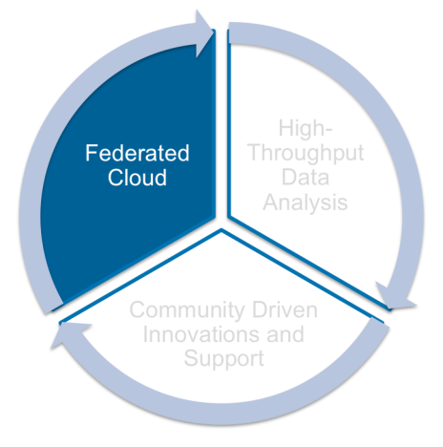
Federated Cloud
Do you need an infrastructure to deploy on-demand IT
services for managing and processing your research data?
European federation of publicly-funded community clouds
Cloud Compute: deploy/manage virtual machines (VM)
Cloud Storage: store/access/retrieve digital objects
Image Repository: store/retrieve certified VM images
Based on open standards and open source software
Integrate heterogeneous cloud technologies
OpenStack, OpenNebula, CloudStack,…
Integrate with commercial providers
Within EGI or through the Helix Nebula Marketplace
Added Value
Uniform access, no lock-in and on-demand scale out capabilities
Easy deployment of own/customised services
Possibility to federate existing institutional clouds
Efficiency by co-locating big data + cloud computing
Launch into production: May 2014

Slide 10
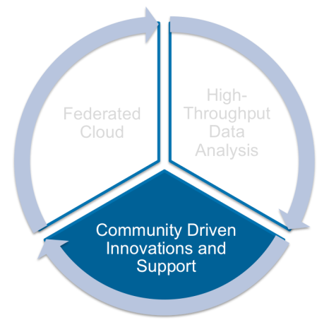
Community-Driven Innovation and Support
Do you want to discover and implement the best approach to your data-intensive compute needs?
Expert assistance for easy and seamless integration and access to the computing and data services
European Distributed Competence Centres
Leveraging expertise of user communities and technology providers
Partnership with external centres
Added Value
Support at both national and EU level
Avoid duplication of solutions
Leverage expertise from the community
Facilitate collaboration across communities and borders‏
User-driven innovation

Slide 11
Collaborations in the area of Open Access
To link research outputs from EGI into a larger open access ecosystem
To evaluate scientific impact by connecting publications to EGI as an enabling platform
To expand service portfolio in the area of data curation/preservation services
To bring in expertise for data repository certification and data management planning

Slide 12
EGI support to Open Access
Integrated large-scale compute and data services
Generate → archive → use → re-use open data
Custom services on cloud
Catch-all distributed open research data repository (prototype)
Consultancy and support embracing a portfolio of services with APARSEN and OpenAIRE
Compute and data management planning
Data repository certification
Integrates with other e-Infrastructures to support complex workflows and enable a single digital market of services for research
GEANT, EUDAT, PRACE, Helix Nebula, …

Slide 13
Conclusion
EGI federates ICT infrastructures and human capabilities in Europe and beyond
EGI develops solutions for research based on high-throughput computing, cloud and data services
EGI is an open platform and promotes open access to research outputs

Slide 14
support@egi.eu

