Slide 1
On-demand Research Computing: the European Grid Infrastructure
Gergely Sipos
EGI.eu, Amsterdam
gergely.sipos@egi.eu

Slide 2
Outline
Introduction to the EGI
Astronomy and astrophysics activities in EGI
EGI as a computing grid platform
The EGI Federated Cloud platform
Support for new types of services
Possible next steps

Slide 3
What is a Grid?
A grid consists of distributed resources controlled by separate organisations that are systematically used securely by users external to that organisation
Resources can include:
Commodity and High Performance Computing clusters
Disk or tape storage
Instruments (e.g. Sensors)
Databases, data archives, digital libraries
The European Grid Infrastructure (EGI) is a sustainable, production grid infrastructure - extended with cloud computing capabilities.

Slide 4
History
2001-4: European Data Grid (EDG)
Proof of concept European Grid Infrastructure
2004-10: Enabling Grid for E-sciencE (EGEE)
Three separate projects
Moving from prototype to production
2007-9: European Grid Initiative Design Study
Community driven sustainability model
2010-14: EGI-InSPIRE
Transitioning towards a sustainable infrastructure
March 2012 – Federated Cloud testbed

Slide 5
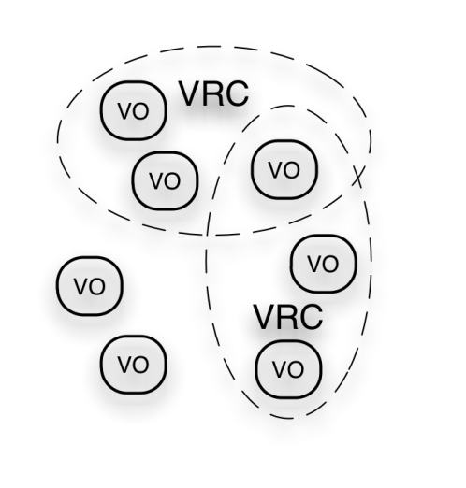
The EGI Ecosystem
User Community
A & A Virtual Organisations
VRC: Virtual Research Community
VO: Virtual Organisation
Project: SCI-BUS
TRANSfoRm
Policies + Funding
Auger
Project: EDGI
...
Glast
...
CTA
...
Requirements + Feedback
Services + Support
Resource & service Providers
Requirements + Feedback
Public Funding Bodies
Policies + Funding
Requirements
Technology Providers
European Commission
EGI.eu foundation
National Grid Infrastructures (NGIs)
Grid middleware software
National Research Councils
Strategic Feedback
Middleware + Support
Cloud provider software

Slide 6
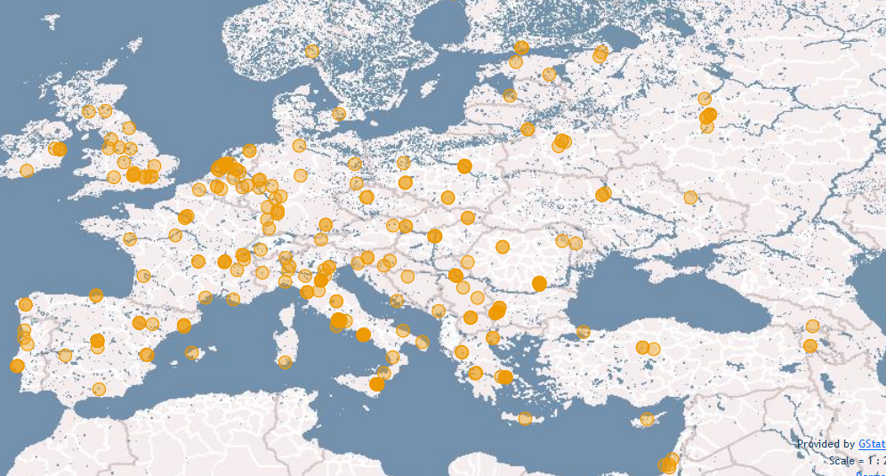
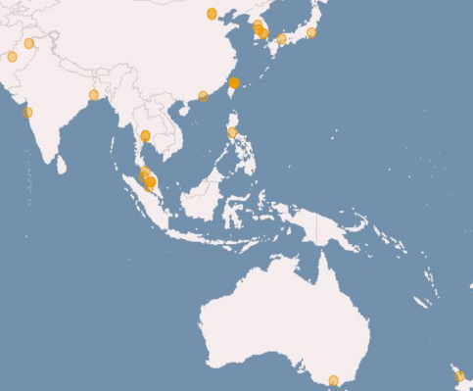
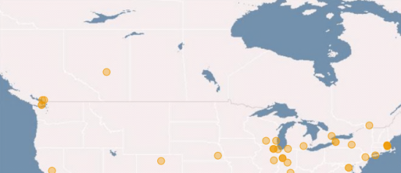
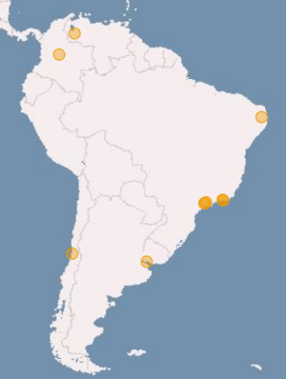
Installed capacity (Apr ‘12)
Metric | Value (yearly increase)
Sites | 326 (+3%)
Nb. of CPU cores | 270,800 (+31%)
Disk (PB) | 139 PB (+31%)
Tape (PB) | 134 PB (+50%)

Slide 7
Capacity usage (May 2011-April 2012)
First runs of the Large Hidron Collider
Metric |  | Value (yearly increase)
CPU time | Total (Billion HEP-SPEC 06 hours) | 10.5 (+52.91%)
Computing jobs | Total (million) | 492.5 (+46.42% )
 | Average job/day (million) | 1.35
% of total consumed CPU time | High-Energy Physics | 93.60%
 | Astronomy and Astrophysics | 2.25% (117%)
 | Life Sciences | 1.30%
 | Various disciplines | 1.23%
 | Remaining disciplines | 1.62%
Driven by Auger VO
Equivalent of the continuous use of ~2.700 CPU cores

Slide 8
EGI’s Strategic Focus http://go.egi.eu/EGI2020
Operational Infrastructure
Operate a European wide infrastructure
Offer its use to other research infrastructures
Build a federated cloud environment
Community & Coordination
Community building through events
Community networking through the NGIs
Virtual Research Environments (VREs)
Support the development, integration & operation of community/project/domain specific services

Slide 9
Astronomy and Astrophysics communities in EGI
8 Virtual Organisations:
Pierre Auger Observatory, Cerenkov Telescope Array, South Pole Neutrino Observatory, Gamma-ray Large Area Space Telescope, Virgo detector (gravitational waves), ARGO-YBJ experiment, ...
Domain specific support from the EGI-InSPIRE project
Integration of domain applications
Visualisation Interface to the Virtual Observatory (VisIVO) – 2D, 3D visualisation framework: http://visivo.oact.inaf.it
FARANEC code
Database integrations
Grid Relational Catalogue (GrelC) – framework to interface DBs and grids/clouds: http://grelc.unile.it
BaSTI DB (A Bag of Stellar Tracks and Isochrones)
Supercomputer and GPU integration (Graphical Processing Unit)
Project collaborations within some NGIs
E.g. Square Kilometer Array

Slide 10
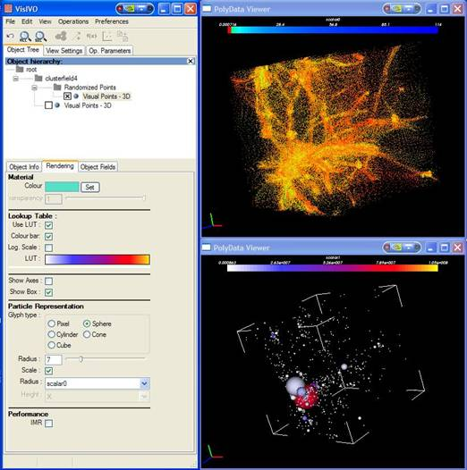
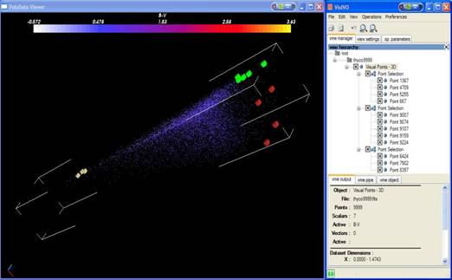
Use case: VisIVO examples
Dark matter distribution of a random subsample of points extracted from the result of aN-Body simulation.
Visualization of a catalogue of stars with selected objects.
Rendering jobs run on EGI

Slide 11
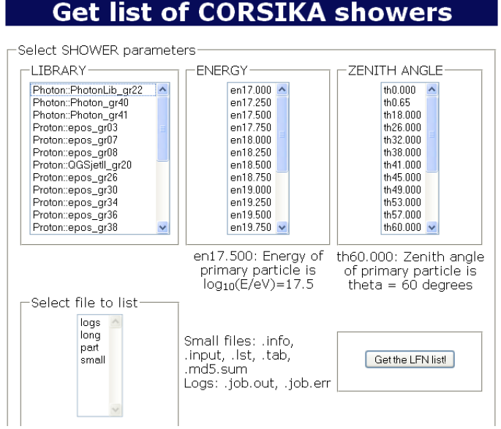
Use case: Auger Virtual Organisation
Pierre Auger Observatory Collaboration
500 members, 111 institutes, 18 countries
Full production since 2006
Computing model:
Data tranfer from Argentina to Lyon
1-3.5 GB / day
Web interface for users to start Monte Carlo simulation jobs on EGI
CORSIKA, Aires, QGSJETII, Sibyll, EPOS
gLite based computing services from 11 NGIs
1.5 million CPU hour / month
160.000 jobs
= 66% of A&A use from EGI

Slide 12
Use case: Cherenkov Telescope Array
Collaboration of 132 institutes from 25 countries
Approx. 6% of A&A use on EGI = 150.000 CPU hour / month
Benefits of using EGI:
Member institutions can share computing power with the CTA community;
Generate data-intensive stimulations in a shorter amount of time;
High level interfaces reduce barriers to access high-end computing infrastructures

Slide 13
Federated Cloud: a new EGI platform
Research Communities
Virtual Research Environment
‘Cloud’ EGI: applications in Virtual Machines
‘Traditional’ EGI: batch processing
job
job
job
Virtual machine
Grid middleware services
Research facilities (e.g. detectors, sensor networks)
Virtual machine
Virtual machine
VM
DB
SW
EGI Federated Cloud
EGI resources (clusters, storages,...)
Dedicated or shared resources/platforms (e.g. Clusters; dekstop grids, commercial cluds, GPUs, etc.)

Slide 14
EGI’s Cloud Strategy
Personalised environments for individual research communities
in the European Research Area
SaaS
Project/community specific services
Project/community specific services
Project/community specific services
PaaS
EGI.eu Coordination
Core software and support
VM Mgmt
Data
Information
VM Mgmt
Data
Information
VM Mgmt
Data
Information
Institutional cloud
NGI cloud
Commercial cloud
IaaS
Monitoring
Accounting
Notification
Monitoring
Accounting
Notification
Monitoring
Accounting
Notification
EGI-wide message bus

Slide 15
EGI Cloud based on open standards
Infrastructure Capabilities
VM Management, Data Management, Information Discovery, Accounting, Monitoring, Notification
Community Capabilities
Federated authentication & authorisation, VM Image Sharing (Virtual Image repository)
Implementation based on third party, open standards and open source implementations:
Frond-end interfaces: OCCI, CDMI-OVF, GLUE-LDAP
Back-end interfaces: UR+-StAR, Nagios, ActiveMQ
Providers: OpenNebula, OpenStack, Stratuslab

Slide 16
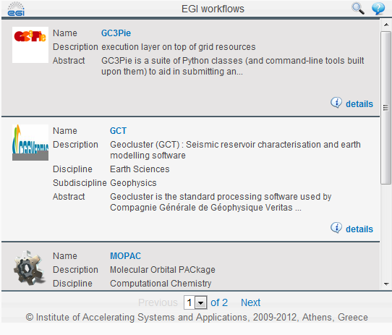
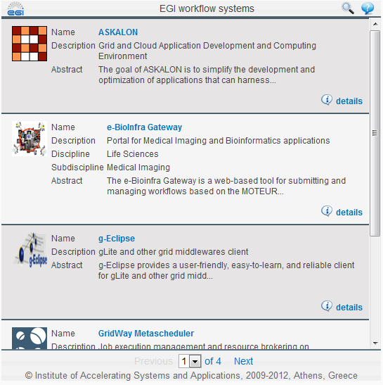
Application/service integration: workflows
Turn applications into repeatable, sharable experiments
Catalogue of existing workflow tools and workflow applications
http://go.egi.eu/workflows
Collaboration with workflow system developers
SHIWA project; ER-Flow project, NGIs
Workshops (http://go.egi.eu/workflowworkshops)

Slide 17
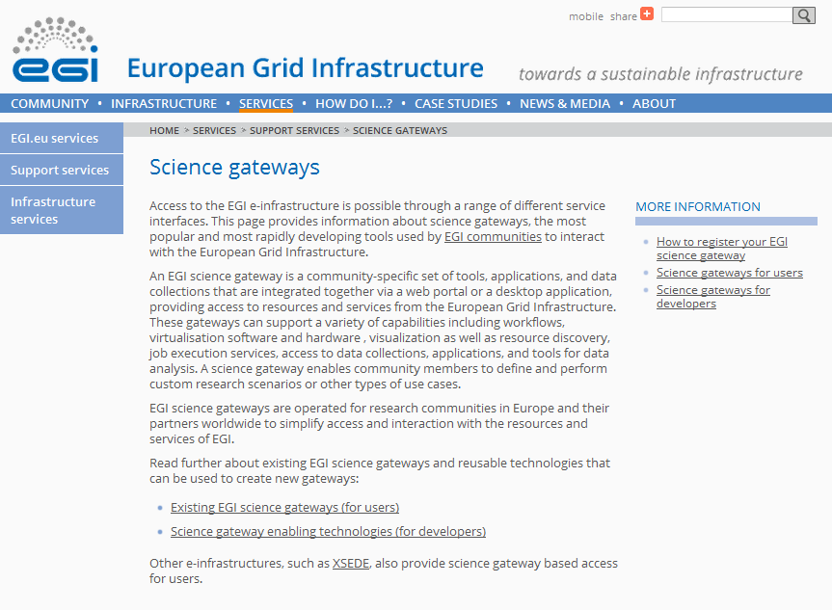
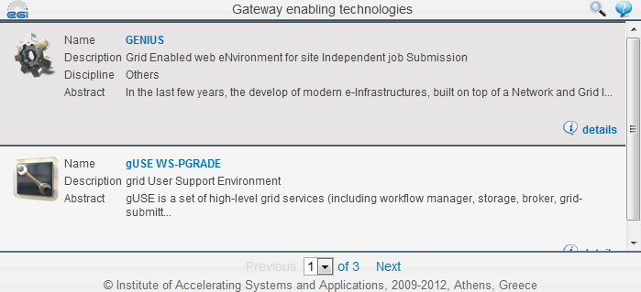
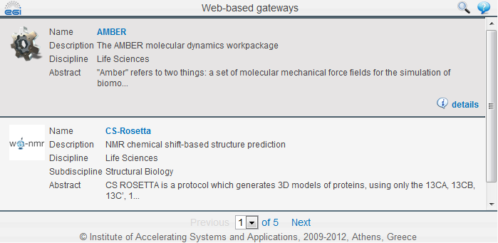
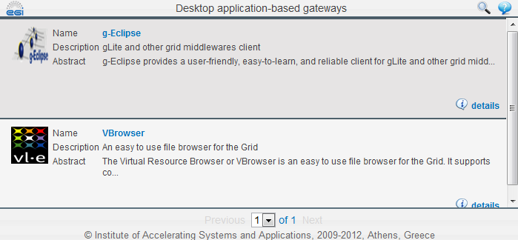
‘Software as a service’ on EGI
Access EGI-based applications through the Web
Catalogue of existing application services
http://go.egi.eu/sciencegateways
“How-to” documentation for developers
Under development https://wiki.egi.eu/wiki/VT_Science_Gateway_Primer
NEW: Become an associated member of the SCI-BUS project
Funding for portal development
http://www.sci-bus.eu

Slide 18
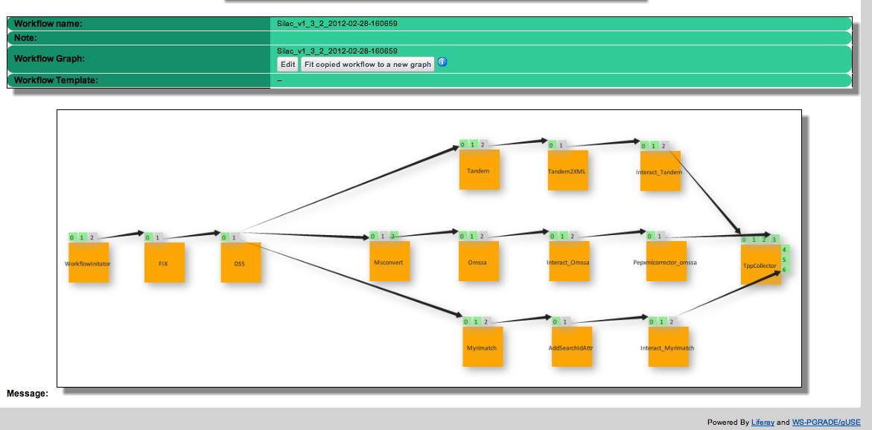
Example: ETH Proteomics Gateway
Private Gateway for one of the largest Proteomics research groups in Europe (inside ETH):
Up to 100 users
50TB of data
Access to 1200 cores local cluster

Slide 19
Summary Possible next steps
Use the ‘traditional’ grid platform
Join one of the existing VOs, or extablish a new VO: http://operations-portal.egi.eu/vo
Use the new Federated Cloud platform
Getting access: https://wiki.egi.eu/wiki/Fedcloud-tf:Testbed
Connect resources to the Federated Cloud testbed
EGI Federated Cloud Task Force: https://wiki.egi.eu/wiki/Fedcloud-tf:FederatedCloudsTaskForce
Work together on GAIA - ASTRA services
Application integration; database integration, query languages, filters, workflows, user interfaces, ...
NGI User Support Teams: http://www.egi.eu/services/support/user_support/

Slide 20
Questions?
EGI.eu user community support team:
ucst@egi.eu
EGI Technical Forum 2012,
Prague, Czech Republic, 17–21 September
www.egi.eu

Slide 21
EGI.eu Contacts
Director
director@egi.eu
Operations Team
operations@egi.eu
User Community Support Team
ucst@egi.eu
Strategy and Policy Team
policy@egi.eu
Marketing and Communications Team
press@egi.eu
Secretariat
contact@egi.eu

Slide 22
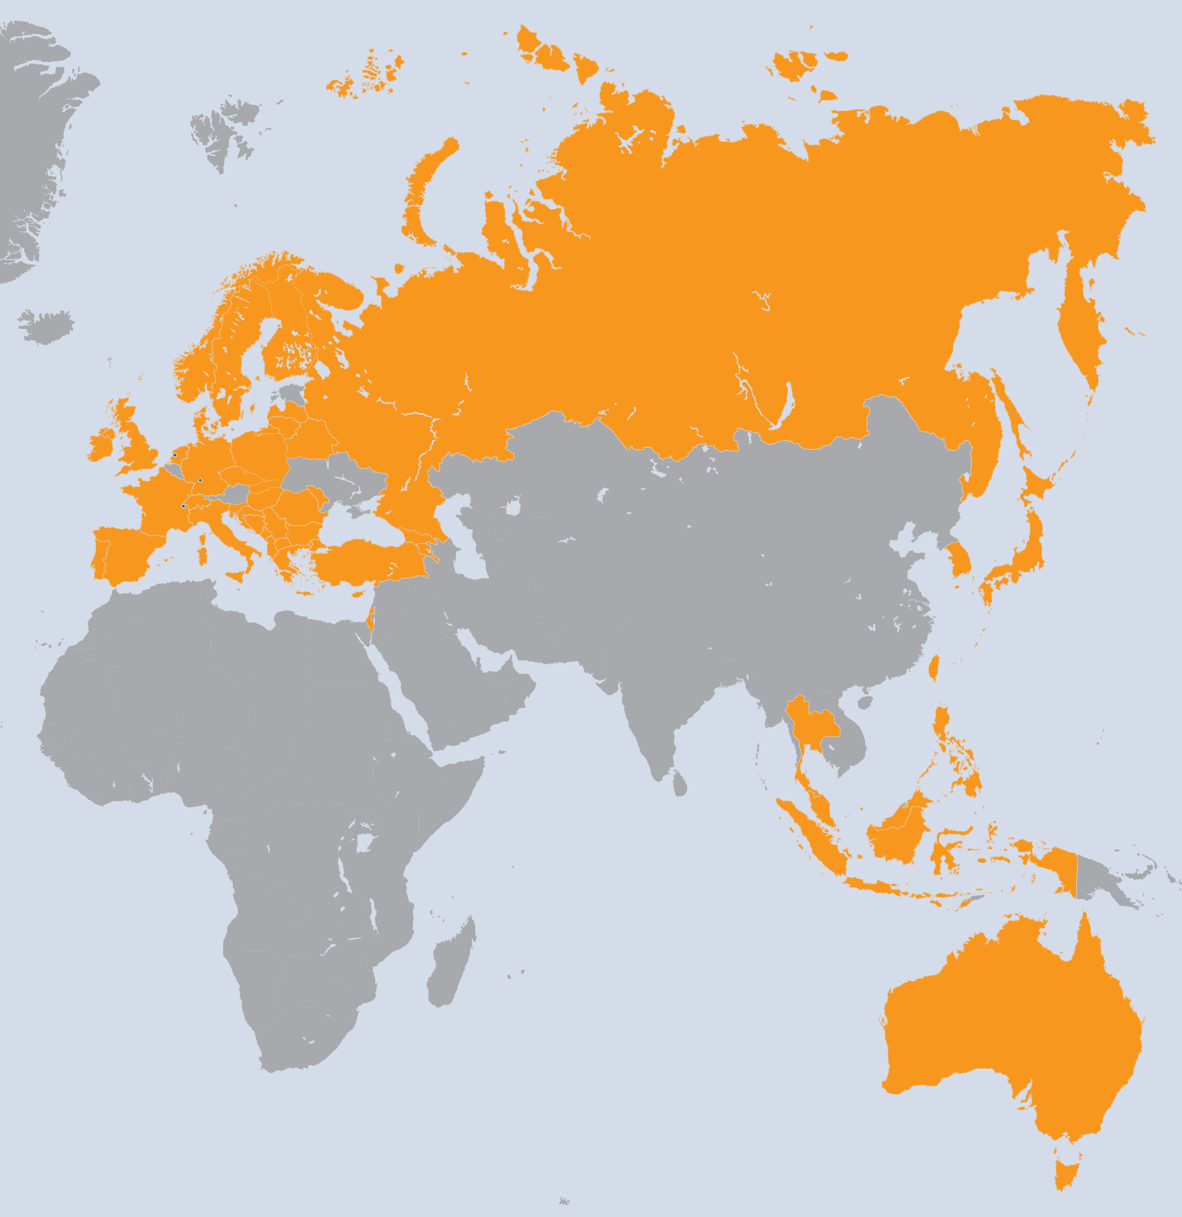
EGI-InSPIRE Project
Integrated Sustainable Pan-European Infrastructure for Researchers in Europe
A 4 year project with €25M EC contribution
Project cost €72M
Total Effort ~€330M
Effort: 9261PMs
Project Partners (50)
EGI.eu, 38 NGIs, 2 EIROs
Asia Pacific (9 partners)

