Slide 1
EGI Cloud Container Compute
Enol Fernández
EGI Foundation
Dissemination level: Public

Slide 2
EGI Cloud Federation
Multi-cloud IaaS with Single Sign-On via Check-in
Technology agnostic, supports OpenStack, OpenNebula and Synnefo
Extra features
Virtual Appliance catalogue
Unified GUI dashboard
Centralised accounting
Resource discovery
SLA monitoring
Cloud
Compute
Cloud Container
Compute
Online
Storage
AoD
Training
Infrastructure

Slide 3
The infrastructure
20 resource centres
15 OpenStack
4 OpenNebula
1 Synnefo
5 centres under integration
2 centres expressed interest on joining

Slide 4
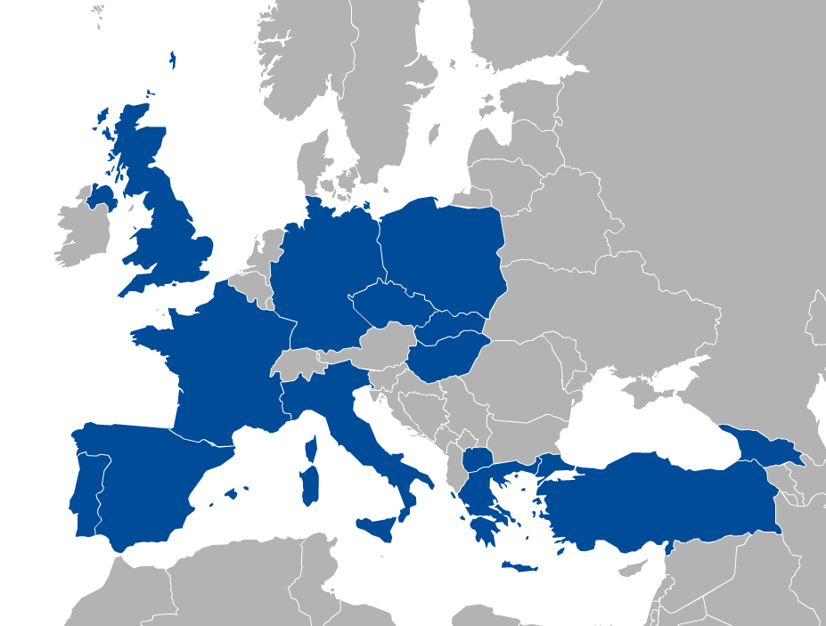
EGI Cloud Compute
Run Virtual Machines on demand on EGI’s Cloud Federation
Similar to AWS EC2/EBS or GCP Compute Engine
Access is VO-based: VO = group of users + providers supporting the VO
Community-specific VOs – e.g. CHIPSTER, EISCAT, etc.
Training VO = training.egi.eu
Generic VOs – e.g. fedcloud.egi.eu
Diverse providers with common:
AuthN and AuthZ
VM Image catalogue
Information discovery
Accounting
Monitoring
GUI dashboard
VO 1 (cloud a, b, c)
VO 2 (cloud b, c,
d, e,f)
a
b
c
d
e
f

Slide 5
EGI Cloud Compute concepts
Object Storage
Persistent,
HTTP access
Immutable representation of OS and applications
Software Appliance
Virtual Appliance
Start in a cloud
VM instance
VM image
Meta data
Configured and ready to be used
Contextualization script
Attach
What to provide
How to start
Block Storage
Persistent even when VM disappears

Slide 6
Manage VMs via AppDB VMOps
Complete Check-in integration
Wizard-like creation of VMs
Single dashboard for all providers

Slide 7
Manage VMs via AppDB VMOps
Global management of VMs
Topologies are a set of related VMs
GGUS integration
Individual management of VMs

Slide 8
Architecture
EGI AAI
Community Platforms
AppDB VMOps
IaaS Federated Access Tools
IaaS Federated Access Tools
IaaS API
IaaS API
Cloud Management Framework
Cloud Management Framework
EGI Federation services:
Accounting, Monitoring, Configuration Database, Information Discovery, VM Marketplace

Slide 9
API access: dealing with heterogeneity
EGI Federated Cloud no longer mandates a single API for every provider
OCCI still widely supported but sites are moving native APIs (mainly OpenStack!)
Tools to deal with heterogeneity:
IaaS orchestration tools with support for multiple APIs:
Infrastructure Manager, Terraform, OCCOPUS, …
https://wiki.egi.eu/wiki/Federated_Cloud_IaaS_Orchestration
IaaS libraries with support for multiple APIs:
libcloud, jclouds,…
See guide on migrating from OCCI to IM on EGI’s wiki: https://wiki.egi.eu/wiki/Federated_Cloud_OCCI_to_IM_Migration

Slide 10
Containers
Containers provide virtualisation at the OS level
Same kernel, isolated user-space
Faster deployment, less overhead, easier migration…
App A
App A’
App B
libs
libs
libs
VMs
Guest OS
Guest OS
Guest OS
App A
App A’
App B
containers
libs
libs
Hypervisor
Host OS
Host OS
Server
Server

Slide 11
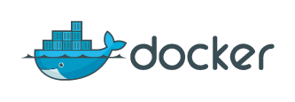
Docker
“Open-platform for building, shipping and running distributed applications”
Docker commoditizes containers
Hides and automates container management process
One-command-line deployment of applications
Easy to move from development to production
Provides ecosystem to create and share images

Slide 12
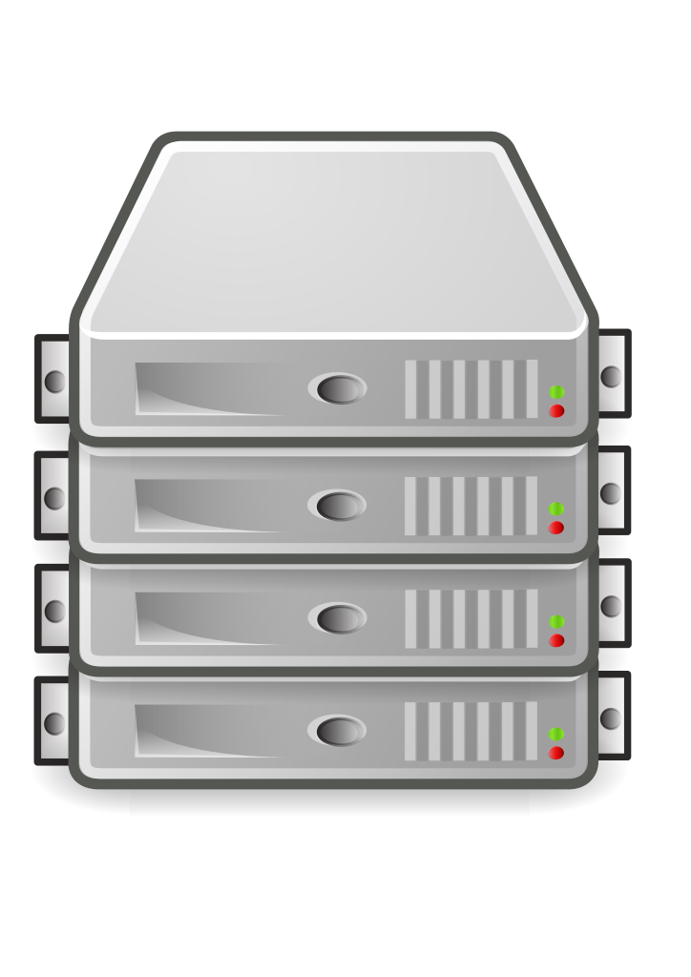
Container orchestration
App A
Container
Container
Container
Container
Container
Orchestrator
App B
Container
Container
Container
Container
Schedule containers to physical or virtual machines
Restart containers if they stop
Provide private container network
Scale up and down
Service discovery
Infrastructure
Notes:
Container applications tend to be comprised of several containers running in a coordinated way
running few containers can be easily managed on a single node (e.g. with docker-compose)
Container orchestration:
Manages a cluster of nodes where to run the containers
Automates the deployment, management, scaling, networking, and availability of container-based applications running on that cluster
Main products: Docker Swarm, Kubernetes & Mesos

Slide 13
Running containers on EGI Cloud
2 (+ 1) options:
Single node: start the EGI Docker VM and run containers directly (or with docker compose)
EGI Cloud Container Compute:
Start a cluster of VMs and create a Kubernetes cluster to run your containers
udocker: run containers as jobs in the EGI HTC service

Slide 14
Cloud Container Compute
Cloud Container Compute gives you the ability to deploy and scale Docker containers on-demand using Kubernetes technology. The service provides with easy provision of Kubernetes clusters on EGI Cloud Compute resources that can be scaled and upgraded without the overhead of installing, managing and operating the nodes.
Cloud Container Compute offers users offers guaranteed computational resources in a secure and isolated environment with industry-standard Kubernetes container orchestration platform that:
Manages the nodes where to run the containers
Automates the deployment, management, scaling, networking, and availability of container-based applications running on that cluster.

Slide 15
Service architecture and interfaces
EGI Cloud Container Compute
2. Deploy Kubernetes cluster
on provisioned VMs
1. Provision cluster VMs
3. Use native Kubernetes tooling
with EGI Check-in authentication
IaaS Federated Access Tools
IaaS API
Cloud Management Framework
EGI Cloud Compute Service

Slide 16
Service options and attributes
Service Options:
General purpose instance: base performance instance type with up to 8 cores and up to 4 GB RAM per core
Compute-intensive instance: optimised instance for cpu-bound tasks. Up to 64 cores (non-overcommitted) and possible low-latency network
High-memory instance: optimised instances for tasks with big memory requirements. Up 120GB RAM per core.
Service attributes:
Associated storage to each VM (GB)
Access type: opportunistic (non guaranteed resources) or reserved
Start of service (date) and duration (days)

Slide 17
Documentation
EGI Container Compute documentation page:
https://wiki.egi.eu/wiki/Federated_Cloud_Containers
Kubernetes documentation:
https://kubernetes.io/docs/

Slide 18
Kubernetes
Kubernetes is an open-source platform for automating deployment, scaling, and operations of application containers across clusters of hosts, providing container-centric infrastructure.
Some concepts:
Pod: group of one or more containers, shared storage and options to run the containers
Deployment maintains the desired count of Pods all the time
Service: logical set of Pods and a policy by which to access them.
Exposed to the exterior of the Kubernetes cluster via mapping of ports and or Load Balancing
Job: A job creates one or more pods and ensures that a specified number of them successfully terminate.

Slide 19
Example
apiVersion: apps/v1
kind: Deployment
metadata:
name: frontend
spec:
selector:
matchLabels:
app: guestbook
tier: frontend
replicas: 3
template:
metadata:
labels:
app: guestbook
tier: frontend
spec:
containers:
- name: php-redis
image: gcr.io/google-samples/gb-frontend:v4
resources:
requests:
cpu: 100m
memory: 100Mi
env:
- name: GET_HOSTS_FROM
value: dns
ports:
- containerPort: 80
apiVersion: v1
kind: Service
metadata:
name: frontend
labels:
app: guestbook
tier: frontend
spec:
# comment or delete the following line if you want to use a LoadBalancer
type: NodePort
ports:
- port: 80
selector:
app: guestbook
tier: frontend
---
apiVersion: extensions/v1beta1
kind: Ingress
metadata:
name: frontend
spec:
rules:
- host: frontend.test.fedcloud.eu
http:
paths:
- backend:
serviceName: frontend
servicePort: 80

Slide 20
EGI Cloud Container Kubernetes
Provides Kubernetes v1.10
Major differences with other offerings:
LoadBalancer ServiceType:
A NGINX ingress configured by default ready to be used offering similar functionality
Expandable with auto-configuration of Let’s Encrypt certificates
Dynamic provision of volumes for PersistentVolumeClaims
No block-storage directly available
NFS-based volumes available instead

Slide 21
A note on AAI
EGI Cloud Compute currently relies on legacy X.509 + VOMS proxies for access to resources
For users without certificates:
PUSP with user-personalised proxies from robot certificate
RCAuth Online CA to obtain personal proxies from EGI Check-in identities
Now rolling-out production providers with native OpenID Connect support
2 sites now available, more coming
No need for certificates at all!

