Slide 1
Joint Service Catalogue for Research state of the art
Sergio Andreozzi
Strategy and Policy Manager, EGI Foundation
sergio.andreozzi@egi.eu
@digitalities
eInfraCentral Kick-Off Meeting
30 January 2017
Brussels, Belgium

Slide 2
Outline
Why “a Joint Service Catalogue for Research”
Work done so far
e-Infrastructure Catalogue of Services (CoS)
Next steps
e-InfraCentral project
Future perspectives
e-Infrastructure Commons
European Open Science Cloud

Slide 3
What do we mean by “Joint Service Catalogue for Research”?
Structured information about all services
including those available for deployment
From independent service providers
Focus on e-Infrastructures
Captured from the customer/user viewpoint
To help them understanding functionalities, value, payment models, contact points, ordering and request processes, etc
That support the production or dissemination of research outputs

Slide 4
.
.
.
.
.
.
service

Slide 5
Benefits
For customers & users
Simplify discoverability of services
Better understand their relevance
Identify similar offerings or gaps
For service providers
Provide shared language for service descriptions
Increase visibility of service offerings
For funding agencies
Improve communication of what they support
Supports evaluation of policy impact

Slide 6
Challenge
Various service offerings from different (federated) e-infrastructure providers
Different ways to define/describe a service
Different vocabulary about service management
Different processes to manage service portfolios
Different standards/frameworks available
ISO20K, ITIL, FitSM, …
Different tools not interoperable

Slide 7
Report on work to create a framework to describe a catalogue of services for e-Infrastructure (bottom-up and best effort initiative)

Slide 8
Main phases
Dec 2015 – Mar 2016
Working group created, several calls organised
April 2016
Workshop at EGI Conference
https://indico.egi.eu/indico/event/2875/session/15/?slotId=0#20160406
Presenting service offerings
Sharing best practices on service portfolio management
Discussing a common model
October 2016
Session at DI4R Conference
https://www.digitalinfrastructures.eu/content/joint-service-catalogue-research
Disseminating the work done
Discussing the way forward with related initiatives (e.g. MERIL) and other stakeholders
November 2016
Presentation at the e-IRG workshop http://e-irg.eu/workshop-2016-11-programme

Slide 9
Approach
Understand the baseline
Current practices and processes in place to manage service offerings
Reusing existing conceptualisations
FitSM: standard for lightweight ITSM
ISO 20000: Service management system requirements
UK Government Service Design Manual
Validate with examples
From the following initiatives:
THOR, EGI, EUDAT, GEANT, OpenAIRE, BlueBRIDGE

Slide 10
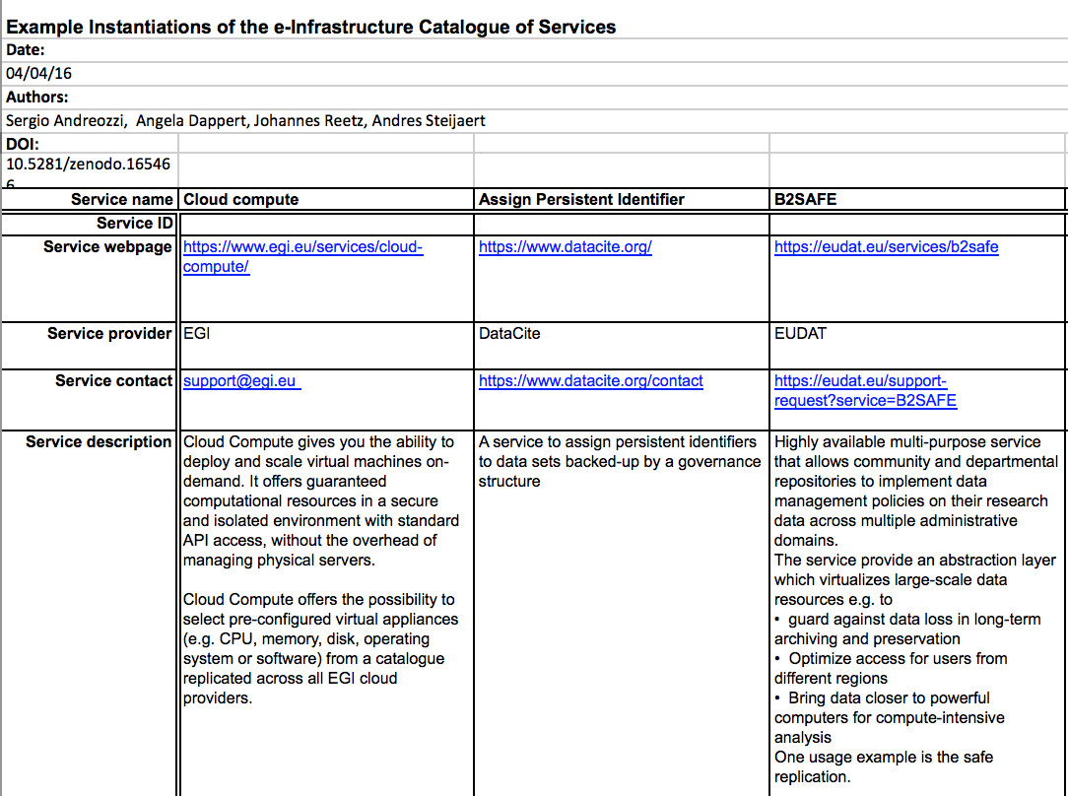
Current Results
Conceptual model
Examples to test the model
https://doi.org/10.5281/zenodo.165467
https://doi.org/10.5281/zenodo.165466

Slide 11
Service Model
Classification
Target groups
Provider
Service Area
Customer group
Service Provider
Service Function
User group
Service Type
Agreement
Identif. & contact
Terms of Use
Service Name
Description & Value
SLA
Service Description
Service ID
Service Condition
Service Value
Service Contact
Payment Model
Service Phase
Service Webpage

Slide 12
Classification
Named set of capabilities
Individual ability
Type of resource
Service Type
Object storage
VM management
IP connectivity
Identity management
Attribute management
…
e.g. federated authentication
e.g. start VM
e.g. create PID
e.g. data replication
Service Function
e.g. attach block storage
...
Service Area
Computing
Storage
Data
Networking
Persistent identifier
…

Slide 13
Question at DI4R: What should be the scope of the Joint Service Catalogue for Research? Services from …
Answers from the audience: 25 replies

Slide 14
Question at DI4R: Which functions should be supported by the Joint Service Catalogue?
Answers from the audience: 20 replies

Slide 15
Open questions
Governance
How to decide who is eligible to be listed
How to resolve conflicts
Management
Who is responsible to ensure quality and freshness of information
How to integrate service catalog management processes
Conceptual model
How to capture interoperability aspects in services
Ensure that metadata cover the needs of community-specific services
Choice between federated service vs. concrete instances from individual provider
Tool functionalities
Functionalities to be supported in the tool (e.g., search, request, …)
Programmatic API (e.g. https://www.tmforum.org/resources/standard/catalog-management-api-rest-specificationrestspec_-_catalog_management_v1-3-3/)
Automatic filtering of services based on policy limitations
(e.g. if there are geographical limitations, then it should be visible only to those eligible)

Slide 16
Future Perspectives

Slide 17
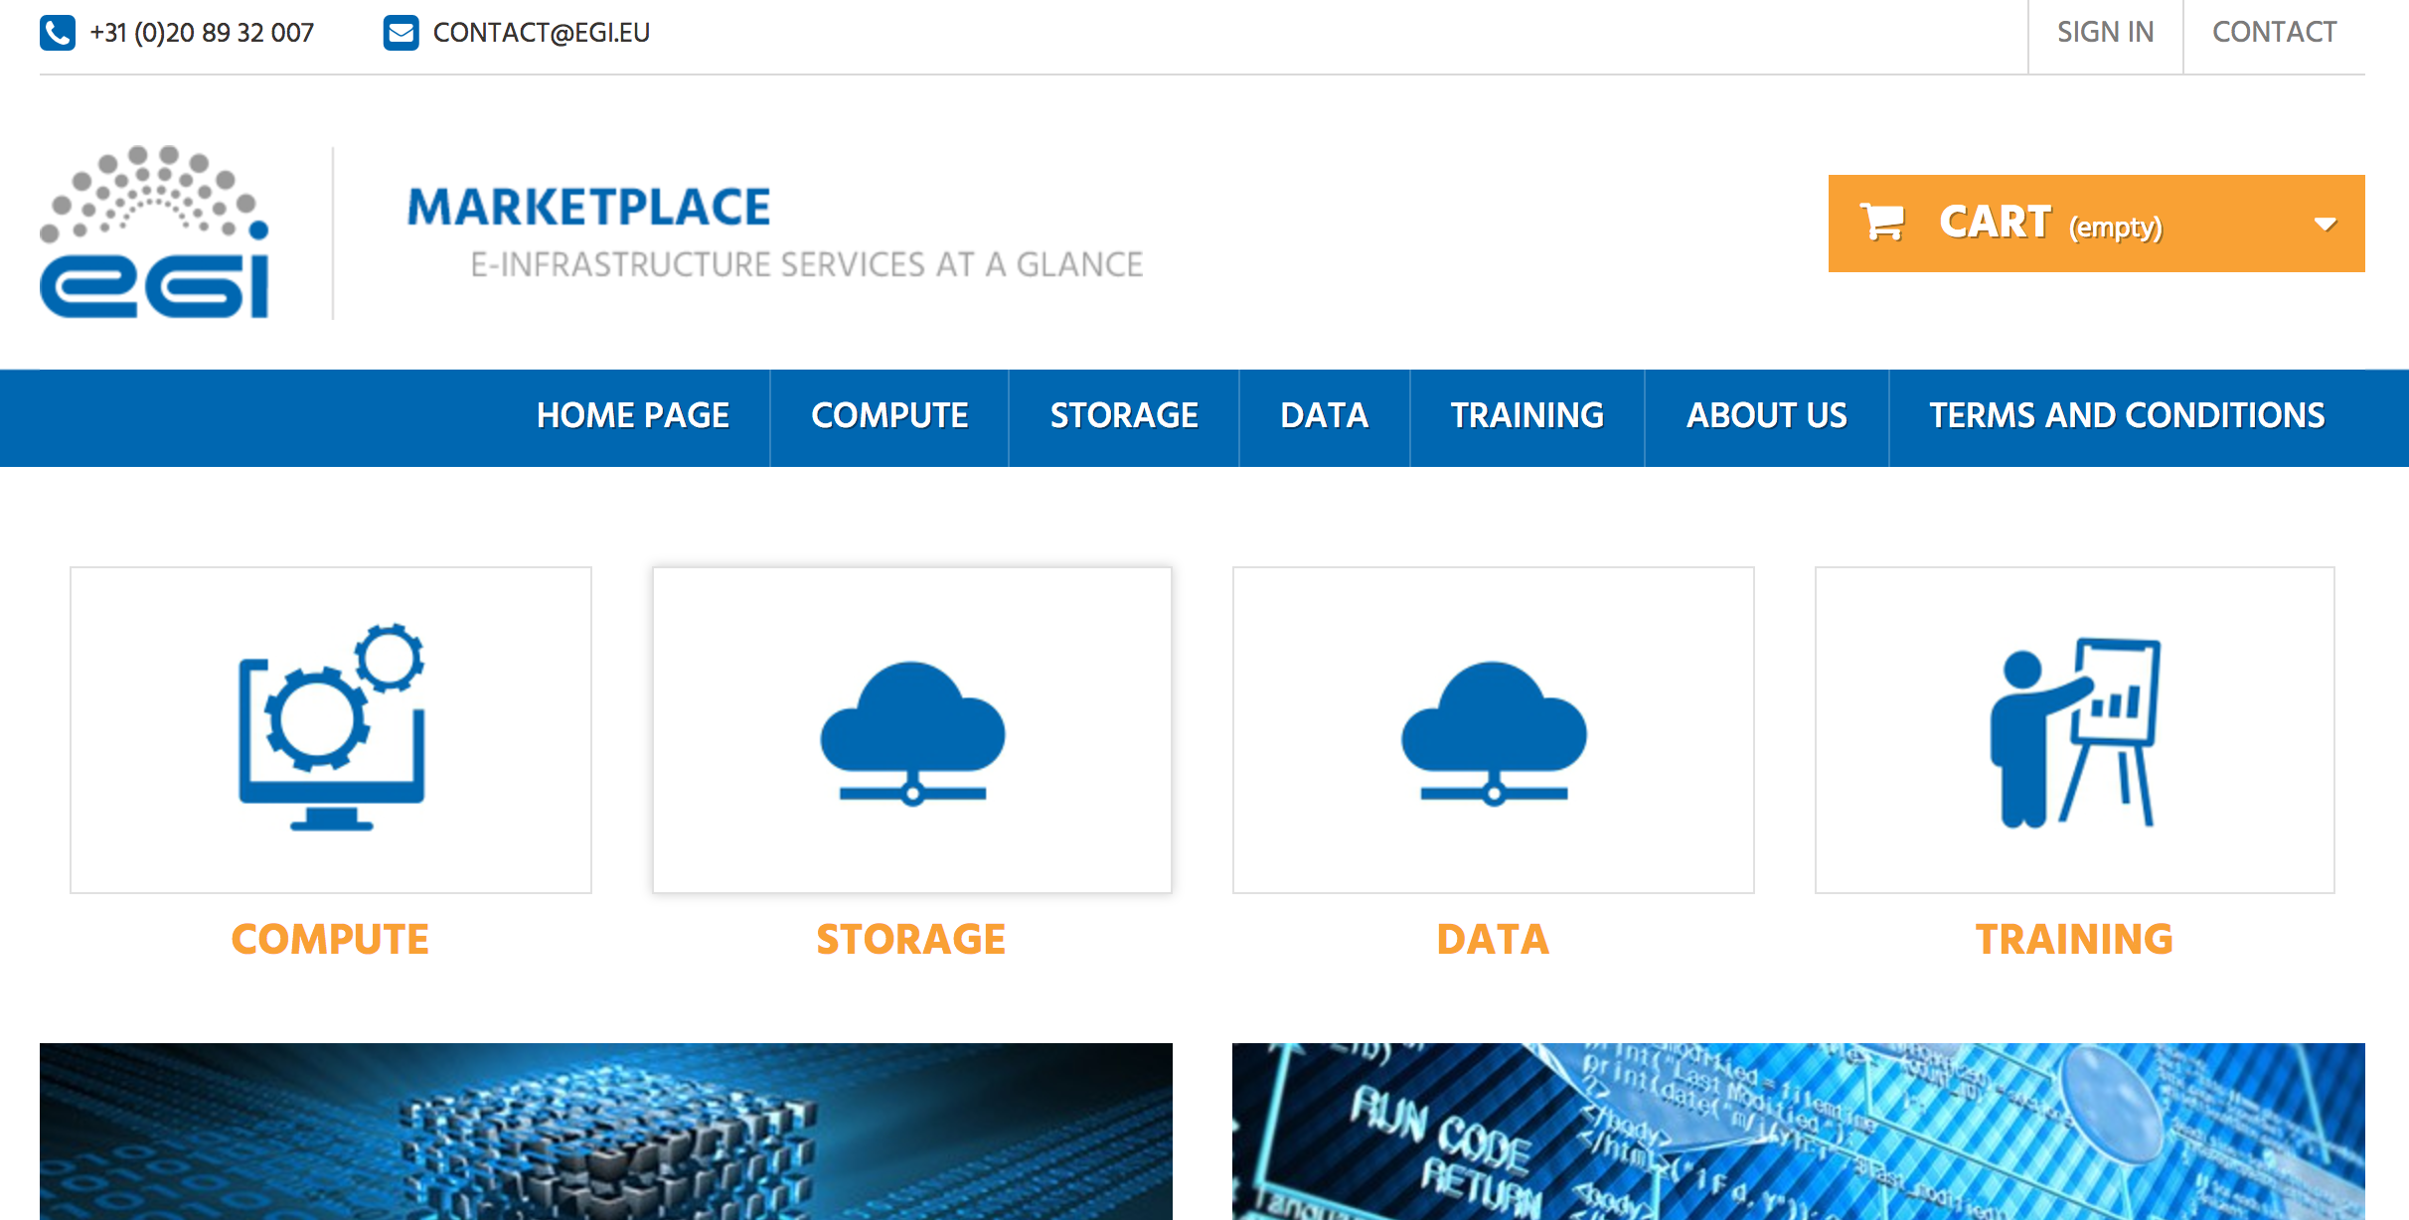
Relationship to other projects
EOSCPilot project: service catalogue activity
EINFRA-12.a:
EGI, EUDAT and Indigo-DataCloud are developing a joint proposal to address the current fragmentation of the data and computing e-Infrastructure landscape
Will reuse results from previous projects to develop a marketplace for the services
e.g. EGI-Engage developed a marketplace tool (prototype)
Federated authentication and user profiling
Service discovery
Order management (in progress)
SLA/OLA management (future)
Important to ensure synergies with related projects

Slide 18
Joint Service Catalogue and the e-Infrastructure Commons
From the e-IRG roadmap 2016 (http://e-irg.eu/roadmap)
“One way to combine different types of e-Infrastructures is to use the metaphor of a “marketplace” for the provision of a single access to all the services and tools”
“The marketplace can use among others … a searchable service catalogue …in this way users can have access to a one-stop-shop, i.e. a place where all eInfrastructure services are available, either directly accessible or redirected elsewhere”
The work on the Joint Service Catalogue can be an essential building block of the searchable catalogue for the e-Infrastructure Commons

Slide 19
Joint Service Catalogue and the European Open Science Cloud
“EOSC: federated, globally accessible environment where researchers, innovators, companies and citizens can publish, find and re-use each other's data and tools for research, innovation and educational purposes”
“P4: Frame the EOSC as the EU contribution to an Internet of FAIR Data and Services underpinned with open protocols”
“G4: Federate the gems”
https://ec.europa.eu/research/openscience/pdf/realising_the_european_open_science_cloud_2016.pdf
The work on the Joint Service Catalogue can be expanded to include the services of the EOSC that comply with the Rules of Engagement

Slide 20
Summary
Joint service catalogue for research
Integrated customer view of service offerings from multiple e-infrastructures providers
Simplify finding services
“e-Infrastructure Catalogue of Services”
Common conceptual service model
Alignment of language & thinking about services
eInfraCentral project
From concept to implementation
Future perspectives
Synergies/Interaction with related projects (e.g. EOSCPilot/EINFRA-12.a)
e-Infrastructure Commons
European Open Science Cloud

Slide 21
Many thanks to all who have contributed this work, in particular:
EGI: Sergio Andreozzi, Tiziana Ferrari, Sy Holsinger, Małgorzata Krakowian
EUDAT: Rob Baxter, Alexis Jean-Laurent, Johannes Reetz
GEANT: Annabel Grant, Matthew Scott, Andres Steijaert
OpenAIRE/BlueBRIDGE: Donatella Castelli, Pasquale Pagano
PRACE: Giovanni Erbacci
THOR project: Angela Dappert
EFIS: Alasdair Reid
MERIL: Julija Baginskaite, Ana Helman
FitSM: Owen Appleton
Thank you for your attention
sergio.andreozzi@egi.eu
@digitalities

