Slide 1
Introduction of EGI Jupyter Notebooks
Giuseppe La Rocca, EGI Foundation
Lecce, 9-13 July 2018

Slide 2
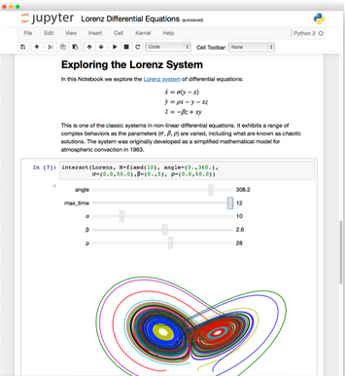
The Jupyter notebook in a nutshell
Open source, interactive platform for Data Science
Notebooks can be shared with others using email, Dropbox, GitHub
Interactive widgets
Favorite tool for:

Slide 3
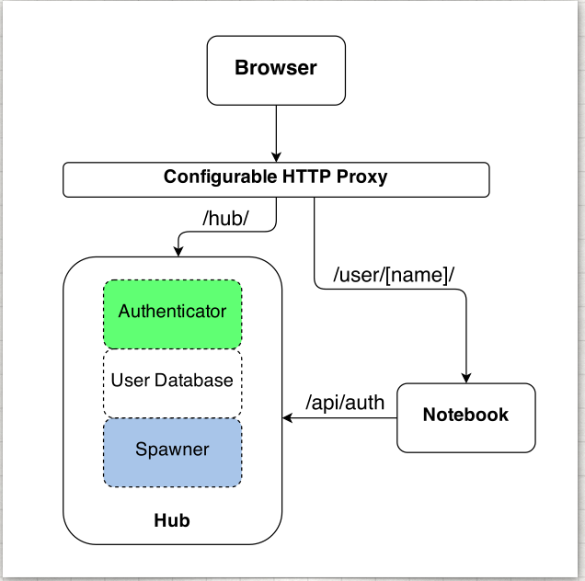
Jupyter vs. JupyterHub
Jupyter is single user by design
JupyterHub adds multi-user capabilities
Manages Authentication
Spawns single-users notebooks servers on-demand
Gives each user a complete Jupyter server

Slide 4
EGI Jupyter Notebooks
Offer Jupyter notebooks ‘as Service’
One-click solution, just login and start using
Extra EGI Features:
Login with the EGI AAI Check-In service
Persistent storage for notebooks
Bring your own environments/kernels
Use EGI computing and storage resources from your notebooks

Slide 5
Single Sign-On
Completely integrated with EGI Check-in
Login with eduGAIN, social (Google, Facebook, LinkedIn) or EGI SSO
Fine grained authorisation
VO membership
Role, group, …

Slide 6
Persistency
Persistent directory linked from home
User decides what to keep
NFS storage
Other files coming from the notebook environment
Looking into DataHub/Onedata

Slide 7
Custom kernels
Easy to extend with your own kernels
Docker container image with JupyterHub v0.8
No root user
Uses $HOME for notebooks
User select what to start when creating their notebooks

Slide 8
Service modes
Catch-all / The EGI Applications on Demand (AoD)
Available via the marketplace
Limited resources (computing + storage), sponsored access
Kills notebooks after 1 hour of inactivity
VO/Community deployment
Tailored to specific VO with custom computing/storage:
access to GPUs, fat nodes
access to Spark, other BigData/ML environments
auto-mount filesystems on notebooks
…

Slide 9
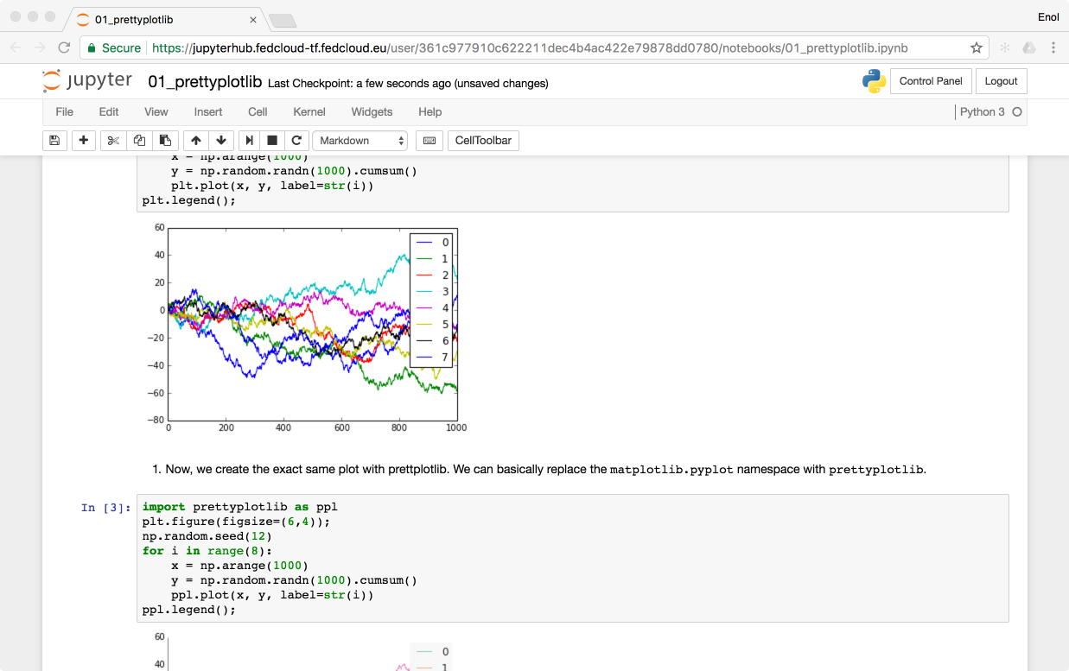
Technology Stack
https://envri-notebooks.fedcloud-tf.fedcloud.eu
Kubernetes @ EGI FedCloud site
k8s nodes
(private IPs)
Edge node
(public IP)
Oauthenticator
KubeSpawner
Kubernetes master
EGI AAI Check-In
NFS Persistent Volume Claims
Notes:
This is what we have now,
Kubernetes:
Scalable and industry tested
Runs on FedCloud and gives independence from the provider
Just needs some VMs and a single public IP per deployment
Can be provisioned with Ansible
Fine-grained control of resource-access for containers
Can impose limits on user resource consumption
Not just Jupyterhub
Can potentially be used to integrate other solutions (e.g. Spark)
New JupyterHub authenticator that allows to:
Use EGI CheckIn or EGI CheckIn dev as source for authentication
Define which claims should the user have in order to authorize (e.g. member of the LToS)
Kernels:
Default is just python, added Octave and SciLab
Storage:
Added hooks into JupyterHub Kubernetes Spawner to better support NFS server

Slide 10
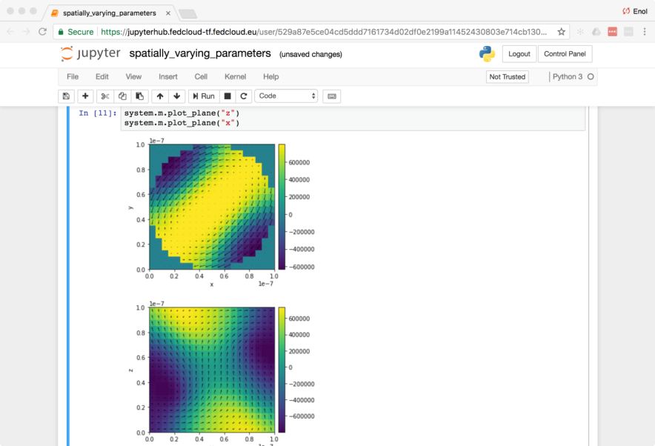
Status
Initial catch-all service deployment available as Alpha
Open for early adopter users
Deployed on CESGA cloud site as part of the EGI AoD
VO-specific deployment tests
For AGINFRA+ community
Binderhub experimental setup

Slide 11
Next Steps
Getting it to beta:
Prometheus Monitoring
Accounting
Performance Tuning
Explore additional features:
User provided environments with binder technology (https://mybinder.org)
Integration with other EGI/EOSC-hub services

Slide 12
Thank you for your attention! support@egi.eu

