Slide 1
Cost of Publicly-Funded Computing e-Infrastructures in Europe: the e-FISCAL Study
Sergio Andreozzi
Strategy and Policy Manager, EGI.eu
sergio.andreozzi@egi.eu

Slide 2
Outline
Project Objectives
Selection of cost assessment methodology
Main findings
Lesson learned

Slide 3
e-FISCAL: Main Objectives
Analyse the costs of the current European dedicated High Throughput and High Performance Computing (HTC/HPC) e-Infrastructures for research
Compare them with the closest equivalent commercial leased or on-demand offerings (i.e, public clouds)
Evaluate the findings through a report

Slide 4
Target Audience Example: European Grid Infrastructure (EGI)
Pan-European federated Infrastructure providing ICT services for digital research
Website: www.egi.eu
Resource Providers: 351 centres
Aggregated resources: 470,000 cores, 143PB disk, 138PB Tape
First-level federator at national level: National Grid Initiative (NGI)
Second-level federator at European level: EGI.eu (Dutch foundation)
Distributed research communities
Users: 21,714 grouped into 233 Virtual Organisations (VOs)
EGI.eu
NGI
NGI
NGI
e-FISCAL focus:
cost of computing services
Out of scope: other type of resources (e.g., data management), cost of EU-level federation
RC
RC
RC
RC
RC
RC
federator
infrastructure

Slide 5
Costing Methodologies
Therefore in our question “What is the cost ?” of the European dedicated High Throughput and High Performance Computing (HTC/HPC) e-Infrastructures for research
The answer to “Why do you want to know?” is multifaceted
What costing methodology better fits the mission?
Full Cost Accounting (FCA)
Total Cost of Ownership (TCO)
We want to know the annual total cost for planning, scenario development, governance models, assessing economies of scale, compare with cloud prices…

Slide 6
Constraints in the e-FISCAL Context
Organizations would not permit access to accounting books
Sensitive information – Reluctance to disclose
NDA with vendors
Lack of detailed cost accounting systems
Multiple independent funding sources
Focus is on cost of the total existing e-infrastructures and not on cash outlays
Consider also all resources consumed irrespectively of whether they are accounted or not
E.g.: a data center may not directly pay electricity as being provided/paid by the University

Slide 7
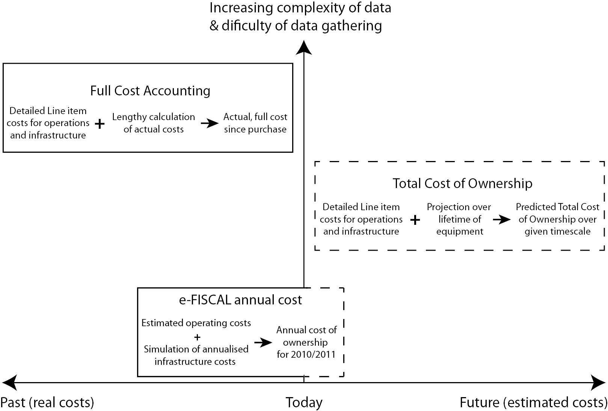
The e-FISCAL Approach

Slide 8
Advantages of the e-FISCAL Methodology
e-FISCAL model is a hybrid model that builds on FCA and TCO and adapts to real case constraints
Balance easiness of information collection with precision in results
Easy to apply
Only a few input requirements
Excel based
Web based application
Cost estimations precision
Not aiming at providing detailed costing data but is good enough to approximate cost
Suitable for cross site comparisons and cost assessments through time
Transparent and auditable
Suitable to perform sensitivity analysis
Possible to be used by stakeholders outside the organization

Slide 9
e-FISCAL - Steps
State of Art review and costing issues
Calculation, benchmarking, comparison with evidence, conclusions, findings
Development of cost model
Sample identification
Questionnaire development
Questionnaire dissemination/follow up/collection
efiscal.eu/state-of-the-art

Slide 10
Cost Categories Identification
Computing and storage hardware costs including interconnection costs
Auxiliary equipment costs (cooling, UPS, power generator)
Software costs
Personnel costs
Site operating costs
Connection costs
Other costs
CAPEX
Capital Expenditures
Expenditures incurred to create future benefits e.g. assets acquired have a useful life beyond one year. The cost is accounted for during the periods the assets are economically used through depreciation
CAPEX or OPEX ( in our case OPEX)
OPEX
Operating expenses
OpEx refers to expenses incurred in the ordinary course of business, such as salaries, administration and selling expenses, energy expenses, overhead, etc.
These expenses are considered costs when they incur.
http://www.efiscal.eu/survey

Slide 11
Sample/Respondents
28 respondents from 16 different countries
The vast majority of respondents provide both computing and coordination
Most of the data from HTC or mixed HTC/HPC centres
Sites affiliated to EGI members (46%)
Sites affiliated to PRACE members (10%)
only tier-1, no tier-0 for NDA constraints
Sites affiliated to both EGI and PRACE members (27%)
Other sites outside EGI and PRACE (17%)

Slide 12
e-FISCAL - Main Findings
 | Average | Median
CAPEX / OPEX ratio in 2011 | 27%-73% | 31%-69%
Personnel / Total costs in 2011 | 50% | 50%
Cost per core/hour in € in 2011 | 0,072 | 0,031
Cost per core in € in 2011 | 390 | 204
CPU useful lives | 5 | 5
Interconnect equipment | 10% of HW cost | 10% of HW cost
Software Cost | 4% of HW cost | 2% of HW cost
Salary in € in 2011 | 53K | 49K
Power Usage Effectiveness | 1,55 | 1,49

Slide 13
e-FISCAL - Main Findings
In-house HPC/HTC e-Infrastructures are cost-effective with high utilisation rates & depreciation
Depreciations rate 5y (literature suggests 3y)
However per application cost analysis is needed
Larger sites have in general less FTEs/core (economy of scale observable)
Small-scale benchmarking efforts between in-house and Amazon EC2 (www.efiscal.eu/final-workshop)
~40% performance degradation on Amazon Compute Cluster vs. in-house HPC
~27% performance degradation on Amazon vs. in-house HTC
Modest size HPC centres similar to state-of-the-art HTC ones

Slide 14
In-house Utilization vs. Amazon
e-FISCAL median at 30%=EC2 on demand
e-FISCAL median at 40%=1year EC2@60%
e-FISCAL median at 50%=1year EC2@80%
e-FISCAL average at 55%=EC2 on demand
e-FISCAL average at 75%=1year EC2@60%
e-FISCAL average at 90%=1year EC2@80%

Slide 15
e-FISCAL - Sustainability
We are preparing the final report
Will also include business models and pricing considerations
We have developed a web tool to support self-assessment
www.efiscal.eu/tools
We have launched a LinkedIn group on ICT cost assessment to continues discussions
linkd.in/VqEth0
Cost collection/estimation to continue in part through the EGI compendium
go.egi.eu/EGI-Compendium-2011
Consortium members can provide consultancy
efiscal.eu/contact

Slide 16
Lessons Learned
Not trivial gathering-estimating costs in a highly heterogeneous-federated environment!
Anonymity, confidentiality, overload, ...
And comparing with cloud prices
profit-margin, like-with-like comparisons, performance normalisation
Cost ≠ price and cost ≠ value
Moving to the Cloud a different exercise
Focus on avoidable costs – some evidence that personnel costs would not ant decrease so much
Successful engagement with policy makers and strategists crucial
16

Slide 17
Conclusion
e-FISCAL pioneer in costing computing e-Infrastructures
Assessing costs in a highly distributed-heterogeneous environment
Results are in line with literature
Costs show decreasing trends - not only for CAPEX but also for OPEX
Emerged issues:
Divergence in cost structures
Higher depreciation rate if compared to literature
FTEs/core and personnel costs: non-unanimous economies of scale existence
Indifference points for in-house utilisation vary a lot:
30-55% compared to Amazon EC2 standard on-demand instances, reserved ones competitive
15-27% compared to cluster compute on demand, 18-40% for reserved ones
No real personnel cost savings through Cloud?
17

Slide 18
Project acronym: e-FISCAL
Partners:
Athens University of Economy and Business - Greece
EGI.eu – The Netherlands
NUI Galway(ICHEC) – Ireland
Emergence Tech Ltd - UK
Contract n°: RI-283449
Project type: CSA-SA
Start date: 01/08/2011
Duration: 18 months (ended 31/1/2013)
Total budget: 392.523 €
Funding from the EC: 349 999 €
Total funded effort in PMs: 33.75
Web site: www.efiscal.eu
Sergio Andreozzi
Strategy and Policy Manager, EGI.eu
sergio.andreozzi@egi.eu

