Slide 1
Integrating and managing services for the European Open Science Cloud
Research Computational Infrastructures: Cloud infrastructures
Gergely Sipos, Giuseppe La Rocca
EGI Foundation

Slide 2
The trainers
Gergely.Sipos@egi.eu
Leading engagement and support for scientific communities
Coordinating training in EGI
Working with Research Infrastructures
Based in Budapest, Hungary
Giuseppe.LaRocca@egi.eu
Leads resource allocation to research communities
Cloud user support
Coordinates training in EOSC-hub
Based in Catania, Italy

Slide 3
Training goals
Learn the concept of cloud computing and EOSC
Understand the model and applicability of EGI cloud
Hands on practice with EOSC-hub and cloud services
EOSC-hub Catalogue
EGI Jupyter Notebook service (with R today)
See future possibilities with EOSC
Steps to become an active user

Slide 4
Outline
PART 1 (8:30-10:30)
GS: Introduction and cloud computing (presentation) (30’)
GS: Introduction to EGI and the EGI cloud infrastructure (30’)
Demo & exercise: Explore EGI services, Explore AppDB (30’)
GLR: The cloud-based EGI Notebooks service (presentation) (30’)
BREAK (30’)
PART 2 (11:00-13:00’)
Intro to hands-on exercise 1 (10’)
Hands-on exercise 1 – Download and plot temperature data
Intro to hands-on exercise 2 (10’)
Hands-on exercise 2 – Add rainfall data
GS: The future of compute infrastructures in Europe: EOSC (30’)
Next steps to become a user (15’)
Feedback forms
Notes:
Possible buffer exercise for the quick ones:
VM management with VMOps dashboard ?
Porting one of the earlier exercises to Jupyter R?

Slide 5
Introduction to cloud computing

Slide 6
Cloud computing & Key terms
Services and solutions delivered and consumed as utilities over the Internet
Applications, Databases, File systems, Email, CRM, etc.
(Some of the) benefits
Lower computer and software cost
Instant software updates
‘Unlimited storage/CPU’ power
Predictable costing (metering by the hour / day / TB / …)
Lot of open source tools to build&use clouds
Job
Job
Job
Job manager
Storage volume
OS
Virtual Machine
Block storage
Hardware (multi-CPUs)
App
Storage volume
Storage volume
Storage volume
HTC cluster stack
OS
App
App
App
OS
Job
Job
Job
Cloud management framework
Misddleware
Storage volume
Hardware
Job
Job
Job
Hardware (multi-CPUs)
OS
Misddleware
Storage volume
Job
Job
Job
Storage volume
Local stack
OS
Hardware (multi-CPUs)
Misddleware
Virtualized Stack
Hardware (multi-CPUs)
OS
Hardware (multi-CPUs)
HTC grid stack
Notes:
Replcate second VM with an Object storage on the last diagram

Slide 7
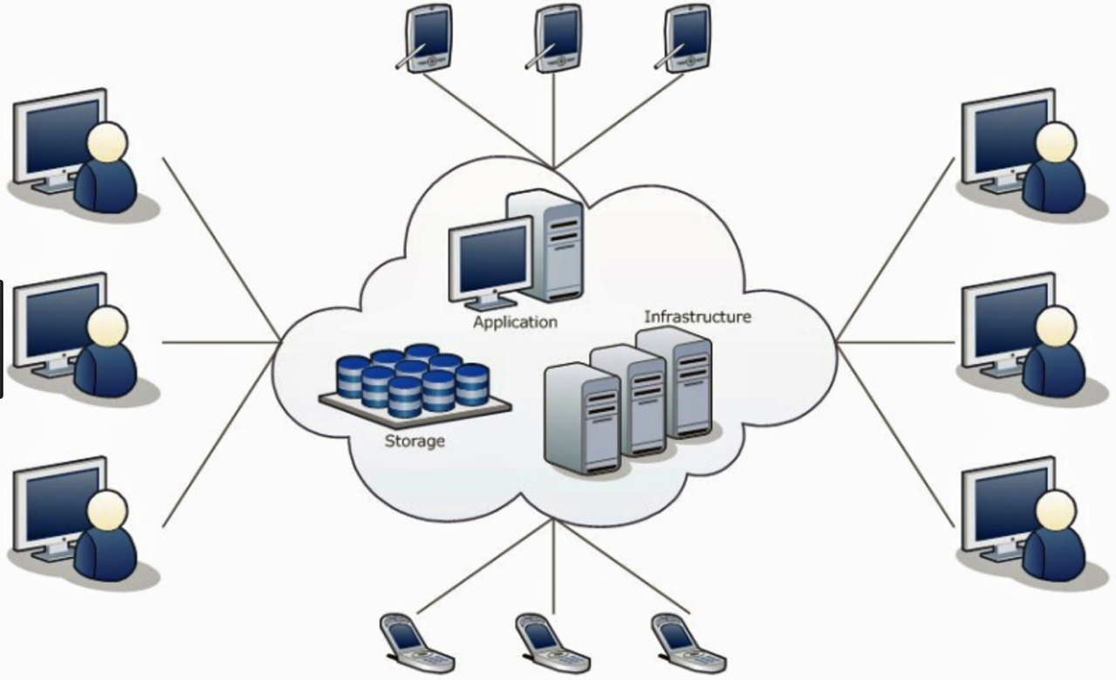
Cloud computing architecture

Slide 8
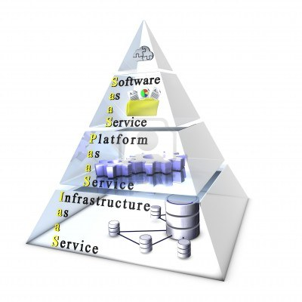
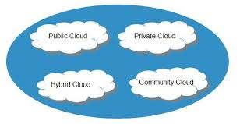
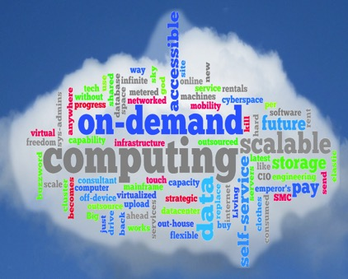
Why cloud: Freedom of choice and flexibility
Service models:
Software as a Service (SaaS)
Platform as a Service (PaaS)
Infrastructure as a Service (IaaS)
Deployment models:
Private Cloud
Public Cloud
Hybrid Cloud
Community Cloud
Main characteristics:
On demand self-service
Broad network access
Resource pooling
Rapid elasticity
Measured service
Notes:
On-demand self-service. A consumer can unilaterally provision computing capabilities, such as server time and network storage, as needed automatically without requiring human interaction with each service provider.
Broad network access. Capabilities are available over the network and accessed through standard mechanisms that promote use by heterogeneous thin or thick client platforms (e.g., mobile phones, tablets, laptops, and workstations).
Resource pooling. The provider's computing resources are pooled to serve multiple consumers using a multi-tenant model, with different physical and virtual resources dynamically assigned and reassigned according to consumer demand.
Rapid elasticity. Capabilities can be elastically provisioned and released, in some cases automatically, to scale rapidly outward and inward commensurate with demand. To the consumer, the capabilities available for provisioning often appear unlimited and can be appropriated in any quantity at any time.
Measured service. Cloud systems automatically control and optimize resource use by leveraging a metering capability at some level of abstraction appropriate to the type of service (e.g., storage, processing, bandwidth, and active user accounts). Resource usage can be monitored, controlled, and reported, providing transparency for both the provider and consumer of the utilized service.
- Software as service: finished application that you “rent” and customize: ie email
Platform as a service: developer platform that abstracts the infrastructure, OS and middleware to drive developer productivity
Infrastructure as a service: deployment platform that abstracts infrastructure
BUSINESSES CAN PICK AND CHOOSE SERVICE + DEPLOYMENT MODELS TO BETTER SERVE THEIR NEEDS

Slide 9
Key terms explained
We will talk about this today with Jupyter
Virtual Machine
SaaS: Offering applications as a service
App
Storage volume
Virtual Machine
App
Storage volume
OS
PaaS: Offering appl. development as a service
OS
Cloud management framework
IaaS: Offering VM management as a service
Hardware
Virtualized Stack
Sitting on a file system
Living in the cloud
Software Appliance
Virtual Appliance
VM instance
Configured and ready to access via the Internet
VM image
Meta data
Contextualisation script
Start in a cloud
What to provide
How to start
Notes:
Replace below the VM instance with the same graphics that’s used above (orage box with content)

Slide 10
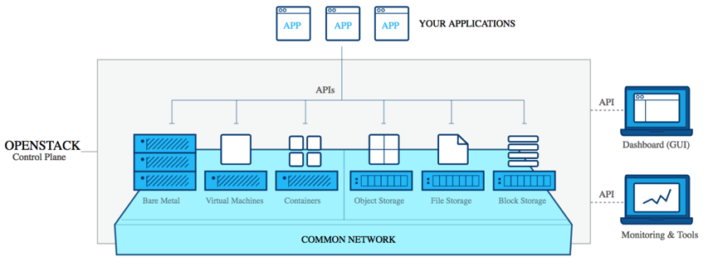
Examples
Cloud technology
Vs.
Cloud service
Open source set of software tools for building and managing cloud computing services. - “Cloud operating system”
Consists of 46 projects/tools (growing)
Primarily deployed as an infrastructure as a service (IaaS) solution
Managed by the OpenStack Foundation.
More than 200 companies have joined, including Dell, Intel, Red Hat and Oracle
A set of online services: over 600, covering IaaS, PaaS, SaaS
Provided from data centres at 21 locations worldwide
Compute, storage and data, mobile, messaging, media, content delivery network, machine learning, ...
Interact via REST/HTTP/XML APIs; MS Visual Studio/Git/Eclipse integration; Azure Portal
Pay-as-you-go (per minute billing)
‘Azure for research’ programme (grants, online exercises, f2f training, etc.)
Notes:
Backed by many companies, open-source, exciting, extremely vibrant INTERNATIONAL community.
Open source, many projects, on compute, networking, vm’s etc etc etc.
Even openstack ironic (early stages ) to manage bare metal,
There are others, (opennebula, eucalyptus, etc, but none have development or backing like openstack)

Slide 11
Comparison of computing approaches
High-Throughput (Yesterday) | IaaS cloud compute | PaaS cloud; SaaS cloud | Container compute | Serverless computing
For batch compute “jobs” Jobs must be grid-enabled Best suitable for ‘embarrassingly parallel’ applications Easy to span across multiple data centres Typically pre-compiled, small jobs Comes with a job scheduler | For compute/data-intensive tasks and to host online services Both batch and interactive computing Flexibility with SW and operating system Easily to scale up (typically within one data centre) VMs can be massive (GBs) Does not include a job scheduler (IaaS) | PaaS: application development SaaS: Web/mobile application use | More lightweight than VMs Portable from laptops to supercomputers Less isolation Still too technical | Focus on application logic Deploy your code into ‘function’ Container provisioning by public cloud provider (e.g. AWS Lambda)

Slide 12
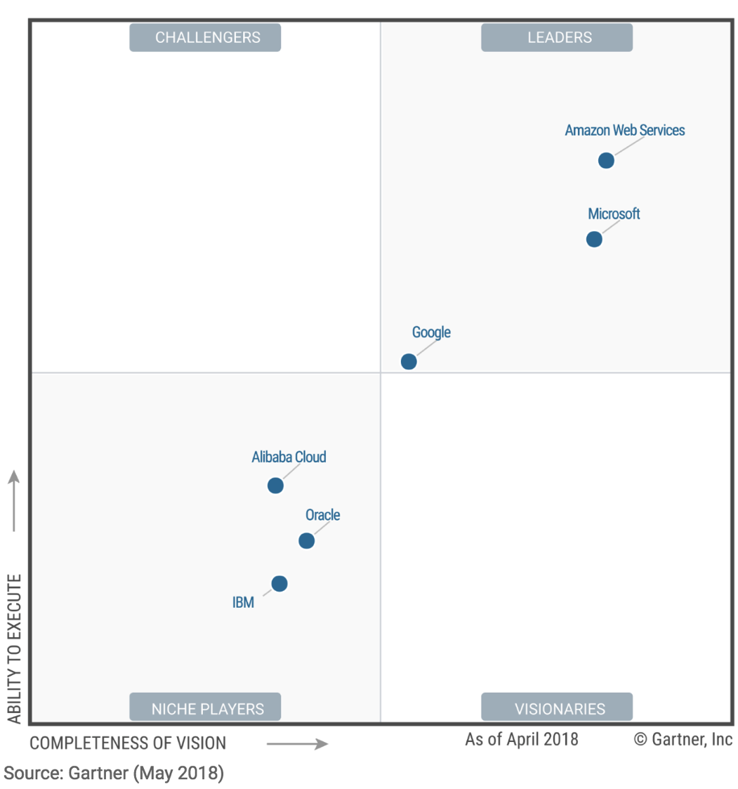
Public IaaS clouds Garner’s Magic Quadrant

Slide 13
A few words about EGI

Slide 14
EGI: Advanced Computing for Research
Notes:
A globally distributed ICT infrastructure that federates the digital capabilities, resources and expertise of national and international research communities in Europe and worldwide.
EGI has delivered unprecedented data analysis capabilities to more than 48,000 researchers from many disciplines and is now committed to bring innovation to the private sector.

Slide 15
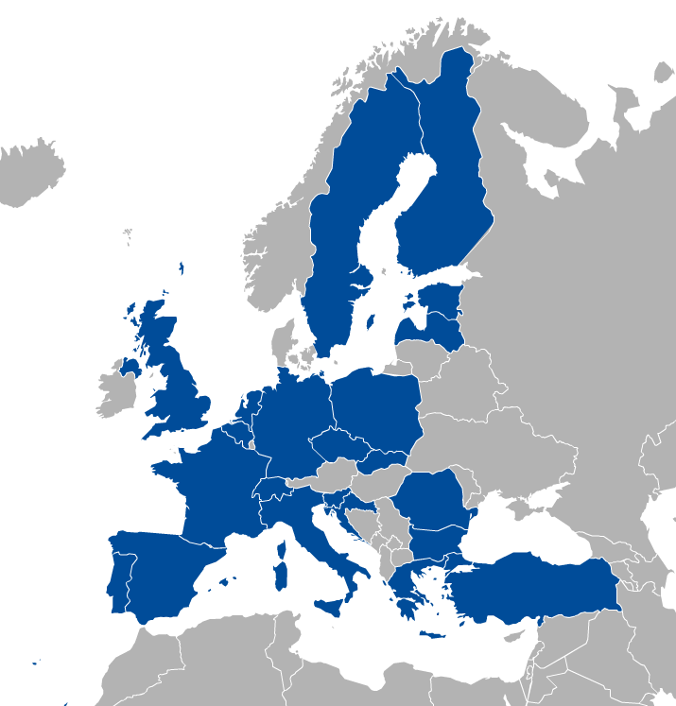
EGI: Federation of national e-infrastructures
Established in 2010
EGI Foundation: Coordinator (Amsterdam, Science Park)
NGIs: National e-infrastructures (22 country + CERN)
Membership fees sustain the federation; Projects innovate (e.g. EOSC-hub)
EGI = Compute, Storage, Data, Training, Consultancy services
Institutional representatives

Slide 16
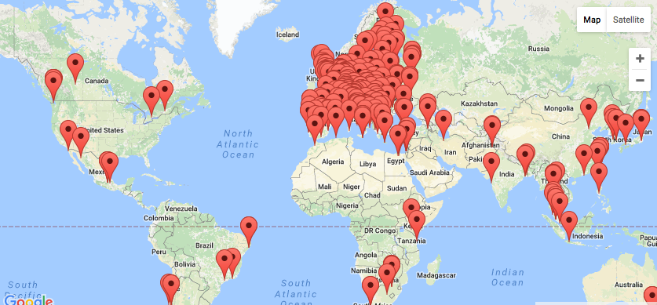
EGI Federation Largest distributed compute e-Infrastructure of the world
EGI Foundation (Amsterdam)
300+ HTC providers
25 Cloud providers
650k CPU cores
285 PB online storage
1.7 Million jobs/day
2.6 Billion CPU hours/year
240 Virtual Organisations
>48 000 users

Slide 17
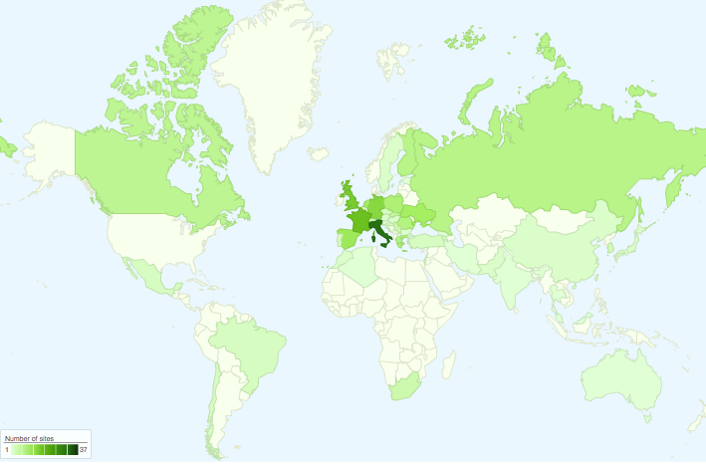
International Partnerships
Canada
China Inst. Of HEP
Chinese Academy
of Sciences
USA
India Centre for
Development of
Advanced Comp.
Africa and Arabia
Council for Scientific and
Industrial Research, South Africa
Asia Pacific Region
Academia Sinica
at Taiwan
Latin America
Universida de Federal do
Rio de Janeiro
Ukraine
Ukrainian National
Grid

Slide 18
EGI serves researchers and innovators
Size of individual groups
WLCG
ELI
CTA
ELIXIR
EPOS
BBMRI
INSTRUCT
CLARIN
EISCAT_3D
DARIAH
LOFAR
LifeWatch
ICOS
EMSO
CORBEL
ENVRIplus
…
VRE projects
OpenDreamKit
WeNMR
DRIHM
VERCE
MuG
AgINFRA
CMMST
LSGC
SuperSites Exploitation
Environmental sci.
neuGRID
…
PeachNote
CEBA Galaxy eLab
Semiconductor design
Main-belt comets
Quantum pysics studies
Virtual imaging (LS)
Bovine tuberculosis spread
Convergent evol. in genomes
Geography evolution
Seafloor seismic waves
3D liver maps with MRI
Metabolic rate modelling
Genome alignment
Tapeworms infection on fish
…
Agroknow
CloudEO
CloudSME
Ecohydros
gnubila
Sinergise
SixSq
TEISS
Terradue
Ubercloud
…
ESFRIs, FET flagships
Multinational communities, (e.g. H2020 projects)
Industry, SMEs
‘Long tail of science’

Slide 19
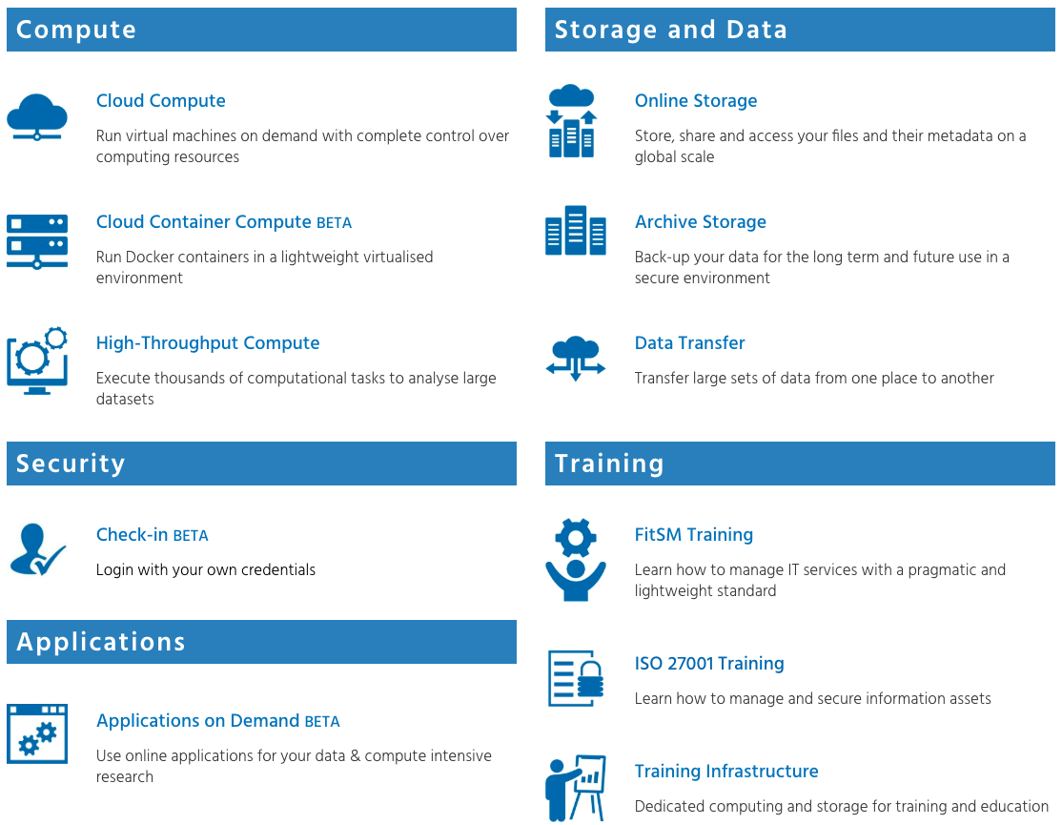
The EGI Service Catalogue
www.egi.eu/services
‘Traditional’ combination

Slide 20
EGI HTC grew out of the WLCG

Slide 21
HTC in practice: WLCG

Slide 22
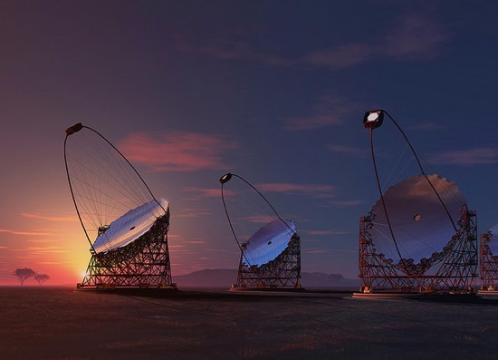
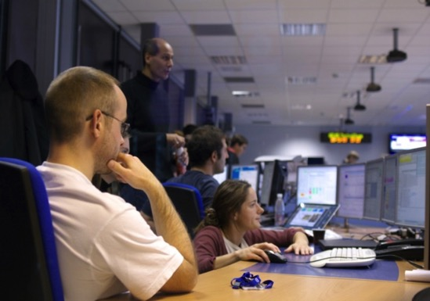
Example for HTC-Online storage use Cherenkov Telescope Array -
the world’s leading gamma-ray observatory
1350 scientists from 32 countries
14HTC sites in 7 countries
30.000 logical CPUs (shared with other VOs)
100s of TB storage
CTA EGI usage (2013-2016):
360 million HS06 CPU hours
11 PB of data transferred
2 PB currently in storage
11 million compute jobs
Credit: Akihiro Ikeshita Mero-TSK
CTA used EGI’s High-Throughput Compute and Online Storage services to manage its computational challenges during the array preparatory phase. http://go.egi.eu/cta

Slide 23
The EGI Service Catalogue
www.egi.eu/services
Used today by Jupyter

Slide 24
Introduction to EGI cloud

Slide 25
EGI Cloud Federation
Multi-cloud IaaS with Single Sign-On via Check-in
Technology agnostic, supports OpenStack, OpenNebula and Synnefo
Extra features
Virtual Appliance catalogue
Unified GUI dashboard
Centralised accounting
Resource discovery
SLA monitoring
Higher level SaaS services built on top
Jupyter Notebooks
Container
Compute
Online
Storage
Applications on Demand
Training
Infrastructure

Slide 26
What is a cloud federation? – A ‘definition’
Practice of interconnecting cloud service providers. Motivations:
Data locality; Data privacy; Shared investment; Distributed expertise, …
Multiple cloud sites with interconnection(s). For example:
Every cloud is registered in a single catalogue
Shared VM image catalogue and image formats
Automated distribution of VM Images to cloud sites
Single sign-on for users
Harmonised operational practices
Cloud configurations, integrated monitoring, accounting, etc.
Integrated support model
Ticketing system, consultancy, training
EGI Cloud can do all this → EGI Federated Cloud

Slide 27
The IaaS infrastructure
20 resource centres
15 OpenStack
4 OpenNebula
1 Synnefo
5 centres under integration
2 centres expressed interest on joining

Slide 28
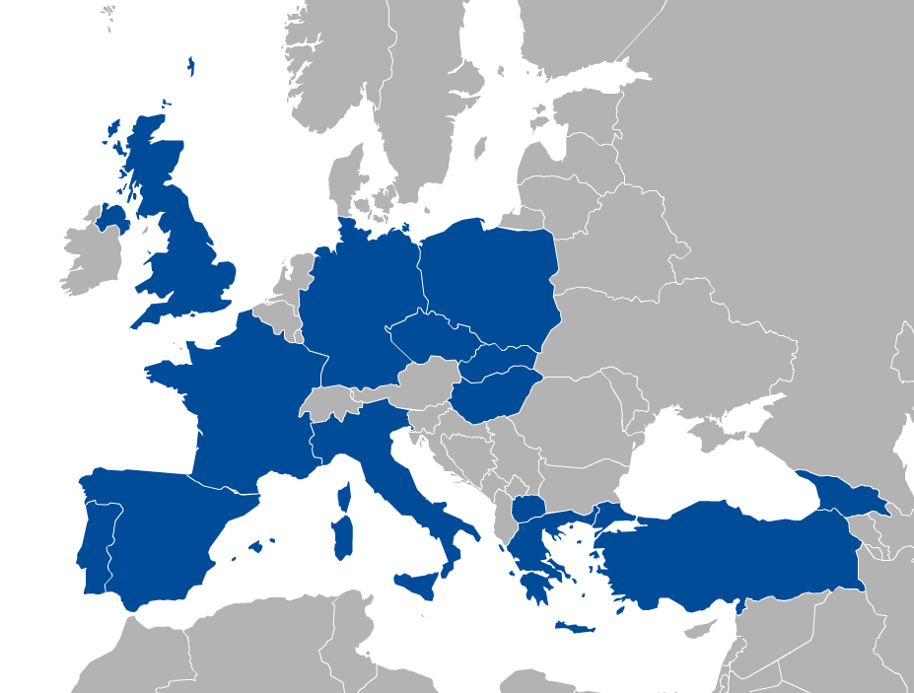
EGI Cloud Compute IaaS
Run Virtual Machines on demand
Similar to AWS EC2/EBS or GCP Compute Engine
Access is based on ‘Virtual Organisations’
VO = group of users + cloud providers supporting them
Community-specific VOs – e.g. CHIPSTER, EISCAT, etc.
Generic VOs – e.g. fedcloud.egi.eu, training.egi.eu
Diverse providers with common:
AuthN and AuthZ
VM Image catalogue (applications)
Information discovery
Accounting
Monitoring
GUI dashboard
VO 1 (cloud a, b, c)
VO 2 (cloud b, c,
d, e,f)
a
b
c
d
e
f

Slide 29
IaaS concepts
Object Storage
Persistent,
HTTP access
Immutable representation of OS and applications
Software Appliance
Virtual Appliance
Start in a cloud
VM instance
VM image
Meta data
Configured and ready to be used
Contextualization script
Attach
What to provide
How to start
Block Storage
Persistent even when VM disappears

Slide 30
Typical use case: Sharing community applications The CHIPSTER example
Analysis software contains over 300 analysis tools for NGS, microarray, proteomics and sequence data.
Bioinformaticians
Clouds of the Chipster Virtual Organisation
VM
Block storage
Chipster portal
Cache
VM
Cache
Cloud calls (CMD/API)
VM
VM
Block storage
Prepare, register VM image
Appliances Marketplace (AppDB)
Virtual Appliances of the Chipster VO
Chipster VM
Push VM image
Cache
VM
Chipster developer (CSC, Finland)
Cache
VM
Read more...
Notes:
Remark: The Virtual Appliances Catalogue does not store physically the VMs. It stores only references and metadata about the VMs. The VMs are physically stored elsewhere – e.g. third party HTTP server, EGI Repository

Slide 31
Manage VMs via AppDB VMOps https://dashboard.appdb.egi.eu/
Complete Check-in integration
Wizard-like creation of VMs
Single dashboard for all providers

Slide 32
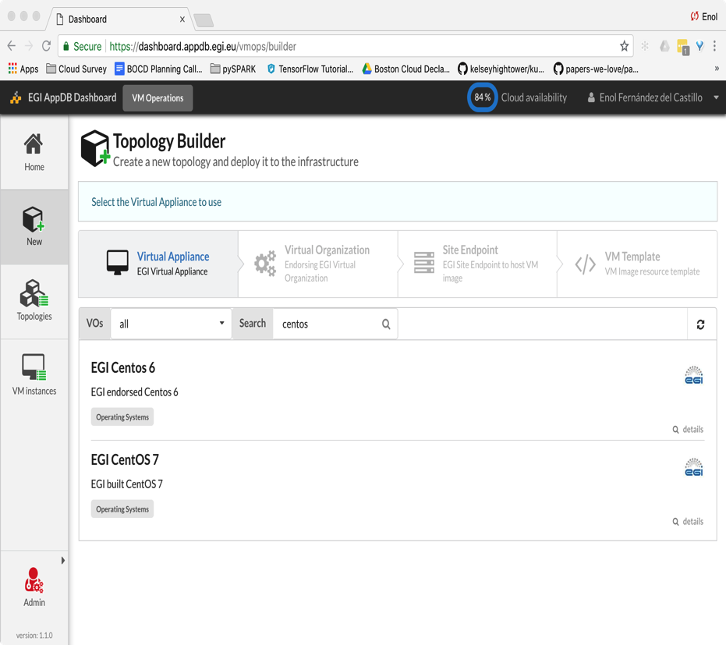
Wizard for starting VMs
Select your VA
Filter to easily find the right appliance

Slide 33
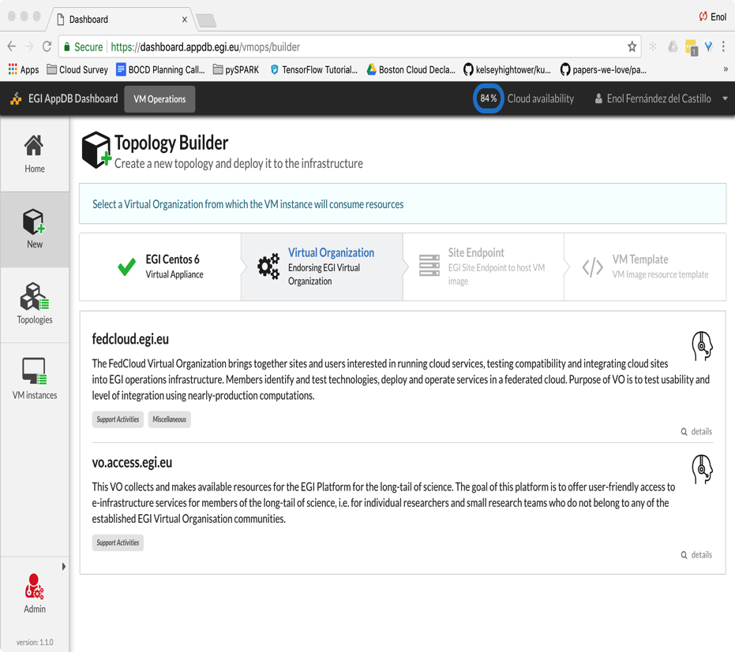
Wizard for starting VMs
Select your VA
Select your VO
VMOps will only show the VO you’re member of

Slide 34
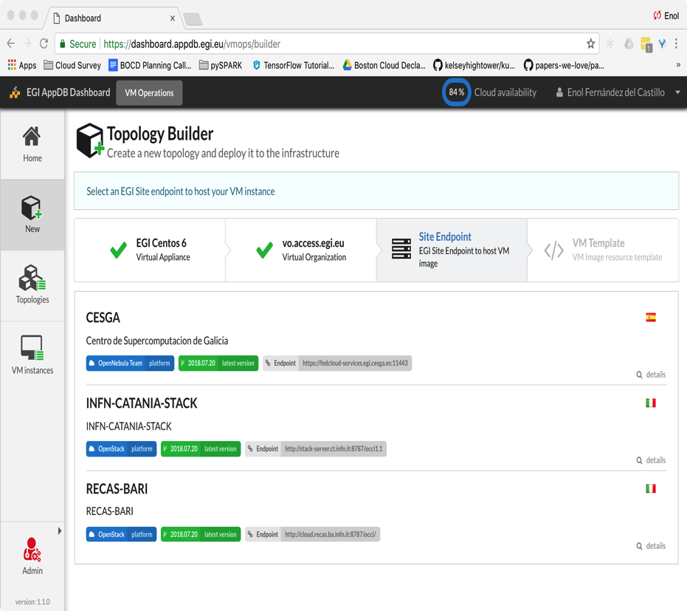
Wizard for starting VMs
Select your VA
Select your VO
Select the provider
Providers with issues or in downtime are disabled

Slide 35
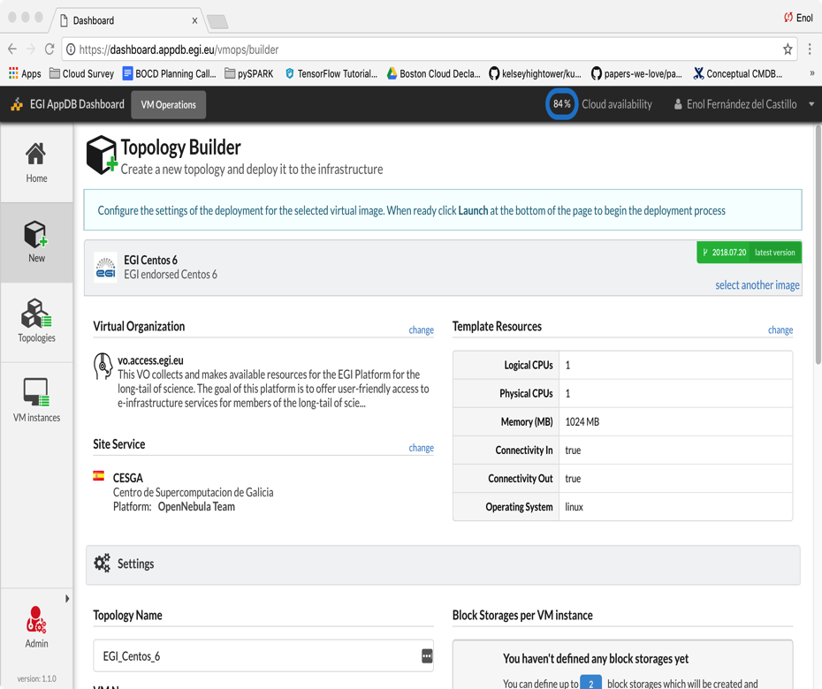
Wizard for starting VMs
Select your VA
Select your VO
Select the provider
Finalise configuration and deploy

Slide 36
Manage VMs via AppDB VMOps
Global management of VMs
Topologies are a set of related VMs
GGUS integration
Individual management of VMs

Slide 37
Summary – Comparing compute infrastructures
HTC Grid (e.g. OSG or EGI HTC) | Commercial clouds (e.g. Azure, AWS, GCE) | EGI cloud (federated IaaS cloud)
For batch computing For embarrassingly parallel applications Using multiple sites at a time Virtual Organisation based access | For interactive and batch computing For service hosting Flexible OS and application use Typically one site is used Pay-as-you-go No user support (or central paid service) | For interactive and batch computing For service hosting Flexible OS and application use Use single or multiple sites at a time Virtual Organisation based access Free at the point of use (for research) With local user support
Notes:
Add to commercial sevice: Broader set of services

Slide 38
EGI Notebooks
Jupyter as a Service in the EGI Cloud
Presentation
Hands-on

Slide 39
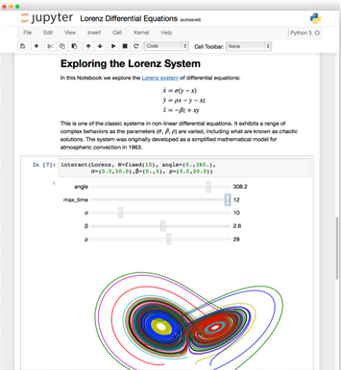
The Jupyter Notebook in a nutshell
Non-profit, open-source, interactive platform for Data Science born out of the iPython project in 2014
Released under the BSD license
Notebooks can be shared with others using email, Dropbox, GitHub
Interactive widgets

Slide 40
Some key features
Language of choice
The Notebook has support for over 40 programming languages, including Python, R, Julia and Scala
Share notebooks
Notebooks can be shared with others using email, Dropbox, GitHub and the Jupyter Notebook Viewer
Interactive output
Your code can produce interactive output: HTML, images, videos, LaTeX, and custom MIME types
Big data integration
Leverage big data tools, such as Apache Spark for Python, R and Scala.

Slide 41
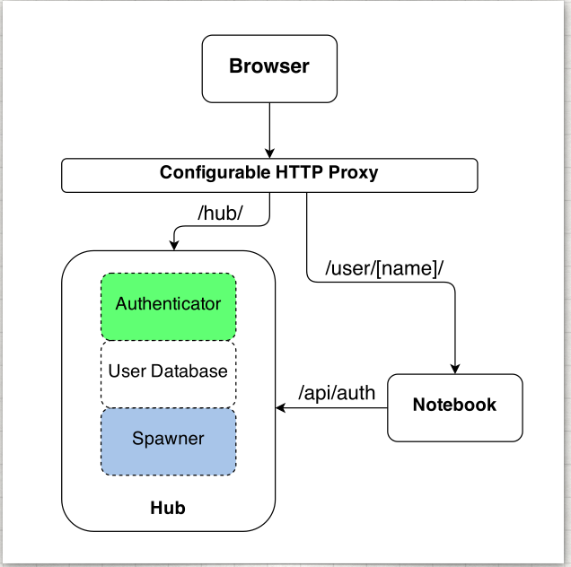
Jupyter is single user by design
JupyterHub is a multi-user version of notebook designed for companies, classrooms and research labs
JupyterHub capabilities:
Manages Authentication
Spawns single-users notebooks servers on-demand
Gives each user a complete Jupyter server
Notes:
If you are a company or an organisation like EGI

Slide 42
The EGI Jupyter Notebooks
Offer Jupyter notebooks ‘as Service’
One-click solution, just login and start using
Extra EGI Features:
Login with the EGI AAI Check-In service
Persistent storage for notebooks
Bring your own environments/kernels
Use EGI computing and storage resources from your notebooks

Slide 43
Key features: Single Sign-On
Completely integrated with EGI Check-in
Login with eduGAIN, social (Google, Facebook, LinkedIn) or EGI SSO
Fine grained authorisation
VO membership
Role, group, …

Slide 44
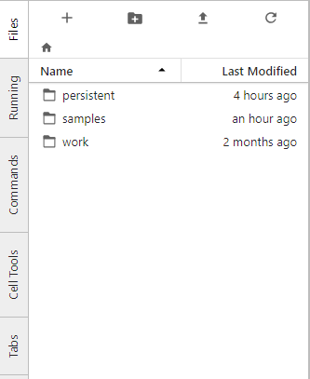
Key features: Persistency
Persistent directory linked from home
User decides what to keep
NFS storage
Other files coming from the notebook environment
Looking into DataHub/Onedata

Slide 45
Key features: custom kernels
Easy to extend with your own kernels
Docker container image with JupyterHub v0.8
No root user
Uses $HOME for notebooks
User select what to start when creating their notebooks

Slide 46
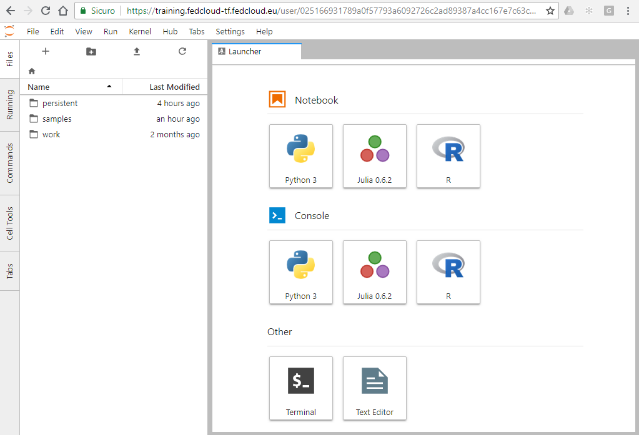
The Jupyter notebook control panel
Launch your notebook with the desired Kernel

Slide 47
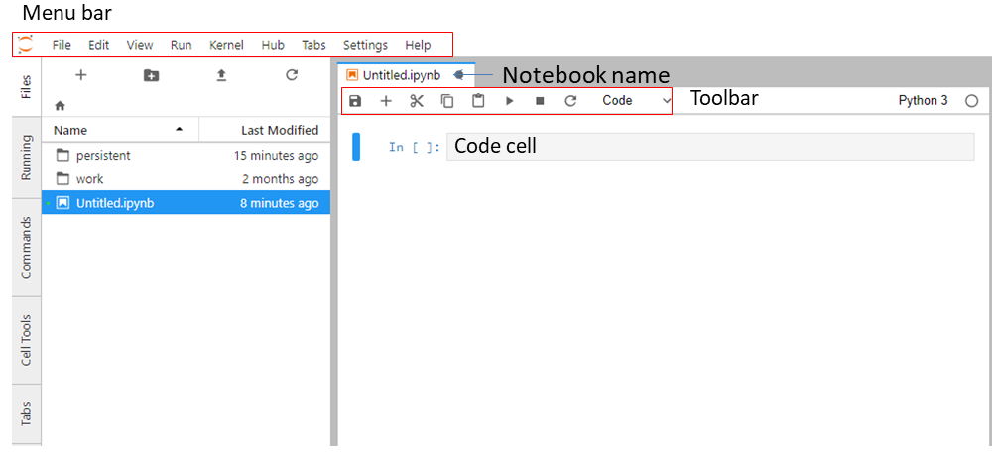
The Jupyter notebook control panel
Menu bar: The menu bar presents different options that may be used to manipulate the way the notebook functions.
Toolbar: The tool bar gives a quick way of performing the most-used operations within the notebook, by clicking on an icon.
Cell: the notebook cell
Notes:
When you start your notebook you create a new .ipynb file

Slide 48
Structure of a notebook
The notebook consists of a sequence of cells.
A cell is a multiline text input field
The execution behaviour of a cell is determined by the cell’s type.
There are three types of cells: Code, Markdown, and Raw cells.
Code cells allow you to edit and write new code, with full syntax highlighting and tab completion.
The programming language you use depends on the kernel
Markdown cells allow to alternate descriptive text with code
Raw cells provide a place in which you can write output directly. Raw cells are not evaluated by the notebook

Slide 49
Shortcuts
The essential shortcuts to remember are the following: Shift-Enter: run cell.
Execute the current cell, show any output, and jump to the next cell below. If Shift-Enter is invoked on the last cell, it makes a new cell below. This is equivalent to clicking the Cell, Run menu item, or the Play button in the toolbar.
Esc: Command mode.
In command mode, you can navigate around the notebook using keyboard shortcuts.
Enter: Edit mode.
In edit mode, you can edit text in cells

Slide 50
Service modes
Catch-all / The EGI Applications on Demand (AoD)
Available via the marketplace
Limited resources (computing + storage), sponsored access
Kills notebooks after 1 hour of inactivity
VO/Community deployment
Tailored to specific VO with custom computing/storage:
access to GPUs, fat nodes
access to Spark, other BigData/ML environments
auto-mount filesystems on notebooks
…

Slide 51
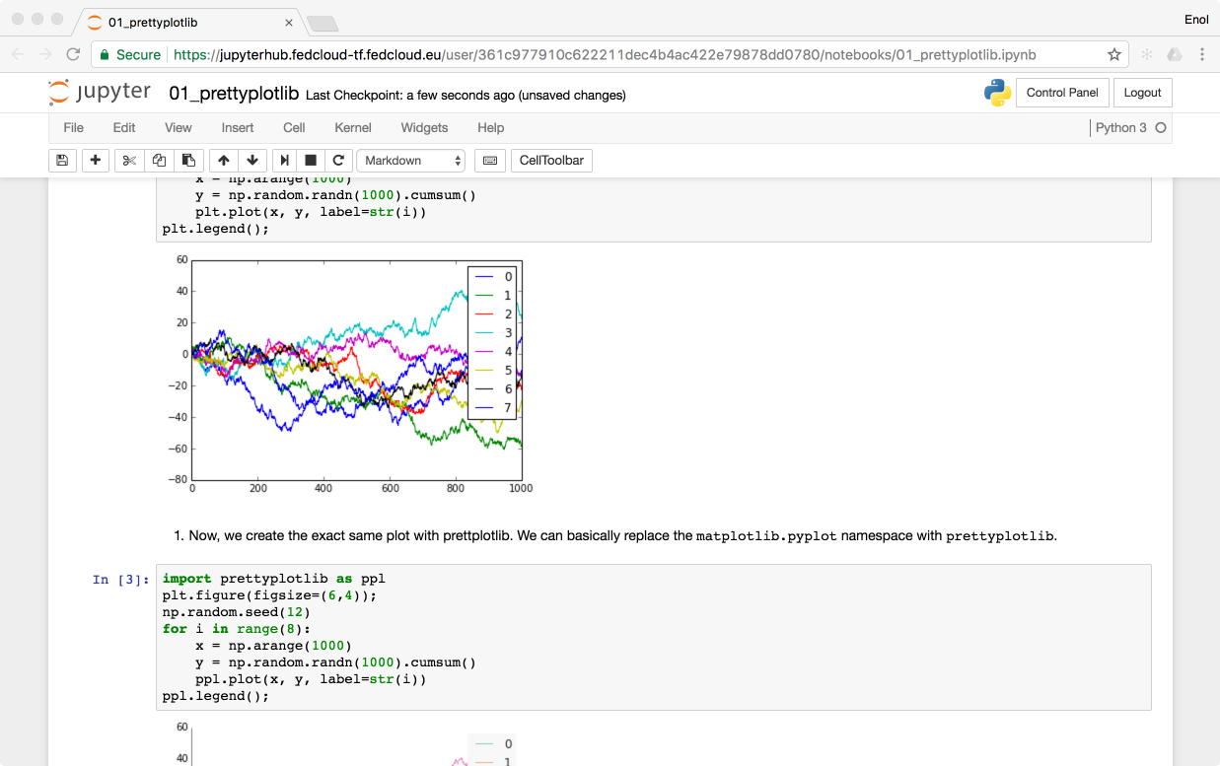
Technology Stack
https://training.fedcloud-tf.fedcloud.eu
Kubernetes @ EGI FedCloud site
k8s nodes
(private IPs)
Edge node
(public IP)
Oauthenticator
KubeSpawner
Kubernetes master
EGI AAI Check-In
NFS Persistent Volume Claims

Slide 52
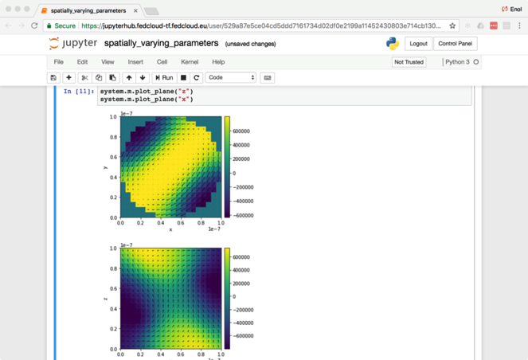
Status
Initial catch-all service deployment available as Alpha
Open for early adopter users
Deployed on CESGA and INFN-CATANIA-STACK cloud sites as part of the EGI AoD service
VO-specific deployment tests
For AGINFRA+ community
Binderhub experimental setup

Slide 53
Next Steps
Getting it to beta:
Prometheus Monitoring
Accounting
Performance Tuning
Explore additional features:
User provided environments with binder technology (https://mybinder.org)
Integration with other EGI/EOSC-hub services

Slide 54
Links
JupyterHub tutorial
Documentation of JupyterHub | PDF (latest)
Documentation of JupyterHub’s REST API
Project Jupyter website
The EGI Jupyter notebook | wiki

Slide 55
EGI Jupyter Notebook
CODA-RDA 2018
Lab session
Download datasets (e.g. temperature) from the Climate Change Knowledge Portal (CCKP) and calculate and plot the average monthly temperature
Add the second datasets (e.g. rainfall) and calculate and plot the average monthly rainfall

Slide 56
The future of research compute infrastructructures in Europe
The European Open Science Cloud (EOSC)

Slide 57
EOSC - Problem statement
How to maximise the incentives for sharing data and to increase the capacity to exploit them?
How to ensure that data can be used as widely as possible, across scientific disciplines and between the public and the private sector?
How better to interconnect the existing and the new data infrastructures across Europe?
How best to coordinate the support available to European data infrastructures as they move towards exascale computing?
European Cloud Initiative by the European Commission (April 2016)
“…a trusted, open environment for the scientific community for
storing, sharing and re- using scientific data and results…”
^{“…by 2020…”}

Slide 58
1st HLEG report (late 2016)
4 Policy; 4 Governance; 7 implementation recommendations
Cloud (=Utility)
For Open Science
Data – Services – People
Rules of Engagement
Federate the gems
F.A.I.R.
Innovative funding (credits?)
Action with Member States
. . .
Notes:
The European Open Science Cloud (EOSC) aims to accelerate and support the current transition to more effective Open Science and Open Innovation in the Digital Single Market. It should enable trusted access to services, systems and the re-use of shared scientific data across disciplinary, social and geographical borders.

Slide 59
What happened since then…
EC activities:
EOSC summits (2017, 2018)
2nd EOSC HLEG (draft report)
EOSC implementation Roadmap (April 2018) (link)
6 action lines (Archi., Data, Services, Access & Interf., Rules, Governance)
Consultation with member states
H2020 projects:
eInfraCentral (2017-19)
EOSCpilot (2017-19)
EOSC-hub (2018-2020)
OpenAIRE-Advanced (2018-2020)
FREYA (2018-2020)
…

Slide 60
EOSCpilot: High Level Aims
The EOSCpilot project supports the first phase in the development of the EOSC. It will between 2017-2019
Establish the governance framework for the EOSC and contribute to the development of European open science policy and best practice;
Develop a number of demonstrators functioning as high-profile pilots that integrate services and infrastructures to show interoperability and its benefits in a number of scientific domains;
Engage with a broad range of stakeholders, crossing borders and communities, to build the trust and skills required for adoption of an open approach to scientific research.
Scientific demonstrators
5x3 demonstrators
1FTE for 1 year / demonstrator
One ‘shepherd’ / demonstrator

Slide 61
List of demonstrators
Environmental & Earth Sciences – ENVRI data integration and harmonised access
High Energy Physics – DPHEP/WLCG long-term data preservation
Social Sciences – TEXTCROWD (PANOSC): Collaborative environment for text enrichment
Life Sciences - Pan-Cancer: Big data analyses
Physics (including materials science): Scale-out community computing facilities
Energy Research – PROMINENCE: HPCaaS for Fusion
Earth Sciences – EPOS/VERCE: Virtual environment for earthquake simulation
Life Sciences / Genome Research: offload regular dataset updates to off-premise system
Life Sciences / Structural Biology: Workflow development, execution and sharing service
Physical Sciences / Astronomy: Easy access to LOFAR data and knowledge extraction
Generic - Frictionless Data Exchange Across Research Data, Software, Paper Repositories
Life Sciences – Genome Research / Bioimaging: Mining a large image repository
Astro Sciences: VisIVO: Data Knowledge Visual Analytics Framework for Astrophysics
Earth Sciences – Hydrology: Reproducible Computational Hydrology by FAIR-ification
Social Sciences, Humanities - VisualMedia: sharing, visualizing visual media files on the web
Recurring needs? – Ongoing analysis in EOSCpilot
Moving beyond demonstration? - Discussion with EOSC-hub…

Slide 62
EOSC-hub mobilises providers from 20 major
digital infrastructures, EGI*, EUDAT CDI** and
INDIGO-DataCloud jointly offering services,
software and data for advanced data-driven
research and innovation.
23 research communities already in the project:
17 academic; 6 SME
* EGI is not an acronym (any more)
** CDI – Collaborative Data Infrastructure

Slide 63
Project figures
European Commission Horizon2020 programme
100 Partners, 76 beneficiaries (75 funded)
3874 PMs, more than 200 staff involved
€33,331,18, funded by:
European Commission: €30,000,000
EGI Foundation and its participants: €2,155,540
EGI participants: €1,221,094
36 months: Jan 2018 – Dec 2020

Slide 64
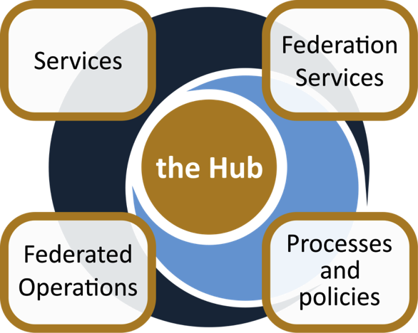
The project creates EOSC Hub:
a federated integration and management system for EOSC
From the consortium AND from external contributors
Usage according to Rules of Participation
Data
Applications & tools
Baseline services (storage, compute, connectivity)…
Training, consultants
Marketplace
AAI
Accounting
Monitoring
…
Lightweight certification of providers
SLA negotiation
Customer Relationship Management
…
Security regulations,
Compliance to standards,
Terms of use,
FAIR implementation guidelines
…
Based on FitSM

Slide 65
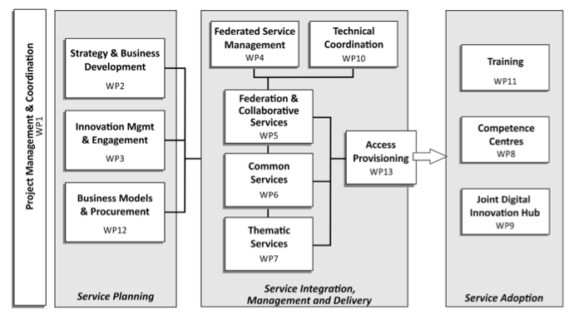
Work packages

Slide 66
Service Integration, Management & Delivery
e-Infra
EGI Federation
EUDAT CDI
Humanities
Language and literature (CLARIN)
Arts (DARIAH)
Engineering
Environmental engineering (sea vessels, LNEC)
Civil Engineering (Disaster Mitigation)
Medical and Health Sciences
Biological Sciences (ELIXIR)
Structural biology (WeNMR)
Natural sciences
INDIGO-DataCloud
Physical Sciences
Astronomy (LOFAR)
Fusion (ITER)
High Energy Physics (CMS and VIRGO)
Space Science (EISCAT-3D)
Thematic services
Generic services
Earth Science
EO Pillar
GEO
Climate Research (ENES)
Seismology (ORFEUS, EPOS)
Biological Sciences
Marine and freshwater biology (IFREMER)
Biodiversity conservation (LifeWatch)
Ecology (ICOS)

Slide 67
Service catalogue
http://www.eosc-hub.eu/catalogue
WP5
WP6
WP7
Open Collaboration services
Basic infrastructure and added-value services
Thematic services
Applications Database
Repositories
ECAS
DARIAH Gateway
OPENCoastS
GEOSS
EO Pillar
WeNMR
DODAS
LifeWatch
CMI
From month 19:
IFREMER
EISCAT_3D Portal
EGI High-Throughput Compute
EGI Cloud Compute
EGI Cloud Container
DIRAC4EGI
EGI Online storage
EGI DataHub
B2HANDLE
B2FIND
B2DROP
B2SAFE
B2STAGE
B2NOTE
ETDR
Sensitive Data Service
Advanced IaaS
TOSCA for Heat
OPIE
WP5
Federation services
Accounting
ARGO
Check-in
GGUS
GOCDB
Marketplace
Operations Portal
RC Auth
SPMT
DPMT
B2ACCESS
TTS
SYMON
+ new service from outside the consortium

Slide 68
Generic services
Open Collaboration services
Applications Database: Virtual appliances and application software repository and management
Repositories: Repositories of verified software to be deployed by the Service Providers

Slide 69
Generic services
Federation services
Accounting: Infrastructure composed by repositories and portal to collect usage statistics of the EOSC-hub services and present them to the stakeholders
ARGO: Monitoring infrastructure to track services status and collect statistics
Check-in: AAI platform for federated authentication to EGI services
GGUS: Helpdesk platform for the EGI infrastructure
GOCDB: Configuration database, service registry
Marketplace: Exposes the service catalogue to services and collects service orders
Operations Portal: Operational tools to manage distributed infrastructures
RCAuth: Online CA for the translation of credentials to X.509 certificates
SPMT: Service portfolio management tool
DPMT: Configuration management & data management tool for the users
B2ACCESS: AAI platform for federated authentication to EUDAT services
TTS: RT-based helpdesk service for the EUDAT infrastructure
SYMON: Service to monitor the deployed service versions

Slide 70
Generic services
Basic infrastructure and added-value services
EGI HTC: High-throughput compute
EGI Cloud Compute: Infrastructure as a service cloud compute
EGI Cloud Container: Docker containers cloud computing
DIRAC4EGI: Workload management service for computational tasks both on cloud and HTC
EGI Online storage: Store data in a reliable and high-quality environment and share it across distributed teams
EGI DataHub: Access public datasets and consume them from compute services
B2HANDLE: Persistent ID management
B2FIND: Metadata based data-discovery service
B2DROP: Secure and trusted data exchange service for researchers
B2SAFE: Distribute and store large volumes of data based on data policies
B2STAGE: Data transfer between resources and computational facilities
B2SHARE: Store / publish research data
B2NOTE: Data annotation service
ETDR: European certified Trusted Digital Repository
Sensitive Data Service
Advanced IaaS
TOSCA for Heat: Support for TOSCA templates in OpenStack heat component
OPIE: Open source implementation of spot instance virtual machines for OpenStack

Slide 71
Disciplinary services
Thematic services
ECAS: Climate Analytics Service
DARIAH Gateway: A portal tailored for the digital arts and humanities communities
OPENCoastS: On-demand Operational Coastal Circulation Forecast Service
GEOSS: GEO DAB (Discovery and Access Broker), GEOSS portal
EO Pillar: Earth observation services coordinated by ESA. The tools are: MEA, EPOSAR, Sentinel playground, Datacube analytic service, Geohazards exploitation platform, OSS-X Sentinel service
WeNMR: Online portals for structural biology analytics: DISVIS, POWERFIT, HADDOCK, GROMACS, AMPS-NMR, CS-ROSETTA, UNIO, FANTEN
DODAS: Dynamic On Demand Analysis Service
LifeWatch: PAIRQURS, Citizen science services, GBIF, Digital Knowledge preservation framework, remote monitoring and smart sensing.
CMI: The Component MetaData Infrastructure, including the Virtual Language Observatory and the Virtual Collection Registry. Provided by CLARIN-ERIC

Slide 72
Mapping Services to the research data lifecycle
4
Access, Deposition & Sharing
Application DB (software & VM)
B2DROP (data)
B2Note (data)
B2SHARE (data)
DataHub
3
1
Data Management, Curation & Preservation
Federation Services
Discover & Reuse
B2HANDLE
B2SAFE
European Certified Trusted Repository
Federated AAI. monitoring, accounting
SLA and order Management
Security incident response and policies
Technical support & Training
B2FIND (data)
Marketplace (Services)
2
Processing & Analysis
Applications on Demand
Federated HTC & Cloud Compute IaaS & PaaS
Processing of sensitive data
Jupyter Notebook
Thematic data analytics
Scientific Workflow Management, Orchestration (DIRAC, PaaS Orchestrator)

Slide 73
IT Service Management
Why IT service management (ITSM)?
About 80% of all IT service outages originate from "people and process issues"
Duration of outages and degradations significantly dependent on non-technical factors
IT service management
Focuses on the provision of high quality IT services that meet customers' and users’ expectations
Defines, documents and maintains service management processes through assigned roles and responsibilities
Reasons for service outages
[Gartner]

Slide 74
FitSM: Requirements
Example – Service Portfolio Management requirements:
PR1.1 A service portfolio shall be maintained. All services shall be specified as part of the service portfolio.
• PR1.2 Design and transition of new or changed services shall be planned.
• PR1.3 Plans for the design and transition of new or changed services shall consider timescales, responsibilities, new or changed technology, communication and service acceptance criteria.
• PR1.4 The organisational structure supporting the delivery of services shall be identified, including a potential federation structure as well as contact points for all parties involved.
FitSM defines 85 requirements that should be fulfilled by an organisation (or federation) offering IT services to customers
Compliance with the 85 requirements can be regarded as a "proof of effectiveness"
The 85 requirements are structured as follows:
16 general requirements (GR)
69 process-specific requirements (PR)
Consideration of the 14 IT service management processes from the FitSM process model
Between 2 and 8 requirements per process
FitSM service management processes:
Service portfolio management
Service level management
Incident management
Change management
Capacity management
Information security management
…

Slide 75
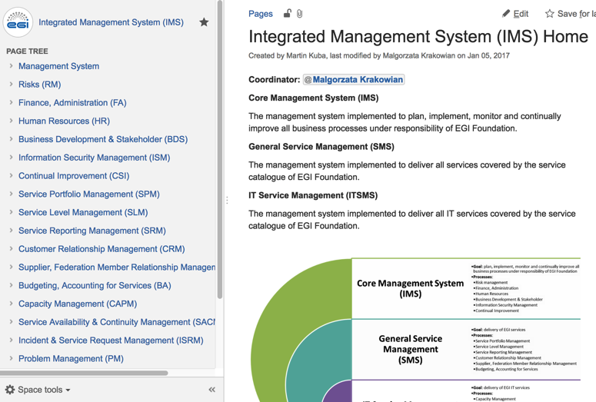
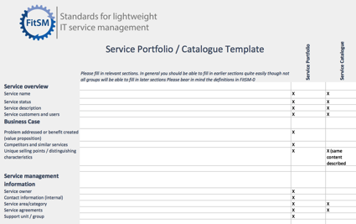
Addressing requirements: Technical tools
Process documentation
e.g. Confluence, Wikimedia
Ticket tool
e.g. GGUS, JIRA, RT
Templates
e.g. Word docs, Excel, Google Apps, Forms

Slide 76
Work packages

Slide 77
CLARIN
CMS (DODAS)
Climate (ECAS)
GEOSS
OPENCoastS
WeNMR
EO Pillar
DARIAH
LifeWatch
CyberHAB (SME: Ecohydros)
Moxoff (3 SMEs + CINECA)
Bot Mitigation Engine (2 SMEs + PSNC)
Suite5Pilot (2 SMEs + CINECA)
ACTION Seaport (SME: Bentley Systems)
DS-DRACO (SME: Hidronav + CESGA)
Service adoption
ELIXIR
Fusion (ITER)
Marine
EISCAT_3D
EPOS-ORFEUS
LOFAR
ICOS-eLTER
Disaster Mitigation
EOSC federating core
Thematic services (9)
WP5
WP6
WP5
WP7
Federation Services
AAI, Accounting, Monitoring, Operations, Security
Added value services
Compute, data, software management, curation & preservation
Open Collaboration Services
Application/software repository, Configuration management, Marketplace
WP10
integration
WP6
Basic infrastructure
Compute and storage
integration
integration
Engagement and support for new communities
integration
WP10
WP10
Provide
WP10
incubate
Integrate & Consume
incubate
Competence Centres (8)
Business pilots (6)
New communities
WP3
WP4
WP8
WP9

Slide 78
Use cases - Competence Centres (WP8)
 | Challenges | Relevant EOSC-hub services
ELIXIR CC | Establish a federation of cloud providers to replicate ELIXIR Core Datasets and Applications Bring these cloud-data providers into EOSC Enable federated AAI across life science and EOSC services | Federated Cloud AAI Operational policies Experience with Virtual Access Code of Conduct for sensitive data
Fusion CC (ITER) | Port fusion workflows to federated compute environment Federate and enable access to distributed datasets Application and data provenance | AAI Data and compute federation (containers) Workflow management Monitoring, helpdesk, PIDs, ...
Marine CC (Ifremer, Euro-Argo) | Cloud-based data subscription and data delivery service (from EMSO, Argo, SeaDataNet, etc.) Enabling users’ simulations to run within custom environments on ‘subscribed data’ Operate the setup as an EOSC service | Storage and compute clusters Data discovery and staging (B2Find, B2Stage) Jupyter service (24/7) FitSM (IT service management)
EISCAT_3D CC | Make EISCAT data accessible via a ‘data webshop’ Enable online data analytics for researchers (based on community and custom applications) Operate the data-compute portal as an EOSC service | B2Share (metadata schema management) DIRAC file catalogue and application manager for researchers Federated compute sites (cloud) User authentication, authorisation (VOMS, Perun) FitSM (IT service management)

Slide 79
Use cases - Competence Centres (WP8) (cont)
 | Challenges | Relevant EOSC-hub services
EPOS - ORFEUS CC | Effective transfer and staging of big data Harmonised data management policies at seismic observatories Enable researchers to analyse data, create and publish ‘user-defined data products’ | AAI Data staging and transfer services Federated compute services Jupyter (data access and analytics environment) Data Management good practices
Radio Astronomy CC (LOFAR→ SKA) | Enable researchers to find, access and process data from the LOFAR Telescope Support application developers in deploying workflows for researchers Support research users in data analytics on federation of compute clusters | B2Find - B2Share B2Stage B2Safe B2Handle (PIDs) Jupyter Federated compute and storage resources
ICOS-eLTER CC | Enable researchers to find, access and process data from ICOS and eLTER Integrate ICOS Portal and analysis tools with large-scale storage and compute resources Support research users in data analytics on federation of compute clusters | B2Safe B2Find B2Stage Federated cloud
Disaster Mitigation Plus CC | Setup simulation web portals for simulation of natural hazards (storm surge, dust transportation, forest fire, flood) Federate environmental data from agencies in Asia-Pacific region | Federated compute resources (HTC and cloud) Operational tools FitSM

Slide 80
Distilled use cases (WP8)
Distilled use case | Implementation by | Relevant services
Application and data platform (portal/mobile) | EISCAT_3D ICOS-eLTER | DIRAC B2Stage, B2Share B2Safe | EOSC-hub AAI Fed.Cloud Containers Storage (online, archive)
Data and application replication ‘backbone’ | ELIXIR EPOS-ORFEUS | FTS, B2Stage Kubernetes Life science AAI; EPOS AAI
‘Dropbox with pattern-matching’ for data streams | Marine | B2Find, B2Stage Jupyter
User workflows over distributed data and compute | Fusion Radio astronomy Disaster Mitigation | DODAS OneData Jupyter

Slide 81
What’s next?
2018:
EOSC-hub Rules of Participation
How to join EOSC-hub as a service provider
EOSC-hub Marketplace
Front-end to request and access EOSC-hub services
DI4R in Lisbon (Oct 9-11)
Programme online
EOSC Portal launch event (Nov)
Expanded EOSC-hub Marketplace
2019-:
Focus on engaging with external communities
New INFRAEOSC-* projects: Research Infrastructure clusters; Commercial procurement; Governance; National services; etc.

Slide 82
Next steps to become a user

Slide 83
Using services after the school
Request services through the EGI or EOSC-hub websites:
https://www.egi.eu/services/
https://www.eosc-hub.eu/catalogue
Compute and storage services are typically brokered from your national compute centre
Free at point of use for national researchers. Payment may apply for others
There are ‘start-up’ allocation for anyone. (E.g. FedCloud VO, EGI Applications On Demand)
‘Centrally provided services’ (e.g. training, certain applications) are from dedicated institutes
Mostly free at point of use for you (Because of co-funding by national or European funding agencies)
…

Slide 84
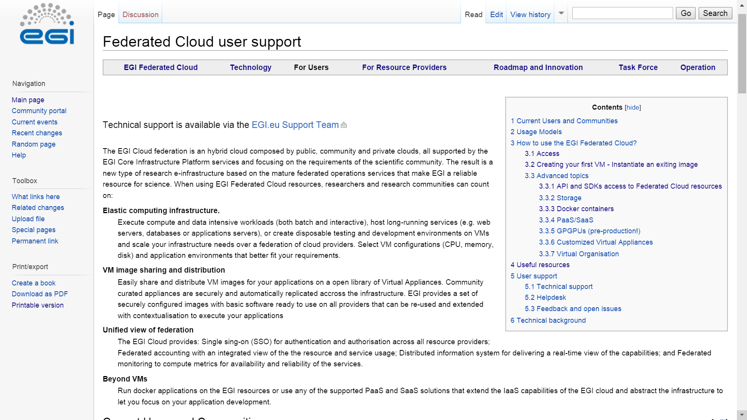
Main documentation about EGI Cloud
EGI Federated Cloud User Guides:
https://wiki.egi.eu/wiki/Federated_Cloud_user_support

Slide 85
CPU and storage allocation via EGI: Virtual Organisations
VO 1 (cloud a, b, c)
a
b
VO 2 (cloud b, c, d, e, f)
c
d
e
f
Community-specific VOs – e.g. CHIPSTER, Highthroughtputseq, EISCAT, etc. (SLA, OLAs)
Training VO = training.egi.eu
Generic VOs – e.g. fedcloud.egi.eu → Incubator for new users (recommended for follow up)
Browse VOs at http://operations-portal.egi.eu/vo/search (both grid and cloud)

Slide 86
Getting access to the EGI FedCloud IaaS
(SaaS services often work with username/pwd!)
Your steplist:
Obtain certificate from
Terena Certificate Service: (online) https://www.digicert.com/sso
OR
National CA (face-to-face identity check) http://www.igtf.net
OR EGI Catch-all CA: https://see-grid-ca.hellasgrid.gr/
Register in a VO
fedcloud.egi.eu is a good starting point
Other VOs:http://operations-portal.egi.eu/vo/search
VO manager authorizes You
Membership DB updated
Identity replicated to resource within 1 day
Interact with the resources
AppDB, API, CMDline
High-level tools
Obtain certificate: Once Renew certificate: Annually
You
CA
Join VO: Once
VIRTUAL ORGANISATION
Use resources
VO manager
Register
Membership service
User database
Cloud sites
DB replication (once a day)

Slide 87
Resource allocation to VO
Trigger the process with a service request on the EGI website
Type, number, size, cost, availability, etc.
Applic. provider
Service requirements
Conditions
Storage provider
Cloud provider
Negotiator
Grid provider
Project/Community representing the VO
Service Level Agreement
Operation Level Agreement
Training
Support
Satisfaction review (every 3/6/12 months)
Performance reports

Slide 88
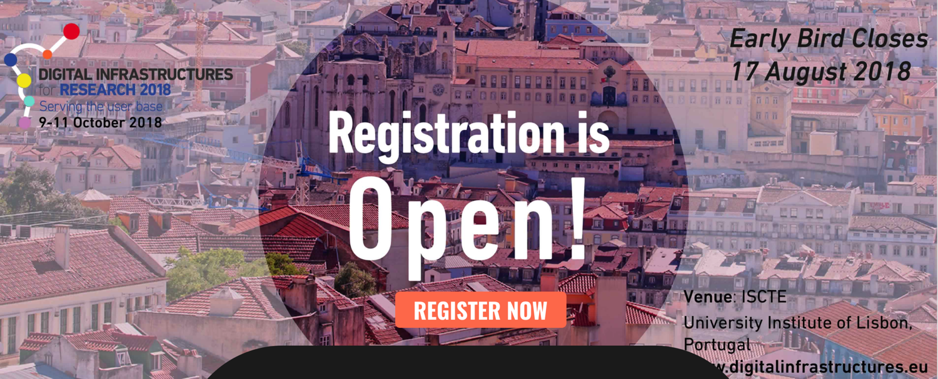
Next community event Digital Infrastructures for Research
Lisbon, Portugal
9-11 October, 2018
www.digitalinfrastructures.eu

Slide 89
Thank you for your attention!
Contact:
www.eosc-hub.eu
Gergely.sipos@egi.eu
Questions?

Slide 90
EXTRA SLIDES

Slide 91
Typical usage models of the EGI Cloud
Compute and data intensive workloads
Batch and interactive (e.g. Jupyter notebooks) with scalable and customized environments
Service Hosting
Long-running services (e.g. web server, database, application server)
Datasets repository
Store and manage large datasets (in a storage volume)
Disposable and testing environments
Host training environments, test applications

Slide 92
Containers
Containers provide virtualisation at the OS level
Same kernel, isolated user-space
Faster deployment, less overhead, easier migration…
App A
App A’
App B
libs
libs
libs
VMs
Guest OS
Guest OS
Guest OS
App A
App A’
App B
containers
libs
libs
Hypervisor
Host OS
Host OS
Server
Server

Slide 93
Docker
“Open-platform for building, shipping and running distributed applications”
Docker commoditizes containers
Hides and automates container management process
One-command-line deployment of applications
Easy to move from development to production
Provides ecosystem to create and share images

Slide 94
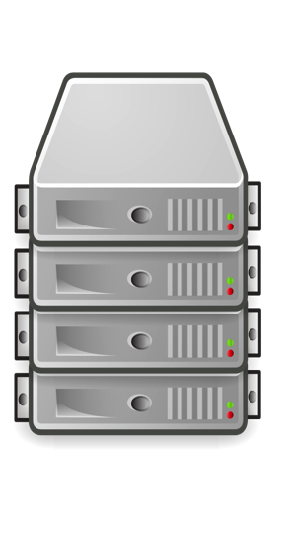
Container orchestration
App A
Container
Container
Container
Container
Container
Orchestrator
App B
Container
Container
Container
Container
Schedule containers to physical or virtual machines
Restart containers if they stop
Provide private container network
Scale up and down
Service discovery
Infrastructure
Notes:
Container applications tend to be comprised of several containers running in a coordinated way
running few containers can be easily managed on a single node (e.g. with docker-compose)
Container orchestration:
Manages a cluster of nodes where to run the containers
Automates the deployment, management, scaling, networking, and availability of container-based applications running on that cluster
Main products: Docker Swarm, Kubernetes & Mesos

Slide 95
EGI Cloud Container Compute
Run containers on top of EGI Cloud Compute VMs
2 (+ 1) options:
Single node: start the EGI Docker VM and run containers directly (or with docker compose)
Kubernetes: start a cluster of VMs and create a Kubernetes cluster to run your containers
Start the cluster using IM + Ansible
Working on: auto-scaling with EC3, Check-in integration at Kubernetes level
udocker: run containers as jobs in the EGI HTC service
https://wiki.egi.eu/wiki/Federated_Cloud_Containers

Slide 96
Kubernetes
Kubernetes is an open-source platform for automating deployment, scaling, and operations of application containers across clusters of hosts, providing container-centric infrastructure.
Some concepts:
Pod: group of one or more containers, shared storage and options to run the containers
Deployment maintains the desired count of Pods all the time
Service: logical set of Pods and a policy by which to access them.
Exposed to the exterior of the Kubernetes cluster via mapping of ports and or Load Balancing
Job: A job creates one or more pods and ensures that a specified number of them successfully terminate.

Slide 97
Example
apiVersion: apps/v1
kind: Deployment
metadata:
name: frontend
spec:
selector:
matchLabels:
app: guestbook
tier: frontend
replicas: 3
template:
metadata:
labels:
app: guestbook
tier: frontend
spec:
containers:
- name: php-redis
image: gcr.io/google-samples/gb-frontend:v4
resources:
requests:
cpu: 100m
memory: 100Mi
env:
- name: GET_HOSTS_FROM
value: dns
ports:
- containerPort: 80
apiVersion: v1
kind: Service
metadata:
name: frontend
labels:
app: guestbook
tier: frontend
spec:
# comment or delete the following line if you want to use a LoadBalancer
type: NodePort
ports:
- port: 80
selector:
app: guestbook
tier: frontend
---
apiVersion: extensions/v1beta1
kind: Ingress
metadata:
name: frontend
spec:
rules:
- host: frontend.test.fedcloud.eu
http:
paths:
- backend:
serviceName: frontend
servicePort: 80

Slide 98
EGI Cloud Container Kubernetes
Provides Kubernetes v1.10
Major differences with other offerings:
LoadBalancer ServiceType:
A NGINX ingress configured by default ready to be used offering similar functionality
Expandable with auto-configuration of Let’s Encrypt certificates
Dynamic provision of volumes for PersistentVolumeClaims
No block-storage directly available
NFS-based volumes available instead

