Slide 1
EGI Science gateways
User Community Support Team
EGI.eu, Amsterdam
ucst@egi.eu

Slide 2
Overview
The European Grid Infrastructure ecosystem
EGI Applications Database
What is a Science Gateway?
Science Gateways and enabling technologies
For researchers
For developers
How to register?
Science Gateway Primer
Users
Developers

Slide 3
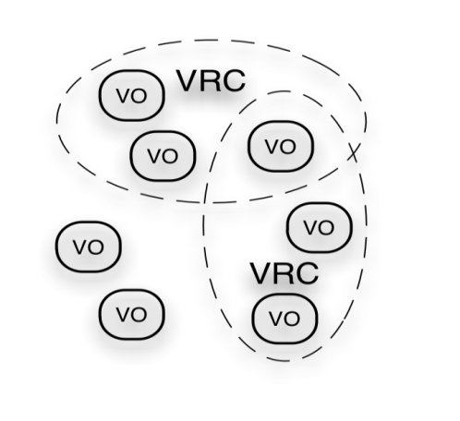
EGI Ecosystem
Legend
Feedback
Funding
Policies
Requirements
Services
Strategic feedback
Support
Technology
…
User Community
Project: GISELA
Project: DECIDE
Project: SCI-BUS
2
3
5
7
EGI-InSPIRE project
2010-2014
1
4
1
4
Public Funding Bodies
Service & Resource Providers
Technology Providers
European Commission
EGI.eu foundation
Open Source Providers
2
3
National Grid Infrastructures
4
National Research Councils
7
8
Commercial Providers
6

Slide 4
EGI infrastructure
Virtual Research Communities
(Users)
Science gateway technologies
Science gateways
Legend
Ecosystem
Partners
NGIs + EGI.eu
Software
Central Services
Domain Services
Community Services
Services
Planning & Coordination
Platforms
gLite
dCache
Globus
Federated cloud testbed
UNICORE
ARC
Support
Infrastructure
Distributed resources

Slide 5
EGI and Science Gateways
Science gateway (SG) is ...
… a community-specific set of tools, applications, and data collections that are integrated together via a web portal or a desktop application, providing access to resources and services from the European Grid Infrastructure.
Science gateways are domain/community specific, but the enabling technologies are typically not. They can be re-used!
Do you want to read more?
http://go.egi.eu/sciencegateways

Slide 6
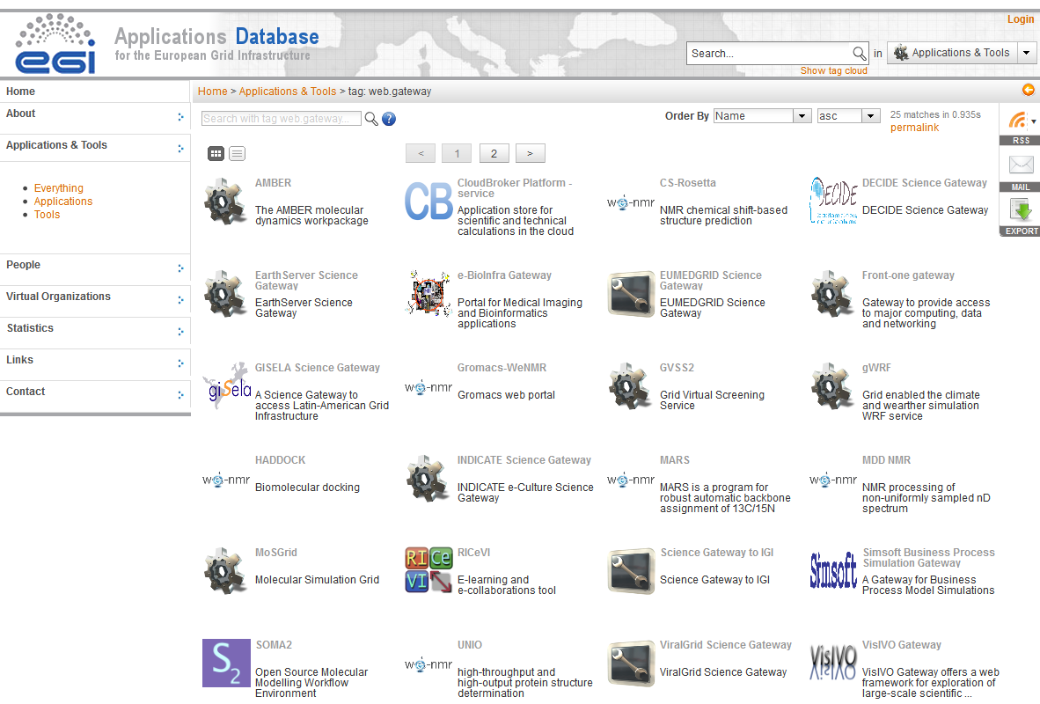
EGI Applications DataBase
In a nutshell:
Stores grid-aware science applications / tools
It embraces all scientific fields
Products are ready for consumption
Target audience: researchers and developers
Filtering and search capabilities
Community features: commenting and ranking
Access through:
web page
web gadget
API
Do you want to read more about this EGI service? EGI aware SGs are registered in AppDB.
http://go.egi.eu/AppDB

Slide 7
Science Gateways for users
EGI Science gateways are categorized as:
web-based (users interact with grid via a web browser)
desktop application-based (users interact with grid via a client program installed directly on the end-users' workstations)
Available SGs ready to be used by researchers?
http://go.egi.eu/SG.4.users

Slide 8
Science Gateways for developers
Enabling technologies are underlying capabilities that can provide required functionality for science gateways.
Several communities, projects and NGIs offer reusable 'off the shelf' components or frameworks for developers to build custom science gateways.
These solutions can save time and effort when developing new gateways.
Which SG enabling technologies are ready for developers to (re-)use?
http://go.egi.eu/SG.4.developers

Slide 9
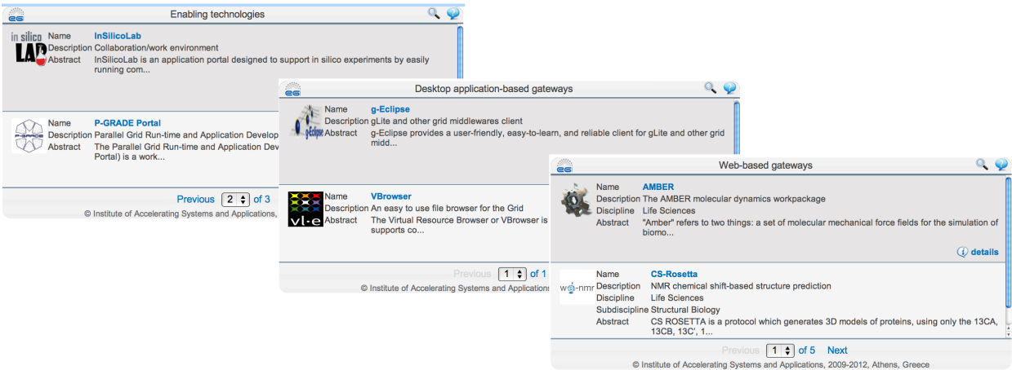
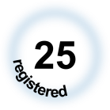
Register a SG to EGI AppDB
Science gateways and enabling technologies are registered in AppDB
Key information stored, such as SG description, access and download links
AppDB gadget can be used to display customized SG lists in your homepage
Step by step instructions?
http://go.egi.eu/SG.register

Slide 10
EGI Science Gateway primer
New project within the ‘EGI Virtual Team framework’
Science Gateway primer
Why?
To identify the right set of technologies from AppDB to build a SG, collecting and applying best practices and solutions to have a science domain specific gateway can be still a difficult task for some. This VT aims to help gateway developers and provides an 'EGI gateway primer', a manual that collects useful and up to date information from the EGI community about science gateway development.
Foreseen outputs:
Up to date and complete information about EGI SGs and enabling technologies at AppDB
Recommendations on how to improve the promotion of SG’s to the community
A comprehensive document, an 'EGI gateway primer', that collects information about technologies, policies, monitoring, accounting, and solutions that exist from the EGI community for gateway developers
All information available at …
http://go.egi.eu/vt.sgp

Slide 11
For enquiries contact us
User Community Support Team
EGI.eu, Amsterdam
ucst@egi.eu

