Slide 1
Digital Agenda going Local, Horizon 2020 and Structural Funds
Damir Marinovic
Policy Development Officer, EGI.eu
damir.marinovic@egi.eu

Slide 2
Outline
Digital Agenda for Europe (DAE) going Local
Join the initiative and become a part of the DA!
Horizon 2020
New CSF programme after 2013!
Structural Funds (SF)
Use the opportunity to apply for funding!

Slide 3
Europe 2020 Strategy
Why Europe 2020?
The crisis is a wake-up call, the moment where we recognise that "business as usual" would consign us to a gradual decline, to the second rank of the new global order. This is Europe's moment of truth. It is the time to be bold and ambitious.
Jose Manuel Barroso, President of the European Commission
EU's growth strategy transforming the EU into a smart, sustainable and inclusive economy with high levels of employment, productivity and social cohesion.
Objectives - smart, sustainable and inclusive growth in EU
Headline targets 3% of GDP invested in R&D

Slide 4
7 key flagship initiatives
Europe 2020
Digital Agenda for Europe
Youth on Move
Resource Efficient Europe
An agenda for new skills and jobs
An industrial policy for the globalisation era
Innovation Union
European platform against poverty
Smart Growth
Digital Agenda for Europe
Innovation Union
Sustainable Growth
Resource efficient Europe
An industrial policy for the globalisation era
Inclusive Gowth
An agenda for new skills and jobs
European platform against poverty
Youth on the move

Slide 5
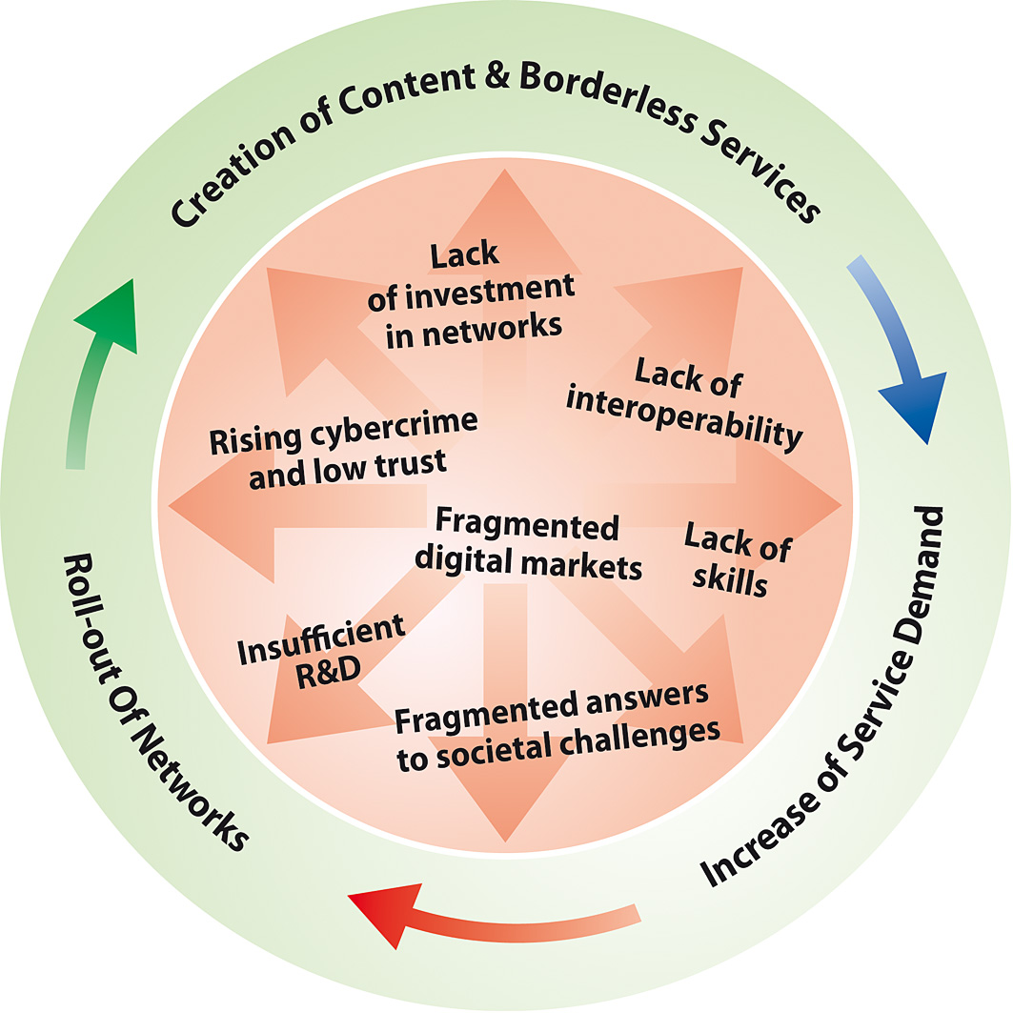
DAE – “Every European digital”
DAE is Europe's strategy for a flourishing digital economy by 2020
“The Digital Agenda for Europe outlines policies and actions to maximise the benefit of the digital revolution for all. Supporting research and innovation is a key priority of the Agenda, essential if we want to establish a flourishing digital economy.”
Neelie Kroes, Vice-President of the EC, Digital Agenda
“Europe should also build its innovative advantage in key areas through reinforced e-Infrastructures (i.e. EGI, GEANT)”
EC Communication Digital Agenda for Europe

Slide 6
DAE 7 Priority Areas and 101 actions
Creating a new digital Single Market
Greater interoperability and improved ICT standardisation
Enhancing internet trust and security
Much faster internet access
More investment in cutting-edge research and innovation in ICT
Enhancing digital skills and inclusion
Applying ICT for the benefit of society( e.g. reduce energy consumption, climate change etc.)
}101 actions
EGI role towards Europe 2020 Report - http://go.egi.eu/317
EGI DAE action list - https://wiki.egi.eu/wiki/PDT:DA

Slide 7
DAE – Going Local
The European Commission is "Going Local" to all Member States, to discuss key areas of the Digital Agenda for Europe with targeted audiences.
Events are adapted to specific priorities in Member States, focusing on country-specific issues.
The objectives of this exercise are:
Reporting on progress of the Digital Agenda
Identifying challenges for the future
Stimulate actions and commitments
Opportunity for NGIs and other interested parties to join and participate, gain visibility for their organisation, have their voice heard, raise certain questions, talk and establish contacts with government representative and EU representatives etc.
Link - http://ec.europa.eu/information_society/digital-agenda/local/index_en.htm
EGI Technical Forum 2011 – Lyon, France

Slide 8
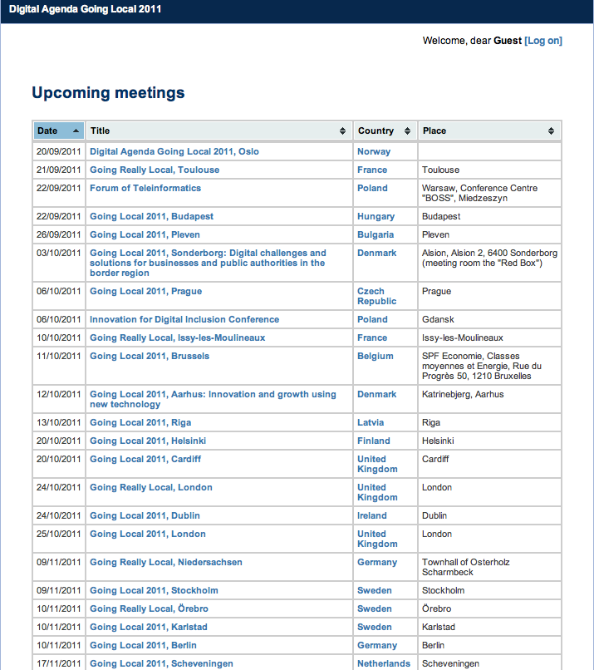
DAE Going Local - Meetings
In following weeks, events will be held in Bulgaria, Denmark, Czech republic, Poland, France etc.
http://ec.europa.eu/information_society/events/cf/daelocal/meetings.cfm

Slide 9
What will happen after 2013?
New Framework Programme for Research and Innovation – Horizon 2020
http://go.egi.eu/horizon-2020
The Green Paper “Towards a CSF for EU Research and Innovation funding” (2011) stimulated debate and launched a process of public consultation http://go.egi.eu/csf-green-paper
EGI.eu submitted a position paper on behalf of EGI along with a set of suggestions:
Support the closer integration of different e-Infrastructure providers in order to provide a coherent technical and policy structure, and integrated services to end-users.
Support the direct engagement between end-users and e-Infrastructure providers to develop new innovative services and applications, provision of a user-driven e-Infrastructure through service charging.
Reinforce the existence and importance of the top-level legal entities governing European e-Infrastructures
Affirm a clear commitment by the EC at both a policy and a technical level for the long-term development of open standards for e-Infrastructures in Europe
http://go.egi.eu/csf-egi-position-paper

Slide 10
New CSF – Horizon 2020
FP7
EIT- European Institution for Technology
CIP – Competetivness and Inovation Framework Programme
The European Framework Programme for 2014-2020
Good opportunity to launch new ideas, new challenges and new collaboration frameworks
Research Infrastructures (RIs) and e-Infrastructures as key elements for excellence in the Science base
CSF – Horizon 2020
+ improve compliance with Structural Funds
EGI Technical Forum 2011 – Lyon, France

Slide 11
Horizon 2020 budget figures
Time frame: 2014-2020
Proposed amount: EUR 80 billion
46% increase compared to current period (2007-2013)
Share of research and innovation in EU Budget increases to 8.5% in 2020

Slide 12
Shift towards simplification, integration and standardisation
2007-2013
strong focus on RTD
2014-2020
a rationalised toolkit of funding schemes across the CSF
coherent support for projects and organisations across the innovation cycle from research to retail
gaps between the stages (R&D, demonstration, market take up, etc)
different priorities in each programme and initiative
common strategic priorities, focusing on societal challenges, competitiveness and research excellence
stronger support for innovation, including non-technological innovation and market take up
a large variety of funding schemes within and between programmes
different rules in each programme and initiative
more standardised rules across all initiatives
a large variety of funding schemes within and between programmes
multiple websites, guidance documents, applications
common entry point, one stop shop, common IT platform

Slide 13
Key feature
Clear set of objectives based on Europe 2020 and Innovation Union
All stages in the innovation chain should be supported, with more attention for close to the market activities.
More openness and flexibility needed, less prescriptive calls, better use of bottom-up instruments,
Simpler funding landscape for research and innovation with common rules and funding schemes
Negotiation and selection phases will be much shorter
Single audit approach across Horizon 2020

Slide 14
^{Horizon} 2020 three main blocks and Europe 2020
Europe 2020 priorities
Market take up
European Research Area
Shared objectives and principles
Excellence in the Science Base
Research infrastructures
Future and Emerging technologies (FET)
Frontier research (ERC)
Skills and Career development
Tackling Societal challenges
Creating Industrial Leadership and
Competitive Frameworks
Simplified Access
Common rules
Toolkit of funding schemes
Coherence with other
EU and MS actions

Slide 15
Horizon 2020 and e-Infrastructures
Horizon 2020 steady focus on European Research and Technological Development (RTD), it will concentrate more on stronger support for innovation, including non-technological innovation and market take up.
EGI.eu participated on Consultation workshop for research infrastructures http://go.egi.eu/horizon-2020-workshop
Through Horizon 2020, the EC plans to:
support the coordination of e-Infrastructures at an EU level to provide seamless services (including international cooperation) since they are seen as critical infrastructures for e-science and open access to scientific data.
subsidise distributed infrastructure coordination that provides added European value and the continuous support of upgrading e-Infrastructures and further federation of national efforts.
e-Infrastructures as knowledge and innovation enablers for RIs (including ESFRI projects) across disciplinary, geographic and administrative boundaries fostering the development of genuine pan-European infrastructures.
The most important aspects of e-Infrastructure are the development of innovative services, digital curation, open access, interoperability and a stronger user-centric approach

Slide 16
Steps forward for RI and e-Infrastructures
Improving the relationship between users and service providers
Addressing underdevelopment of the data layer of e-Infrastructures
Reducing the distance between Research Infrastructures and e-Infrastructures
Addressing the lack of awareness for the fundamental role of data and interoperability
Leveraging activities and services beyond research and including communication, education and training as part of all e-Infrastructures initiatives
Enhancing the dialogue with industry (especially SMEs) in order to foster knowledge and technology transfer, both as a supplier and as user
Combining top-down, policy-driven approaches with a bottom–up approach to identify innovation opportunities and new needs and communities
Broaden the role of e-Infrastructures beyond research to other areas, for example transport, government, energy and health
Tackle environmental ICT issues

Slide 17
Horizon 2020: e-Infrastructures and ESFRI
Closer cooperation between the Directorate General (DG) for Information Society and Media (the funding source for e-Infrastructure projects) and the DG for Research and Infrastructure (the funding source for ESFRI projects).
Durable connection between e-Infrastructures and ESFRI projects that will result in increased mutual benefits.
Gaining momentum and a strong element of continuity in collaboration between EGI and ESFRI projects will lead to stronger links between e-Infrastructures and emerging Virtual Research Communities (VRCs).
Ideally, every ESFRI infrastructure should eventually become part of the discipline-specific VRC.

Slide 18
Horizon 2020 and EGI
The implementation of the upcoming “Horizon 2020” for Research and Innovation will be of crucial importance in defining the future funding environment of EGI and ensuring its sustainability.

Slide 19
Horizon 2020 Next steps
Commission proposal for Horizon 2020 before the end of 2011
Legislative decisions on Horizon 2020 by the Council and European Parliament during 2012 and 2013
Horizon 2020 starting from 2014
expecting 1st call of proposals in Autumn 2013

Slide 20
Structural Funds (2014-2020) changes?
"We need to spend more intelligently, focus on the EU's top priorities and add visible value to what national and regional authorities are already doing"
Johannes Hahn, EC Commissioner for Regional Policy
Structural Funds are one of the financial tools set up to implement the Cohesion policy by the EC http://go.egi.eu/cohesion-policy
Major changes for SF (2014-2020):
Linking allocation of funds to the Europe 2020 objectives
Inviting member states to sign partnership contracts
Focusing resources on a small number of priorities

Slide 21
Structural Funds (SF) and Europe 2020
Digital Agenda for Europe and Innovation Union - opportunity for the EGI community to play an important role in achieving some of the key objectives defined in this strategy and to benefit from it.
Action 55 of the DAE states that Member States should double the annual public spending on ICT research and development. By increasing the use of structural & regional development funds for ICT research facilities, and development projects on ICT products, services and applications.
Commitments 24 and 25 of Innovation Union are related to SF:
Member States should considerably improve their use of existing Structural Funds for research & innovation projects
Member States should initiate the preparation of post 2013 Structural Fund programmes with an increased focus on innovation and smart specialisation
On consultation workshop on the possible content of "Horizon 2020” the EC representative stated it would use SF for research and innovation to:
develop world-class research and ICT infrastructures;
establish networks of research facilities;
develop regional partner facilities.

Slide 22
Applying for SF
Organisations from the EU MS eligible for funding include public bodies, some private sector organisations (especially small businesses), universities, research institutes, NGOs and voluntary organisations.
Requirement to submit project proposals for approval
EU Member States managing authority responsible for selecting projects and monitoring their implementation
National contacts http://go.egi.eu/sf-national-contacts
The application process http://go.egi.eu/sf-how-to-apply
List of funded RTD projects http://go.egi.eu/sf-rtd-projects

Slide 23
NGI Sustainability
SF of crucial importance in defining the future funding environment of NGIs and their sustainability
In a period of financial constraints on public funding from national governments, it is important for NGIs to establish relationship with the SF managing authorities in order to fully utilise opportunities
The potential introduction of SF as a possible revenue stream to develop an NGI’s business model highlights how the future sustainability lays in the diversity of funding (SF programme, EC project funding, service charging, etc.)
The important event is the EGI Sustainability and Business workshop is this afternoon http://go.egi.eu/egitf11-sustainability-workshop

Slide 24
Thank you for your attention!
Questions?
Policy Development Team @ EGI.eu
Damir Marinovic
damir.marinovic@egi.eu
policy@egi.eu

