Slide 1
Workflows & workflow systems in EGI
ucst@egi.eu
Slides are collected from various sources in EGI

Slide 2
Overview
EGI Ecosystem
The Infrastructure
EGI and workflow technologies
Workflows and workflow systems
EGI Applications Database
Workflows in EGI Applications Database
Workflow systems in EGI Applications Database
Workflows use cases from EGI scientific communities

Slide 3
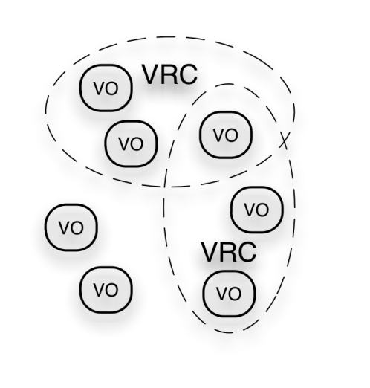
EGI Ecosystem
User Community
SHIWA
Anduril
TRANSfoRm
...
Policies + Funding
Wf4Ever
Galaxy
BioVel
...
Requirements + Feedback
Services + Support
EGI-InSPIRE
Service & Resource Providers
Requirements + Feedback
Public Funding Bodies
Policies + Funding
Requirements + Feedback
European Commission
EGI.eu
Technology Providers
Open Source Providers
National Research Councils
Resource Infrastructure Providers
Strategic Feedback
Technology + Support
Commercial Providers
Policies + Funding

Slide 4
Workflows and workflow systems
Workflows allow the reuse of software, applications and simulations. They are a powerful mechanism to develop, execute and share scientific calculations.
Workflow systems are graphical or text environments that can be used to design workflows, just like word or spreadsheet processors allow users to write a document or set up a series of calculations.
Visit EGI dedicated page: Workflows and workflow systems

Slide 5
Infrastructure - layered view
Workflow technologies
Virtual Research Communities
(Users)
Workflows and Workflow systems
Key
Ecosystem
Partners
NGIs + EIRO EGI.eu
Software
Central Services
Domain Services
Community Services
Services
Planning & Coordination
Platforms
gLite
dCache
Federated Clouds
UNICORE
ARC
Globus
Support
Infrastructure
NGI
NGI
EIRO
NGI
NGI

Slide 6
EGI and workflow technologies
Workflow services are domain / community specific
Outside of middleware
Support for the integration and operation of workflow services within the ecosystem
Services by communities & projects
Services by the NGIs
Number of aspects:
Gathering and tracking requirements
Support the technical integration of workflow systems
Promoting existing & emerging solutions
Identify and support the reuse of best practices

Slide 7
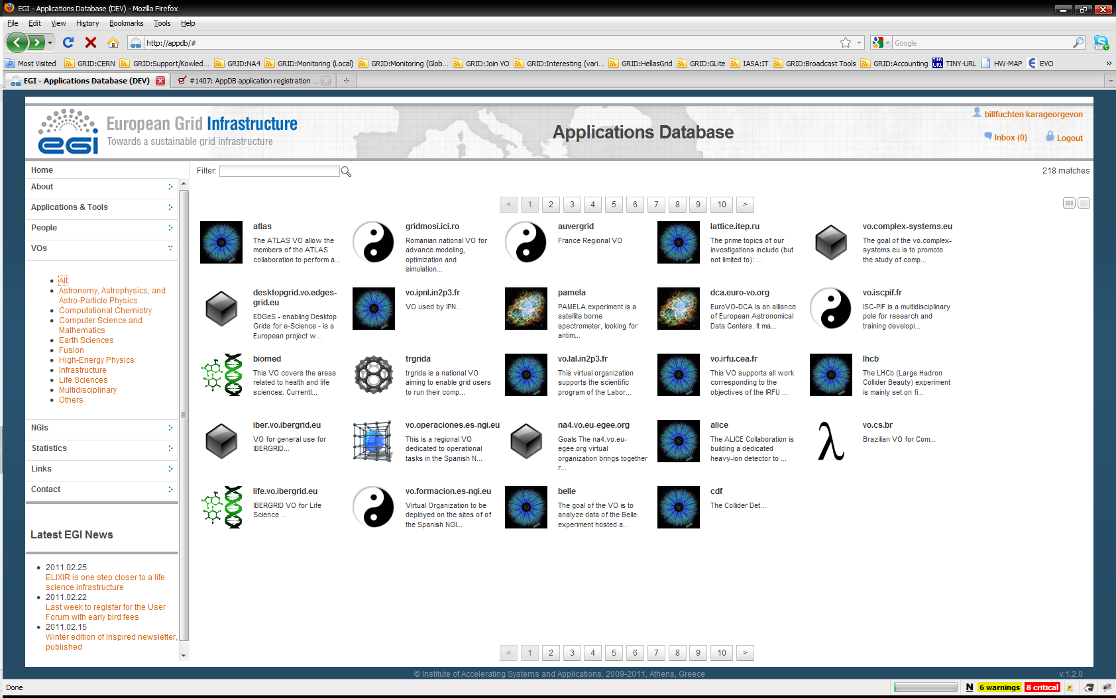
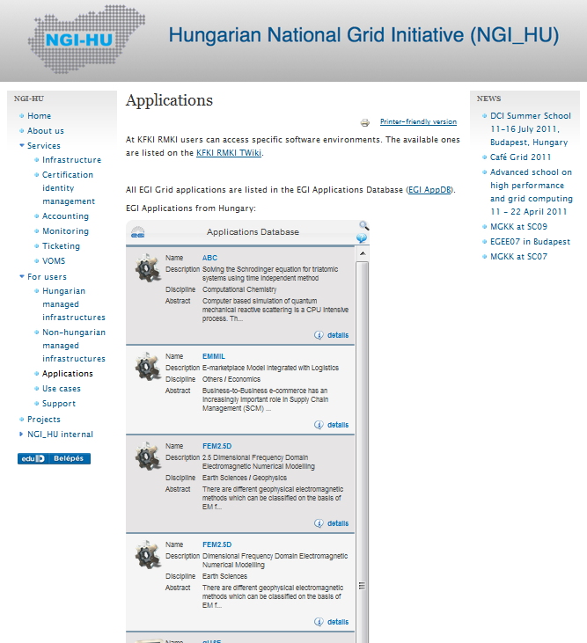
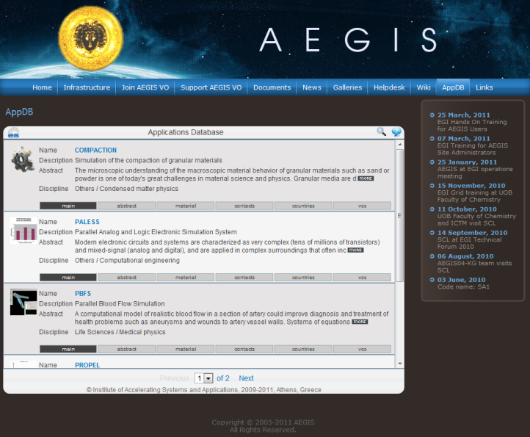
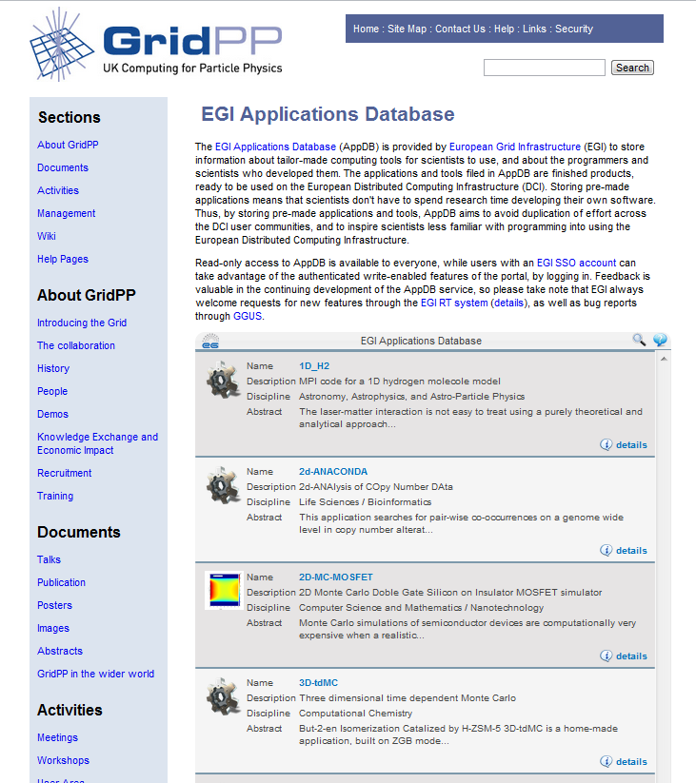
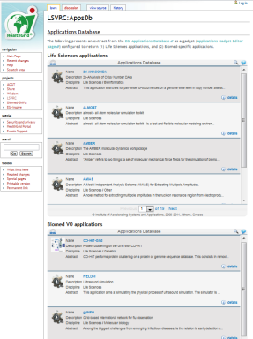
EGI Applications Database
Benefits:
Gives recognition to reusable Scientific applications and application developer tools
Gives recognition to application developers
Access through web page AND web gadget
Community features such as commenting and ranking
http://appdb.egi.eu
How to register an EGI workflow ?

Slide 8
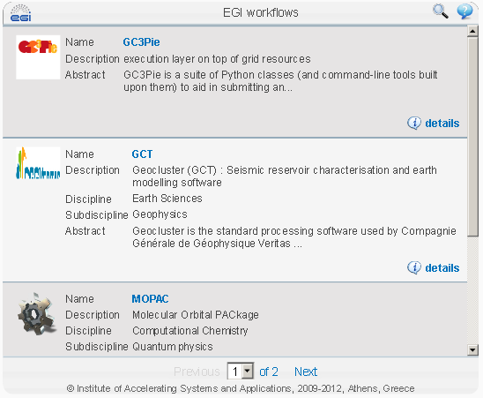
Workflows in EGI Applications Database
EGI workflows are sequences of computational and data manipulation steps required to perform a specific analysis, using resources from the European Grid Infrastructure.
More details:
EGI registered workflows
Other workflows:
Kepler workflows in the MyExperiment registry
LONI Pipeline workflows in the MyExperiment registry
Workflows in the SHIWA Workflow Repository

Slide 9
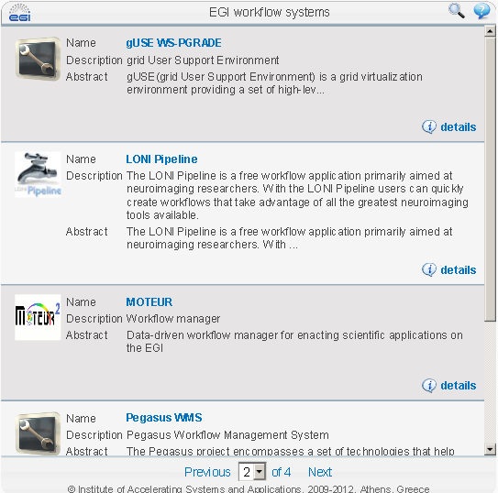
Workflow systems in EGI Applications Database
EGI workflow systems are graphical or text environments that enable scientific communities to write and execute their own workflows on resources of the European Grid Infrastructure.
More details:
EGI registered workflow systems

Slide 10
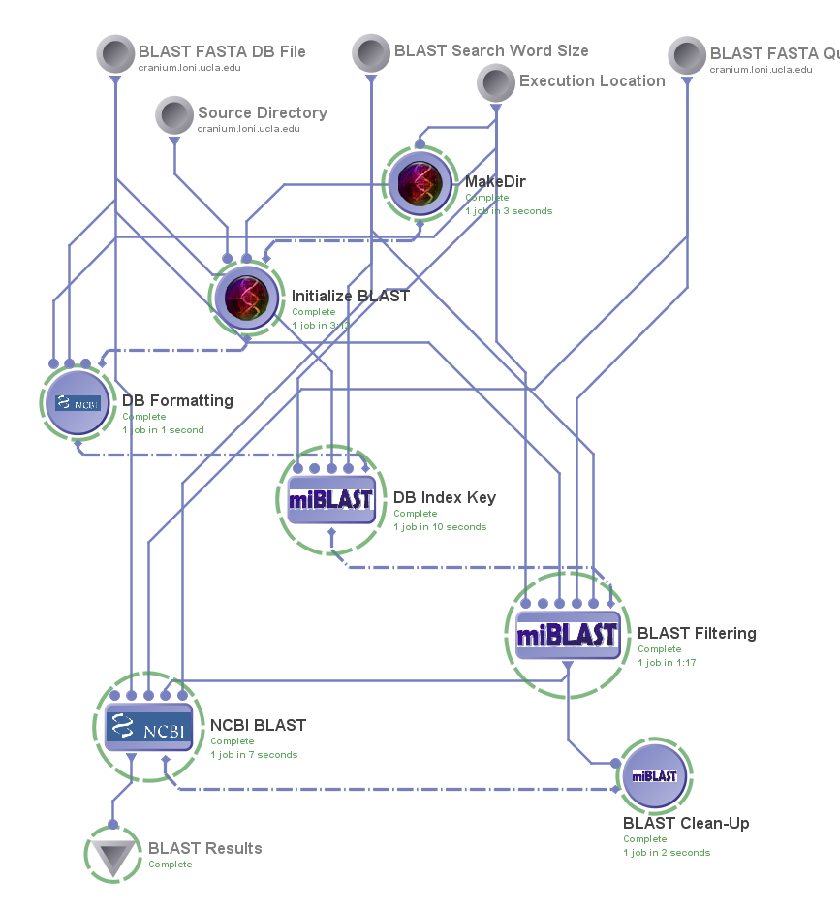
Workflows use cases from EGI scientific communities
Source: http://www.myexperiment.org/workflows/2048.html
Source: MOTEUR workflow use case provided by Johan Montagnat
LONI Pipeline and MOTEUR workflows
LONI Pipeline: http://appdb.egi.eu/?p=L2FwcHMvZGV0YWlscz9pZD03MDQ=
MOTEUR: http://appdb.egi.eu/?p=L2FwcHMvZGV0YWlscz9pZD02OTY=

Slide 11
Questions? Contact us:
ucst@egi.eu

