Slide 1
Building a Communications Strategy
Catherine Gater
e-ScienceTalk Project Coordinator, EGI.eu
www.e-sciencetalk.eu

Slide 2
Content
Why communicate?
Lessons learnt through dissemination
Key elements of a communications strategy
Talking to different audiences
What the European Commission wants to see
PRACTICAL: Key messages + audiences
Reporting and measuring outcomes
Metrics and statistics

Slide 3
Why communicate?

Slide 4
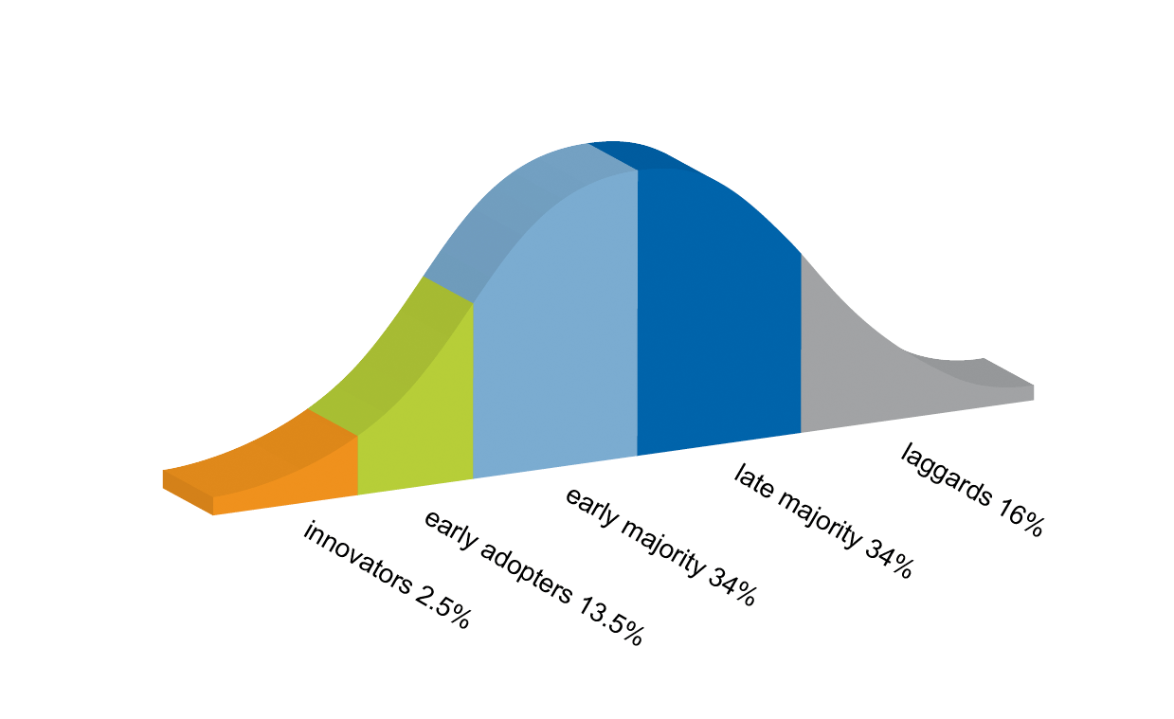
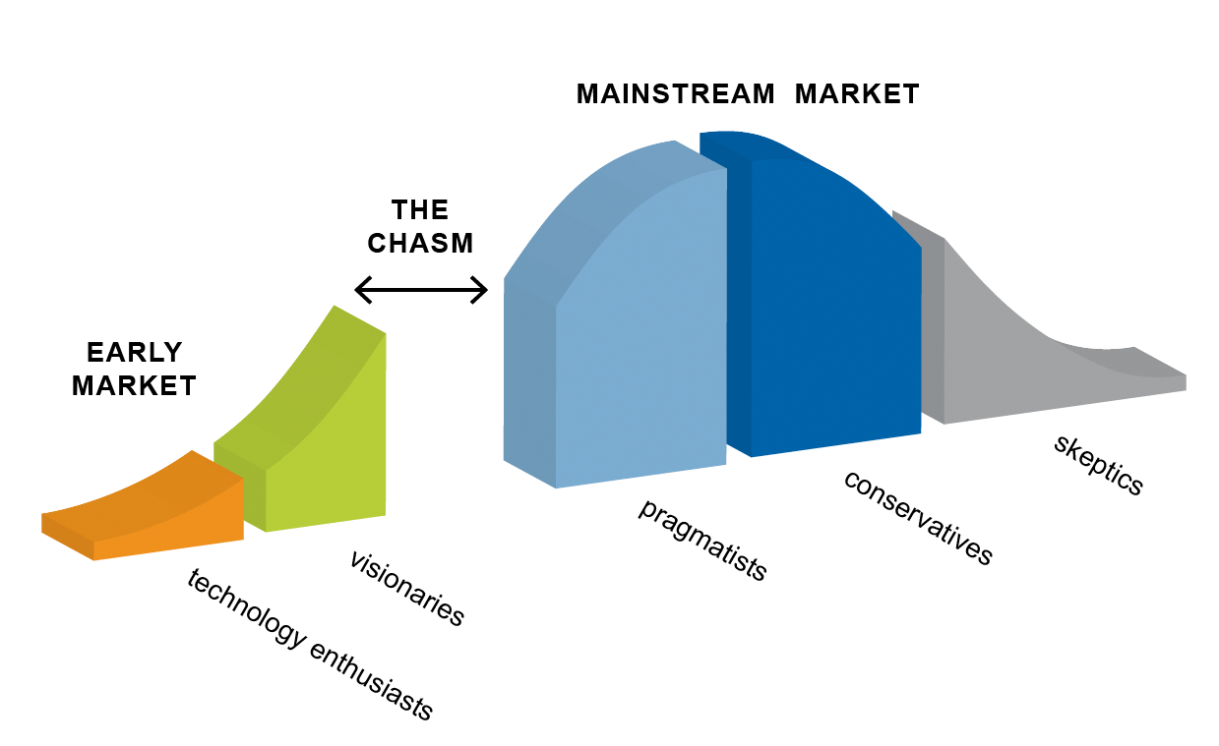
Bridging the chasm
Researchers are increasingly turning to e-science
A chasm exists between early adopter communities eg HEP and others eg humanities
Crossing the Chasm by Geoffrey A. Moore

Slide 5
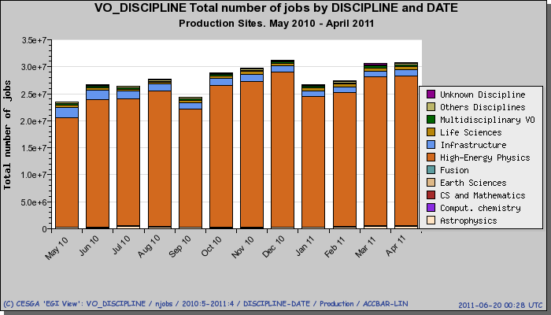
Users of grid computing
New additions to the Applications Database during EGI-InSPIRE Year 1
Virtual Organisations and jobs

Slide 6
Why communications?
Publicise project results through case studies
Show funders that the work has an impact
Inform new users of what is possible with the e-infrastructure
Build a sense of community
Publicise the outcome of events
Ask researchers to blog and share their work
Use social media to encourage networking
Sustainability of the e-infrastructure
Bringing new communities on board brings in new resources and funding for the future

Slide 7
Lessons learnt
How to communicate? What works and what doesn’t?

Slide 8
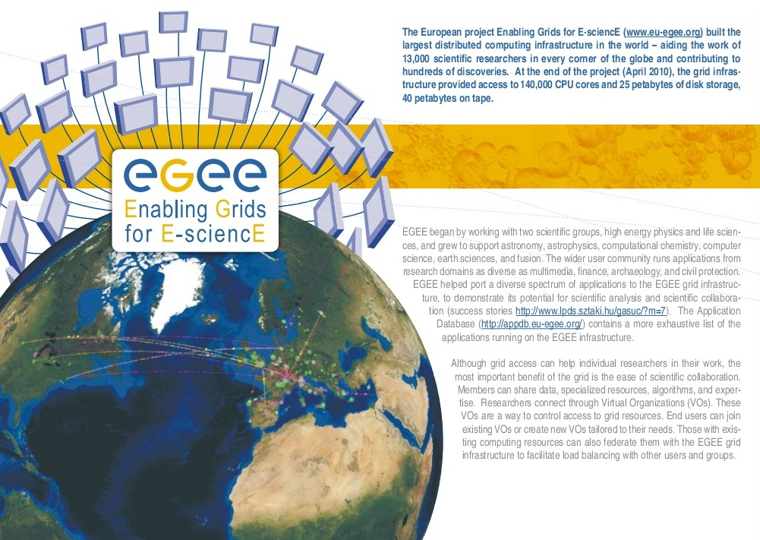
Lessons from EGEE
Communicate regularly with your colleagues eg newsletters, emails, updates, web news
Collaborate with other projects – spread the load and share communications channels
The press are interested in what e-infrastructures are for, not how they work
Build a story – publish a series of articles in one publication over time to engage an audience
Establish relationships with media partners eg iSGTW, HPCwire
The LHC start up generated a lot of media interest, which included WLCG and EGEE

Slide 9
Lessons from EGI
Make your materials visually appealing
One size does not fit all – channel content to the right readers eg general public, users, new users
Case studies, case studies and more case studies
Annual reports – give a professional impression
Goodies! T-shirts, pens, gadgets are always popular
Make events interactive – use hash tags, blogs, mobile phone apps
Leverage publicity around events as much as possible

Slide 10
Key elements of a communications strategy

Slide 11
Communications Strategy
Messages: What to say
Target audiences: Who to say it to
Communications plan: When to say it
Communications channels: How to say it
Outcomes: How will we know it worked?
Metrics and statistics: Did it work?
Impact: Will it go on working?

Slide 12
EGI target audiences
Primary audiences:
New user communities (social sciences, environmental sciences, humanities)
Existing user communities (life sciences, physics, computational chemistry)
Journalists and media
General public
National Grid Infrastructures (NGIs) and European International Research Organisations (EIROs)
Resource providers
Collaborating projects
Decision makers
Governmental representatives
Secondary audiences
Secondary schools, educational institutions
Local communities in the partner countries

Slide 13
Defining audiences
What is special about this audience?
Why is this audience important?
What will success in communicating to this audience look like?
How will we achieve success in reaching out to this audience?
What techniques have worked in the past?
What are the challenges?

Slide 14
Talking to different audiences

Slide 15
Messages: EGI
Current key messages are:
What the project is about;
What resources, infrastructure and services the project can provide;
Which applications/scientific fields are already using the EGI;
Benefits to a range of potential users;
Comparison of grids, cloud computing and other distributed computing infrastructures;
The project’s potential to revolutionise the way scientists work;
How to get involved;
Major developments such as:
New applications;
Key milestones;
Key events;
Who is involved in the project;
The future beyond EGI-InSPIRE for a sustainable infrastructure.

Slide 16
Targeted messages
For the general public:
EGI gives scientists the computing power they need to analyse the vast amounts of data pouring from large-scale experiments, such as the Large Hadron Collider and the ESFRI projects.
Modelling the natural world requires international collaboration. EGI gives scientists the computing power and collaboration platforms they need to understand phenomena such as climate change, ocean currents or how drugs work in the body.
For scientists:
EGI provides 350,000 processor cores and more than 250 petabytes of tape and disk storage to 21,000 users across Europe and beyond.
You don’t have to be a computer expert to benefit from expert computing. EGI is the gateway to hundreds of cutting-edge software packages ready to use across many fields.
EGI nurtures virtual research communities across all fields of science and works closely with users to provide an integrated e-Infrastructure.

Slide 17
Targeted messages
For funders and stakeholders:
EGI delivers sustainable, integrated computing services to European scientists and their international partners.
EGI integrates new technologies to support the Digital Agenda’s vision for a Europe with no boundaries or obstacles to the free circulation of knowledge.
EGI provides a pan-European e-Infrastructure that is more efficient and better value than the sum of each country’s individual efforts.

Slide 18
For all audiences…
Know your message or story
Identify the "so what" element for different groups
Eliminate jargon from your story
Find colour, anecdote, personalities
Look for novel, interesting, unexpected applications

Slide 19
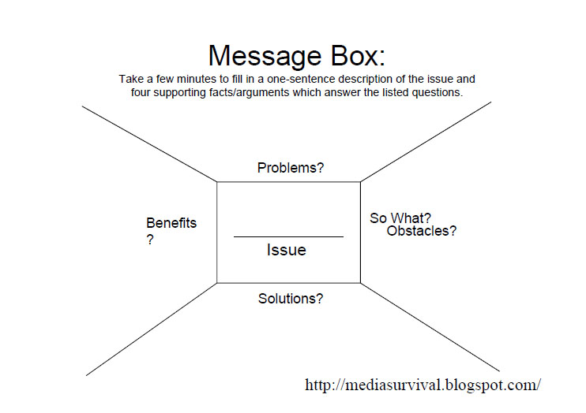
The message box

Slide 20
What the EC would like to see

Slide 21
Communication for the EC
Why communicate?
Everyone is a stakeholder. We have to get into the debate – why continue this research? Give the EC the tools to justify the added value.
Success is not just measured by the quality of the research but ALSO by how much it has been noticed.
Demonstrated impact means that the EC can argue to invest in this work in the next Framework Programme.
Is the message that you are sending being received? Aim for communication (2 way) instead of dissemination (1 way).
How to communicate?
Put yourself in the audience’s shoes, adapt the message to match.
Remove jargon, explain simply, avoid overloading with the one way type of information.

Slide 22
Communication for the EC
Work with the EC
Let them know in advance of successes to allow joint PR activities
Social media channels available from the EC:
Digital Agenda Facebook http://www.facebook.com/DigitalAgenda
Twitter http://twitter.com/digitalagendaeu
Blog http://blogs.ec.europa.eu/digital-agenda
Technology Marketplace on Cordis http://cordis.europa.eu/marketplace
Make the website part of the overall communications strategy and keep it up to date
Only issue press releases when they are newsworthy and timely, target local news, your MEPs, and social media.
Acknowledge support from the EU please!

Slide 23
PRACTICAL: Key messages and audiences

Slide 24
Practical: 20 mins
Move into groups of 4 or 5
Identify your key audiences – top 5
Brainstorm some general messages
One or two targeted messages for your top audience
Share with the rest of the groups

Slide 25
Reporting and measuring outcomes

Slide 26
Channels
Channels | Outcomes
Events | Workshops, conference sessions, presentations, posters, booths
Website | Project website, blogs, wiki
Materials | Brochures, info sheets, articles
Publications | Newsletters, bulletins
Media | Press releases, clippings
PR | Interviews, briefings
Social media | Facebook, Twitter, videos, images, infographics
-> Set targets for the outcomes

Slide 27
Metric and statistics

Slide 28
What to measure?
Project metrics e.g. the size of your infrastructure, number of users
Strategy metrics – are you meeting the wider strategic goals?
ERINA+ and eFiscal – measuring the socio economic impacts of EC projects

Slide 29
Stretch targets for EGI
No | Objective Summary | Metrics | Target PY1 | Target PY2 | Target PY3
PO1 | Expansion of a nationally based production infrastructure | Number of resource centres in EGI-InSPIRE and integrated partners (M.SA1.Size.1) | 300 | 330 | 350 (355) (355)
 |  | Number of job slots available in EGI-InSPIRE and integrated partners (M.SA1.Size.2) | 200,000 | 250,000 | 300,000 (325,000) (333,000)
 |  | Reliability of resource centre functional services (M.SA1.Operation.5) | 90% | 91% | 95% (96%) (97%)
 |  | Reliability of NGI functional services (MSA1.Operations.4) |  |  | 97% (98.5%) (99%)
 |  | Reliability of critical operations tools (MSA1.Operations.6a) |  |  | 97% (98.5%) (99%)
PO2 | Support of European researchers and international collaborators through VRCs | Number of papers from EGI Users (M.NA2.5) | 50 | 60 | 70 (80) (90)
 |  | Number of jobs done a day (M.SA1.Usage.1) | 500,000 | 525000 | 1.2M (1.4M) (1.5M)
PO3 | Sustainable support for Heavy User Communities | Number of sites with MPI (M.SA1.Integration.2) | 50 | 100 | 120 (130) (140)
 |  | Number of users from HUC VOs (M.SA1.VO.6) | 5000 | 5500 | 12,000 (15,000) (17,000)
PO4 | Addition of new User Communities | Peak number of cores from desktop grids (M.SA1.Integration.3) | 0 | 0 | 1,000 (5,000) (7,500)
 |  | Number of users from non-HUC VOs (M.SA1.vo.5) | 500 | 1000 | 10,000 (12,000) (13,000)
 |  | Public events organised (attendee days) (M.NA2.6) | 1500 | 2000 | 15 000 (17 000) (19 000)
PO5 | Transparent integration of other infrastructures | MoUs with resource providers (M.NA2.10) | 3 | 5 | 4 (5) (5)
PO6 | Integration of new technologies and resources | Number of HPC resources (M.SA1.Integration.1) | 1 | 3 | 50 (50) (50)
 |  | Number of resource centres part of the EGI Federated Cloud (M.SA2.19) | 0 | 1 | 10 (15) (20)
Target – expected
Target – optimal
Target – stretch

Slide 30
Strategic metrics
EGI Balance Scorecard relates the EGI Strategy to the metrics gathered
Based on linked performance measures from a range of perspectives:
Learning & growth – how EGI must develop as an organisation
Processes – where to excel to satisfy beneficiaries and funders
Direct beneficiaries – needs of the beneficiaries
Funders – return on investment
Income – effect of success on income

Slide 31
Vision
Support the digital ERA through a pan-European e-infrastructure based on an open federation of reliable services that provide uniform access to national computing, storage and data resources
Mission
Connect researchers from all disciplines with the reliable and innovative ICT services
they need to undertake their collaborative world-class research
Strategic Themes
Communication & Coordination
Operation Infrastructure
Virtual Research Environments
Income
Achieve continued European&national funding
Achieve community funding for continued operation
O1
Funders
Contribute to
EU2020 priorities
Contribute to national priorities
Cost effective management
Direct Beneficiaries
Easy and reliable access to the services that meet the needs of researchers
Promote the sharing and re-use of innovation
Support uniform operation of resource centers
O2
O3
O4
O1
O2
Processes
Develop EGI as
open ICT ecosystem
O6
O4
Integrate new physical
resources
Improve
technical outreach
Improve operational efficiency and effectiveness
Integrate new technologies
O1
O5
O4
O1
O2
O6
Learning & Growth
Strengthen governance
Strengthen strategic partnerships
Develop technical expertise
O1
O1
O6
O6
Core Values
Leadership
Openness
Reliability
Innovation

Slide 32
Strategy perspectives
Learning & growth
Develop technical expertise
Strengthen strategic partnerships
Strengthen governance
Processes
Develop EGI as an open ICT ecosystem
Integrate new physical resources
Integrate new technologies
Improve technical outreach
Improve operational efficiency and effectiveness
Beneficiaries
Easy and reliable access to the services that meet the needs of researchers
Promote the sharing and re-use of innovation
Support the uniform operation of resource centres
Funders
Contribute to EU2020 priorities
Contribute to national priorities
Cost effective management
Incomes
Achieve continued European and National funding
Achieve community funding for continued operation

Slide 33
Communications strategies
EGI: https://documents.egi.eu/document/1070
E-ScienceTalk: https://documents.egi.eu/document/232
Presentation:

Slide 34
Key points
To bridge the chasm new users need to know what the e-infrastructure can do
Demonstrating the impact of your work means it is more like to attract future funding from the EC
Match the message to your audience
Collaborate with other projects to maximise impact
Try out new channels

