Slide 1
Sensitive data services in EOSC-hub
Gergely Sipos, EGI Foundation
Adbulrahman Azab, University of Oslo
Slides are available at http://go.egi.eu/miuf2018
Dissemination level: Public

Slide 2
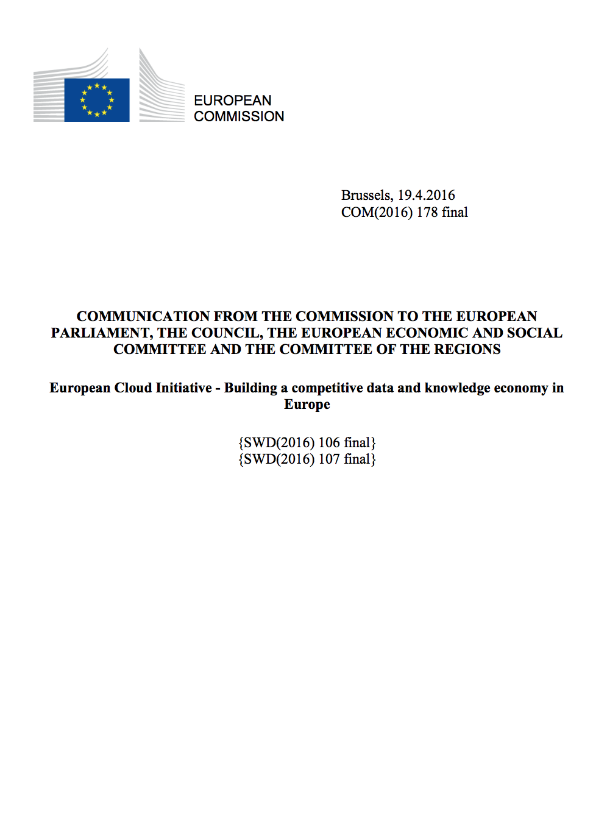
European Open Science Cloud - Problem statement
How to maximise the incentives for sharing data and to increase the capacity to exploit them?
How to ensure that data can be used as widely as possible, across scientific disciplines and between the public and the private sector?
How better to interconnect the existing and the new data infrastructures across Europe?
How best to coordinate the support available to European data infrastructures as they move towards exascale computing?
European Cloud Initiative by the European Commission (April 2016)
“…a trusted, open environment for the scientific community for storing, sharing and re- using scientific data and results…” ^{“…by 2020…”}

Slide 3
Outline
Introduction of the project (2018-2020, 3 years, 33m EUR, 100+ partners)
Information for service users
Already available services
Services for sensitive data (TSD, ePOUTA)
Further EOSC-hub activities related to sensitive data
Information for new providers
Why to join
How to join
Partnership framework

Slide 4
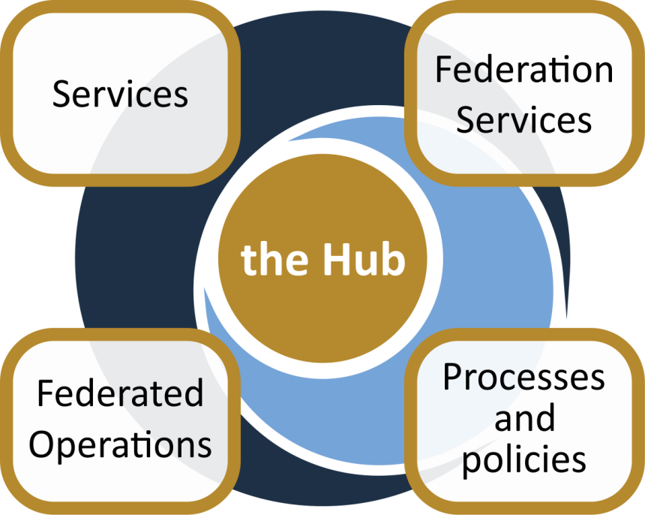
The project creates EOSC Hub:
a federated integration and management system for EOSC
From the consortium AND from external contributors
Baseline services (storage, compute, connectivity)…
Data
Applications & tools
Support: Training, consultants
Marketplace
AAI
Accounting
Monitoring
…
Security regulations,
Compliance to standards,
Terms of use,
FAIR implementation guidelines
…
Lightweight certification of providers
SLA negotiation
Customer Relationship Management
…
Based on FitSM

Slide 5
EOSC-hub: services & service areas today
Request acess via https://eosc-hub.eu/catalogue
Compute
EGI High-Throughput Compute
EGI Cloud Compute
EGI Cloud Container Compute
Data Management & Storage
B2Handle
B2Find
B2Drop
B2Safe
B2Stage
CVMFS
EGI Datahub
EGI Online Storage
eTDR
Services for sensitive Data
Thematic Services
ECAS
DARIAH Science Gateway
OPENCoastIS
GEOSS
EO Pillar
WeNMR Suite
DODAS
LifeWatch Services
CLARIN CMI
Professional Services
FitSM Training
Data Management Planning
Platforms
EGI Workload Manager
IM (Infrastructure Manager)
PaaS Orchestrator
Research Data
LOFAR
EPOS-Orfeus
…
Identity & Security
EGI Check-in
B2Access
IAM
Aggregators
Applications Database
Repository of Validated Software
ePOUTA and TSD
Note: work in progress, mapping to services areas being reassessed

Slide 6
CSC ePouta secure cloud

Slide 7
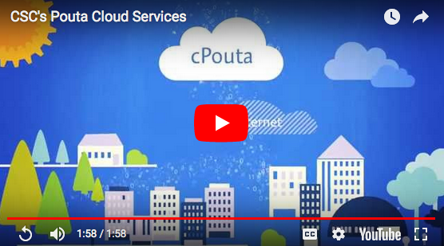

Slide 12
Getting Access to ePouta
Apply for a CSC project (You can apply through EOSC-hub)
Setup your own network
Establish the connection with your ePouta network
OPN (Optical Private Network) or - within FUNET and European academic networks - an MPLS (Multiprotocol Label Switching) connection
More info:
Connection: https://research.csc.fi/pouta-application
Pricing (google “epouta pricing”) → EOSC-hub Virtual Access

Slide 13
Services for Sensitive Data

Slide 14
TSD in rapid growth
> 500 research projects
> 2200 users
> 800 virtual machines
~ 2.0 petabyte data
# Research project over time

Slide 15
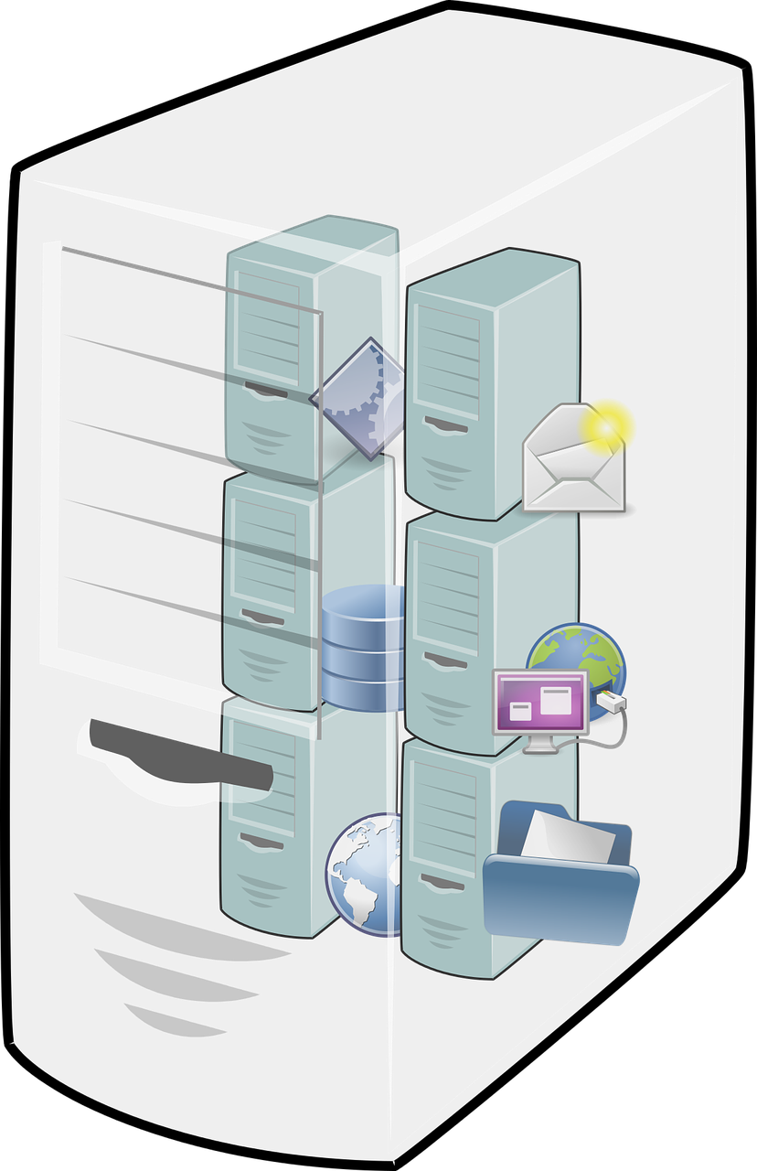
TSD in a nutshell
VMs
2-factor authentication
Firewall
High performance computing
Storage
Analyzes
Software
Databases
Data collection

Slide 16
Colossus
BeeGFS
p01
p02
pN
Two factor Authentication
NFS
p01
p02
pN

Slide 17
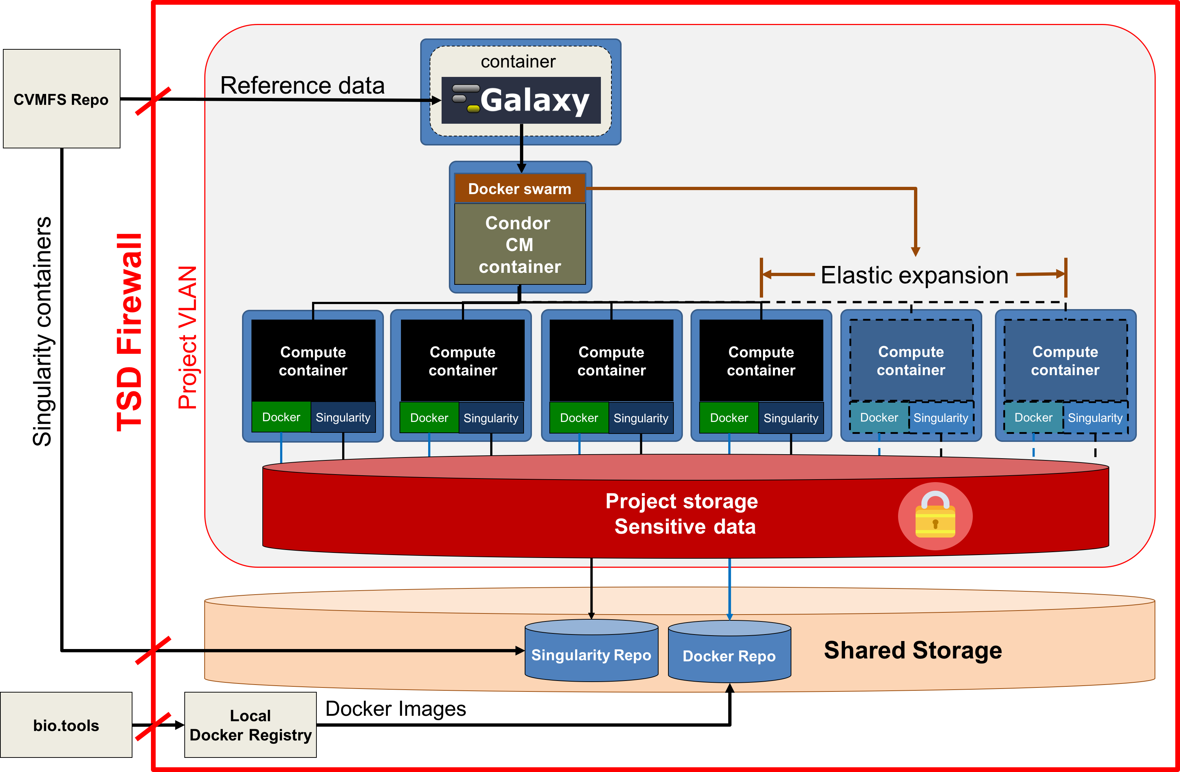
GYOSC2 – Get Your Own Secure

Slide 18
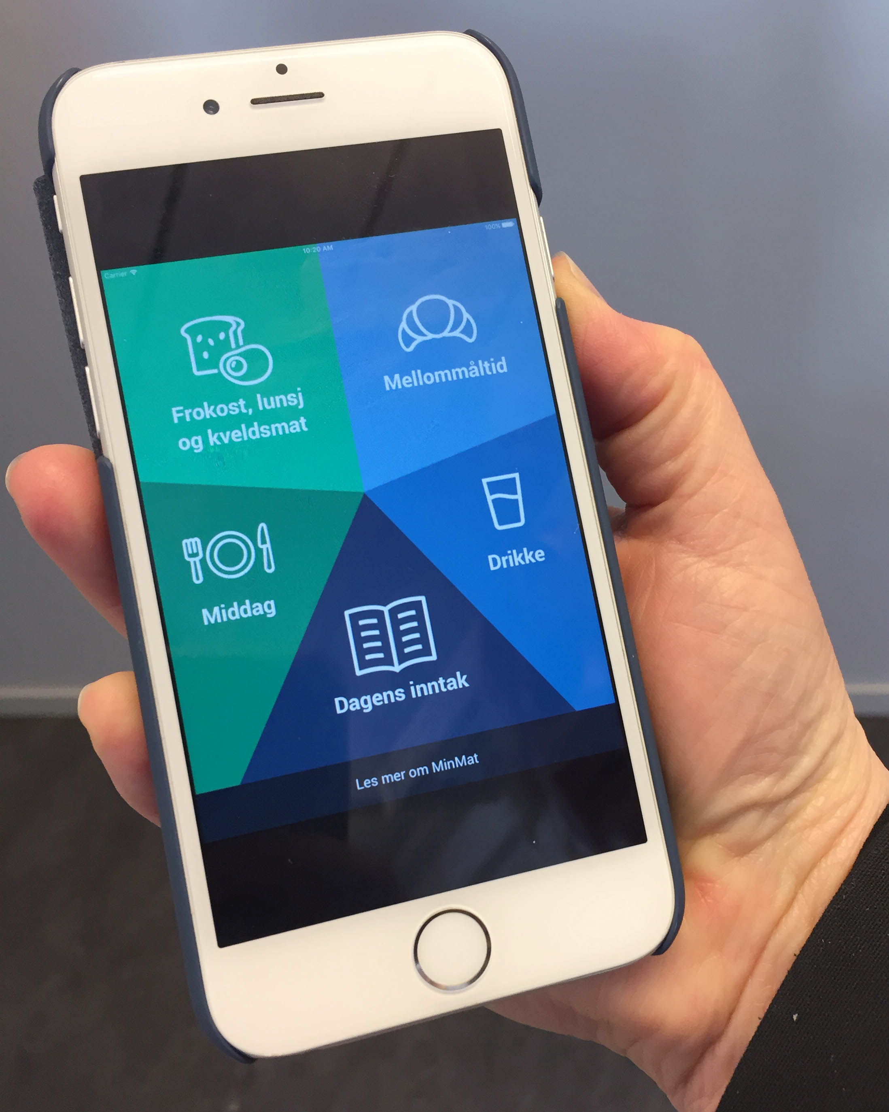
Data Collection
Web form – online questionnaire for secure data collection
API – import of data from smartphone and tablet
Min Mat - Mapping of malnutrition in patients
Others ….

Slide 19
TSD Consent system
The consent system is a system designed to provide a service that manages the consents given by persons for handling data imported in TSD by a project. The consents are intended to allow the persons provided data to be processed by researchers inside TSD. The system will provide the following functionality:
Allow a person to give, view and revoke consents for a data uploaded in TSD.
Allow a researches query user consent for a data in TSD

Slide 20
TSD Consent system - Design

Slide 21
TSD Consent system - Query

Slide 22
Data anonymization in TSD
Data anonymization tool, that allows to remove identifying information from data.

Slide 23
Colossus
BeeGFS
p01
p02
pN
Two factor Authentication
NFS
p01
p02
pN

Slide 24
TSD features summary
PaaS & SaaS → We take care of you ☺
Support for both Windows and Linux (platform and software)
High performance computing (HPC) → both elastic and bare metal
Sensitive data Web forms
Data collection using Smart devices
Consent system
Anonymization of structured data

Slide 25
Getting Access to TSD
Apply for a TSD project (You can apply through EOSC-hub)

Slide 26
Apply for a TSD project
In the electronic application you will be asked to upload the documentation collected during the following steps:
Step 1: Some document proving your rights to perform your research (i.e. your data usage approval) (typically REK, NSD, Privacy Officer, Data Inspectorate or other such body). NB : If your research falls outside of this, but still has data that should be especially secured, you just upload a document that describes the situation. Typically economic secrets or other data that is business secrets.
Step 2: Documentation regarding partner institutions (if of interest to the project application, most of the time this is not needed)
Step 3: Data Processor Agreement between your institution and UiO/TSD
Step 4: TSD Commercial Contract between your project and UiO/TSD
Step 5: Electronic Application (required)

Slide 27
Getting Access to TSD
Apply for a TSD project (You can apply through EOSC-hub)
Upload your data
Start working ☺
More info:
User guide: https://www.uio.no/english/services/it/research/sensitive-data/use-tsd/
Pricing (google “TSD pricing”) → EOSC-hub Virtual Access

Slide 28
Further EOSC-hub activities relating to sensitive data: Task T2.4 – Data Sharing Policies
“policies to facilitate the sharing and safe processing of both open and ‘restricted’ data from across European research infrastructures and promote current models of good practice on the management of restricted data from around the EOSC-hub consortium”
Members: EPCC (lead: Rob Baxter), EMBL-EBI, BBMRI ERIC, DANS-KNAW, ECRIN, CSC, EGI.eu, Masaryk University
D2.8 First Data policy recommendations
due end 2018
“First version of a set of policies to facilitate the sharing and safe processing of both open and ‘restricted’ data from across European research infrastructures”

Slide 29
Don’t reinvent the wheel!
EOSCpilot D3.3: https://eoscpilot.eu/content/d33-Draft-Policy-Recommendations
deliverable and 4 supporting whitepapers
Covers four areas
Open Science and Open Scholarship
Data Protection, Assurance and Special Information Regulation Regimes
Procurement
Ethics
Timelines between EOSCpilot and EOSC–hub match quite well
 | Q3 ’18 | Q4 ’18 | Q1 ’19 | Q2 ’19 | Q3 ’19 | Q4 ‘19
EOSCpilot WP3 | D3.3 | Survey (policy) | D3.6
EOSC-hub Task 2.4 | → | D2.8 | → | Survey? (implem’n) |  | D2.9

Slide 30
Participate in EOSC-hub
Users & customers
EOSC-hub website
EOSC-hub marketplace
Services without authentication
Services requiring access control
Integration (optional)
Science community providers (from EOSC-hub and beyond)
EOSC-hub service catalogue
Thematic services
EOSC-hub common services
Basic infrastructure
Compute and storage
Federation Services
AAI, Accounting, Monitoring, Operations, Security
Added value services
Compute, data, software management, curation & preservation
Open Collaboration Services
Application/software repository, Configuration management, Marketplace
E-infrastructure providers (from EOSC-hub and beyond)
Notes:
Explain that users and service providers can participate in EOSC either as a service provider in offering a (thematic) service to researchers, to the end user. But services providers can also participate in EOSC as user or customer of services and resources provided via EOSC. The constrains under which a service is offered or can be used must be clear and can differ. The constrains under which a service is offered can differ because of community, national constrains or can depend on different requirements, for example the amount of resources requested.
A customer assembles a service (instance) for a group of users he/she represents.
Users use already configured service instances.
Thematic services can choose whether or not to be present in the Marketplace. If they opt out from the Marketplace then users will be redirected to them from the EOSC-hub website.

Slide 31
EOSC-hub makes services and data F.A.I.R.
Findable → Harmonised service descriptions; Catalogue (→EOSC-Portal); PID service (B2HANDLE); Software and VM catalogue (AppDB), …
Accessible → Marketplace; Federated login across services; Harmonised access policies; …
Interoperable → Portable and scalable compute and storage; Orchestrators; Growing, community-defined standards; …
Reusable → Training & documentation; Long-term preservation service (B2SAFE)

Slide 32
EOSC-hub makes services reliable
Service validation (when entering the catalogue)
Aligned service management practices (based on FitSM processes)
Service monitoring with configurable test probes (based on ARGO)
Operations security (distributed Software Vulnerability Group)
Helpdesk reaching distributed service operators

Slide 33
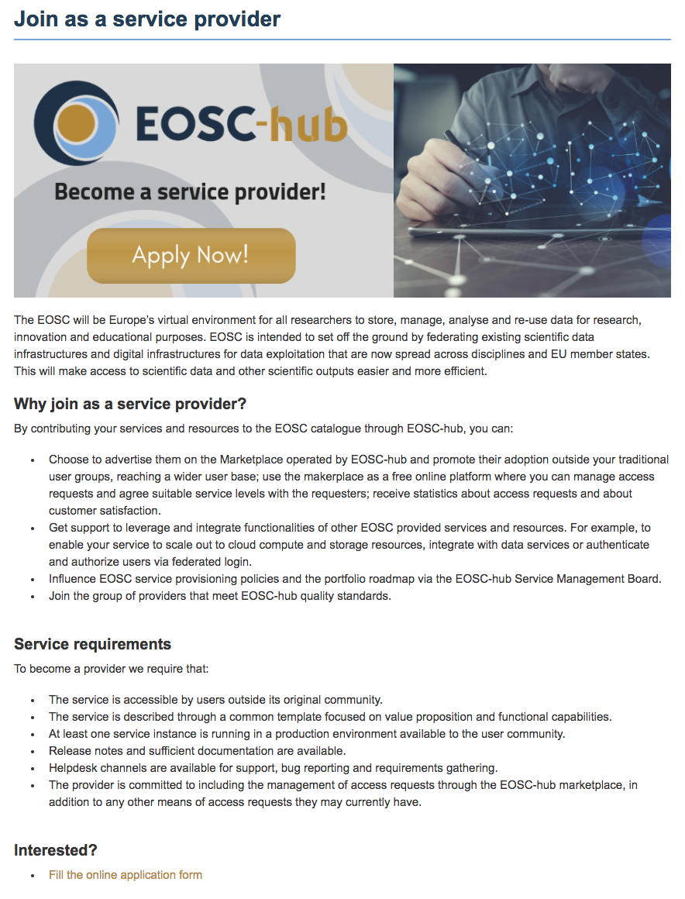
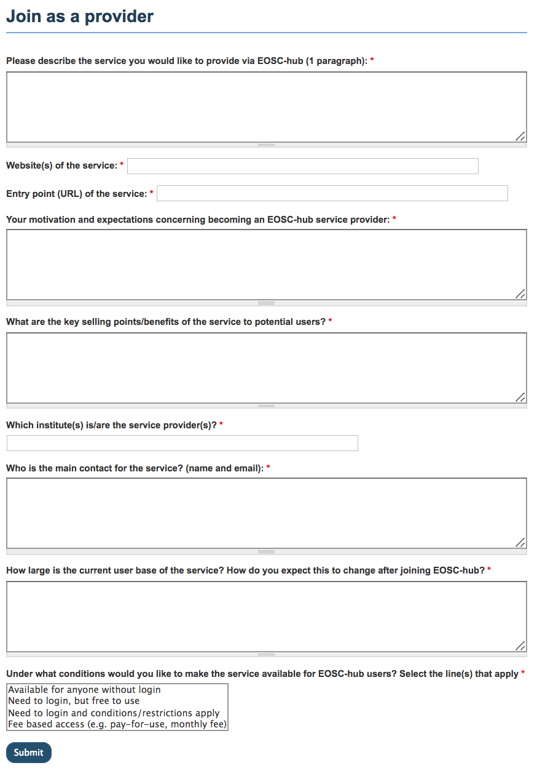
Become a provider https://www.eosc-hub.eu/join-as-service-provider

Slide 34
Technology Readiness Level (TRL)
TRL - Method of gauging the maturity of technology/service, used by EC
TRL Level | Description
1 | Basic principles observed
2 | Technology concept formulated
3 | Experimental proof of concept
4 | Technology validated in lab
5 | Technology validated in relevant environment
6 | Technology demonstrated in relevant environment
7 | System prototype demonstration in operational environment
8 | System complete and qualified
9 | Actual system proven in operational environment
TRL8 & 9 – considered Production Level within EOSC-hub:
past development and PoC/pilot/pre-production stages
evident to users which functionalities are present
users’ reasonable expectation of stability are met
Notes:
EC definition of the Technology Readiness Levels. The TRL levels are linked to the different phases within Service Development process.

Slide 35
Growing the service catalogue through partnerships
INFRAEOSC-04:
Life and medical sciences
Neutron & photon physics
Social Sciences and Humanities
Environmental Sciences
Astro- and astro-particle physics
INFRAEOSC-02: New innovative services
INFRAEOSC-05(b): National services
INFRAEOSC-01: Commercial services
Research infrastructures (ERICs)

Slide 36
Cross-coordination across EOSC initiatives
Areas:
Offering groups of services
Service validation and provisioning
User support (online guides and technical helpdesk)
Training for users (service-specific training & DMP)
Outreach and onboarding of users
EOSC-hub: collaboration framework for EOSC consortia targeting specific stakeholder groups (e.g. disciplinary groups / national groups / commercial entities)

Slide 37
Summary
EOSC-hub established key elements for European Open Science Cloud
First set of services
Service request, provisioning and management processes
EOSC-hub includes two cloud service for sensitive data: ePOUTA and TSD
IaaS, PaaS and SaaS
Proven at national level
Accessible for foreigners via H2020 Virtual Access
EOSC-hub is open and brings value to new providers
Increased visibility and accessibility
Expanded capabilities
Higher reliability
EOSC-hub is open for partnership with provider consortia

Slide 38
EOSC Stakeholders Forum
Vienna, 21-22/Nov
https://eoscpilot.eu/events/second-eosc-stakeholders-forum
EOSC Launch event
Vienna, 23/Nov/2018
Slides are available at http://go.egi.eu/miuf2018

Slide 39
EXTRA SLIDES

Slide 40
The Project in numbers
European Commission Horizon 2020 Programme
100 Partners, 76 beneficiaries (75 funded)
https://www.eosc-hub.eu/partners
Budget: €33,331,18, contributed by:
European Commission: €30,000,000
EGI Foundation and its participants: €2,155,540
EGI participants: €1,221,094
36 months: Jan 2018 – Dec 2020

Slide 41
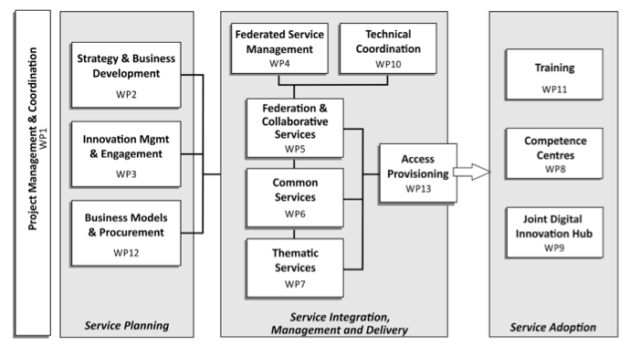
Work packages

Slide 42
Services by area
e-Infra
EGI Federation
EUDAT CDI
Humanities
Language and literature (CLARIN)
Arts (DARIAH)
Engineering
Environmental engineering (sea vessels, LNEC)
Civil Engineering (Disaster Mitigation)
Medical and Health Sciences
Biological Sciences (ELIXIR)
Structural biology (WeNMR)
Natural sciences
INDIGO-DataCloud
Physical Sciences
Astronomy (LOFAR)
Fusion (ITER)
High Energy Physics (CMS and VIRGO)
Space Science (EISCAT-3D)
Earth Science
EO Pillar
GEO
Climate Research (ENES)
Seismology (ORFEUS, EPOS)
Biological Sciences
Marine and freshwater biology (IFREMER)
Biodiversity conservation (LifeWatch)
Ecology (ICOS)

Slide 43
Describe your Service
Service Catalogue
Marketplace
Basic Service Information
Service Classification
Service Maturity
Service Provider
Service Management
Service Contract
Service Access Policies
Service Dependencies
Service Options
Order Management
Manage Access Requests
Service providers must at least be able sufficiently describe a service
16 mandatory fields: Service ID, Service URL, Service Provider Name, Service Name, Service Description, Service Symbol, Service Version, Service Last Update, Service Phase or Life Cycle Status, Service TRL, Service Category, Service Subcategory, Service Place, Service Language, Service Order, SLA
74 fields to describe a service
Additional information required for a service description in the Marketplace
https://legacy.gitbook.com/@jnp

Slide 44
EOSC-hub Internal Service Portfolio
Operations
Accounting
ARGO
GOCDB
Marketplace
Operations portal
RC Auth
SPMT
DPMT
WaTTS
EOSC-hub Helpdesk
SVMon
BDII
Identity & Security
EGI Check-in
B2Access
Coordination
Order management
…
Note: work in progress, the organization of this list may change

Slide 45
Another view on the services based on the Research Data Lifecycle
4
Access, Deposition & Sharing
Application DB (software & VM)
B2DROP (data)
B2Note (data)
B2SHARE (data)
DataHub
3
1
Data Management, Curation & Preservation
Federation Services
Discover & Reuse
B2HANDLE
B2SAFE
European Certified Trusted Repository
Federated AAI. monitoring, accounting
SLA and order Management
Security incident response and policies
Technical support & Training
B2FIND (data)
Marketplace (Services)
2
Processing & Analysis
Applications on Demand
Federated HTC & Cloud Compute IaaS & PaaS
Processing of sensitive data
Jupyter Notebook
Thematic data analytics
Scientific Workflow Management, Orchestration (DIRAC, PaaS Orchestrator)

Slide 46
EOSC-hub Marketplace
Platform where services can be
Discovered
Ordered
Accessed
3 steps process for users
Authentication & registration
Product discovery and specification
Ordering and request processing

Slide 47
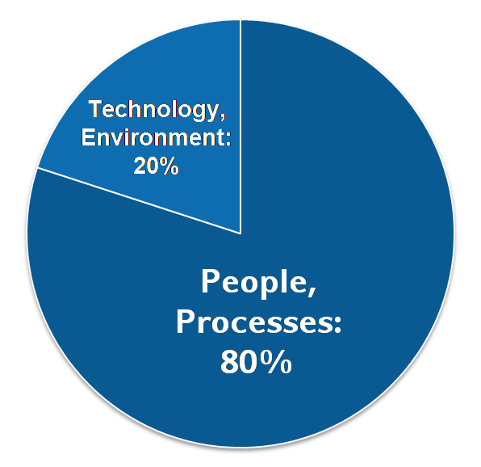
IT Service Management
Why IT service management (ITSM)?
About 80% of all IT service outages originate from "people and process issues"
Duration of outages and degradations significantly dependent on non-technical factors
IT service management
Focuses on the provision of high quality IT services that meet customers' and users’ expectations
Defines, documents and maintains service management processes through assigned roles and responsibilities
EOSC-hub operates a Service Management System based on the FitSM standard
Reasons for service outages
[Gartner]

Slide 48
FitSM standard: Requirements
Example – Service Portfolio Management requirements:
PR1.1 A service portfolio shall be maintained. All services shall be specified as part of the service portfolio.
• PR1.2 Design and transition of new or changed services shall be planned.
• PR1.3 Plans for the design and transition of new or changed services shall consider timescales, responsibilities, new or changed technology, communication and service acceptance criteria.
• PR1.4 The organisational structure supporting the delivery of services shall be identified, including a potential federation structure as well as contact points for all parties involved.
FitSM defines 85 requirements that should be fulfilled by an organisation (or federation) offering IT services to customers
Compliance with the 85 requirements can be regarded as a "proof of effectiveness"
The 85 requirements are structured as follows:
16 general requirements (GR)
69 process-specific requirements (PR)
Consideration of the 14 IT service management processes from the FitSM process model
Between 2 and 8 requirements per process
FitSM service management processes:
Service portfolio management
Service level management
Incident management
Change management
Capacity management
Information security management
Customer Relationship Management
…

Slide 49
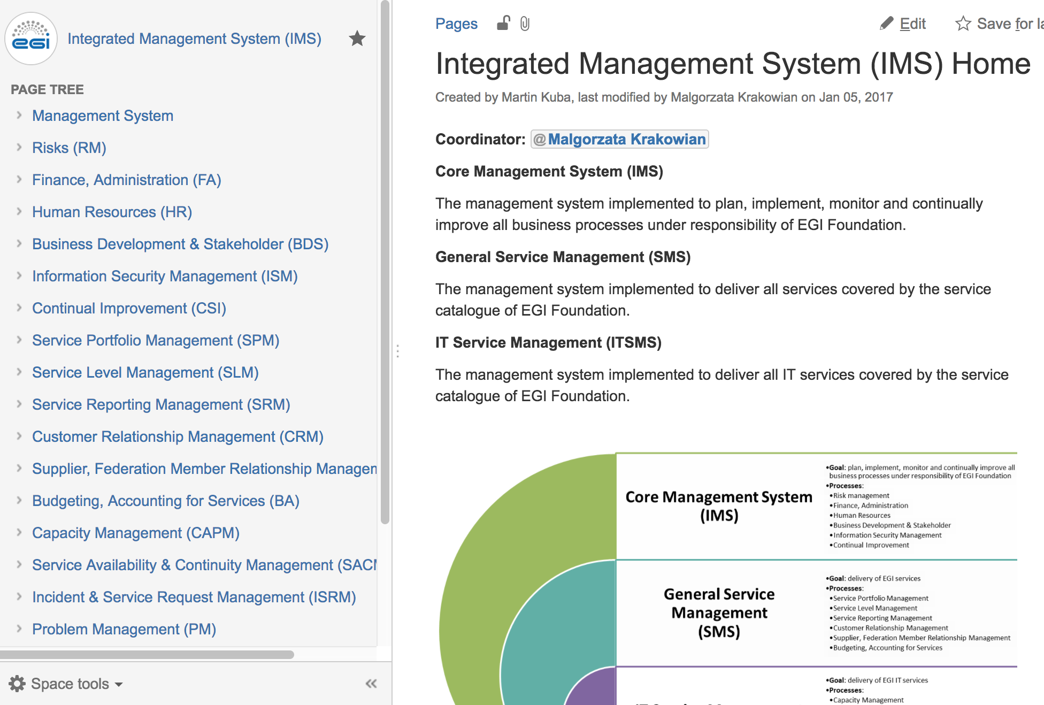
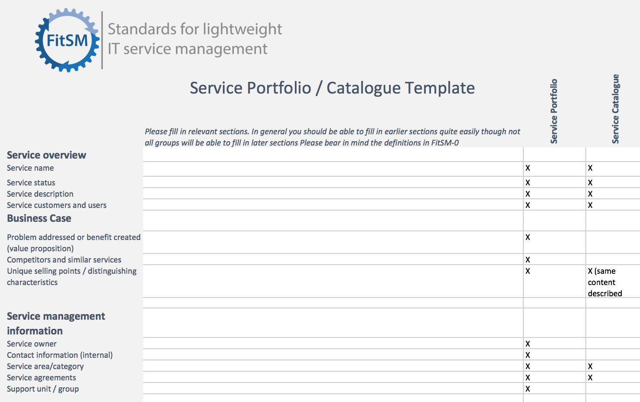
Implementing a FitSM service management system: Technical tools
Process documentation
e.g. Confluence, Wikimedia
Ticket tool
e.g. GGUS, JIRA, RT
Templates
e.g. Word docs, Excel, Google Apps, Forms

