Slide 1
EGI: advanced computing for research
in Europe… and beyond!
Gergely Sipos and Giuseppe La Rocca
User Community Support Team
EGI Foundation
Kenet Research Infrastructures Workshop
1 December 2016
www.egi.eu
Permalink to slides: https://documents.egi.eu/document/2999
The EGI-Engage project is co-funded by the European Union (EU) Horizon 2020 program under grant number 654142

Slide 2
Outline
EGI overview talk (Gergely) 15’
OneData intro talk (Giuseppe) 15’
OneData demo (Giuseppe) 15’
Federated Cloud talk (Gergely) 15’
Federated Cloud demo (Giuseppe) 15’
Next steps 5’
Q&A 10'

Slide 3
EGI: Advanced Computing for Research
Notes:
A globally distributed ICT infrastructure that federates the digital capabilities, resources and expertise of national and international research communities in Europe and worldwide.
EGI has delivered unprecedented data analysis capabilities to more than 48,000 researchers from many disciplines and is now committed to bring innovation to the private sector.

Slide 4
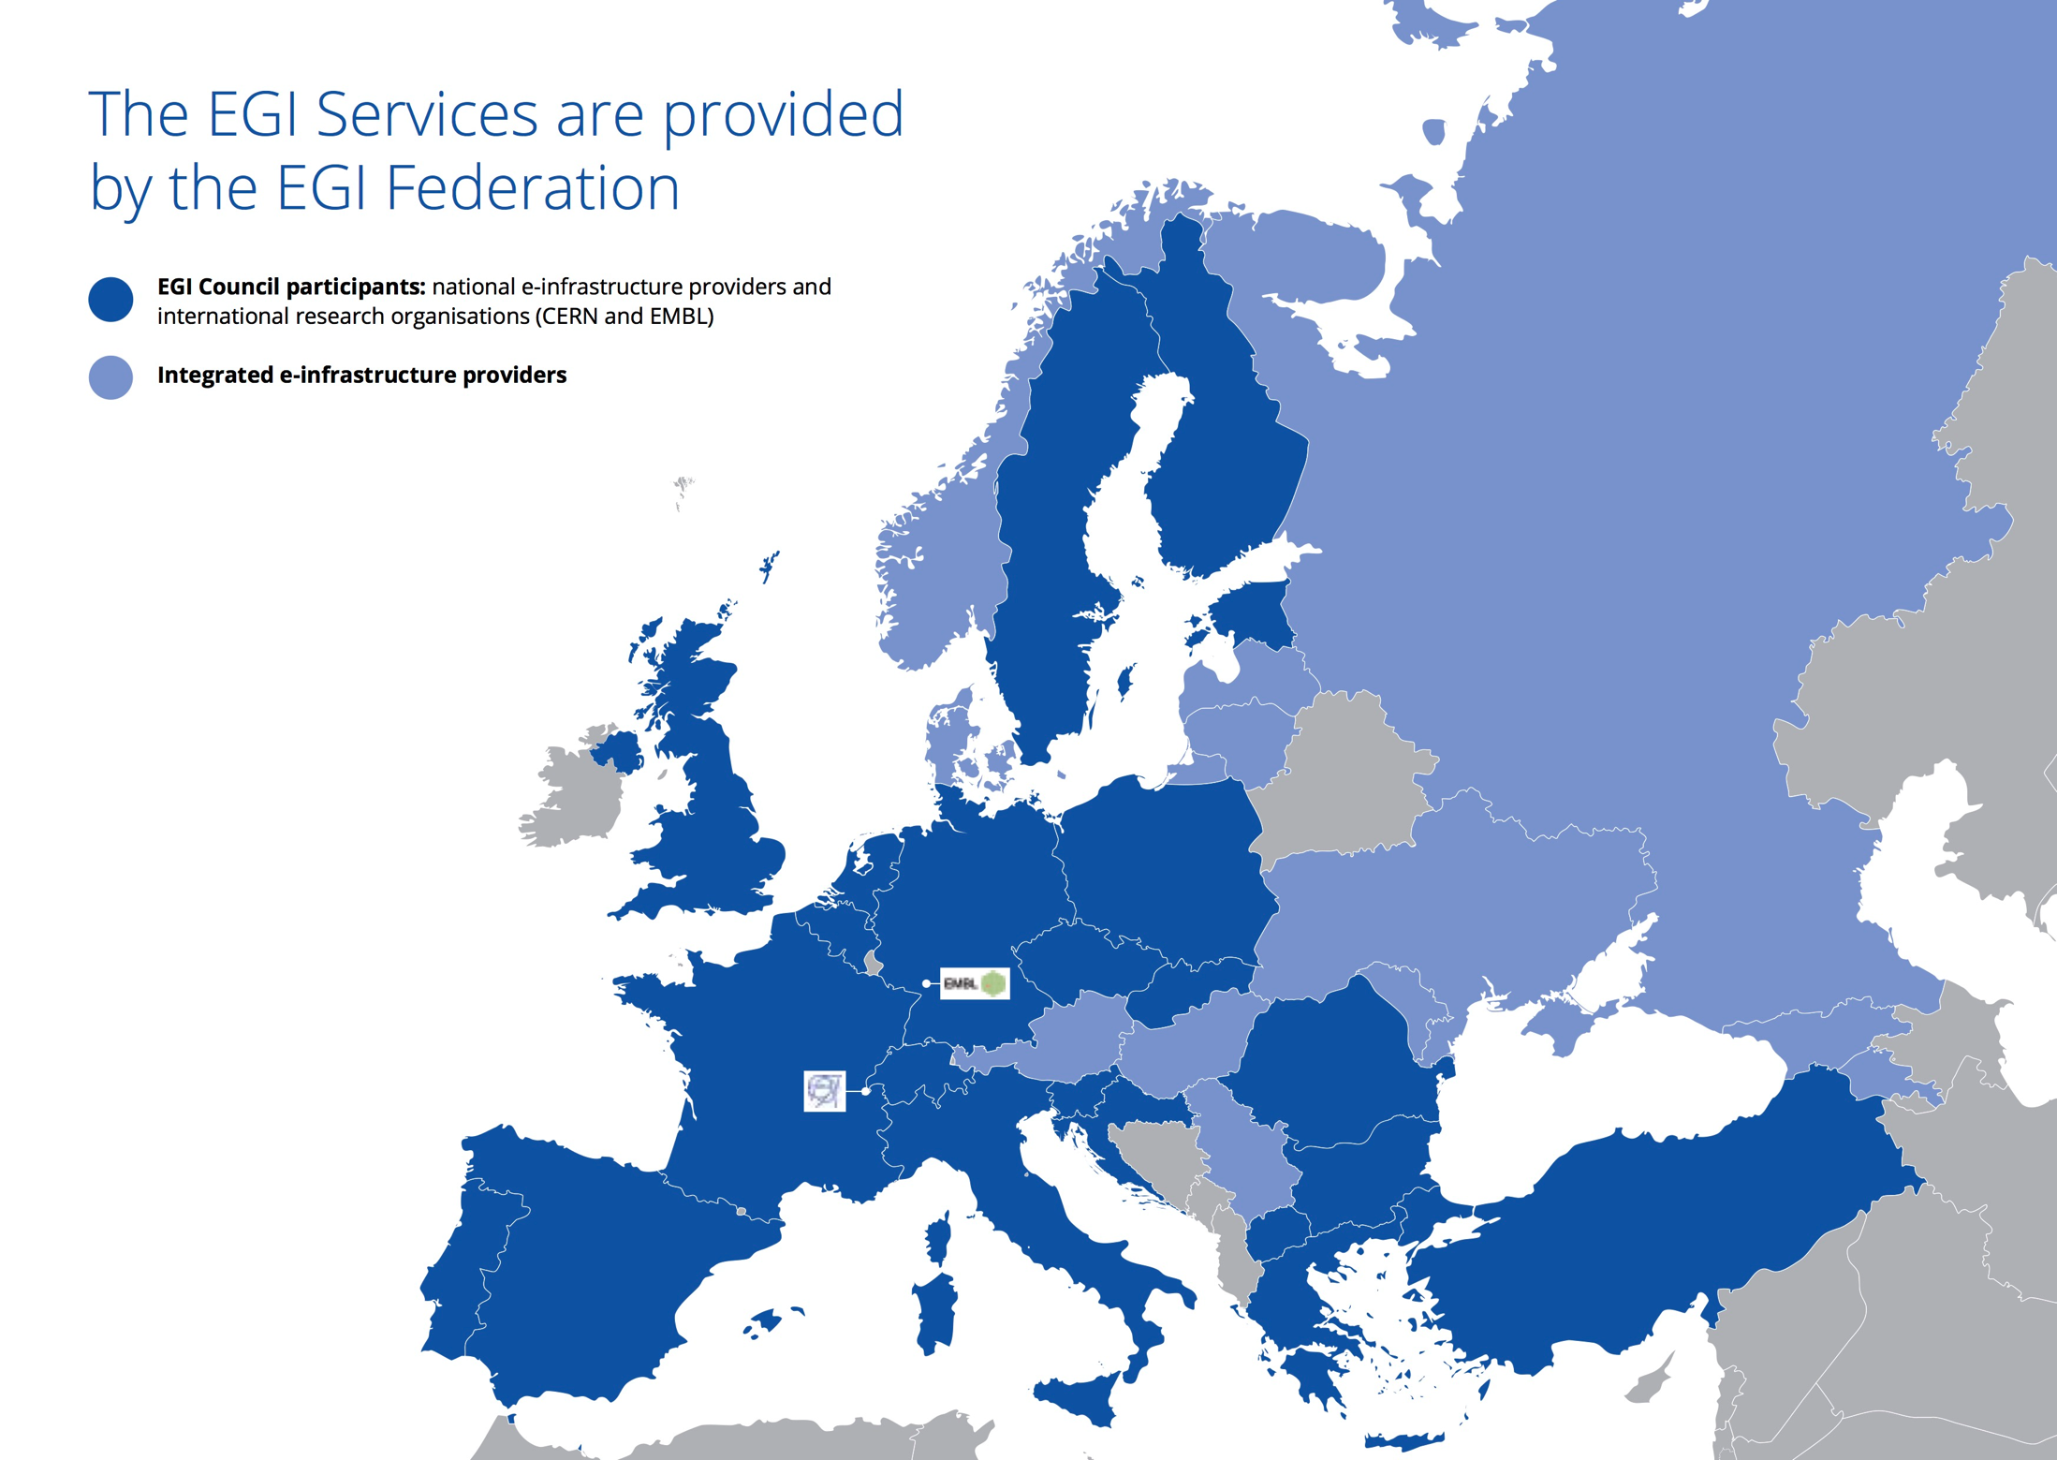
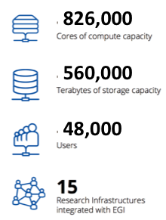
EGI Foundation
Notes:
E-Infrastructures are geographically distributed computing resources and data storage facilities linked by high-performance networks. They allow scientists to share information securely, analyse data efficiently and collaborate with colleagues worldwide. They are an essential part of modern scientific research and a driver for economic growth.
EGI was established in 2010 building on over a decade of investment by national governments and the European Commission. EGI is a European-wide federation of national computing and data storage resources. Its aim is to support cutting-edge research, innovation and knowledge transfer in Europe. EGI federates resources from various resource centres, mainly from research insitutes and universities. These centres provide computer clusters, storage servers, applications and human support services for secure access and sharing. EGI provides these services to European researchers and their international collaborators.
EGI is coordinated by EGI.eu, a not-for-profit foundation based in Amsterdam and owned by EGI’s participants, the National Grid Infrastructures (NGIs).

Slide 5
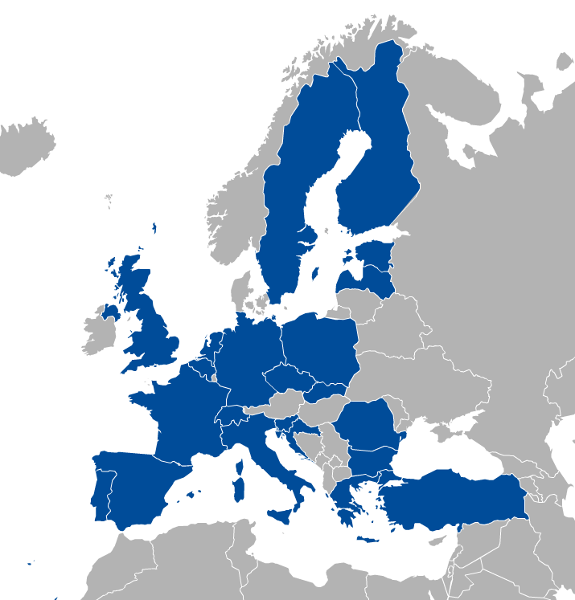
EGI Membership
Major national e-Infrastructures: 22 NGIs
EIROs: CERN and EMBL-EBI
EGI Foundation
(ERICs)
www.egi.eu/about/egi-foundation/

Slide 6
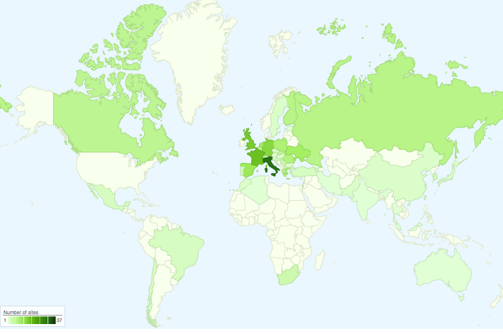
International Partnerships
Canada
China Inst. Of HEP
Chinese Academy
of Sciences
USA
India Centre for
Development of
Advanced Comp.
Africa and Arabia
Council for Scientific and
Industrial Research, South Africa
Asia Pacific Region
Academia Sinica
at Taiwan
Latin America
Universida de Federal do
Rio de Janeiro
Ukraine
Ukrainian National
Grid

Slide 7
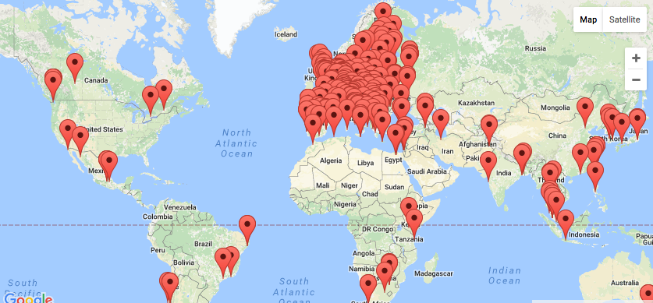
EGI Federation, 2016 QR3 The largest distributed compute e-Infra worldwide
23 Cloud providers, +300 data centres
+250 000 instantiated VMs/year
1.7 Million jobs/day
2.6 Billion CPU hours/year +26%
>48 000 users, +25%

Slide 8
Serving researchers and innovators
Size of individual groups
WLCG
ELI
CTA
ELIXIR
EPOS
EISCAT_3D
BBMRI
CLARIN
LOFAR
EMSO
LifeWatch
ICOS
EMSO
CORBEL
ENVRIplus
…
PeachNote
CEBA Galaxy eLab
Semiconductor design
Main-belt comets
Quantum pysics studies
Virtual imaging (LS)
Bovine tuberculosis spread
Convergent evol. in genomes
Geography evolution
Seafloor seismic waves
3D liver maps with MRI
Metabolic rate modelling
Genome alignment
Tapeworms infection on fish
…
VRE projects
WeNMR
DRIHM
VERCE
MuG
AgINFRA
CMMST
LSGC
SuperSites Exploitation
Environmental sci.
neuGRID
…
Agroknow
CloudEO
CloudSME
Ecohydros
gnubila
Sinergise
SixSq
TEISS
Terradue
Ubercloud
…
ESFRIs, FET flagships
Multinational communities
Industry, SMEs
‘Long tail’

Slide 9
EGI Service Catalogue
Compute
Cloud Compute
Run virtual machines on demand with complete control over computing resources
Cloud Container Compute
Run Docker containers in a lightweight virtualised environment
High-Throughput Compute
Execute thousands of computational tasks to analyse large datasets
→ Aka. ‘Grid computing’
Storage and Data
Online Storage
Store, share and access your files and their metadata on a global scale
Archive Storage
Back-up your data for the long term and future use in a secure environment
Data Transfer
Transfer large sets of data from one place to another
Training
FitSM training
Learn how to manage IT services with a pragmatic and lightweight standard
Training infrastructure
Dedicated computing and storage for training and education

Slide 10
EGI Service Catalogue
with New Developments
Compute
Talk & Demo 2
Cloud Compute
Run virtual machines on demand with complete control over computing resources
Cloud Container Compute
Run Docker containers in a lightweight virtualised environment
High-Throughput Compute
Execute thousands of computational tasks to analyse large datasets
→ Aka. ‘Grid computing’
Storage and Data
Talk & Demo 1
Online Storage
Store, share and access your files and their metadata on a global scale
Open Data Platform (based on OneData)
Share, discover, and process data federated from different sources
Archive Storage
Back-up your data for the long term and future use in a secure environment
DataHub
Access key scientific datasets scalably
Data Transfer
Transfer large sets of data from one place to another
Content Distribution
Deliver data in the most efficient way
Training
FitSM training
Learn how to manage IT services with a pragmatic and lightweight standard
Training infrastructure
Dedicated computing and storage for training and education

Slide 11
Example: Powered by High-Throughput Compute
http://haddock.science.uu.nl/enmr/services/HADDOCK2.2/
HADDOCK
A web portal offering tools for structural biologists
Used to model the structure of proteins and other molecules.
So far, HADDOCK processed + 130,000 submissions from over 7,500 scientists.
Read more...

Slide 12
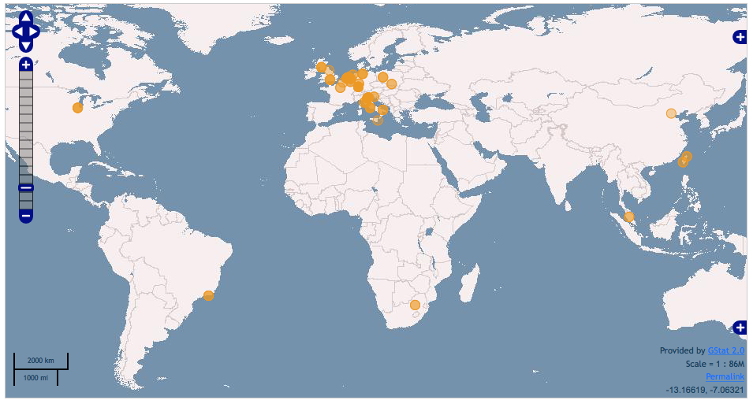
WeNMR0 HADDOCK relies on EGI resources
HADDOCK Portal
Workload manager (DIRAC)
EGI Clusters (CPU and GPU)
World-wide: > 120’000 CPU cores from 41 sites (EGI & OSG)

Slide 13
E-Infrastructure services enable the Open Science Vision
Open research data
Data and computing intensive science
Research and education networking
High performance computing
Big data innovation
Courtesy of the European Commission
Notes:
Positioning EGI on the e-infrastructure landscape

Slide 14
The European Cloud Initiative
European Open Science Cloud (EOSC)
Integration and consolidation of e-infrastructures
Federation of existing research infrastructures and scientific clouds
Development of cloud-based services for Open Science
Connection of ESFRIs to the EOSC
European Data Infrastructure (EDI)
Development and deployment of large-scale European HPC, data and network infrastructure
Widening access
SMEs, Industry at large, Government
Courtesy of the European Commission

Slide 15
OneData
Talk and demo by Giuseppe

Slide 16
Open Science Commons Vision
“Researchers from all disciplines have easy, integrated and open access to the advanced digital services, scientific instruments, data, knowledge and expertise they need to collaborate to achieve excellence in science, research and innovation.”
Open Science Commons paper
KENET Research Infrastructure workshop, 1st. December 2016, Kenya

Slide 17
Open Data challenges
Availability
Distributed, reliable storage, standard and easy protocols for accessing data, replicas
Interoperability
Data should be available in standard, interoperable, open formats
Discovery
Data should be enriched with metadata, which discovery services and users can understand and which can be indexed
Identification
Preservation
Data sets and items must have global unique identifiers which allow for their unambiguous referencing
Provenance
Information on how the data was obtained or generated, in case of simulation data it should be possible to reproduce it
Data stored in long term retention archive should be usable after tens of years after creation
KENET Research Infrastructure workshop, 1st. December 2016, Kenya

Slide 18
Before we start
EGI Open Data Platform (ODP)
Support EC Open Data Cloud vision
Integrate different data repositories available in a distributed environment
Offer the functionalities to make data open and link them to Open Data Catalogues
Onedata
Software stack for distributed data management platform developed externally to EGI
www.onedata.org
KENET Research Infrastructure workshop, 1st. December 2016, Kenya

Slide 19
Open Data Platform – Users’ perspective
ODP
Non-Grid users friendly security – no VO certificate necessary for open data – EGI AAI
Single user interface for personal, research and open data management
Open data specific functionality including DOI registration, publication policies and long term preservation
Users and community data is organized into spaces (virtual folders)
Web interface for data management, including ACL and sharing.
Data can be accessed from local filesystem or Grid and Cloud protocols
KENET Research Infrastructure workshop, 1st. December 2016, Kenya

Slide 20
Open Data Platform – Interfaces
GUI
Web based
Easy data management and sharing, access control
Publication of data items and collections
REST
Advanced data and collection management API for integration with community tools and portals
CDMI
Standard data management operations
Advanced metadata queries
Integration with future data management applications
POSIX
OAI-PMH
HTTP
Enable direct mounting of spaces in the local filesystem without full data transfer
OAI Data Provider interface
Dublin Core metadata by default
More complex metadata can be registered in ODP manually
Direct download of open data from URL’s
KENET Research Infrastructure workshop, 1st. December 2016, Kenya

Slide 21
The EGI DataHub in a nutshell
EGI DataHub is the central point of access for the Open Data Platform.
Makes existing large scale open data collections discoverable and available in an easy way for both EGI users and the general public
Supports fine-grained access policies
KENET Research Infrastructure workshop, 1st. December 2016, Kenya

Slide 22
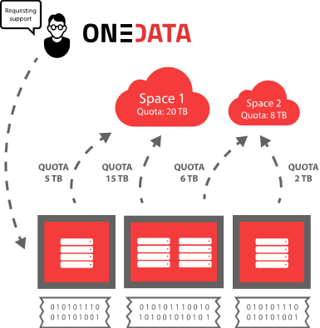
OneData: some basic concepts
Spaces – distributed virtual volume where users can organize their data
Each space has to be supported by at least one Provider, which means that this provider reserve a certain storage quota for this particular space.
Spaces can be shared with other users and even exposed to the public.
KENET Research Infrastructure workshop, 1st. December 2016, Kenya

Slide 23
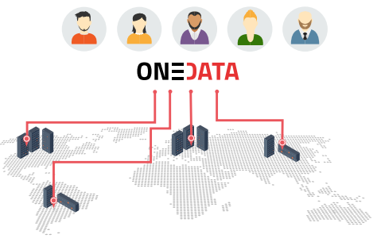
OneData: some basic concepts
Providers – entities who support spaces with storage resources
Any centre can become a provider by installing OneProvider service, attaching some resources and registering it in OneZone service
KENET Research Infrastructure workshop, 1st. December 2016, Kenya

Slide 24
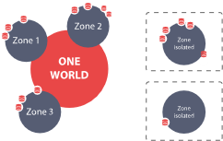
OneData: some basic concepts
Zones – federations of providers
Any organization, community or users group can deploy their own Onezone service
Onezone is responsible for authentication and authorization of users
It allows providers from different zones to interact with each others and share data
KENET Research Infrastructure workshop, 1st. December 2016, Kenya

Slide 25
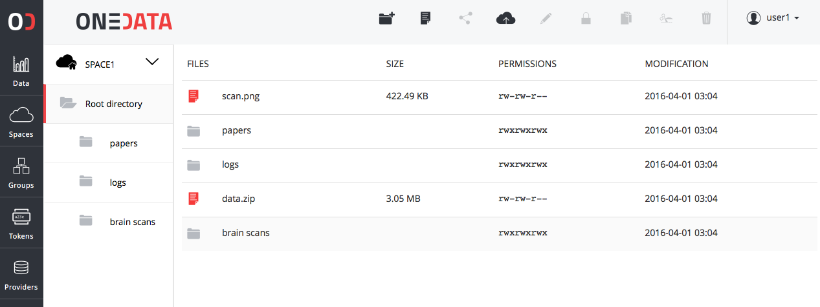
OneData: user interfaces
User web interface
User command line interface
OneData provides also the oneclient CLI
KENET Research Infrastructure workshop, 1st. December 2016, Kenya

Slide 26
Open Data Platform – The big picture
DOI Registrar (e.g. DataCite)
Community Portal
EGI User 1 (VO x)
Anonymous
User 1
EGI User 2
(Onedata space)
Anonymous
User 2
REST
Web GUI
POSIX
HTTP
OAI-PMH
CDMI
REST
Space Manager
Space Manager
Open Data Manager
Metadata Registry
OAI-PMH Data
Provider
Authentication and Authorization
Long Term Retention
Open Data Platform
Generatore AIP package for abc
EGI Site 1
EGI Site 2
EGI Site 3
Cloud storage
EUDAT
KENET Research Infrastructure workshop, 1st. December 2016, Kenya

Slide 27
Browse Copernicus data stored in the EGI DataHub
Open Data Platform – Demo
KENET Research Infrastructure workshop, 1st. December 2016, Kenya

Slide 28
Federated Cloud
Talk (Gergely)

Slide 29
Cloud computing - Key terms
Services and solutions delivered and consumed in real time over the Internet
(Some of the) benefits
Virtualisation – Platform-independence; Self-servicing
Scalability – ‘Pay-as-you-go’; Multi-tenant allocation
Predictability – Versioning of VMs and contextualisation scripts
Abstractions – IaaS, PaaS, SaaS
Open source – KVM, OpenStack, OpenNebula, …
Virtual Machine image
App
App
App
Storage volume
OS
Cloud management framework (e.g. OpenStack)
Hardware
Virtualized Stack

Slide 30
What is a cloud federation? – A ‘definition’
Practice of interconnecting cloud service providers. Motivations:
Data locality; Data privacy; Shared investment; Distributed expertise, …
Multiple cloud sites with some sort of interconnection(s). Examples:
Every cloud registered in a single catalogue
Single VM image catalogue for users
Support for the same image format
Automated distribution of VM Images to the federated clouds
Single sign-on for users
Harmonised operational practices
Cloud configurations, integrated monitoring, accounting, etc.
Integrated support model
Ticketing system, consultancy, training
EGI Federated Cloud can do all this

Slide 31
EGI Federated Cloud
Grid of clouds
Unified user interfaces
Harmonised operational behaviour
Clouds and their interconnections are based on open standards, open technologies
Infrastructure → Access online AND technology → Deploy at your site

Slide 32
Benefits, technologies
Uniform user interfaces
Harmonised operation
OpenStack
OpenNebula
Cloud registry
Information system
Virt. Machine marketpl.
Usage accounting
Access control
Synnefo
OpenStack
OpenNebula
OpenStack

Slide 33
Benefits, technologies
VM and block storage management:
Object storage management (optional):
CDMI - on any site
OpenStack SWIFT – on OS sites
- On every site
OpenStack Nova - On OS sites
Uniform user interfaces
Harmonised operation
OpenStack
OpenNebula
Cloud registry
Information system
Virt. Machine marketpl.
Usage accounting
Access control
Synnefo
OpenStack
OpenNebula
OpenStack

Slide 34
Inside a cloud site – Technical slide
OpenStack Nova
Manage instances
Uniform interfaces and behaviour
Share & endorse VM images (OVF)
Cloud Site
(OpenStack)
Cloud Site
(OpenNebula)
Cloud Site
(Synnefo)
Image replication (VMCatcher)
Cloud Providers
Virtual Appliances Catalog (AppDB)
VM image in the VO image list
Service registry (GOCDB)
Information system (BDII)
Accounting (APEL)
Monitoring (ARGO)
AAI (PERUN)
Operation services
EGI e-infrastructure operation tools

Slide 35
The current infrastructure
Today:
23 providers from 14 NGIs
15 OpenStack
7 OpenNebula
1 Synnefo
~6.000 cores in total

Slide 36
Access to EGI resources: Virtual Organisations
VO 1 (cloud a, b, c)
VO 2 (cloud b, c, d, e)
Generic VOs – e.g. fedcloud.egi.eu → Incubator for new users
Discipline/community-specific VOs – e.g. CHIPSTER, EISCAT, biomed, etc. (with SLAs & OLAs)
Browse VOs at http://operations-portal.egi.eu/vo/search (both grid and cloud)

Slide 37
The typical user workflow
Clouds in your Virtual Organisation (e.g. fedcloud.egi.eu)
Visual lookup
OCCI or Nova calls (GUI/CMD/API)
VM
VM
VM
VM
VM
VM
VM
Storage
Appliances Marketplace (AppDB)
VM
Virtual/Software Appliances of your Virtual Organisation
VM
VM
VM
VM
VM
VM
VM
VM
VM
Notes:
Remark: The Virtual Appliances Catalogue does not store physically the VMs. It stores only references and metadata about the VMs. The VMs are physically stored elsewhere – e.g. third party HTTP server, EGI Repository

Slide 38
The typical user workflow
Clouds in your Virtual Organisation (e.g. fedcloud.egi.eu)
Application Portal, framework, SaaS, etc..
Visual lookup
OCCI or Nova calls (GUI/CMD/API)
VM
VM
VM
OCCI or Nova calls (CMD/API)
VM
VM
VM
Programmatic lookup (API)
VM
Storage
Appliances Marketplace (AppDB)
VM
Virtual/Software Appliances of your Virtual Organisation
VM
VM
VM
VM
VM
VM
VM
VM
VM
Notes:
Remark: The Virtual Appliances Catalogue does not store physically the VMs. It stores only references and metadata about the VMs. The VMs are physically stored elsewhere – e.g. third party HTTP server, EGI Repository

Slide 39
Typical usage models
Compute and data intensive workloads
Batch or interactive (e.g. Jupiter notebook) with scalable and customized environments
Service Hosting
Long-running services (e.g. web server, database, application server)
Datasets repository
Store and manage large datasets (in a storage volume)
Disposable and testing environments
Host training environments, test applications

Slide 40
Combined models
Combine usage models in a single application
Scalable Service hosting
Block Storage RAID
Web
Server
Data
Server
attach
End User
spawns
mount
Worker
Worker
Worker
analyse
data
Scalable Compute and data processing
Object Storage*
* Object storage (CDMI or other) is not available on every site

Slide 41
Example: Chipster
Analysis software contains over 300 analysis tools for NGS, microarray, proteomics and sequence data.
Usage Model
Heavy computation and large memory
Scientific Disciplines
Bioinformatics
Deployment in the Federated Cloud
Web service
Manage large datasets
Chipster
VM
Chipster
VM
EGI FedCloud Resource Provider
NFS
Server
Complex deployment through contextualisation
shared block storage exported as NFS up to 1 TB
Tools
Volume
Data
Volume

Slide 42
Demo
(Giuseppe)

Slide 43
Next steps

Slide 44
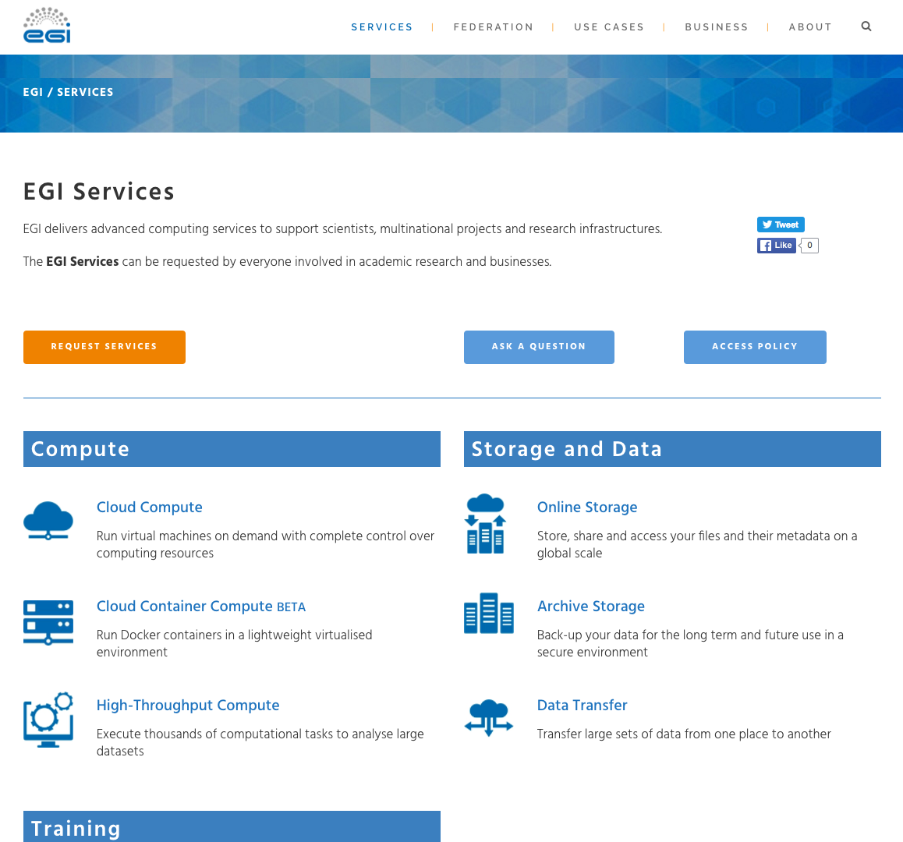

Slide 45
Practical next steps
Support through national partners → Working with Kenet
Central allocations
EGI Federated Cloud: fedcloud.egi.eu Virtual Organisation
https://wiki.egi.eu/wiki/Federated_Cloud_user_support
To be opened soon: Easy Access platform
Community-specific allocations
https://operations-portal.egi.eu/vo/search → E.g. search by discipline
You can request a new allocation too! (Through www.egi.eu website)
Community-specific applications:
Browse the EGI Applications Database: http://appdb.egi.eu → E.g. search for ‘monte carlo’
Webinars:
https://wiki.egi.eu/wiki/EGI_Webinar_Programme → See past recordings
In case of questions:
Contact the User Community Support Team: support@egi.eu

Slide 46
Thank you!
Get in touch!
@EGI_eInfra
EGI Foundation • Science Park 140 • 1098 XG Amsterdam •
The Netherlands
+31 (0)20 89 32 007 • egi.eu

