Slide 1
Federated infrastructures for data valorisation and open science
Gergely Sipos
Head of Services, Solutions, Support
EGI Foundation
Notes:
Chinese partners are present since the beginning: IHEP since 2010, CAS since 2020 - Pictures of their contributions
Value proposition 1: Services for federation
Value proposition 2: Services for science
Complexity → Cloud. Example with WeNMR
Big data and AI → DataHub, FTS, RUCIO. Example with ?
Reproducibility → Notebooks+Binder. Example with ?
We are an important part of the European Open Science puzzle, EOSC
Other players: OpenAIRE - Scholarly comms; Science clusters: Disciplinary data producers, FAIR-ifiers, Processors

Slide 2
The EGI Federation is an international e-infrastructure
We provide advanced computing and data analytics for research and innovation
2010
From the Large Hadron Collider compute grid…
2022
….to a multidisciplinary, global, open science infrastructure

Slide 3
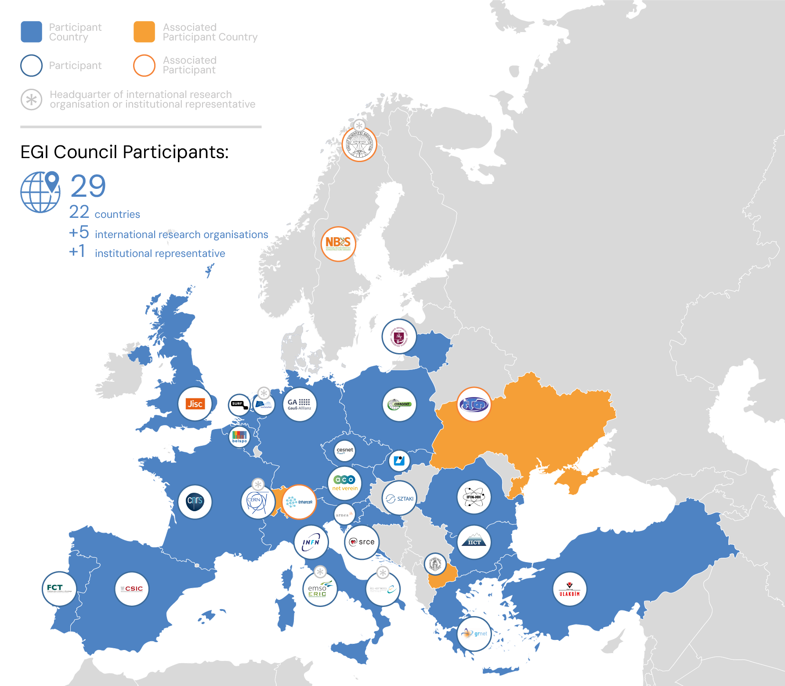
EGI today
Vision
All researchers have seamless access to services, resources and expertise to collaborate and conduct world-class research and innovation
Mission of the EGI Federation
Deliver open solutions for advanced computing and data analytics in research and innovation
Mission of the EGI Foundation
Enable the EGI Federation to serve international research and innovation together

Slide 4
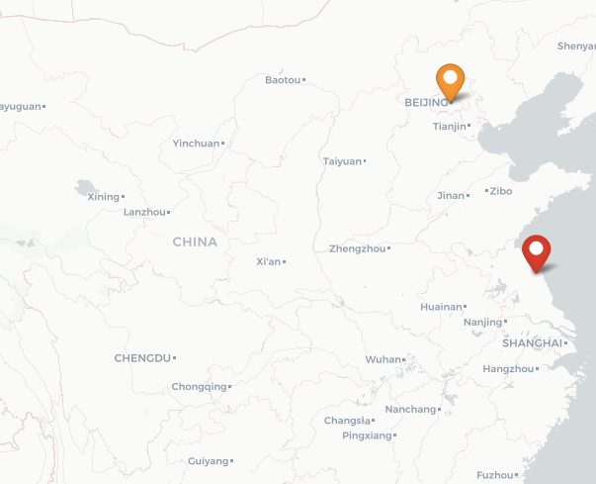
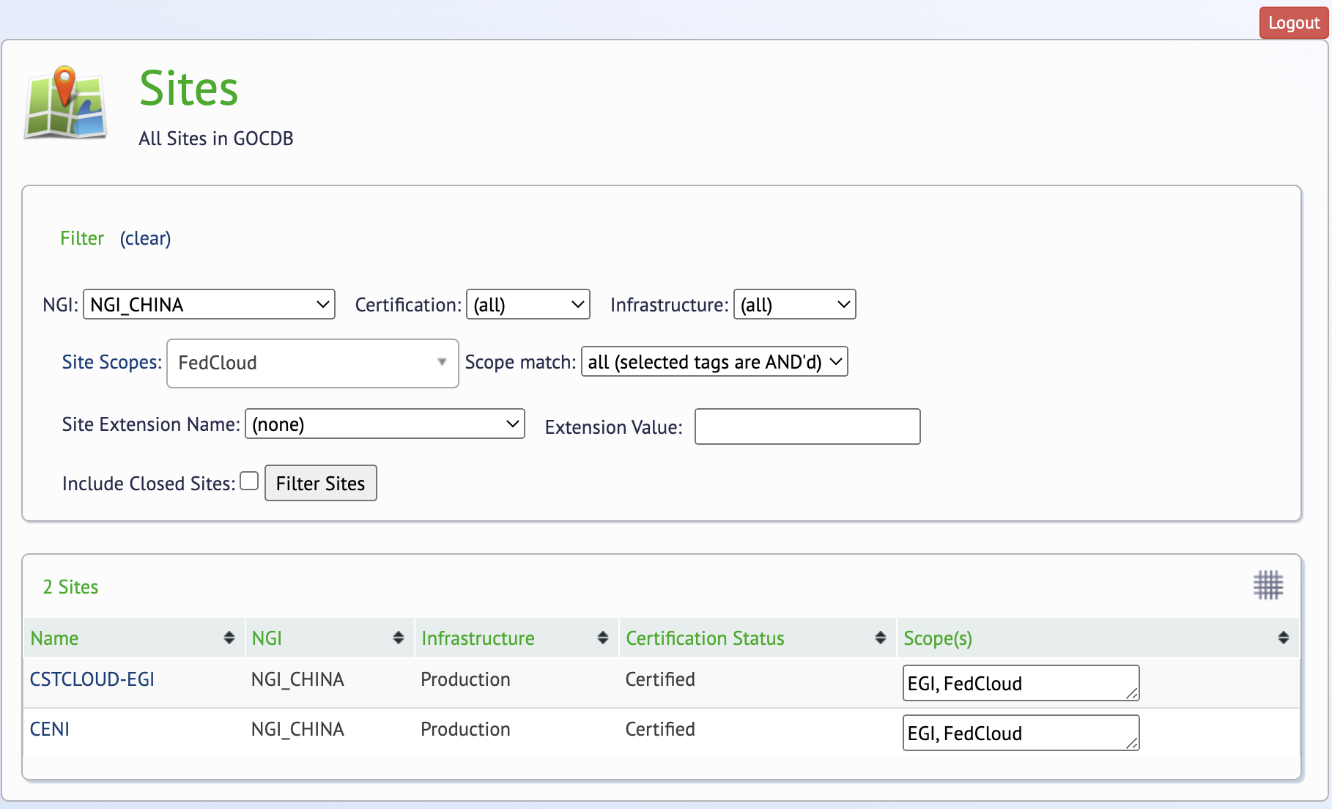
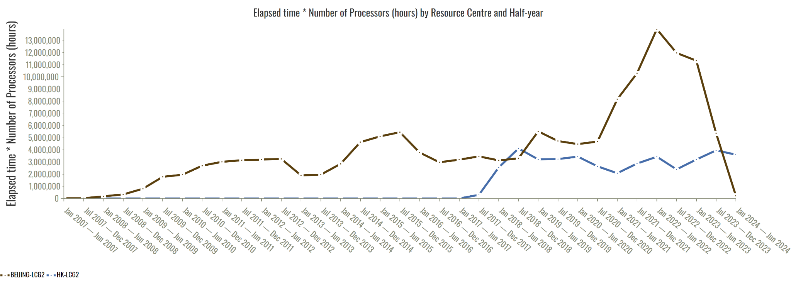
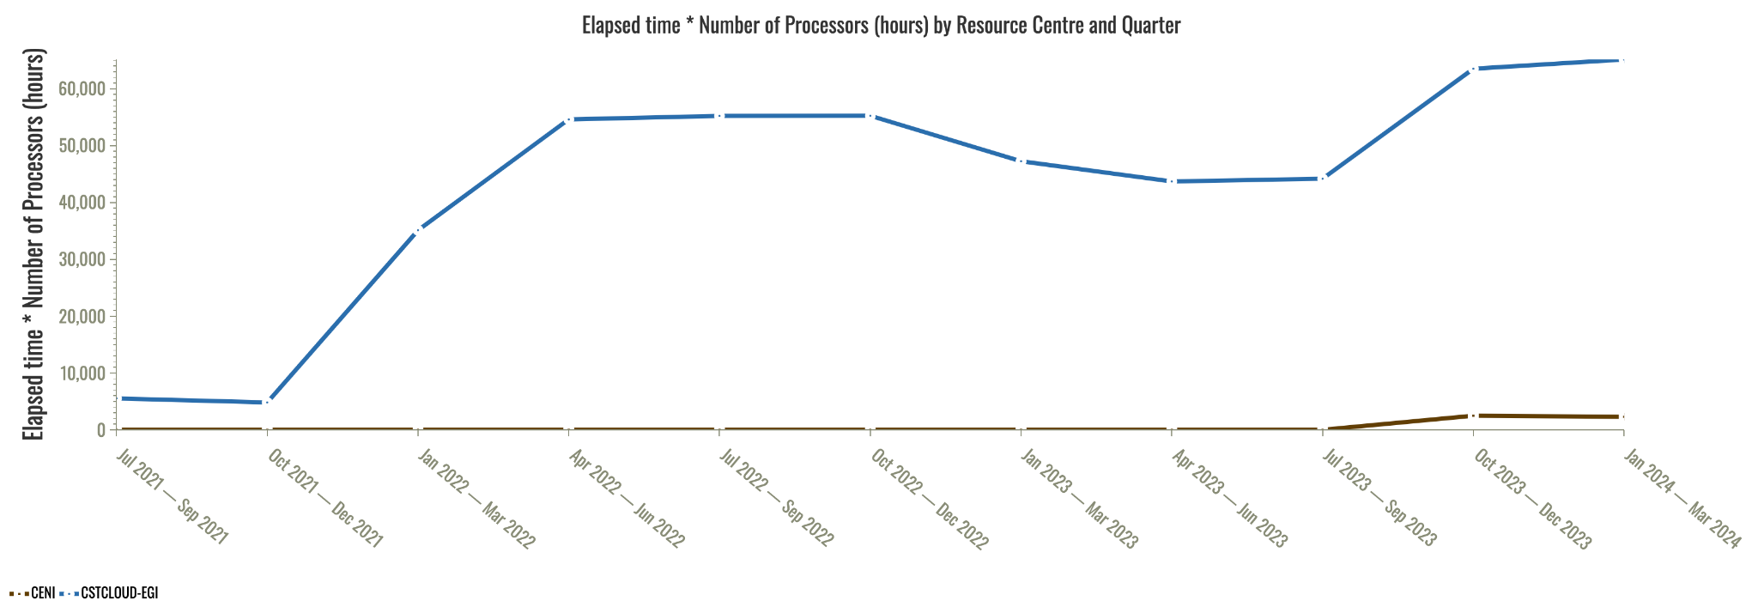
Partnerships in China
Since 2007 - IHEP - High Throughput resources for CERN experiments
(2) In 2019 - Shanghai Science and Technology Innovation Resources Center (SSTIR)
(3) Since 2020 - Chinese Academy of Sciences (CAS) - Cloud resources for WeNMR (structural biology), EISCAT_3D (atmospheric research) and future communities

Slide 5
(Some of the) challenges in open science
Infrastructure complexity
Big data & machine learning
Scientific reproducibility
…the iMagine project example

Slide 6
iMagine project from the Horizon Europe programme
OBJECTIVE:
To deploy, operate, validate, and promote a dedicated iMagine AI framework and platform, connected to the European Open Science Cloud and AI4EU, giving researchers in aquatic sciences open access to a diverse portfolio of AI based image analysis services and image repositories from multiple Research Infrastructures, working on and of relevance to the overarching theme of ‘Healthy oceans, seas, coastal and inland waters’.
36 months
From Sept. 2022 until Aug. 2025
€4.5 million EC funding
23 participant institutes
18 service installations (Virtual Access)

Slide 7
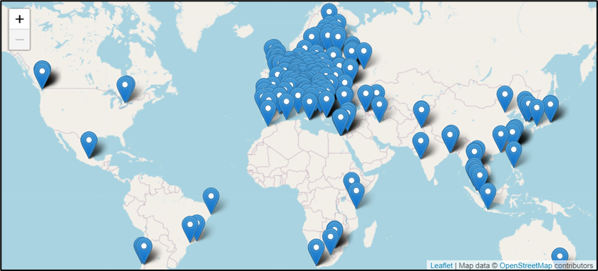
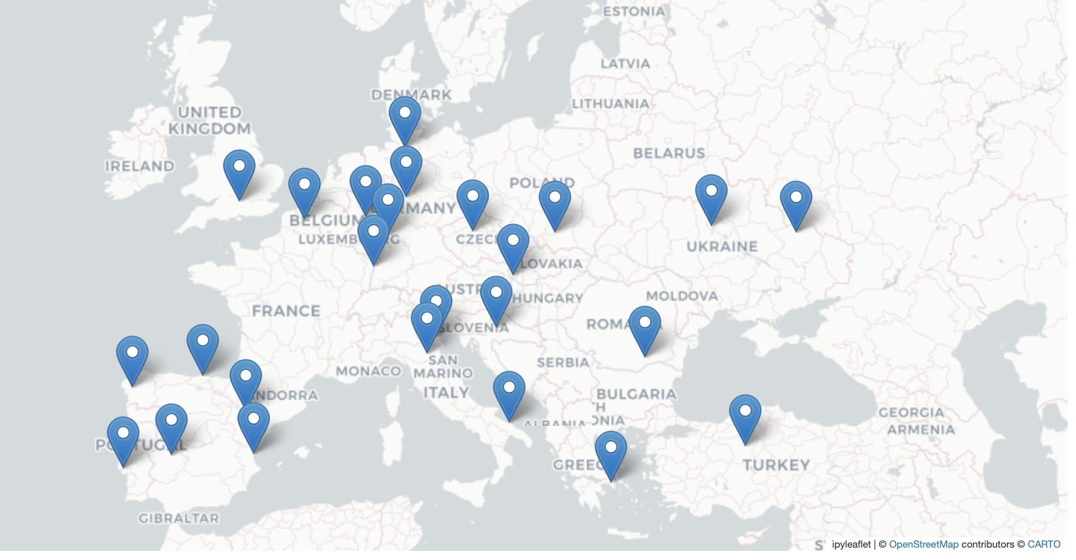
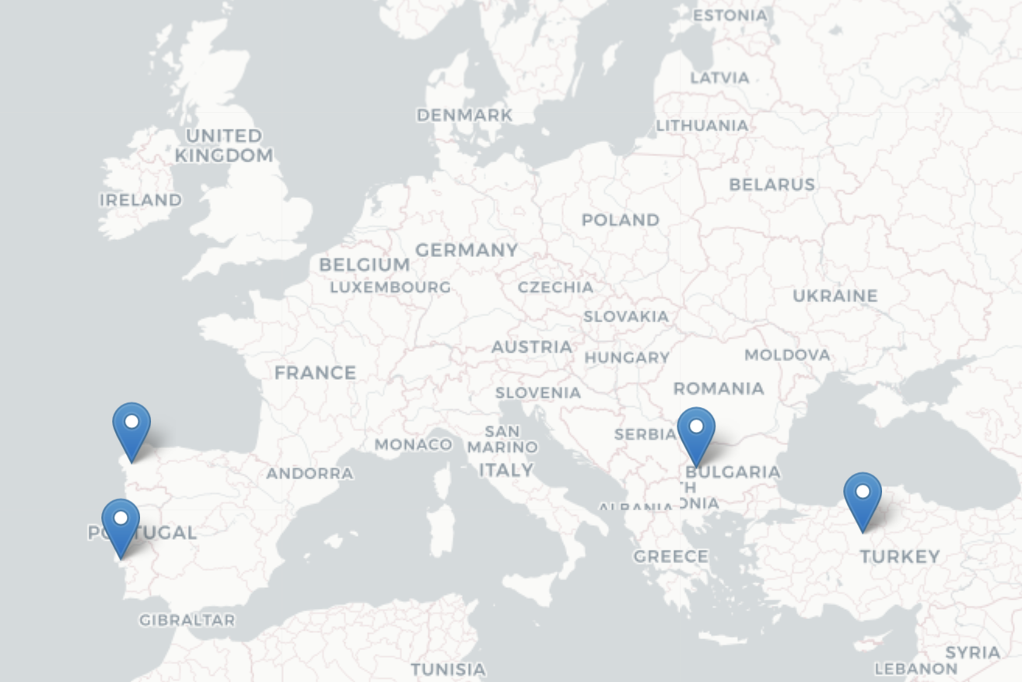
Infrastructure complexity → EGI compute continuum
High Throughput Compute
Benefiting providers
Integrated management capabilities (ISO20k, ISO27k)
User request handling, Helpdesk ticketing, Availability-reliability monitoring, Single Sign-on, Security oversight, etc.
Cloud compute
Benefiting users
High Performance Compute
Harmonised behaviour and access
GUI, API, Command line; Workload and data management, Container, IP addresses, etc.

Slide 8
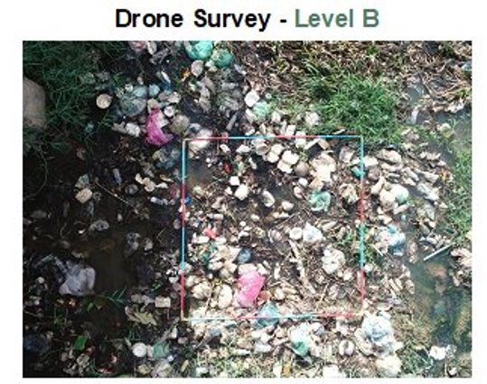
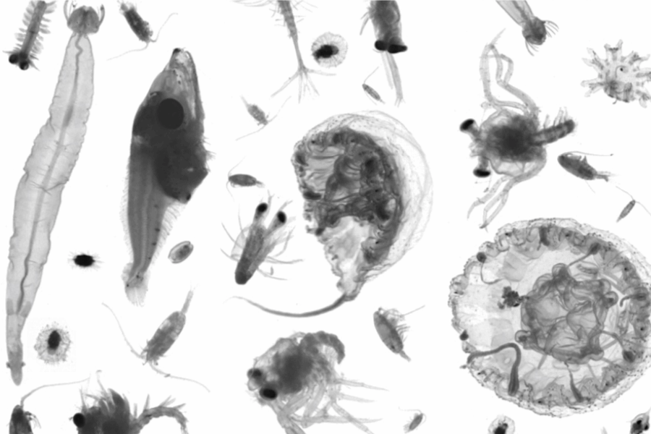
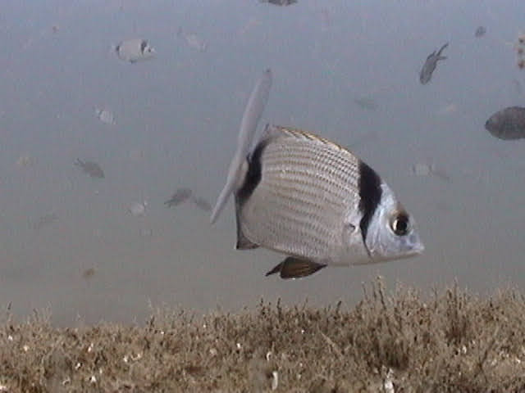
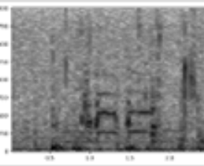
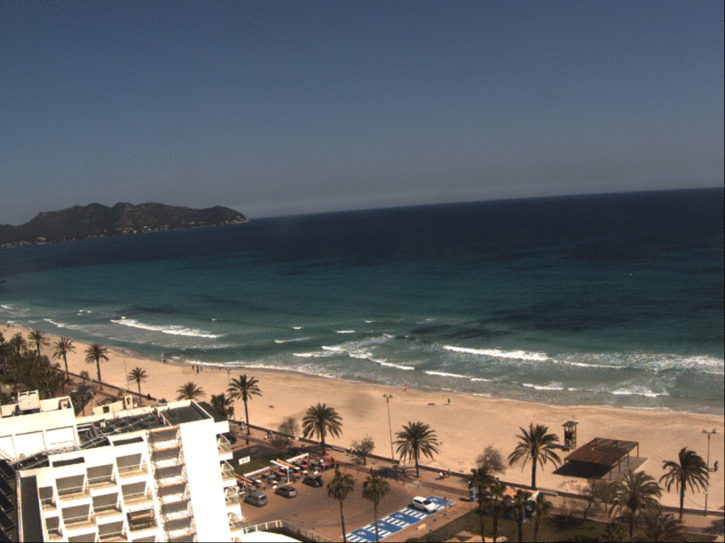
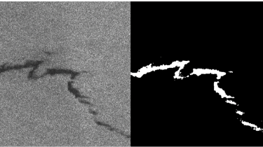
Big data & machine learning → Data federation and AI framework
Use cases
Training images
AI application lifecycle
Data publishing
iMagine AI Platform
Model publishing (for inference)
Powered by:
EGI Cloud Federation

Slide 9
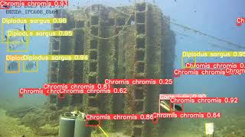

Slide 10
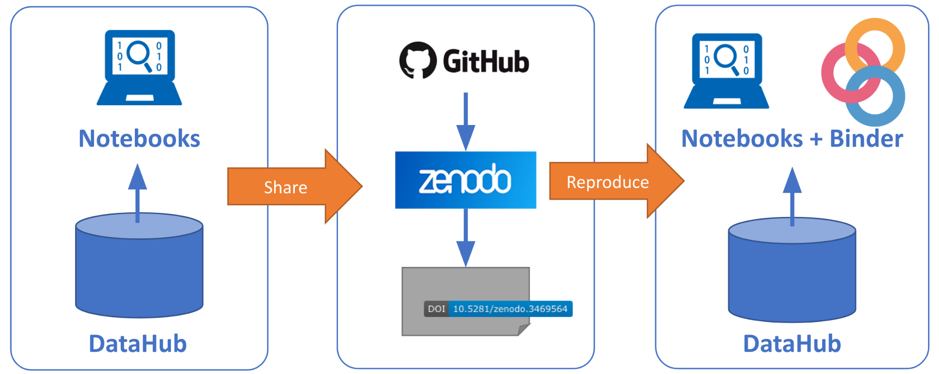
Scientific reproducibility → EGI Notebooks and Binder services
Develop processing application with reference to big data
Share application with a DOI
Re-run application, reuse data

Slide 11
Strategic View
EOSC is the European web of FAIR data and related services for research
Research data that is easy to find, access, interoperate and reuse (FAIR)
Trusted and sustainable research outputs are available within and across scientific disciplines
What
Unlock the full potential of research data to accelerate discoveries and innovation
Why
Strategic Research and Innovation Agenda (SRIA)
eosc.eu/sria-mar
Enable the definition of standards, and the development of tools and services, to allow researchers to find, access, reuse and combine results
Establish a sustainable and federated infrastructure enabling open sharing of scientific results
Ensure that Open Science practices and skills are rewarded and taught, becoming the ‘new normal’
How

Slide 12
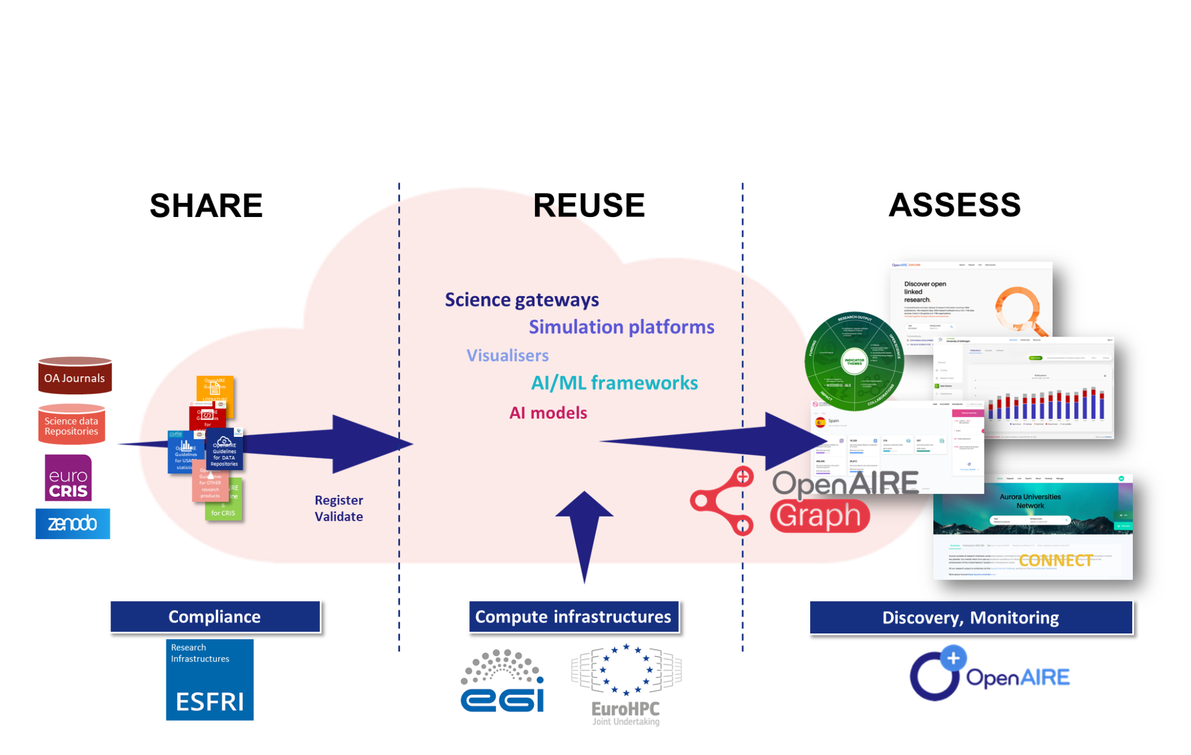
Supporting the entire open science cycle

Slide 13
Related new EOSC Projects on the landscape
Lasting interdisciplinary FAIR data services and working practices through cascading grants to Research Infrastructures
Addressing the call from the EC on the Implementation of the EOSC monitoring mechanism
Create integrated research flows that capture scientific knowledge production from the planning stages, track it, and help assess it.
providing new EOSC Core capabilities allowing scientific applications to find, compose and access multiple Open Science resources

Slide 14
Thank you!
Questions?

