Slide 1
e-ScienceTalk: Supporting Grid and High Performance Computing Reporting across Europe
GA No. 260733
1 September 2010 – 31 May 2013
Catherine Gater
e-ScienceTalk Project Coordinator

Slide 2
Aims of e-ScienceTalk
To build on the significant achievements of GridTalk in bringing the success stories of Europe’s e-Infrastructure to its audiences.
The key challenges are to work with the new EGI ecosystem, maintain and enhance the quality of the existing outputs, while reaching out to new disciplines and regions.
Project dates: 1 Sep 2010 – 31 May 2013

Slide 3
Partners
EGI.eu coordinates the pan-European distributed computing network, the European Grid Infrastructure, and leads the dissemination task.
Queen Mary, University of London coordinates dissemination for GridPP, the UK Grid for Particle Physics and managed press and PR and event co-ordination for EGEE-III.
APO is a web design business based in Bellegarde, France. It has worked previously on grid multimedia communication, including the GridCafé website.
Imperial College is active in e-Science and created the 3-D graphical grid display tool, the Real Time Monitor.
CERN is heavily involved in grid dissemination and coordinated all three phases of EGEE, including leading the outreach activity.

Slide 4
Audiences
Influential policy makers in European science, government and business.
European scientists in a position to develop or exploit grid computing.
The general public in Europe and worldwide.
New audience is university students and final year high school students, the future users of the infrastructure.

Slide 5
Logos

Slide 6
New areas
Cover the broader e-Infrastructure eg volunteer, cloud, high performance computing and the network layer
Work with projects from a wider geographical area, including Asia, Latin America and Africa
Expand the Consortium to include Imperial College, to bring on board their expertise with the Real Time Monitor
Include EGI.eu in the Consortium in the Management work package to maximise synergy in the areas of networking and dissemination
Analyse the reach and impact of longer running products, such as iSGTW and GridCafé and explore sustainability beyond the lifetime of the project for all products
Explore new Web 2.0 technologies such as social media sites and interactive visual environments

Slide 7
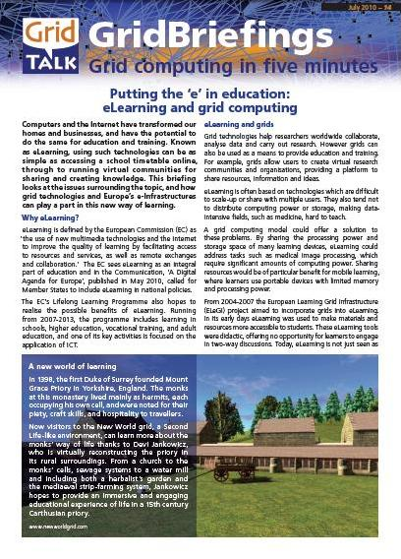
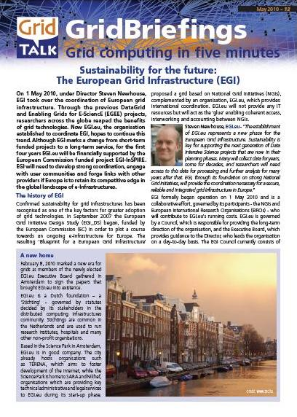
WP1: Policy, impact and sustainability
Reporting targeted at policy makers in government and businesses.
Expand the audience and distribution lists for these outside Europe.
Assess the impact of long running products and explore options for sustainability.
Attend events in order to influence policy makers and distribute GridBriefings.
Lead the e-concertation meetings in the e-Infrastructure area, maximising media impact

Slide 8
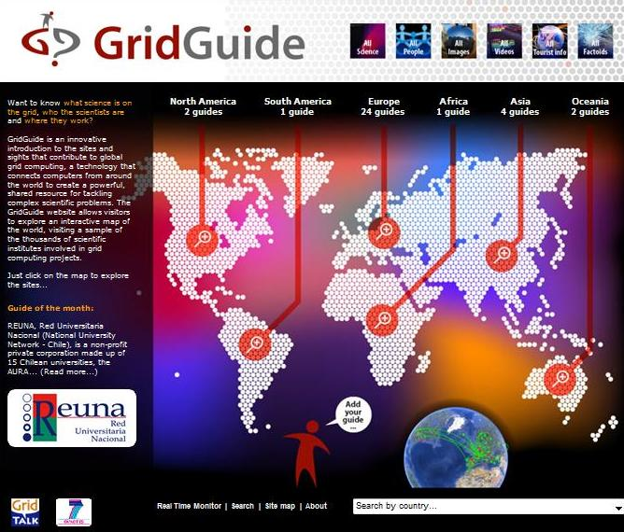
WP2: GridCafé, GridCast and GridGuide
Keep the GridCafé site at the cutting edge and expand it to cover new areas of distributed computing.
Expand the GridGuide to cover more sites and develop further interactivity with the Real Time Monitor.
Explore interactive environments and new web tools for GridCafé and GridCast.
Update the GridCast website and market it widely to the e-Infrastructure community and beyond.

Slide 9
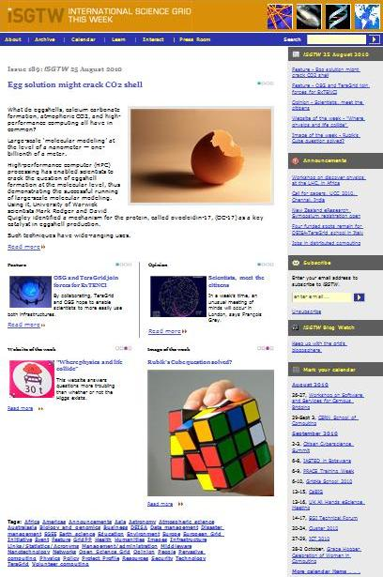
WP3: International Science Grid This Week
Produce a weekly electronic newsletter in partnership with the US Editor about grid and e-Infrastructure projects around the world.
Expand the coverage of iSGTW to report from geographic regions outside Europe and the US, particularly Asia and Latin America.
Expand the coverage to other forms of distributed computing, such as clouds, volunteer grids, high performance computing, networks and data.

Slide 10
WP4: Management
Ensure the effective coordination and running of the project, manage activities and monitor progress.
Handle all reporting on behalf of e-ScienceTalk to the EC services.
Compile and organise the assessment of the project’s results and produce an overall guide to dissemination for EU projects, based on the lessons learnt.
Assist the EC in the organisation of information days, concertation and brainstorming activities with access to videoconferencing activities.

Slide 11
Upcoming events
Citizen Cyberscience Summit 2-3 September, London
Media sponsor and project launch
EGI Technical Forum 2010 14-17 September, Amsterdam
Joint booth with EGI, media sponsor
ICT 2010: Digitally Driven 27-29 September, Brussels
Joint booth with EUIndiaGrid

Slide 12
Upcoming events
eChallenges 2010 27-29 October, Warsaw
Booth
E-Concertation Meeting 4-5 November, CERN
Hosts and media outreach
SC10 14-20 November, New Orleans, US
Gridcast, iSGTW coverage

