Slide 1
European grid services for earth science
Steve Brewer
Steve.brewer@egi.eu

Slide 2
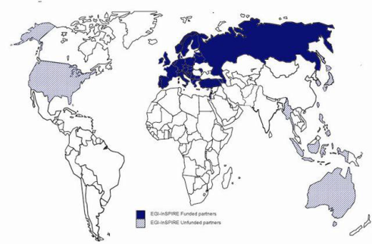
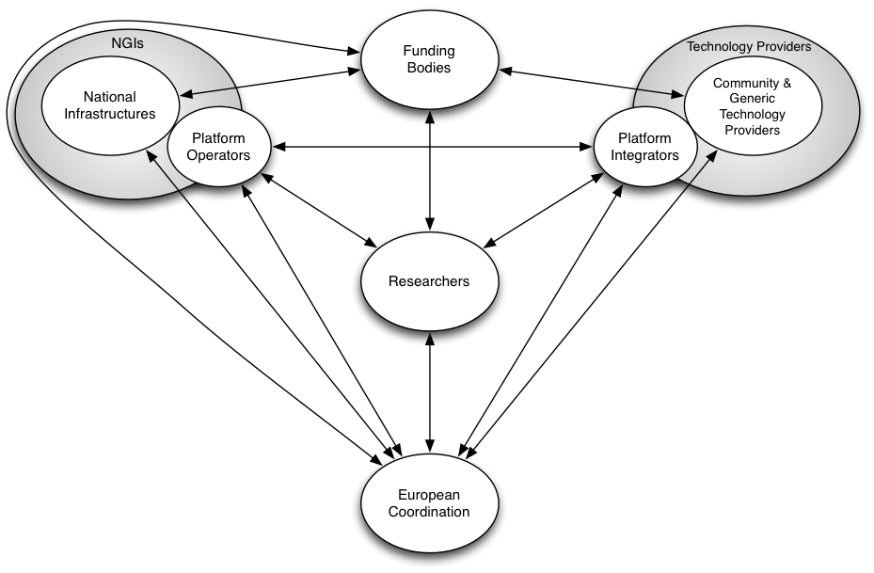
European Grid Infrastructure
EGI.eu (not-for-profit org)
Established February 8th 2010
Central policy & services
Sustainable, ~20 people
Based in Amsterdam, NL
Partners provide services
EGI-InSPIRE project
4 year project, 25M EC funds
50 project partners
EGI Ecosystem

Slide 3
VOs, VRCs and partner projects
Virtual Organisations: rules defining people & resources
VRCs are self-organised (virtual) research communities which give individuals within their community a clear mandate to represent the interests of their research field within the EGI ecosystem.
Current EGI VRCs: (http://www.egi.eu/community/vrcs/)
WeNMR - Structural biology
LSGC – Life sciences
HMRC – Hydro-meteorology
WLCG – High energy physics NEW!
CLARIN/DARIAH – Humanities (with a Letter of Intent)

Slide 4
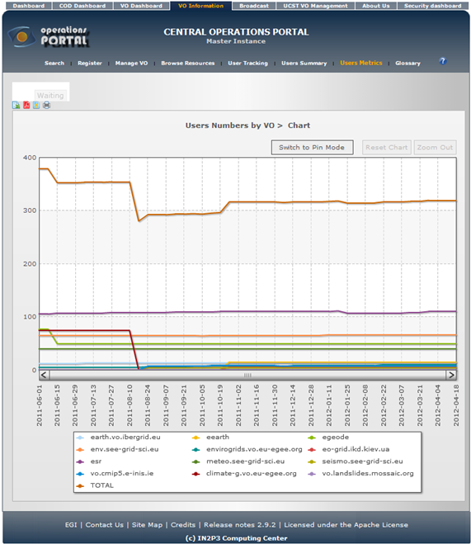
EGI and the Earth Sciences
ES Community in EGI-InSPIRE – Sustainable services for ES
Participation in User Community Board (UCB)
Synergy with other communities
Requirements gathering
Contact Horst Schwichtenberg or Monique Petitdidier for further info.
http://www.euearthsciencegrid.org
ES Teams in 25 European and related countries and beyond
12 Virtual Organisations related to Earth Sciences
operations-portal.egi.eu/vo/usersMetrics

Slide 5
EGI: strategy for 2020
Pillars of the strategy:
European-wide coordination and interaction with research communities and national resource infrastructure providers
Coordination, maintenance, operation and delivery of an open uniform European-wide federated production infrastructure
Developing and promoting technologies for federating new resources
Supporting the integration and operation of scalable interdisciplinary Virtual Research Environments personalised to each research community
http://go.egi.eu/EGI2020

Slide 6
EGI activities: forums, workshops, VTs and TFs
Forums
Every 6 months, around 500 people meet to share knowledge and plans
Keynotes, presentations, workshops, training, demonstrations, posters
Task Forces
Federated Clouds
MAPPER
Identity
Workshops (face-to-face and also ‘webinars’)
Integration of complex scientific workflow systems with EGI’s services.
Research Infrastructure interested in adopting EGI’s operational tools to support their own distributed production infrastructure
Science Gateways Workshop
Virtual Team (VT) projects – 3- 6 months (with NGIs)

Slide 7
Technical Forum TF12 - Prague
Theme of Technical Forum in September (17th – 21st):
“Developing an open and sustainable EGI ecosystem to support open science in the digital European Research Area.”
5 tracks:
Operational services
Operational services used by EGI to deliver a federated infrastructure composed of national resource providers
Physical Infrastructure services
Work of technology providers and platform integrators to provide generic infrastructure services that can be integrated into virtual research environments upon which research communities depend
Virtualised Resources: challenges and opportunities
Work of technology providers, platform integrators and platform operators of the grand challenges that relate to the integration of virtualized resource
Virtual Research Environments
Research communities are seeking to establish their own virtual research environments with their own resources and operating their own customized services through the work of platform integrators and platform operators
Coordination and Communication
Focus on reaching out to communities and partners across the ecosystem

Slide 8
VRCs – VREs & EGI
Virtual Research Communities
Created by a project such as CLARIN, ELIXIR, LifeWatch, ...
Virtual Research Environment
EGI Collaboration platform
EGI Community Platform
VM
VM
DB
SW
EGI Infrastructure platform
VM
VM
Research facilities (e.g. detectors, sensor networks)
VM
DB
SW
EGI resources (clusters, storages,...)
Dedicated or shared resources/platforms (e.g. Clusters; EC2, PRACE, XSEDE)

Slide 9
Anatomy of a VRE
EGI support
Service access (Science gateways - portal, desktop and mobile)
EGI support
Service integration (workflows)
EGI support
Services (Applications & data)
Off-the-shelf and custom VM images
Domain specific and generic data repositories
Off-the-shelf and custom applications
EGI support

Slide 10
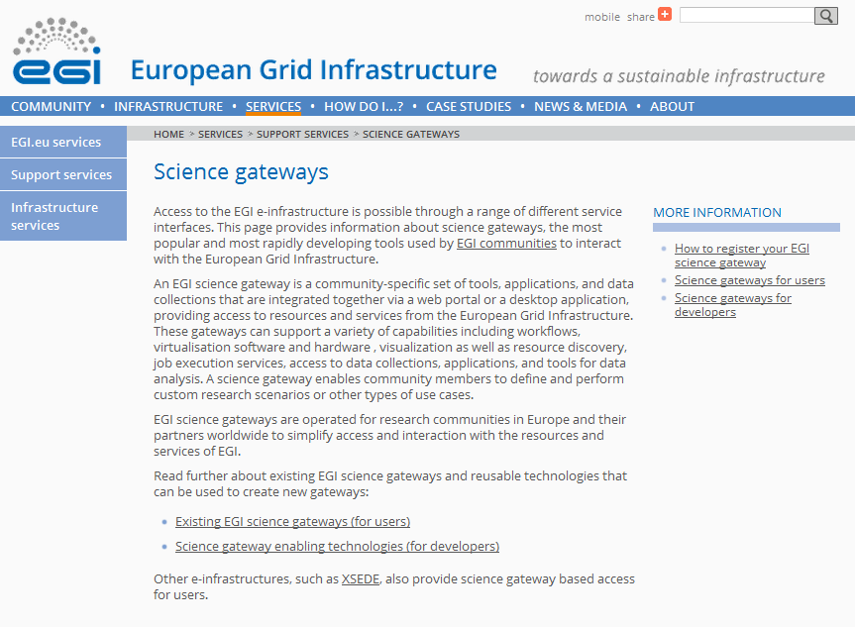
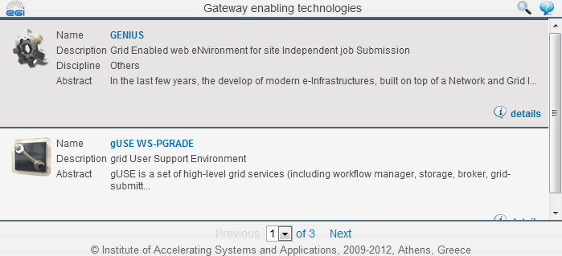
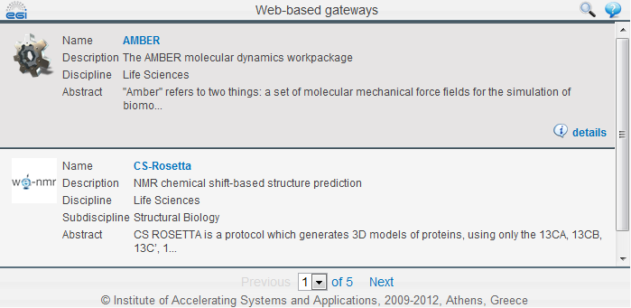
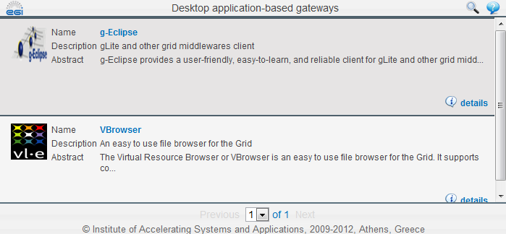
EGI support: Service access
Catalogue of existing solutions
http://go.egi.eu/sciencegateways
Gateway components repository
SCI-BUS portlet repository will be used (see MoU)
Plan: “How-to” documentation
Develop an EGI science gateway primer (through a new EGI Virtual Team project and portal-community@mailman.egi.eu)
Portal & gateway workshops
CF & TF
Portal workshops by NGIs
Community workshops on portals

Slide 11
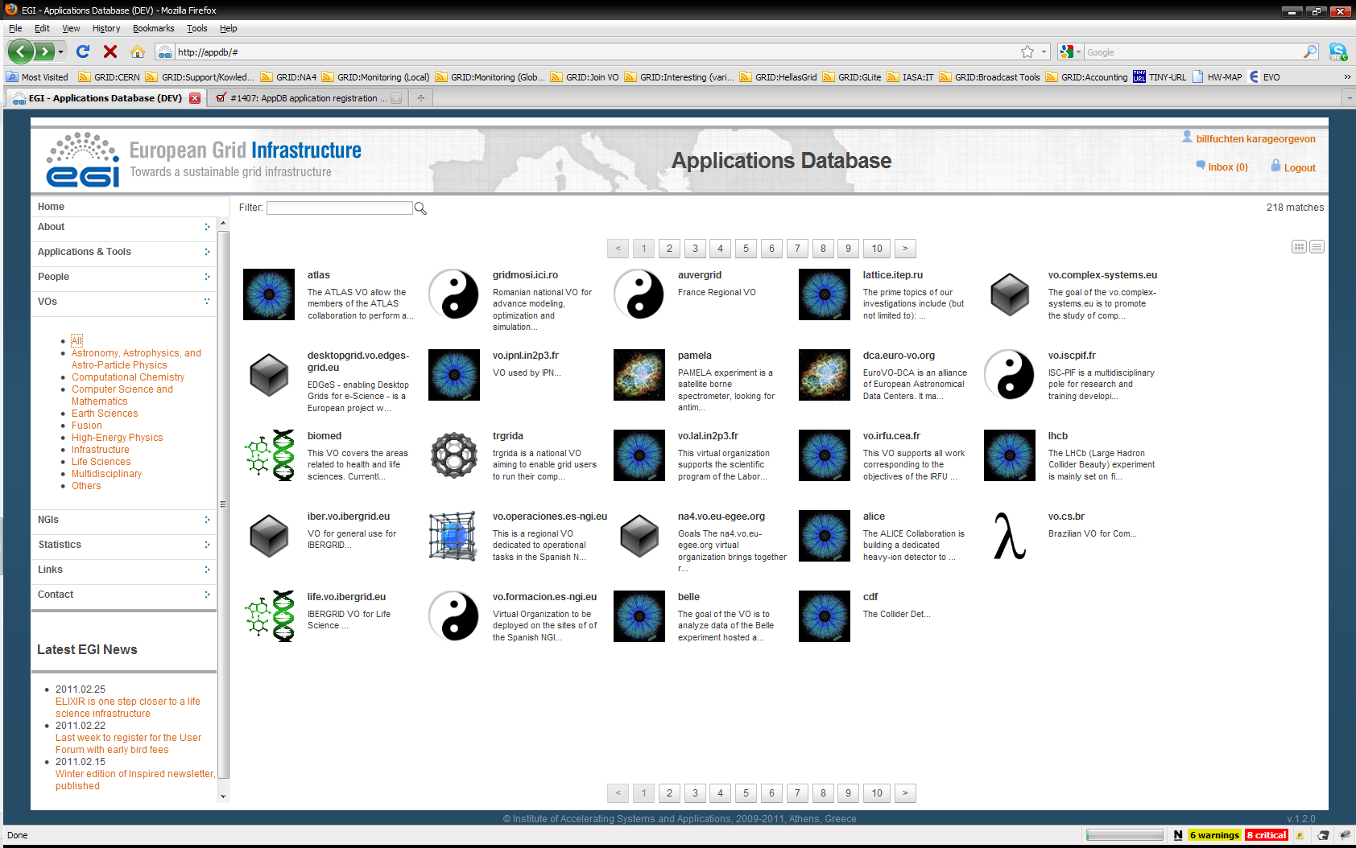
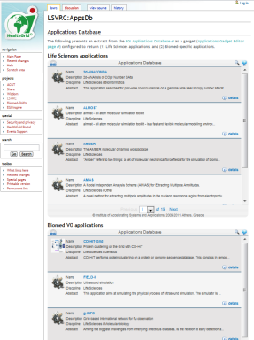
EGI support: Cross cutting support
Applications Database (EGI software catalogue)
Stores information about any EGI software
Tags:
Organise software into clusters
Subscription:
Join an item/cluster as supporter (developer, operator, expert)
Notifications:
To get informed about changes
Web gadgets:
Embed customised lists of software into your website
Write API → Planned
Itegrate the catalogue with the EGI platform (e.g. Info system)
Integrate the catalogue with other catalogues
Training Marketplace
Advertise and search for events, materials, online courses
Web gadgets:
Embed customised lists of software into your website
Events
Community and Technical Forums (Call for TF2012 co-located events is open!)
Topical workshops (hosted by NGIs)

Slide 12
EGI support: Service development and operation
Established & evolving processes from various EGI(-InSPIRE) stakeholders:
EGI Operations
EGI Technology
NGIs, VRCs, EGI.eu
Pojects (e.g. BioVel, Scalalife, ...)
But the EGI platform is about to change:
Services will run in Virtual Machines
EGI Strategic Plan; EGI Platform Roadmap
Developers & operators will need new support mechanisms:
VM image repository
VM information system
VM monitor with helpdesk integration
...
EGI Federated Cloud Task force → EGI Infrastructure platform
Join as user community!

Slide 13
Conclusions
EGI is more than a production infrastructure:
A framework for sharing and innovation
A forum for communication and collaboration
Earth sciences research community has strong grid history
Involved from the start of grid developments
Many grid-based applications, research and publications (~40)
http://www.euearthsciencegrid.org
Earth Science community key part of future EGI Strategy
EGI Strategy is aligned with EU 2020 strategy inc. Innovation Union
EGI will support and partner various ESFRI projects and researchers
EGI will develop requirements with technology developers & providers

Slide 14
Questions?
steve.brewer@egi.eu
See you at the EGI Technical Forum 2012,
Prague, Czech Republic between 17–21 September

