Slide 1
EGI Notebooks tutorial - ISGC 2019
Enol Fernández - enol.fernandez@egi.eu
Gergely Sipos – gergely.sipos@egi.eu
Dissemination level: Public

Slide 2
Meet the trainers
enol.fernandez@egi.eu
Cloud Technologist
Service owner of EGI Notebooks
Based in Spain
Gergely.sipos@egi.eu
Customer and Technical Outreach Manager
Training coordinator
Based in Hungary

Slide 3
Training objectives
Learn the basics of EGI notebooks
EGI
Jupyter
Hands on practice with the EGI notebooks service
Your first notebook
Bringing some data in and basic analysis
Binder, Zenodo
Sharing & re-executing notebooks
Next steps
Handling big data
EGI Notebooks and European Open Science Cloud
How to become a user

Slide 4
Outline
Session 1:
Introduction to EGI and the EGI cloud infrastructure
The EGI based Jupyter notebooks
Hands-on
Exercise 1 – Getting started
Exercise 2 – Get some data and plot it
Other features demo (10’)
A real notebook example
Session 2:
Binder, GitHub, Zenodo – Sharing, Identifying, Re-executing notebooks
Talks + hands-on exercises
Session 3:
Accessing external (big?) data – Notebooks-B2DROP; Notebooks-DataHub integration (demos)
How to deploy a customised Notebooks instance (talk)
Become a user - Notebooks in EOSC (talk)
Feedback forms (10’)

Slide 5
EGI and the EGI Cloud
Notes:
How many of you know about EGI and its Cloud services?

Slide 6
Notes:
A globally distributed ICT infrastructure that federates the digital capabilities, resources and expertise of national and international research communities in Europe and worldwide.
EGI has delivered unprecedented data analysis capabilities to more than 48,000 researchers from many disciplines and is now committed to bring innovation to the private sector.

Slide 7
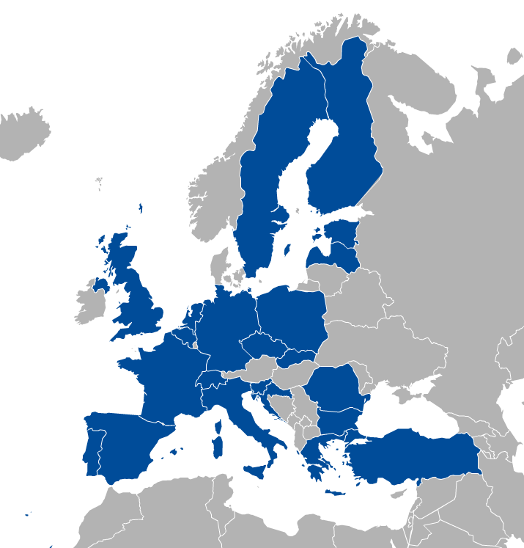
EGI: Federation of national e-infrastructures
Established in 2010
EGI Foundation: Coordinator (Amsterdam, Science Park)
NGIs: National e-infrastructures (22 country + CERN)
Membership fees sustain the federation; Projects innovate (e.g. EOSC-hub)
EGI = Compute, Storage, Data, Training, Consultancy services
Institutional representatives

Slide 8
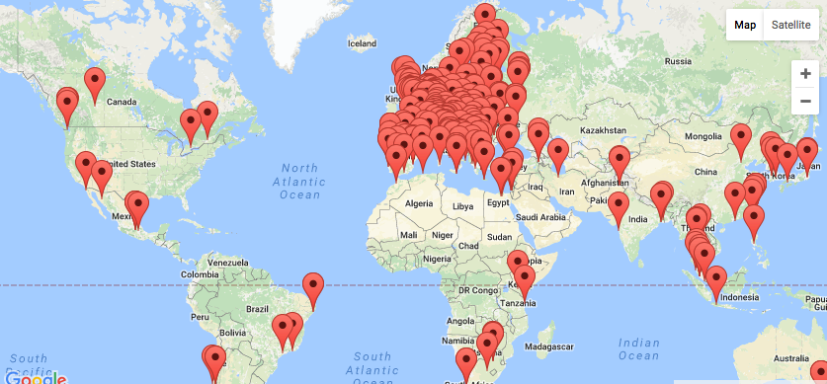
EGI Federation Largest distributed compute e-Infrastructure of the world
EGI Foundation (Amsterdam)
300+ HTC providers
25 Cloud providers
650k CPU cores
285 PB online storage
1.7 Million jobs/day
2.6 Billion CPU hours/year
240 Virtual Organisations
>48 000 users

Slide 9
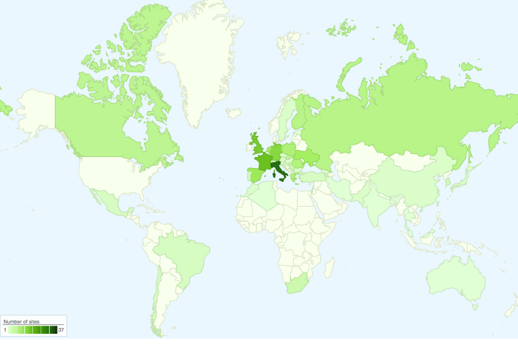
International Partnerships
Canada
China Inst. Of HEP
Chinese Academy
of Sciences
USA
India Centre for
Development of
Advanced Comp.
Africa and Arabia
Council for Scientific and
Industrial Research, South Africa
Asia Pacific Region
Academia Sinica
at Taiwan
Latin America
Universida de Federal do
Rio de Janeiro
Ukraine
Ukrainian National
Grid

Slide 10
EGI serves researchers and innovators
Size of individual groups
WLCG
VIRGO
LIGO
INSTRUCT
ELI
CTA
ELIXIR
EPOS
BBMRI
CLARIN
EISCAT_3D
DARIAH
LOFAR
LifeWatch
ICOS
EMSO
CORBEL
ENVRIplus
…
VRE projects
OpenDreamKit
WeNMR
DRIHM
VERCE
MuG
AgINFRA
CMMST
LSGC
SuperSites Exploitation
Environmental sci.
neuGRID
…
PeachNote
CEBA Galaxy eLab
Semiconductor design
Main-belt comets
Quantum pysics studies
Virtual imaging (LS)
Bovine tuberculosis spread
Convergent evol. in genomes
Geography evolution
Seafloor seismic waves
3D liver maps with MRI
Metabolic rate modelling
Genome alignment
Tapeworms infection on fish
…
Agroknow
CloudEO
CloudSME
Ecohydros
gnubila
Sinergise
SixSq
TEISS
Terradue
Ubercloud
…
ESFRIs, FET flagships
Multinational communities, (e.g. H2020 projects)
Industry, SMEs
‘Long tail of science’

Slide 11
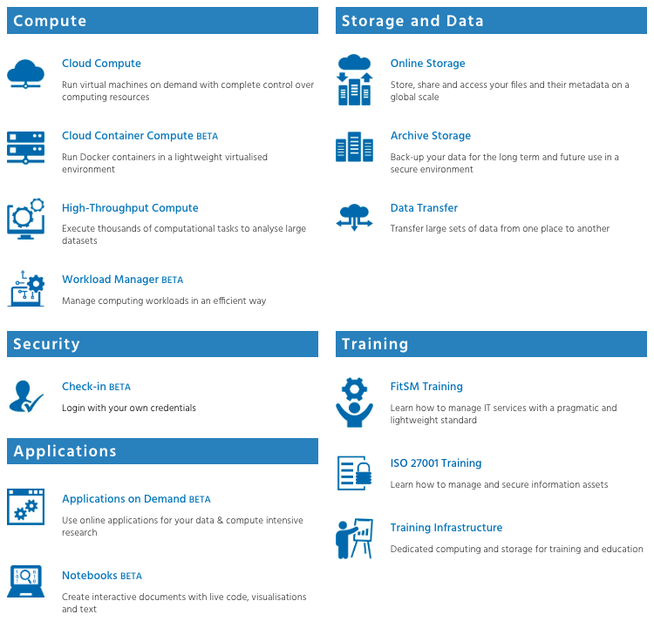
The EGI Service Catalogue: www.egi.eu/services
Used by Notebooks

Slide 12
EGI Cloud
Multi-cloud Infrastructure as a Service
Single Sign-On via Check-in
Harmonised access to participating cloud sites
Technology agnostic, supports OpenStack, OpenNebula and Synnefo
Key features
Virtual Appliance catalogue
Unified GUI user dashboard
Centralised accounting
Resource discovery
Service Level Agreement monitoring
Cloud
Compute
Cloud Container
Compute
Online
Storage
High level applications
Training
Infrastructure

Slide 13
EGI Notebooks
Jupyter as a Service in the EGI Cloud
Notes:
How many know about Jupyter
Used jupyter before?
Programming experience?

Slide 14
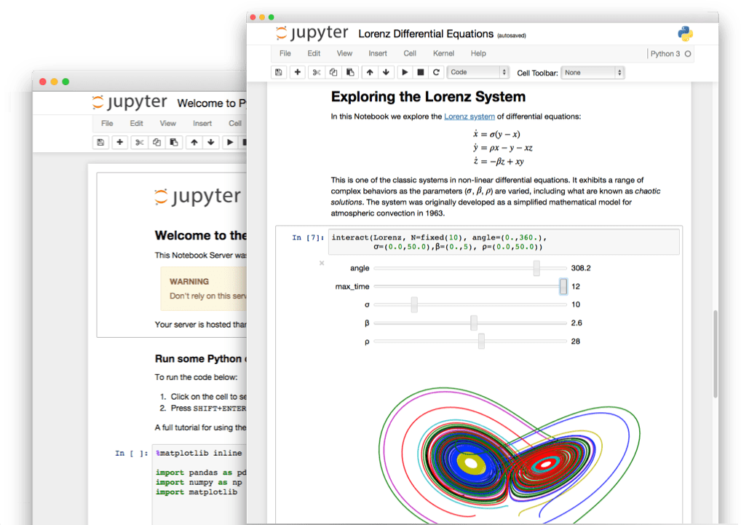
The Jupyter Notebook in a nutshell
Non-profit, open-source, interactive platform for Data Science born out of the iPython project in 2014
Released under the BSD license
Notebooks can be shared with others using email, Dropbox, GitHub
Interactive widgets

Slide 15
Some key features
Language of choice
The Notebook has support for over 40 programming languages, including Python, R, Julia and Scala
Share notebooks
Notebooks can be shared with others using email, Dropbox, GitHub and the Jupyter Notebook Viewer
Interactive output
Your code can produce interactive output: HTML, images, videos, LaTeX, and custom MIME types
Big data integration
Leverage big data tools, such as Apache Spark for Python, R and Scala.

Slide 16
JupyterHub
Jupyter is single user by design
JupyterHub is a multi-user version of notebook designed for companies, classrooms and research labs
Manages Authentication
Spawns single-users notebooks servers on-demand
Gives each user a complete Jupyter server
Notes:
If you are a company or an organisation like EGI

Slide 17
EGI Notebooks
JupyterHub hosted in the EGI Cloud
Offers Jupyter notebooks ‘as Service’
One-click solution: login and start using
Extra EGI Features:
Login with the EGI AAI Check-In service
Persistent storage for notebooks
Bring your own environments/kernels
Use EGI computing and storage resources from your notebooks

Slide 18
Service modes
Catch-all instance
Available via the Marketplace
Limited resources: 1 CPU, 1GB RAM and 10GB of persistent storage
Sponsored access (free for the users)
Kills notebooks after 1 hour of inactivity (Use the persistent folder → Don’t loose your work!)
VO/Community deployments
Tailored to specific VO with custom computing/storage, e.g.:
access to GPUs, fat nodes
access to Spark, other BigData/ML environments
auto-mount filesystems on notebooks
…
Community deployment for training
1 CPU / 1GB RAM and 10GB storage / user
To be used today

Slide 19
Single Sign-ON
Completely integrated with EGI Check-in
Login with eduGAIN, social (Google, Facebook, LinkedIn) or EGI SSO
Fine grained authorisation
VO membership
Role, group, …
Login at https://training.notebooks.egi.eu
Choose EGI SSO, Google, Facebook, ORCID for login (to setup EGI SSO account: https://egi.eu/sso)

Slide 20
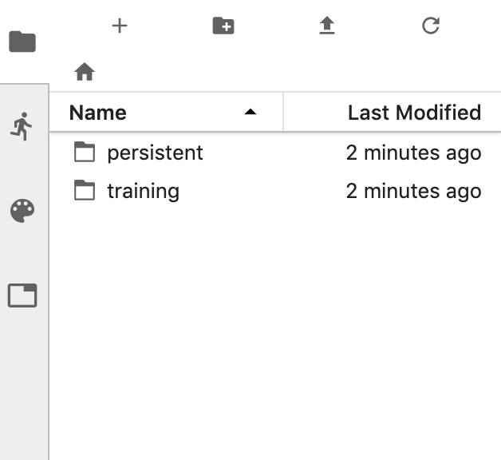
Persistency
Persistent directory linked from home
User decides what to keep
NFS storage
Other files coming from the notebook environment
Looking into DataHub/Onedata

Slide 21
Custom environments
Easy to extend with your own notebook environment
Docker container image with JupyterHub v0.9
No root user
Uses $HOME for notebooks
User select what to start when creating their notebooks (disabled in today’s hands-on)

Slide 22
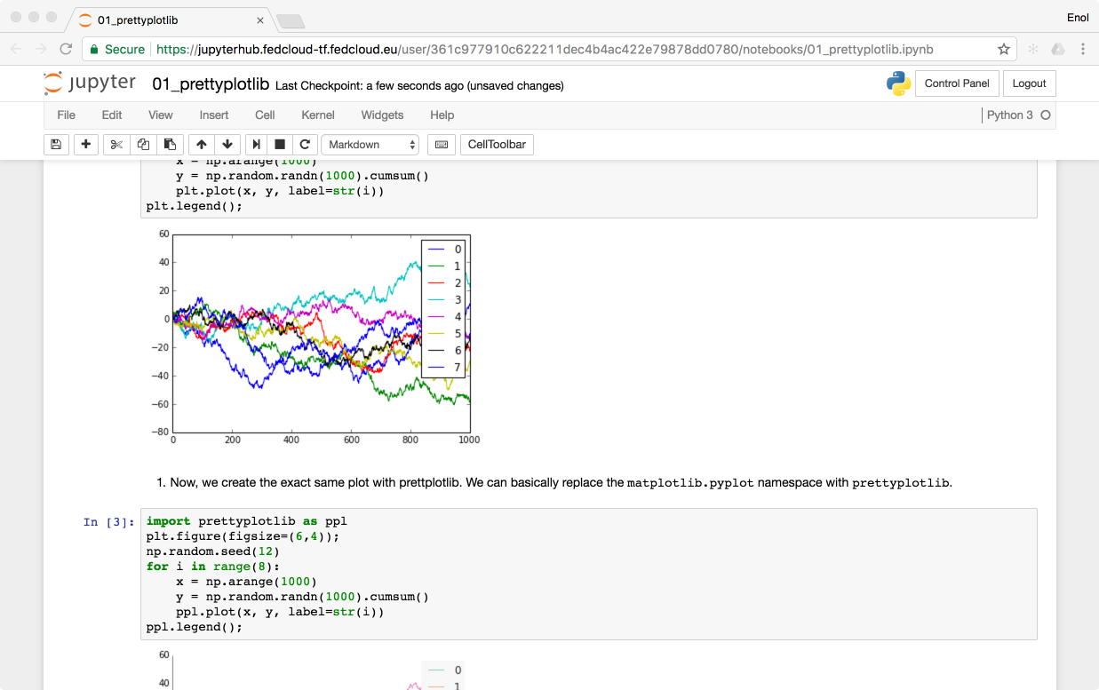
Technology Stack
https://training.notebooks.egi.eu
EGI CheckIn
Kubernetes cluster powered by EGI Cloud Compute
SSL Certificate
Persistent
Storage
Kubernetes
Ingress

Slide 23
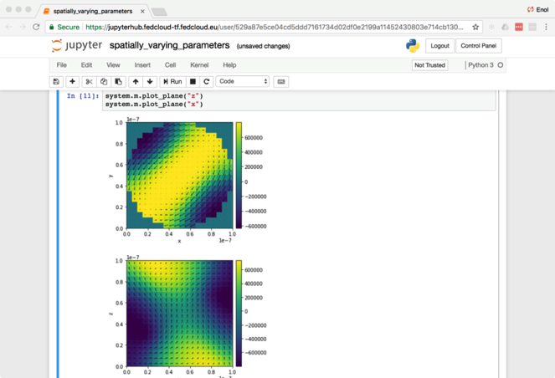
Status
Catch-all instance is available for production users
https://notebooks.egi.eu → Don’t use this today
User has to register in Check-in at the first login
Deployed on INFN-CATANIA-STACK cloud site
Community-specific deployments
E.g. for AGINFRA+ community
E.g. for training (deployed on CESNET cloud) Use this today!!!
Binderhub experimental setup
Today we will use MyBinder.org instead

Slide 24
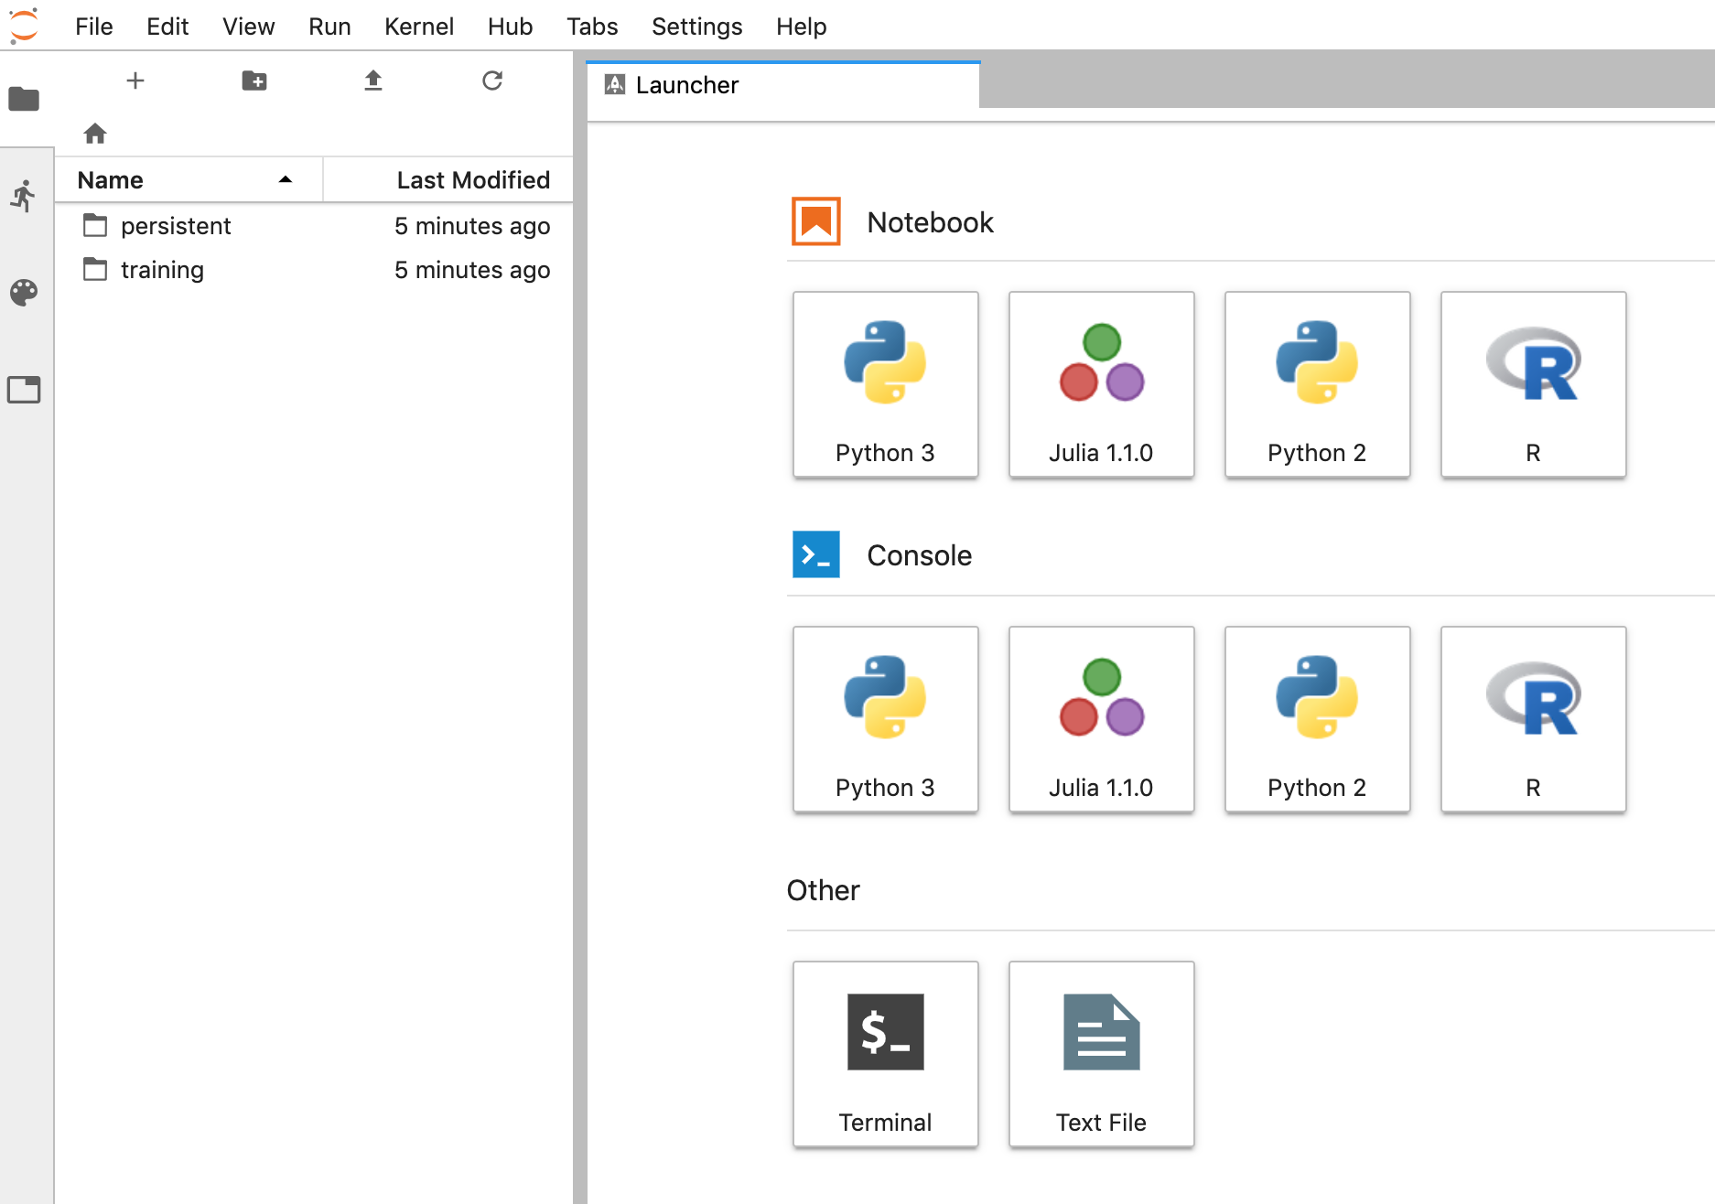
JupyterLab interface
Launch your notebook with the python Kernel

Slide 25
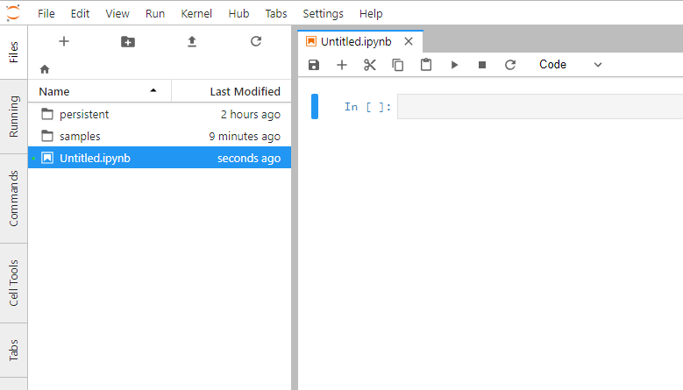
JupyterLab interface
Menu bar: The menu bar presents different options that may be used to manipulate the way the notebook functions.
Toolbar: The tool bar gives a quick way of performing the most-used operations within the notebook, by clicking on an icon.
Cell: the notebook cell
Menu bar
Toolbar
Notes:
When you start your notebook you create a new .ipynb file

Slide 26
Structure of a notebook
The notebook consists of a sequence of cells.
A cell is a multiline text input field
The execution behaviour of a cell is determined by the cell’s type.
There are three types of cells: Code, Markdown, and Raw cells.
Code cells allow you to edit and write new code, with full syntax highlighting and tab completion.
The programming language you use depends on the kernel
Markdown cells allow to alternate descriptive text with code
Raw cells provide a place in which you can write output directly. Raw cells are not evaluated by the notebook

Slide 27
Shortcuts
The essential shortcuts to remember are the following: Shift-Enter: run cell.
Execute the current cell, show any output, and jump to the next cell below. If Shift-Enter is invoked on the last cell, it makes a new cell below. This is equivalent to clicking the Cell, Run menu item, or the Play button in the toolbar.
Esc: Command mode.
In command mode, you can navigate around the notebook using keyboard shortcuts.
Enter: Edit mode.
In edit mode, you can edit text in cells

Slide 28
Hands-on
http://go.egi.eu/notebooks-training

