Slide 1
Human Brain Project (HBP) Testing Status Update
Matthew Viljoen
EGI.eu Operations Team

Slide 2
EGI/HBP Testing History
Apr ‘15 - HBP EGI Usecases written (LD et at.)
https://documents.egi.eu/secure/ShowDocument?docid=2468
Sep ’15 – Bi-weekly Skype meetings (CZ, LD, MV) preparing for demo at Bari
https://indico.egi.eu/indico/categoryDisplay.py?categId=174
retrieved sample dataset (~500GB) (Cyfronet+DESY sites)
installed Imaging Service via docker on EGI infra.
performance tests proved service was adequate ~2 users/sec.
Nov ‘15 HBP pilot demo at Bari (Cyfronet+DESY sites)
Dec ’15 – Started bi-weekly open fedcloud-vt meeting for HBP
Jan ’16 – deployed ATLASViewer visualization app on fedcloud. Imaging Service now load balanced. ~10 users simultaneously/sec.
Apr ‘16 – Fully functioning and costed pilot ready for HBP

Slide 3
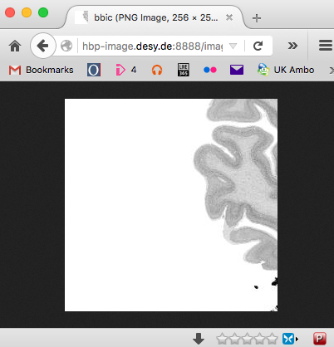
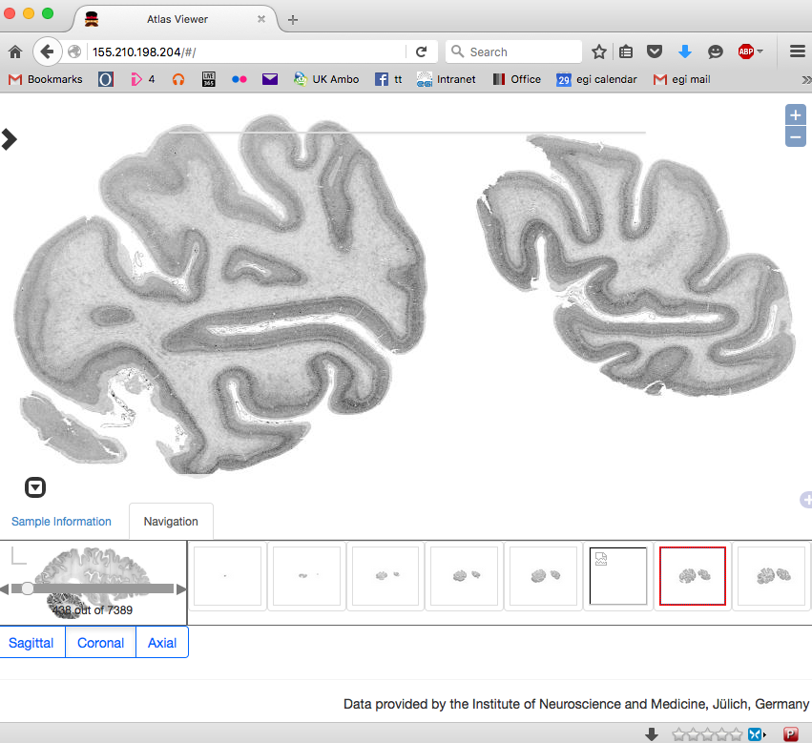
Software stack
1. Image service
Java visualization web service installed by Docker. POSIX access to underlying storage (onedata, dCache, …) with load balancing
2. User Visualization applet
Server-side applet based on Angular.js installed on Apache. Deployed on fedcloud

Slide 4
HBP data hosting site requirements
1-2 TB of data hosting behind OneData or dCache exposed via POSIX
NGINX capable of running multiple Docker instances
Next steps
Improved stress testing
Clarify pilot final acceptance criteria with HBP
AAI interoperability with HBP using OpenID Connect
Testing with larger datasets

Slide 5
Try the ATLASViewer on EGI:
http://155.210.198.204/ (OneData)
http://155.210.198.214/ (dCache)

