Slide 1
Compute services for Open Science Opportunities for ENVRI
EGI Advanced Computing for EOSC
Gergely Sipos Head of Services, Solutions, Support
EGI Foundation
ENVRI Community Meeting
3/Feb/2022

Slide 2
Outline
EGI-ACE services
Environmental science and climate research platforms and use cases (so far)
Uptake and impact
After EGI-ACE

Slide 3
EGI-ACE mission
Implement the Compute Platform of the European Open Science Cloud and contribute to the EOSC Data Commons by delivering integrated computing, platforms, data spaces and tools as an integrated solution that is aligned with major European cloud federation projects and HPC initiatives.
Start: January 2021
Duration: 30 months
Consortium: 33 participating partners, 23 third-parties
Budget: 12 Million EUR (8 Million EC)

Slide 4
Objectives for EOSC Exchange capacity/capability building
Objective 1: Deliver the European Open Science Cloud Compute Platform and expand the supply-side
EOSC-Exchange
Objective 2: Contribute to the implementation of the EU Data Strategy and the EOSC Data Commons to support the Green Deal, Health and Fundamental Research
O4
O1
Federated Data
O5
O2
EGI-ACE
Objective 3: Integrate the EOSC Compute Platform with the EOSC Portal and the EOSC Core
O3
EOSC Core
Objective 4: Contribute to the realization of a global Open Science Cloud
EOSC Architecture: Solutions for a sustainable EOSC (report from the EOSC Sustainability WG)
Objective 5: Expand the demand-side of EOSC across sectors and disciplines

Slide 5
EOSC Exchange Capacity Building
Distributed Computing Services
Collaboration agreement signed on 15/Oct/21:
Technical Activities
Architecture & Technical Interoperability
Service Provisioning
Resource Provisioning and Technical Support
Uptake
Joint promotional activities
Joint events
Training
Joint EOSC training
Co-development of new EOSC training materials
RELIANCE (Research Lifecycle Management for Copernicus users)
Data discovery, deposition, bit preservation storage
C-SCALE (Copernicus EOSC data analytics engine)
Open scholarship services

Slide 6
Integrated tiered service architecture
Data Spaces
and Analytics
Data and thematic data analytics and processing tools
EOSC portal
Thematic services
Green Deal Data Space
Health Data Space
Fundamental Science Data Space
Humanities Data Space
Platforms
generic added-value platform level services
Interactive Computing
Automated Cluster deployment
Distributed AI training
Workload Management
EOSC
users
Service Management, Tools, Processes, Policies
Federated
Access
Federation-wide management of data and computing
Federated Compute
Federated Identity
Federated Data
Federated
Resources
Compute and storage facilities
Research Clouds
Public Clouds
HTC
HPC
Federated resource brokering and allocation
Usage accounting across sites and communities
Service availability/reliability monitoring
User/admin response mgm via Helpdesk
Continuous improvement (feedback from users and sites)

Slide 7
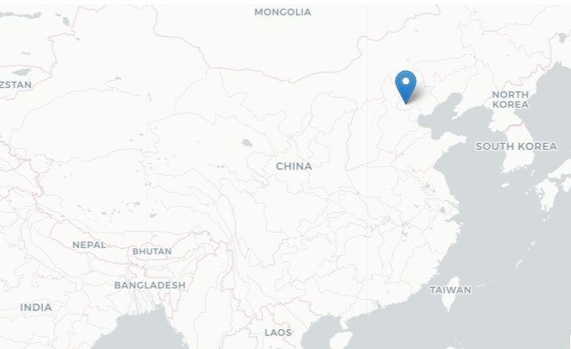
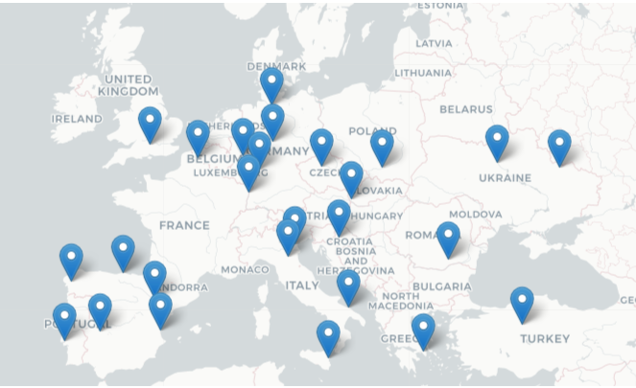
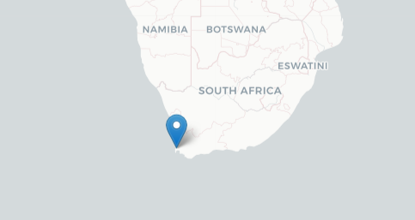
Towards a Global Open Science Cloud
New in 2021:
27 cloud providers
New in 2022

Slide 8
HPC in the EOSC Compute Platform
4 scientific use cases and 4 providers piloting integration of HPC resources:
Use cases: HEP (WLCG), Fusion, ELI-NP (Lasers), Climate Change (ENES)
Providers (also part of EuroCC): IICT-BAS (BG), INCD (PT), TUBITAK (TR), CESGA (ES)
Integration areas:
Federated Authentication and Authorization
Portable containers
Data transfers between HPC-HTC-Cloud
Presence in EOSC Portal, Availability monitoring, Usage accounting
Status and next steps:
First version of the integration manual available by end of Jan (M7.3)
Validation by HPC providers outside EGI-ACE
Second (final) version of manual available by end of June (D7.3)
Promotion campaign to HPC providers outside EGI-ACE
IICT-BAS

Slide 9
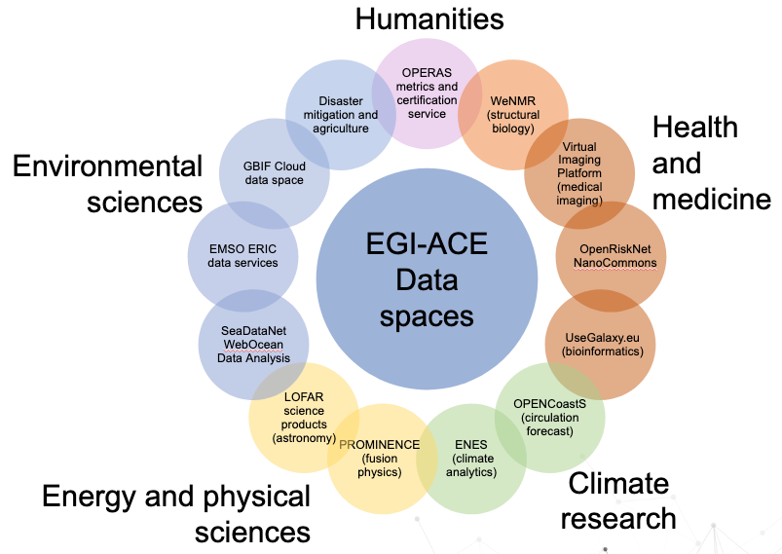
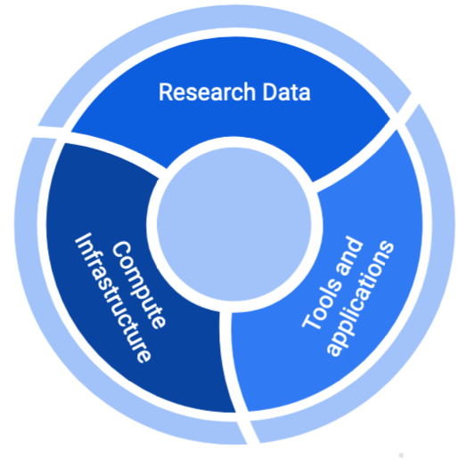
Thematic Services from EGI-ACE: Scientific Data Spaces
Already in EOSC Portal
Supported by federated resources, access and platform services with SLAs

Slide 10
Environmental Sciences and Climate Research Thematic services in the consortium
EGI-ACE WP5 platform | Relevant services | Usage in 2021
SeaDataNet WebOcean Data Analysis | High Throughput Compute, Cloud Compute Workload Manager | To start operation in 2022
EMSO ERIC data services | Cloud Compute, Online Storage, Check-in (AAI) | 1,400 new users 2,110,627 (Cloud) CPUh
GBIF Cloud data space | Data transfer, Check-in (AAI) | 700 users 5 TB data stored
Disaster mitigation and agriculture | Cloud Compute, Online Storage, Jupyter | To start operation in 2022
OPENCoastS | High Throughput Compute, Cloud Compute Workload Manager, Check-in (AAI) | 50 new users 1,366,033 Cloud CPUh
ENES Data Space | Cloud Compute, Online Storage, Jupyter, DataHub, EC3, HPC | 16 new users 33,600 Cloud CPUh

Slide 11
SLIDE FROM: Climate modelling: data and computing challenges (Sylvie Joussaume, CNRS)
Keynote talk at EGI Conference 2021

Slide 12
Delivery channels for EOSC
International projects
Multi-national communities
RIs
Single users, small groups (Long tail)
Experimental users
EOSC USERS
Business-to-User
Business-to-Business
EOSC Portal
EGI-ACE Open Call
Ready-to-use resources/services
Self-service configuration
Short term engagement
High capacity demand
Custom configurations
Long term engagement
https://marketplace.eosc-portal.eu/
https://www.egi.eu/projects/egi-ace/call-for-use-cases
Continuously open, Cut-off dates every 2 months
Serving with the use of...
EC funds (VA, projects)
Local funds (institutional/national investments)
80million CPUh
250,000 GPUh
20 PB storage

Slide 13
Allocating resources for user communities
Negotiate access to resources
Taking into consideration user requirements (type, number, size, cost, availability, ++)
Match user demand and provider priorities
Type, number, size, cost, availability, etc.
Applic. provider
Instance requirements
Conditions
Storage provider
Cloud provider
Negotiator
HTC provider
Project/Community representative
Service Level Agreement
Operation Level Agreement
Training
Support
Regular satisfaction interviews
Regular service delivery reports
Specify what’s delivered
Ensuring that agreed targets are met
Notes:
Motivations of providers – National/institutional mission vs. pay for use

Slide 14
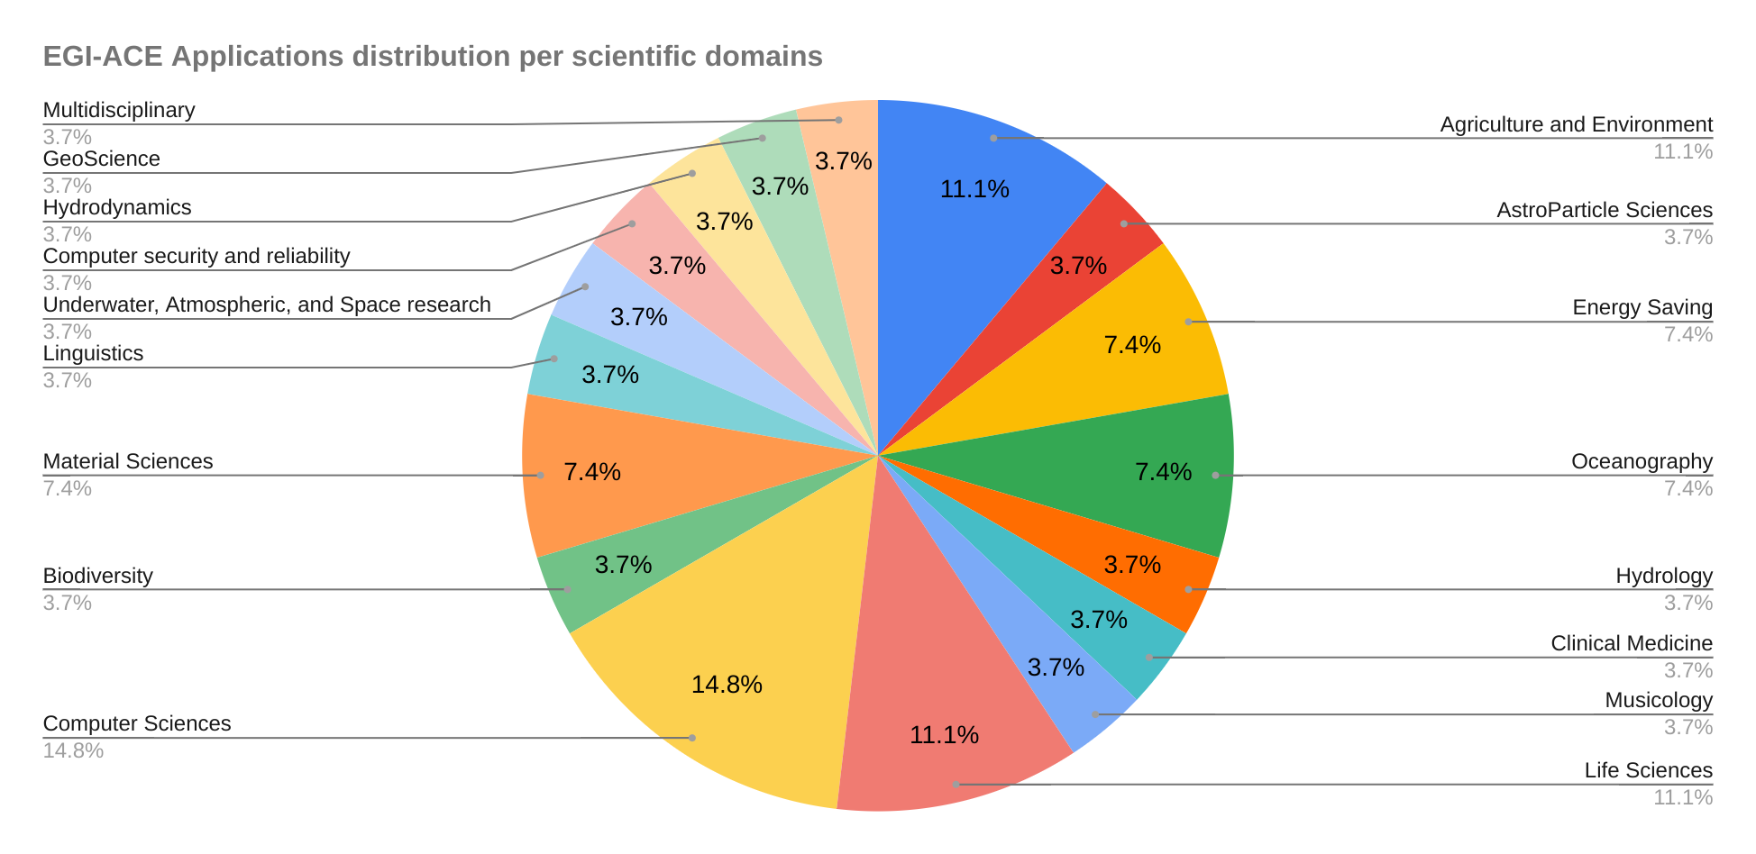
EGI-ACE Open Call: Statistics
5 cut-off dates (since March 2021)
28 Applications
21 Supported with Virtual Access
2 supported by NGIs (national funds)
5 in discussion
Next date: 15/Feb/2022: https://www.egi.eu/projects/egi-ace/call-for-use-cases/

Slide 15
Submitted use cases from Environmental Sciences and Climate Research
Use case | Submitter | Relevant services
Processing and Visualization of underwater noise data in the North-East Atlantic (the PLOCAN project) | Plataforma Oceánica de Canarias – Canary Islands | Check-in (AAI), Cloud Compute Jupyter Notebooks
Cloud-based data services to integrate and share qualified marine data generated by the MINKE open infrastructures | Institute of Marine Sciences (ICM-CSIC) | Check-in (AAI), Cloud Compute IM
Surface‌ ‌energy‌ ‌balance‌ ‌Automated‌ ‌Processing‌ ‌Service‌ ‌(SAPS)‌ ‌for water management, forest masses and crops evolution | Universidade‌ ‌Federal‌ ‌de‌ ‌Campina‌ ‌Grande‌ ‌(UFCG)‌ | Cloud Compute & Storage Check-in (AAI)
Towards an e-infrastructure for plant phenotyping | INRAE | Check-in (AAI), Cloud Compute Jupyter Notebooks, DEEPaaS, DataHub
Pangeo earth system sciences | IFREMER | Cloud Compute, Online Storage Jupyter Notebooks

Slide 16
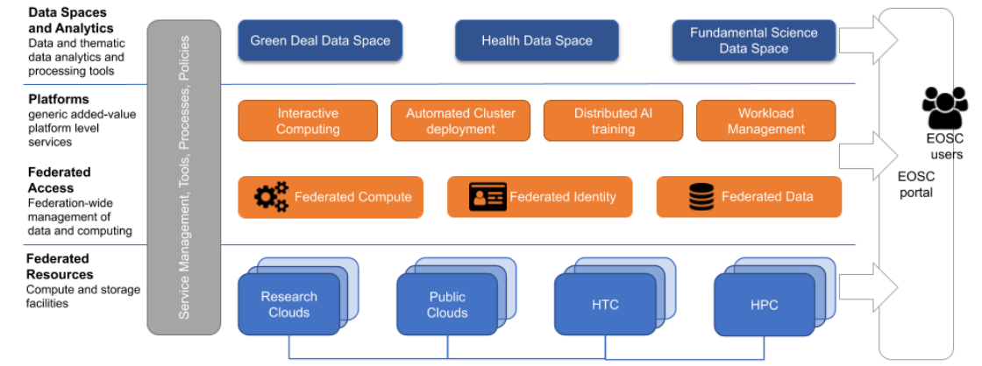
How EGI-ACE supports communities: 4 pillars
Assignments in the Customer DB: https://confluence.egi.eu/display/EGIACE/Customers+DB
14 webinars, 436 attendees, 804 Youtube views
2 more in the pipeline
Use case shepherds (lead experts)
Training Programme
Users docs
Provider specific support
https://docs.egi.eu

Slide 17
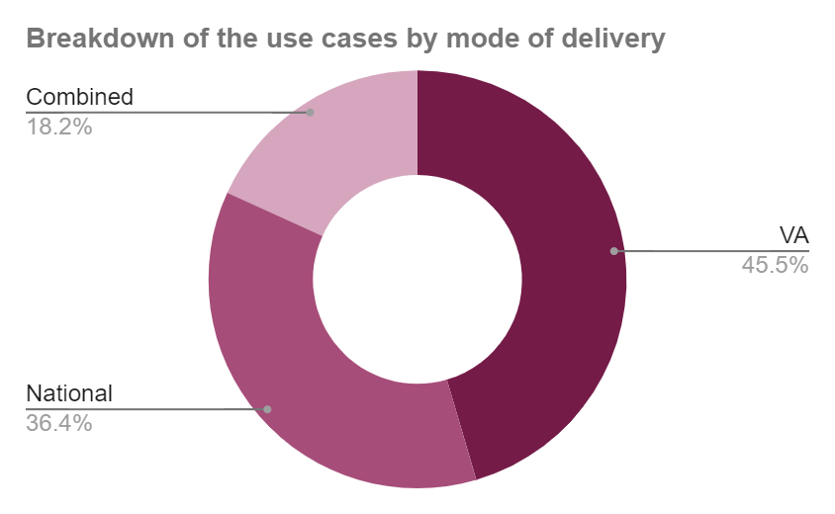
Distribution of national and EC funds for service delivery for 56 use cases
EC funds in external projects
VA: 47 Million CPU hours
105 mill. CPUh in total

Slide 18
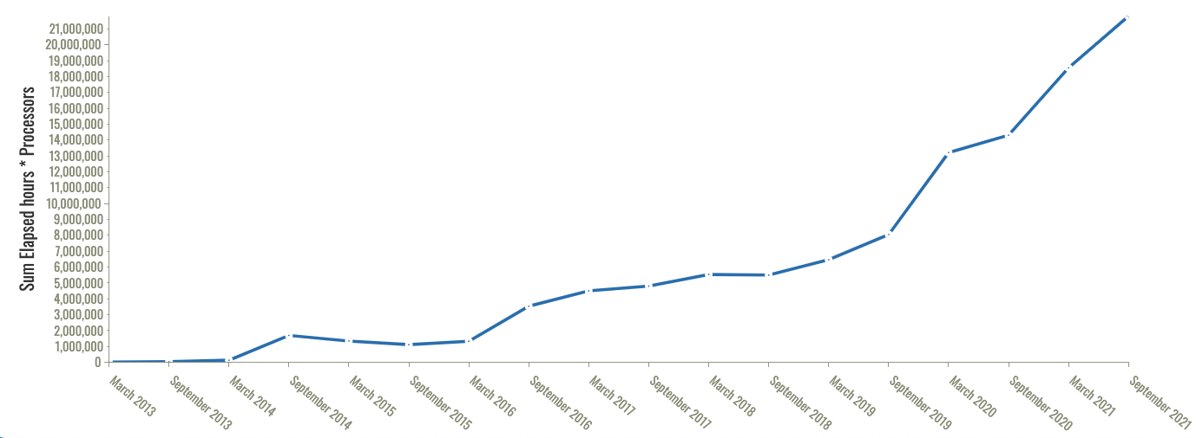
Cloud capacity consumption trends
Start of EGI-ACE
Start of EOSC-hub
+60% 2021-2022
43 Million CPU hours

Slide 19
Sustainability beyond EGI-ACE
EOSC Compute Platform → a distinguished element within Exchange because other services depend on it
Continued funding after EGI-ACE?
For international delivery (~VA)
Compute Platform (IaaS, PaaS)
Thematic services w. broad interest, e.g. ENES, SAPS → What else?
Coordinated resource allocation
Provider integration
EC procurement from 2023
Input fed by EGI-ACE through EOSC Future (D2.9) in Dec 2021
EOSC-Exchange
Data space services
Data processing use cases
Compute Platform
Federated Data
EOSC- Core
Further information: EGI-ACE D2.2 Strategic Plan - https://zenodo.org/record/5745168

Slide 20
Cut off every 2 months, next: 15/Feb/2022

Slide 21
Thank you
https://www.egi.eu/projects/egi-ace/

Slide 22
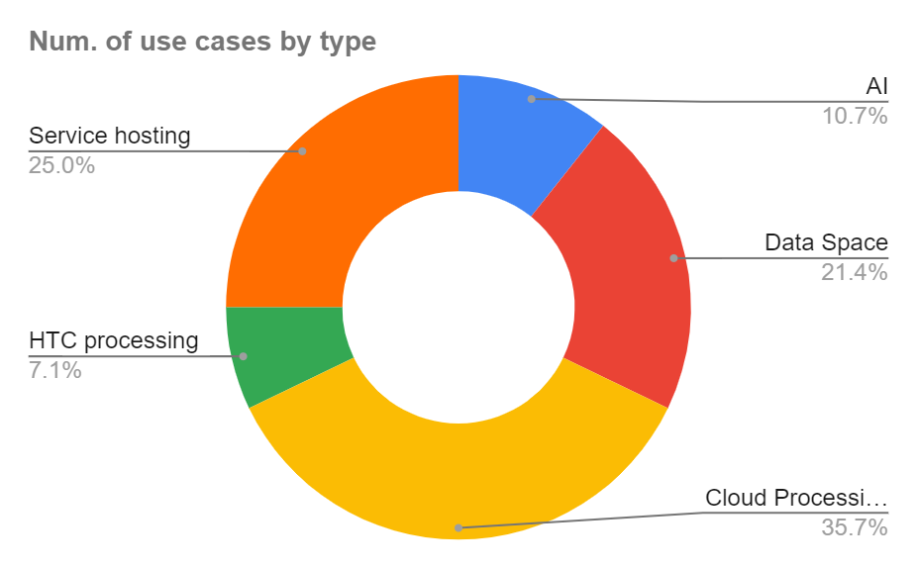
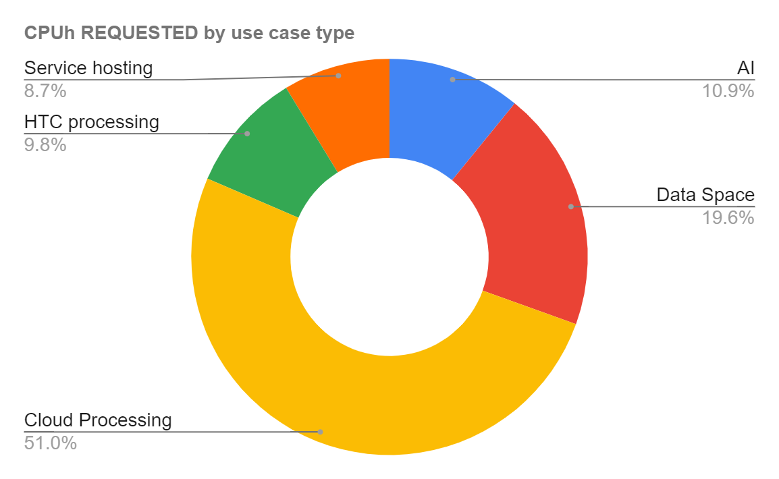
Diversity of EOSC compute cases
56 use case
105 mill. CPUh in total
Notes:
Meaning:

Slide 23
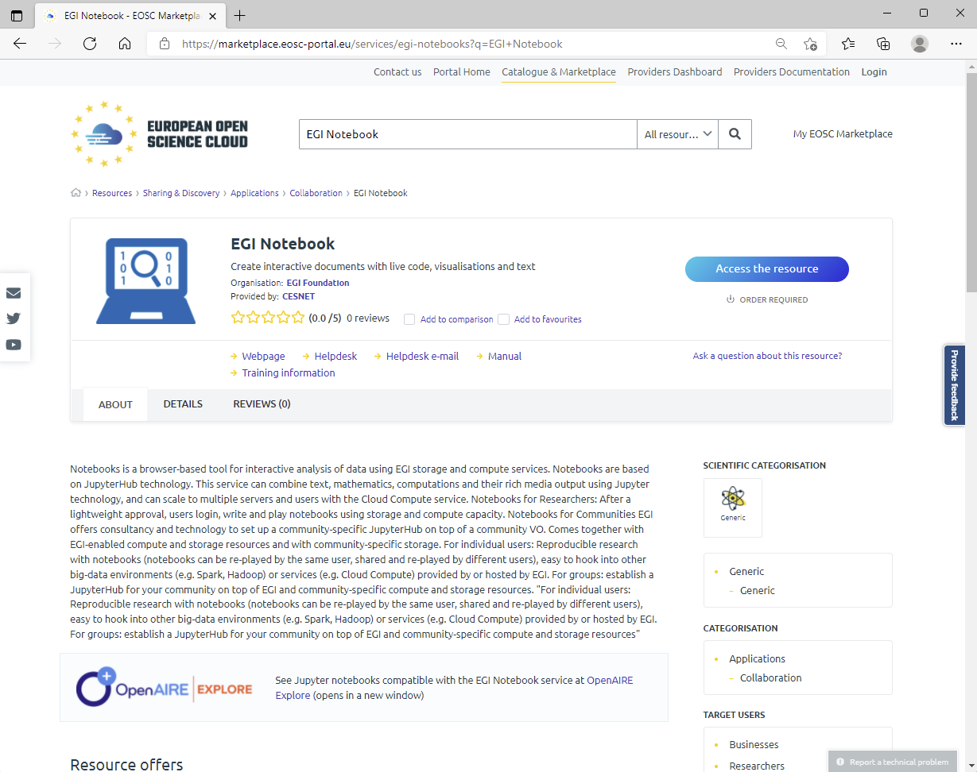
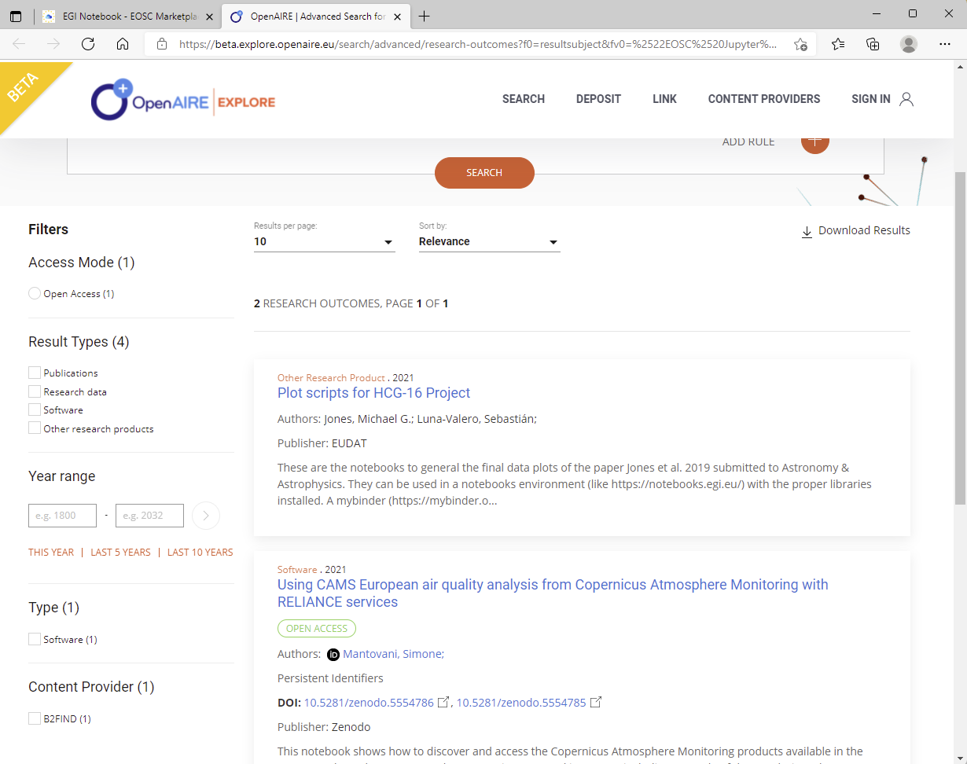
Combining services & resources: EGI-ACE Notebooks and OpenAIRE

Slide 24
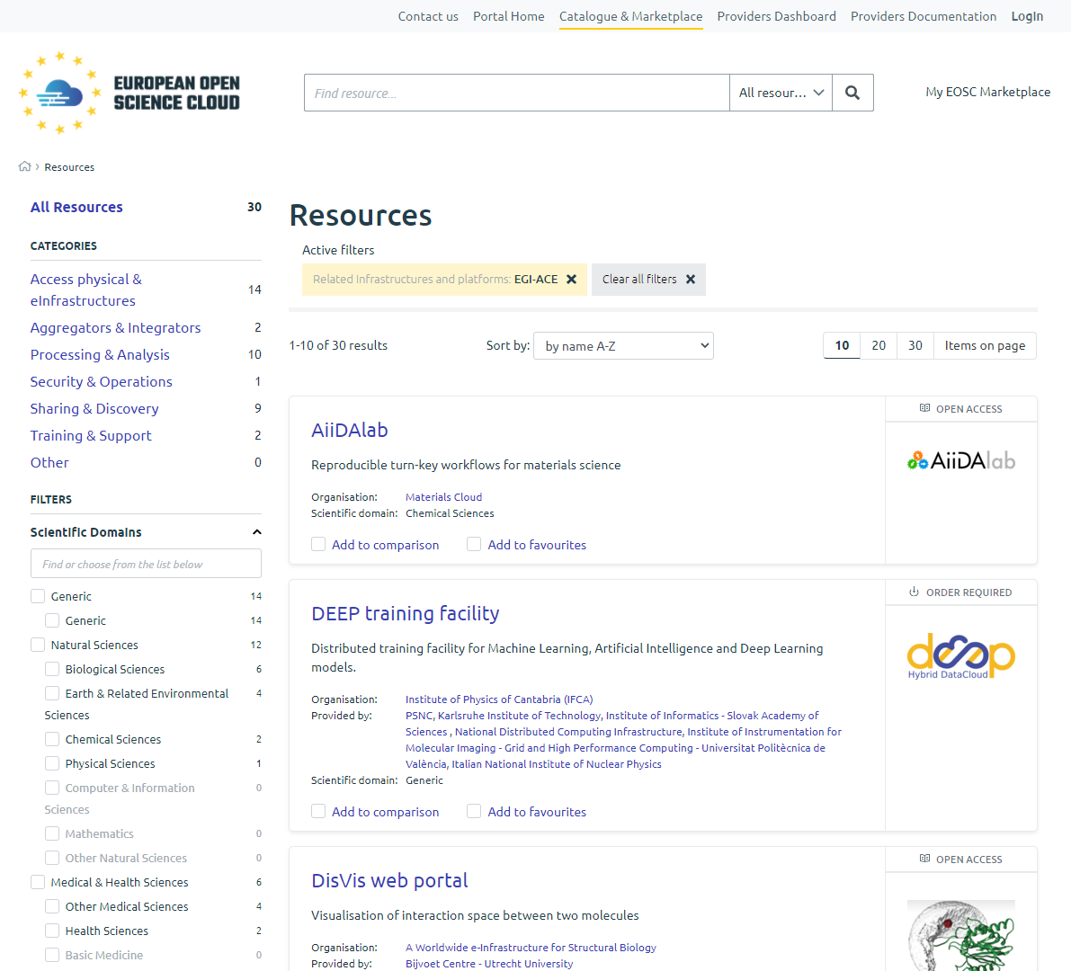
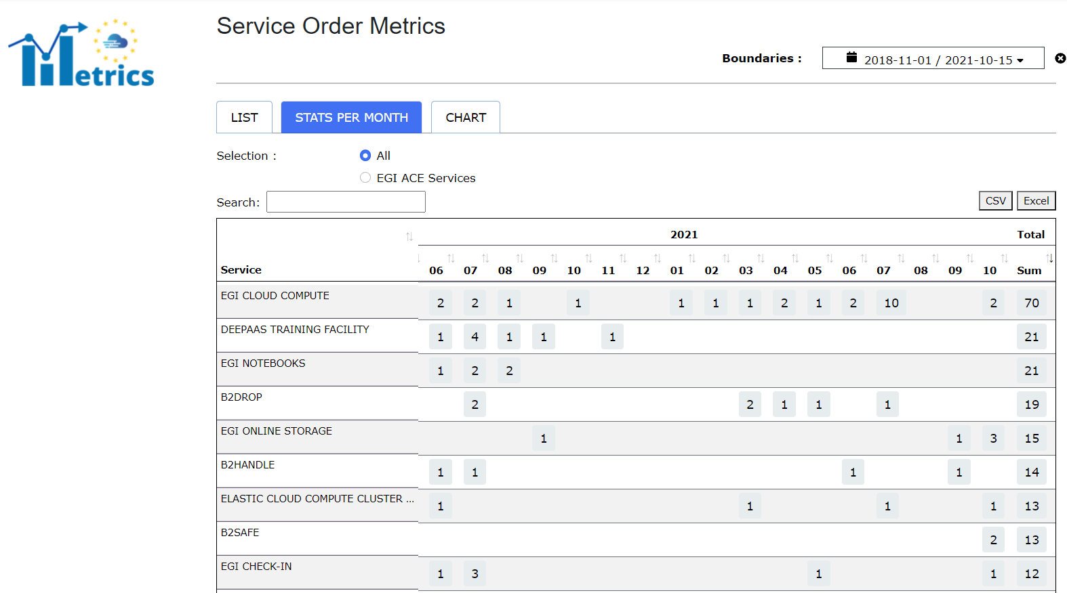
31 services from EGI-ACE in EOSC so far
9 EGI-ACE service among the top10 ‘most ordered’ EOSC service since 2018

