Slide 1
EGI Testbed for the Human Brain Project
Matthew Viljoen
EGI.eu Operations Team
8 April 2016, Amsterdam

Slide 2
Acknowledgements
EGI Team
Łukasz Dutka (Cyfronet), Christian Bernardt (DESY), Björn Hagemeier (FZ Jülich) et al.
HBP Team
Catherine Zwahlen, Jeffrey Muller, Huanxiang Lu, Sean Hill, Dupont Michaël et al.

Slide 3
EGI/HBP Testing History (Overview)
Apr ‘15 - HBP EGI Usecases
https://documents.egi.eu/secure/ShowDocument?docid=2468
Sep ’15 – Bi-weekly meetings preparing for demo at Bari
https://indico.egi.eu/indico/categoryDisplay.py?categId=174
retrieved sample dataset (~500GB) (Cyfronet+DESY sites)
installed Imaging Service via docker on EGI infrastructure.
performance tests proved service was adequate ~2 users/sec.
Nov ‘15 HBP pilot demo at Bari (Cyfronet+DESY sites)
Dec ’15 – Started bi-weekly open fedcloud-vt meeting for HBP
Jan ’16 – deployed ATLASViewer visualization app on fedcloud. Imaging Service now load balanced. ~10 users simultaneously/sec.
Apr ‘16 – Fully functioning and costed pilot ready for HBP

Slide 4
HBP Visualization Usecase
Hosting of replicas (~5TB) of the following datasets:
Golgi rat brain
R602 rat brain
Waxholm rat brain
Allen_v3 mouse brain
Adult human brain (100μm)
Adult human brain (20μm)
Infant human brain
Jubrain
‘Tiles’ exposed by web service via http
a tile is a small segment of a HBP image, 256x256px in size
http://hbp-image.desy.de:8888/image/v0/api/bbic?fname=/srv/data/HBP/BigBrain_jpeg.h5&mode=ims&prog=TILE%200%200%203%201000%200%201%20none%2010%202
Absolute minimum delivery time specified for one user
(8 tiles delivered in <1s)
Required access speed sufficient for >10 users for production

Slide 5
First steps – Demo at EGI CF (Oct ’15, Bari, IT)
Simple application written to parse image stacks
(screenshot)
Animation created from 20k tiles of human brain

Slide 6
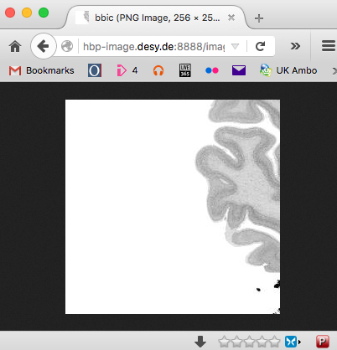
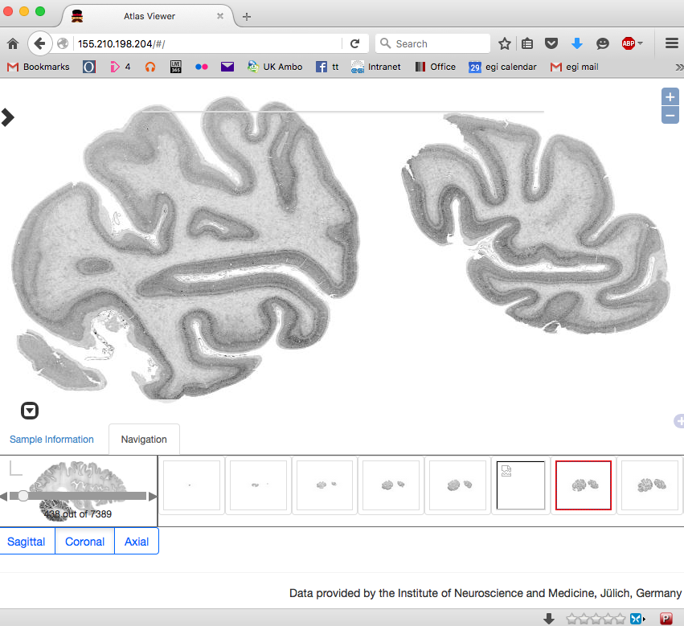
Complete software stack
1. Image service
Java visualization web service installed by Docker. POSIX access to underlying storage (onedata, dCache, …) with load balancing
2. User Visualization applet
Server-side applet based on Angular.js installed on Apache. Test instance deployed on the fedcloud

Slide 7
Testing & Scalability considerations
Bespoke testing software developed
Image Server
Python, Golang
ATLASViewer
Angular-Protractor
Load balancing on imaging software enabled 5 - 10x increase in performance
Without load balancing:
With load balancing:
#Users dCache Onedata
1 790ms 560ms
2 1300ms 700ms
3 1800ms 1000ms
4 1200ms
#Users dCache Onedata
1 979.55ms 943.02ms
5 954.58ms 935.14ms
10 963.36ms 998.66ms
15 955.31ms 1030.87ms
20 980.62ms 1193.38ms
25 1469.84ms 1314.01ms
30 2106.38ms 1637.65ms
50 2589.30ms 3449.66ms
100 9101.70ms 5460.86ms
200 30900.36ms 44338.79ms

Slide 8
HBP data hosting site requirements
5-10 TB of data hosting behind enterprise data hosting service exposed to Docker via POSIX
OneData and dCache on EGI testbed
Load balancing capable of running multiple Docker instances (NGINX/S5)
Minimum data delivery speed to visualization software

Slide 9
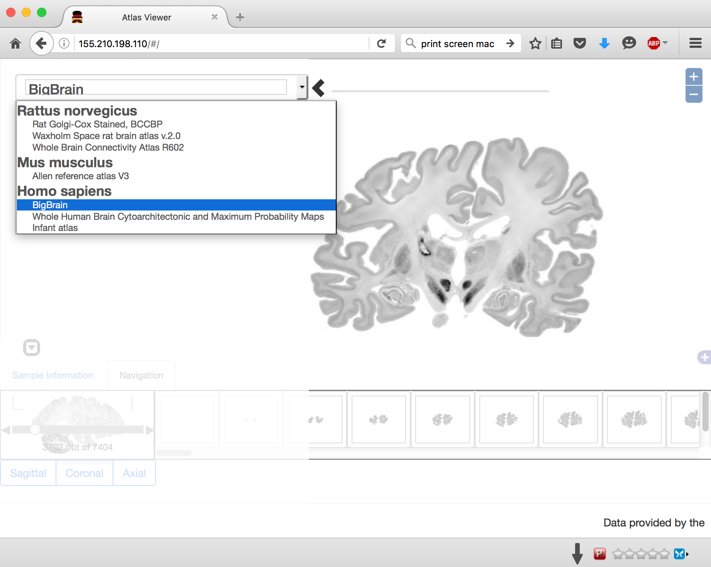
Demo of the ATLASViewer on EGI:

Slide 10
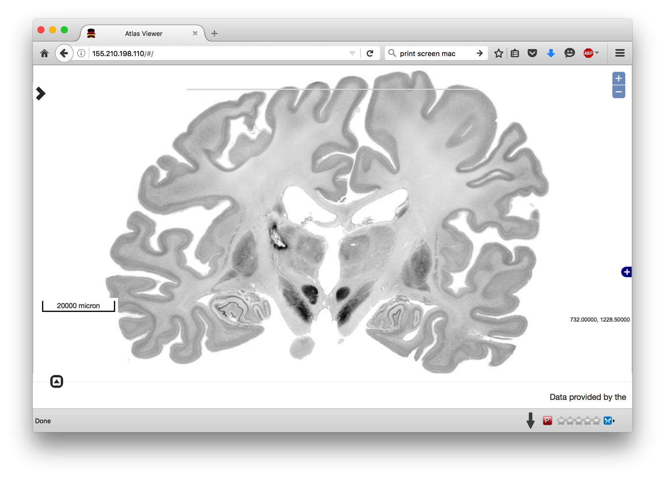
Demo of the ATLASViewer on EGI:

Slide 11
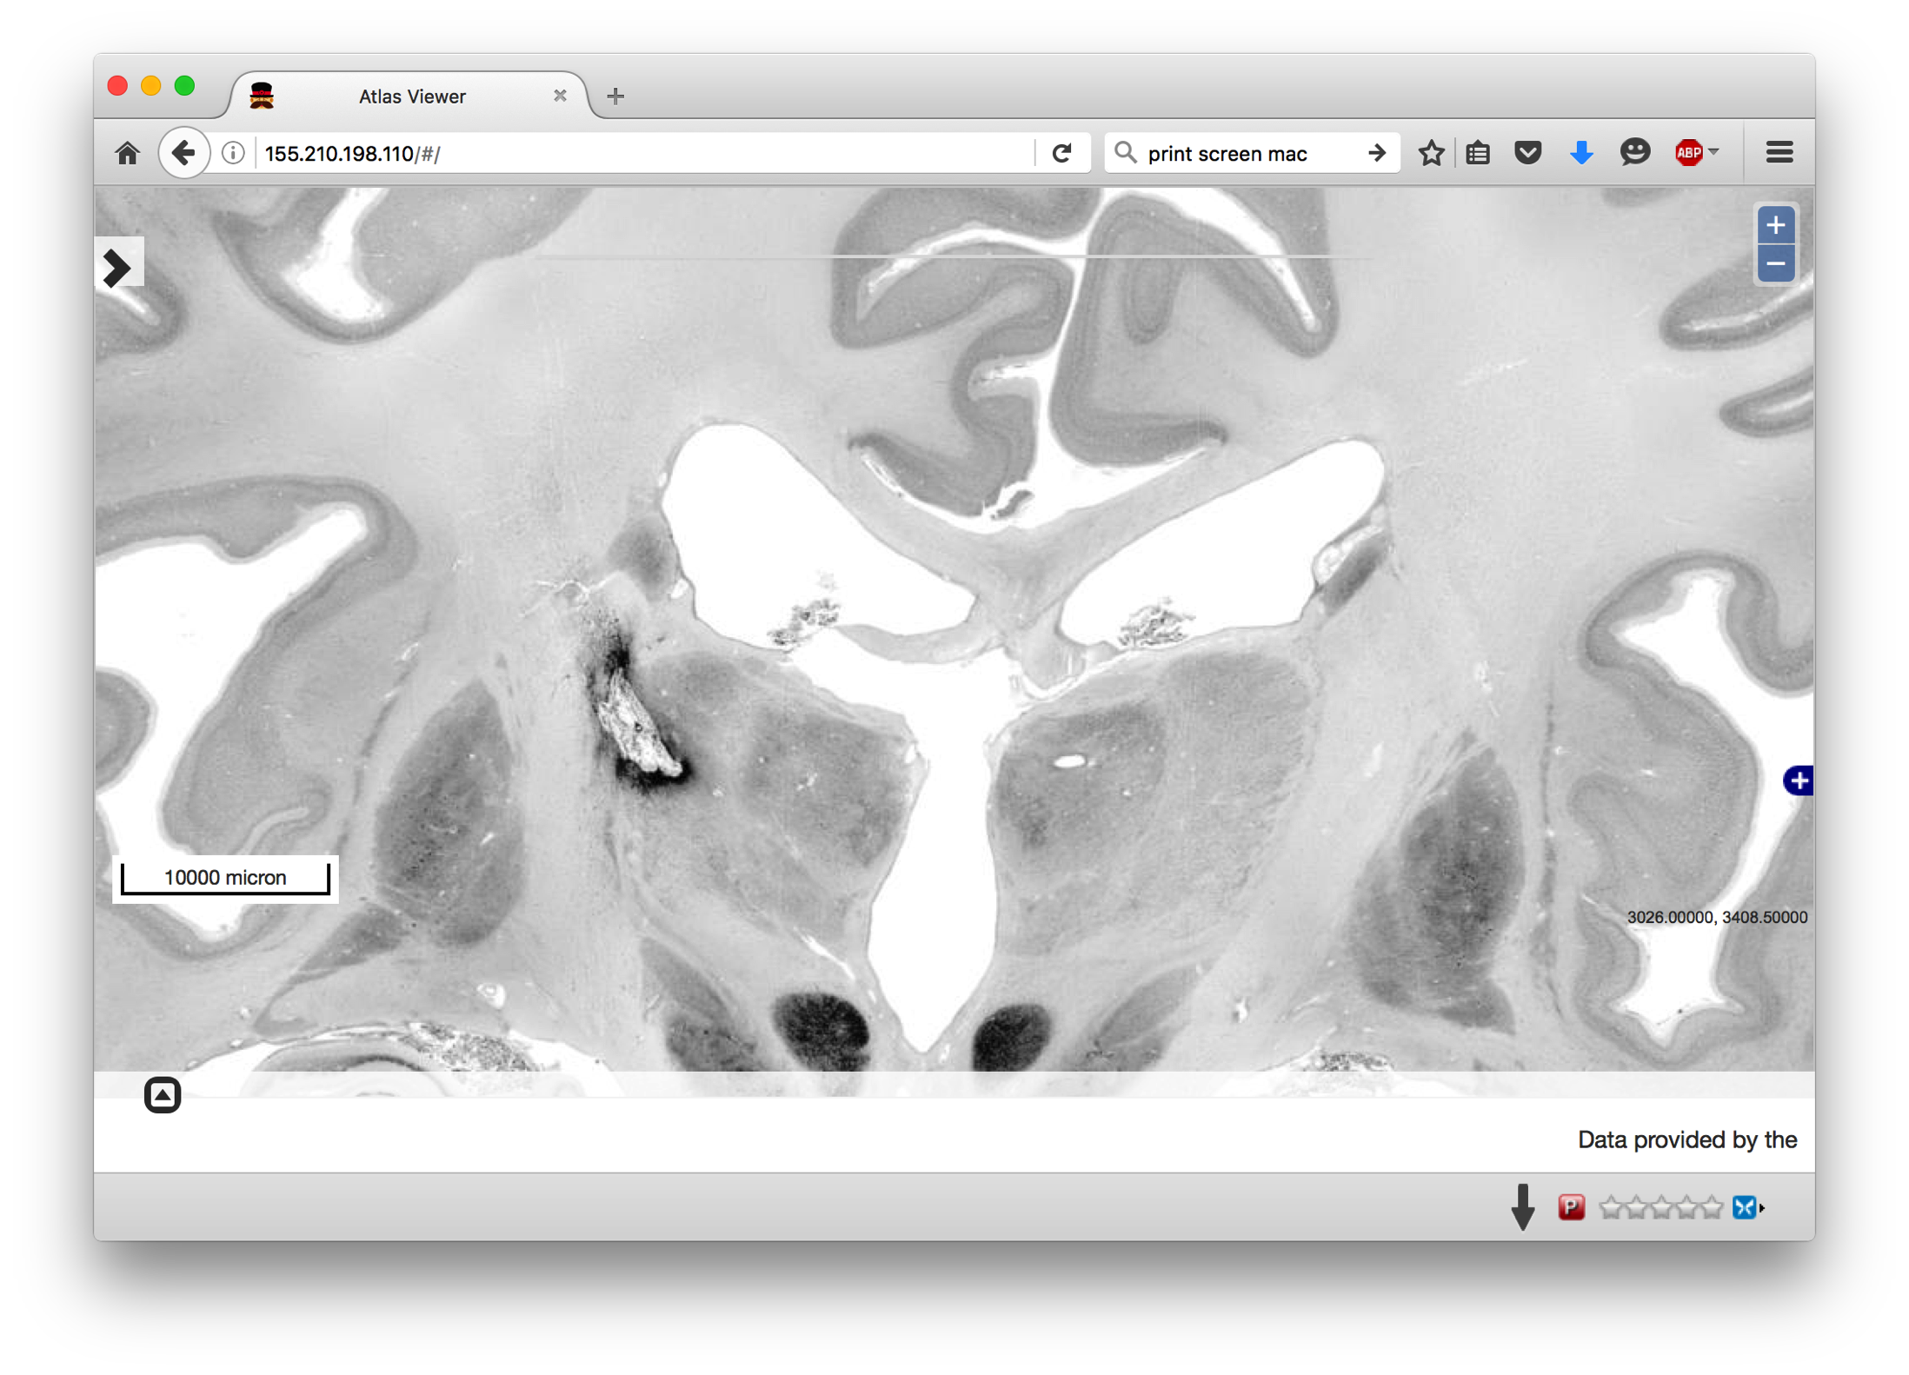
Demo of the ATLASViewer on EGI:

Slide 12
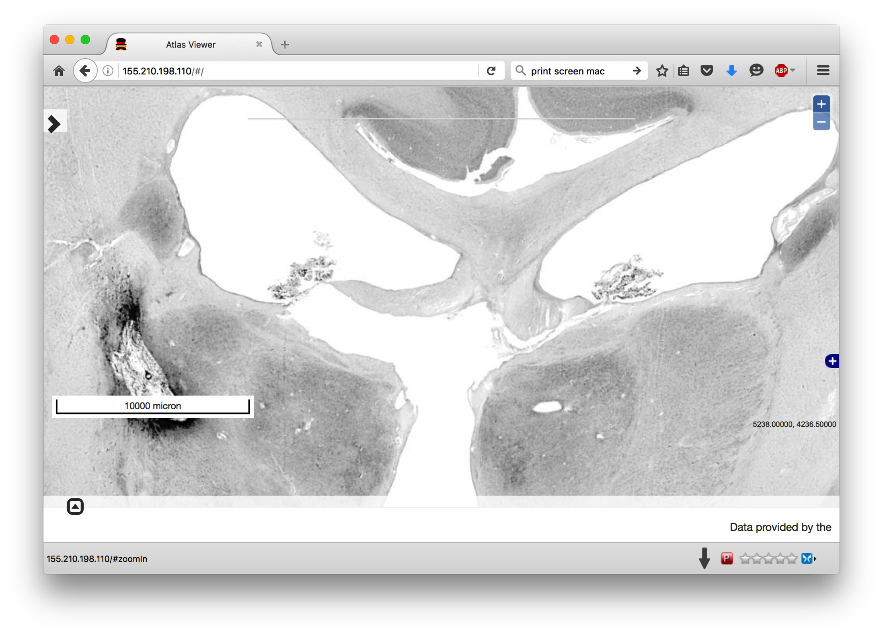
Demo of the ATLASViewer on EGI:

Slide 13
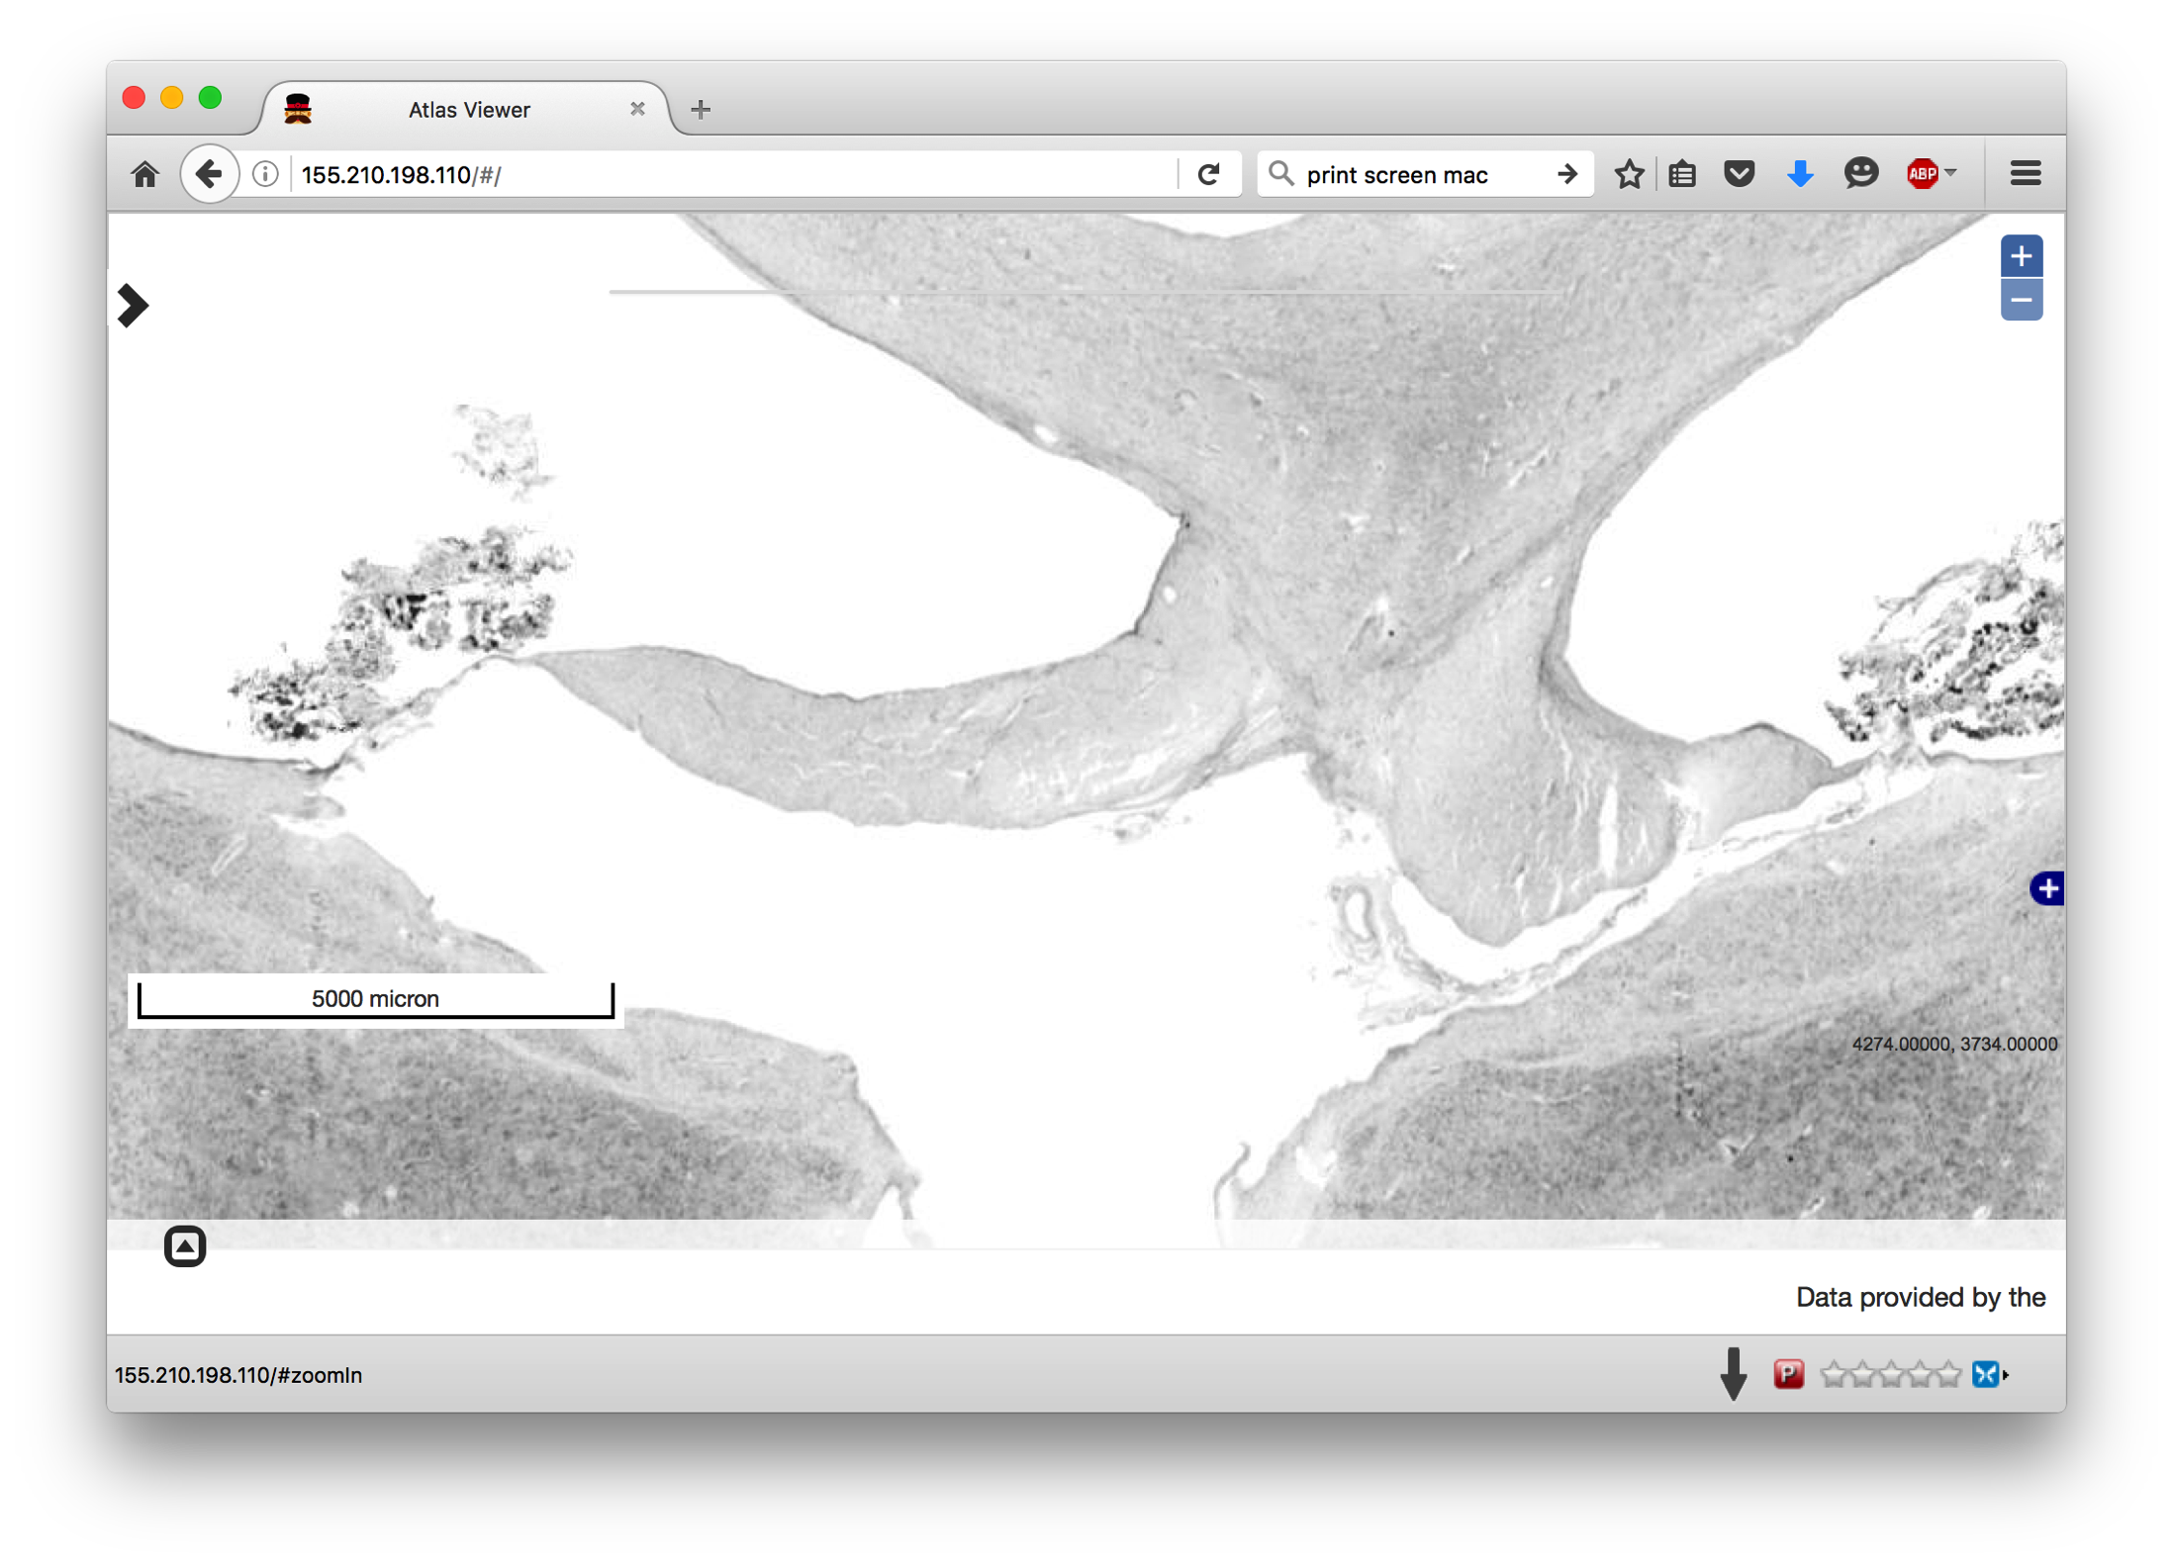
Demo of the ATLASViewer on EGI:

Slide 14
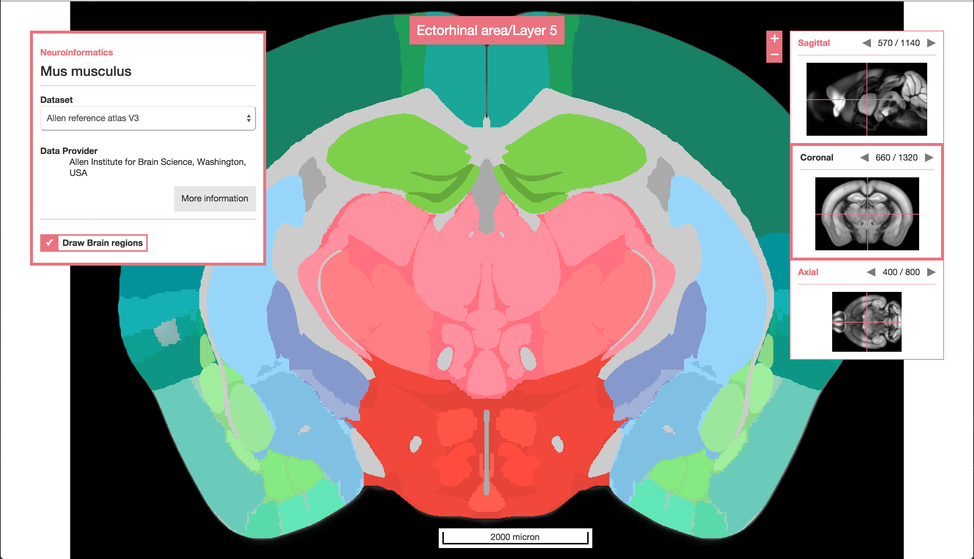
Next version of ATLASViewer

Slide 15
Next steps - 1
Interoperation of ATLASViewer with Open ID Connect HBP AAI
Move to full production
functional monitoring
deployment of production ATLASViewers by HBP
SLA agreed and finalized
Further scalability (more sites for capacity and geographical distribution)

Slide 16
Next steps - 2
Further scalability (more sites for capacity and geographical distribution)
Federated access to data (e.g. Dynafed, EGI Open Data platform)
From Visualization to Computation of datasets
Easier transfer HBP->EGI, cross-site replication
Globus Connect, FTS3
Passive – Active HBP datasets HBP
Archived (passive) datasets on e.g. Zenodo
Active datasets on EGI

Slide 17
Thanks!
Further information
Matthew Viljoen, EGI
matthew.viljoen@egi.eu

