Slide 1
Open Science with Notebooks in EOSC - Big Data 2019 Conference
Giuseppe La Rocca – EGI Foundation
Dissemination level: Public
http://go.egi.eu/bigdata2019

Slide 2
Agenda
Open Science
EOSC
EOSC-hub
Reproducibility with Notebooks and Binder, Zenodo, OpenAIRE
Hands-on
Analyse big data with Notebook
Hands-on
Become an user
Feedback form

Slide 3
Open Science
Open science is the movement to make scientific research and its dissemination accessible to all levels of an inquiring society, amateur or professional.
Publications, data, physical samples, and software
A continuation of, rather than a revolution in research practices
An important approach to increase the reproducibility of research
Benefits: increased science output; lower costs; reproducibility;
Jupyter Notebooks, Virtualisation/containerisation, Open Access data repositories provide new foundation for open science

Slide 4
Motivation: Increased science output
Publications from science archive data
Source: Michael Wise / EUDAT Conference / January 23, 2018

Slide 5
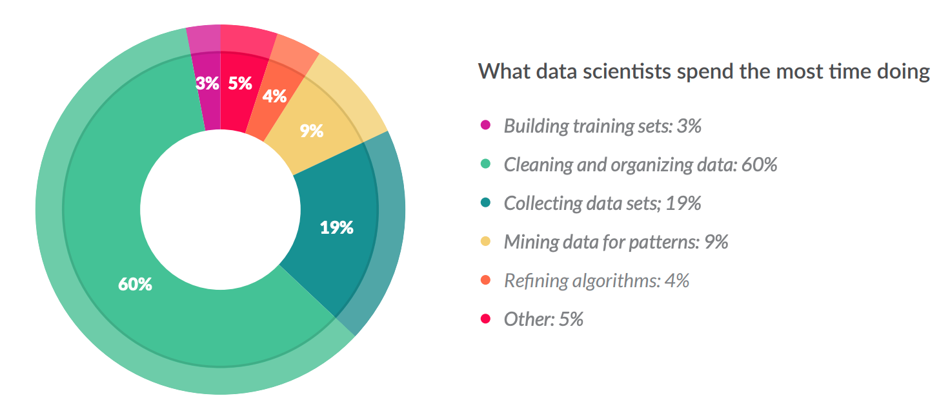
Motivation: Financial
Less than 20% !
From 80% spent on data wrangling to 80% spent on analytics/research
Source: CloudFlower data science report 2016 https://visit.figure-eight.com/rs/416-ZBE-142/images/CrowdFlower_DataScienceReport_2016.pdf
Slight increase in the 2018 report

Slide 6
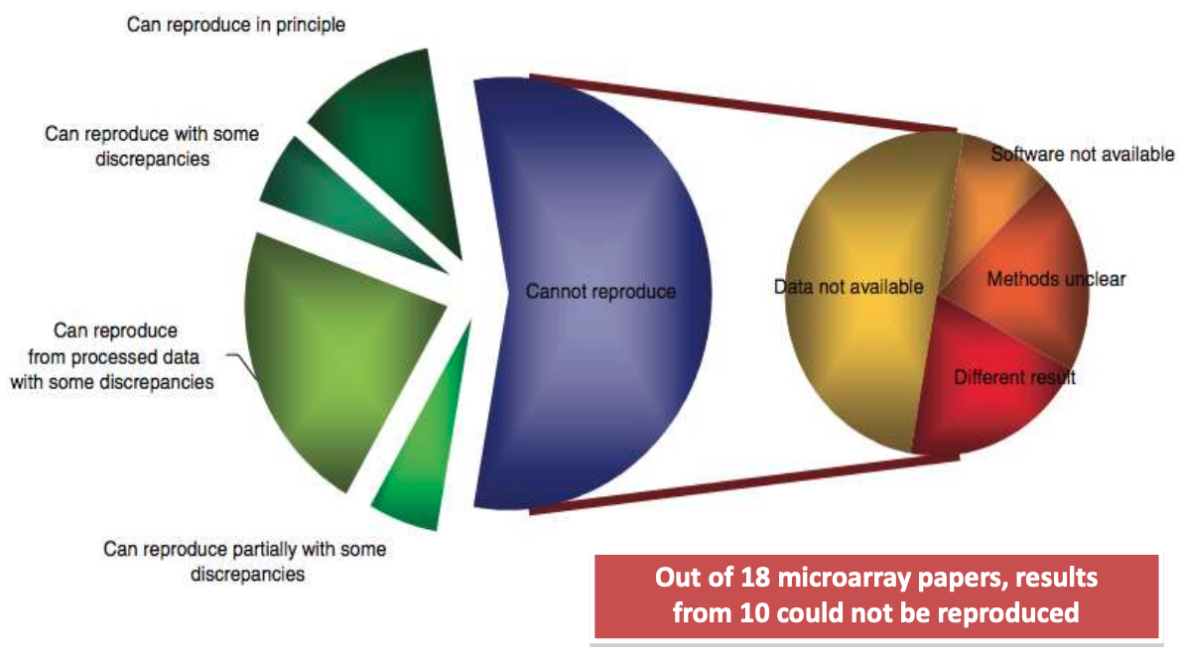
Motivation: Reproducibility
Source: Ioannidis et al., 2009. Repeatability of published microarray gene expression analyses. Nature Genetics 41: 14
See also: Science publishing: The trouble with retractions http://www.nature.com/news/2011/111005/full/478026a.html Bjorn Brembs: Open Access and the looming crisis in science https://theconversation.com/open-access-and-the-looming-crisis-in-science-14950

Slide 7
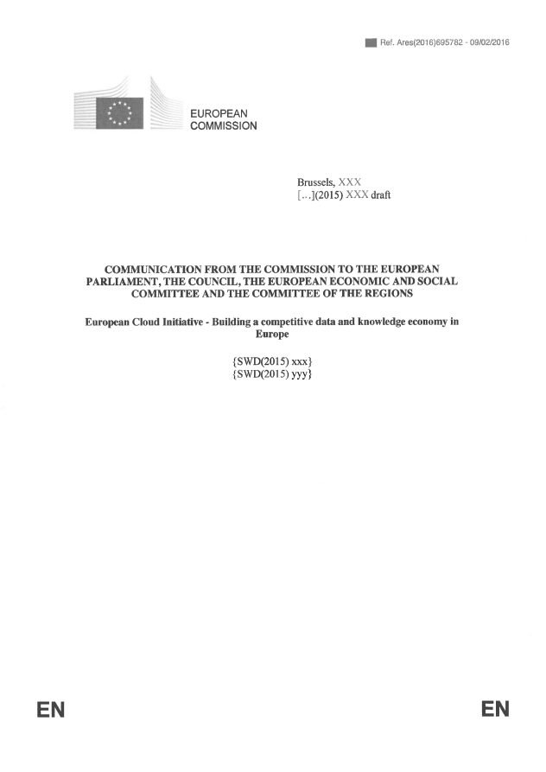
European Open Science Cloud - Problem statement
How to maximise the incentives for sharing data and to increase the capacity to exploit them?
How to ensure that data can be used as widely as possible, across scientific disciplines and between the public and the private sector?
How better to interconnect the existing and the new data infrastructures across Europe?
How best to coordinate the support available to European data infrastructures as they move towards exascale computing?
European Cloud Initiative by the European Commission (April 2016)
“…a trusted, open environment for the scientific community for storing, sharing and re- using scientific data and results…” “…by 2020…”

Slide 8
What happened since April 2016: EC initiatives
1st EOSC High Level Expert Group (final report)
2nd EOSC High Level Expert Group (final report)
EOSC summits (2017, 2018)
EOSC implementation Roadmap (April 2018) (link)
6 action lines (Archi., Data, Services, Access & Interf., Rules, Governance)
EOSC Portal launch (Nov 2018)
EOSC Executive Board (Nov 2018. Members)
EOSC Governance board (Jan 2019)
EOSC Symposium (26-28. Nov, 2019, Budapest)

Slide 9
What happened since April 2016: Projects
EOSC Implementation
Roadmap action lines
On-going H2020 projects contributing to the implementation
Architecture
Data
+ from Q3 2019:
Regional projects:
EOSC-Nordic
NI4OS-Europe
EOSC-Pillar
EOSC-synergy
Services
Access and Interface
Governance
Rules of Participation

Slide 10
About the European Open Science Cloud
The federated infrastructure and supporting initiative providing
all researchers, innovators, companies and citizens
with seamless access to an open-by-default, efficient and cross-disciplinary environment
for storing, accessing, reusing data, tools, publications and other scientific outputs for research, innovation and educational purposes
Credits: EOSCpilot (https://eoscpilot.eu/)

Slide 11
Mission
The EOSC-hub project mobilises providers of European relevance offering services, software and data for advanced data-driven research and innovation.
These resources are offered via the Hub – the integration and management system of the European Open Science Cloud, acting as a European-level entry point for all stakeholders.
33m EUR
100+ partners
2018-2020
Coord. by EGI Foundation

Slide 12
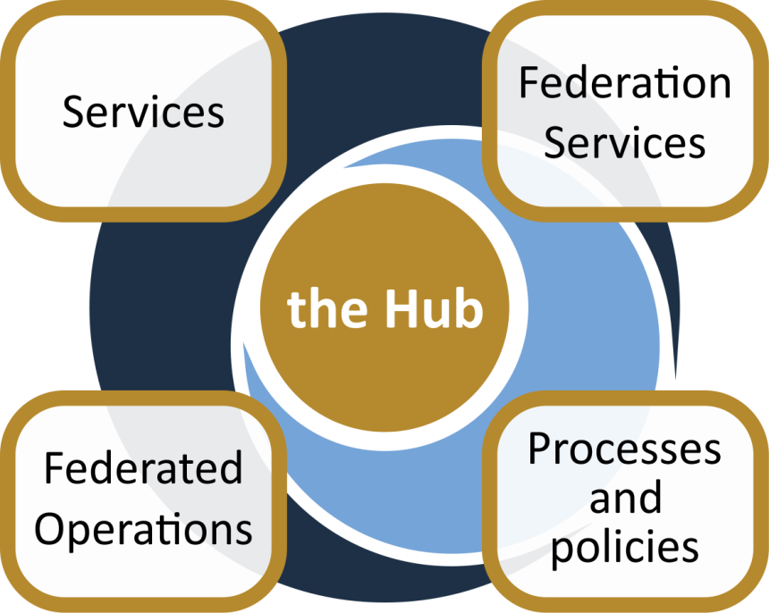
The EOSC-hub project established ‘The Hub’
From the consortium AND from external contributors
Usage according to Rules of Participation
Data
Applications & tools
Baseline services (storage, compute, connectivity)…
Training, consultants
Marketplace
AAI
Accounting
Monitoring
…
Lightweight certification of providers
SLA negotiation
Customer Relationship Management
…
Security regulations,
Compliance to standards,
Terms of use,
FAIR implementation guidelines
…
Based on FitSM

Slide 13
Area 1: Services
e-Infra
Humanities
Engineering
Medical and Health Sciences
Natural sciences
Generic services
EGI Federation
PHYSICAL SCIENCES
Astronomy (LOFAR)
Fusion (ITER)
High Energy Physics (CMS and VIRGO)
Space Science (EISCAT-3D)
Language and literature (CLARIN)
Environmental engineering (sea vessels, LNEC)
Biological Sciences (ELIXIR)
+ a growing number of external contributions
EUDAT CDI
EARTH SCIENCE
EO Pillar
GEO
Climate Research (ENES)
Seismology (ORFEUS, EPOS)
Arts (DARIAH)
Civil Engineering (Disaster Mitigation)
Structural biology (WeNMR)
INDIGO-DataCloud
BIOLOGICAL SCIENCES
Marine and freshwater biology (IFREMER)
Biodiversity conservation (LifeWatch)
Ecology (ICOS)

Slide 14
Generic services from e-Infrastructures:
Support to the Research Data Lifecycle
Access, Deposition & Sharing
Application DB (software & VM)
B2DROP (data)
B2Note (data)
B2SHARE (data)
DataHub
4
1
Data Management, Curation & Preservation
Discover & Reuse
B2HANDLE
B2SAFE
European Certified Trusted Repository
B2FIND (data)
Marketplace (Services)
3
Processing & Analysis
2
Applications on Demand
Federated HTC & Cloud Compute IaaS & PaaS
Processing of sensitive data
Jupyter Notebook
Thematic data analytics
Scientific Workflow Management, Orchestration (DIRAC, PaaS Orchestrator)

Slide 15
Reproducible Open Science in EOSC-hub

Slide 16
Reproducibility: beyond sharing code and data
Peng, Science, 2011

Slide 17
Reproducible Open Science in EOSC-hub (cont.)
Notebooks
Notebooks + Binder
Share
Reproduce
DataHub
DataHub
>> Testing during this tutorial! <<
Notes:
EGI supports Open Science with the Notebooks
Researchers can perform their analysis of open data sets by using the EGI Notebooks which has :
Enabling access to open datasets via the EGI DataHub, this a complete environment where researchers can produce meaningful analysis together with a description of their computing environment.
These analysis can be shared in GitHub and Zenodo, this turning them into citable artifacts that can be included in any publication. Fellow researchers can easily discover these artifacts which then can be reproduced into the notebooks environment extended with Binder, a powerful tool to recreate computing environments, so results can be guaranteed to be the same as the original analysis

Slide 18
Reproducible Open Science in EOSC-hub
The computational tools to solve a problem
Python, R, Julia, and wide ecosystem of libraries and tools for science
An interface to facilitate coding/creating
Jupyter
A way to communicate your work
Notebooks
Leverage on the EGI Cloud to scale-up the resources
A way to share your work
GitHub, Zenodo or other similar repositories
A way to pack it all for replication
Docker (used by Binder)
A way to persistently identify it
DOIs (Digital Object Identifiers)
binder

Slide 19
Reproducible Open Science in EOSC-hub (cont.)
EGI Notebooks
EGI Binder
1. Perform data analysis and visualisation
GitHub
6. Reproduce analysis
Your repository
5. Resolve DOI to Notebook
2. Publish notebook and Generate DOI
3. Cite DOI
in publication
Fellow researchers
Journal paper
4. Discover DOI

Slide 20
Git & GitHub
Git is a distributed version-control system for tracking changes in source code during software development
Written to manage development of Linux
GitHub is a social network for software development
Git repository hosting service + extra features
GitHub provides a web-based interface on top of git.
Collaboration features: access control, wikis, issues, projects, …
Connected with Zenodo:
Got a DOI from a GitHub repo

Slide 21
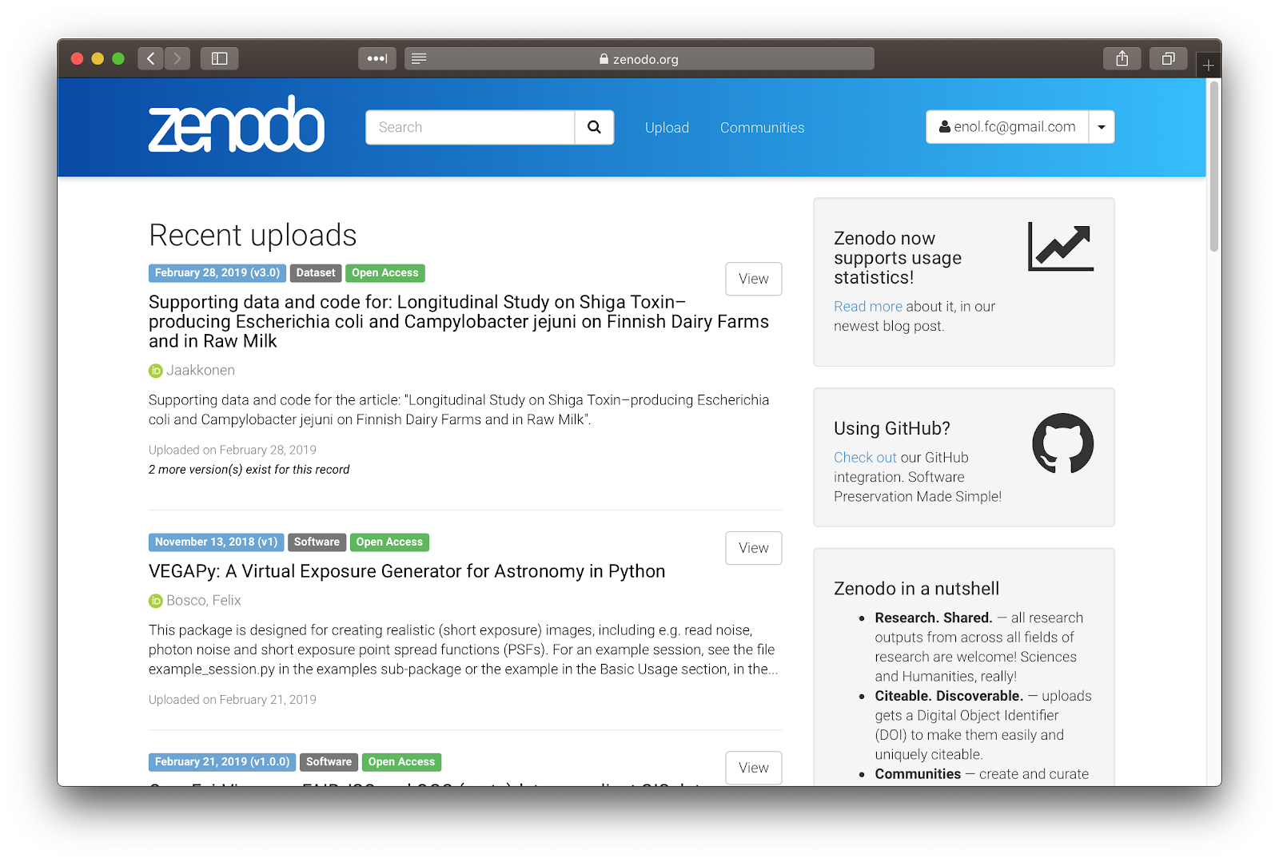
Zenodo
‘Open Science’ repository from OpenAIRE
Hosted at CERN data centre
http://zenodo.org
For
Publications, white papers, datasets, software, etc.
For
Long-tail science
Projects
Communities
Research groups
…
Dropbox, GitHub integration: - Web or API access
Access stats and reports for communities

Slide 22
Binder
An open-source web application to turn repositories in interactive notebooks
It uses Modern technology in cloud orchestration (Kubernetes), interactive computing (Jupyter), scientific computing (the open-science ecosystem)
Credit: Juliette Taka https://twitter.com/JulietteTaka

Slide 23
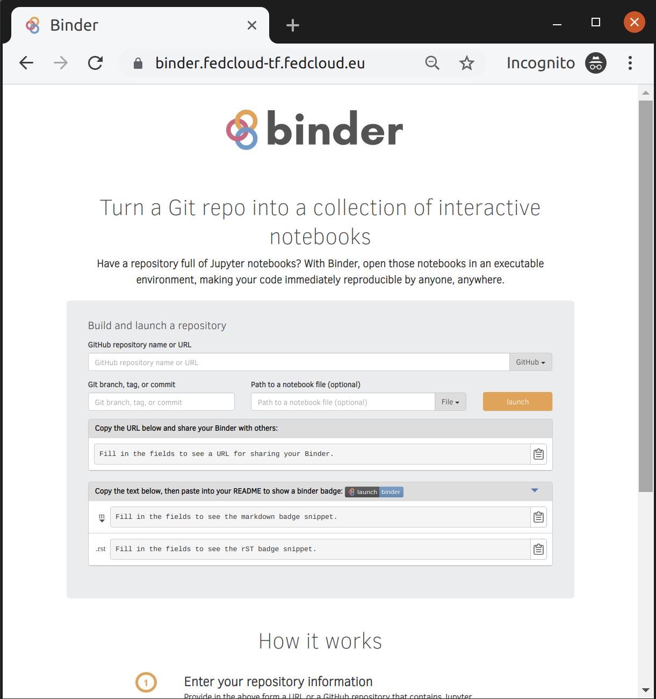
What does Binder do?
Pulls code from repository
repo2docker: Creates reproducible containers from repositories
jupyterhub: Generates user sessions that serve these containers
Kubernetes: manages the computing infrastructure
EGI Binder:
Provides an interface to create, share, and share the sessions

Slide 24
EGI Binder service
The service is available in Alpha mode for restricted users
Notebooks to reply in the service are limited to 1 CPU, 1GB RAM and 10GB of persistent storage per user
Production version is planned to be opened in late 2019

Slide 25
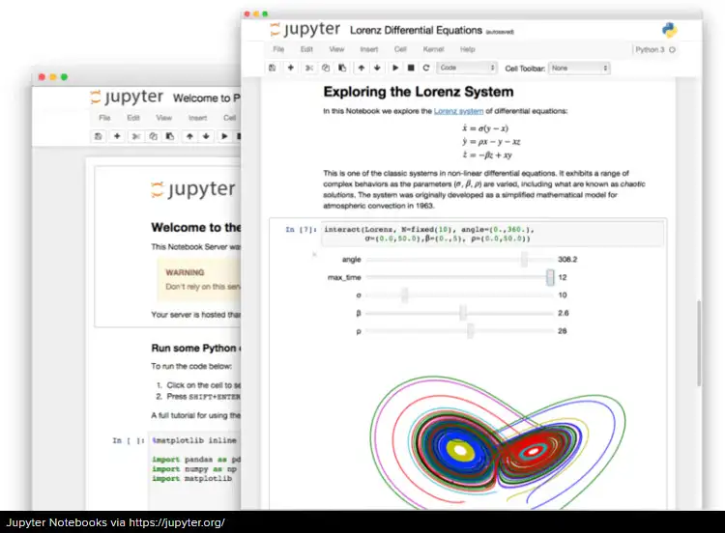
Overview of the hands-on
1. Edit the notebook 1'. Download the ipynb file
EGI Notebooks services
EGI Binder Notebooks
Re-execute
2. Create repository
2'. Upload ipynb file
2''. Add requirements.txt
GitHub
7. Provide GitHub project reference
Your repository
3. Specify the GitHub repo
6. Obtain GitHub project reference
Fellow researchers
4. Generate a DOI (this is done by Zenodo)
5. Discover Notebook (use DOI)

Slide 26
Hands-on
Create your first shareable Binder notebook

Slide 27
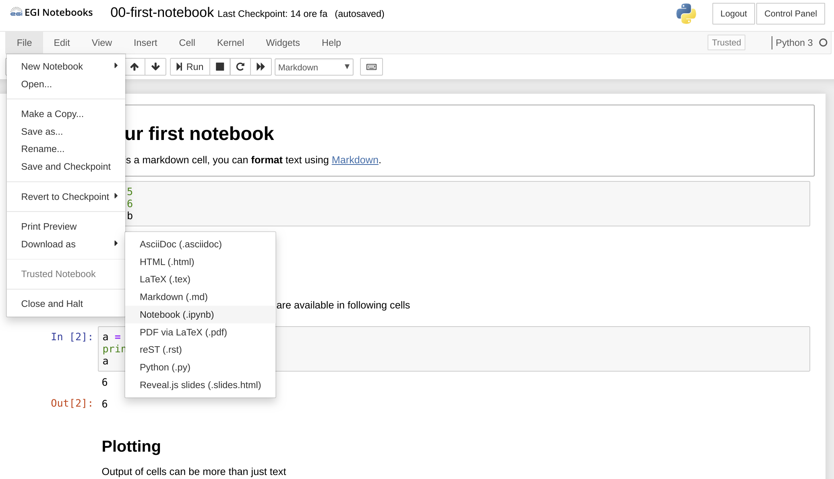
Create your first shareable Binder notebook
Go to https://training.notebooks.egi.eu
Go to the training-binder folder
Download the notebook 00-first-notebook to your laptop

Slide 28
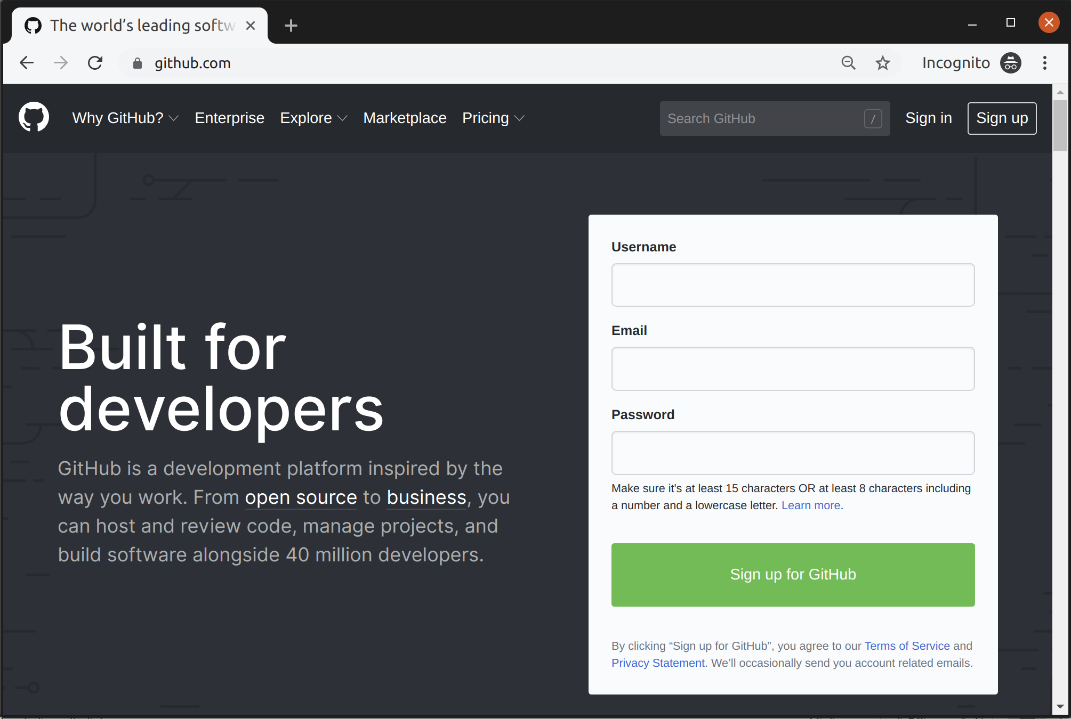
Sign up for a GitHub account (if you don't have it!)
Sign-up if you don’t have an account already.
Only requires a valid email

Slide 29
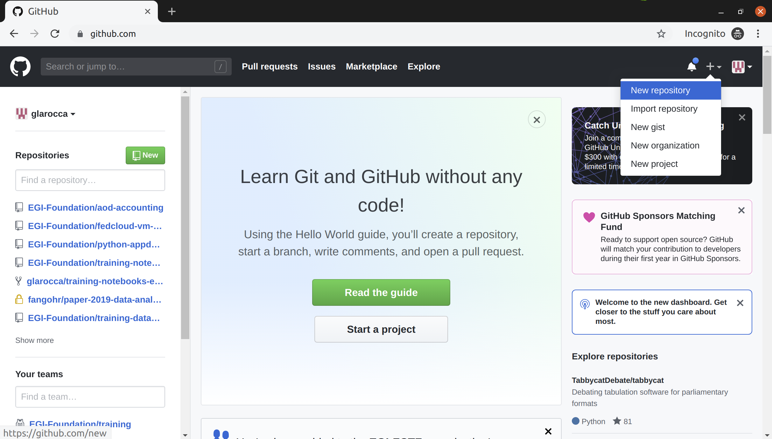
Create a new repository on GitHub

Slide 30
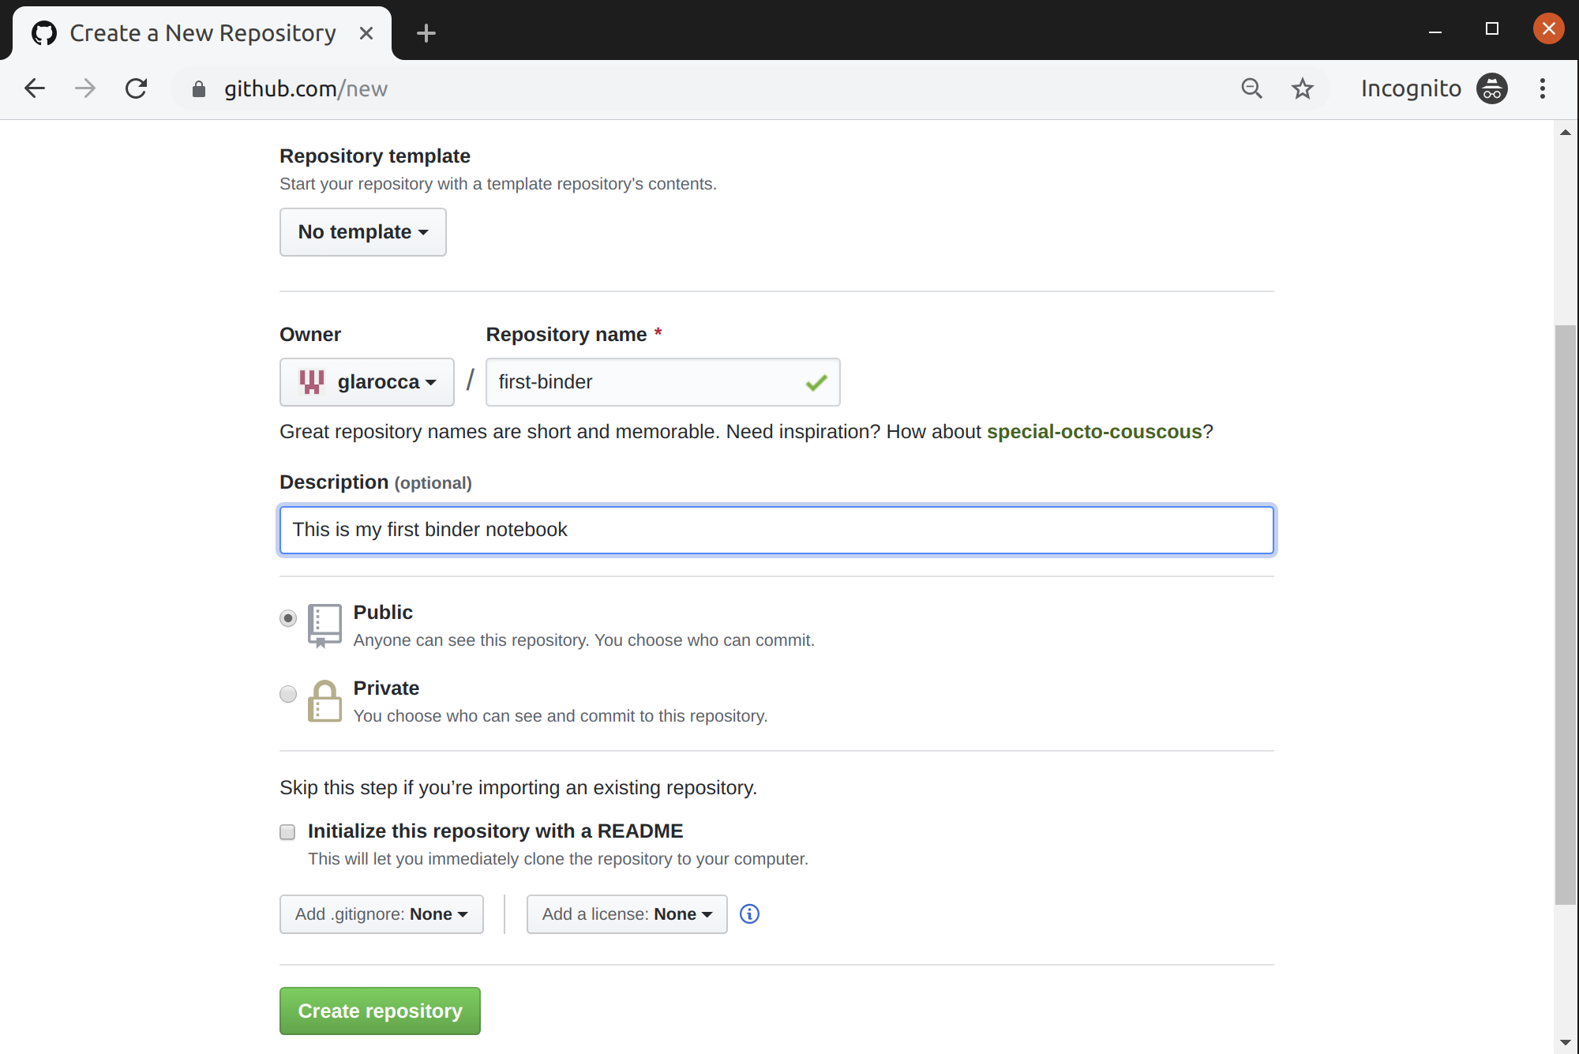
Create a new repository on GitHub (cont.)

Slide 31
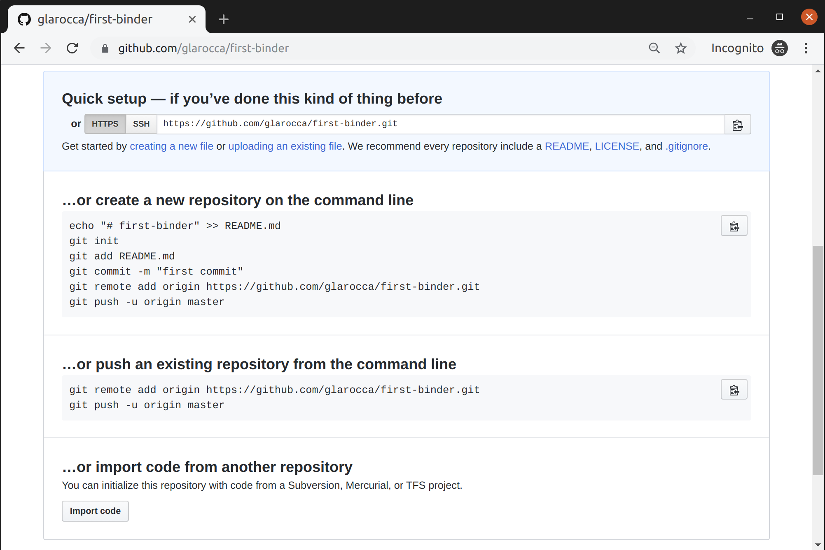
Upload your notebook (00-first-notebook)

Slide 32
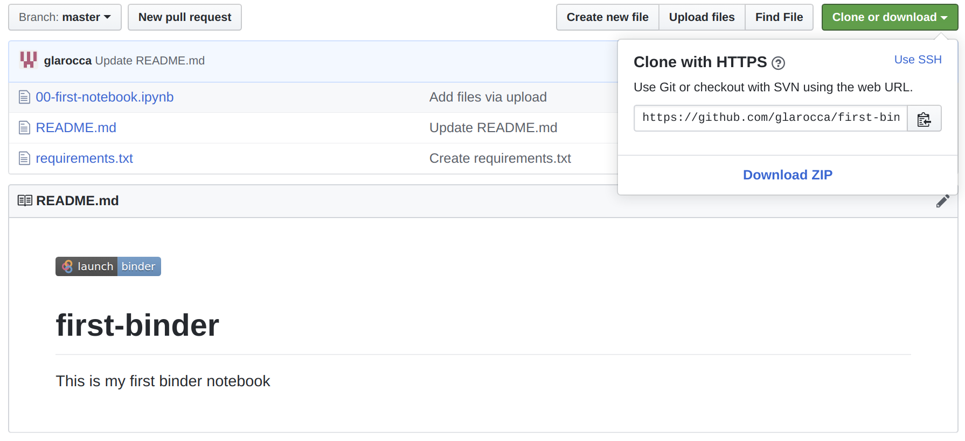
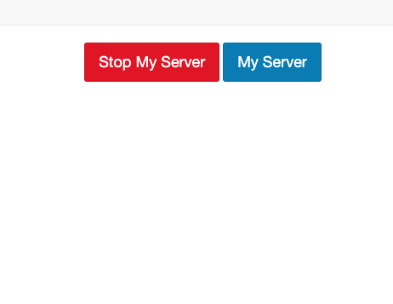
Add missing requirements in the GitHub repo
Go to https://cs3.fedcloud-tf.fedcloud.eu/hub/home and stop your server before retry!

Slide 33
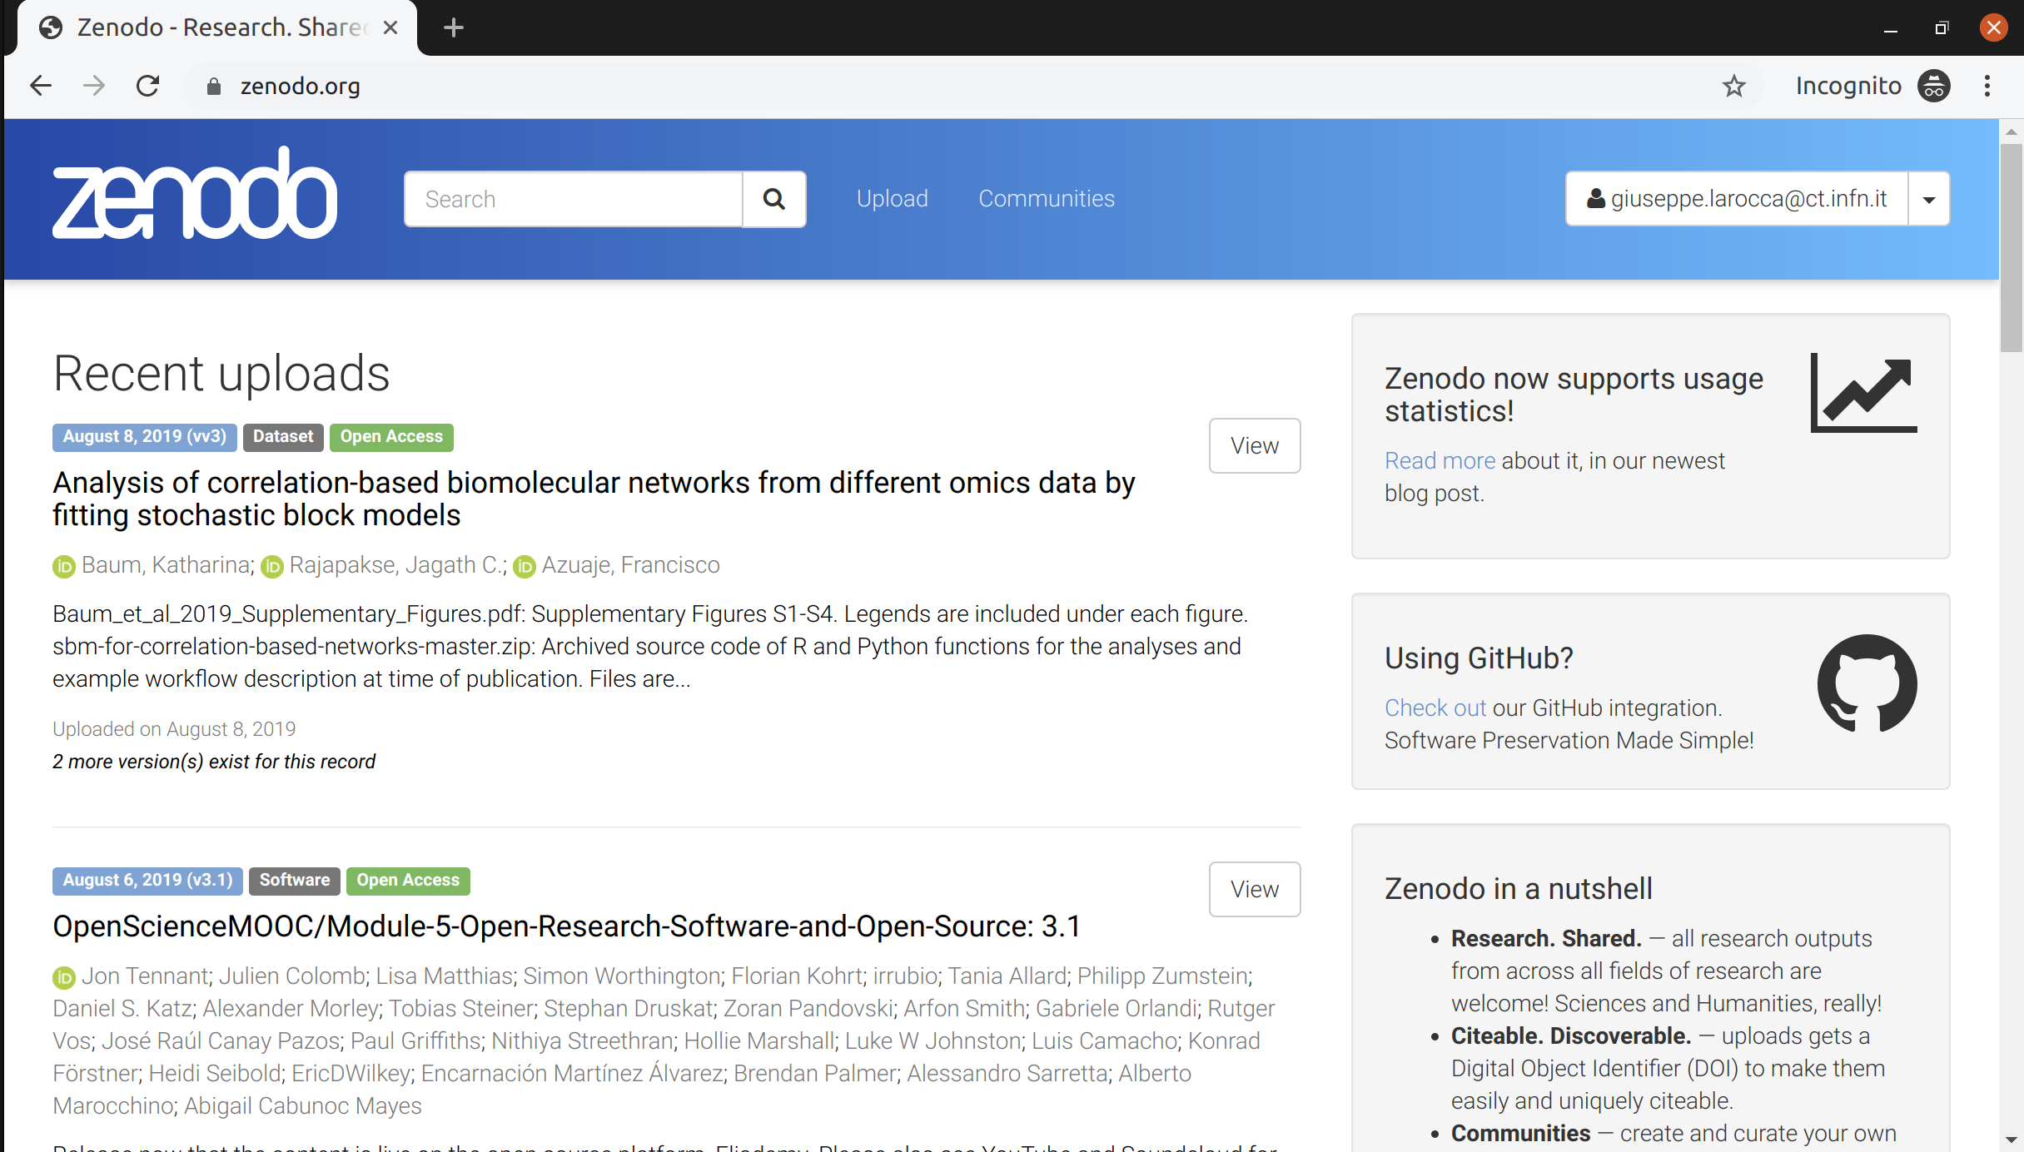
Share your GitHub repo on Zenodo
Login to Zenodo - https://zenodo.org with your GitHub account

Slide 34
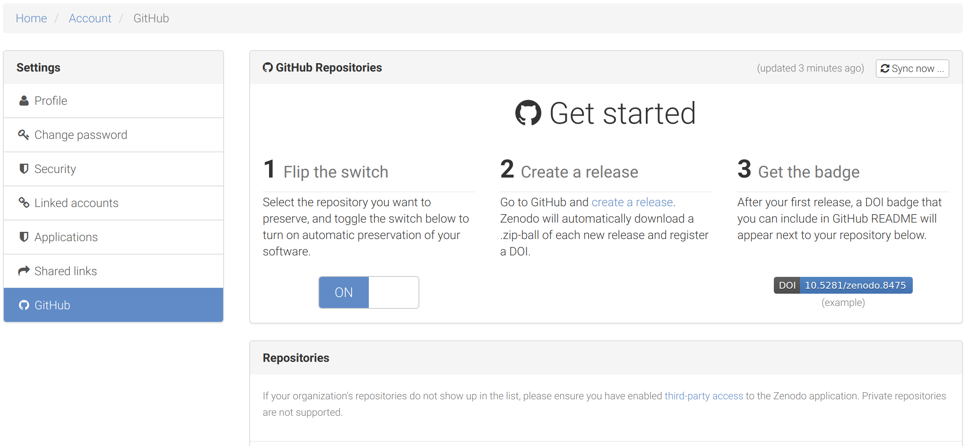
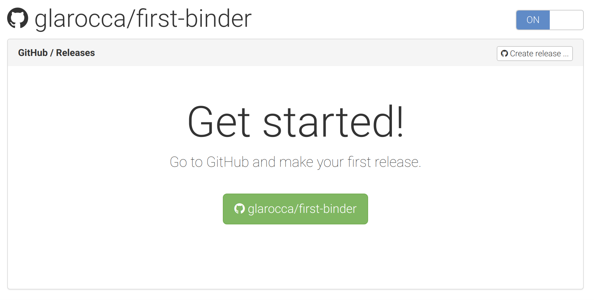
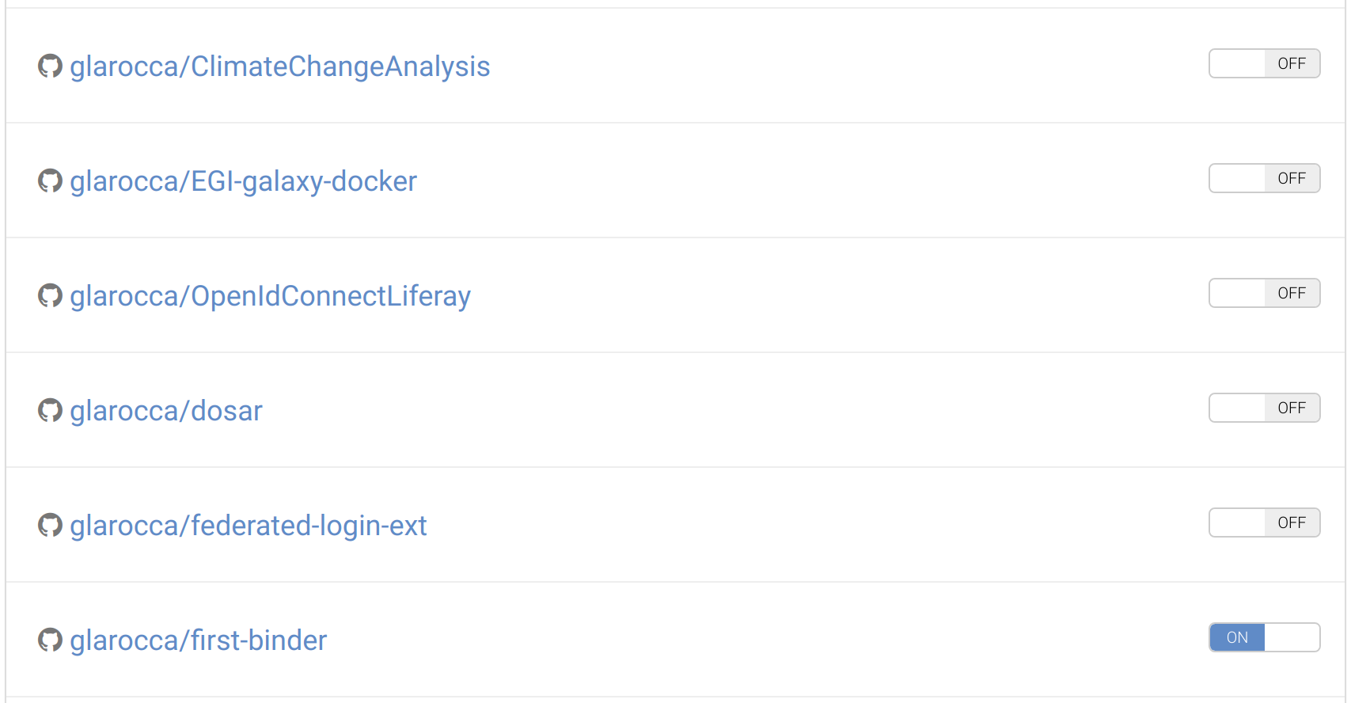
Enable your GitHub repository at Zenodo
Select the repo to enable from the Repositories list
Enable the repo (click ON)
Click on the GitHub repo link
Create a release

Slide 35
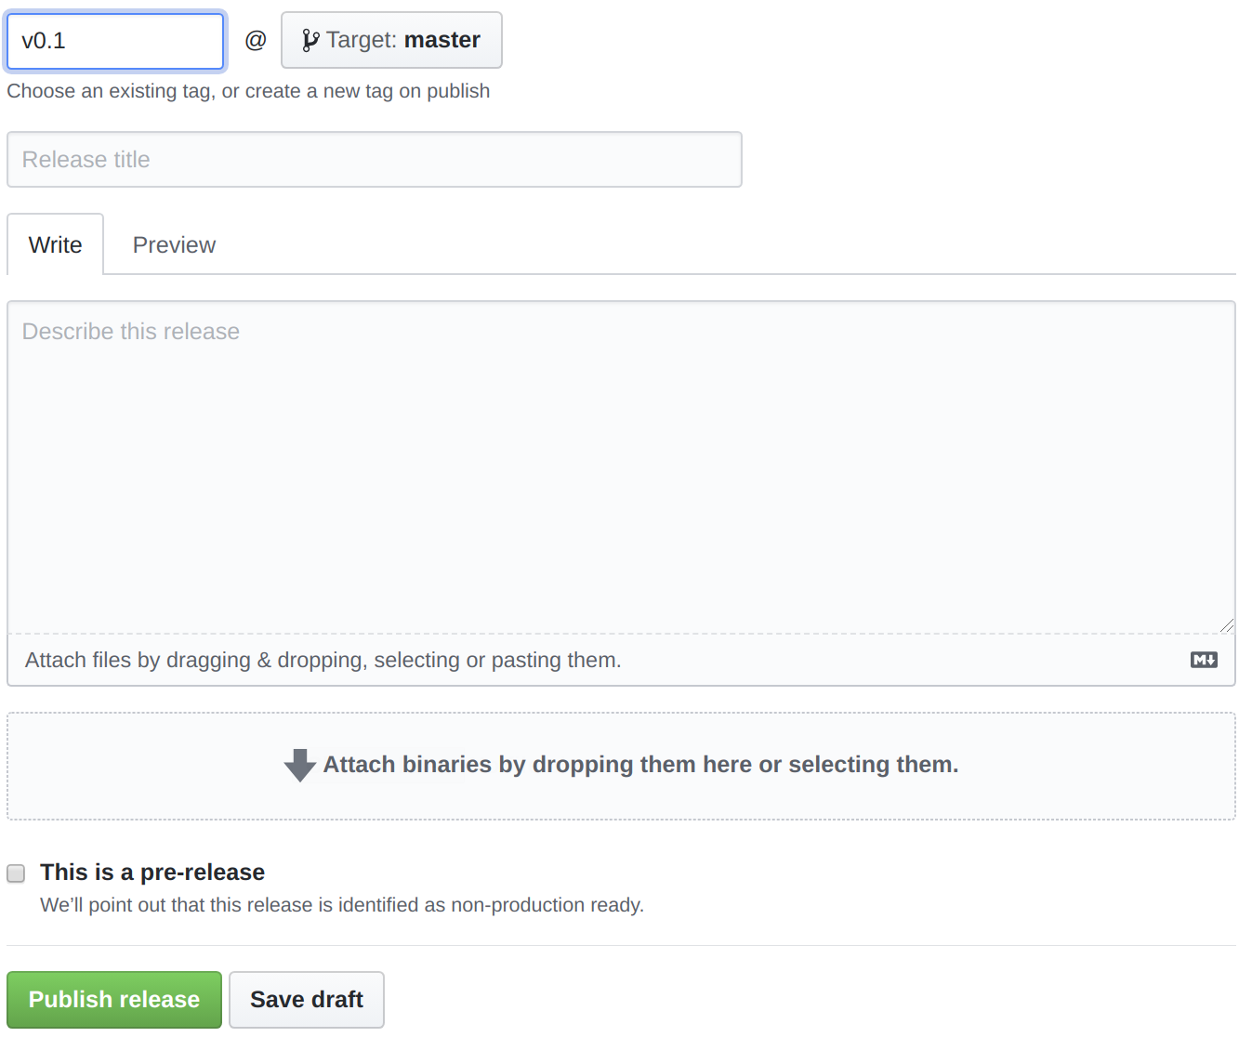
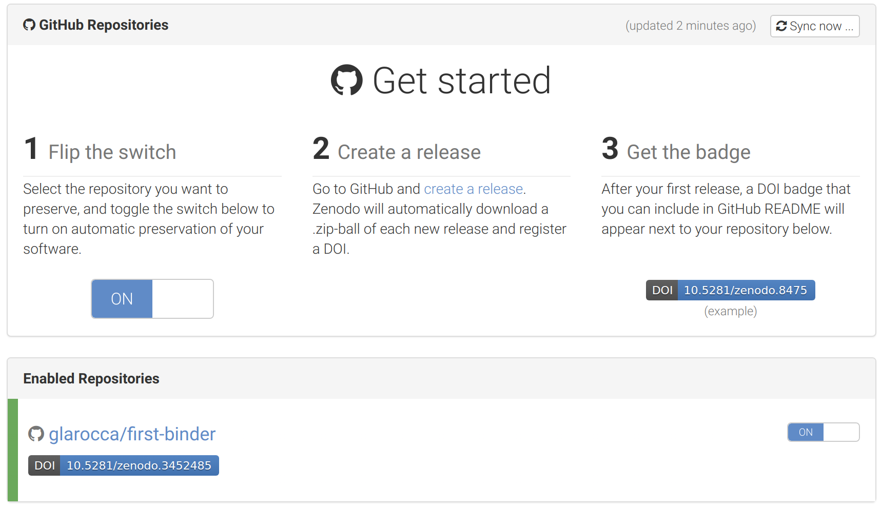
Create a release for your GitHub repo

Slide 36
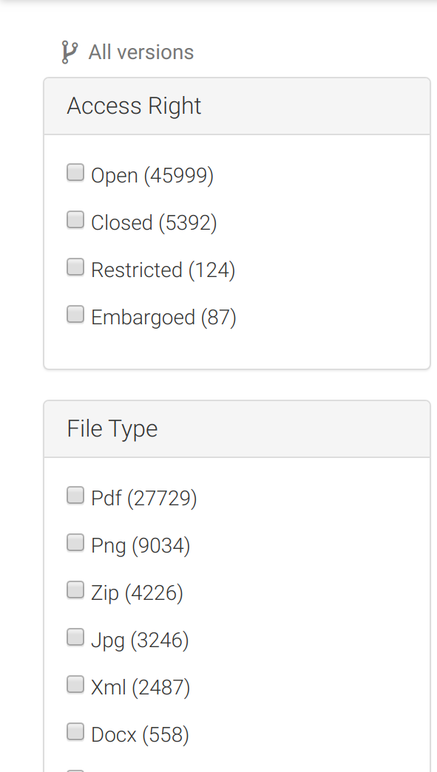
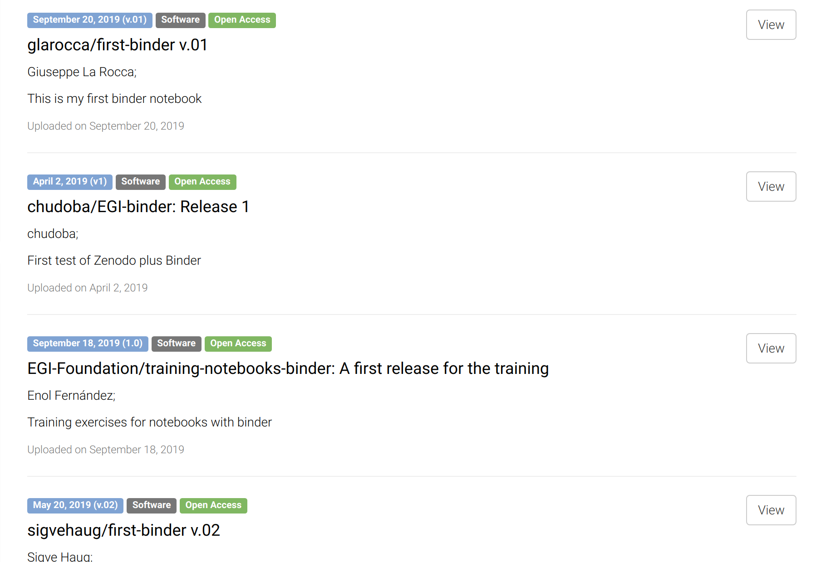
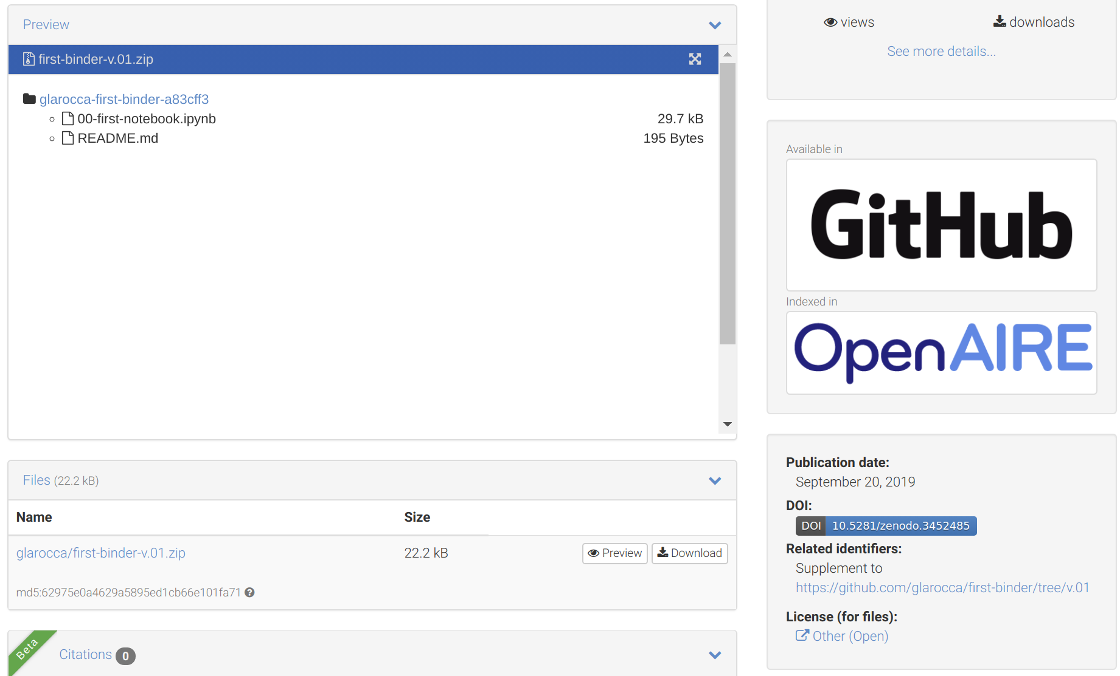
Search your GitHub repo in Zenodo
v
COPY

Slide 37
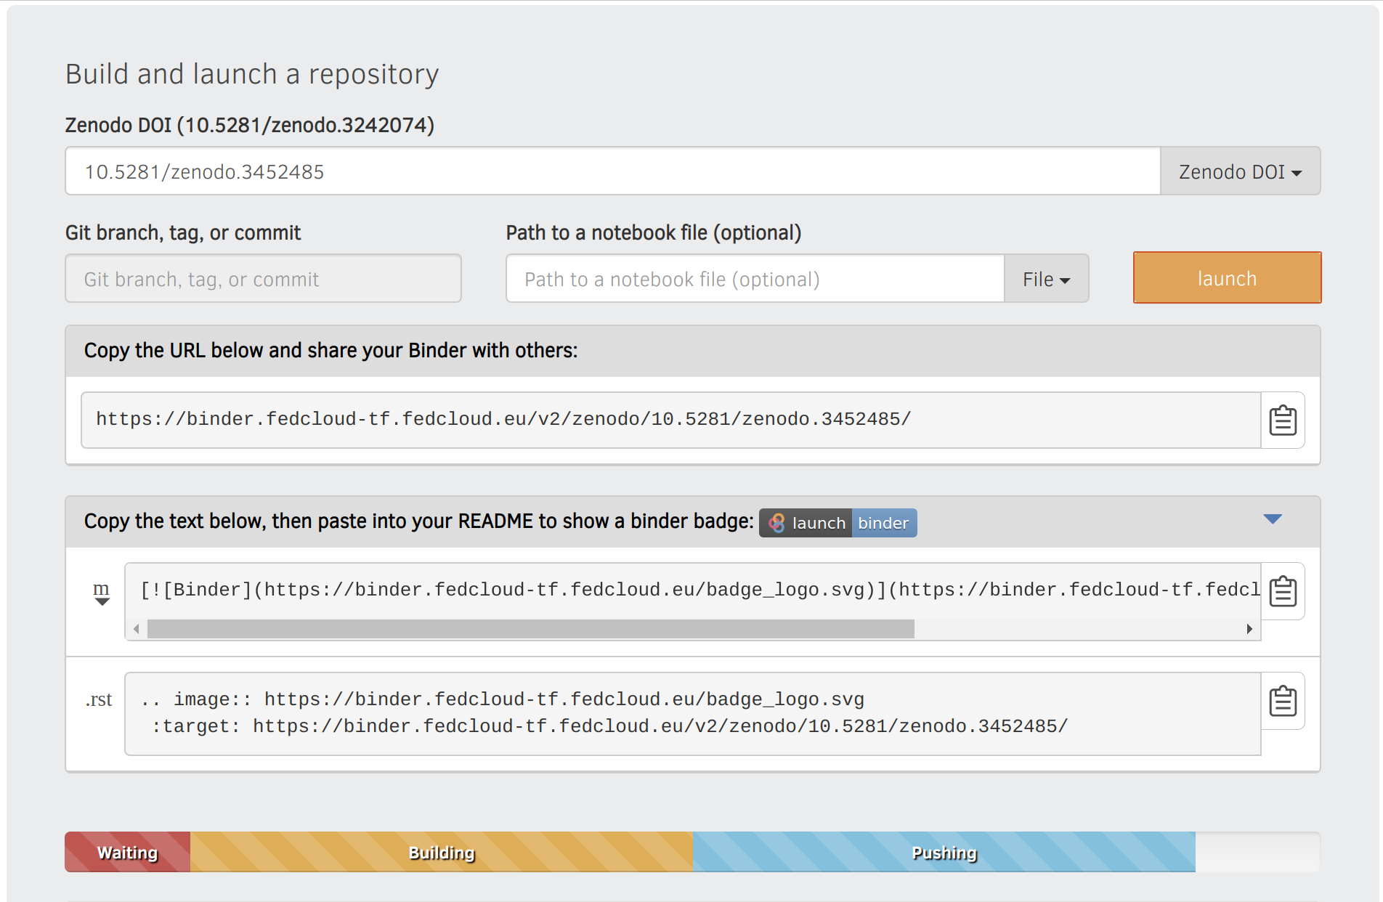
Reproduce your analysis with Binder
WARNING:
Registration of the DOI can take up to 10 minutes
Binder has to wait until registration is finished.
To check whether the DOI is resolved, please use the website: https://dx.doi.org/
Create a LaunchBinder button in your repo
Go to https://cs3.fedcloud-tf.fedcloud.eu/hub/home and stop your server before retry!

Slide 38
Hands-on summary
1. Edit the notebook 1'. Download the ipynb file
EGI Notebooks services
EGI Binder Notebooks
Re-execute
2. Create repository
2'. Upload ipynb file
2''. Add requirements.txt
GitHub
7. Provide GitHub project reference
Your repository
3. Specify the GitHub repo
6. Obtain GitHub project reference
Fellow researchers
4. Generate a DOI (this is done by Zenodo)
5. Discover Notebook (use DOI)

Slide 39
Working with big data
EGI Notebooks integrated with DataHub

Slide 40
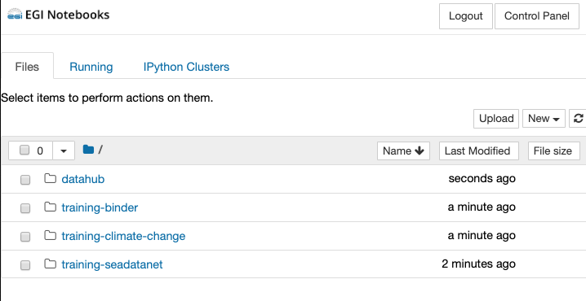
Analyse big data with Notebooks
Big data accessed via EGI DataHub
EGI Notebooks
EGI Binder
1. Perform data analysis and visualisation with big Data
GitHub
6. Reproduce analysis with big data
Your repository
2. Publish notebook and Generate DOI
5. Resolve DOI to Notebook and Data
3. Cite DOI
in publication
Fellow researchers
Journal paper
4. Discover DOI

Slide 41
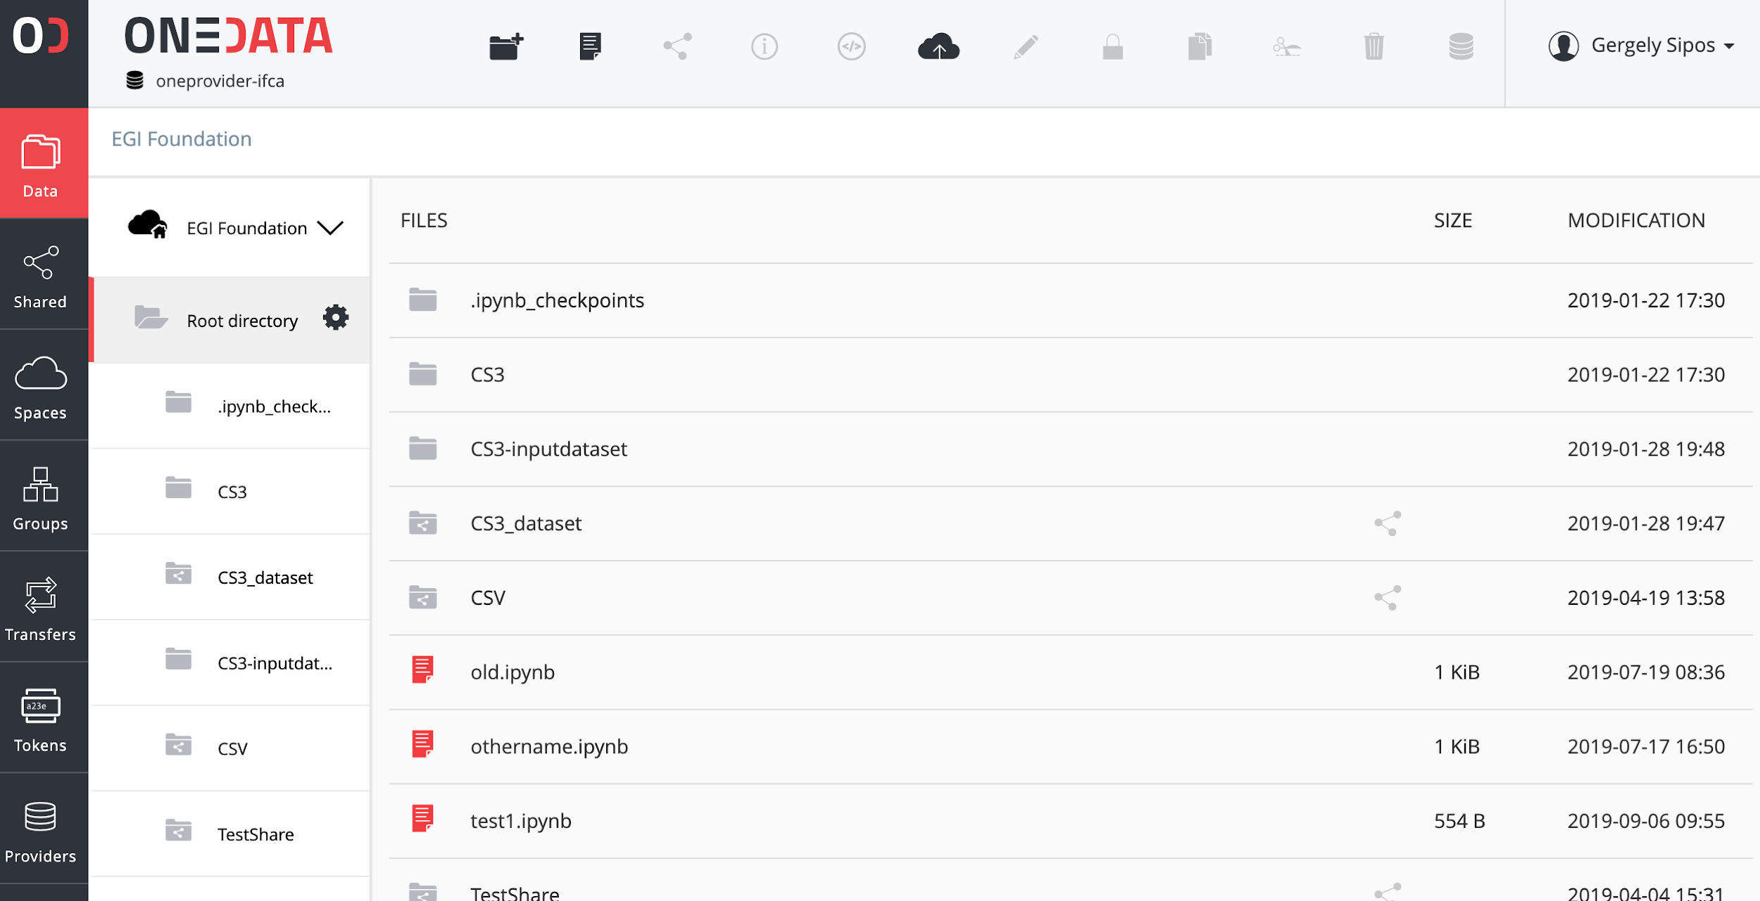
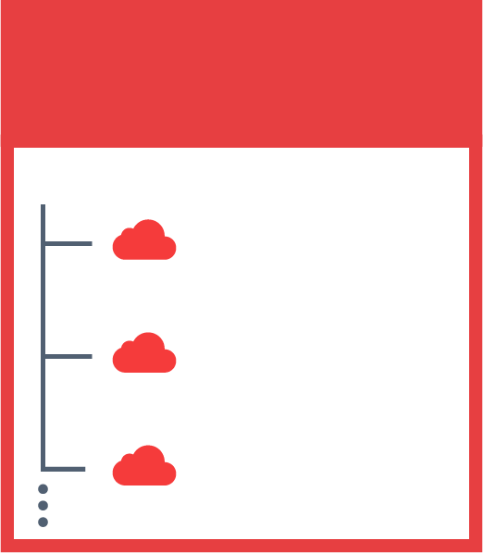
The problem we want to address
Cloud provider:
Physical storage for files
JOHN’S SPACES
SENTINEL 2
DEEP LEARNING
SARA’S SPACES
PUBLICATIONS
REPLICATION
Space: Local organisation of files (directory structure)
SENTINEL 2
SKY MAPS
MY DATA

Slide 42
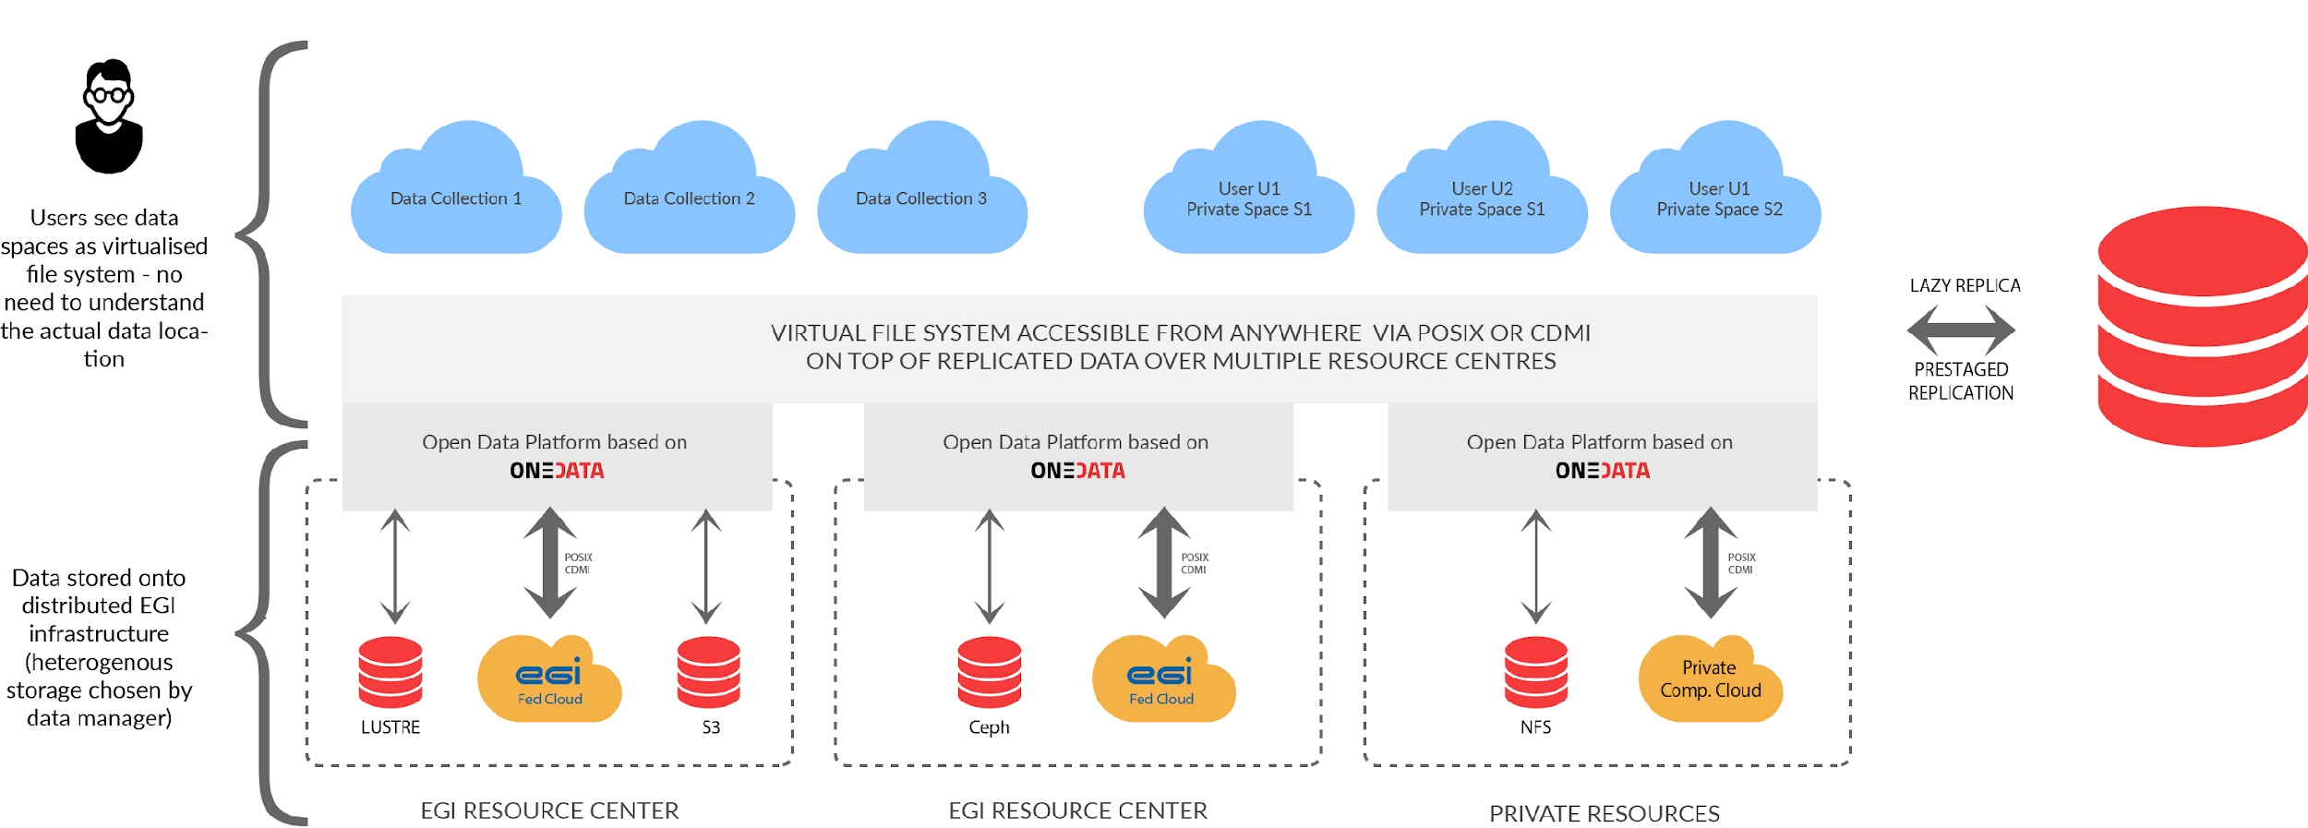
Accessing federated data in Notebooks
Federated files appear as a directory structure for the user
EGI Notebooks
EGI Binder

Slide 43
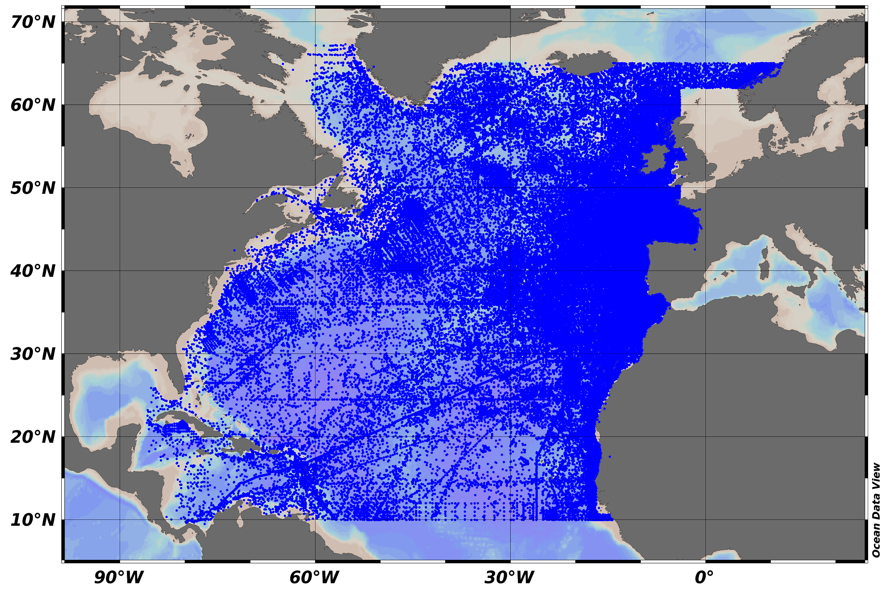
SeaDataNet climatology data
SeaDataNet provides aggregated regional datasets (e.g. collections of all unrestricted SeaDataNet measurements of temperature and salinity by sea basins, and climatologies).
The dataset format is ODV binary collections.
For data access please register at: http://www.marine-id.org
Data can be downloaded here

Slide 44
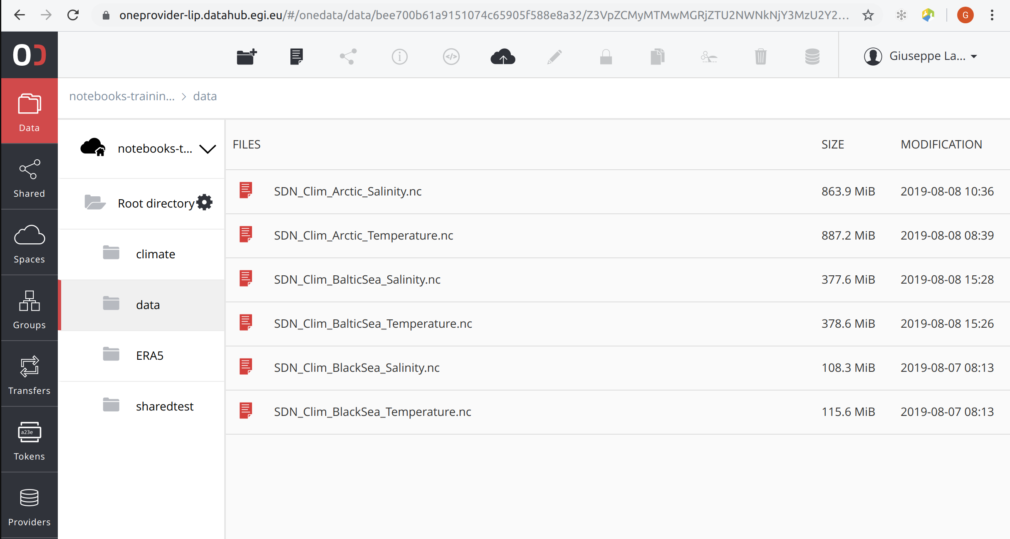
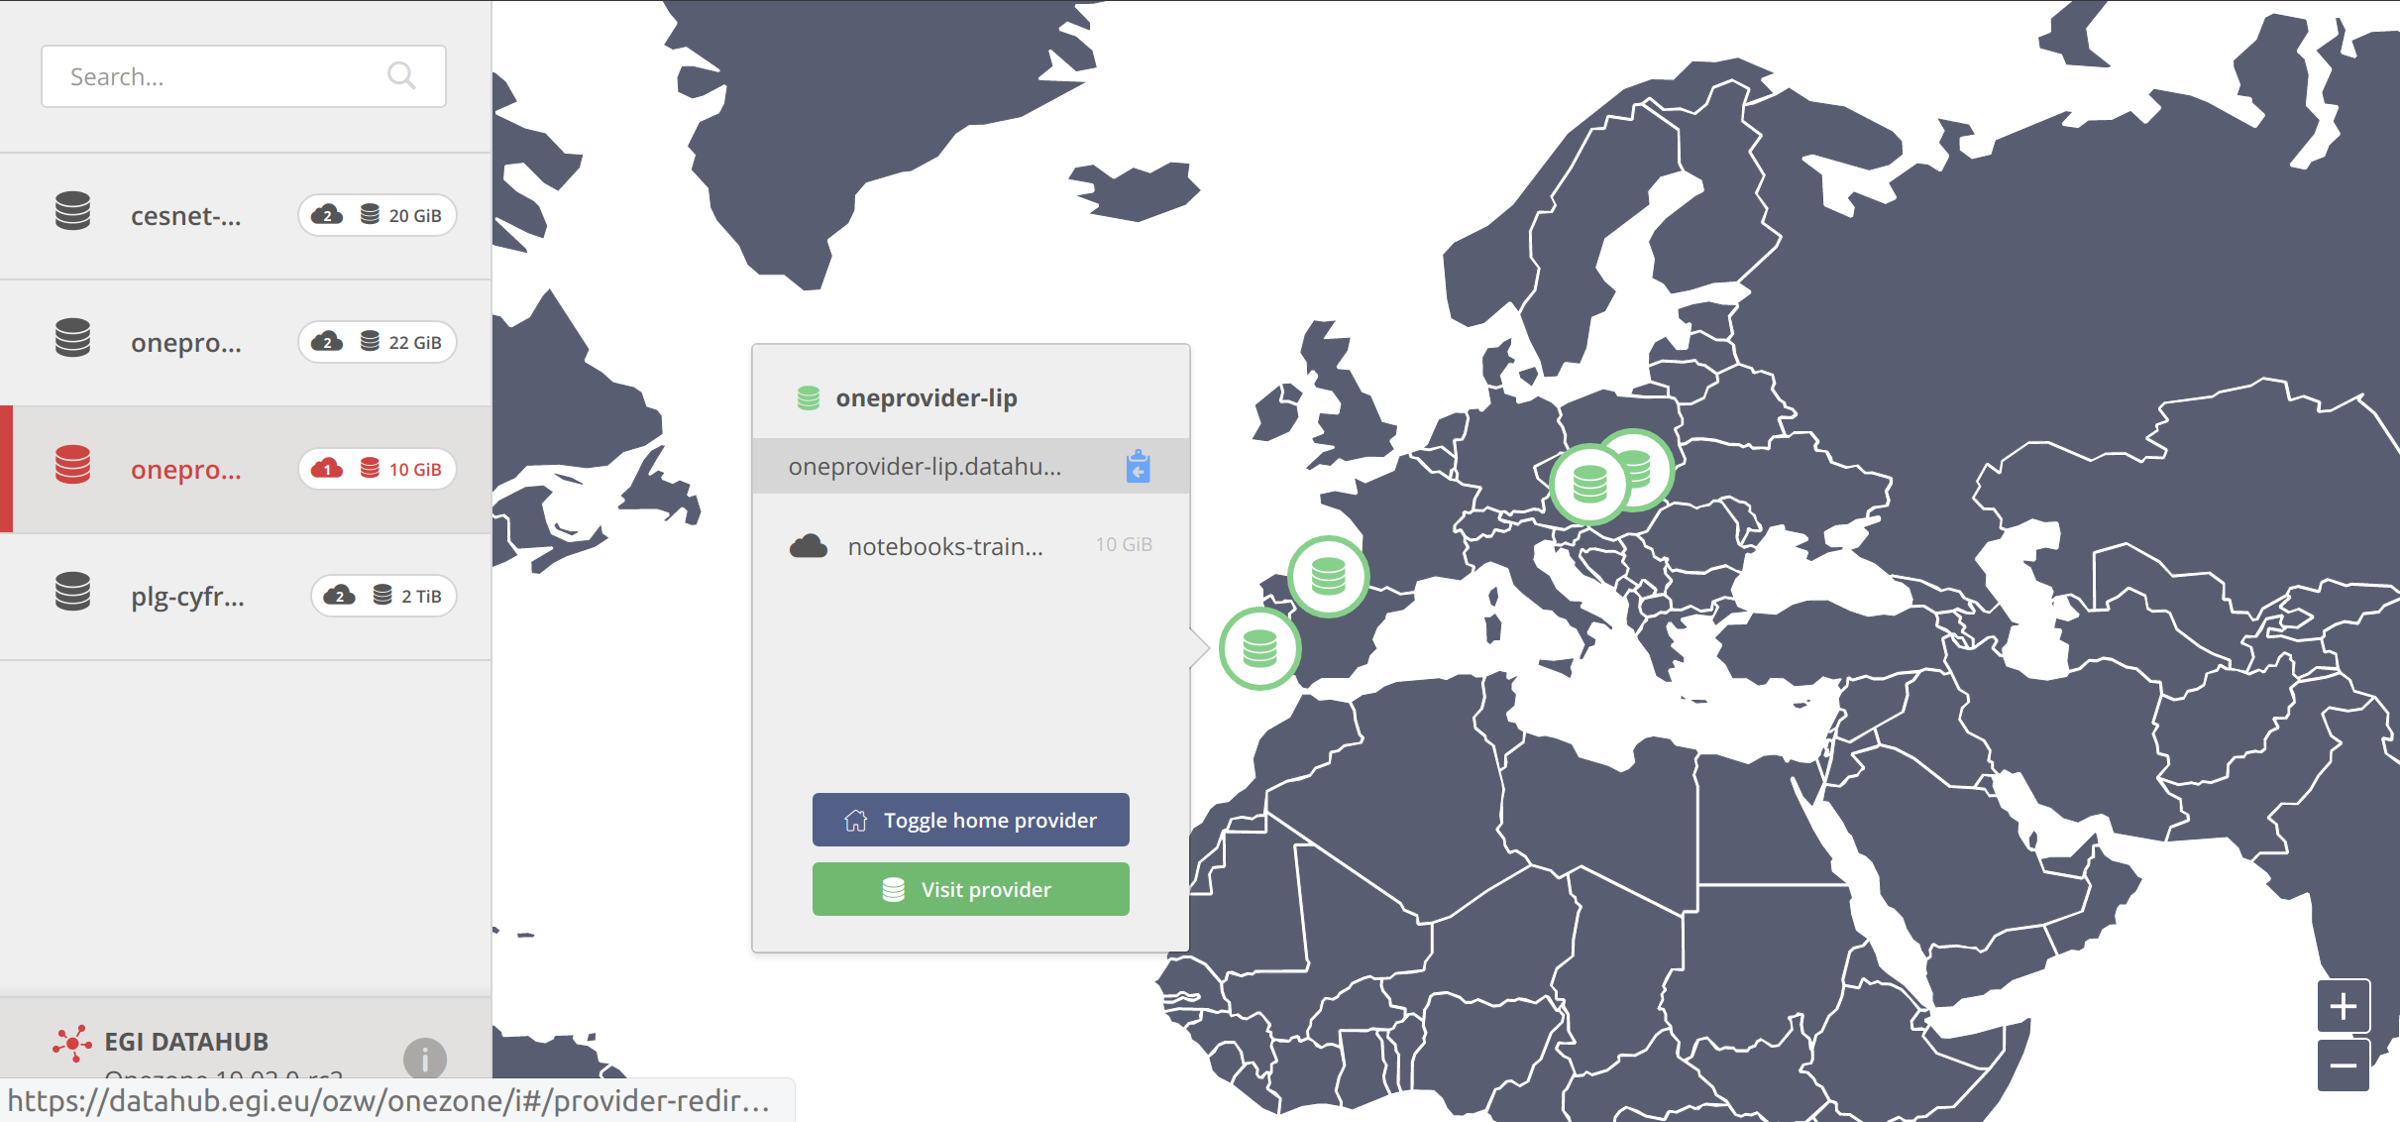
SeaDataNet climatology data in EGI
Configured the EGI Infrastructure to host the SeaDataNet climatology datasets:
Installed 1 Jupyter Notebook instance at CESNET-MCC
Mirrored SeaDataNet datasets in 4 oneproviders of the EGI Federation (IFCA, LIP, …)

Slide 45
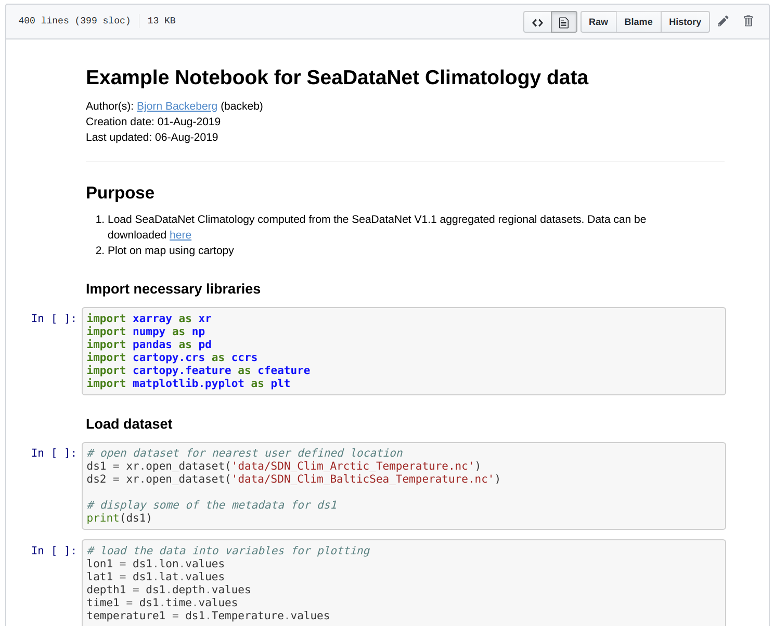
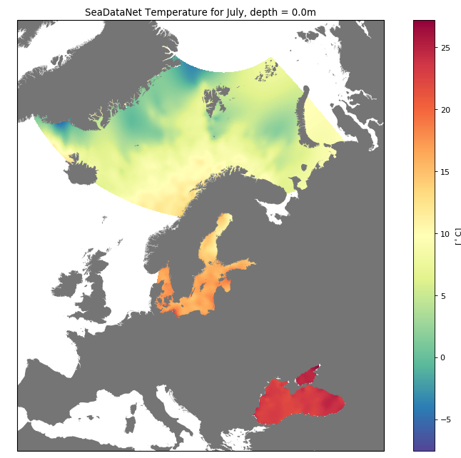
SeaDataNet climatology data in EGI (cont.)
Created a Jupyter Notebook to analyse the SeaDataNet V1.1 aggregated regional datasets (10.5281/zenodo.3475785)
SeaDataNet datasets identified by a PID: http://hdl.handle.net/21.T15999/3Byz9Cw
Used Binder to replicate data analysis

Slide 46
Next steps
Become an EGI user

Slide 47
Using the services after this training
EGI Notebooks - We talked about 2 access modes:
Catch-all instance: https://notebooks.egi.eu
Community deployment
Data access services
E.g. DataHub, B2DROP - Check in EOSC-hub Marketplace. Some with, some without user approval
Zenodo – There are three access modes
Sandbox: For testing purposes
Normal user user: Zenodo.org - Upload your ‘research objects’
Community: Request community dashboard via https://www.zenodo.org/signup/
GitHub: Login and use (outside EOSC)

Slide 48
Setting up an EGI Notebooks
Join EGI Cloud with a new site
https://wiki.egi.eu/wiki/Federated_Cloud_resource_providers_support
https://egi-federated-cloud-integration.readthedocs.io/en/latest/
Join EGI DataHub with a new oneprovider (for access to big data) running on your cloud:
https://onedata.org/docs/doc/administering_onedata/deployment_tutorial.html
Support the DataHub spaces you are interested in your new oneprovider
Deploy EGI Notebooks
https://egi-notebooks.readthedocs.io/en/latest/technical.html
https://zero-to-jupyterhub.readthedocs.io/en/latest/index.html
See additional material at https://indico.egi.eu/indico/event/4431/session/4/?slotId=0#20190506

Slide 49
Getting EGI resources for a community Notebook
We also welcome and support providers to join!
Trigger the process with an ‘EGI Cloud’ or ‘EGI Notebooks’ order in the EOSC Portal
Type, number, size, cost, availability, etc.
Applic. provider
Requirements
Conditions
Storage provider
Cloud provider
Negotiator
Grid provider
Project/Community representative
Service Level Agreement
Operation Level Agreement
Training
Support
Satisfaction review (every 3/6/12 months)
Performance reports

Slide 50
FEEDBACK FORMS

